Slide 1


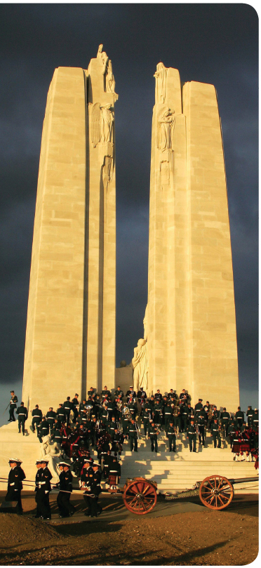
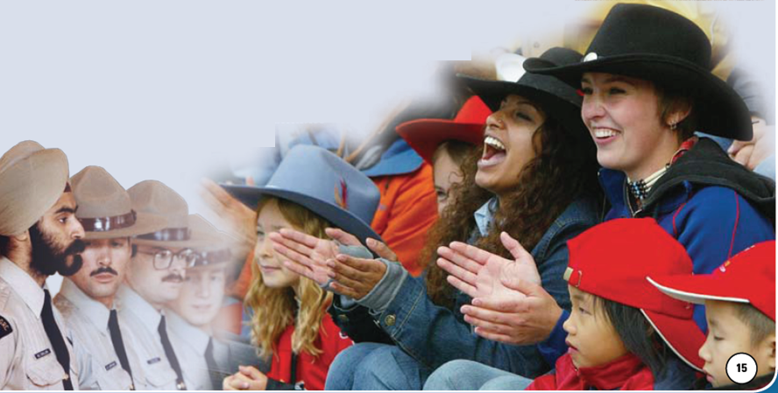
To What Extent Should Nation Be The Foundation of Identity?
Review these four photographs
Where were they all taken?
Write captions for all four of these
All four of these photographs have something to do with the Related Issue question above

Slide 2
Exploring Nationalism
Turn to page 14 of your textbook
Review Related Issue #1 and the four chapters included
What is the connection between related issue question, the individual chapter question and each of the chapter inquiry questions?

Slide 3
The Big Picture
Read page 15 and answer the following:
What is the main idea of this section?
In what ways is a national identity similar to an individual identity?
What is the main difference between a nation and a nation-state, or country?
What are a few examples of how nationalism has been used – anywhere or at any time, for good and evil – to exploit people’s feelings?

Slide 4

Current Events, Nationalism and Identity
Your Challenge:

Slide 5


Nation and Identity
Review pages 18-19
Be prepared to respond to the questions
I Am Canadian

Slide 6
What Are Some Concepts of Nation?
Read pages 20-21
As you read, respond to all three of the activities
How might a persons concept of a nation affect his/her identity?

Slide 7
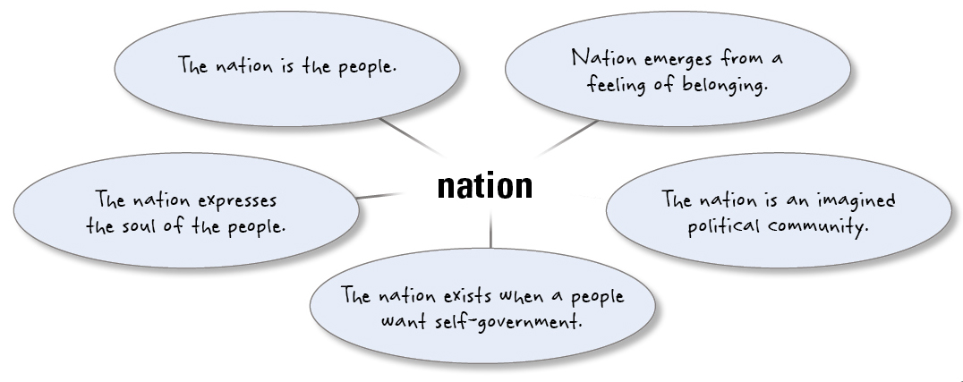
Some Understandings of Nation
Which of these views of nation do you most agree with? Why?
Read The View From Here – Page 22
Complete #1 of Explorations

Slide 8
Nation as a Collective Concept
Read Page 23
If words like ‘we’, ‘us’ and ‘our’ are used to demonstrate a sense of collective identity, how might these words also create divisions between or unite people in a country? In different countries?
How might these words make someone within Canada feel if he or she does not share the ideals or values of the collective?
How could we avoid implying that ‘they’ are not part of ‘us’?
Review Figure 1-5 (Page 23) and respond to the question

Slide 9
Dying for one’s nation is the highest expression of patriotism!
True?
Read Page 24
What are other ways that citizens can demonstrate patriotism for their nation?

Slide 10
It’s All About Me…
ME
Think about your present understanding of nation and complete Reflect and Respond on page 24

Slide 11
And Finally…
Continue with your list of terms from this chapter, which include…
Any term/phrase/concept that would be considered important in helping you with your …
Challenge / Related Issue #1 Exam
Any suggestions as to what you should include?

Slide 12

What Are Some Understandings of Nation?
Read FYI on page 25
What are some common historical last names in the Fort?
How about certain family names recognized in the community: Street names…Building names?
Read page 25 – Complete the Activity

Slide 13
Some Ways to Understand Nation
Momentarily, you will be numbered off one through four. Each of you will go to one of the four assigned EXPERT groups and complete a summary (in point form) of your section on the handout provided. You will have approximately 15-20 minutes to do this.
  #1 – Ethnic/Cultural Understanding of Nation
  (Page 26)
  #2 – Religious/Geographic Understandings of
  Nation (Page 27)
  #3 – Relationships/Spiritual Understandings
  of Nation (Page 28)
  #4 – Political Understandings of Nation (Page 29)
When finished, return to your original group of four and share your EXPERTISE with your other three group members. They will do the same for you. When you are done, your chart WILL be filled in completely.
Get into groups of four…
Ignore the Activities for now

Slide 14

Understandings of Nation
Linguistic
Ethnic
Cultural
Religious
Geographic
Relationship to the Land
Spiritual
Political
You may use the following Understandings:
Using a chart similar to this, complete the Reflect and Respond on page 29

Slide 15
And Finally…
Continue with your list of terms from this chapter, which include…
Any term/phrase/concept that would be considered important in helping you with your …
Challenge / Related Issue #1 Exam
Any suggestions as to what you should include?

Slide 16
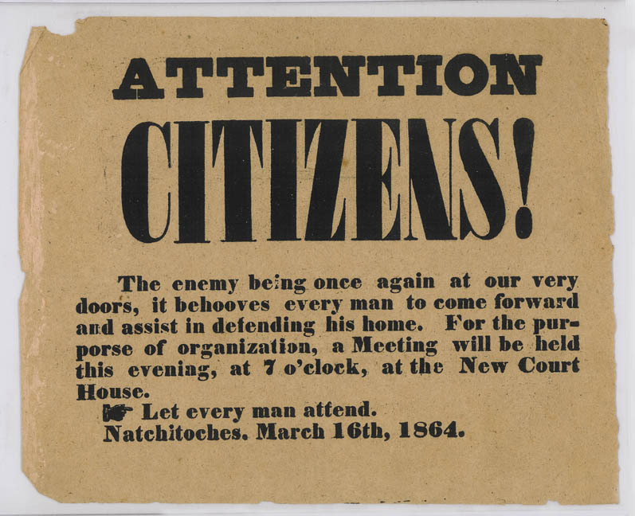
How Can Nation Be Understood As A Civic Concept?
When did Canada become a nation?
In 1867, with Confederation?
In 1917, at Vimy Ridge?
In 1982, when the Constitution was proclaimed?
On another date?
Or not yet?
Do people or events determine when a country becomes a nation?
Do people have to share a long common history before they can feel they are part of a nation?
Does the global community see Canada as a nation?

Slide 17
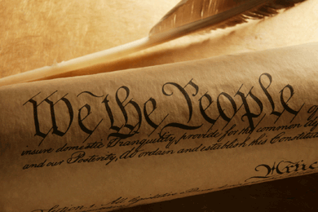
How Can Nation Be Understood As A Civic Concept?
Read the top half of page 30
Keeping in mind that The United States Constitution begins with:
“We the People of the United States…”
What do you think of the decision to delete:
“We, the People of Canada…”?

Slide 18

Is Canada A Nation?
Return to your home groups and complete the handout
Is Canada a Nation?

Slide 19

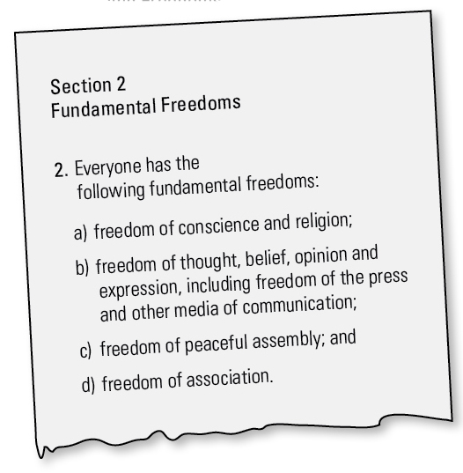
Shared Values and Beliefs Expressed in Law
Read the rest of page 30
Using Section 2 of the Canadian Charter of Rights and Freedoms, provide a specific example for each of the freedoms listed
Would Canadians still share values and beliefs if the Charter or Constitution did not exist?
Why do you think the creators of the Constitution set up a complex amending formula?
How does the Charter contribute to a sense of civic nation?

Slide 20
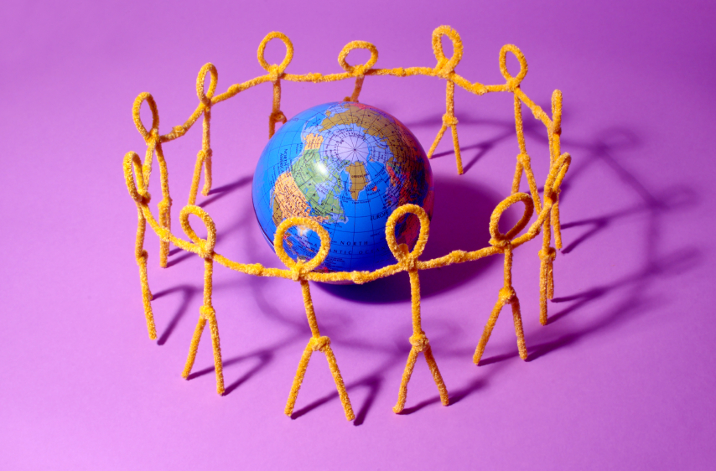
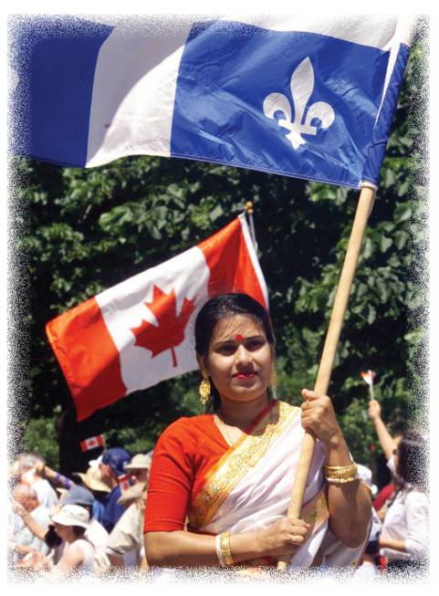

Civic Nation
Using the photograph and the ideas of Ignatieff and Ibbitson, create a mind map that illustrates the concept of Civic Nation
Read page 31
Civic Nation

Slide 21
Nation and Nation-State
Read page 32
Complete the Activity
Complete Reflect and Respond – Use Examples!

Slide 22
And Finally…
Continue with your list of terms from this chapter, which include…
Any term/phrase/concept that would be considered important in helping you with your …
Challenge / Related Issue #1 Exam
Any suggestions as to what you should include?

Slide 23
Canadian Myths
Write out as many Canadian myths that you can think of…
Any Examples?
Canada is a hockey nation
Canadians are polite
Canada is a country of peacemakers

Slide 24
How Do People Express Their Identity Through Nation?
Read page 36
As you read, note the differences between…
Individual, Collective and National Identities

Slide 25




The Evolution of National Identity
Read the top of page 37
As you read, decide which of the two description describes the way Canada’s national identity evolved…

Slide 26


Myths and National Identity
Read page 38
Seth Rogen
5:00

Slide 27




Myths and National Identity
Read page 39
Myth or Reality?
Just for Fun…
3:00

Slide 28
And Finally…
Complete your list of terms from this chapter, which include…
Any term/phrase/concept that would be considered important in helping you with your …
Challenge / Related Issue #1 Exam
Any suggestions as to what you should include?

Slide 29

Chapter One Quiz
10 Multiple Choice Questions
Review the Chapter – Including the Terms

