Slide 1
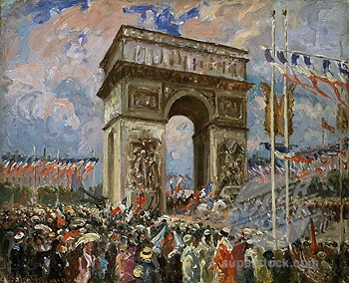
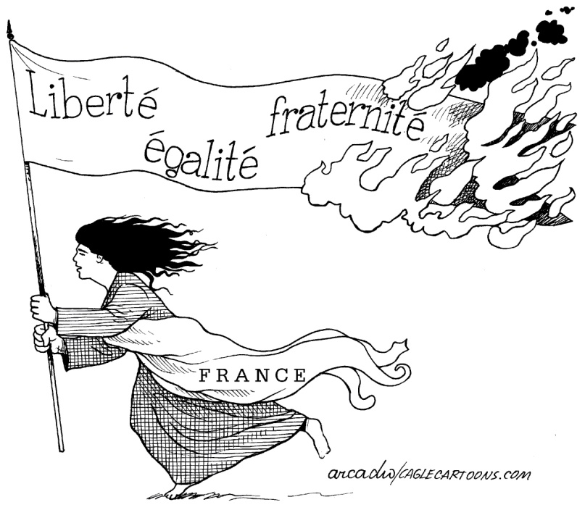
Shaping Nationalism
What do these three French words translate into?
What do Liberty, Equality and Fraternity mean?
Read the caption of this picture on page 42
What three words or symbols best capture the essence of Canada as a nation?
Could any events in Canadian history be considered a revolution?
In Canada, a revolution was not required to establish freedom and power for the people. How has that shaped the country’s development?
If you were drawing a cartoon for Canada similar to the one on page 42, what particular symbol or person would you include? Why?

Slide 2

Shaping Nationalism
With a partner review page 43
Respond to the questions in writing
Paris Riots
2:00

Slide 3
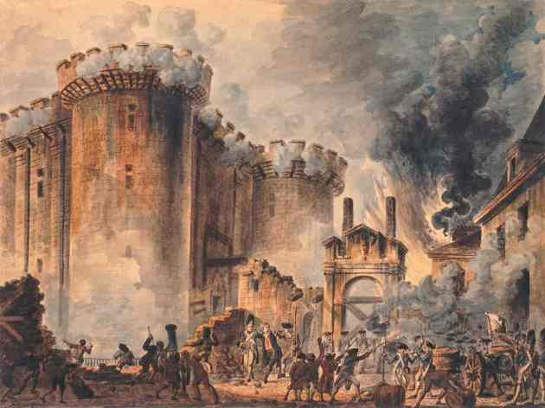
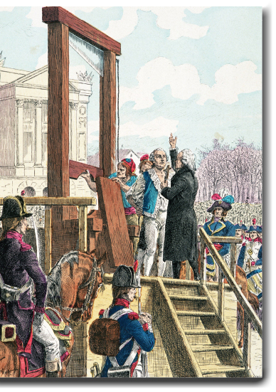
What Are Some Factors That Shape Nationalism?
Read page 44 and the top half of page 45
Including Voices
Why might have the words of Louis XV angered some people?
What do his words say about the concept of nation?
Review Figure 2-2 (Page 44)
Why do you think that the execution of Louis XVI attracted such a large crowd?
Why were they shouting: “Long Live the nation! Long live the republic!”

Slide 4
Historical Factors That Shaped French Nationalism: Storming the Bastille
Complete the Handout

Slide 5
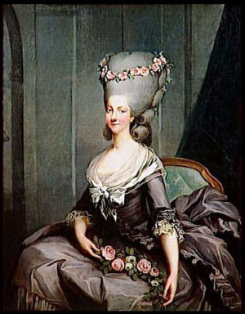
Social Factors That Shaped French Nationalism
With a partner review the rest of page 45 and all of page 46
Respond to the questions in Figure’s 2-4 and 2-5 and the Activity at the top of page 46
If time, complete the final Activity on page 46

Slide 6
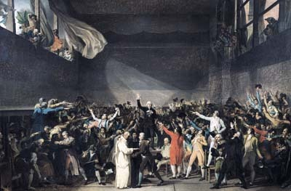
Economic Factors That Shaped French Nationalism
Review FYI on page 47
How much different would Canada be today if the French had defeated the British on the Plains of Abraham?
Review Voices on page 47
What can you infer about Canada’s global significance during the time of Voltaire?
With your partner, read page 47
If time, complete the final Activity on page 47

Slide 7

Some Factors That Shaped Nationalism
Record what you’ve learned, so far in chapter two, in the first three rows of column two of the handout provided… Save this for later!
This is for homework!

Slide 8

And Finally…
Begin a list of terms from this chapter, which include…
Any term/phrase/concept that would be considered important in helping you with your …
Related Issue #1 Exam / Coat of Arms
Any suggestions as to what you should include?

Slide 9
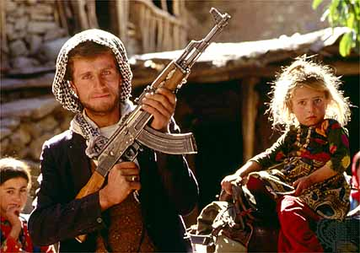
Is Armed Rebellion Justified When People Believe That Government Actions Are Causing Their Hardships?
Decide if you Agree, Strongly Agree, Disagree or Strongly Disagree
Find those of the same opinion and go sit with them
Within the next five minutes, write a short defense of your position: Be sure to use examples!
Review
With your group, read page 50 and write a response to…
Were the Geographic Factors That Shaped French Nationalism Enough to Justify an Armed Rebellion?

Slide 10


Geographic Factors That Shaped French Nationalism
FYI
In August 1788, Parisians paid nine sous for a two-kilogram loaf of bread. By February 1789, the price had risen to 14.5 sous. A labourer who was lucky enough to have a full-time job might earn between 20 and 35 sous a day.
Calculate the percentage of his/her daily wage a loaf of bread would cost a labourer who made 20 sous a day
72%
Calculate the percent increase in the price of bread over these six months
61%

Slide 11

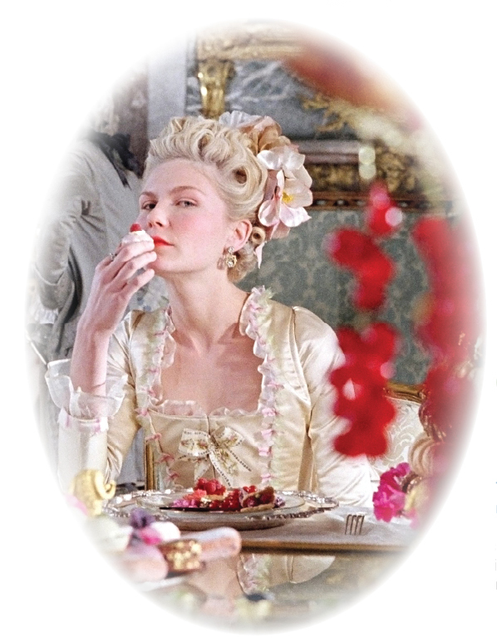
Marie Antoinette
Review this picture and caption on page 50
What were the pro’s and con’s of the arranged marriage between Marie Antoinette and Louis XVI

Slide 12
Some Factors That Shaped Nationalism
Continue to record what you’ve learned, in chapter two, filling in the row on geographic factors. Save this for later!
Review

Slide 13
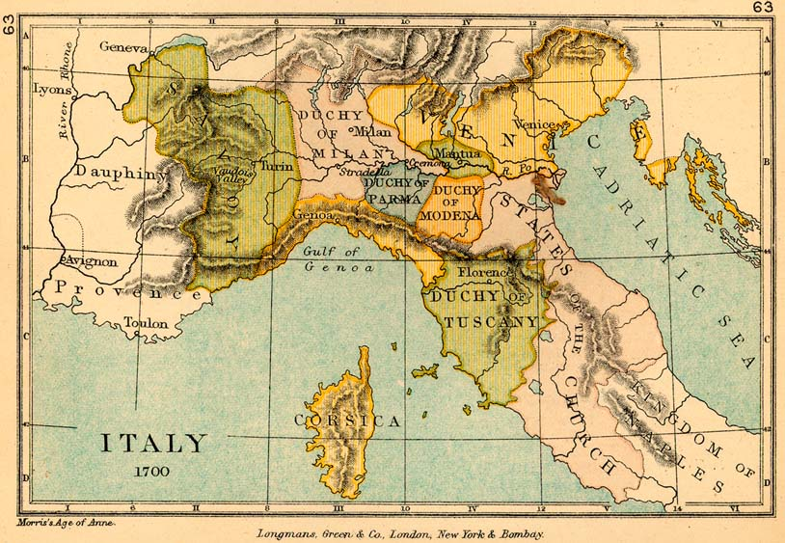
Political Factors That Shaped French Nationalism
Read the top three paragraphs on page 52 and respond to the Activity
What does the word Nation mean in Article Three of the Declaration?
Read the rest of page 52 and all of page 53
From both of these pages, complete a brief timeline

Slide 14
Political Factors That Shaped French Nationalism: Timeline
1789: The Declaration of the Rights of Man and of the Citizen is written
1789 following: French royalists flee and other countries try to invade France to restore the monarchy
1791: Olympe de Gouges writes the Declaration of the Rights of Woman and of the Female Citizen
1793: Louis XVI and Marie Antoinette executed
1793-1794: The Reign of Terror established
1793: Olympe de Gouges executed
1799: Napoleon rises to power

Slide 15
Some Factors That Shaped Nationalism
Complete and record what you’ve learned, in chapter two, filling in the row on political factors.
You can use the last column of the chart to help you consider the questions about Canada in Reflect and Respond (page 53)

Slide 16
And Finally…
Continue with your list of terms from this chapter, which include…
Any term/phrase/concept that would be considered important in helping you with your …
Related Issue #1 Exam / Coat of Arms
Any suggestions as to what you should include?

Slide 17

90 Minutes
French Revolution and Napoleon Handout: A Review/Preview
All Four sets of questions are Due Tomorrow!

Slide 18

90 Minutes
French Revolution and Napoleon Handout: A Review/Preview
All Four sets of questions are Due Tomorrow!
Further Clarification

Slide 19
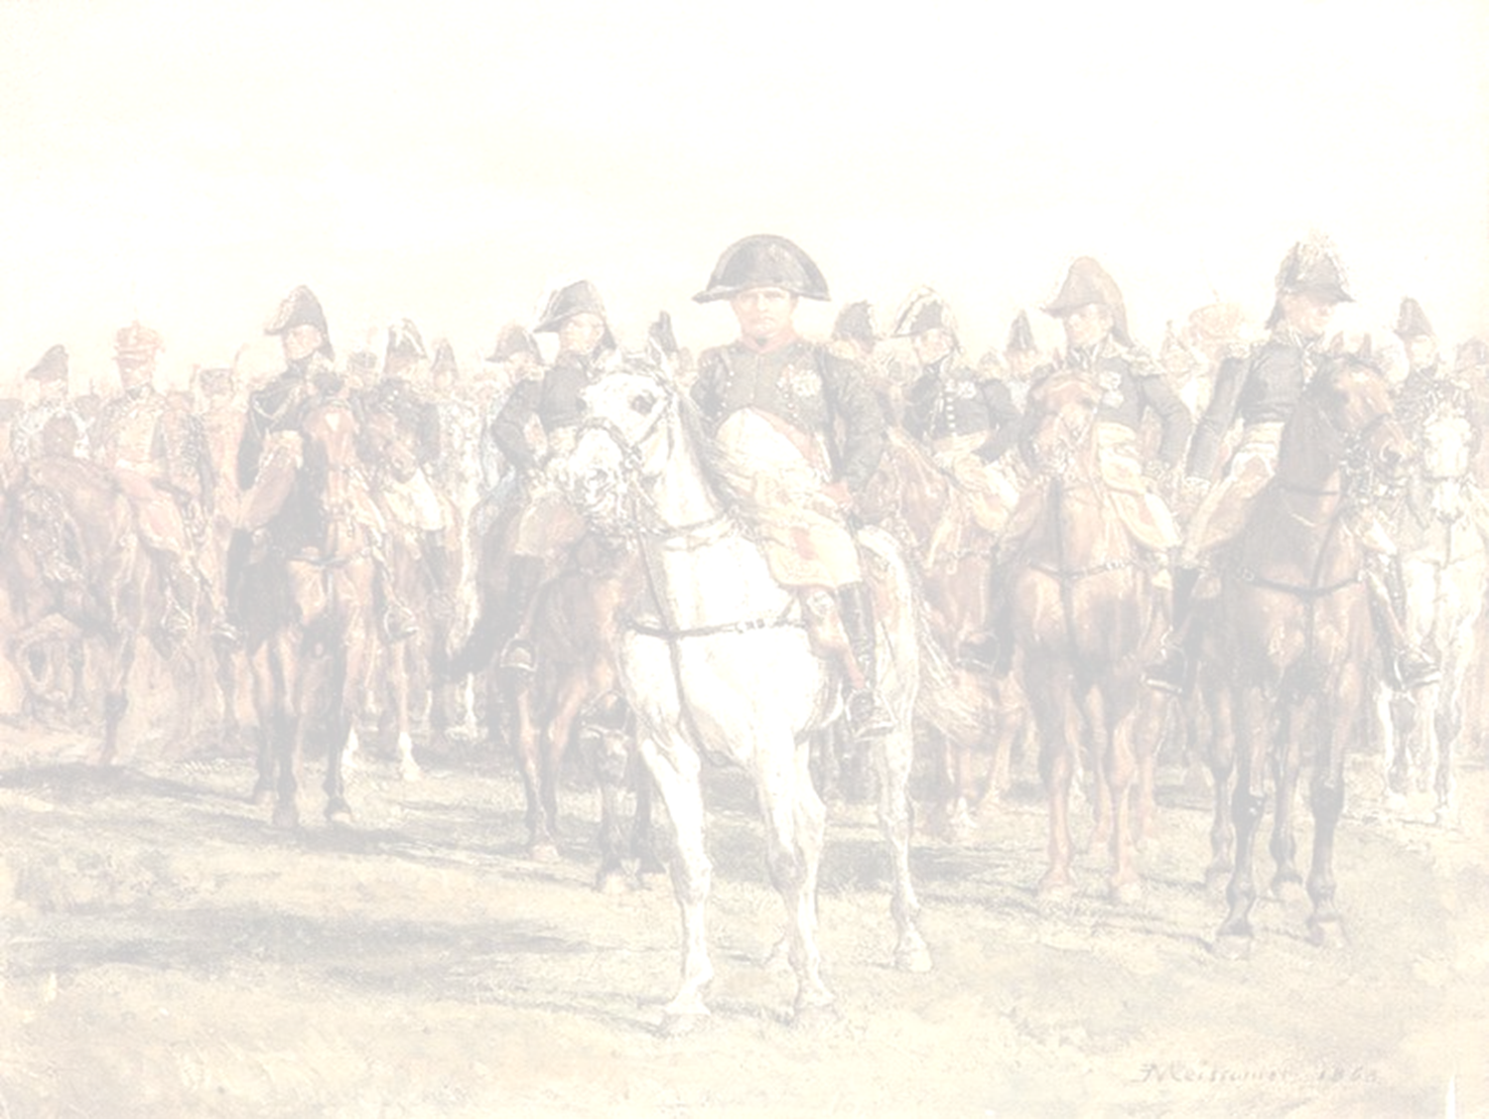
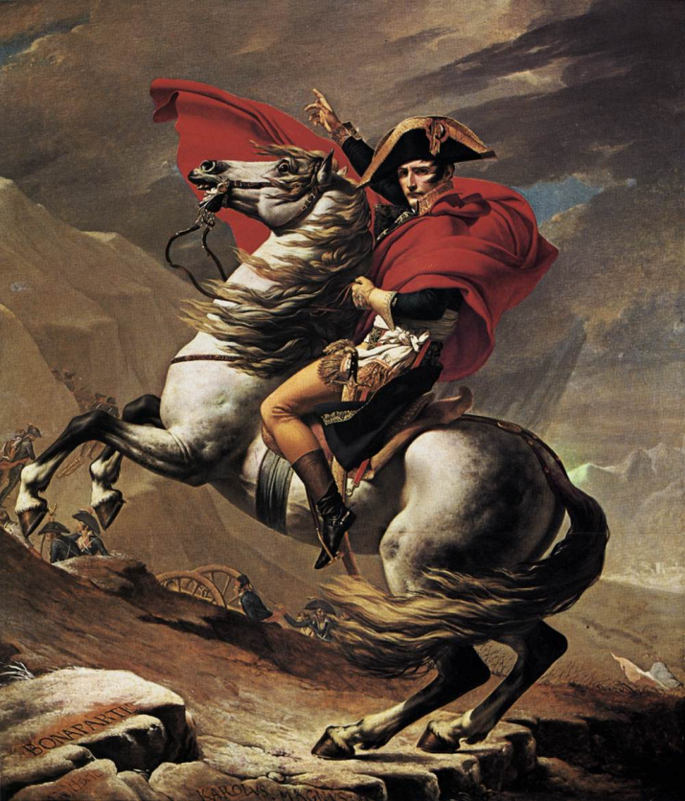
Napoleon Bonaparte: The Glory of France
50 Minutes
Read Pages 54-55 and Complete Explorations on Page 55
Complete Handout: Napoleon Bonaparte’s Domestic Policy

Slide 20
French Revolution and Napoleon Handout: Review
90 Minutes
Assignment: The Napoleon Dossier
Laptops on Friday – Due Tuesday!
Further Clarification

Slide 21
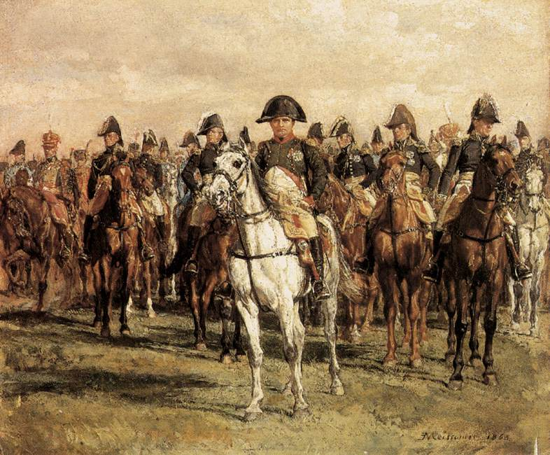

Is requiring people to study their country’s history a positive way of ensuring that citizens develop shared memories…?
Or is it nothing but a way of manipulating citizens’ nationalistic feelings?
Discuss with one other person

Slide 22
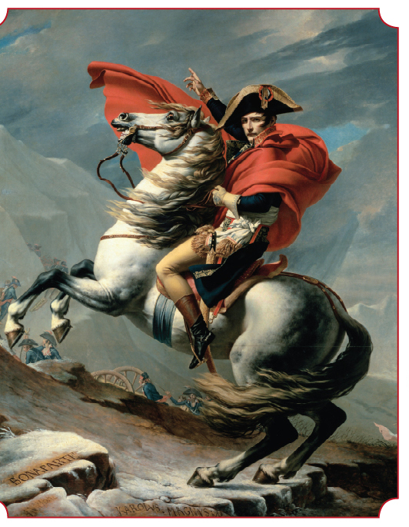
How Have People Responded To Some Factors That Shape Nationalism?
In what way did events from the French Revolution become powerful historical symbols for the French?
Are these symbols based on myth or reality?
How did Jacques-Louis David alter historical truth in his painting of Napoleon crossing the Alps?
Is it wrong to make changes when retelling historical events
How do we decide which version of history to teach in schools? For example, do we describe Napoleon from the point of view of his supporters or his enemies?
Can history be used to unify a nation if it includes stories of failure and defeat?
Read Page 56, including Figure 2-13

Slide 23

Does the ban on headscarves violate France’s national ideals of liberty, equality and brotherhood?
Read page 57 – Including Voices
The left-hand side of the class will take the Yes side
The right-hand side of the class will take the No side.
Each side will prepare up to five arguments
Discuss

Slide 24
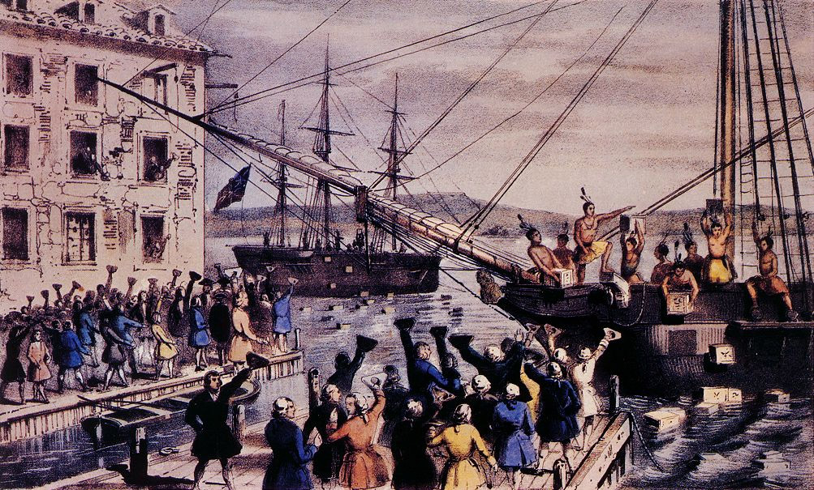
Boston Tea Party
Read page 58
As you read, keep the following question in mind…
In what ways was the Boston Tea Party in the United States similar or dissimilar to the storming of the Bastille in France?

Slide 25
And Finally…
Continue with your list of terms from this chapter, which include…
Any term/phrase/concept that would be considered important in helping you with your …
Related Issue #1 Exam / Coat of Arms
Any suggestions as to what you should include?

Slide 26
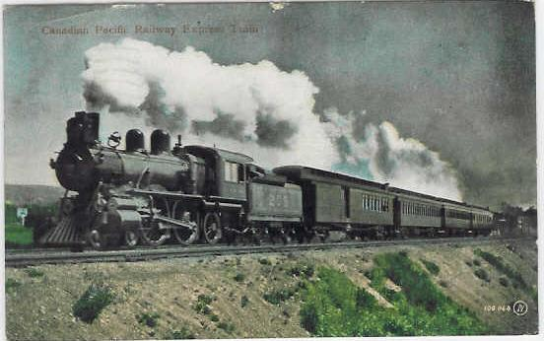

Canadian Railway Trilogy
Listen to Gordon Lightfoot and follow along with the Lyrics
How does Lightfoot describe Canada before the railroad was constructed?
How would life change when the railroad was finished?
Who built the railway? What was the work like?
Why does the song refer to the dead? To tearing up trails? To opening the earth’s heart and letting its life blood flow? To opening up the soil with teardrops and toil?
Read the top half of page 59, including Figure 2-15

Slide 27

Defining Canada’s Stories
“History is written by the victors “
What is meant by this quote?
Read the rest of page 59
What traditions/holidays do we or have we shared with Great Britain?
Our Flag (until 1965)
Boxing Day
Thanksgiving
Victoria Day

Slide 28
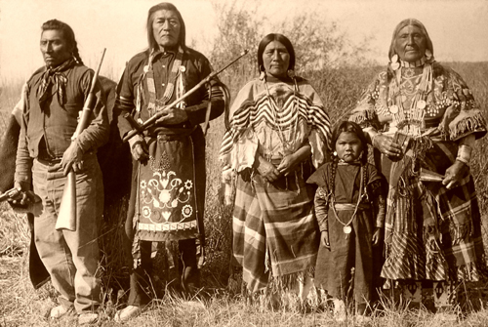
Challenging Canadian Myths
Discovering
Wilderness
What do these words mean?
Why do people say Canada and the Canadian West were discovered as European settlers migrated?
Why would people use this term when Aboriginal people’s had lived here for hundreds, and sometimes thousands, of years?
What do the terms discovering and wilderness say about Aboriginal peoples’ place in Canadian history?
What words might people use if they told these stories from different points of view or perspectives?
Read the top of page 60 – Respond to the Activity

Slide 29
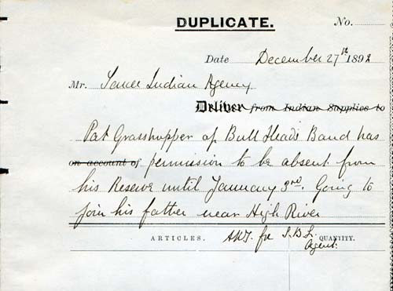
“Our objective is to continue until there is not a single Indian in Canada that has not been absorbed into the body politic and there is no Indian question, and no Indian department”
This was a direct quotation from a Canadian politician
What is meant by this quote?
Duncan Campbell Scott, Deputy Superintendent-General for Indian Affairs, viewed aboriginal people as a “problem” that could only be solved by assimilation.
Assimilating Canadian Aboriginals meant..?
Making Aboriginal peoples more like the British majority
What year was this statement made?
1920
How would this objective affect government policy?
How would it affect the lives of Aboriginal peoples?
What about other people’s attitudes toward Aboriginal peoples?

Slide 30
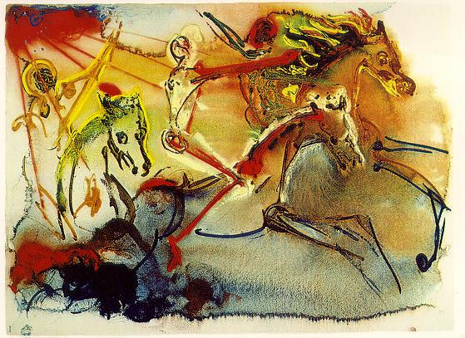
Some Perspectives on Nationalism
Within Canada
In your notes, make and title and chart like this one
Read page 61 and using the first column of the chart, record important points about First Nations and Métis views on nation and nationalism
Continue by reading pages 62 and 63.
Use the second and third columns to record important points on Inuit and Quebecois views on nation and nationalism
Whose stories have been excluded in Canada?
Whose stories have been dominated?
Has the balance shifted? How? Why?

Slide 31
And Finally…
Complete your list of terms from this chapter, which include…
Any term/phrase/concept that would be considered important in helping you with your …
Related Issue #1 Exam / Coat of Arms
Any suggestions as to what you should include?

Slide 32
Think About Your Challenge
Review the bottom of page 65
By the beginning of class on Monday, you need to submit the following:
A brief written update on the status of your challenge in response to the following questions:
What format do you intend to use for your coat of arms?
What symbols will you incorporate
What is the purpose of each of your symbols?
Where did you find the symbols?
What is each symbol’s relative importance in your overall design?
How does each symbol illustrate a relationship between nationalism and your identity?

