Slide 1
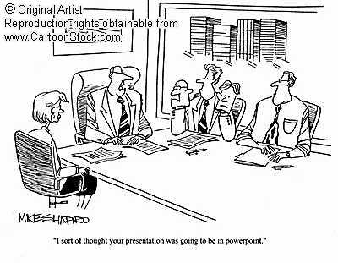
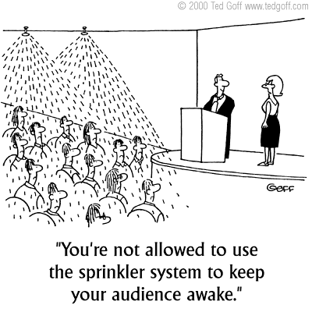
Presentations
Will be at the front of the class, one at a time, over the course of two days: Monday, October 4th and Tuesday, October 5th
Tuesday’s Presenters will be the back half of Row3 and Rows 4 and 5
Monday’s Presenters will be Rows 1, 2 and front half of Row 3
Tired of PowerPoint? Try Prezi
If you miss your day and don’t schedule another time, you will sacrifice your presentation marks!

Slide 2
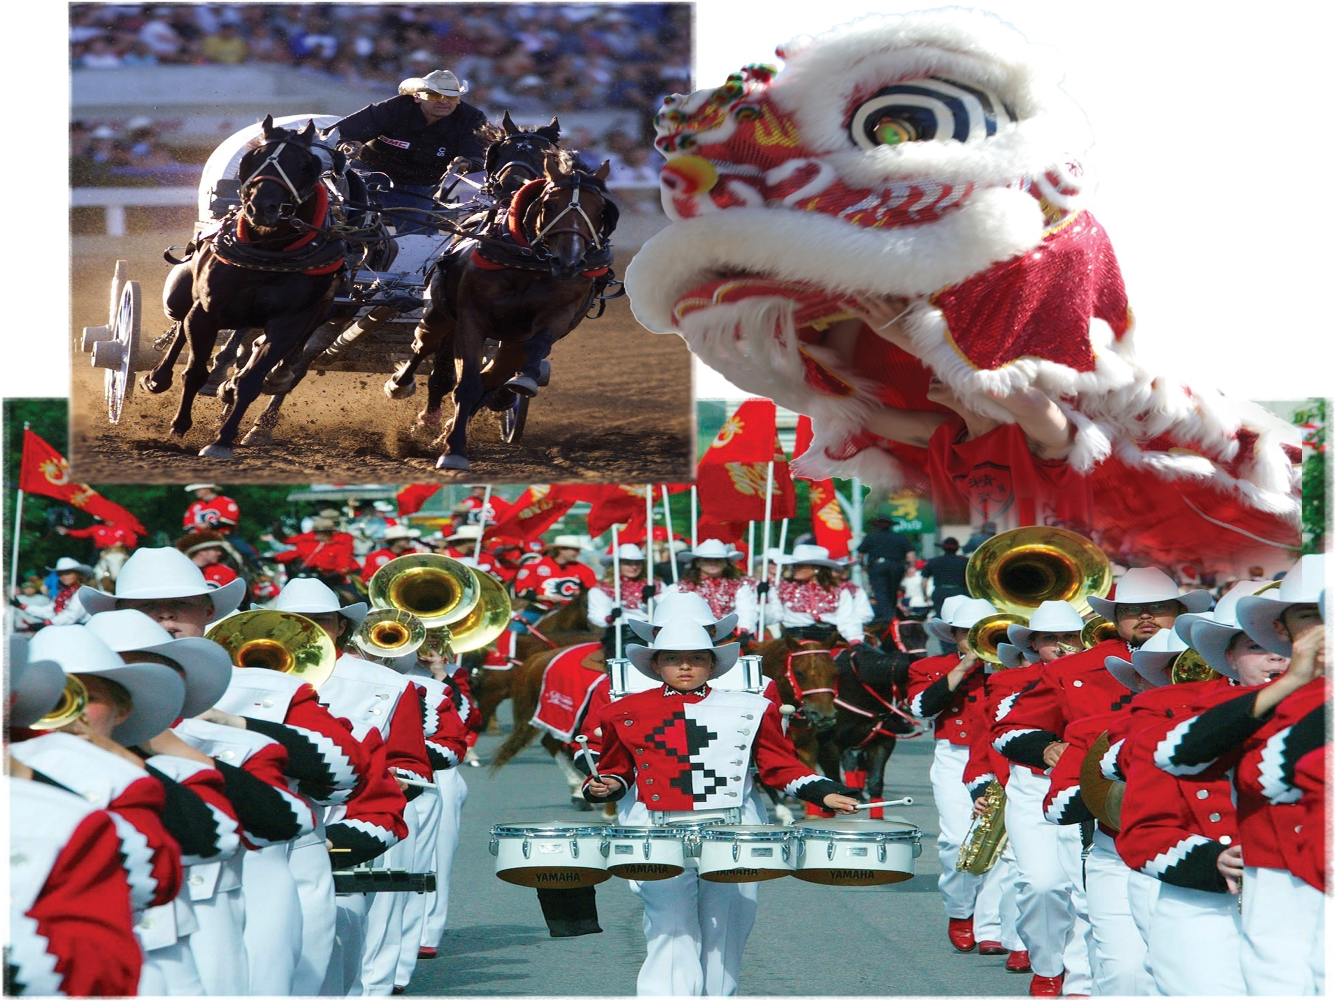
Affirming Identity, Language and Culture
Read the top half of page 89
What are other celebrations that help people state their identity and culture in a globalizing world?
What can people do to respond to the globalizing forces that affect who they are… their identity?
Review Looking Ahead on page 89

Slide 3
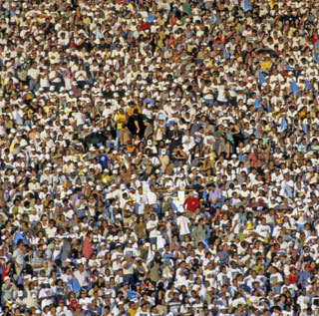
How Do People Affirm and Promote Their Language in a Globalizing World?
Read the first half of page 90
Complete the Activity by listing as many activities and language interactions as you can think of
Respond to the questions in the final paragraph of this section

Slide 4
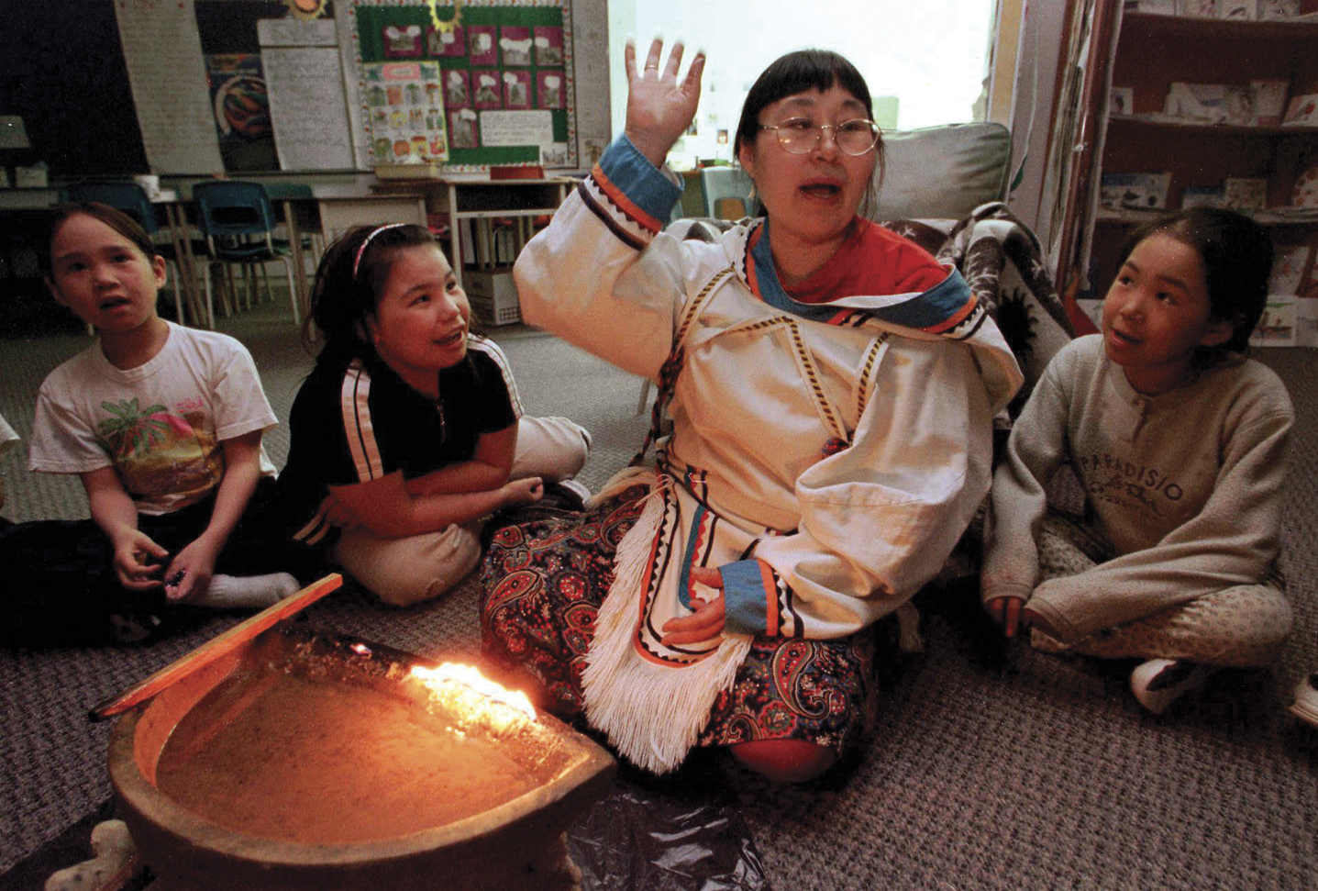
Teaching…Inuit Style!
What is happening in this photograph?
How are the children being taught?
Why is the teacher using this method?
Why is it important that she is speaking Inuktitut?
What parts of Inuit identity and culture does this photo show?
How is this teacher promoting the language and culture of her people?

Slide 5
Differing Views
Read the rest of page 90, including the two ‘Voices’ on pages 90 and 91
Does this information help you with Figure 4-3?
What does it mean to be educated in your own language?
How would you react if you were told that from now on, all classes would no longer be taught in English?
How could a change like this affect students’ individual and collective identities?

Slide 6
Endangered Languages
Read Endangered Languages and Why Languages Disappear on page 91
FYI
The Caucasus region has been an historical battleground for centuries…
How might this effect the loss of ‘Ubykh’?
English has been dominant in government, business and education in British Columbia…
How might this have contributed to the endangerment of Nuuc’aar’u?
Therefore, what challenges do people face in promoting their language in the face of the many forces of globalization?

Slide 7
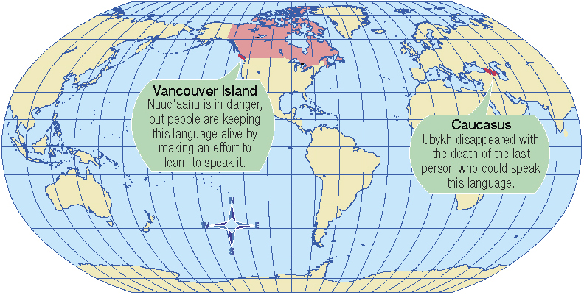
Geographic Factors?
Could the geographic location of Vancouver Island and the Caucasus contributed to the endangerment of these languages?
What physical characteristics may have contributed to in placing these languages at risk?

Slide 8
Dominating With English…?
Read page 92 and…
Think about the chapter question (below) and how it relates to the possible decline of your language – English!…
What can people do to respond to the globalizing forces that affect who they are… their identity?

Slide 9
Think About Your Challenge
Review your challenge for this Related Issue
The Social Dimension of Globalization Presentation
Starting with Chapter Four, is there anything you can add to your notes for
Your Challenge?
Take a few minutes to review and write
Social 10-1

Slide 10
And Finally…
Begin your list of terms from this issue, which include…
Any term or phrase that would be considered important in helping you with your …
Exams, quizzes and your presentation
The Social Dimension of Globalization Presentation
Any suggestions as to what you should include?

Slide 11
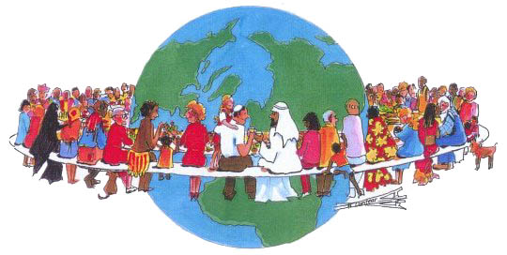
How Do People Strengthen and Promote Their Culture in a Globalizing World?
Read ‘Voices’ on page 96
What is meant by all cultures… “…being fed into an industrial-strength blender”?
Read page 96 and write out examples of people strengthening and promoting their cultures

Slide 12
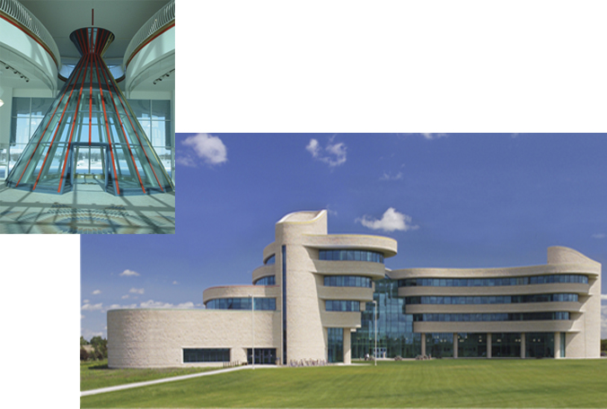
“This building…was conceived of and designed specifically to give a voice and a recognizable symbol to the First Nations University, as well as all native peoples of Saskatchewan. It is a source of pride – bricks and mortar signifying the realization of their endeavors and achievements.”
Cultural Revitalization – Challenges and Opportunities
Read the top half of page 97
How can creating institutions like the First Nations University of Canada give people a voice?

Slide 13
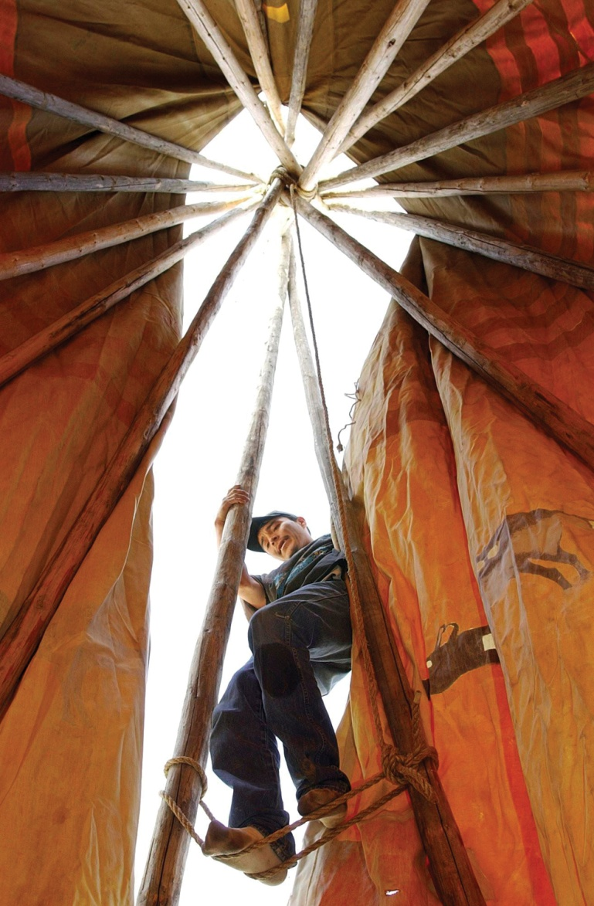
Akaitapiiwa: Ancestors Exhibit
Read page 100
How is this man promoting and affirming the culture of his people?

Slide 14
How Do Governments Affirm and Promote Languages and Cultures in a Globalizing World?
Can you think of how any government policies have affected people around the world?
What about….
Those who spoke ‘Ubykh’…
The government of Russia made Russian the official language of this area and the language slowly died out…

Slide 15
Read the Introduction on Page 101
Canada’s Role
In her quotation, Governor General Michaelle Jean uses a number of descriptive words…
What does she mean by:
Enriches
Challenge
Dialogue

Slide 16
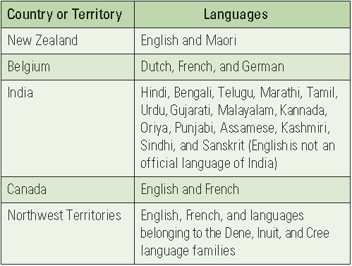
A Few Official Languages…
Why isn’t English an official language of India?
Why does India have 15 official languages?
What might the government of India have been thinking when they made their list?
Why do you think the Northwest Territories have five or more languages?
What challenges might all these languages present to healthcare workers, educators, in both the Northwest Territories and India?

Slide 17
Government Roles in Promoting Language and Culture
Read the first part of page 102
With the new ‘90 Hour Rule’, how effective do you think the Aboriginal instruction will be?
Will ‘English’ satellite programming help or hinder this program?

Slide 18

And the winner is….
Sofia Hou
What aspects of Canadian Culture are included in her poster?
Why do you think her poster was chosen?
How does her poster promote Canadian Culture?
What type of images would you include?

Slide 19


Controlling Content
Read the rest of page 102
How successful do you think countries like Canada, Australia, China and Mexico have been in protecting their culture against American culture and the dominance of English?

Slide 20
Think About Your Challenge
Review your challenge for this Related Issue
The Social Dimension of Globalization Presentation
Continuing on with Chapter Four, is there anything you can add to your notes for
Your Challenge?
Take a few minutes to review and write
Social 10-1

Slide 21
And Finally…
Continue with your list of terms from this issue, which include…
Any term or phrase that would be considered important in helping you with your …
Exams, quizzes and your presentation
The Social Dimension of Globalization Presentation
Any suggestions as to what you should include?

Slide 22
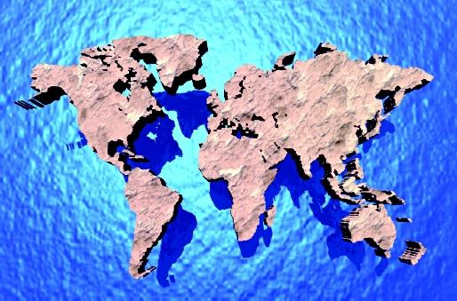
How do International Organizations Affirm and Promote Languages and Cultures in a Globalizing World?
Read the first two paragraphs on page 104
What are some of the examples of cultural heritage that we have looked at so far:
APTN
Calgary Stampede
Métis National Council
Métis Nation of Alberta
First Nations University of Canada

Slide 23
The International Network for Cultural Diversity
If the word Tangible means…
Something that is solid or permanent
What does Intangible mean?
Something that is imaginary or temporary
Read the rest of Page 104
Examples?
Examples?

Slide 24
La Francophonie
Read page 105
Why would this international organization, La Francophonie, want to respond to the needs of its young people?
Why would it be a worry for young French speaking youth in trying to find work in a global workforce where French is not most people’s first language?

Slide 25
Cultural Revitalization
What does cultural revitalization mean?
Why is cultural revitalization important to Indigenous peoples in Canada? In other countries?
How are cultural revitalization and human rights connected?
Do you think it’s important for Indigenous peoples around the world that all countries agree to affirm that they deserve human rights?

Slide 26
The Assembly of First Nations and the Declaration on the Rights of Indigenous People
Read page 106
Why do you think that Canada and the United States did not want to sign the
2006 Draft Declaration on the Rights of Indigenous People?

Slide 27
Think About Your Challenge
Review your challenge for this Related Issue
The Social Dimension of Globalization Presentation
Finishing up with Chapter Four, is there anything you can add to your notes for
Your Challenge?
Take a few minutes to review and write
Social 10-1

Slide 28
And Finally…
Complete your list of terms from this issue, which include…
Any term or phrase that would be considered important in helping you with your …
Exams, quizzes and your presentation
The Social Dimension of Globalization Presentation
Any suggestions as to what you should include?

Slide 29

Related Issue #1 Exam
Part of your exam for Related Issue One is an analysis and interpretation of three sources
It will be marked according to the rubric provided to you (Writing Assignment I)
You will have the entire class to complete the exam
The three sources will be used to answer the following questions:
What perspectives do each of the three sources present on the concept of globalization and identity?
and
What relationships exist between the sources?

Slide 30
The Question: Specifics
What perspectives do each of the three sources present on the concept of globalization and identity, and what relationships exist between the sources?
Examine each source. Write a response in paragraph form in which you:
>Interpret each source to identify and explain the perspective on globalization and identity; explain the links between the principles of globalization and identity and each source
>Identify and explain one or more of the relationships that exist among the sources; support your response with evidence drawn from the sources and knowledge of social studies

