Slide 1

Related Issue #4
(To What Extent) Should I , As A Citizen, Respond to Globalization?
Students will examine their roles and responsibilities in a globalizing world
Micro-financing
Overview of one Organization
Intro

Slide 2


Related Issue #4
(To What Extent) Should I , As A Citizen, Respond to Globalization?
Examples
3:00
4:00
Now What?
Intro

Slide 3
Related Issue #4
(To What Extent) Should I , As A Citizen, Respond to Globalization?
Beginning next Wednesday, the class will be working together to learn more about micro-financing, what Kiva does and how it is a response to Globalization
Most Wednesday’s will be known as Kiva Wednesday’s, where we will work towards making a personal and global impact…
We will be doing this through a number of activities, but eventually we will be making a loan of our own!
(Over $2250 has been loaned to 30 entrepreneurs over the two last years!)
Intro

Slide 4
Related Issue #4
(To What Extent) Should I , As A Citizen, Respond to Globalization?
Between today and February 9th , it is up to you to become familiar with the website (kiva.org) and all that Kiva has to offer!
Intro

Slide 5
Kiva Vocabulary
Randomly, the class will be divided into two groups
One ‘team’ will receive a list of terms and the other ‘team’ will receive a set of definitions
Each person on each team will be responsible for either a term or a definition
Get into two teams…My choice!
Related Issue #4
To What Extent Should I , As a Citizen, Respond to Globalization?
Day 1

Slide 6
Kiva Vocabulary
The team closest to the window will be “Team Term”
The team closest to the door will be “Team Definition”
After all members on “Team Term” have been given their ‘term’, all of you are to sit together as a group (or smaller groups) and come up with a synonym for each of the terms. Write this synonym on the back of the paper.
And
After all members on “Team Definition” have been given their ‘definition’, all of you are to sit together as a group (or smaller groups) and agree on an alternate version for each definition. Write this alternate version on the back of the paper.
Related Issue #4
To What Extent Should I , As a Citizen, Respond to Globalization?
Day 1

Slide 7
Kiva Vocabulary
Before reviewing your new terms and definitions, attempt to find the matching term with the correct definition. When you feel you have been matched correctly, sit with your match and wait until everyone is finished.
Review
Review handout of terms
Related Issue #4
To What Extent Should I , As a Citizen, Respond to Globalization?
Day 1

Slide 8
Kiva Vocabulary
Additional terms may be added to this handout as we come across them
Now, work independently to use each word in a sentence that expresses your own personal values or opinions – Write neatly!
If you aren’t sure how to phrase these sentences, you could start with…
“I feel that…” or “I believe that…”
Keep these completed sentences and your handout for future reference
Related Issue #4
To What Extent Should I , As a Citizen, Respond to Globalization?
Day 1

Slide 9
Kiva Portfolio
Part of your mark for Related Issue #4 involves keeping an updated portfolio
This is to take the form of a duo-tang or similar type folder that will be kept in the back of the classroom
It needs to have some sort of title page on it, followed by any and all work we do on Kiva Wednesday’s (including today’s work!) This includes work you may have been absent for
Although you will not be marked on ‘neatness’, your portfolio is to be complete, organized and legible!
Handout – Final Assessment
Related Issue #4
To What Extent Should I , As a Citizen, Respond to Globalization?
Day 1

Slide 10
Telling a Story
The Assignment:
Using photographs, journal entries and other documents related to a Kiva entrepreneur, students will gather information needed to retell the entrepreneur’s story in a newspaper-style article
Objectives:
Students will be able to describe the “Who,” “What,” “Where” and “Why” of a story and present it in a logical sequence
Students will write a newspaper-style article that describes a Kiva entrepreneur, his or her business, and the country he or she lives in
Students will gain an understanding of Kiva entrepreneur countries and express similarities and differences in lifestyle and culture
Day 2-3

Slide 11
Telling a Story
Procedure:
Visit the Kiva website and find an entrepreneur, such as Bailoh Jalloh.
Examine the entrepreneur’s picture very closely and write down ALL of the details you notice.
What did you notice?
In what ways is the scene in the photograph similar to your own experience?
In what ways is it different?
For example, what kinds of products is Bailoh selling?
(Juice and soda, scrub brushes, batteries and flashlights, and packaged food.)
Why is she selling batteries and flashlights?
(Electricity may be intermittent where she lives.)
Day 2-3

Slide 12
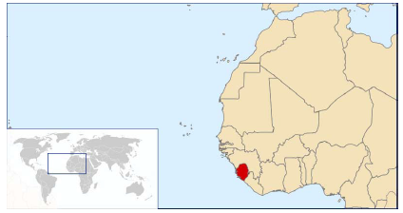
Telling a Story
Procedure (con’t):
Read the details of the entrepreneur’s story and examine the picture again. Do you notice any additional details?
Look at the map of the entrepreneur’s region. Explain the “Who,” “What,” “Where,” and “Why” of the story, using the photo and map as visual aids.
Day 2-3

Slide 13
Telling a Story
Procedure (con’t):
5. Individually (or within a group of no more than two), choose one Kiva entrepreneur to research.
You are to produce a one page newspaper-style article that describes the entrepreneur.
The article should include photographs or images, and should use descriptive headings and quotes from the entrepreneur’s journal entries.
Each group or individual should focus on making the stories of each entrepreneur
“Come Alive!”
Assessment:
Student stories will be assessed based on how well they referenced details in the photographs, details from the Kiva website, and from their entrepreneur’s journal.
Stories should present the “Who,” “What,” “Where” and “Why” of the entrepreneur.
Day 2-3

Slide 14
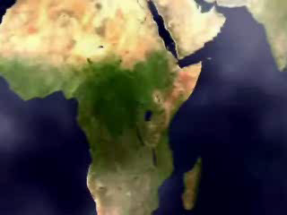
Telling a Story
Use the handout as a review and a reference.
You will have today and next Wednesday to work on this.
It is to be completed and placed in your portfolio by March 2nd
(A copy must be found in each student’s portfolio)
11:30
A Little Goes A Long Way
Day 2-3

Slide 15
Interview an Entrepreneur
The Assignment:
This activity will help students practice interviewing skills as groups of two alternate between playing the role of a Kiva entrepreneur and a lender
Objectives:
Students will practice interviewing and oral communication skills and giving constructive feedback
Students will begin to identify how needs and values influence the relationships between Kiva lenders and entrepreneurs
Day 4

Slide 16
Interview an Entrepreneur
Procedure
1. Students will be grouped into pairs. In each pair, one student plays the role of a Kiva
entrepreneur, and the other plays the role of the lender.
(Your partner cannot have the same entrepreneur as you!)
Students will alternate roles after a few minutes
2. Using your newspaper article (that was to be finished for today), each student will be given ten minutes to research and take notes on your Kiva entrepreneur and his or her loan request.
You will focus on the needs of the entrepreneur:
Why is he or she requesting a loan?
If the loan enables the entrepreneur to generate more income, how will this money be spent?
(For example, much of the revenue generated by microfinance lending is used to pay school fees)
Day 4

Slide 17
Interview an Entrepreneur
Procedure
3. You will have ten minutes to prepare your questions for the interview.
Develop questions that reveal what the entrepreneur might consider important.
Does the entrepreneur have a family?
How will the loan benefit the family as a whole?
You are to keep asking “why” until you feel that the entrepreneur has expressed his or her values.
For example:
Need: “A loan of $500”
Why? “To expand a business”
Why? “To generate more income”
Why? “To improve health care and education for my family“
Why? “Because I value our quality of life and want to improve it”
Day 4

Slide 18
Interview an Entrepreneur
Procedure
Students will write their questions and their partner’s responses on an interview sheet that will be placed in their portfolio’s at the end of class
(Therefore, write questions and responses neatly!)
Use the title:
Interview an Entrepreneur
5. Guidelines for participation to students:
The borrower has to start with the sentence:
“I would like to borrow money because my business is….”
The lender has to start with the sentence:
“I like the idea of … because….”, or “I don’t agree with your idea of ….because….”
Begin the interview sessions. The entrepreneur will have two minutes to describe his or her business, explain why he or she is requesting a loan, and explain how the loan will be repaid.
The interviewer has approximately three minutes to ask follow up questions.
Then students will switch roles and repeat the process.
Day 4

Slide 19

Interview an Entrepreneur
Procedure
7. At the end of the interview sessions, some of the lenders will review the loan application to the entire class and tell whether or not he or she would lend money to the entrepreneur and why.
As you explain your decision, be sure to do so in terms of needs and values.
Upon completion of this process, we will be recording a list of entrepreneur’s needs and values on the board/notes and discussing the differences between needs and values.
Use the title:
Entrepreneurs Needs and Values
Assessment
Observing each pairs’ performance and note if students are making persuasive arguments and asking pertinent questions.
Could students identify the values and needs of each entrepreneur?
Interview sheets will be reviewed after being placed into students’ portfolios.
A Fistful Of Dollars: The Story of a Kiva.org Loan
(11:00)
Day 4

Slide 20
Kiva in the World
The Assignment:
In this project, students will work in teams to create a classroom bulletin board that highlights Kiva’s activities around the world.
Students will learn about the history, geography, and cultures in which Kiva
entrepreneurs work.
Objectives:
Students will learn about the countries in which Kiva entrepreneurs live and be
able to recognize patterns that are common to developing nations.
Students will express how differing geographic and social conditions produce
different opportunities for Kiva entrepreneurs.
Day 5-7

Slide 21
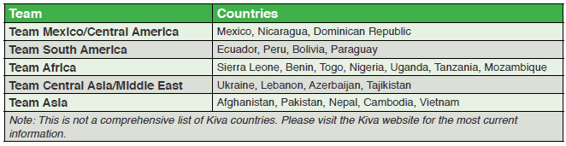
Kiva in the World
Procedure
1. Students will be divided into five teams, each team will be responsible for a different region of the world
Day 5-7

Slide 22
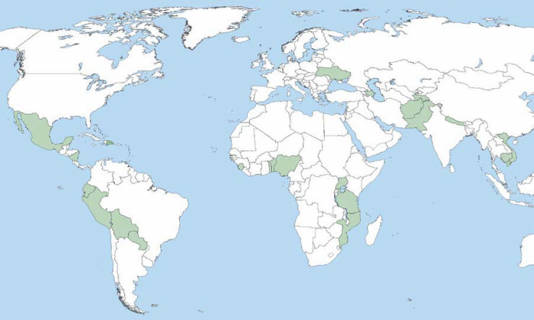
Kiva in the World
Ukraine
Azerbaijan
Tajikistan
Lebanon
Nepal
Dominican Republic
Afghanistan
Pakistan
Mexico
Nicaragua
Sierra Leone
Cambodia
Benin
Vietnam
Ecuador
Togo
Uganda
Peru
Nigeria
Tanzania
Mozambique
Bolivia
Paraguay
Day 5-7

Slide 23
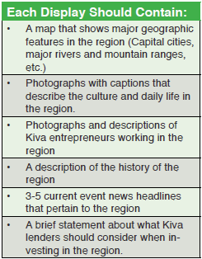
Kiva in the World
Procedure
2. Each team will be contributing to a display that shows Kiva’s activities around the world.
Each team’s job is to develop a display that will communicate the history, culture, geography, and economic conditions in the region.
More importantly, each display should communicate how geographic and social conditions in a particular region affect the lives of Kiva entrepreneurs.
Be sure you include the title of your region!
Day 5-7

Slide 24
Kiva in the World
Procedure
3. Upon completion, each group should prepare a five minute presentation for the class.
Groups can use any format to present their understandings, but each group should highlight the information in their display and present the information as if they were trying to advise potential lenders who are interested in investing in the region.
The library is booked for you March 9th and March 16th
Presentations will take place at the beginning of class on March 23rd
Day 5-7

Slide 25
Kiva in the World
Procedure
4. Each of the two Social 10 classes will be given one of the two bulletin boards at the back of the classroom where your work will be displayed.
Therefore, each group will be limited to only their designated space
Once presentations are complete on March 23rd, each teams work will be displayed on their bulletin board
* Be sure that your work not only fits into your designated area on the bulletin board, but that it can be read by those looking at it! – Don’t make it too small!*
Use the handout as a review and a reference.
Assessment
Displays should clearly communicate what it is like to live in the region and should contain the features listed in the table.
Presentations should be engaging and should cover the major points in each display.
Day 5-7

Slide 26
Statistical Analysis
The Assignment:
In this activity, students will assess the significance of data related to the economic well-being of nations.
You will explore terms like Childhood Mortality and Per-Capita GDP
Objectives:
As data is collected, the students may be able to answer questions such as:
What factors create a high infant mortality rate?
2. What might happen if mothers can’t read?
3. How can anyone exist on $1 a day?
4. Which nations might experience more religious tension?
5. How does corruption affect the economy?
Day 8

Slide 27
Statistical Analysis
Introductory Quiz
Gapminder
Procedure
Students will be assigned two countries (from the handout); one from the countries from the Developed Countries list and one from the Developing Countries list
Using the two countries, students will be using the laptops to complete both sides of the handout: Statistical Information Handout
Upon completion of the handout, you will put away the laptops
Day 8

Slide 28
Statistical Analysis
Procedure
4. When all are complete, students will get into groups of 4 – 5
5. Once you’ve reviewed and analyzed your data, you will be given a challenge. First, select a product. It could be anything: automobiles, wind turbines, solar panels, sneakers, soda, or board games, etc.
6. Second, using the handout provided (What’s the Best Spot for Us?) your job is to determine which nation (of the 8-10 nations in your group) should be the site for the construction of a factory that will manufacture your product.
Day 8

Slide 29
Statistical Analysis
Procedure
7. To complete this assignment, you will have to first determine which information you should consider:
Does literacy matter?
Does infant mortality matter? Why or why not?
You may have to think of additional information you need to make your decision.
8. Each group can present their findings to the class through a variety of means.
You can simply stand and explain your findings, or you could compose a presentation. It’s up to you.
9. Presentations will begin today and (if necessary) finished next class
Day 8

Slide 30
Statistical Analysis
Assessment
Statistical research should be complete and accurately reported.
Determinations on where your products will be manufactured are thoughtfully considered.
3. Presentations should be thorough and complete.
Due:
It is to be completed and placed in your Kiva portfolio no later than April 13th
Day 8

Slide 31
Walk a Mile in Another’s Shoe
The Assignment:
Play a “game” which students will be (in a very basic sense) walking in the shoes of those living in developing countries
Objectives:
Students begin to appreciate what it might be like to live in poverty, realizing that two of the greatest obstacles to getting out of poverty are disease and political situations that are beyond the control of the poor
This “game” provides the opportunity to have students empathize with people who are the victims of circumstances beyond their control
Day 9

Slide 32
Walk a Mile in Another’s Shoe
Procedure
Clear the desks out of the center of the classroom.
2. Create a pathway on the floor of the classroom. Use masking tape to create the pathway.
3. The pathway should have about 15 steps (approximately one foot in length each). The pathway will have to be wide enough to accommodate about half of the students in the class all on one step.
4. At the end of the pathway, line up a row of desks. There should be enough desks to accommodate half of the students in the class. Place numbers on the desks, in order, starting with one.
5. Select one umpire. Her/his job is to make sure no one cheats. You can select two umpires if there are an even number of students in the class
Day 9

Slide 33
Walk a Mile in Another’s Shoe
Procedure
6. Have students pick numbers out of a hat. Students with matching number become partners.
7. One member of the team stands on the “starting point” or 8th step.
8. The other member of the team sits in the desk with the corresponding number.
9. The person sitting in the desk selects a piece of paper out of a hat. That piece of paper details what has befallen the pair, and gives instruction for the other person to move forward or backward on the path. All team members who are in the desks will take turns pulling a piece of paper.
10. The goal of the activity is to reach the 15th step. Whoever reaches first wins.
11. If time, we will play again, switching roles so the person sitting now has to stand.
12. When we finish, we will be processing the activity through discussion.
Day 9

Slide 34
Walk a Mile…
Processing
What did we learn?
2. What causes poverty?
3. What conditions have to exist for people to get out of poverty?
4. Why has the “Canadian dream” been possible for so many people in our country? Do we have the right conditions for people to escape poverty? What are they?
5. Is our economic situation ideal? Are there any problems in our economy that could prevent people from being economically secure?
What could we improve in our own economy?
Can we accomplish those goals?
6. What can we do, as outsiders, to help people who are impoverished around the world?
Day 9

Slide 35
Writing a Kiva Resume
The Assignment:
In this activity, students will review several examples of resumes and then practice writing a sample resume for a Kiva entrepreneur
Objectives:
Students will learn the basics of resume writing, and practice writing a resume that clearly expresses an individual’s talents, skills, and experiences
Students will discuss the limitations of resumes as tools for communicating the experiences and skills of individuals who have different cultural and socioeconomic backgrounds
Day 10

Slide 36
Writing a Kiva Resume
Procedure
1. Review examples of resumes to share with the class.
What is the purpose of a resume?
How are they used by employers and job applicants?
2. Discuss the major parts of a resume— goal statement/objective, work experience, educational experience, and talents/skills.
3. Why are resumes designed the way they are?
Resumes must be concise, easily scannable, and accurate.
4. Students will be working individually to find an entrepreneur on the Kiva website who has a detailed description.
Attempt to write a resume for the entrepreneur using any acceptable resume format.
If students find areas that are incomplete, or lacking (such as education) jot down these areas.
5. Have students share their resumes in class
Day 10

Slide 37
Writing a Kiva Resume
Assessment
How did writing a resume reveal similarities and differences between the lives of students and the lives of entrepreneurs?
How effective is a resume in communicating information about an individual who is very different in culture, heritage, and experience?
Can students think of alternative ways to communicate this information?
Review the resumes in class, and if you have the time, have students revise the resumes based on your feedback and that of their peers.
Due:
It is to be completed and placed in your Kiva portfolio no later than April 27th
Day 10

Slide 38
Writing a Letter
The Assignment:
In this activity, students will work independently to write a letter for an audience of their choosing
In the letter, the students will explain what Kiva is, express their personal values related to global social action and try to communicate the challenges faced by a Kiva entrepreneur
Objectives:
Students will practice writing a persuasive letter
Students will express their values related to Kiva and attempt to communicate why a small loan might make a big difference for a Kiva entrepreneur
Day 11

Slide 39
Writing a Letter
Procedure
1. Discuss the elements of a letter with students. Discuss with students the specific elements of letters to the editor, letters to politicians, etc.
2. The purpose of their letters will be to describe Kiva, to express what the student finds personally important or valuable about participating in Kiva, and to communicate why a loan may help a specific Kiva entrepreneur:
Explaining Kiva
• Students should explain what Kiva is, how it works, and how people participate in Kiva.
• Students should include specific figures in this section: how many people lend to Kiva, how many people have been impacted?
Personal Values
• Why do you think loaning to Kiva is important? How is it different from other forms of “charity”?
• What are your personal values related to Kiva? How has participating in Kiva changed your perspective on the world?
Expressing the Impact
• Choose a specific entrepreneur, and describe what life is like for him or her using details from the Kiva website. How is their life different from your own, how is it similar? How might a loan from Kiva help this individual?
Day 11

Slide 40
Writing a Letter
Procedure
3. Have students choose one of the following audiences for their letter: the editor of a local or national newspaper, a political representative, a family member, another teacher or student, or a local business or organization
Discuss with the students how the tone of each type of letter may be different for each audience. In each case, however, the purpose of the letter should be to persuade the audience that the student’s point of view is valid
4. Stress that students must anticipate questions or concerns the audience might have. Brainstorm these as a group, and discuss possible responses to each of these questions or concerns
5. Students will begin to write their letters in class, using peers for feedback and revision. If students wish, they may send their letters. If so, they will be sent from school as it will be easier to collect and post responses
Day 11

Slide 41
Writing a Letter
Assessment
Each letter will be evaluated to see if it clearly explains what Kiva is, if it expresses a student’s personal values, and if it communicates why a loan will make a difference in the life of an entrepreneur
The rubric shown in Step 2 will be used to evaluate student letters
Due Date:
Each letter must be in their portfolios no later than May 4th
Day 11

Slide 42

It’s Loan Day!
Before we begin, here is an example of how a loan can impact the life of one individual…
In the world of…
The Simpsons
Day 12

Slide 43
Make a Kiva Presentation
The Assignment:
In this activity, students will prepare and deliver a multimedia presentation to educate others about the lives of Kiva entrepreneurs.
By preparing multimedia presentations, students practice gathering information from various resources and organizing it in a coherent manner.
In addition, delivering presentations in public helps students practice public speaking skills and builds self-confidence.
Objectives:
Students will combine text, images, and audio and draw information from resources such as television broadcasts, videos, films, newspapers, magazines, and the Internet to create a presentation.
Students will learn about Kiva’s entrepreneur countries and understand how these factors influence an entrepreneur’s life experience.
Day 12-14

Slide 44
Make a Kiva Presentation
Procedure
1. Students will be organized into groups no larger than four.
Each group will choose one of Kiva’s entrepreneur countries to research.
Students will use a variety of media to prepare their presentations.
2. Student groups should use graphics, video clips and text to create a multimedia presentation regarding the country’s:
Geography
History
Culture
Transportation
Climate
Population
Trade
Economic Activities
Students should use Kiva entrepreneur profiles and pictures to help add a more personal dimension to their presentations.
Day 12-14

Slide 45
Make a Kiva Presentation
Procedure
3. Students will include a slide (with an accompanying handout) at the beginning of the presentation with questions that assess the audience’s knowledge of the country they chose (pre-test).
At the end of the presentation, students will include an additional slide (also with an accompanying handout) that assesses the audience’s comprehension of the material they presented (post-test).
Questions in the post-test are to be variations of the questions in the pre-test and not the exact same questions!
Day 12-14

Slide 46
Make a Kiva Presentation
Assessment
Each presentation will be assessed on accuracy, depth of coverage, and the appropriateness of questions asked.
The audience’s answer sheets will be collected by the presenting group and will be evaluated (by the group members) as to each student’s reasoning.
The presenting group will use the pre- and post- presentation responses from the audience to evaluate their effectiveness of the presentation.
The presenting group will prepare a summary of these pre- and post-presentation responses, which will include a written group self-evaluation and a grade (out of a /100) with a written rationalization for this mark.
The summary and the group self-evaluation will be due two days after your presentation.
Attendance by all group members is essential!
Due Date:
Research and preparation will take place on December 9th and December 16th with presentations December 18th.
Day 12-14

Slide 47

As a Global Citizen, What in the World Do I Need to Respond To?
What are some of the ‘problems’ of the world that need to be responded to?
Human Rights
Gender Inequality
Work/Labour Issues
Ineffective/Corrupt Governments
Health Crisis’
Poverty
More?
Which of the above does Kiva attempt to help with?

Slide 48


To What Extent Should I, as a Citizen, Respond to Globalization?
Ideas?
6:00
Born Into Brothels - Preview

Slide 49
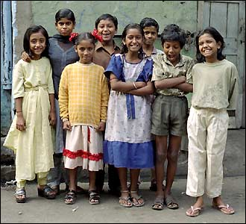

Born Into Brothels
To What Extent Should I, As A Citizen, Respond to Globalization?
A Personal Response
85 minutes
Day 15

Slide 50
Kiva Portfolio
Part of your mark for Related Issue #4 involves keeping an updated portfolio
This is to take the form of a duo-tang or similar type folder
Although you will not be marked on ‘neatness’, your portfolio is to be complete, organized and legible!
Related Issue #4
To What Extent Should I, As a Citizen, Respond to Globalization?
Final Day!

Slide 51
Your Kiva Portfolio is to Include:
Title Page
Kiva Vocabulary Terms - Handout
Vocabulary Sentences
Telling a Story – Newspaper Article
Interview an Entrepreneur - Notes
Statistical Information - Handout
What’s the Best Spot for Us? – Handout
Kiva Resume
Kiva Letter
*All of the above should be clearly labelled, therefore, you may but do not have to include any of the assignment sheets!*
Related Issue #4
To What Extent Should I, As a Citizen, Respond to Globalization?
Final Day!

Slide 52
Your Kiva Portfolio is to Include:
Title Page
Kiva Vocabulary Terms - Handout
Vocabulary Sentences
Telling a Story – Newspaper Article
Interview an Entrepreneur - Notes
Statistical Information - Handout
What’s the Best Spot for Us? – Handout
Kiva Resume
Kiva Letter
Evidence of Your Kiva Presentation
(Any or all of the following - Pre-Test / Post-Test/‘Handout’ of slide show)
**All of the above should be clearly labelled, therefore, you are not to include ANY of the assignment sheets!**
Related Issue #4
To What Extent Should I, As a Citizen, Respond to Globalization?
Final Day!

