Slide 1

What Is in My Best Personal Interests?
Brainstorm a list of your personal interests and how you might go about pursuing them
For example:
Professional Athlete
What would I have to do to become one?
Remember:
The best way to pursue our interests may involve things we may not like!
Take one of the Interests you just listed and complete the questions listed

Slide 2

To What Extent Should National Interest Be Pursued?
Turn to page 110 of your textbook
Review Related Issue #2 and the four chapters included
What is the connection between the related issue question, the individual chapter questions and each of the chapter inquiry questions?

Slide 3
Canada’s Role In Afghanistan
Choose a number from 1 to 4 and write it down
Read page 111 – The Big Picture
As you read the bulleted points, consider Canada’s role in Afghanistan
How does each of the four bulleted items relate to Canada’s mission?
Write down up to three points for your assigned bullet

Slide 4

Your Challenge: Investigative Report
To What Extent Should National Interest Be Pursued?
Review the top of page 112 – Your Challenge
Read the rest of page 112
Any suggestions on what National Movements you might include?
How might you use technology to present your results?

Slide 5
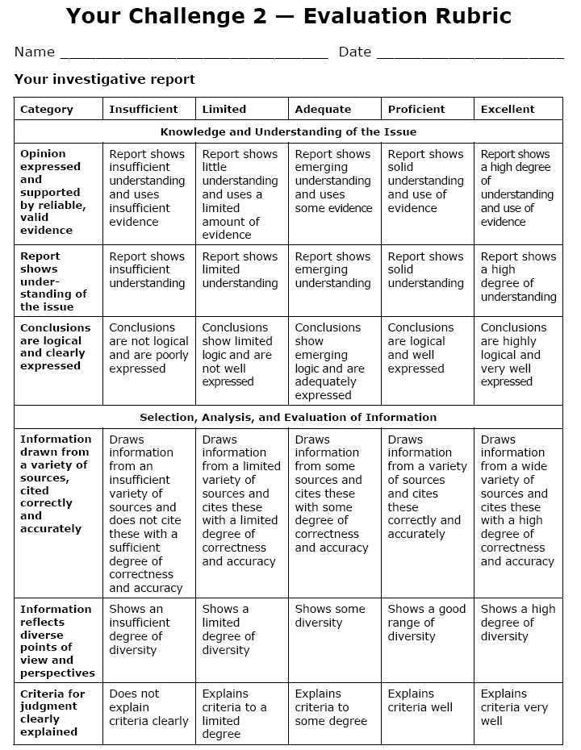
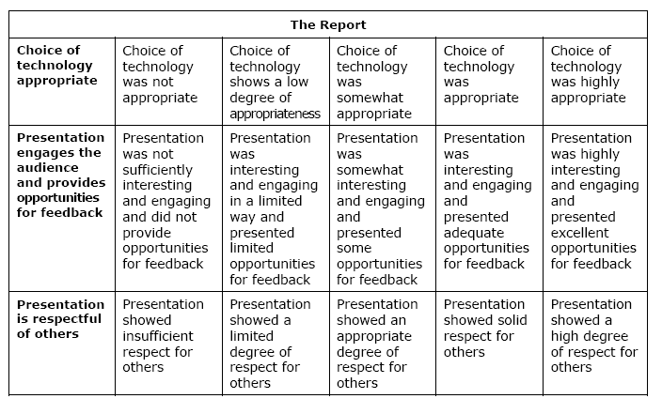
Investigative Report:
Evaluation
Review Evaluation Rubric
No PowerPoint!

Slide 6
Preparing Your Report
Read all of page 113
Use this handout to stay organized as you collect information and materials for your report
I will be collecting these handouts from you in the near future, so use them and don’t lose them!

Slide 7

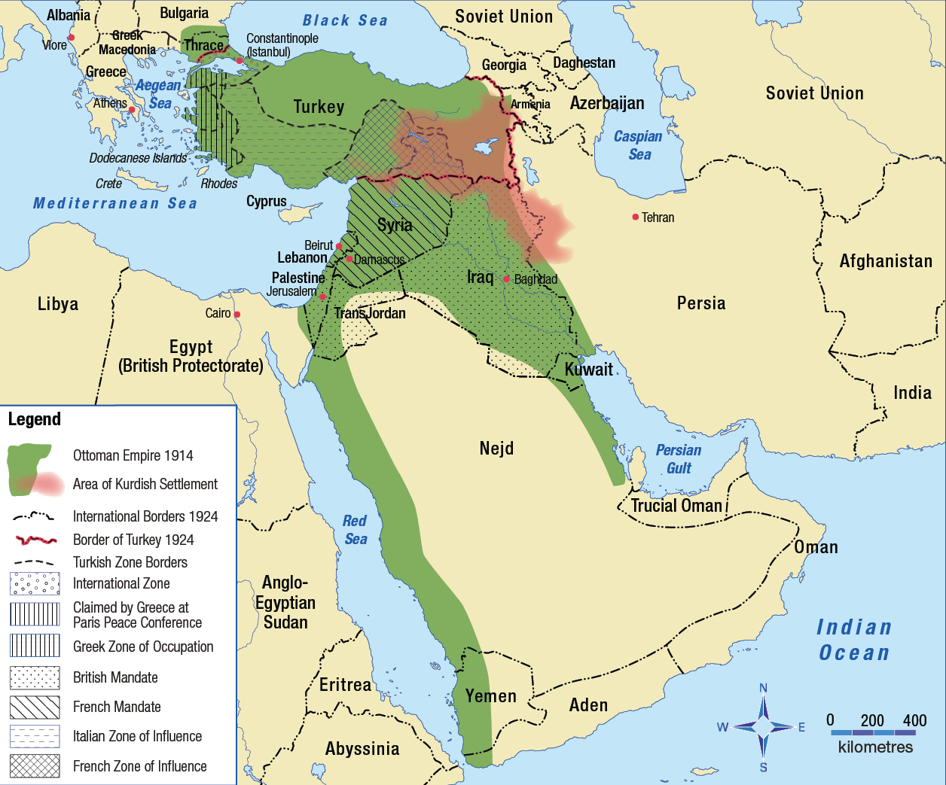
National Interest and Foreign Policy
What are some of the major changes to the Ottoman Empire that occurred after WWI?
How might people living in these areas have felt when the country they lived in was divided up and given a new name and government?
With a partner review page 115
Respond to the questions regarding the Middle East
Read Looking Ahead
This map shows the Middle East before and after World War I – Page 114

Slide 8


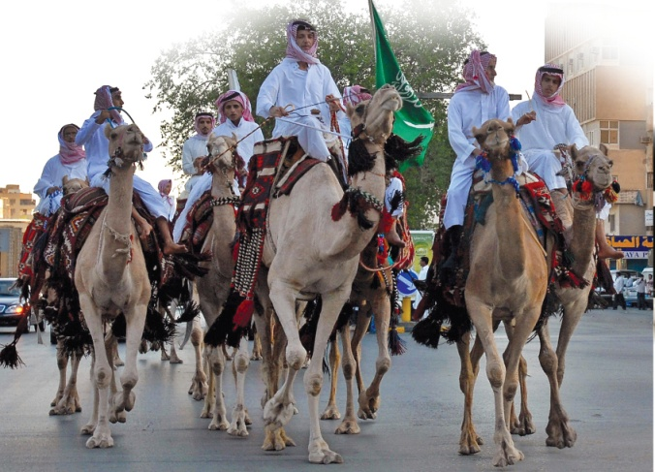

How Are Nationalism and National Interest Related?
Read pages 116 - 117
Represents an interest in promoting beliefs, values and culture
Represents an interest in economic stability and a good quality of life
Represents an interest in safety and security
Examine the photographs on page 116
What aspects of personal interest does each one portray? Is this also a national interest?
Complete the Activity on page 117

Slide 9
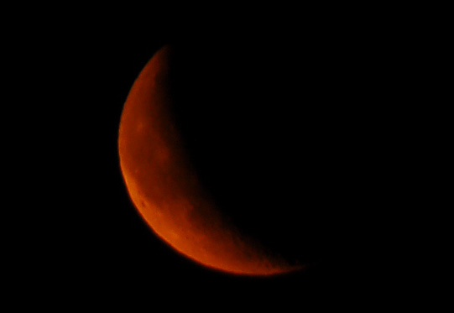

Does this photograph on page 117 illustrate the ideas raised by Annan?
Read Voices on page 117
Explain the difference between National Interests and Collective Interests
Why do you think Annan says the concept of national interest needs to change?

Slide 10
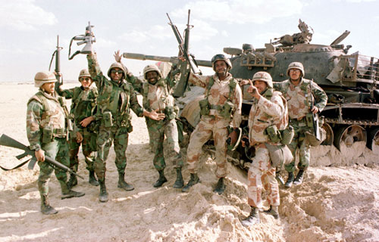
Differing Views on National Interest
Using the handout, read pages 118 and 119 and take jot notes about each person’s point of view
Can a national government ever represent the interests of all citizens through a single national policy?
Use the information on your chart to prepare a response to the question

Slide 11
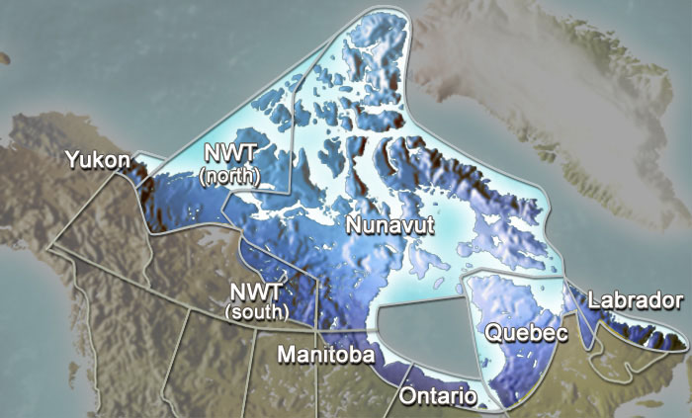
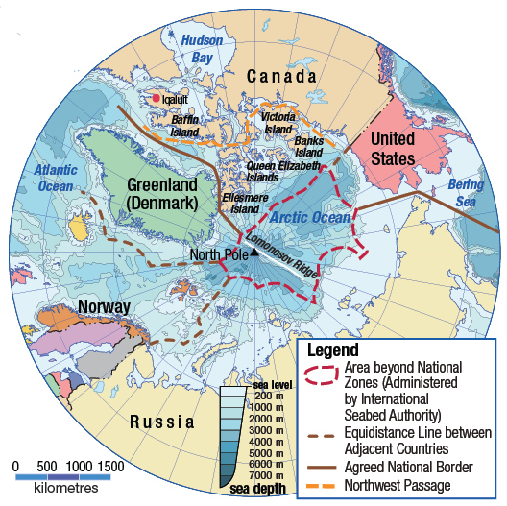
National Interest and Arctic Sovereignty
Has climate change affected the Northwest Passage?
Is it in Canada’s national interest to claim the Northwest passage? Why?
What arguments might the government use to claim the Northwest Passage for Canada?
Should Canada maintain a military presence in the Arctic?
How should the issue of Arctic sovereignty be resolved?
Review this illustration on page 119

Slide 12
What Is in My Nations Best Interests?
Fill in this handout with an issue of your own choice
File this for future reference

Slide 13
And Finally…
Begin a list of terms from this chapter, which include…
Any term/phrase/concept that would be considered important in helping you with your …
Investigative Report
Any suggestions as to what you should include?

Slide 14

How Has National Interest Shaped Foreign Policy?
What are some elements of our school policy?
Write out 5-6 aspects of Fort High’s school policy
and
For one of these elements, make notes on how the policy affects students, teachers, school administrators and parents
Read page 122
Be certain you understand the meanings of
Domestic Policy and Foreign Policy

Slide 15
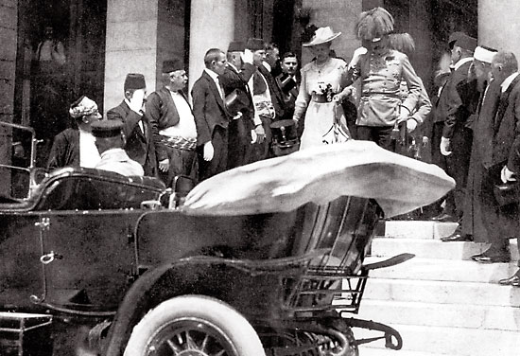
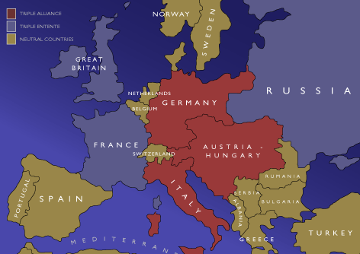
Causes of World War One
Read pages 232 – 237 of the handout
Complete all questions on pages 235 and 237
Use the map handout to assist you
The First World War: To Arms - 1914
(35 minutes)

Slide 16

Causes of World War I -
MANIA
M
A
N
I
A
ilitarism – policy of building up strong military forces to prepare for war
lliances - agreements between nations to aid and protect one another
ationalism – pride in or devotion to one’s country
mperialism – when one country takes over another country economically and politically
ssassination – murder of Austrian Archduke Franz Ferdinand

Slide 17
Causes of WWI - Militarism
Total Defense Expenditures for the Great Powers [Ger., A-H, It., Fr., Br., Rus.]
in millions of £s (British pounds).
1870 | 1880 | 1890 | 1900 | 1910 | 1914
94 | 130 | 154 | 268 | 289 | 398
 | 1910-1914 Increase in Defense Expenditures
France | 10%
Britain | 13%
Russia | 39%
Germany | 73%

Slide 18






Causes of WWI - Alliances
Triple Entente:
Triple Alliance:
Great Britain
Germany
France
Austria-Hungary
Russia
Italy

Slide 19
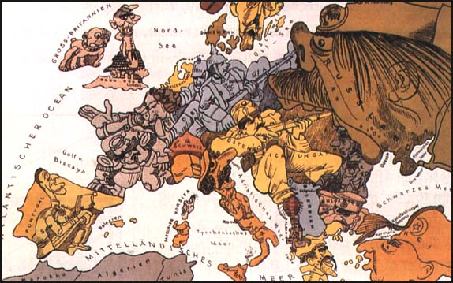
Causes of WWI - Nationalism

Slide 20




Causes of WWI - Nationalism
Pan-Germanism - movement to unify the people of all German speaking countries
Germanic Countries
Austria *
Belgium
Denmark
Iceland
Germany *
Liechtenstein *
Luxembourg
Netherlands
Norway
Sweden
Switzerland *
United Kingdom
* = German speaking country

Slide 21
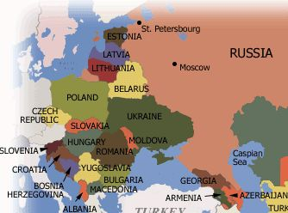
Causes of WWI - Nationalism
Pan-Slavism - movement to unify all of the Slavic people

Slide 22
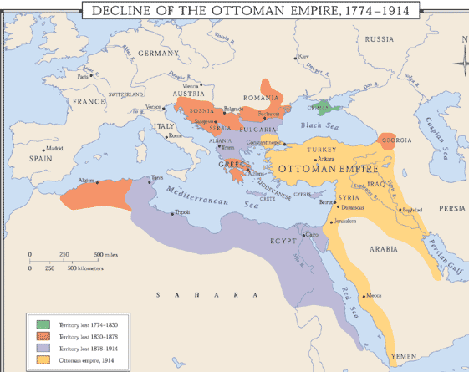
Causes of WWI - Imperialism

Slide 23
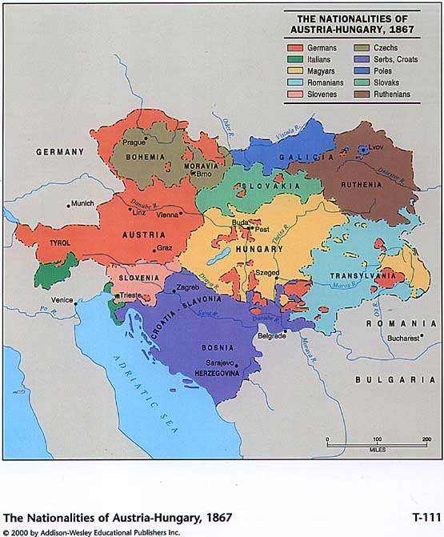
Causes of WWI - Imperialism

Slide 24
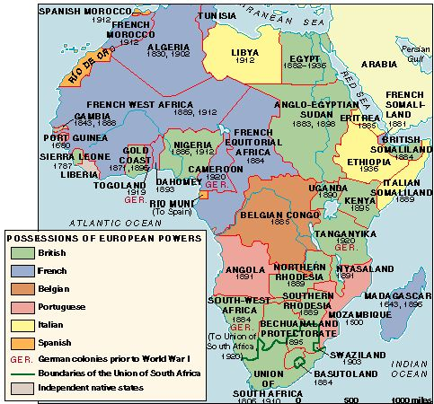
Imperialism: European conquest of Africa

Slide 25

The
“Spark”

Slide 26
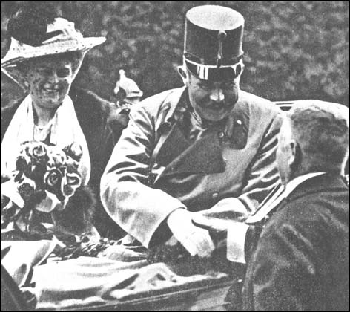
Causes of WWI - Assassination
Archduke Franz Ferdinand and Duchess Sophie at Sarajevo, Bosnia, on June 28th, 1914.

Slide 27
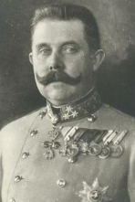
Causes of WWI - Assassination

Slide 28
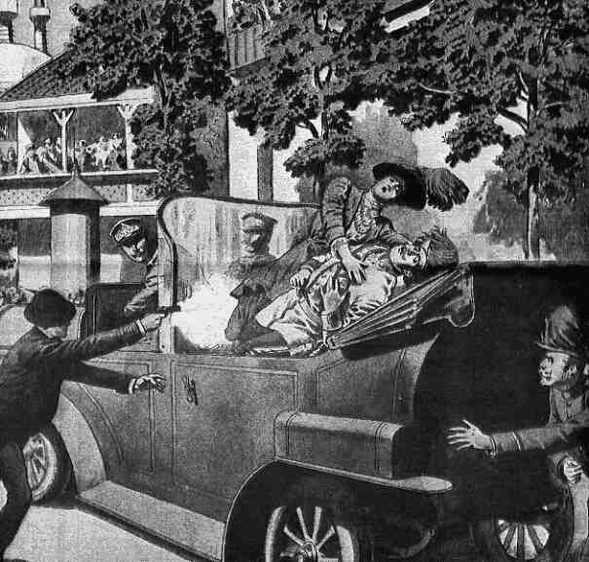
Causes of WWI - Assassination
Austrian Archduke Franz Ferdinand was killed in Bosnia by a Serbian nationalist who believed that Bosnia should belong to Serbia.

Slide 29
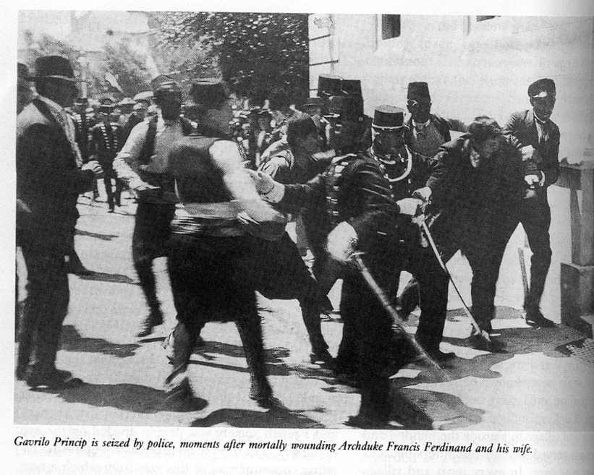
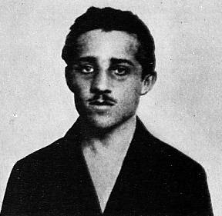
Causes of WWI - Assassination
Gavrilo Princip after his assassination of Austrian Archduke Franz Ferdinand.

Slide 30
The Point of No Return: The Assassination of Archduke Franz Ferdinand
Austria blamed Serbia for Ferdinand’s death and declared war on Serbia.
Germany pledged their support for Austria -Hungary.
· example of Pan-German nationalism
Russia pledged their support for Serbia.
· example of Pan-Slavic nationalism

Slide 31
The Point of No Return: The Assassination of Archduke Franz Ferdinand
Germany declares war on Russia.
France pledges their support for Russia.
Germany declares war on France.
Germany invades Belgium on the way to France.
Great Britain supports Belgium and declares war on Germany.

Slide 32

Allied Powers:
Central Powers:
Germany
Great Britain
World War I
France
Austria-Hungary
Russia
Ottoman Empire
Italy

Slide 33

132 Minutes

Slide 34

National Interest and World War One Peace Settlements
The First World War: War Without End
(28 minutes)
Get into groups of five…
Momentarily, you will be numbered off one through five. Each of you will go to one of the five assigned EXPERT groups and complete a brief summary. You will have approximately 15-20 minutes to do this.
  #1 – World War One (top half of page 123)
  #2 – Treaty Negotiations in France (page 123)
  #3 – National Interests after World War One (top half of page 126)
  #4 – Nationalism and National Interests in the Middle East (page 126)
  #5 – Treaties in the Middle East (page 127)
When finished, return to your original group of five and share your EXPERTISE with your other four group members. They will do the same for you. When you are done, you will have information on all five readings

Slide 35
National Interest and World War One Peace Settlements
Review Treaty Negotiations in France (Page 123) and complete the Activity
Review Nationalism and National Interests in the Middle East (Page 126) and complete the Activity

Slide 36
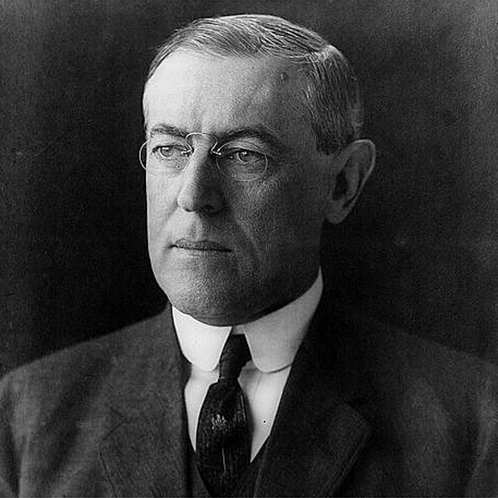
Read Woodrow Wilson: Visionary or Dreamer?
Page 124
Complete Explorations at the bottom of the page

Slide 37
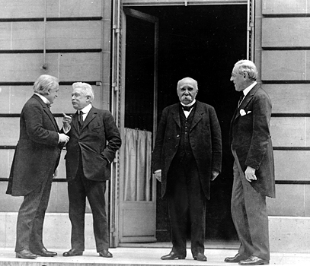
The Treaty of Versailles Was a Significant Cause of World War II
Using the knowledge you gained from chapter five and the handout Some Terms of the Treaty of Versailles, prepare for a
TAG Debate
The left-hand side of the class will take the Agree side
The right-hand side of the class will take the Disagree side.
Each side will prepare up to five arguments
Discuss

Slide 38
Nationalism as a Major Cause of World War One
Much of the origin of the war was based on the desire of the Slavic peoples in Bosnia and Herzegovina to no longer be part of Austria- Hungary but instead be part of Serbia. In this way, nationalism led directly to the War.
In a more general way, however, the nationalism of the various countries throughout Europe contributed not only to the beginning but the extension of the war in Europe. Each country tried to prove their dominance and power.

Slide 39
And Finally…
Continue your list of terms from this chapter, which include…
Any term/phrase/concept that would be considered important in helping you with your …
Investigative Report
Any suggestions as to what you should include?

Slide 40
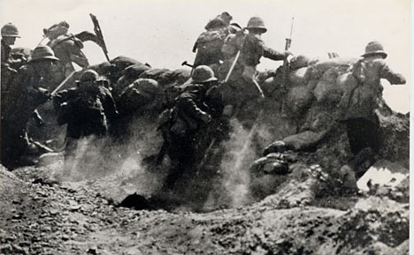

111 Minutes

Slide 41
Using both movies, All Quiet on the Western Front and Gallipoli, answer the following question:
Using examples from history and both movies, All Quiet on the Western Front and Gallipoli, explain how nationalism, militarism and alliances were all factors in the causes and length of World War One.
You have the rest of the class to complete this

Slide 42
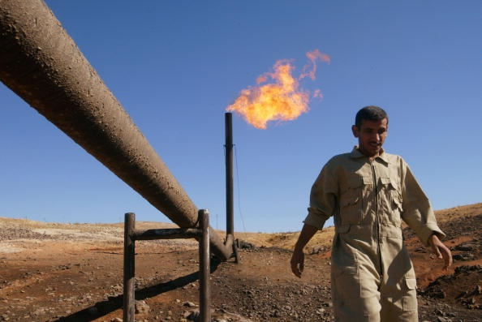
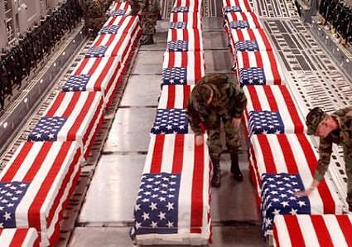
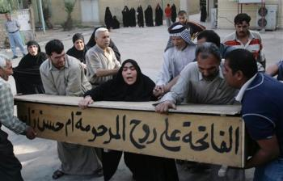


Oil and National Interest In Iraq
What do you know about the history of Oil in Iraq?
What do you know about the Iraq War of 2003?
What do you know about the Iraq War recently?
With a partner open to pages 128-129 and read the introduction and the passages under each heading
As you read, in a sentence or two, summarize each of these sections
When complete, check your summaries with another group – revise as needed!
Complete Explorations on page 129

Slide 43
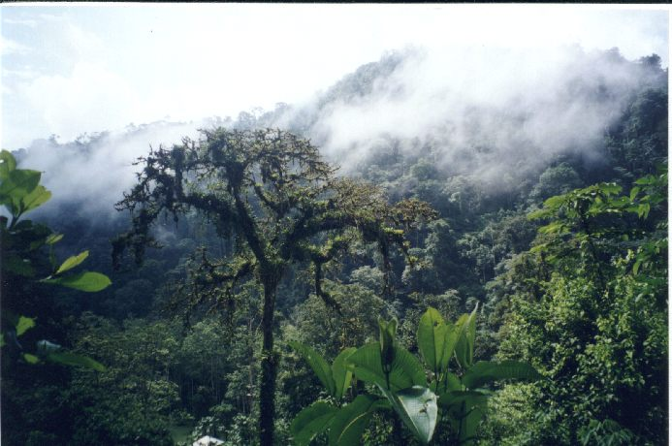
How Has Foreign Policy Shaped National Interest?
Because rainforests affect the health of the whole planet, should we all have a say in how other countries manage their rainforests?
Read page 130, completing the Activity at the bottom of the page

Slide 44
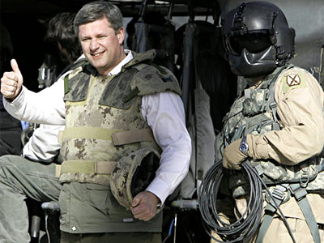
“Canada Should Continue To Support The Military Mission In Afghanistan”
Read the three sections on pages 131- 133 in order to prepare yourself for a
Debate
The left-hand side of the class will take the Agree side
The right-hand side of the class will take the Disagree side.
Give your handout a title and use it to collect information supporting both sides of the argument, so you will be prepared to refute these points during the debate
Agree
Disagree
What are you waiting for…?

Slide 45
“Canada Should Continue To Support The Military Mission In Afghanistan”
A Debate
Four students, two from each side, begin to debate. Either side may start and from this point on, the two sides take turns refuting the position taken by the opposing side.
Once the debate has started, the remaining students may ‘tag’ into the debate. Or I (the moderator) may choose to stop the debate at any time and require that a ‘tag’ take place.

Slide 46
And Finally…
Complete your list of terms from this chapter, which include…
Any term/phrase/concept that would be considered important in helping you with your …
Investigative Report
Any suggestions as to what you should include?

Slide 47
Think About Your Challenge
Review the bottom of page 135
Have you decided what nationalist movement you want to research?
Have you started any of your research?
Have you started tracking down sources?
What format will your report take?
Have you started filling in your organizational chart?

