Slide 1
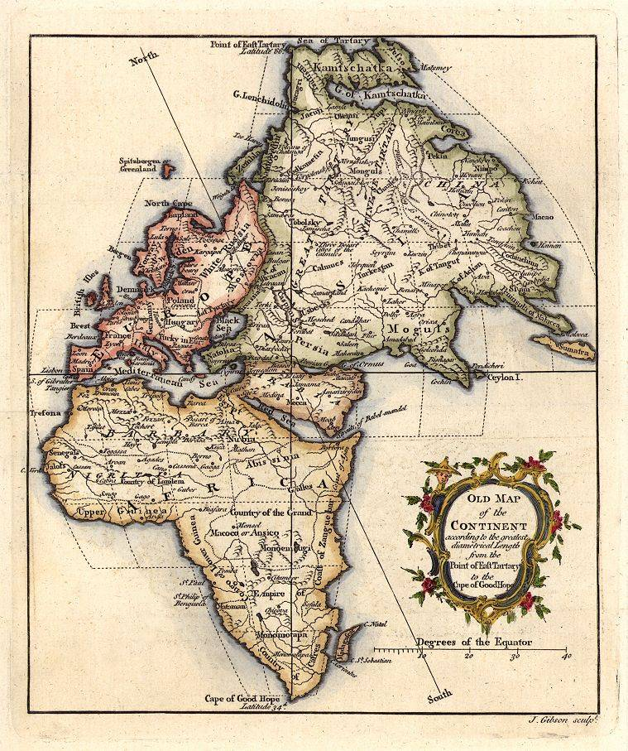
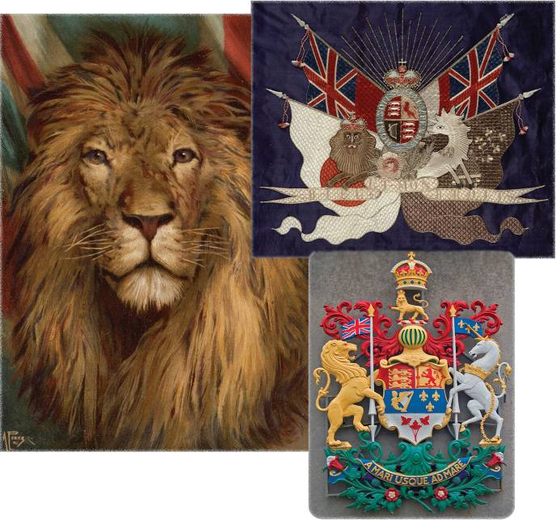
Legacies of Historical Globalization
Describe the various symbols you see…

Slide 2
To What Extent Do the Legacies of Historical Globalization Affect Peoples of the World?
Read page 136-137, answering the six questions. List your responses in your notebook.

Slide 3
Legacies of Historical Globalization
Scan pages 136 – 141 and suggest ways that these pages reflect legacies of historical globalization…
What language is being used in this textbook…?
Most of the flags are from which continent…?
What continent are the monarchs from…?
Anything else?
Is there anything in these pages that may not fit the ‘European’ view?

Slide 4
What Are Some Legacies of Historical Globalization?
Read the opening two paragraphs on page 138
Take a few minutes and think of some of the legacies that have been passed on to you
What are they?

Slide 5
Ethnocentrism and Eurocentrism
Read the rest of page 138, including Voices
What do these two terms mean?
Read the handout:
The Economy of Aboriginal Peoples at Contact
After reading, create a list of the legacies and values found in the handout

Slide 6
The Economy of Aboriginal Peoples at Contact
Would a better understanding of the Aboriginal economy by the Europeans have changed their attitude towards them?
Were the values of the Aboriginals compatible with the values of the Europeans?
Are the values at all reconcilable or able to be brought together?

Slide 7
There were two major periods of European Imperialism
The first period occurred between the late 1400s and the beginning of the 1700s. This period saw mostly the establishment of colonies during pursuits of adventure in which explorers sought to get rich. Also, the desire to Christianize the world played a significant role. And, in addition, these colonies were a place to send excess, dissident, and/or persecuted groups.
Notes:
7

Slide 8
The Second Period of Imperialism
By the middle of the 19th Century, Europe had undergone a phase of nationalism. The Industrial Revolution had been established in England and had begun to be adopted in other Western European states, and several ideologies had been adopted.
In the second phase of imperialism the goals or reasons were economic, political, social/Humanitarian and technological. The aims of the imperial states were economic prestige (political), and strategic (military.)
Notes:
8

Slide 9
Mercantilism
Raw materials were sold to the mother country at a low price
Mother
Country
Colony
Finished goods were sold to colonies at a high price
Another aspect of this imperialism was its use of the economic practice of mercantilism. Under mercantilism colonies were useful as a captive market and a source of materials. In the economic exchanges that occurred the benefit was always for that of the mother country. Also, restrictions were placed on the colonies with regard to whom they could and could not trade with … Again to benefit the mother country.
Notes:
9

Slide 10
Reasons for Imperialism
Social Darwinism
End Pagan Rituals
Desire for status and glory
“White Man’s Burden”
Desire for security
Imperialism
Desire for diplomatic Bargaining chips
Slavery
Need for advantageous trade after tariffs in Europe
Need for markets for surplus goods
Need for raw
materials
Notes:
10

Slide 11
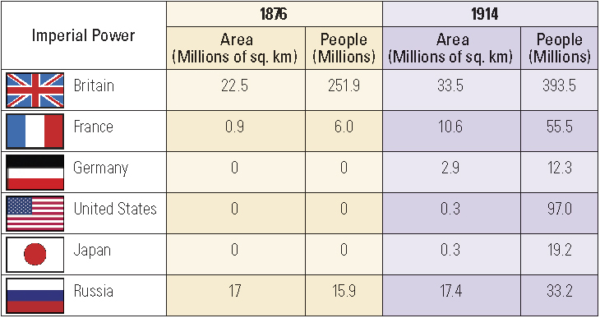
Building Empires
Read the top of page 139 and complete the Activity
Can you calculate the percent increases in both the land area and number of people during this time?

Slide 12
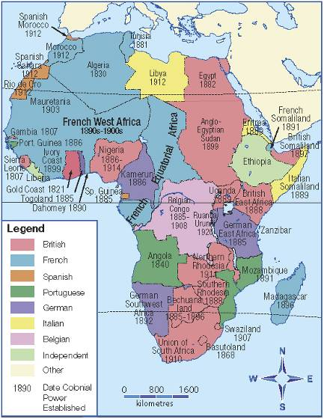
The Scramble for Africa
What areas were the first to be colonized? Which ones were last?
Which imperial power controlled the largest area? Which ones controlled only small areas?
What geographic pattern does the French-controlled region show? What pattern does the British-controlled show? What about the other European-controlled regions?
Which countries remained independent? Why do you suppose they were able to stay independent?

Slide 13
The Scramble for Africa
Read the first four paragraphs of page 140
Now, listen to the words of Mukunzo Kioko…
Are you able to complete the Activity at the bottom of the page?

Slide 14
King Leopold and the Congo
Review the Handout:
Legacies of Ethnocentric and Eurocentric Attitudes in Africa
Read page 141
Fill in the ‘Evidence’ side of the chart as you read
Keep this handout for future reference…
Don’t lose it!!

Slide 15
Evidence of Legacies in the Congo
The European development of the slave trade
Imperial powers’ policies of promoting mercantilism and global trade
European (Eurocentric) attitudes that saw nothing wrong with conquering and ruling the Americas, Africa and Asia

Slide 16
The Continuing Legacy in the Congo Today
The effect of the slave trade on race relations around the globe today
The global dominance of the European and American economies
The willingness of some countries to interfere in the politics of other countries

Slide 17
And Finally…
Begin a list of terms from this chapter, which include…
Any term or phrase that would be considered important in helping you with your …
Four Corners Debate!
Any suggestions as to what you should include?

Slide 18
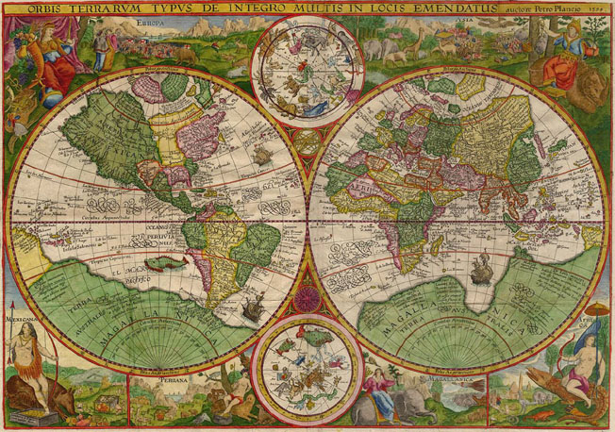
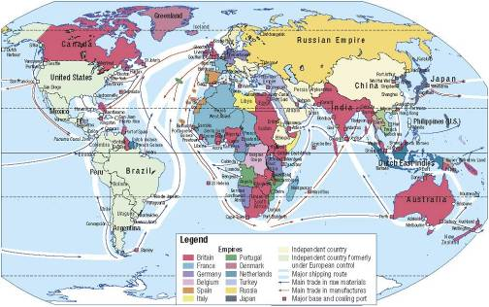
How Has Cultural Contact Affected People?
Complete the Activity on page 144
Read page 144
With a partner, review the map by writing six questions about the map that can fit into the following three categories:
People, Places and Things
If time, pass your questions on to someone else to answer

Slide 19
Legacies and Patterns of Historical Change
Review the Handout:
Analyzing Legacies of Historical Globalization
Read pages 146 – 148
As you read, look for the main ideas and supporting information and jot down notes about these in the appropriate area of the handout
Be sure to include a summary statement!

Slide 20
Analyzing Legacies of Historical Globalization

Slide 21
And Finally…
Continue with your list of terms from this chapter, which include…
Any term or phrase that would be considered important in helping you with your …
Four Corners Debate!
Any suggestions as to what you should include?

Slide 22
To what extent did the causes of the imperial powers’ division of Africa affect the future of the Indigenous peoples of that continent?
OR
How did the splitting up of Africa (by many of the European countries) affect the future of the Indigenous peoples of that continent?

Slide 23
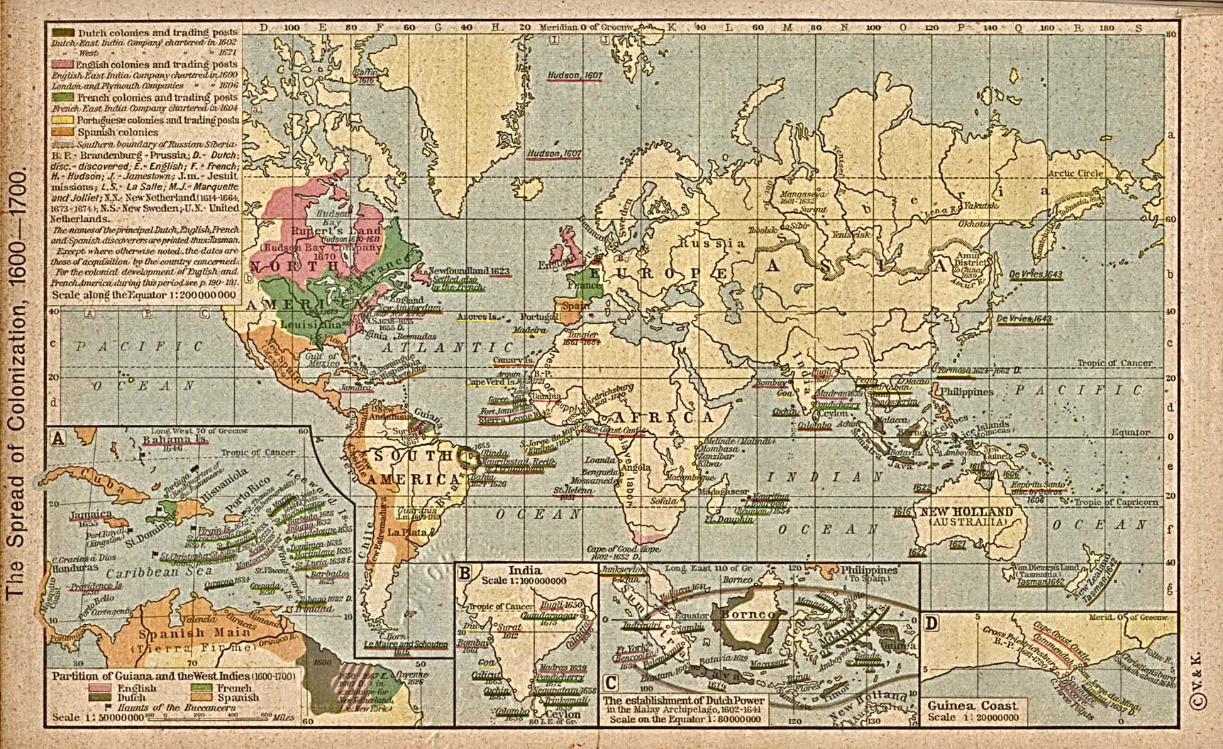
Division of Africa…
With a partner, complete the following cause and effect chart
African Imperialism Assignment

Slide 24
Results of Colonization
(Some Examples)
Political:
  Immediately after independence, Western-style political systems were all the former colonies knew which lead to….
  Serious instability with repeated military coups (violent government overthrows) as the consequence
Economic:
  Introduced ‘European’ economic structure
  These economic structures =
    Dependency: on exports and on the fluctuations or ‘up’s and down’s' of the world market
    Therefore, continued inability to ‘get ahead’ economically, as a result, many African countries continue to be poverty stricken
Social:
  European languages such as English and French are spoken
  European education systems are widely copied
  European sports like cricket or football (soccer) are widely played across much of Africa
  Colonial privileging of one ethnic group over another (one cultural group is superior than another) has made civil war a problem

Slide 25
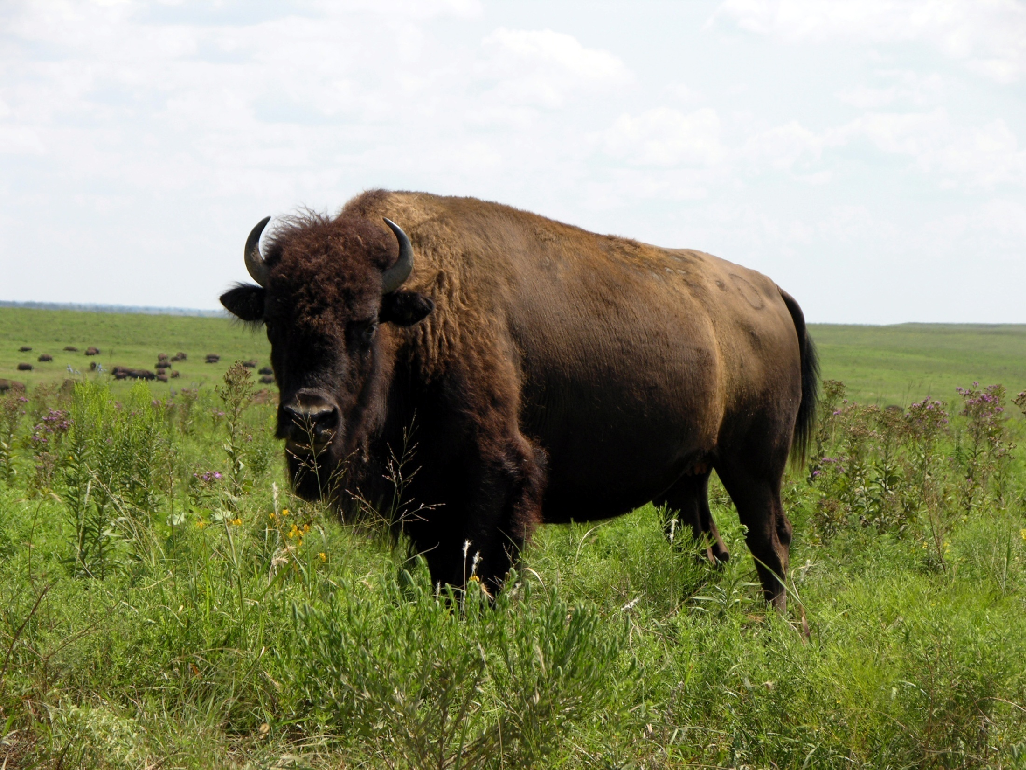
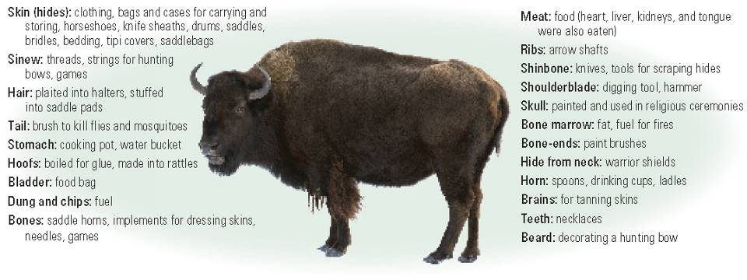
The Buffalo
Point out former uses of the buffalo and describe items now used in their place

Slide 26
How Has the Exchange of Goods and Technologies Affected People?
Read page 149

Slide 27
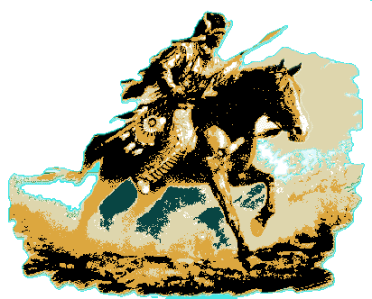
Before and After the Horse
Create a ‘T’ Chart like the one below
Ways of Life Without Horses/Guns Ways of Life With Horses/Guns
As you are filling this in, consider changes in transportation, hunting, communication with other groups and status symbols

Slide 28
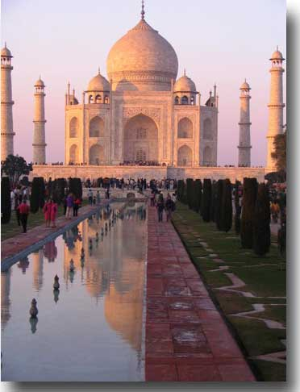
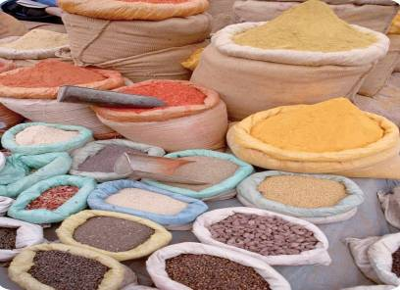
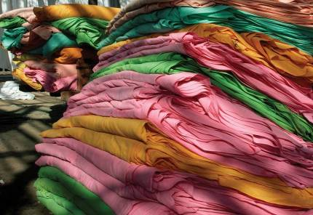
Contact and Cultural Exchange in India
Review these two pictures and their captions on pages 150 -151
Who can summarize what you learned about the Silk Road?
What do these two pictures have in common?
Read all of page 150, including responding to the Activity and The Raj on page 151

Slide 29
Deindustrialization in India
British Ban on Imports of Cloth from India
Read the section on Deindustrialization in India on page 151, completing the chart
How would you respond to the Activity?

Slide 30
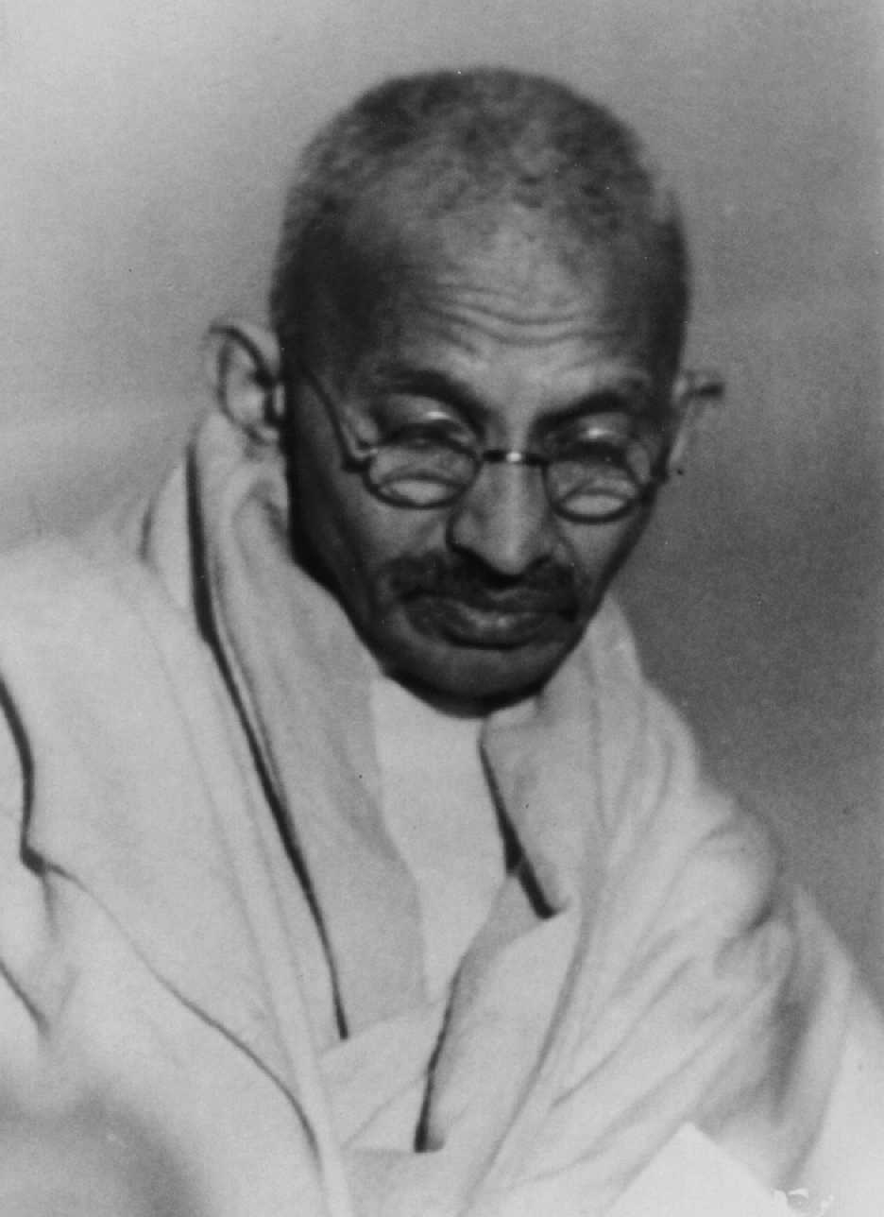
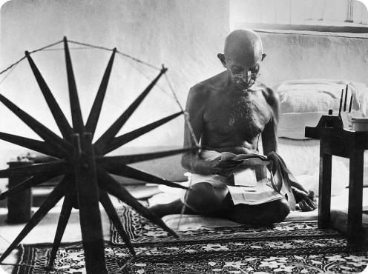
Mohandas Gandhi
This photograph was taken in 1946, at a time when many in India were attempting to gain their independence from Great Britain
Their independence came in 1947

Slide 31
Mohandas Gandhi
“I want to save time and labour, not for a fraction of mankind, but for all. I want the concentration of wealth, not in the hands of a few, but in the hands of all.”
What do you think the speaker is wanting?
Read page 152
Now that you have read and know who the author is, what do you think Gandhi meant?
Complete the Reflect and Respond on page 152

Slide 32
And Finally…
Continue with your list of terms from this chapter, which include…
Any term or phrase that would be considered important in helping you with your …
Four Corners Debate!
Any suggestions as to what you should include?

Slide 33
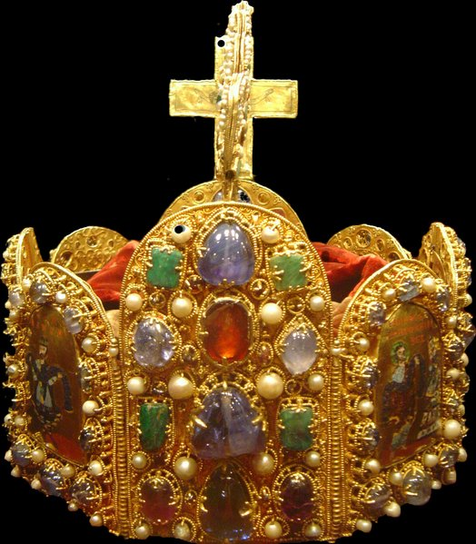
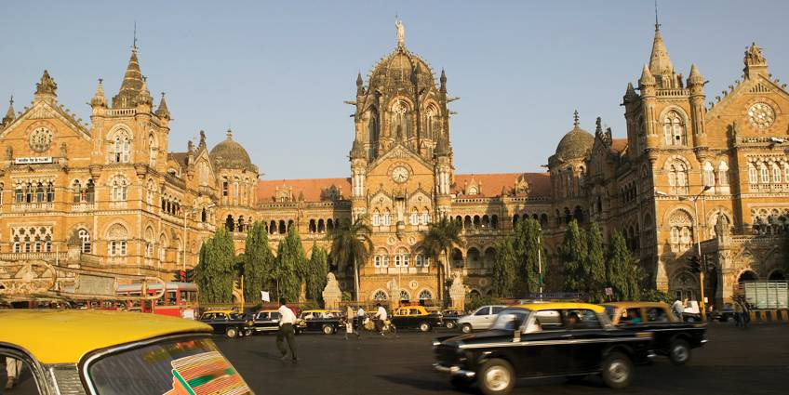
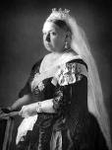
This is a train station in India that was built as a replica of a similar station in Great Britain
Can you see what the statue is at the top of the station?
Queen Victoria – The Queen of Great Britain (and her colonies) for almost 40 years!
Is this station a positive or negative legacy of historical globalization?

Slide 34
How are the Legacies of Historical Globalization Continuing to Affect People?
We have already discussed the some of the history of India and Africa…
What do you know about India and Africa that would help you answer the question above?
Read page 153, not including the Activity

Slide 35
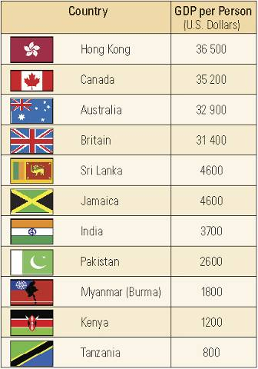
The Grosser the Better!
What is GDP?
Gross Domestic Product
The measure of strength of a countries economy!
The more the $$ the wealthier the country!
Complete the Activity on page 153

Slide 36
Finally…Free from Great Britain!!
Date of Independence from Britain Selected Countries
Looking at this information and the GDP chart, discuss your responses to the Activity on page 153
Why are some of these countries ‘richer’ than some of the others?

Slide 37
Legacies of British Imperialism in India
Record details about the Legacies of Imperialism in India
While reading pages 156-157…
Focus on how each of your points relate to a Legacy of Imperialism
And not on how many points you come up with!!

Slide 38
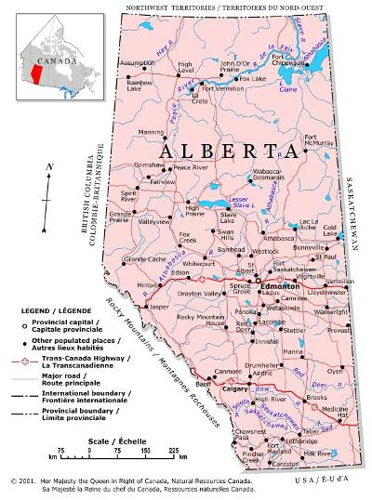
Dividing up Alberta
Let’s divide Alberta up into two!
What groups should we talk to before we make this decision?
Why?
Where are we going to make the division?

Slide 39
And Finally…
Complete your list of terms from this chapter, which include…
Any term or phrase that would be considered important in helping you with your …
Four Corners Debate!
Any suggestions as to what you should include?

Slide 40
Think About Your Challenge
Review your challenge for this Related Issue
Contemporary society has done enough to respond to the legacies of historical globalization
Remember to respond to the statement above with either:
Agree, Disagree, Strongly Agree or Strongly Disagree
Is there anything from this chapter (or chapter five) that you can add to your notes on Your Challenge?
Only two more chapters remaining….
Social 10-1

