Slide 1
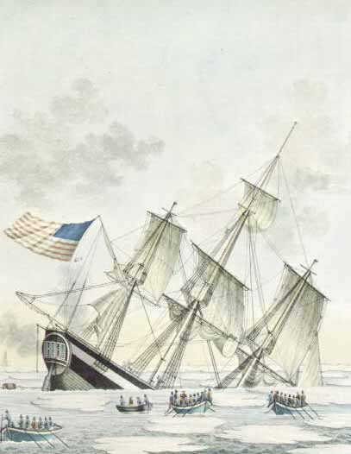
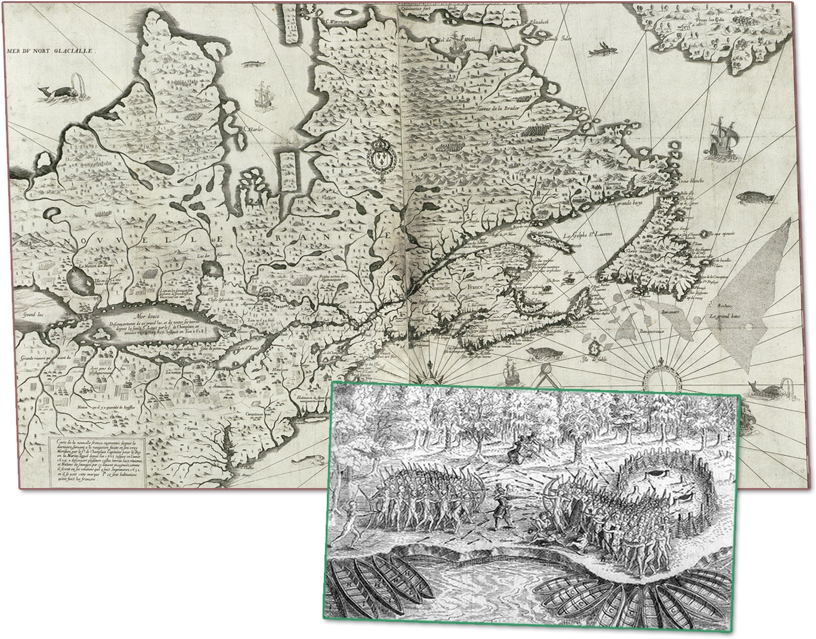
Read the caption to this picture on page 160 and the top half of page 161, responding to the six questions…in writing!
Scan Chapter 7 and write down five questions that you think relate to the chapter issue question

Slide 2
How Did Historical Globalization Affect Canada?
In groups of four, each group member must summarize one page from pages 162 – 165
When summarizing, your goal is to answer the inquiry question above… So read carefully!
You must summarize only on one of the sides of the paper provided!
When each of your group members are finished, get together and make one page notes of all four pages, with the above inquiry question as your title
Add topic headings, etc, but DO NOT use page numbers as titles!
All members of the group will need to have a copy of this page when finished!
When finished, complete the Activity on page 162

Slide 3
Points of View and Perspectives on the Arrival of Europeans and Fur Traders in North America
Based on what you know, how would each of these groups have responded?
Complete

Slide 4
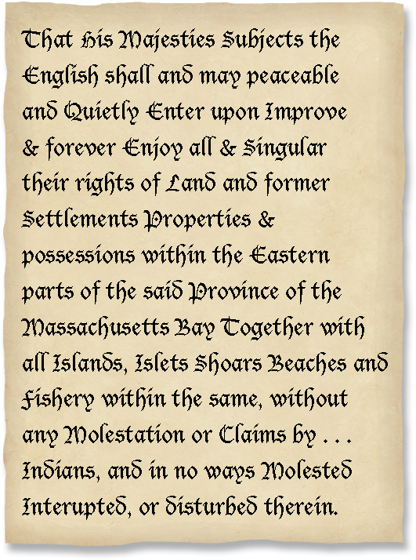
First Nations and European Settlers
Why might the language of treaties like this have led to problems for the First Nations peoples who signed them?
Can you complete the Activity on page 164?

Slide 5
Your Five Questions:
Answers?
Return to the questions you asked at the beginning of the chapter…
Can you answer any of them?

Slide 6
And Finally…
Begin a list of terms from this chapter, which include…
Any term or phrase that would be considered important in helping you with your …
Four Corners Debate!
Any suggestions as to what you should include?

Slide 7
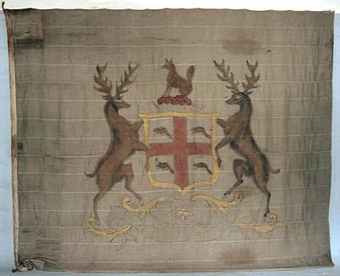




Read pages 166 - 167
From 1670 to 1850, create a brief timeline of important events in the history of Hudson’s Bay Company

Slide 8

Conditions for First Nations as the Hudson’s Bay Evolved
Subjects may include:
Copy and complete the chart
Primary Activities of Fur Traders
Effects on Wildlife
Changes in Family and Community Life
Value of Furs

Slide 9
Hudson’s Bay Company
Opinions on the Hudson’s Bay Company monopoly on the fur trade in Rupert’s Land were divided
Write a paragraph response for the possible opinions for one of the following stakeholders:
An HBC official
A Cree go-between
A First Nations or Métis Trapper
A North West Company Partner
The monopoly is good for the share holders of the company because it is profitable, it makes it easy to control the fur trade, and the trappers know who they are trading with and the conditions under which they will trade.
The monopoly limits me because there is only one place to take the furs and the company dictates the price. The Cree do a lot of the work – and make less.
I get too little in return for my furs and I can’t take them anywhere else. The HBC has all the power and I have none
The HBC controls the trade and it makes all the rules. Our company can serve traders and trappers better because we are meeting them in their lodges and we pay more for furs.

Slide 10
Your Five Questions:
Answers?
Return to the questions you asked at the beginning of the chapter…
Can you answer any of them…now?

Slide 11
Think about Your Challenge
Review your challenge for this Related Issue
Contemporary society has done enough to respond to the legacies of historical globalization.
Remember to respond to the statement above with either:
Agree, Disagree, Strongly Agree or Strongly Disagree
Is there anything from this chapter that you can add to your notes on Your Challenge?
Less than two more chapters remaining….
10 -1

Slide 12
And Finally…
Begin a list of terms from this chapter, which include…
Any term or phrase that would be considered important in helping you with your …
Four Corners Debate!
Any suggestions as to what you should include?
10 -1

Slide 13
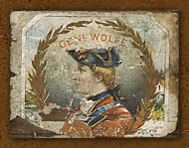
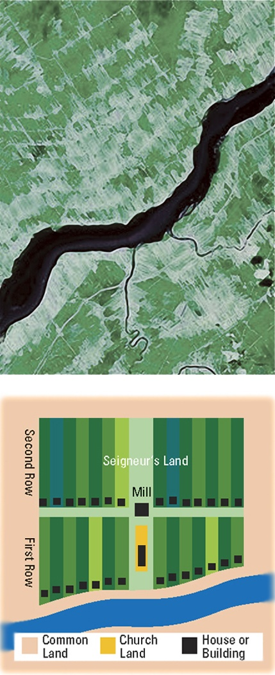
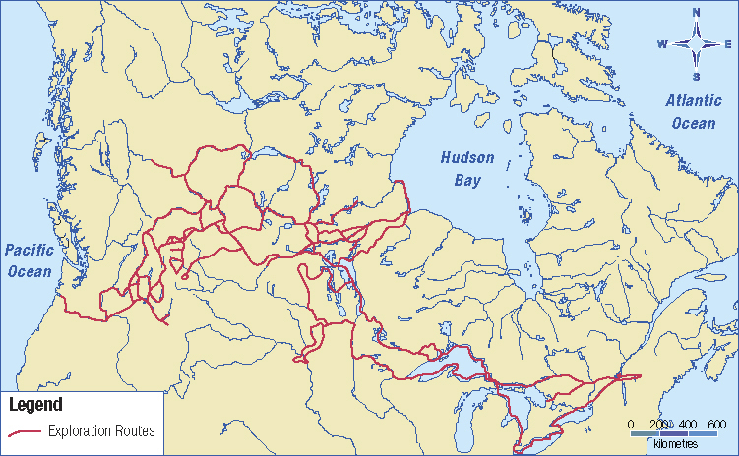
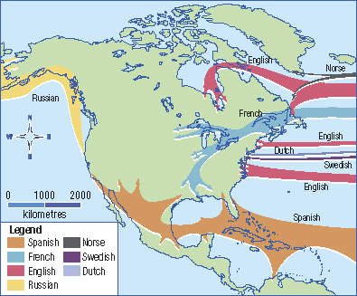
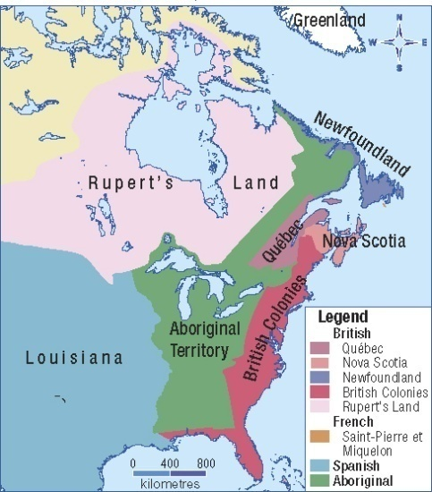
What are Some Legacies of Historical Globalization in Canada?
What do each of these pictures represent?
Which of these maps may help you understand historical land uses ?
Why?
Pages 170-173

Slide 14

Competition Leads to Conflict
Canada: 1763
Review the map and identify which nation controlled each of the regions
Read pages 170 - 171

Slide 15
Before and After the Seven Years’ War
After reading pages 170 – 171, copy and complete the chart:
You may use the following topics to assist you:
Settlement Patterns
Control by Imperial Powers
First Nations People
Assimilation of the Francophone population
Important Changes

Slide 16
British Rule
Take a look at the headings, pictures, etc on
pages 172 – 173
Predict what you think some of the legacies the British left behind were…
Read the two pages
Make a list of some of these British legacies
Complete the Activity on page 172

Slide 17
Comparing French and British Legacies
How much of this comparison chart can you do?

Slide 18
Your Five Questions:
Answers?
Return to the questions you asked at the beginning of the chapter…
Can you answer any of them…now?

Slide 19
And Finally…
Continue with your list of terms from this chapter, which include…
Any term or phrase that would be considered important in helping you with your …
Four Corners Debate!
Any suggestions as to what you should include?

Slide 20
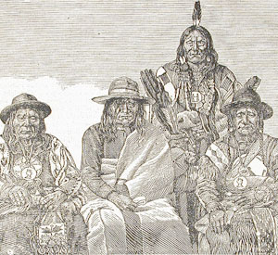
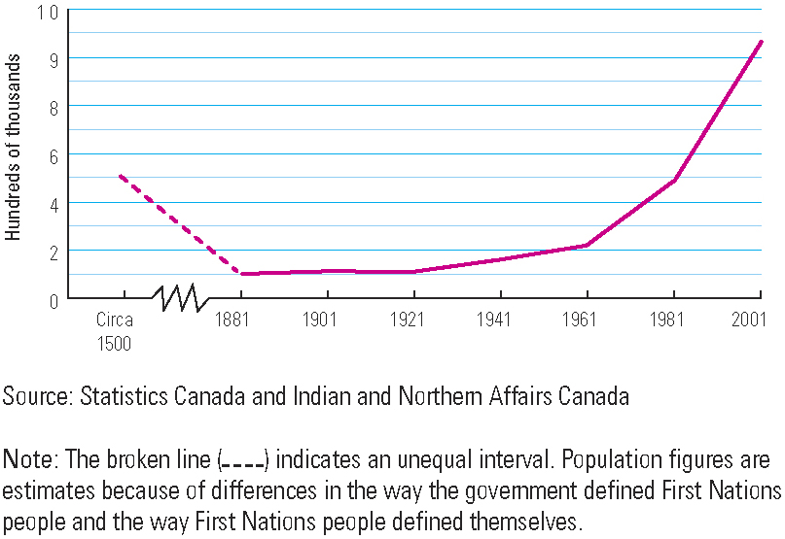
Estimated First Peoples Population of Canada 1500 - 2001
Can you guess why the population of the First Nations of Canada fell from approximately 500,000 to 100,000?
Can you explain the pattern of the chart displayed by the dotted line up to 1921?
Can you explain why there has been such a huge increase in population in recent years?
Will this pattern have a positive or a negative effect on First Nations in the future?

Slide 21
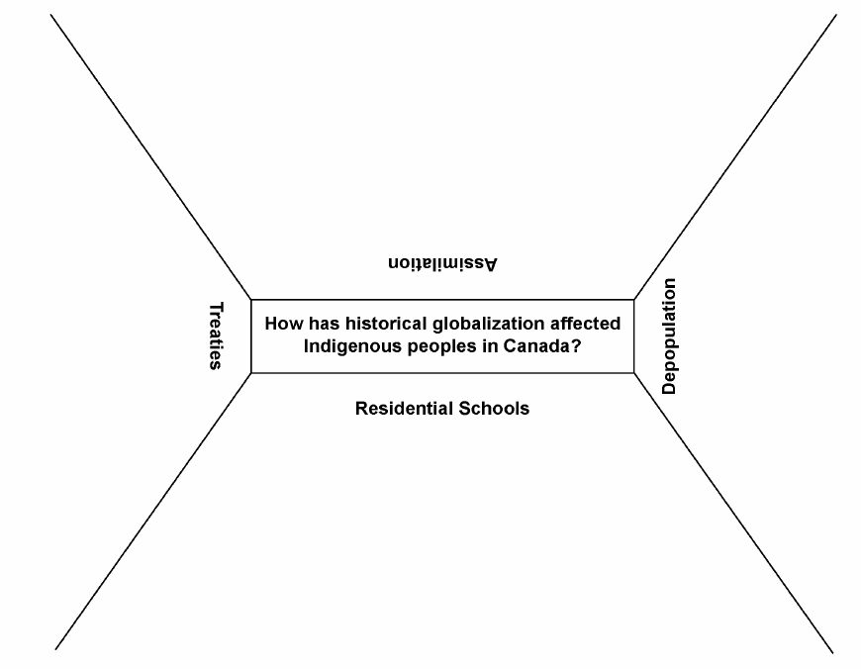
How Has Historical Globalization Affected Indigenous Peoples in Canada?
Effects of Historical Globalization on Indigenous Peoples in Canada
Each group member must write jot notes for the one area on the chart they have been assigned
In groups of at least four, review the material on pages 174 to 179
The Indian Act
As a group, write a one sentence summary, answering the inquiry question
When finished, respond to the Activity on page 175

Slide 22
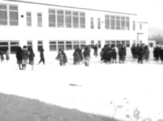
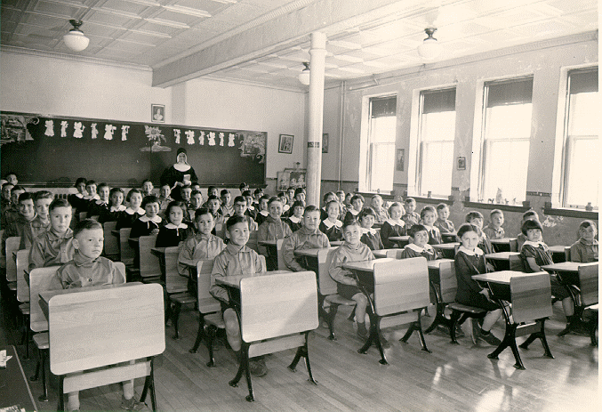
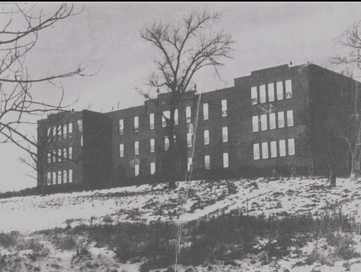
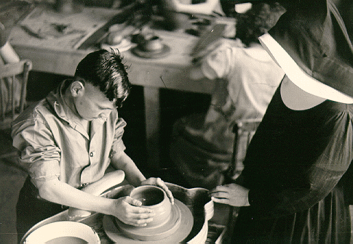
Residential Schools
Residential Report 1955
Read pages 178 – 179, responding to the Activity
Shubenacadie Residential School (1922 – 1968)

Slide 23
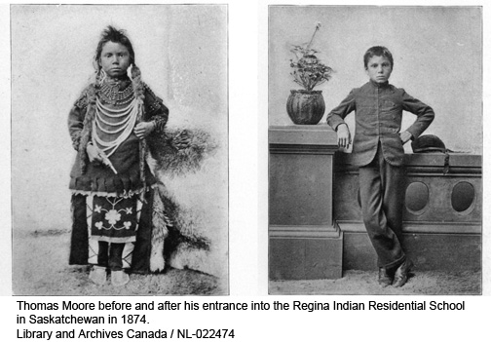
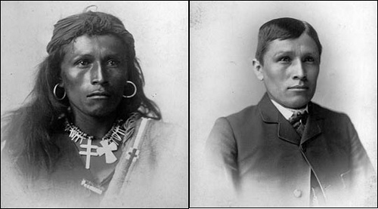

Residential Schools
War Party - 3:30
With Lyrics

Slide 24
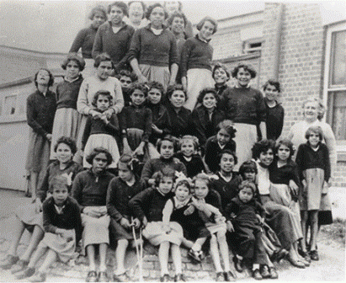


Rabbit-Proof Fence
Residential School were not just in Canada...
In 1931, three aboriginal girls escape after being plucked from their homes to be trained as domestic staff and set off on a trek across the Australian Outback.
94 minutes
Handout
Preview

Slide 25
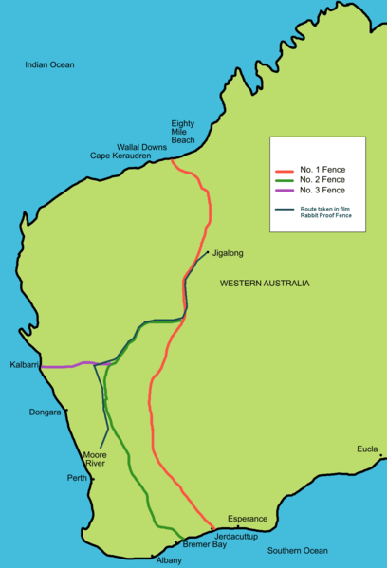
Rabbit-Proof Fence

Slide 26
Your Five Questions:
Answers?
Return to the questions you asked at the beginning of the chapter…
Can you answer any of them…now?

Slide 27
And Finally…
Continue with your list of terms from this chapter, which include…
Any term or phrase that would be considered important in helping you with your …
Four Corners Debate!
Any suggestions as to what you should include?

Slide 28

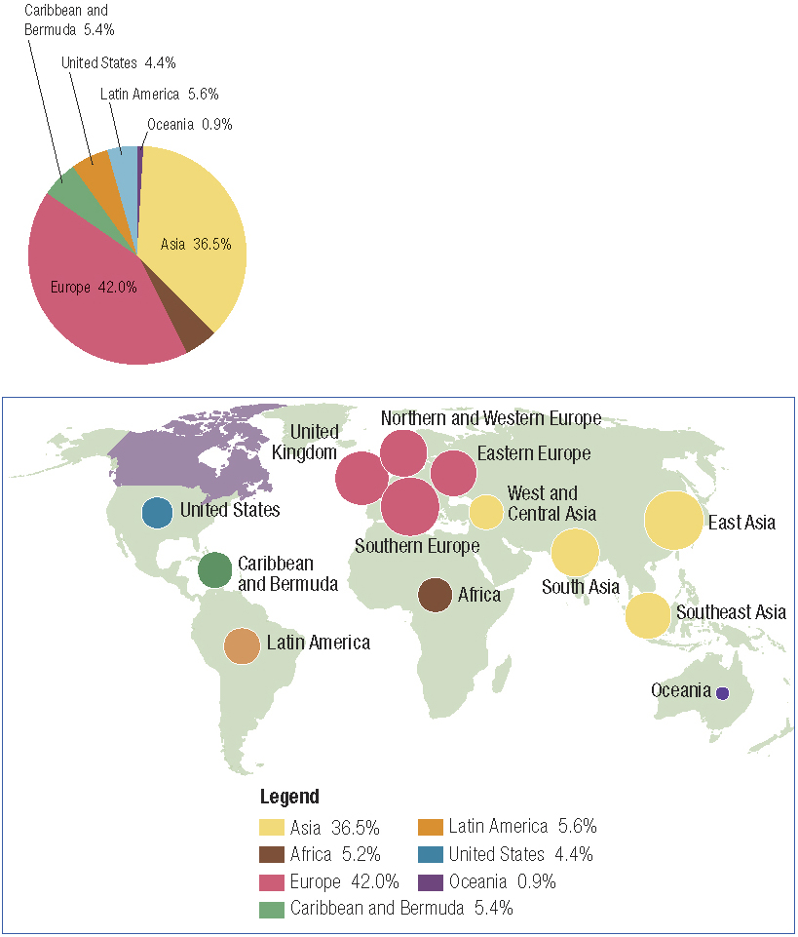
How Do Some Legacies of Historical Globalization Continue to Affect Canada?
Regarding Canada’s immigrants, what do these two figures tell us?
Read the Activity icon on page 180.
What do these two figures tell us about the continuing legacies of historical globalization?
Read the rest of page 180.

Slide 29
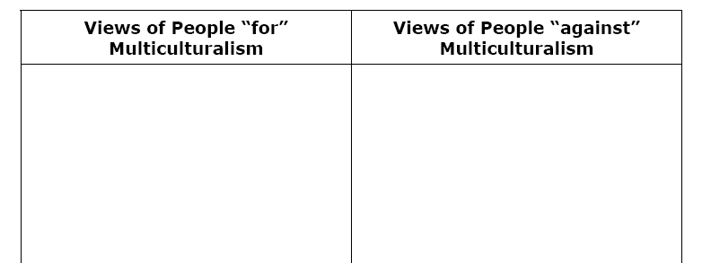
Multiculturalism
What does this word mean to you?
What does this word mean to all of Canada?
Read page 181 and using the chart above, provide reasons people did – or did not – support multiculturalism today and in the past.

Slide 30
Stereotyping
In your discussions on multiculturalism and immigrants, many of the views presented may or may not have been stereotypical views.
What does stereotyping mean?
Do you think the characteristics of a few should be applied to the whole population?
Why or why not?

Slide 31
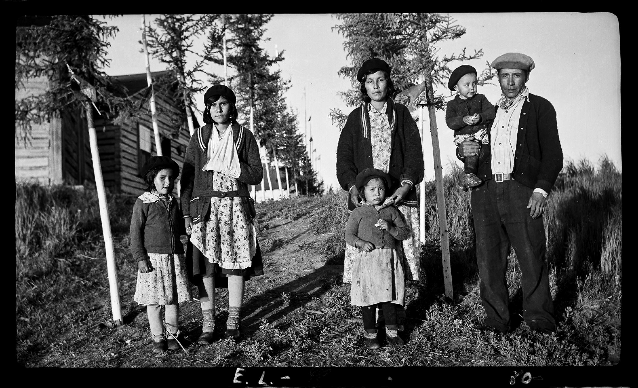
Land Claims
Read the top half of page 182
Complete the following:
    Tell the difference between ‘Comprehensive’ and ‘Specific’ land claims.
    2. Find two or more examples of each of these types of land claims
    3. Organize your information to be handed in tomorrow

Slide 32
Aboriginal Land Claims
Comprehensive Claims:
Recognition that there are continuing Aboriginal rights to lands and natural resources where Aboriginal title (ownership) has not previously been dealt with by treaty and other legal means. The claims are called "comprehensive" because of their wide scope such as land title, fishing and trapping rights and financial compensation.
Specific Claims:
Specific claims deal with specific grievances that First Nations may have regarding the fulfillment of existing treaties and grievances relating to the administration of First Nations' lands and assets under the Indian Act.

Slide 33


The Quiet Revolution
What do you think the above phrase means?
Read page 183, completing the chart as you go – Use point form!
If possible, use this space to answer the question on the bottom of the page

Slide 34
Your Five Questions:
Answers?
Return to the questions you asked at the beginning of the chapter…
Can you answer the rest of them…now?

Slide 35
And Finally…
Complete your list of terms from this chapter, which include…
Any term or phrase that would be considered important in helping you with your …
Four Corners Debate!
Any suggestions as to what you should include?
Also
Review your challenge for this Related Issue!

Slide 36
Chapter Quiz
Be ready for your quiz on Tuesday!!
Prepare by responding to the following:
How did historical globalization affect Canada?
Explain how both the British and the French left lasting legacies in Canada
Did colonization have a positive or negative affect on the Indigenous people of Canada?
Canadian Indigenous land claims: Positive or Negative?
Early immigration in Canada – What did it look like?

