Slide 1
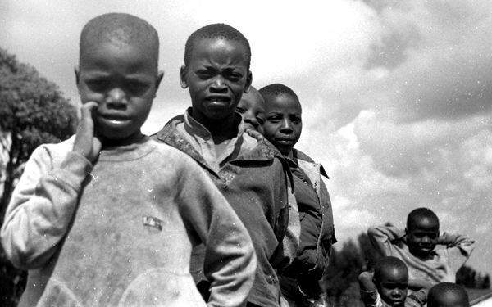
To What Extent Have Attempts to Respond to the Legacies of Historical Globalization Been Effective?
What might effective responses look like?
Ensuring peace and prosperity…
What might ineffective responses look like?
Conflict and poverty…
1994 Genocide in Rwanda
What do you know about this tragic event?

Slide 2
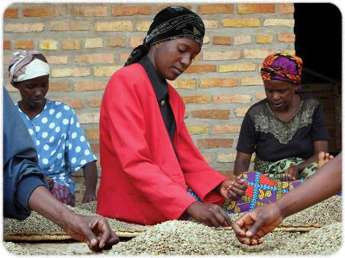
Living with the Legacies of Historical Globalization
Review this picture with it’s caption on page 186
Read the introduction and questions on page 187
Write out the third and fourth questions in order to help you with your Debate
Can you answer them?

Slide 3
To What Extent Have Attempts to Respond to the Legacies of Historical Globalization Been Effective?
Read page 188
Can you complete the Activity?
Research some current world events and complete this activity for Wednesday

Slide 4
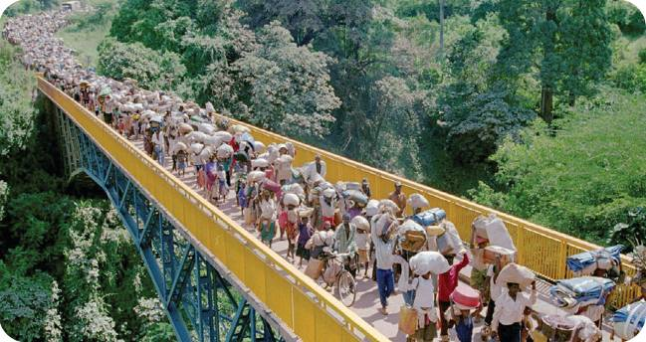
Rwanda:
A Response to Historical Globalization
Review this picture on page 189
Can you imagine yourself on the bridge?
What does the word Genocide mean?
Who are the people in the photograph and what are they doing?
Where are they going and where are they coming from?
How are they traveling and why are they traveling this way?

Slide 5
Genocide in Rwanda
In small groups, read page 189 and on the left-hand side of the chart, make a list of the various Causes to the Rwandan Genocide
European countries interfering with Rwanda as they ‘Scramble for Africa’
Response by the United Nations
Read pages 190, 192 and 193, taking notes on the effects of the Rwandan Genocide
Complete the Effects side of the chart
Eurocentric attitude of the imperial powers
Justice and Reconciliation’
The purposeful influence of the Tutsis against the Hutus
Rebuilding through Coffee Exports
More?
International Support
The Activity in the middle of the page should guide your thinking about these causes

Slide 6
Assessing the Responses to the Rwandan Genocide
Using what you have learned about the effectiveness of many of the responses to the Rwandan Genocide, complete the chart
Use the column “Actions” to summarize what each of the groups did to rebuild Rwandan Society
After ranking the level of success, be prepared to explain your ranking

Slide 7
Point of View
(Page 191)
Read the statement of Romeo Dallaire, the commander of the United Nations in Rwanda, before and during the Genocide
Do you think the final two questions can be answered?

Slide 8
Rwandan Genocide
How can people try to prevent genocides from happening again?
What background information do you need to have to answer this appropriately?

Slide 9
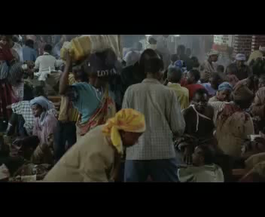
Sometimes in April
Preview
3:30

Slide 10

Sometimes in April
140 minutes
Handout

Slide 11

Shake Hands With The Devil
Handout of Questions
Complete and Review Tomorrow
91 minutes

Slide 12
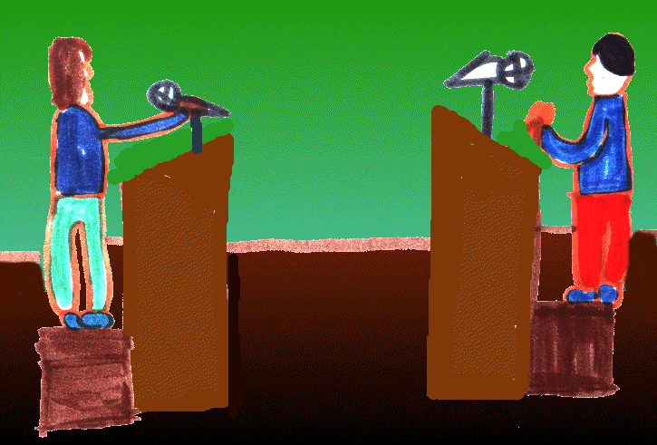
And Finally…
Begin a list of terms from this chapter, which include…
Any term or phrase that would be considered important in helping you with your …
Four Corners Debate!
Any suggestions as to what you should include?

Slide 13
How Effectively Have Governments Responded to the Legacies Of Historical Globalization?
What is the difference between this and the previous Inquiry Question?
Read the opening paragraph on page 196

Slide 14


United Nations and Indigenous Peoples
Discuss the caption on page 196 that goes with this picture
Complete the Activity
Read the rest of the page

Slide 15
United Nations and Indigenous Peoples
Would the goals of the Canadian government be the same as the goals of First Nations people?
What might be some of these differences?
Perhaps conflict may arise about where and how certain rights should be claimed and the limits of how to express these rights

Slide 16
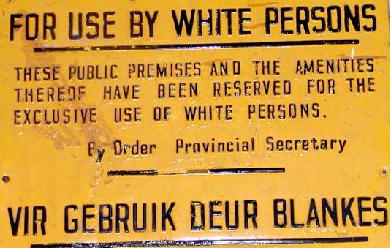
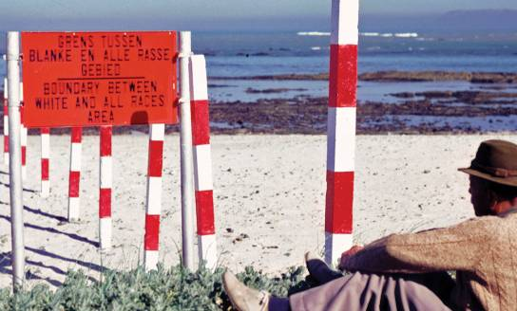
Apartheid
Define Apartheid
Provide two examples
Write two reasons why you think it lasted as long as it did
How would you feel if you saw a similar sign in Canada?
Read pages 197 and 198 – Including the Profile on Nelson Mandela
Respond to the Activity

Slide 17
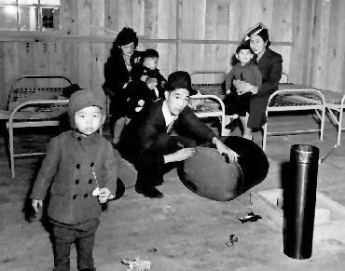
Legacies of Historical Globalization in Canada
After reading page 199, respond to the following questions on paper:
What does the word INTERN mean?
Why did the government of Canada intern these people?
Is it fair to lock up a whole group of people because you suspect some members of the group may feel bad for the enemy?
Why or why not?
What should Canadians do when they see government-supported discrimination?

Slide 18
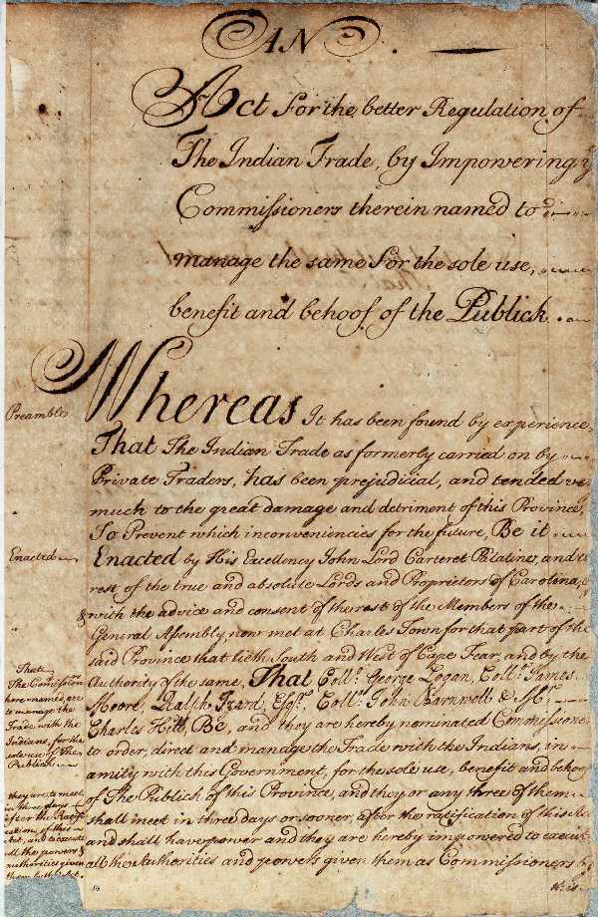
Legacies of the Indian Act
Do you remember the goal of the Indian Act of 1876?
To assimilate Indigenous peoples into mainstream society
Read pages 200 and 201 and respond to the following:
How would you feel if your family was negatively singled out by the government?
How would this make you feel about yourself?
How do you think the Indian Act should be changed?
Can you think of new goals for the Indian Act? How would they be reached?

Slide 19
Think About Your Challenge
Is there anything so far in Chapter Eight that could be used for your Four Corners Debate?
And don’t forget to add…
Terms to your Chapter Eight List!

Slide 20

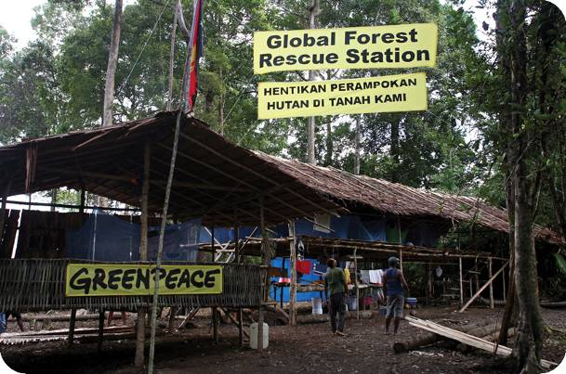
How Effectively Have Organizations Responded to the Legacies Of Historical Globalization?
What do you know about Greenpeace?
What is it’s purpose?
Who are it’s members?
Greenpeace is a non-governmental organization – (NGO)

Slide 21
How Effectively Have Organizations Responded to the Legacies Of Historical Globalization?
In this Inquiry Question, what does the word effectively mean?
As you read pages 202 – 203…
Record in your notebook the names of the NGO’s, along with any important details of their Campaigns and Programs:

Slide 22
NGO’s are nothing more than a new form of imperialism!
Aren’t these organizations just imposing the views of the developed world onto the developing world?
Do you believe either of these statements to be true?
Why or why not?

Slide 23
Think About Your Challenge
Is there anything from this section of Chapter Eight that could be used for your Four Corners Debate?
And don’t forget to add…
Terms to your Chapter Eight List!

Slide 24

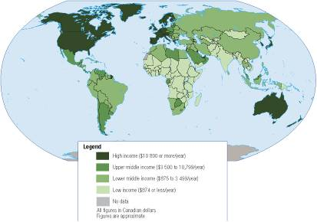
How Does Historical Globalization Continue to Affect the World?
Read all of page 206
Refer to the map on the page and answer the following:
What is the map’s title?
What do the colours mean?
What geographic areas are shown?
Refer to both this map and the world map in the classroom and answer the following:
What areas of the world have high income?
Where in the world do people have low incomes?
Which countries in Africa and the Indian subcontinent have low incomes?
What patterns are apparent in the map?

Slide 25
Foreign Aid
What is it?
Foreign Aid could be viewed as a response to the income inequalities identified in the map
Countries like Canada contribute a portion of our yearly budget to Foreign Aid, yet seldom is the budgeted amount reached
Read Foreign Aid on page 207

Slide 26
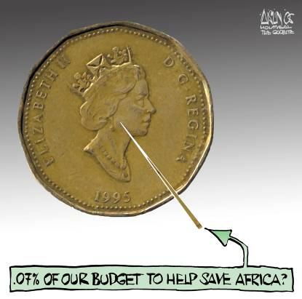
Foreign Aid
What is the cartoonist message?
What is the story behind the cartoon?
What issues does the cartoon deal with?
What is Aislin’s message?
What clues does the cartoonist give about his point of view?
Review the cartoon

Slide 27
How Can I Respond Effectively to the Legacies of Historical Globalization?
In the Ideas section on page 207, three students are responding to the question above.
Read all three responses aloud
Each of the three students responded differently:
Tom – Government
Ling – Organizations
Katerina – Individuals
Which of these three choices best represents how you would answer the question?
Is there another point of view you’d choose?

Slide 28
Think About Your Challenge
Is there anything from this final section of Chapter Eight that could be used for your Four Corners Debate?
And don’t forget to add…
Terms to your Chapter Eight List!

