Slide 1
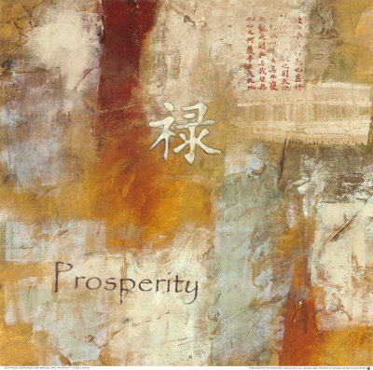
Related Issue #3
To what extent does globalization contribute to sustainable prosperity for all people?
OR
To what extent does globalization help keep the people of the world continuously successful?

Slide 2
The Big Picture
After reviewing and reading pages 210 and 211, answer the following questions:
How would you define prosperity?
Wealth, health, happiness…
How would prosperity be measured?
Having lots of $$, being happy, being healthy…
How would you explain the idea of sustainability?
Making things last forever, using only what can be replaced…
How do you think your way of life is connected to sustainability?
Your way of life may depend on a constant supply of resources and if these resources run out, your life will change drastically!

Slide 3
Your Challenge
To what extent does globalization contribute to sustainable prosperity
for all people?
A Persuasive Essay
See Handout

Slide 4
How Does Economic Globalization Affect You?
If the term Economics is defined as:
Any consideration dealing with finances
What does the above inquiry question mean?
How are Economics and Globalization related?
Does Economic Globalization affect you?

Slide 5
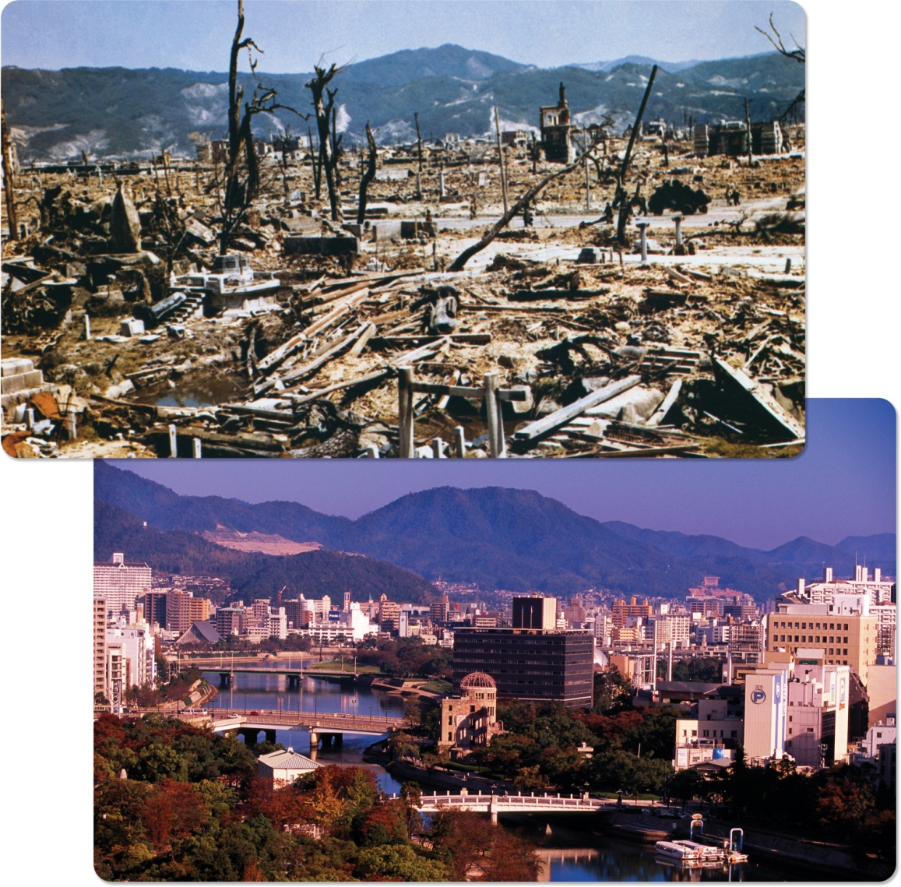
What Does Economic Globalization Mean?
Read the caption to this picture on page 214
Read page 215, including the questions
How do international conflicts arise from competition for economic power?
Read: Looking Ahead

Slide 6
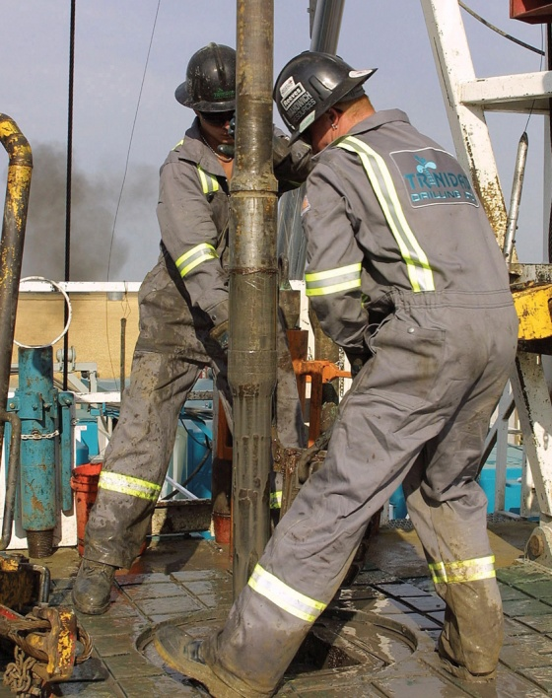
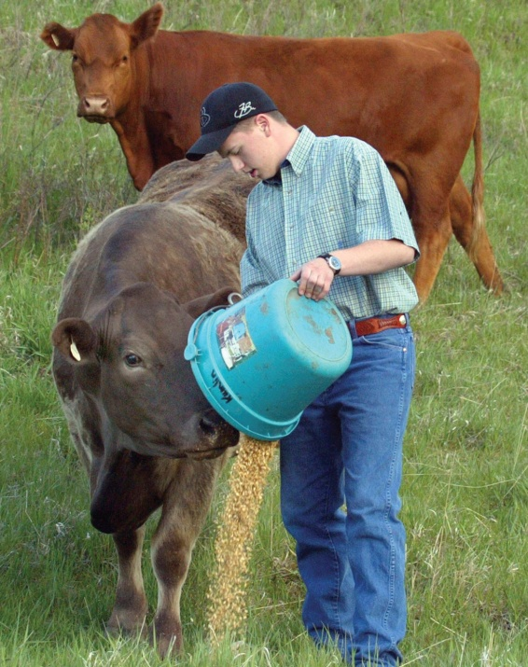
What Does Economic Globalization Mean?
Read Page 216
Answer the above question…again
Read pages 217 - 218

Slide 7
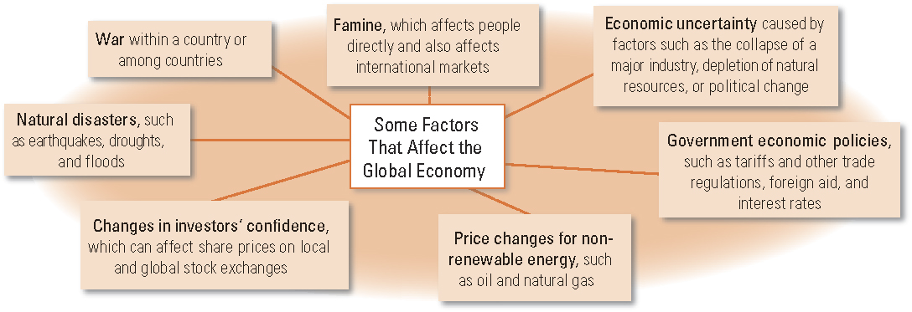
What Does Economic Globalization Mean?
Review the Chart on page 218
Can you think of anything else to add to the above?

Slide 8
Think About Your Challenge
Is there anything in this opening section of Chapter Nine that could be used for your Persuasive Essay?
And don’t forget to begin a list of…
Terms for Chapter Nine!

Slide 9
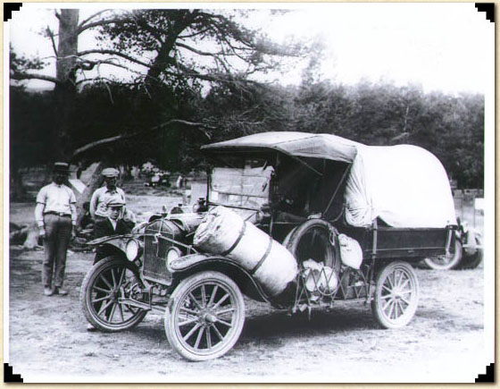
How Has the Past Shaped the Present?
Do Historical Events Influence Who You Are and Who You Want to Be?
Is Where You Are Today a Result of Random Events?

Slide 10
20th Century World Events
Write out a list of 20th Century World Events
What makes an event worthy of the title ‘world event’?
What criteria did you use?
How many countries have to be involved to make something a world event?
How many people?
How widespread does the impact have to be?
Do all the events on page 219 fit ‘the criteria’?

Slide 11
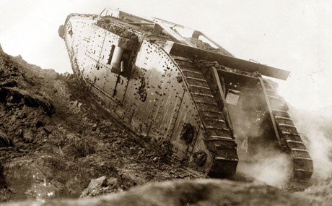
How Did 20th Century World Events Shape Contemporary Economic Globalization?
Read the Introduction on Page 219
Consider Possible Responses to the Activity
Read ‘The Cost of World War I’ up to ‘The Russian Revolution’ (Pages 219 – 220)
When finished, make a list of both the Economic and Human Costs of World War One
If you were alive at the time, how would these costs have changed your plans for the future?

Slide 12
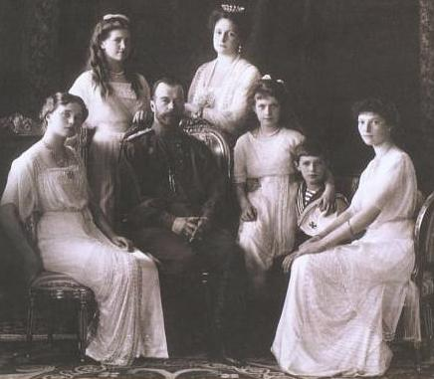
The Russian Revolution
Russia 1891
Do you see examples of disparities like these in Alberta or Canada? Around the world?
Read the remains of page 220 - 221
Consider Possible Responses to the Activity

Slide 13
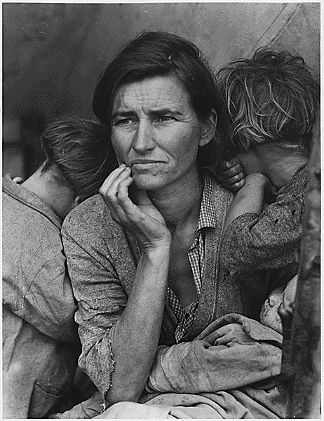
The Great Depression
Read page 222
Respond to the Second Activity

Slide 14
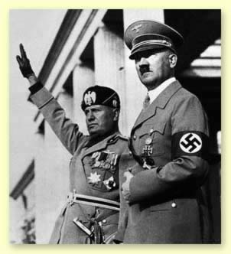
World War Two
Read page 223
Be sure to read the caption to Figure 9-14
Do you know how many people were killed in this war.... Guesses?
Approximately 72,609,600 or 3.70% or the worlds population!

Slide 15
Chapter Nine
Complete the Reflect and Respond on page 223
Continue with your list of terms for this section of the chapter

Slide 16
Persuasive Essay
Write out any ideas from this section that may be useful for your essay

Slide 17
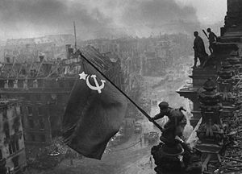
World War One, The Great Depression and World War Two
How do you think people would have responded to the legacies of these events?
What kind of questions do you think people may have been asking immediately after their conclusion?
Who would pay for the damage caused by the wars? For reconstruction?
How could they prevent another world war?
How could they prevent such losses of wealth and unemployment?
What could they do about the environmental problems like the ones in Alberta during the Depression?

Slide 18
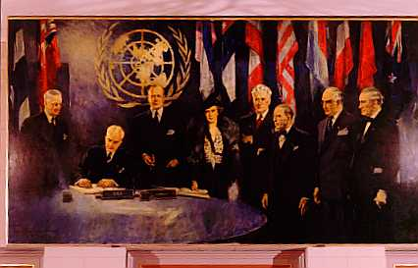
What Factors Laid the Foundations of Contemporary Global Economics?
Read the introduction on page 226
Why would Canada be interested in an organization that focused on the four bulleted items?
Read the rest of page 226
Consider responses to the Activity

Slide 19
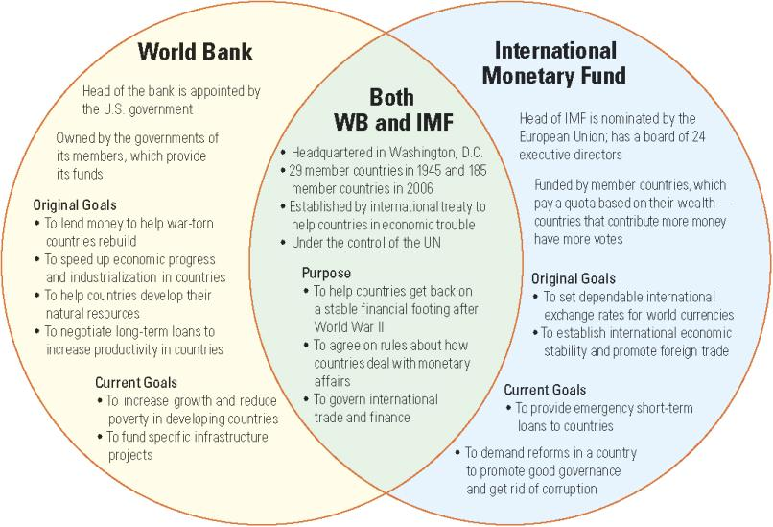
Foundation Factors – A Summary
Read pages 227 & 228 on your own time, paying particular attention to the chart below (page 228)
Copy out the Current Goals for both of these organizations
Social 10-1

Slide 20
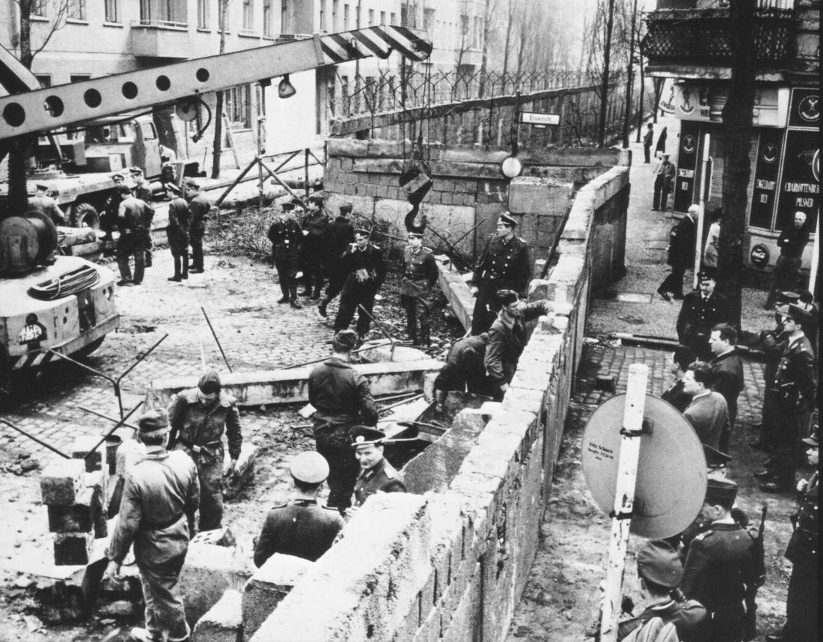
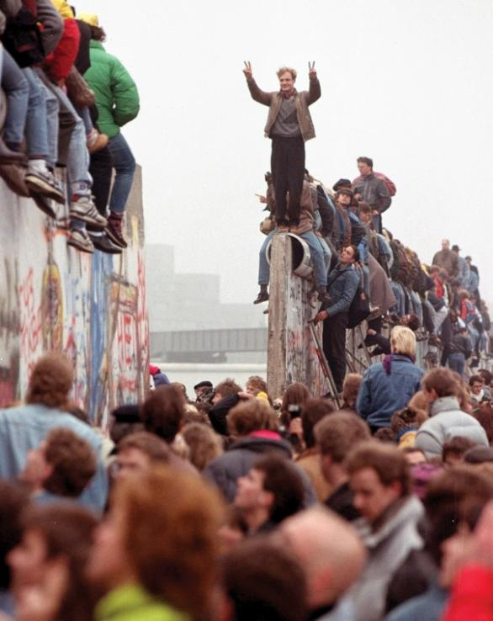
Capitalism vs. Communism
Berlin Wall
After reading the caption to this picture on page 230 review the terms ‘Capitalism’ and ‘Communism’ from the textbooks glossary
What do you know about the history of the Berlin Wall?
Why do you think the Berlin Wall became such a symbol to people around the world?
What would the destruction of the wall have meant to Berliners and to people around the world?
Read the opening half of page 230 and respond to the Activity

Slide 21
Market Economy
Read the rest of page 230 and 231
What is the difference between a Market Economy and a Mixed Economy?

Slide 22
Chapter Nine
Continue with your list of terms for this section of the chapter

Slide 23
Persuasive Essay
Write out any ideas from this section that may be useful for your essay

