Slide 1

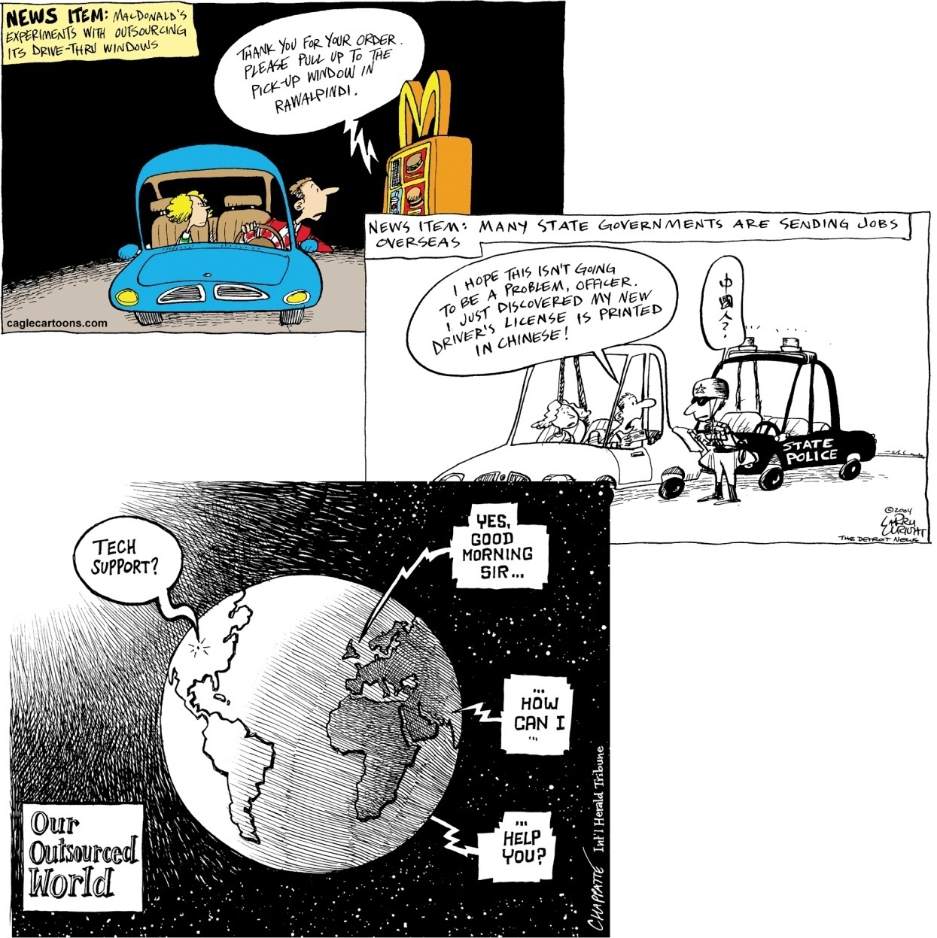

Expanding Globalization
Do political cartoons lead to solutions to controversial issues?
What is the main idea of each of these cartoons?
Read the introduction on page 237
&
Review the bulleted questions
Did You Know
(5:00)

Slide 2


What Factors Contribute to Expanding Globalization?
Communication
Read page 238, responding to the Activity

Slide 3

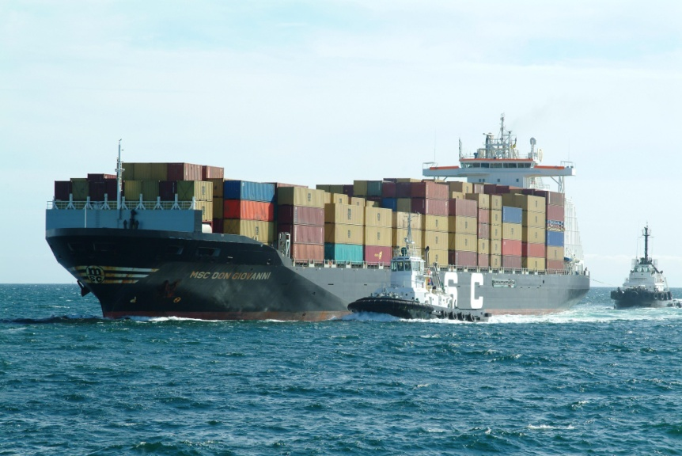
What Factors Contribute to Expanding Globalization?
Trade
Just-in-Time Delivery Systems
Read the above sections on pages 239 and 241
Respond to the Activity on page 239

Slide 4
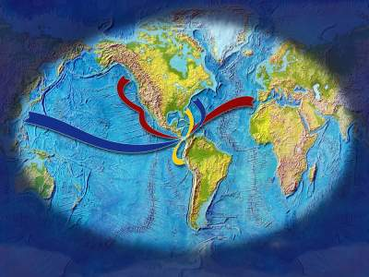
What Factors Contribute to Expanding Globalization?
Read
Reshaping Trade Patterns
Page 240

Slide 5
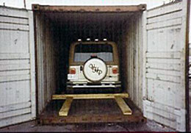
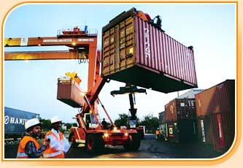
What Factors Contribute to Expanding Globalization?
Read
Transportation
Page 240

Slide 6

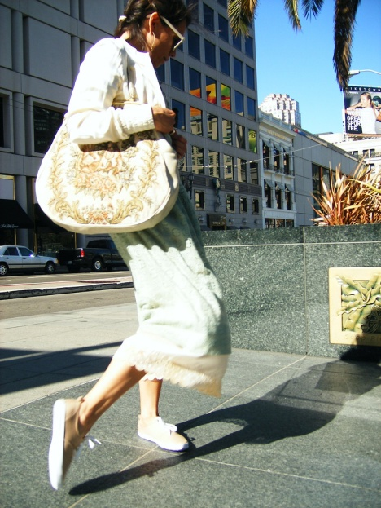
What Factors Contribute to Expanding Globalization?
Read
The Media
Page 241
Respond to the question in the picture’s caption

Slide 7
Reflect and Respond
Communication Technologies
Media
Factors Contributing to Expanding Globalization
Trade
Transportation
Using point form, add at least two reasons/examples (for every one) as to why each of the above are included as Factors Contributing to Expanding Globalization

Slide 8
And…
Begin a Chapter Ten Term List!

Slide 9
Think About Your Challenge
Is there anything in this opening section of Chapter Ten that could be used for your Persuasive Essay?

Slide 10
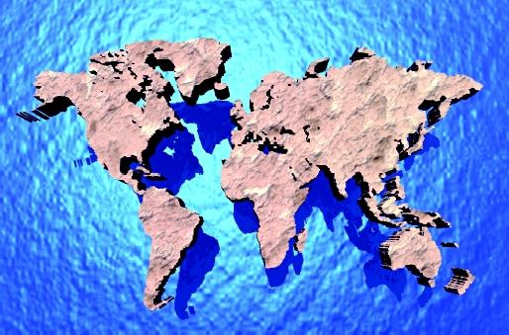
How Do International Agreements And Organizations Contribute To Expanding Globalization?
Scan pages 244 to 249
What is the above Inquiry Question referring to?
Read the introduction on page 244

Slide 11

The World Trade Organization
Review the information below (page 244) that describes how the Canadian clothing industry was effected by different trade agreements
The World Trade Organization
Read and summarize the opening paragraph of this section
Complete reading pages 244 - 245
One goal of expanding globalization is to: Help reduce barriers to trade.
This way, goods and services can move around the world easily.
Overall, have the Effects been more positive or negative? Explain.

Slide 12

North American Free Trade Agreement
Review page 248 and write out the answers to the following:
What countries are involved in this agreement?
What is/was the goal of NAFTA?

Slide 13

European Union
Review page 249 and write out the answers the following:
Why was the European Union created?
What are the similarities and differences between the European Union and NAFTA?

Slide 14
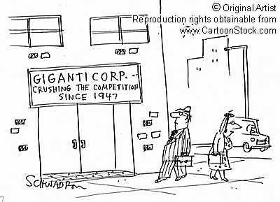
How Do Transnational Corporations Contribute to Expanding Globalization?
Use the glossary and review Transnational Corporation
What is the above Inquiry Question asking?
Read the introduction on page 250

Slide 15

An Example of How Corporations and One Country Contribute to Expanding Globalization
10:00

Slide 16

Contributions of Transnational Corporations
Using the lists of Transnational Organizations on either page 250 or page 45, complete the handout
When finished, read the rest of page 250

Slide 17
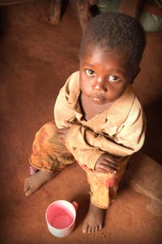
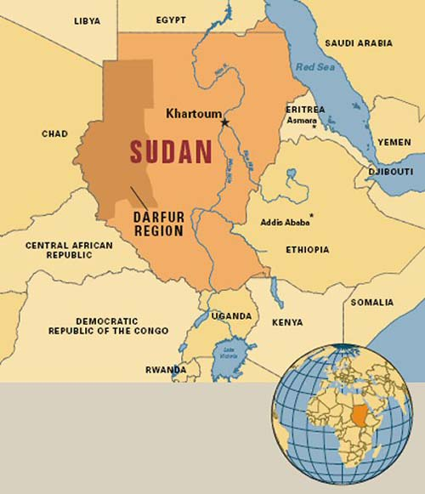
Transnational's and Poverty
Read the first section on page 251
When finished, respond to the questions below in written form:
What do you think would happen to people in developing countries if transnational corporations ruled the world?
Do you think that transnational corporations can bring greater prosperity to all people?

Slide 18

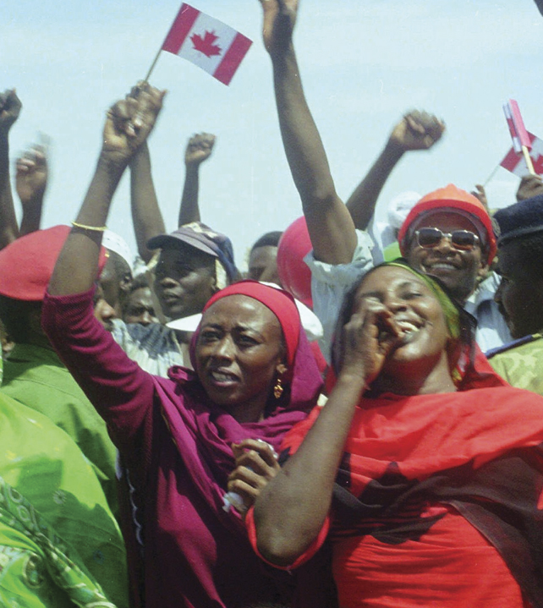

The Calgary Connection
Review these two pictures and their captions on pages 251 and 252.
How are these two events related?
Read both of the Talisman sections on pages 251 and 252

Slide 19

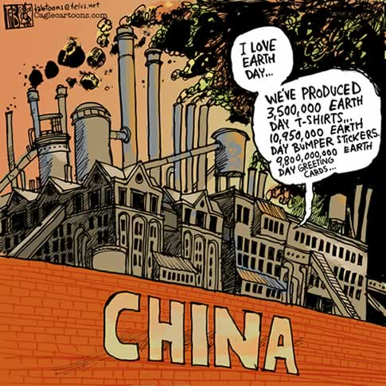
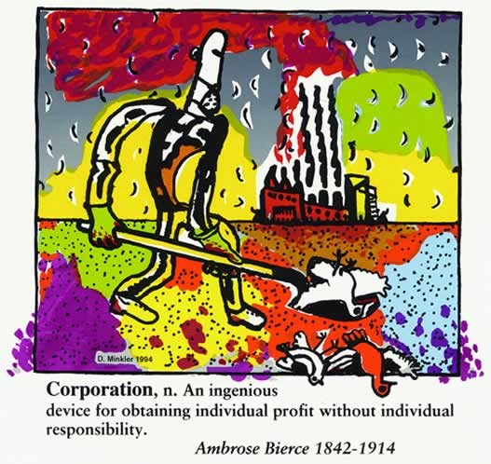

Slide 20
This film is about ‘corporations’. What are some examples?
What is a corporation?
Amongst other things, a corporation permits groups of people to become shareholders, who participate in the profit of the company while only the organization itself is legally responsible for any wrong doing.
If a corporation causes harm to others, who is held responsible?
Can you think of any corporations that have possibly caused harm to others?
Complete the Handout while watching

Slide 21

Food Inc.
Do you know where your food comes from?
Food for Sustainability or Just Plain Scary Food?
94 minutes

Slide 22


Wal-Mart
How much do you know about Wal-Mart?
Do you like Wal-Mart?
Do you shop there?
Handout
95 minutes

Slide 23

Ecuador and Chevron
An example for today…
14:00

Slide 24

Socializing Online…
How many of you have sent or received a message on a social networking web site yesterday or today?
Why is this form of communication used?
Is this typical of teenagers in Canada? Around the world?

Slide 25

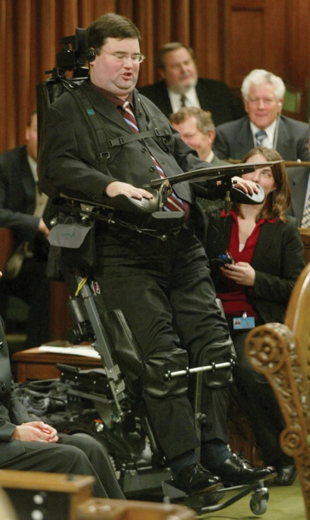
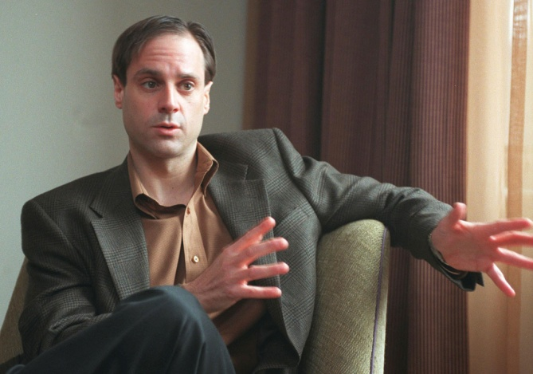

Technology
Review these photographs and their captions on page 254
What do all three photographs have in common?
What benefits of technology do the photos present?
Where were the photographs taken?
What can people in Canada and Japan do that people in developing countries may not be able to do?

Slide 26
How Do Communication Technologies Contribute To Expanding Globalization?
Read the opening two paragraphs on page 254
Read E-Commerce on the same page and write a response to all of the questions in the Activity
Read the top of page 255 and write a written response to the Activity

Slide 27

And…
Continue With Your Chapter Ten Term List!

Slide 28
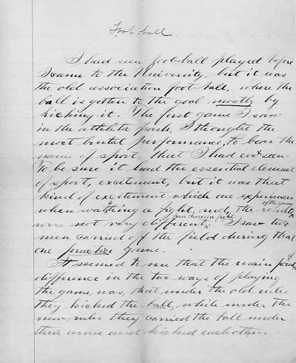
Think About Your Challenge
Is there anything in these sections of Chapter Ten that could be used for your…
Persuasive Essay?
Chapter 9-10 Quiz…

