Slide 1
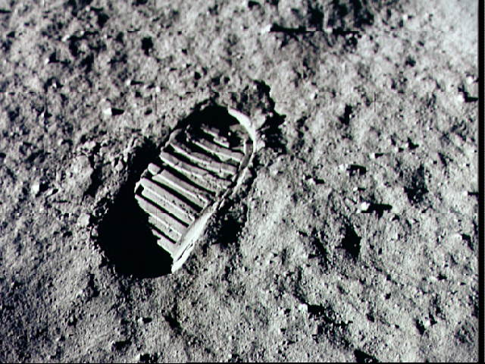
Globalization
And
Sustainability

Slide 2
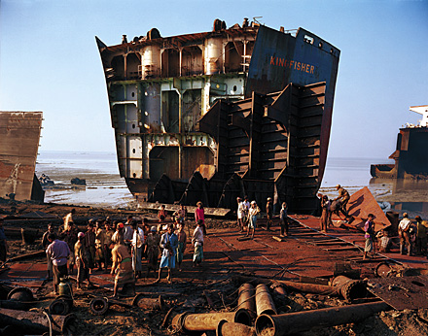
To What Extent Does Globalization Affect Sustainability?
What Does Sustainability Mean?
Read page 259 and record your
responses to the seven
questions in your notebook

Slide 3
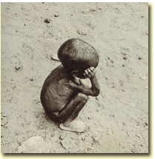
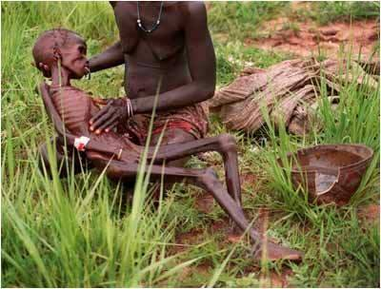
Sustainability:
To keep in existence,
to supply with
necessities or
nourishment

Slide 4
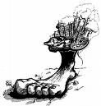
Your text book refers to an Ecological Footprint. (Also know as a Carbon Footprint.)
What is a carbon footprint?
It is the measure of impact human activities have on the environment in terms of the amount of greenhouse gases produced. Measured in units of carbon dioxide.
The challenge is to reduce your carbon footprint!

Slide 5
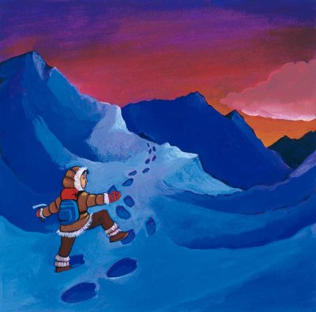
Ecological Footprints
With a partner, read and review pages 260 – 263
Answer the following in your notes:
Explain why there is such a huge inconsistency between the Ecological Footprint in Canada and that of Bangladesh.
ALSO
With a partner complete the “Reflect and Respond”
Have a list of your refuse items to share with the class

Slide 6
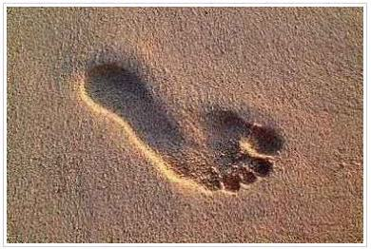
How does your list compare?
Ten things to do to reduce your footprint
Change a light
RECYCLE MORE
Changing one regular light
bulb with a compact fluorescent
light bulb will save 150 pounds of carbon dioxide a year
You can save 2,400 pounds
of carbon dioxide per year
by recycling just half of your household waste
Drive less
Walk, bike, carpool or
take public transit.
You’ll save one pound of
carbon dioxide for every
kilometre you don’t drive
Check your tires
Keeping your tires inflated
properly can improve your
gas mileage by more than
3%. Every litre of gasoline
saved keeps 20 pounds of
carbon dioxide out of the
atmosphere
USE LESS HOT WATER
It takes a lot of energy to heat
water. Use less hot water by
installing a low flow showerhead.
This saves 350 pounds of carbon
dioxide a year. Washing your clothes
in cold or warm water saves 500 pounds
per year

Slide 7
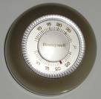
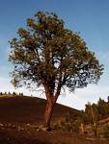
AVOID PRODUCTS WITH LOTS OF PACKAGING
You can save 1,200 pounds of carbon dioxide if you cut your garbage by 10%
ADJUST YOUR THERMOSTAT
Moving your thermostat down 2 degrees in
winter and up 2 degrees in the summer you
could save more than 2,000 pounds of
carbon dioxide a year.
PLANT A TREE
TURN OFF ELECTRONIC DEVICES
A single tree will absorb
1 ton of carbon dioxide
over a lifetime
Simply turning off your television,
DVD player, stereo and computer
when you’re not using them will
save thousands of pounds of
carbon dioxide a year
USE PRINTER PAPER THAT IS 100% RECYCLED
Save 5 kilograms of carbon dioxide per ream of paper. The paper industry
is the third greatest contributor to global warming emissions

Slide 8
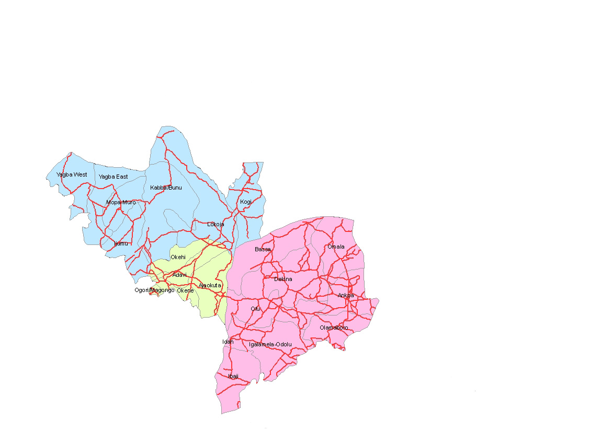
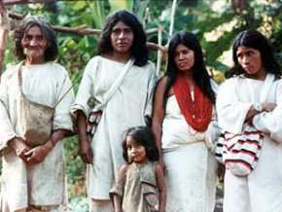
“WE MAMAS SEE YOU ARE KILLING THE WORLD BY WHAT YOU DO. WE CAN NO LONGER REPAIR THE WORLD. YOU MUST.”
This quote is from “The Kogi – At The Heart of the World” (262). Read the article and then answer the three questions under Explorations
How do you feel about the title “Younger Brother?”
How do you think your parent’s generation would feel about this title.
Explain your answers.

Slide 9
Now we know of the 4 R’s instead of the well known 3 R’s.
Design a visual for the symbol of the decrease of carbon foot-printing. Remember the 4 R’s
Recycle
Reduce
Reuse
Refuse

Slide 10
FOCUS ON SKILLS
PAGES 264, 265 OF YOUR TEXT BOOK OUTLINES
STEPS FOR ANALYZING RELATIONSHIPS IN
GEOGRAPHY.
THESE STEPS CAN BE USED WHEN
INVESTIGATING OTHER QUESTIONS THAT WILL
ARISE THROUGHOUT THE HIGH SCHOOL SOCIAL
STUDIES JOURNEY.
READ THROUGH STEP 1 “ASK POWERFUL QUESTIONS”
AND PREPARE THREE QUESTIONS THAT YOU MIGHT
SHARE WITH THE CLASS.

Slide 11
FOCUS ON SKILLS
Now that we have shared with the entire class
Choose one or two of the research questions and make them the focus of your research.
Read through Step 2: acquire information.
Now that you have gathered your information
Read through Step 3: organize information
Now read through Step 4: analyze information
Now read through Step 5: answer your question
Finally your summation. Read summing up.
This is a valuable skill process that you may use in future research.

Slide 12
And…
Begin a Chapter Eleven Terms List!

Slide 13
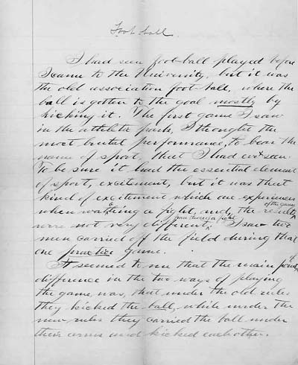
Think About Your Challenge
Is there anything in this section of Chapter Eleven that could be used for your
Persuasive Essay?

Slide 14
How Are Globalization And Sustainability Related?
With a partner, look through pages 266-267 of your textbook and…
Make a brief outline of these two pages
Also…
Answer in your notebook the second activity (267)

Slide 15
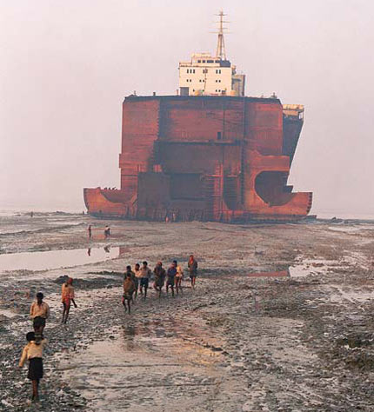
Disposing of Old Ships
Page 268 informs us about the disposal and death of a ship
After reading this page, answer in your notebook the questions in the last paragraph and the response required for Figure 11-19
What is the connection of this type of profession and how globalization and sustainability are related?

Slide 16
POINTS OF VIEW
The shipbuilding industry raises the issue of whether people in developed countries have a responsibility – or even a right – to demand that industries in developing countries observe the same environmental and labour rules as they do.
On page 269 there are three people with three different opinions on this issue. Read through these and then work through the explorations at the bottom of the page.

Slide 17
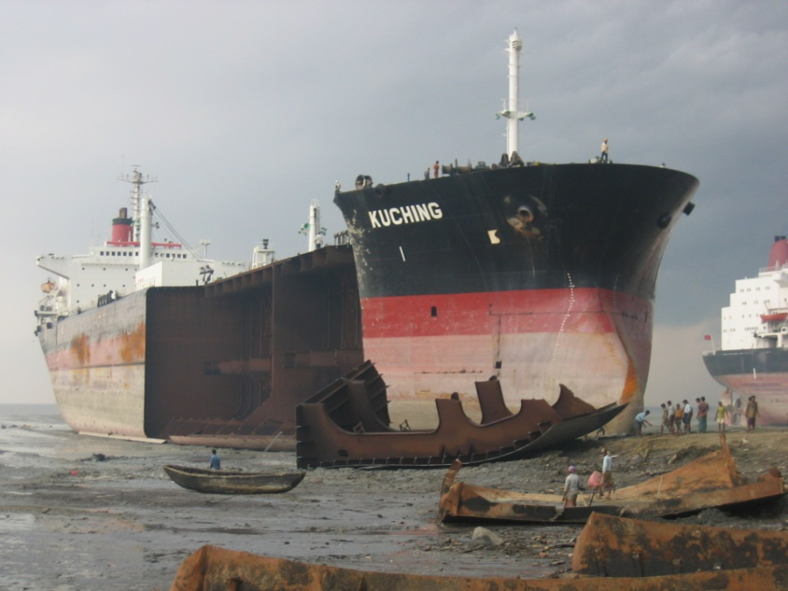
Read Pages 270 - 271
Complete a chart like the one on page 271 and answer the question…
Have Efforts to Promote Sustainability in Shipbreaking Been Successful?

Slide 18
Shipbreaking: An Example
13:00

Slide 19
Have Efforts to Promote Sustainability Been Successful?
Divide Into Six Groups
Group 1&4
The Kyoto Protocol (page 272)
Group 2&5
Alberta Tar Sands (page 273)
Group 3&6
Alternative Energy Sources (page 274)
While reading your section individually and silently, take brief jot notes.
When finished, discuss your topic with your group and be certain you all have complete notes
What do you know about the Kyoto Protocol?
Assign one leader for each group

Slide 20
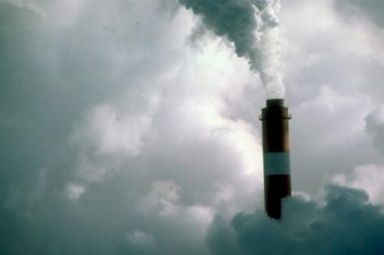
In your groups, discuss whether the efforts to achieve sustainability described in your topic have been successful.
Each group leader must report the groups findings to the class
In the same groups, create a visual that communicates the conclusion your group have reached about sustainability
THIS VISUAL WILL BE POSTED IN THE CLASS

Slide 21
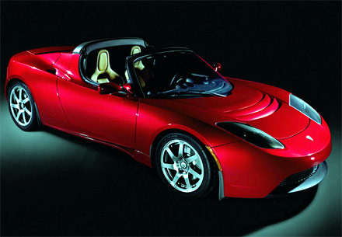
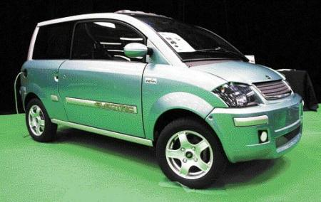
Alternative Energy Sources: Examples
13:00
5:00

Slide 22
Individual Initiatives
Read page 275 in your textbook, including the profile about Wangari Maathai
Jot down some items that you have discovered or that you already knew about what individuals can do to help with global environmental issues

Slide 23
Terms
Go through all that you have done in this chapter and make a vocabulary list

Slide 24
Think About Your Challenge
Is there anything in these sections of Chapter Eleven that could be used for your
Persuasive Essay?

