Slide 1
SUSTAINABLE PROSPERITY
CHALLENGES
AND
OPPORTUNITIES

Slide 2
To What Extent Can Globalization Bring Sustainable Prosperity To All People?

Slide 3
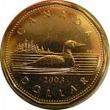
Read page 279 and then in your notebook
answer the four questions
When finished the above, refer to page 278 and in your notebook answer the questions below :
How would your life be different if you were one of the young women carrying water in Kenya?
How would the difference affect your future prosperity?
What would the word PROSPERITY mean to you if you were one of the young Kenyan women?

Slide 4
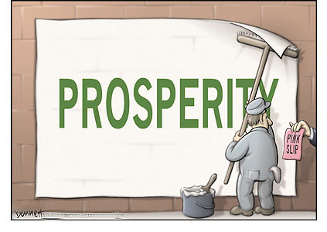
What is Sustainable Prosperity?

Slide 5
Read page 280
Write down a one sentence explanation of the concept of Sustainable Prosperity
Read page 281
“Sustainable Prosperity and Global Interdependence”
Complete the Activity on page 281
Be prepared to share with the class by discussing the situation that you have described in your cause and effect diagram

Slide 6
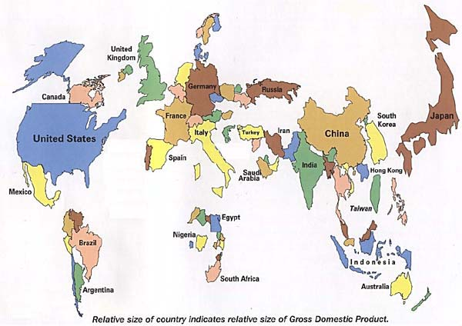
The map below is measuring prosperity by G.D.P. alone.
Jot down some other criteria that you think could be used to measure Prosperity
Read the introduction on page 282
Read the first half of page 282

Slide 7
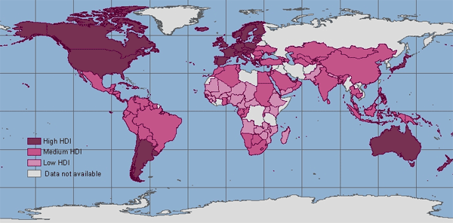
H.D.I. was created by the United Nations to measure quality of life based on:
Longevity, Knowledge and Standard of Living
Read the rest of page 282
H.D.I. stands for Human Development Index

Slide 8
Did you notice the differences in Canada when you compare the G.D.P. with the H.D.I.?
What’s the difference?

Slide 9
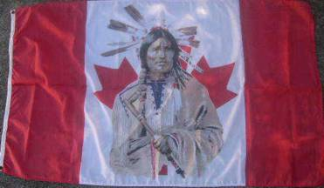
Read the first paragraph on page 283. Review the graph.
Be prepared to discuss with the class why there are G.D.I. differences within Canada between the general population and the Aboriginal people.
Suggestions for the gap?

Slide 10
Why is access to clean water important to human development and sustainable prosperity?
Read the three comments in “Points of View” (Page 284)
In your notebooks, describe in your own words the
essential message of each speaker

Slide 11
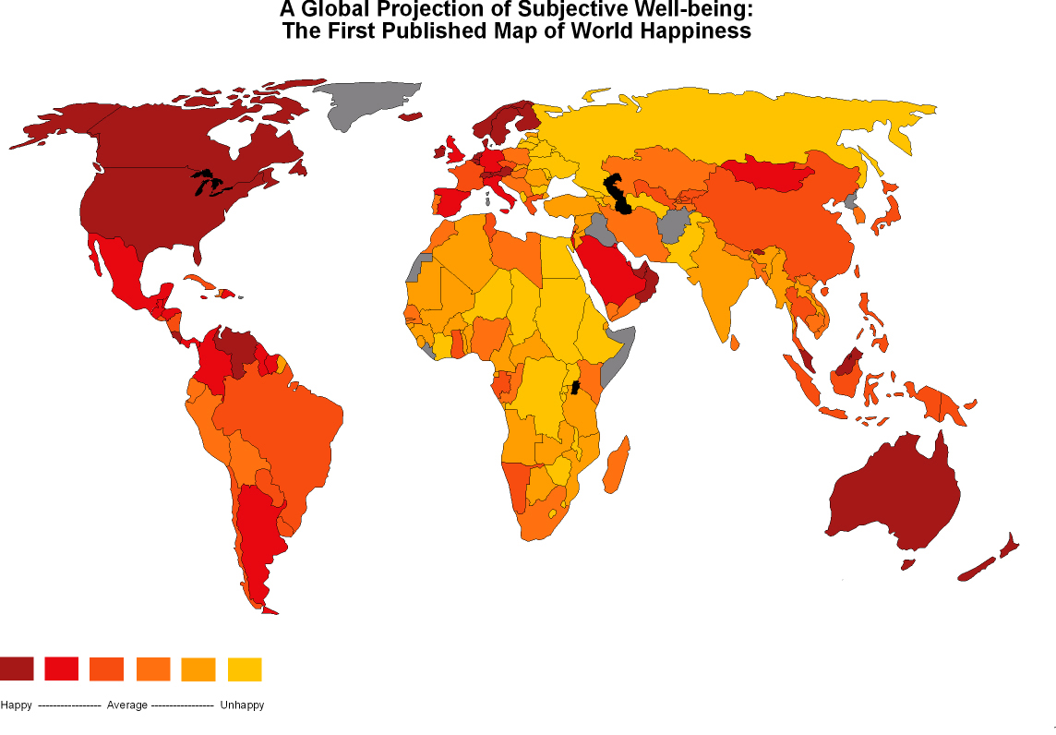
Read “Other Measures of Prosperity” page 285
Do you believe that “Happiness” can be measured?
Now complete “Reflect and Respond”

Slide 12
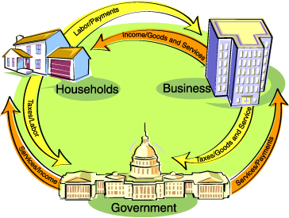
With the class it’s
time to review the
difference between
Market Economy
and
Interventionist (Mixed) Economy
Which approach best
meets the needs of
the citizens?
Together with the class read the first two paragraphs:
What Political and Economic Challenges and Opportunities Are Associated With Globalization?
(Page 286)

Slide 13
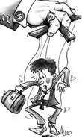
Discuss:
To what extent should governments control their countries economies?
Will expanding economies lead to sustainable prosperity for all?
Should the governments control their economies in interest of their citizens?
Will expanding free markets economies result in prosperity for all people?
Will that prosperity be sustainable?

Slide 14
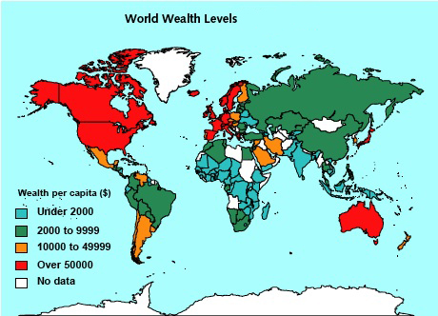
Read “Economic Growth and Sustainable Prosperity”
page 286

Slide 15
You will be divided into groups of four.
This is your home group.
Each member of the group takes a number from 1 to 4.
You will then be divided into four groups.
All the same numbers from each group should meet in the four different areas
Complete the following assignment:

Slide 16
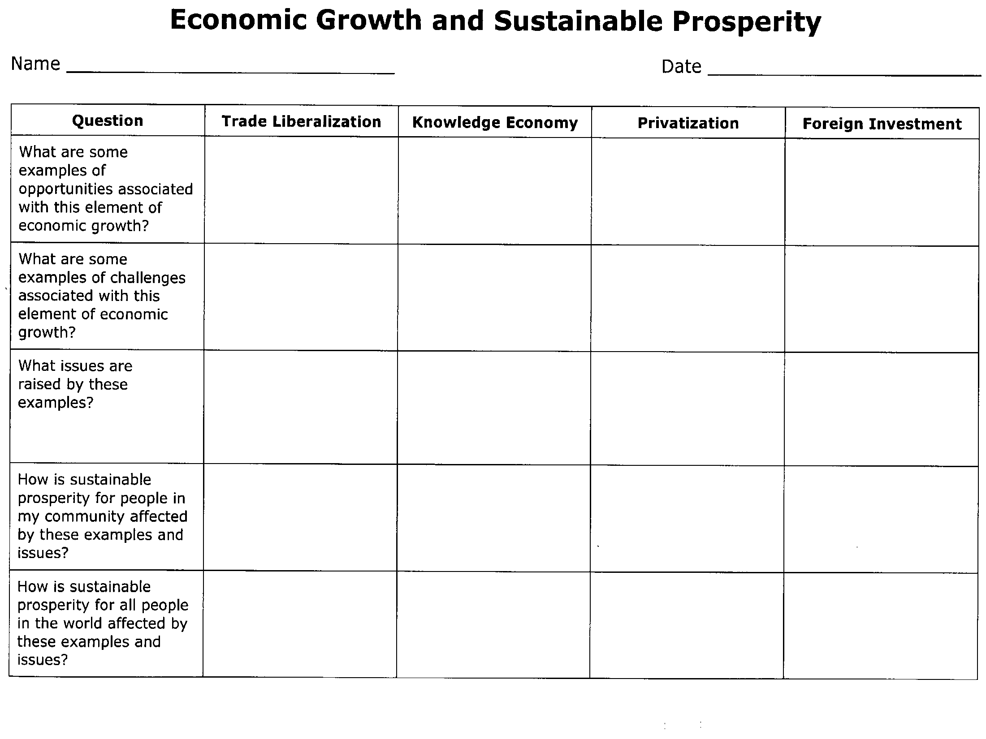
1
2
3
4
INFORMATION
FOUND ON
PAGE 287
INFORMATION
FOUND ON
PAGE 290
INFORMATION
FOUND ON
PAGES 291-292
INFORMATION
FOUND ON
PAGES 292-293
Read your assigned sections of the text and discuss the information as a group. Work together to fill in all of your assigned column.
Make sure to check all of the visuals and margin features.
After all is complete, return to your home group and share your information. All students need to make sure that all of the four columns of their individual sheets are completely filled in.

Slide 17
What Choices Are Associated With Sustainable Prosperity?
Why do you think that the word CHOICES is used in this inquiry question?
What do CHOICES have to do with sustainable prosperity?
How can people choose sustainable prosperity?
Read page 294
Scan the bar graph (Figure 12-16) and respond to the following:
Which regions of the world have the largest proportion of people living on less that $1.00 a day?
Which regions have seen the greatest decrease in people living on less that $1.00 a day?
Which regions of the world are not represented in the graph? Why not?

Slide 18
Millennium Development Goals
What do the various points of this plan mean and why are they important?
These are found on page 294.
DECENTRALIZATION
The people who live in the affected communities must be the ones who decide what should be done and how money should be spent.
TRAINING
People need to be trained to run poverty reduction programs. This training should be carried out at the national, district and village level.
INFORMATION TECHNOLOGIES
The people involved in poverty reduction programs need to have access to computers, e-mails and mobile phones so that they can communicate quickly with one another.

Slide 19
MEASURABLE BENCHMARKS
(A BENCHMARK IS A STANDARD)
People must have specific goals that are designed to suit their national conditions, needs and availability of data.
AUDITS
No country should receive funding unless funding can be audited.
MONITORING AND EVALUATION
Budgets and plans for monitoring programs should be part of all poverty reduction programs.
Which millennium goal do you think you might be able to influence most directly? Why?

Slide 20
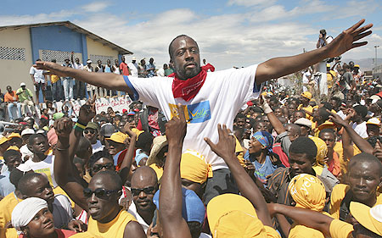
A Personal Choice To Help Achieve Sustainable Prosperity
13:00

Slide 21
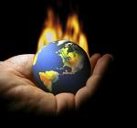
Climate Change and Sustainable Prosperity
Read page 295 and the top of page 296 and then answer the following:
Has there been a change in the climate where you live?
Are people in your community concerned about climate change?
What do you think should be done about climate change?
What could you at Fort High or in the community do to lessen the impact?
Why are issues involving climate change so hard to resolve?

Slide 22
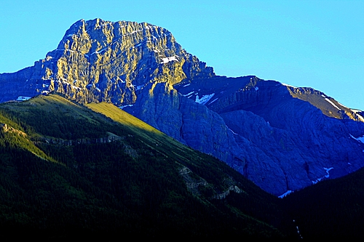
Changing Government Policies
Shaping a Provincial Climate Change Action Plan
What goals do you want to set?
2. What important steps need to be taken?
3. What actions should Albertans take?
4. What role can individuals play?
Read pages 296 - 297
Consider how the policies of the governments of Bolivia, Norway and Alberta represent choices associated with sustainable prosperity
Answer: Questions to Alberta on
Shaping a Provincial Climate Change Action Plan

Slide 23
Saving The Worlds Seeds
4:23

Slide 24
Turn to page 299 and read Watershed Rap
Summarize its message in a couple of sentences.
Add two more verses that expand the message and include mention of Sustainable Prosperity
With a partner perform your verses for the class

Slide 25
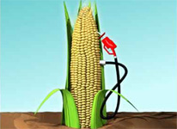
Terms
Go through all that you have done in this chapter and make a vocabulary list

Slide 26
Think About Your Challenge
Is there anything in these sections of Chapter Twelve that could be used for your
Persuasive Essay?
It’s Due On Thursday!

Slide 27
Related Issue #3 Exam
See Review Handout

Slide 28
Social 10-2 Final Exam (Part A)
See Handout

Slide 29
Social 10-1 Final Exam (Part B)
Consists of 70 Multiple Choice Questions

Slide 30
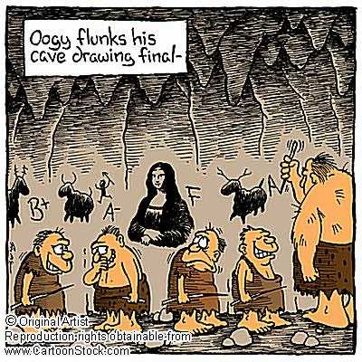
Final Review
Beginning with chapter one, complete the following for EACH of the chapters (One through Sixteen):
Make/find a list of all the important terms –In your own words define
each of them, using examples if necessary.
Make a list of all of the Inquiry Questions, leaving space for
responding – Using examples, provide a personal response for each.
Your Kiva portfolio folders are due on January 18th!
Exam
Part A – Tuesday, January 18th Room 24
Part B – Thursday, January 20th (12:30) Gymnasium
Good Luck
☺
You will not finish the above in class, therefore, it will be a useful review method to complete @ home!

