Slide 1

Should Nation Be The Foundation of Identity?
In groups of 4-5, make two columns on your chart paper and title each National Identity and Individual Identity
Work as a group and answer the following questions:
What does the photograph tell us about Canada’s national identity?
What does it tell us about the fans’ individual identity?

Slide 2
Understanding Nationalism
Turn to page 14 of your textbook
Review Related Issue #1 and the four chapters included
What is the connection between related issue question, the individual chapter question and each of the chapter inquiry questions?
What is the difference between the words should and does?

Slide 3
The Big Picture
Read page 15 and answer the following:
What is the main idea of this section?
In what ways is a national identity similar to an individual identity?
What are some of the factors that influence national identity?
Is more than one perspective represented?

Slide 4

Your Challenge: E-Zine
Should Nation Be The Foundation of Identity?
Read all of pages 16 and 17

Slide 5
Your Challenge:
Vocabulary
Explore:
  To inquire into and investigate thoroughly
Analyze:
        To break down into parts and examine in detail, to examine critically, and to bring out essential elements
Evaluate:
  To assess or appraise
Explain:
        To present a position that is well expressed, well supported and persuasive

Slide 6

Your Challenge: E-Zine
Review the magazines presented, again looking carefully at the design elements that appear.
Record these elements on the back of your chart paper
Review the sample two page spread (page 17) looking carefully at the design elements that appear

Slide 7
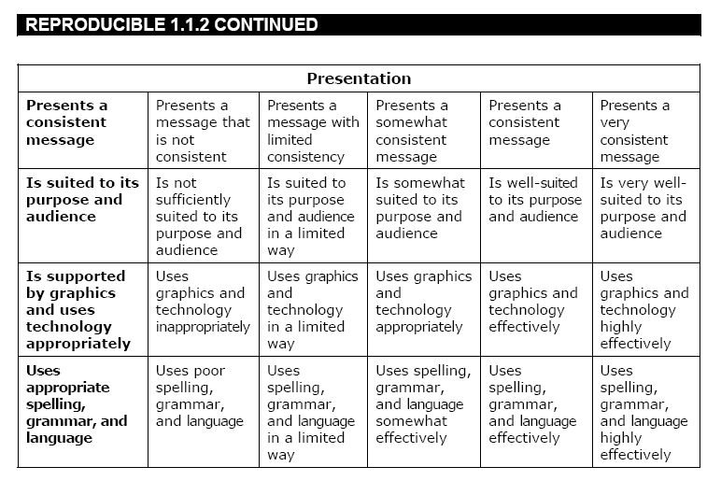
Your E-Zine:
Evaluation
Review Evaluation Rubric
Each category is worth five marks for a total of /55

Slide 8

Nation and Identity
Review the photograph and it’s caption on page 18
Has anyone ever dressed up for Canada celebrations before?
Are people who dress up more patriotic than those who don’t?
I Am Canadian

Slide 9
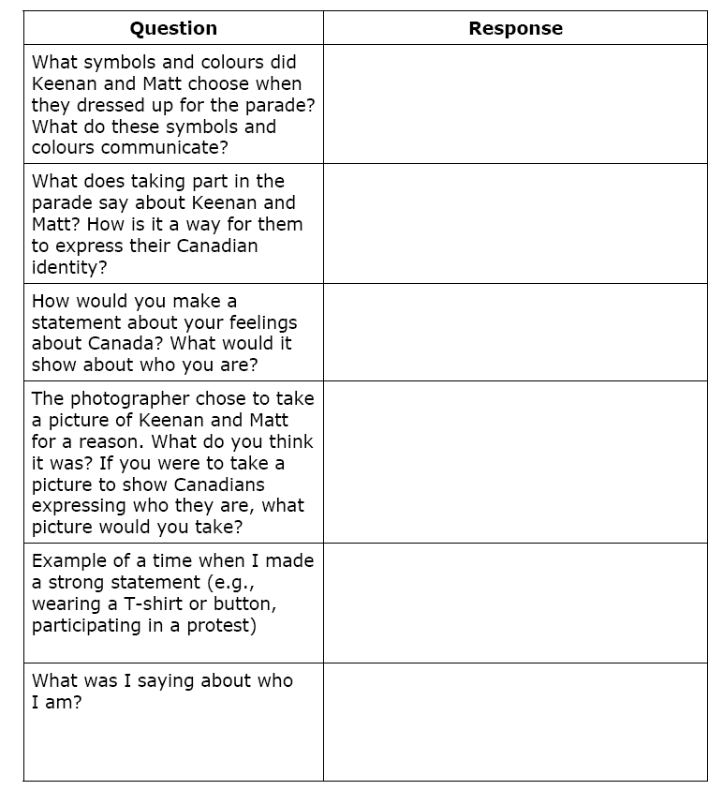
Personal Identity and Concepts of Nations
With a partner, read page 19 and respond to the questions
Answer all six questions!

Slide 10

What Are Some Concepts of Nation?
Review the concepts of nation and country
Is Canada mainly a country or mainly a nation?
Or does it really matter?
How might a person’s idea of nation affect his or her identity?

Slide 11
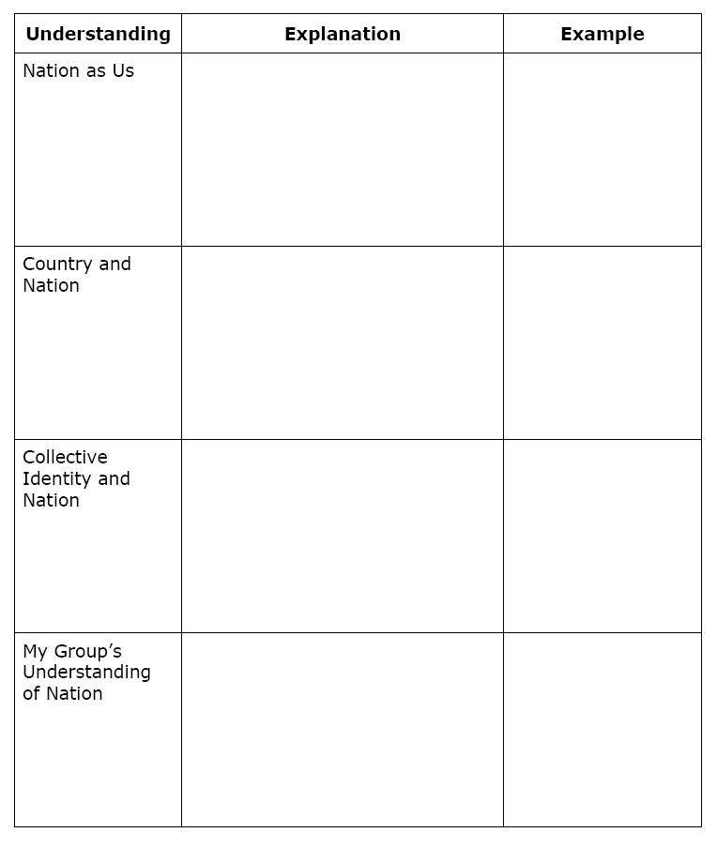
What Are Some Concepts of Nation?
Momentarily, you will be numbered off one through three. Each of you will go to one of the three assigned EXPERT groups and complete (in point form) your section on the handout provided. You will have approximately 15-20 minutes to do this.
  #1 – Nations as Us - Page 20
  #2 – Country and Nation – Page 21
  #3 – Collective Identity and Nation – Pages 23-24
When finished, return to your original group of three and share your EXPERTISE with your other two group members. They will do the same for you. When you are done, your chart WILL be filled in completely.
Get into groups of three…

Slide 12
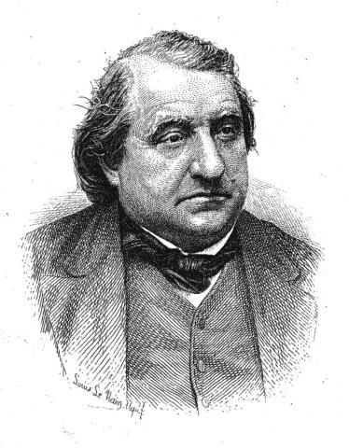
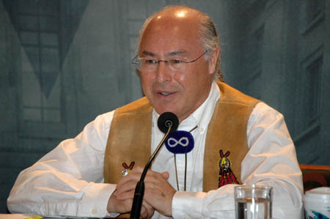
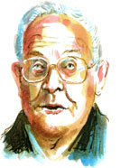
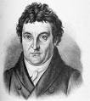
The View From Here
Read page 22 and with a partner, complete #2 of Explorations

Slide 13
And Finally…
Begin a list of terms from this chapter, which include…
Any term/phrase/concept that would be considered important in helping you with your …
E-Zine
Any suggestions as to what you should include?

Slide 14
Canada and You
What does Canada mean to you…?
Make a list of at least five responses

Slide 15
What Are Some Understandings of Nation?
Momentarily, you will be numbered off one through four. Each of you will go to one of the four assigned EXPERT groups and complete a summary (in point form) of your section on the handout provided. You will have approximately 15-20 minutes to do this.
  #1 – Language (Page 25)
  #2 – Ethnicity/Cultural/Religion (Pages 26-27)
  #3 – Geography/Land/Spirituality (Pages 27-28)
  #4 – Politics (Page 29)
Use your own understanding of Canada to complete the third column.
When finished, return to your original group of four and share your EXPERTISE with your other three group members. They will do the same for you. When you are done, your chart WILL be filled in completely.
Get into groups of four…
When the chart is complete, go back and complete the Activities for your assigned pages

Slide 16

Understandings of Nation?
Review the photographs and captions on page 27
Do you think Tibetans have the right to call themselves a nation?
Read the 1975 Dene declaration on page 29…
What reasons do the Dene give for wanting to be considered a nation by the world community?
Do the Dene have as much right as Tibetans to call themselves a nation?
If the Dene were given this consideration, what might be the impact on Canada?

Slide 17









Understandings of Nation
Complete the Recall…Reflect… Respond on page 29
Language
Ethnicity
Cultural
Religion
Geography
Relationship to the Land
Spirituality
Politics
You will use the following Understandings:

Slide 18
And Finally…
Continue with your list of terms from this chapter, which include…
Any term/phrase/concept that would be considered important in helping you with your …
E-Zine
Any suggestions as to what you should include?

Slide 19
“In the psychological sense, there is no Canadian nation… There is a legal and geographical body, but the nation does not exist. For there are no objects that all Canadians share as objects of national feeling.”
What does the statement mean?
What is meant by ‘psychological sense’? ‘National feeling’?
Do you agree with this statement?
Can you name some ‘objects of national feeling’ in Canada?
Does it matter whether there are objects of ‘national’ feeling?

Slide 20

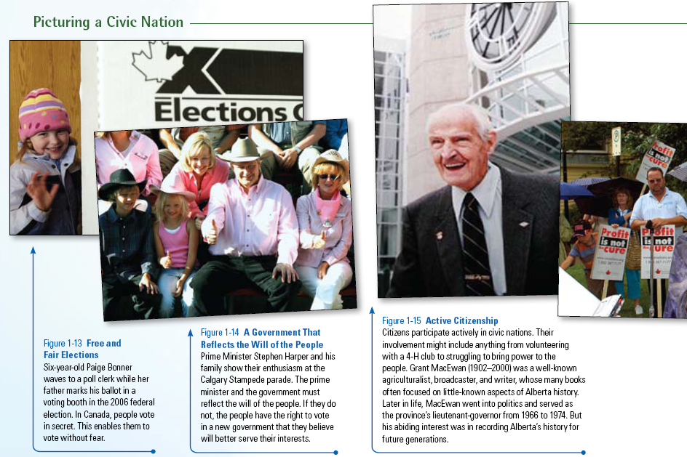
What is a Civic Nation?
Record the ideas of Civic Nation into your notes
Review the photo-essay on pages 30-31
Many believe that Canada is a Civic Nation…Agree?
If a civic nation is based on shared values and beliefs, what values and beliefs do these photographs express?
Do any of these photographs make you question the idea of Canada as a civic nation?

Slide 21
What is a Civic Nation?
Read pages 30-31
As a class, complete the Activity on page 31 – Write out your responses

Slide 22

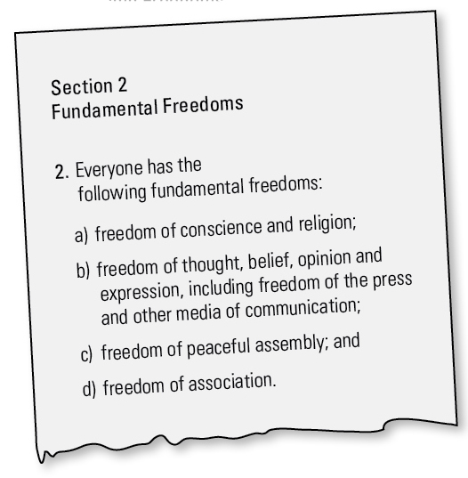
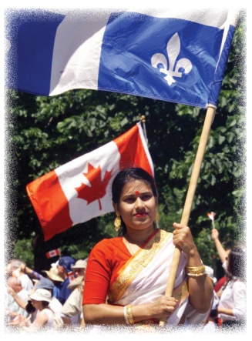
Expressing Shared Values and Beliefs
Read page 32
Using Section 2 of the Canadian Charter of Rights and Freedoms, provide a specific example for each of the freedoms listed
How important is the Charter of Rights and Freedoms in shaping the values and beliefs of Canadians?
Would Canadians still share values and beliefs if the Charter or Constitution did not exist?
How does the Charter contribute to a sense of civic nation?
Why do you think the creators of the Constitution set up a complex amending formula?
Discuss the caption of the photograph (Page 32)

Slide 23
Nation and Nation State / Nationalism
With a partner, read page 33
With your partner, complete the Activity on page 33
Pay special attention to Figure 1-22
When finished, record definitions for the terms Ethnic Nationalism and Civic Nationalism
With your partner, complete Recall…Reflect…Respond

Slide 24
And Finally…
Continue with your list of terms from this chapter, which include…
Any term/phrase/concept that would be considered important in helping you with your …
E-Zine
Any suggestions as to what you should include?

Slide 25

A Sense of Belonging
(Page 35)
What other groups or collectives may give you a sense of belonging?

Slide 26
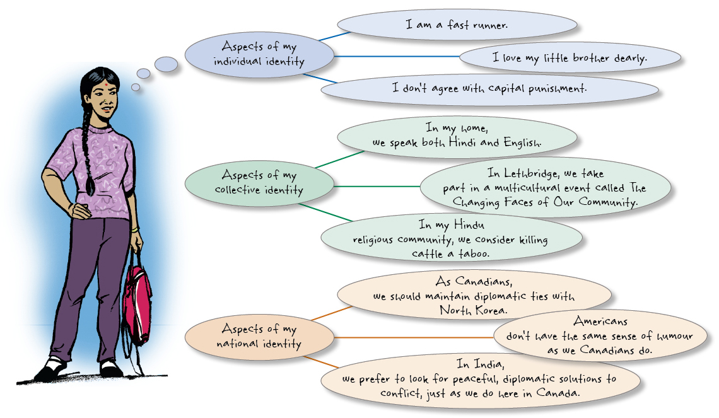
In What Ways Can Identity And Nation Be Related?
Read page 35
Complete the Activity
When Done…
Either in words or as a drawing, create your own representation of your individual, collective and national identity

Slide 27





Stories, Myths and the Civic Nation
With a partner read page 36, responding to the Activity
Is Canada a Hockey Nation…. Myth or Reality?
Just for Fun…
Canadian Seth Rogen… Funny or just Super Bad?
Read the top of page 37
Joe Mufferaw
Follow along with some of the lyrics on page 38

Slide 28



How is Nation a Part of Who You Are?
After being number off 1-3, read the corresponding quotation in the Taking Turns section on page 37
1: Harley
2: Jean
3: Violet
After reading, summarize how your ‘person’ answered the question:
How is Nation a Part of Who You Are?

Slide 29
Now…
Complete your list of terms from this chapter, which include…
Any term/phrase/concept that would be considered important in helping you with your …
E-Zine
Any suggestions as to what you should include?

Slide 30
Skill Builder to Your Challenge
With two or three others, work through the Steps on page 39
Before you begin, do you know what Bias is?
Review the Vocabulary Tip on the bottom of the page

Slide 31

Chapter One Quiz
Friday
10 Marks
Review the Chapter – Including the Terms

