Slide 1
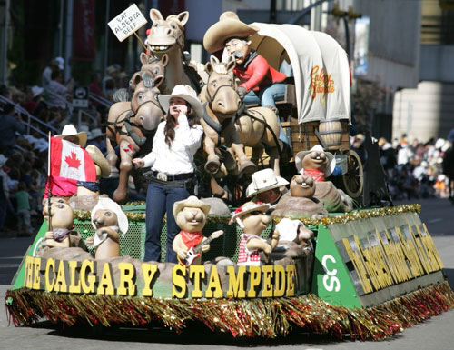
Reconciling Nationalist Loyalties
Does everyone love a parade?
Why do people enjoy them?
Read page 63
Respond to the questions in writing
Review the Key Terms… What do you think some of them mean?
Write out…
Nationalist Loyalties Commitment to one’s nation
Non-nationalist Loyalties Commitment to other aspects of peoples identity
Read the caption on page 62

Slide 2

How Do Nationalist Loyalties Shape People’s Choices?
Read the Introduction on page 64, including the Activity
Create a similar example that illustrates your own loyalties
When you’re finished, rank you loyalties in order of importance to you

Slide 3
Loyalty
Read Loyalties and Choices on page 64
While you read, think about what would you do in each of the described situations

Slide 4
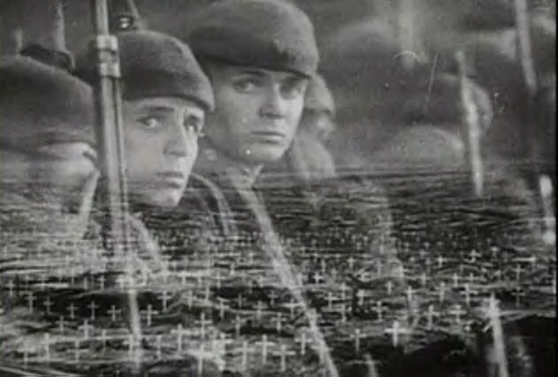
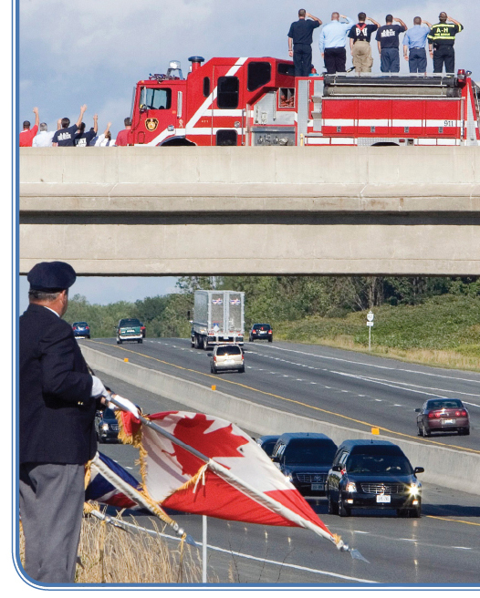
Loyalty
Read Patriotism and Loyalty on page 65
Do you agree with renaming Highway 401? Why?
Review the caption on page 65
Respond to the questions

Slide 5

Edmonton Troops Return Home
September 18, 2008
Read the rest of page 65

Slide 6
Loyalty
Write out this concept (page 66) and its related meanings in your notebook
Read How Contending Loyalties Can Affect Choices on page 66
Complete #1 and #2 of
Recall…Reflect…Respond

Slide 7

And Finally…
Begin a list of terms from this chapter, which include…
Any term/phrase/concept that would be considered important in helping you with your …
E-Zine
Any suggestions as to what you should include?

Slide 8
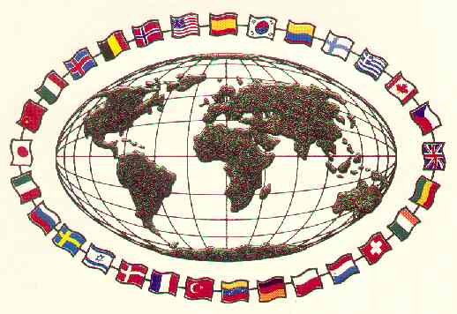
Affirming Nationalist Loyalties
Complete the first section of this handout
As you read page 67, begin to fill out the rest of the handout
You will not be completing it until later on into the chapter
One way a group has affirmed their National Identity was when, in 1982, the National Indian Brotherhood
changed their name to the
Assembly of First Nations
Was this really a significant action?
What Choices Have People Made To Affirm Nationalist Loyalties?

Slide 9
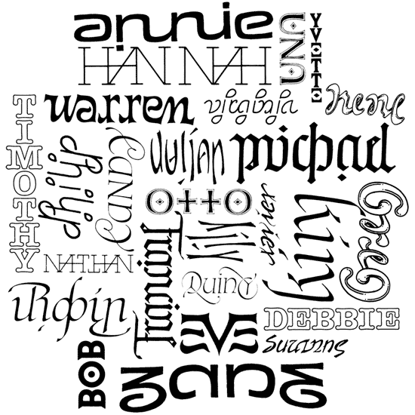
What’s In A Name?
How important is a name?
How do you feel when someone mispronounces your name?
How would you feel if someone changed your name?
What is the difference between a number and a name?
What are some examples of situations where people are referred to by a number?
How would you feel if you were referred to by a number instead of a name?
Read Names and Inuit Identity at the top of page 68
Read Making a Difference and, in paragraph form, complete Explorations (Page 68) for homework

Slide 10
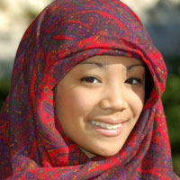
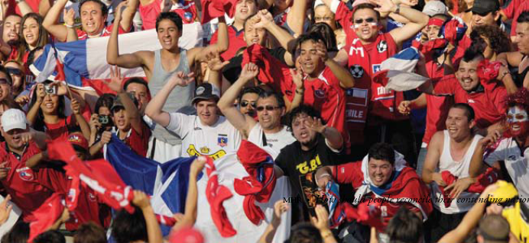
National Loyalties in a Pluralistic Society
Write out this concept (page 69) and its related meanings in your notebook
Can you think of two or three examples of Cultural Pluralism in action in Canada?

Slide 11

National Loyalties in a Pluralistic Society
Pros and Cons of Multiculturalism
Pros
Cons
After making a similar chart, read page 69, making point form notes

Slide 12
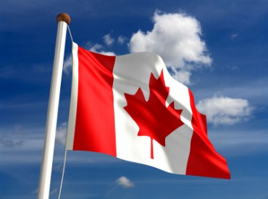
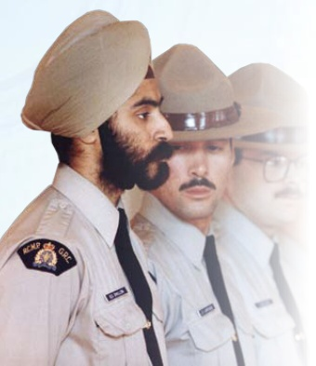
Non-Canadian Nationalist Loyalties
Read the Introduction on page 70
What are some stories of when you had trouble fitting in…
Read these quotes (page 70) and decide which one fits most closely to your understanding of Canada
In groups of 3-4, read Putting Pluralism to the Test (Page 70) Reasonable Accommodation and Nationalist Loyalties / Reasonable Accommodation in Quebec (Page 71)
And
Complete Recall…Reflect…Respond on page 71
Add to your handout Affirming Nationalist Loyalties

Slide 13
And Finally…
Continue with your list of terms from this chapter, which include…
Any term/phrase/concept that would be considered important in helping you with your …
E-Zine
Any suggestions as to what you should include?

Slide 14
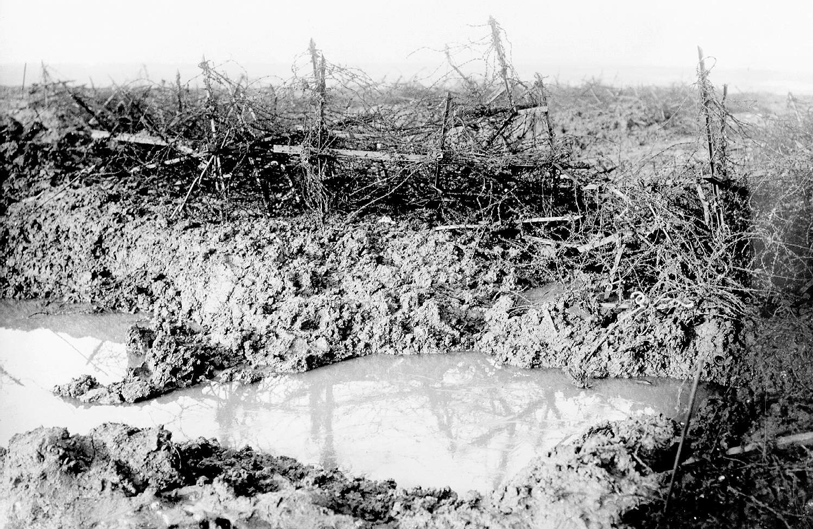

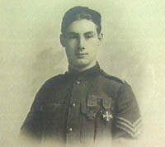
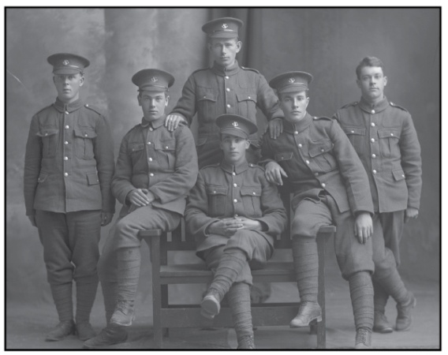
How Can Nationalist Loyalties Create Conflict?
Have you ever been in a situation where you had very mixed feelings about a person or place?
Have you ever had mixed feelings about being Canadian?
What are some aspects of Canada that you love?
What are some aspects of Canada that give you cause for concern?
Have you ever had to deal with contending loyalties? If so, how did you deal with this conflict?
Read the first two paragraphs on page 72
and July 1 in Newfoundland
Respond to the question in Figure 3-13
Recruiting Sergeant

Slide 15
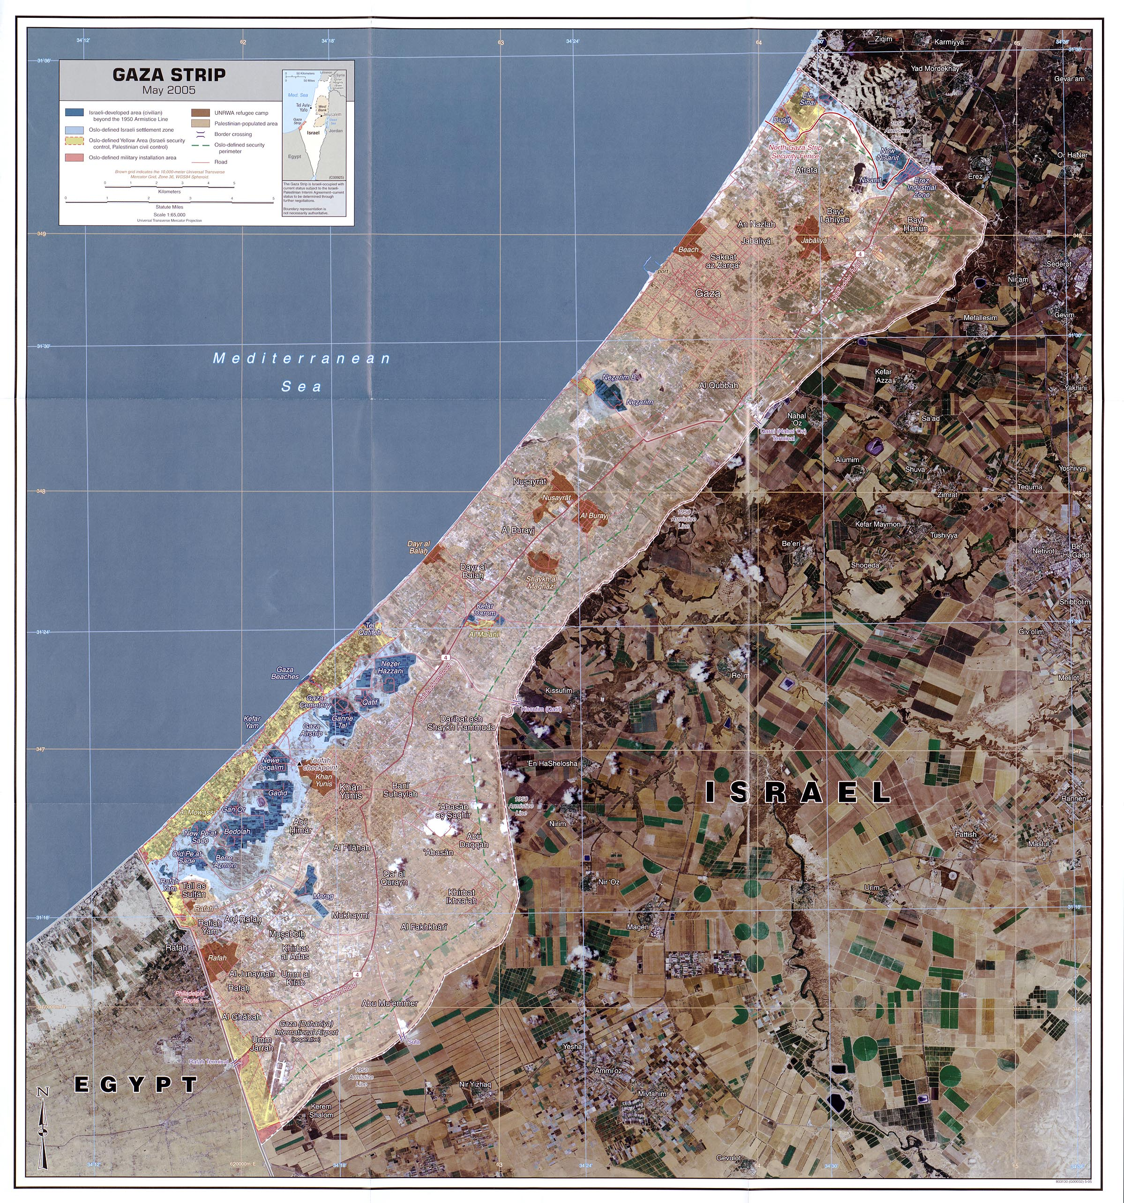
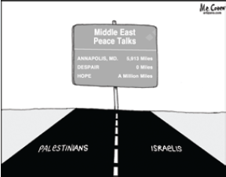
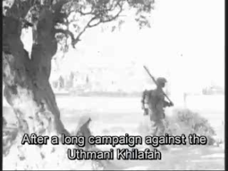
Contending Loyalties and Conflict
Read the top of page 73
Then…
What loyalties, if any, would you consider worth fighting for?
Review the cartoon and it’s caption on page 73. Answer the question
A Pro-Palestinian view of this crisis

Slide 16
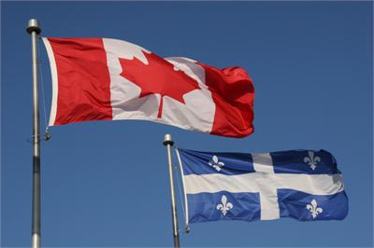
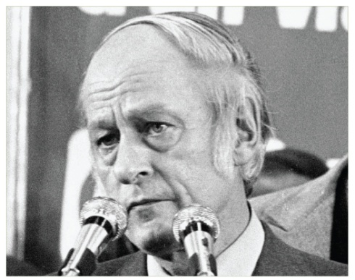
Québec Nationalism
Protecting Language and Culture in Québec
Read pages 74-75
Keep the following question in mind as you read: How has Québec tried to preserve its language and culture?
With a partner, complete the handout
When finished, complete Explorations on page 75

Slide 17
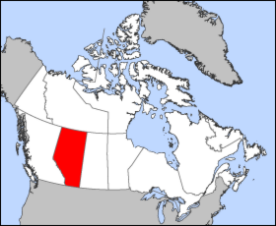

Should Alberta Separate From Canada?
Pros and Cons of Alberta Separation
Pros
Cons
After making a similar chart, brainstorm both positive and negative responses to the above question

Slide 18
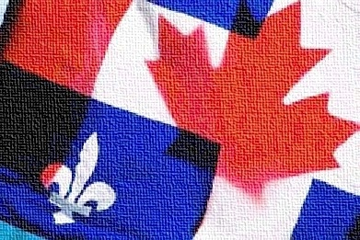
Contending Loyalties in Québec
Read page 76
Looking for additional arguments in support or against Québec sovereignty
Add them to your chart
Take a few minutes and complete the Reflect and Respond

Slide 19
And Finally…
Continue with your list of terms from this chapter, which include…
Any term/phrase/concept that would be considered important in helping you with your …
E-Zine
Any suggestions as to what you should include?

Slide 20
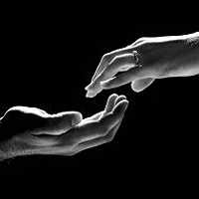
Write out this concept (page 77) and its related meanings in your notebook
Can you think of two or three examples of a treaty, apology or settlement?

Slide 21
Read the following:
Self-determination is a right which belongs to peoples. It does not belong to states. It is a right of all peoples. It is universal and non-divisible; that is, either you have it or you do not. It is not a right that is given to peoples by someone else. Please understand, you may have to fight to exercise this right, but you do not negotiate for the right of self-determination because it is yours already.
Matthew Coon Come, Cree leader and former grand chief of the Assembly of First Nations
Do you agree with Coon Come’s thoughts?
Does his position have consequences for individuals? For peoples? For governments? What might these consequences be?
Who should be responsible for protecting the right to self-determination?

Slide 22
How Have People Reconciled Contending Nationalist Loyalties?
Read the opening two paragraphs on page 77
Can you think of a few examples of situations that may lead to a need for reconciliation?
How were or could they have been reconciled?

Slide 23
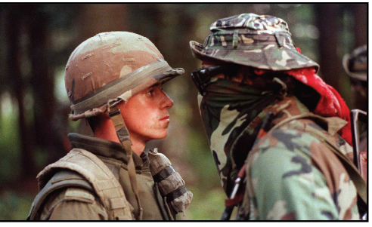
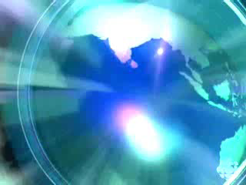
Oka
This could arguably be Canada’s most famous picture. The Oka Crisis was a land dispute between the Mohawk nation and the town of Oka, Quebec which began on March 11 1990, and lasted until September 26, 1990
What ideas make this picture so powerful?
What contending loyalties are displayed?
The Oka Crisis
13:00

Slide 24
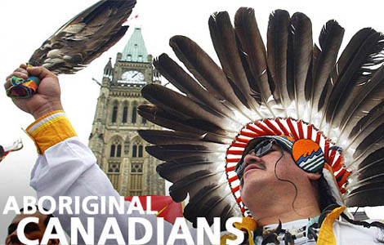
Aboriginal Peoples’ Attempts to Reconcile Contending Nationalist Loyalties
Get into groups of four…
Momentarily, you will be numbered off one through four. Each of you will go to one of the four assigned EXPERT groups and complete a brief summary. You will have approximately 15-20 minutes to do this.
  #1 – Oka Crisis (Page 77)
  #2 – The Royal Commission on Aboriginal Peoples (Page 78)
  #3 – Statement of Reconciliation (Page 79)
  #4 – Land Claims (Page 80)
When finished, return to your original group of four and share your EXPERTISE with your other three group members. They will do the same for you. When you are done, your worksheet WILL be filled in and complete.

Slide 25
Aboriginal Peoples’ Attempts to Reconcile Contending Nationalist Loyalties
When your chart is complete, for each of the four events, decide if it helped or hindered Aboriginal peoples’ attempts to reconcile contending nationalist loyalties

Slide 26
And Finally…
Complete your list of terms from this chapter, which include…
Any term/phrase/concept that would be considered important in helping you with your …
E-Zine
Any suggestions as to what you should include?

Slide 27
Skill Builder to Your Challenge
By the end of Chapter Two, you were to have completed names, headlines, visuals and captions!
Today, in part three of your Challenge, you will begin planning and drafting a supported Opinion Paragraph in response to the related issue:
Should nation be the foundation of identity?
Read the Steps on page 83
Plan and Draft an Opinion Paragraph
Use the RAFTS handout to complete Step Three

Slide 28

Related Issue #1 Exam
Part of your exam for Related Issue One is an examination and interpretation of three sources
It will be marked according to the rubric provided to you (Writing Assignment I)
You will have the entire class to complete the exam
The three sources will be used to answer the following questions:
What ideas do each of the sources presented on the two pages communicate to you about nationalism/national loyalty?
AND
Considering the sources presented on the two pages, how much should the nation be the foundation of our own identity?

Slide 29
The Question: Specifics
What ideas do each of the sources presented on the two pages communicate to you about nationalism/national loyalty?
AND
Considering the sources presented on the two pages, how much should the nation be the foundation of our own identity?
Write a response in which you must
*interpret each source to identify what the source tells you about
national identity
*explain your position on how much the nation should be the foundation of our identity
*support your interpretations and position by referring to the sources and your understanding of social studies
Reminders for Writing
>Remember that you must answer both questions.
>Plan your response
>Organize your response to effectively address the assignment
>Refer to the sources as you write your response.
>Correct errors that you find in your writing.

