Slide 1

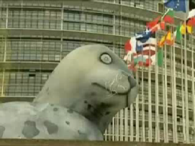
Reconciling Nationalist and Non-Nationalist Loyalties
European Seal Ban – May 2009
What are the some of the pros and cons of the seal hunt?
Pros:
Provide an income for Canadians
Preserves traditions ways of life
Controls seal population
Cons:
Killing innocent animals
Provokes international condemnation of Canada – Bad reputation!
What is the picture on page 84 displaying?
Read page 85, completing all the questions
Read Looking Ahead on page 85

Slide 2

What Are Non-Nationalist Loyalties?
Write out this concept (page 86) and its related meanings in your notebook
Individually, make a list of at least 10 of your loyalties, such as your family, friends, sports teams…

Slide 3
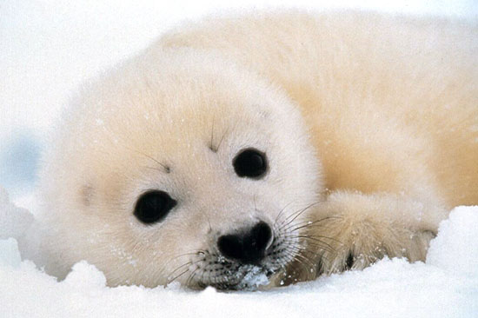
The Canadian Seal Hunt - Debate
To prepare for your debate, read the top part of page 86 – Including all the margin features
The left-hand side of the class will take the For side
The right-hand side of the class will take the Against side.
Each side will prepare up to five arguments
Discuss
Can this conflict ever be resolved?

Slide 4

The Nature of Loyalties
With a partner, examine the photographs and captions on page 87
Take a look at the loyalties you just made and categorize them as being Religious, Regional, Cultural, Ethnic or Class Based
With your partner, read page 88

Slide 5

And Finally…
Begin a list of terms from this chapter, which include…
Any term/phrase/concept that would be considered important in helping you with your …
E-Zine
Any suggestions as to what you should include?

Slide 6
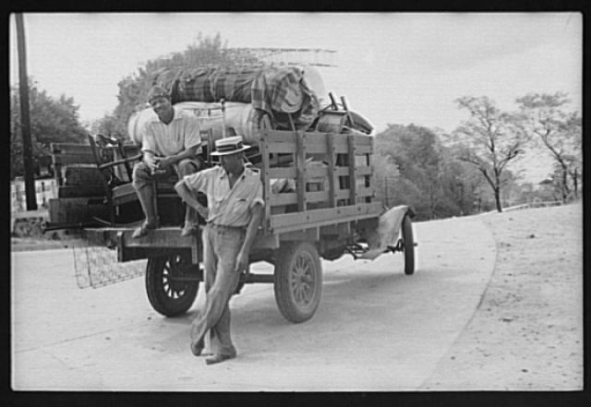
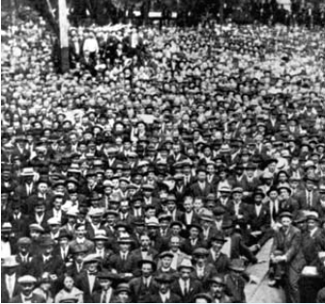
How Do Nationalist and Non-Nationalist Loyalties Contend?
When Class and Nationalist Loyalty Compete
What does “social-class” mean?
What assumptions are sometimes made about members of the upper class? The middle class? The lower – or working – class?
Why do people use labels like upper and lower class? How are they significant?
Why do people tend to pigeonhole others according to class?
Read page 89, responding to the Activity and answering the question from Figure 4-9

Slide 7
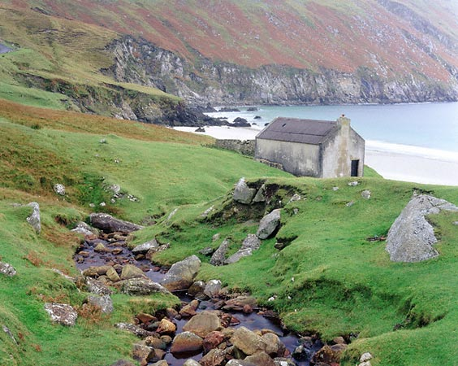

When Religious and Nationalist Loyalty Compete
Read all of page 90
Take jot-notes for this page
Pay close attention to all the margin features as you complete jot notes for the Activity
As you read….Listen

Slide 8

When Religious and Nationalist Loyalty Compete
The Irish Catholic vs. The Irish Protestant
Through the eyes of The Simpsons

Slide 9

When Regional and Nationalist Loyalty Compete
Get into groups of four…
Momentarily, you will be numbered off one through four. Each of you will go to one of the four assigned EXPERT groups and complete a brief summary. You will have approximately 15-20 minutes to do this.
  #1 – Oil, Gas and Regional Loyalty (Page 91) and A Class of Loyalties (Page 91)
  #2 – The National Energy Program (Page 92) and The Oil Sands and Loyalties (Page 92)
  #3 – The Oil Sands and Ideological Loyalties (Page 93)
  #4 – The Oil Sands and Cultural Loyalties (Page 94)
When finished, return to your original group of four and share your EXPERTISE with your other three group members. They will do the same for you. When you are done, your chart WILL be filled in and complete.

Slide 10
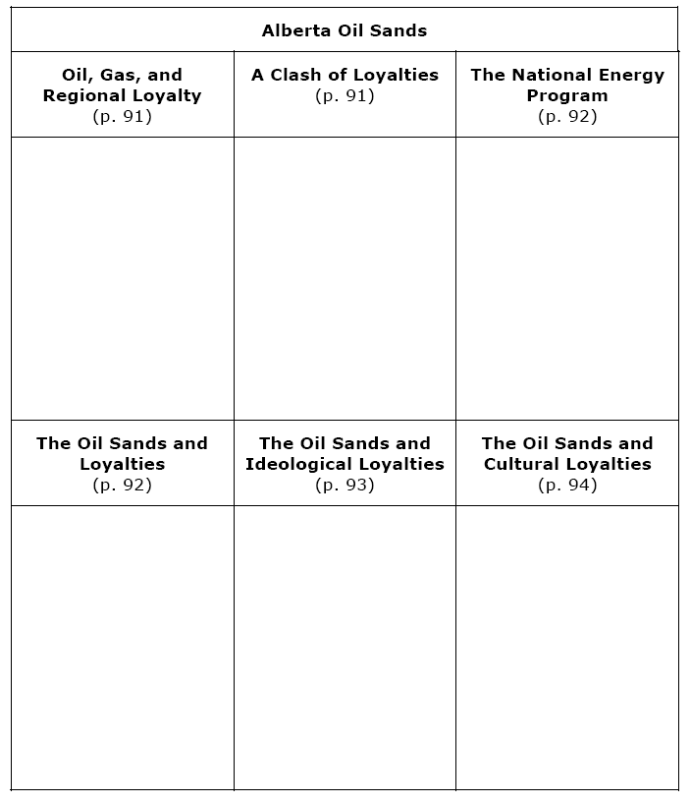
When Regional and Nationalist Loyalty Compete

Slide 11
And Finally…
Continue with your list of terms from this chapter, which include…
Any term/phrase/concept that would be considered important in helping you with your …
E-Zine
Any suggestions as to what you should include?

Slide 12
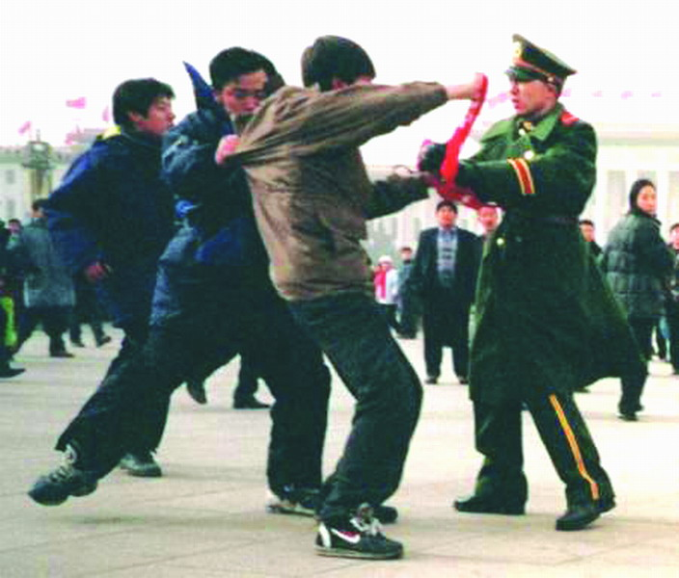
How Have People Reconciled Contending Nationalist and Non-Nationalist Loyalties?
What are examples of occasions where you may have had to struggle with contending loyalties?
How did they turn out?
Did you feel good about how they were resolved?
What would you do differently, if anything, if you had to go through it again?

Slide 13
How Have People Reconciled Contending Nationalist and Non-Nationalist Loyalties?
Read page 96
As you read, fill in Advantages and Disadvantages of the first two strategies listed on the handout
When done, grab a partner and fill in as many examples as you can think of

Slide 14
How has Michaelle Jean been able to reconcile her nationalist and non-nationalist loyalties?
When done, create a list of points in response to the question above
When done, read the top of page 98 and complete the chart
With your partner, read EVERYTHING on page 97
As you read, fill in Advantages and Disadvantages of the third strategy listed, using Jean as an example

Slide 15
And Finally…
Continue with your list of terms from this chapter, which include…
Any term/phrase/concept that would be considered important in helping you with your …
E-Zine
Any suggestions as to what you should include?

Slide 16


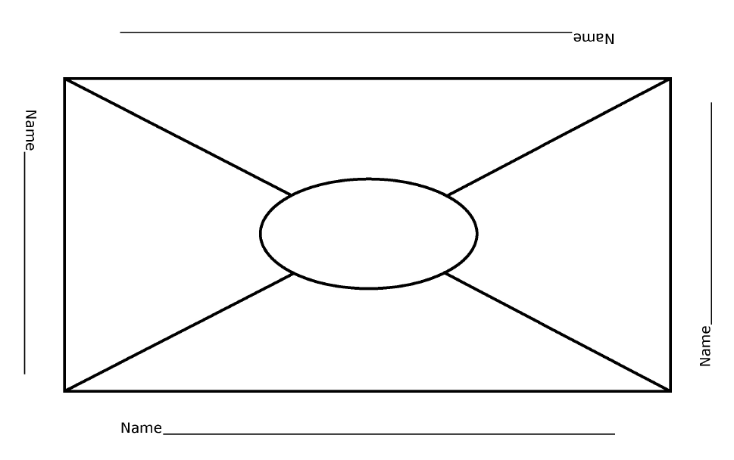
Bringing About Change
Little Rock Nine
In groups of 3 or 4, read the four sections from pages 99 – 101
Individually, using the ‘Placemat’ handout, record the main points for one of the four sections
When complete, decide as a group which points to record in the centre section

Slide 17
And Finally…
Complete your list of terms from this chapter, which include…
Any term/phrase/concept that would be considered important in helping you with your …
E-Zine
Any suggestions as to what you should include?

Slide 18
Skill Builder to Your Challenge
Should nation be the foundation of identity?
By the end of Chapter Three, you were to have completed names, headlines, visuals, captions and a paragraph!
Today, in part four of your Challenge, you are to take all the elements that you have already created and complete the steps on page 103.
Read these Steps on page 103

Slide 19

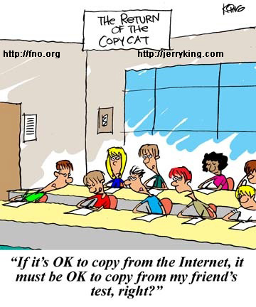
Your Challenges…
Are Due on Friday, October 1st
Library Day: Today… Thursday
(Bring Memory Sticks, Etc.)
Do you have the Rubric?
Your Related Issue #1 Exam…
Is Next Week – October 4th
I have a Review Handout…

Slide 20

Related Issue #1 Exam
Your exam for Related Issue One is an examination and interpretation of three sources
It will be marked according to the rubric provided to you (Writing Assignment I)
You will have the entire class to complete the exam
The three sources will be used to answer the following questions:
What ideas do each of the sources presented on the two pages communicate to you about nationalism?
AND
Considering the sources presented on the two pages, how much should the nation be the foundation of our own identity?

Slide 21
The Question: Specifics
What ideas do each of the sources presented on the two pages communicate to you about nationalism?
AND
Considering the sources presented on the two pages, how much should the nation be the foundation of our own identity?
Write a response in which you must
*interpret each source to identify what the source tells you about
national identity
*explain your position on how much the nation should be the foundation of our identity
*support your interpretations and position by referring to the sources and your understanding of social studies
Reminders for Writing
>Remember that you must answer both questions.
>Plan your response
>Organize your response to effectively address the assignment
>Refer to the sources as you write your response.
>Correct errors that you find in your writing.

