Slide 1

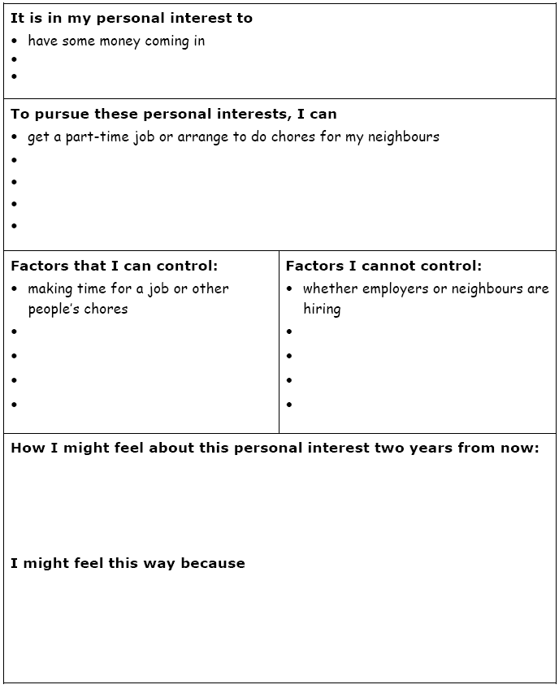
My Personal Interests
Brainstorm a list of your personal interests and how you might go about pursuing them
For example:
Professional Athlete
What would I have to do to become one?
Remember:
The best way to pursue our interests may involve things we may not like!
Take one or two of the Interests you just listed and complete the questions on the handout

Slide 2

Should Nations Pursue National Interests?
Turn to page 104 of your textbook
Review Related Issue #2 and the four chapters included
What is the connection between the related issue question, the individual chapter questions and each of the chapter inquiry questions?
Make a list of words you see on this page that are new to you
What are some of these words?

Slide 3
The Big Picture
Read the first two sentences on page 105
Do you think it is acceptable to pursue personal interests without considering the interests of others?
Would you act in your personal interests if doing so may result in harm to someone else?
For example…If you were late for an job interview and you saw a toddler walking down the street….All of you would hopefully sacrifice being on time for your interview to make sure the child was safely returned to his or her parents….

Slide 4
Canada’s Role In Afghanistan
Choose a number from 1 to 5 and write it down
With a partner, read all of page 105 – The Big Picture
As you read the bulleted points, consider Canada’s role in Afghanistan
How does each of the five bulleted items relate to Canada’s mission?
Write down up to two points for your assigned bullet

Slide 5
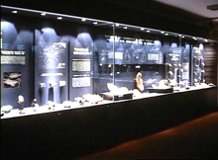
Your Challenge: Museum Display
Should Nations Pursue National Interests?
Review the top of page 106 – Your Challenge
Read the rest of page 106

Slide 6
Museum Display:
Evaluation
Review Evaluation Rubric
Each category is worth five marks for a total of /55

Slide 7
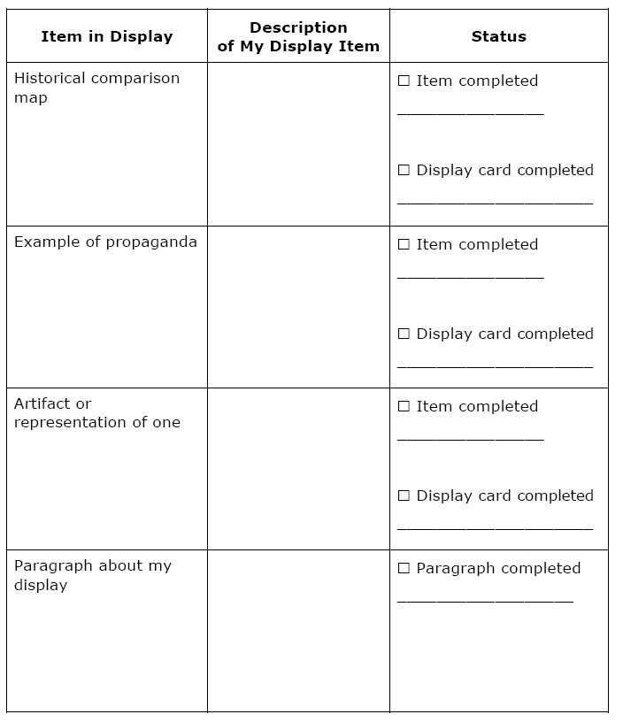
Tracking My Museum Display
Read all of page 107
Use this handout to monitor your progress as you develop each item in your museum display
I will be reviewing these handouts from time to time, so use them and don’t lose them!

Slide 8

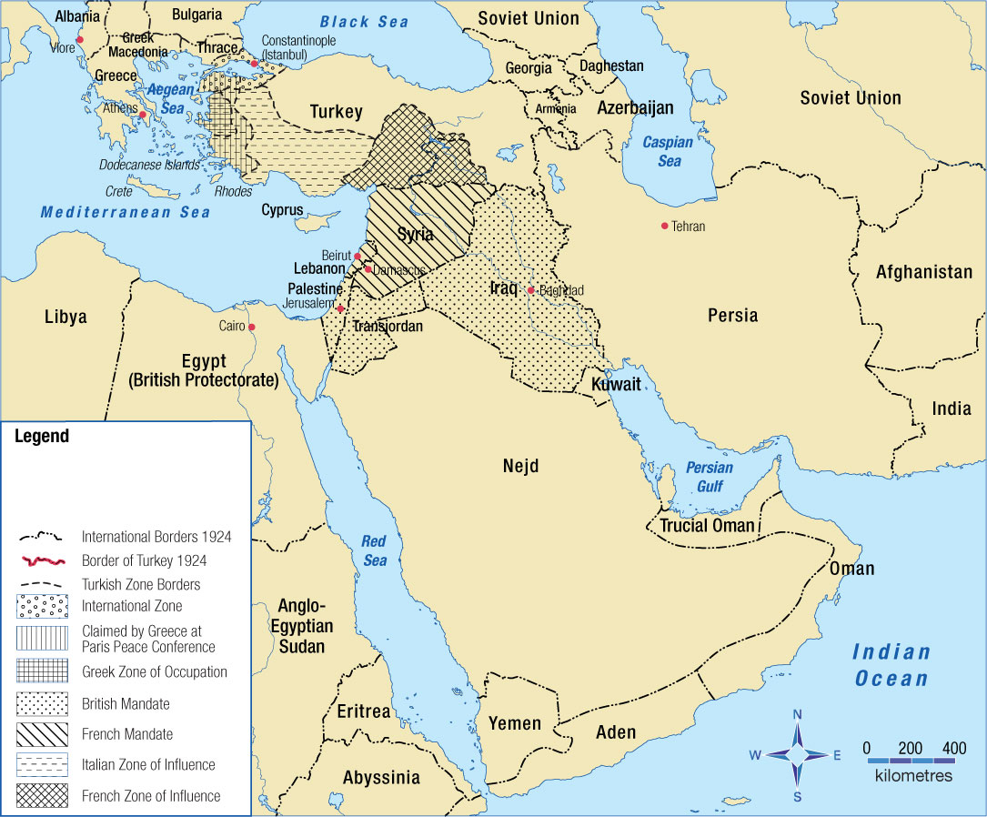
National Interest and Foreign Policy
What area of the world does the map show?
How do you know this?
What mapping conventions are used?
What does the map tell you about the region?
How do you know this?
What period of time does this map show?
How do you know this?
Examine this map and answer the following questions:

Slide 9
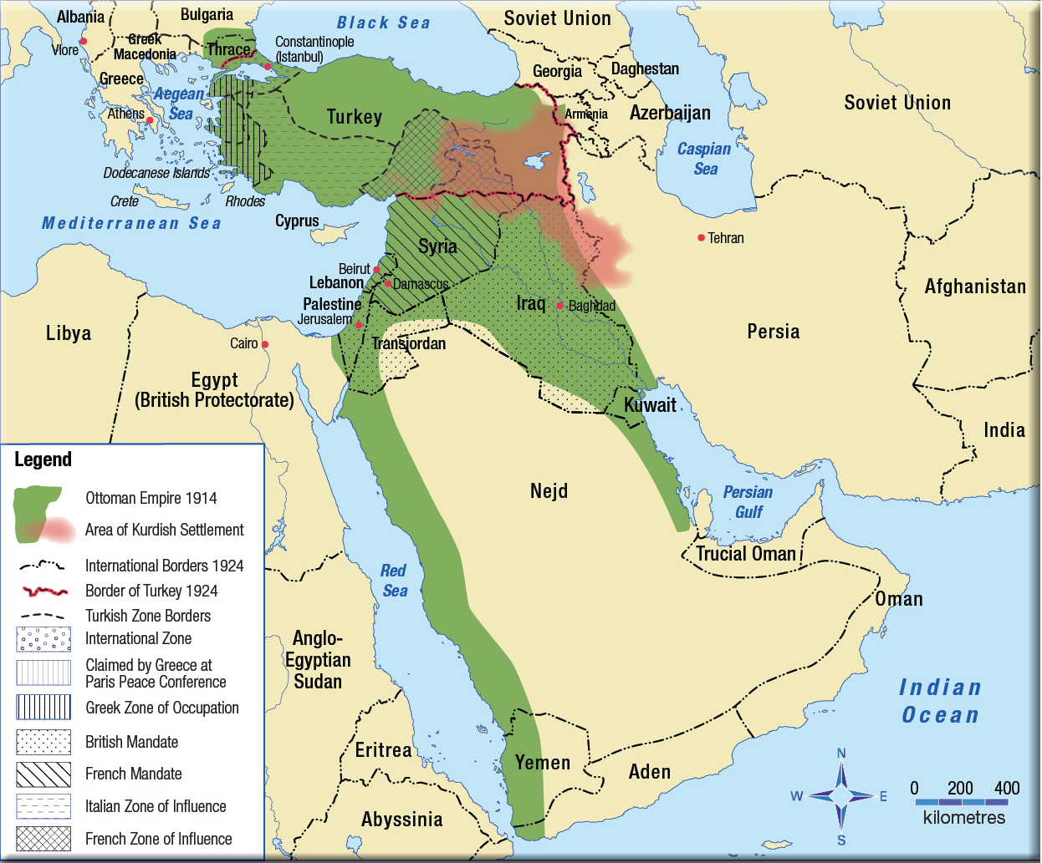
National Interest and Foreign Policy
What does the overlay add that was not on the previous map?
What mapping conventions are added?
What are the benefits and drawbacks of using one map with an overlay or just using two different maps?
Examine this map that is in your textbook that allows for two time periods to be shown at once Page 108

Slide 10
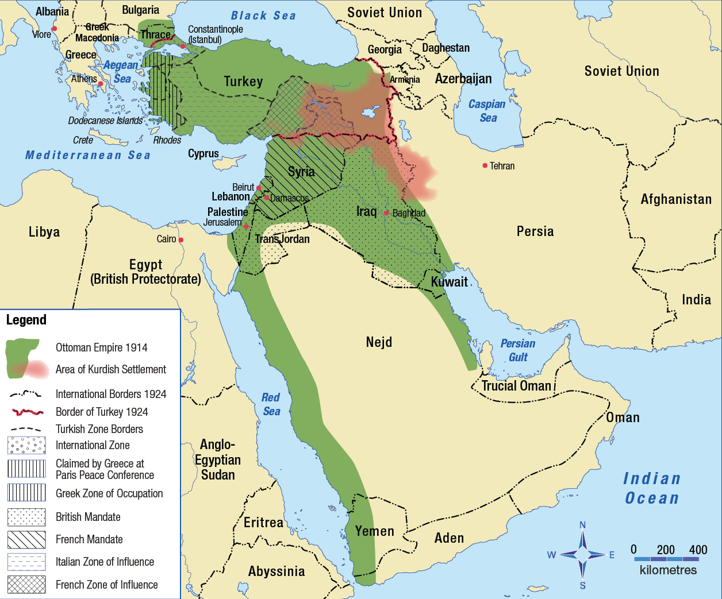
National Interest and Foreign Policy
What are some of the major changes to the Ottoman Empire that occurred after WWI?
How might people living in these areas have felt when the country they lived in was divided up and given a new name and government?
With a partner review page 109
Respond to the questions regarding the Middle East
Read Looking Ahead
This map shows the Middle East before and after World War I – Page 108

Slide 11


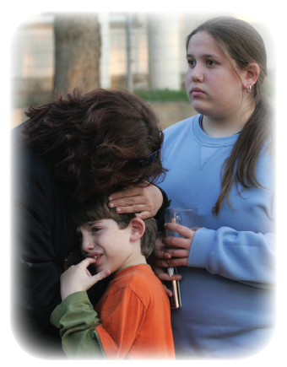
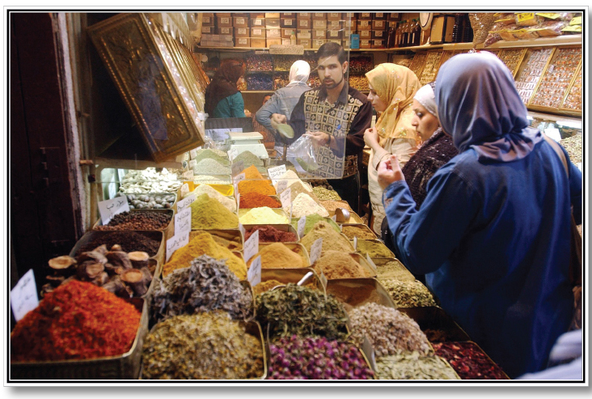
What is National Interest?
Read page 110
Represents an commitment to beliefs and values
Represents an interest in safety and security
Represents a desire for economic prosperity
Examine the photographs on page 110
What aspects of personal interest does each one portray? Is this also a national interest?
Complete the Activity on page 110

Slide 12
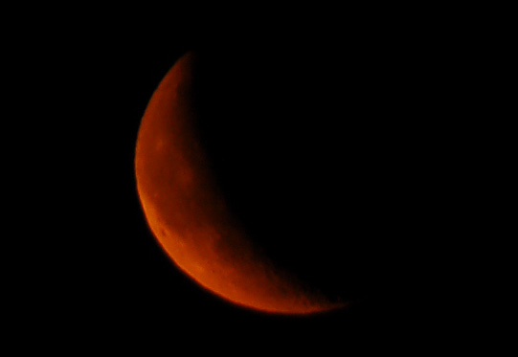
National Interest
Read page 111
What might happen if a nation failed to meet the need of Economic Prosperity?
Security and Safety?
Beliefs and Values?
Can a nation afford NOT to meet these three needs?

Slide 13
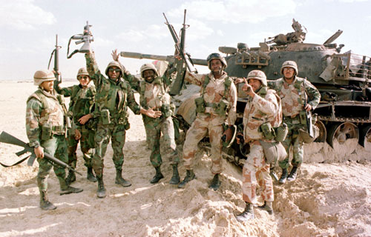

Differing Views on National Interest
Reread Kofi Annan’s words on page 112
Explain the difference between National Interests and Collective Interests
Can these two phrases mean the same thing, as Annan suggested?
How? Or Why Not?
Does Figure 5-6 illustrate Annan’s ideas?
Using the handout, read page 112 and take jot notes about each person’s point of view
If time, complete Recall, Reflect, Respond on page 112

Slide 14
And Finally…
Begin a list of terms from this chapter, which include…
Any term/phrase/concept that would be considered important in helping you with your …
Museum Display
Any suggestions as to what you should include?

Slide 15
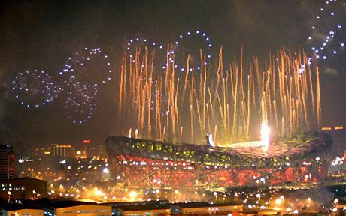

How Are Nationalism and National Interest Related?
National Interest
What do you think we will be exploring in this section of chapter five?
Read the opening paragraph on page 113
How can Nationalism inspire people to take action on their nation’s behalf?

Slide 16

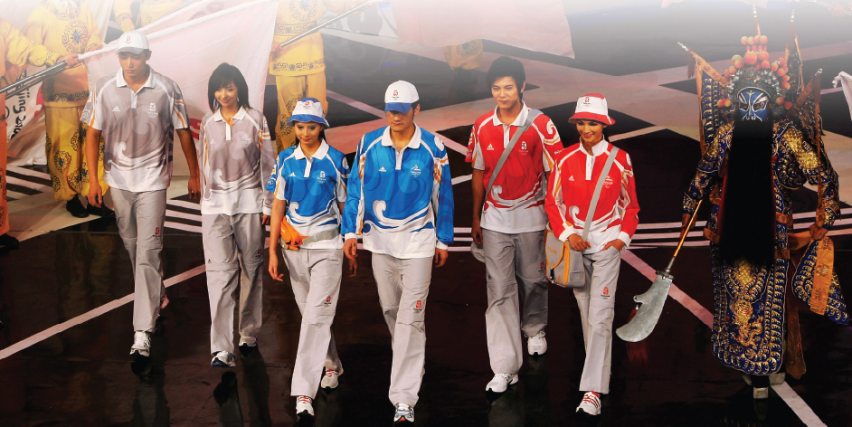
2008 Beijing Olympics
Review the photographs on page 113
Read the rest of page 113
Why are they protesting?
Were either of these actions inspired by nationalism?
Protesters want self-determination for Tibet
The Chinese government wants China to be seen as a world power and bring glory to China
What are the students doing?

Slide 17
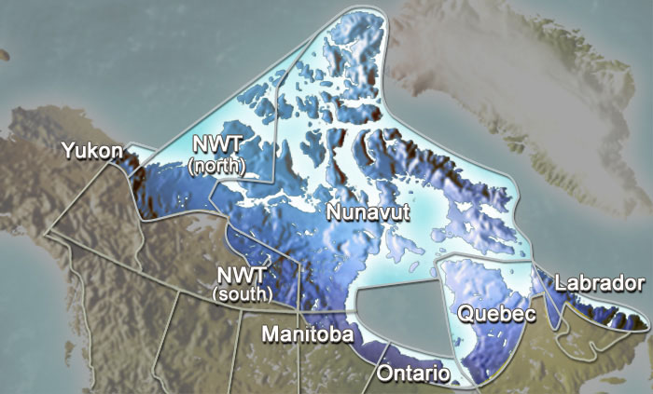
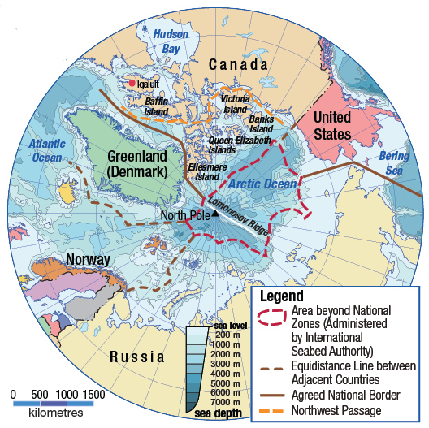
National Interest and Arctic Sovereignty
Scan the margin features on pages 114-115
Predict what the content of the reading is about
Read pages 114 - 115
Is it in Canada’s national interest to claim the Northwest passage? Why?
What arguments might the government use to claim the Northwest Passage for Canada?
Should Canada maintain a military presence in the Arctic?
Review this illustration on page 114
How should the issue of Arctic sovereignty be resolved?

Slide 18
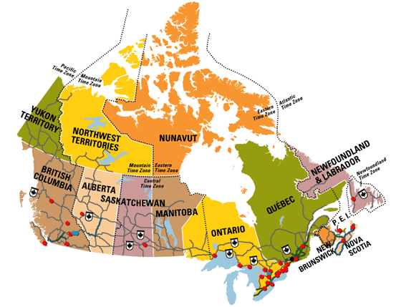
Which has more visible features, Southern Canada or Northern Canada?
Why?
Which area do you know less about?
Why should you care about a part of Canada that you know little about and few Canadians ever visit?

Slide 19
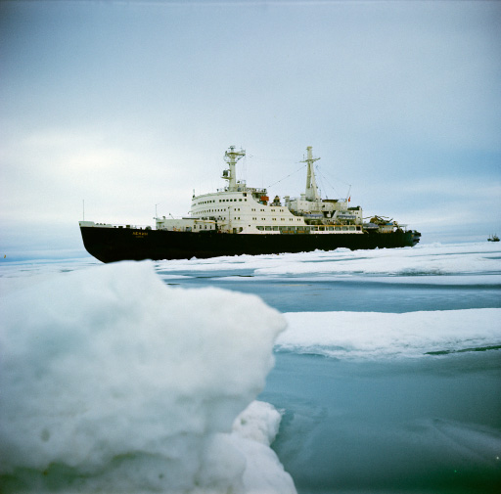
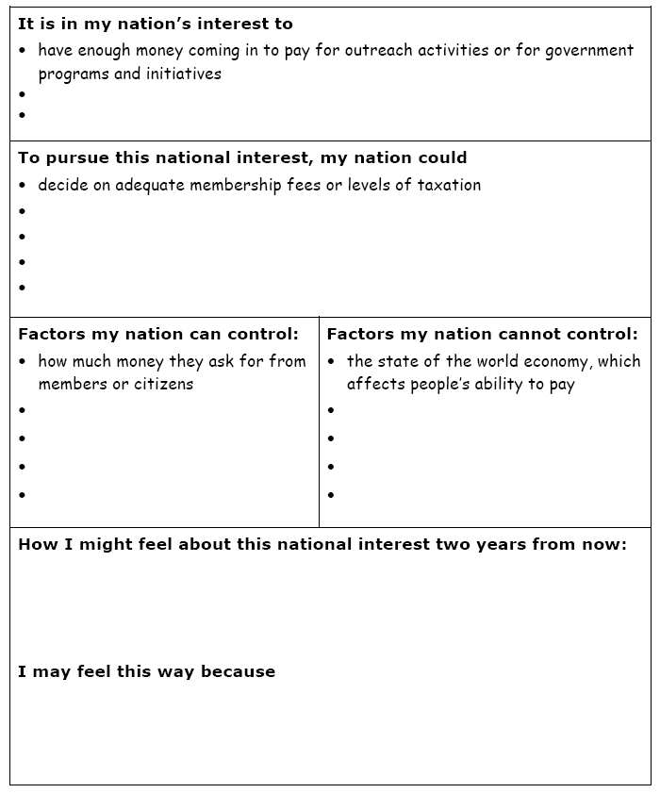
In The National Interest
Read over and complete the handout
Remember, your use of the word Nation may be Canada or some other group or collective to which you belong
Complete the Recall Reflect Respond on page 115 when your finished the worksheet

Slide 20
And Finally…
Continue with your list of terms from this chapter, which include…
Any term/phrase/concept that would be considered important in helping you with your …
Museum Display
Any suggestions as to what you should include?

Slide 21
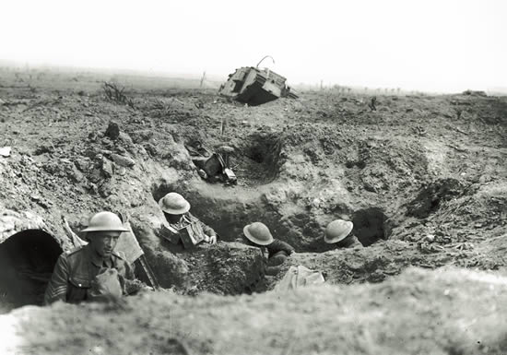
How Has National Interest Shaped Foreign Policy?
What are some of our school policies?
Read the opening paragraph on page 116
Nations, just as schools, have policies to help them make decisions
Read over the ‘exploding concept’ Policy in the margin and read the rest of the introduction on page 116
When complete, create your own ‘exploding concept’ for both Domestic Policy and Foreign Policy
Read the rest of page 116
Ignore the Activity

Slide 22
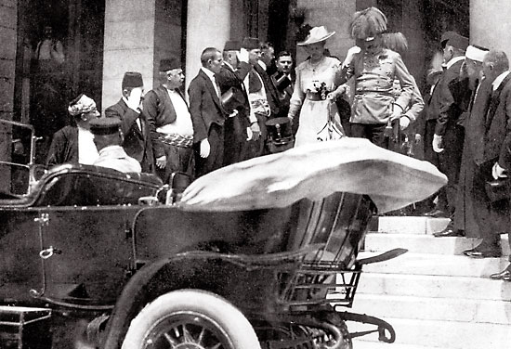
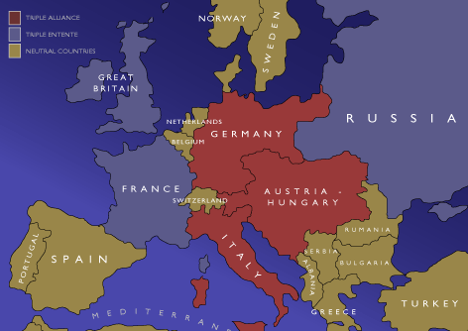
Causes of World War One
Read pages 232 – 237 of the handout
Complete all questions on pages 235 and 237
Use the map handout to assist you
The First World War: To Arms - 1914
(35 minutes)

Slide 23

Causes of World War I -
MANIA
M
A
N
I
A
ilitarism – policy of building up strong military forces to prepare for war
lliances - agreements between nations to aid and protect one another
ationalism – pride in or devotion to one’s country
mperialism – when one country takes over another country economically and politically
ssassination – murder of Austrian Archduke Franz Ferdinand

Slide 24
Causes of WWI - Militarism
Total Defense Expenditures for the Great Powers [Ger., A-H, It., Fr., Br., Rus.]
in millions of £s (British pounds).
1870 | 1880 | 1890 | 1900 | 1910 | 1914
94 | 130 | 154 | 268 | 289 | 398
 | 1910-1914 Increase in Defense Expenditures
France | 10%
Britain | 13%
Russia | 39%
Germany | 73%

Slide 25






Causes of WWI - Alliances
Triple Entente:
Triple Alliance:
Great Britain
Germany
France
Austria-Hungary
Russia
Italy

Slide 26
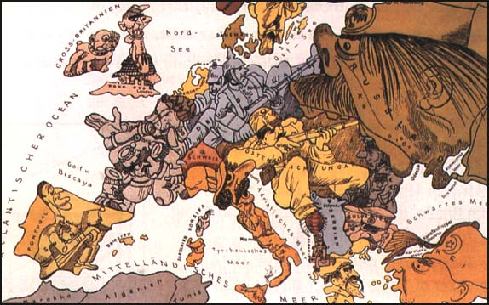
Causes of WWI - Nationalism

Slide 27




Causes of WWI - Nationalism
Pan-Germanism - movement to unify the people of all German speaking countries
Germanic Countries
Austria *
Belgium
Denmark
Iceland
Germany *
Liechtenstein*
Luxembourg
Netherlands
Norway
Sweden
Switzerland *
United Kingdom
* = German speaking country

Slide 28
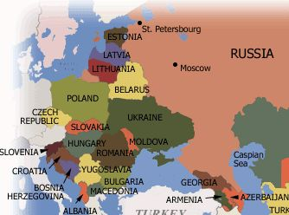
Causes of WWI - Nationalism
Pan-Slavism - movement to unify all of the Slavic people

Slide 29
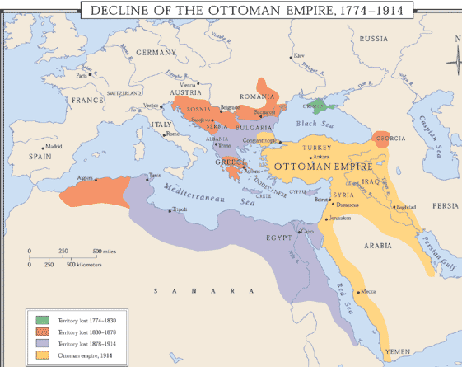
Causes of WWI - Imperialism

Slide 30
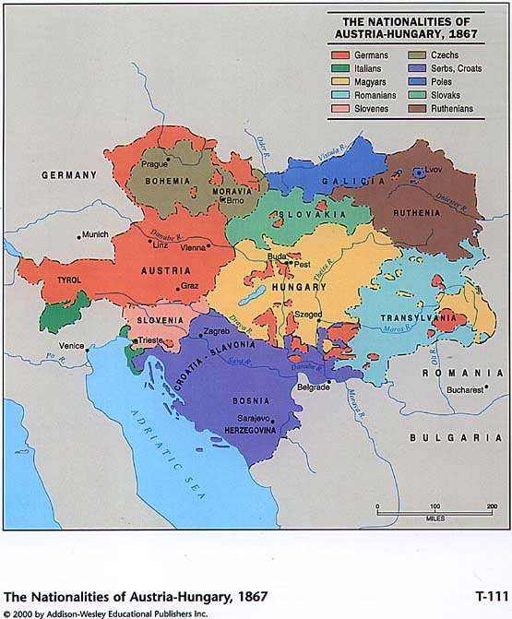
Causes of WWI - Imperialism

Slide 31
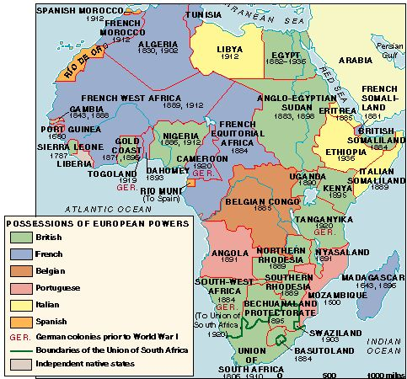
Imperialism: European conquest of Africa

Slide 32

The
“Spark”

Slide 33
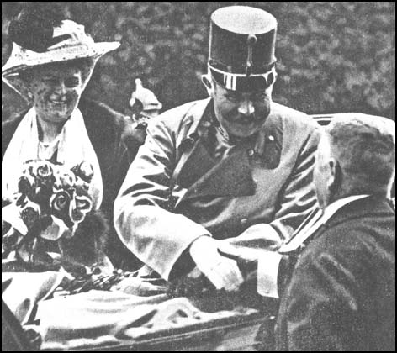
Causes of WWI - Assassination
Archduke Franz Ferdinand and Duchess Sophie at Sarajevo, Bosnia, on June 28th, 1914.

Slide 34
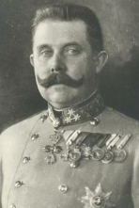
Causes of WWI - Assassination

Slide 35
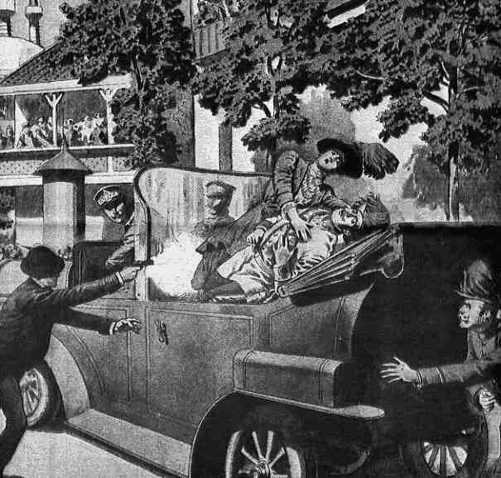
Causes of WWI - Assassination
Austrian Archduke Franz Ferdinand was killed in Bosnia by a Serbian nationalist who believed that Bosnia should belong to Serbia.

Slide 36
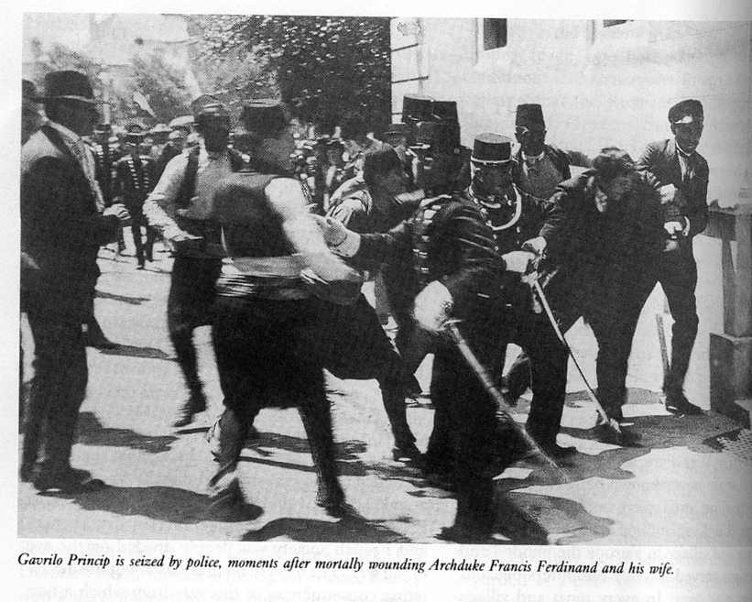
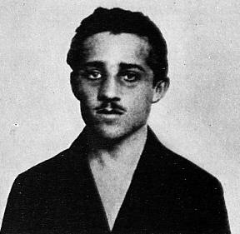
Causes of WWI - Assassination
Gavrilo Princip after his assassination of Austrian Archduke Franz Ferdinand.

Slide 37
The Point of No Return: The Assassination of Archduke Franz Ferdinand
Austria blamed Serbia for Ferdinand’s death and declared war on Serbia.
Germany pledged their support for Austria -Hungary.
· Example of Pan-German nationalism
Russia pledged their support for Serbia.
· Example of Pan-Slavic nationalism

Slide 38
The Point of No Return: The Assassination of Archduke Franz Ferdinand
Germany declares war on Russia.
France pledges their support for Russia.
Germany declares war on France.
Germany invades Belgium on the way to France.
Great Britain supports Belgium and declares war on Germany.

Slide 39

Allied Powers:
Central Powers:
Germany
Great Britain
World War I
France
Austria-Hungary
Russia
Ottoman Empire
Italy

Slide 40

How Nationalism played a role in Germany… A theatrical example
Complete handout as you watch
132 Minutes

Slide 41
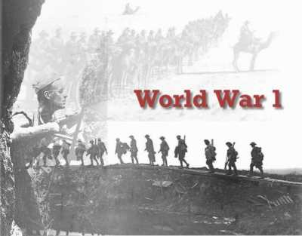
National Interest and World War One Peace Settlements
The First World War: War Without End
(28 minutes)
Get into groups of five…
Momentarily, you will be numbered off one through five. Each of you will go to one of the five assigned EXPERT groups and complete a brief point-form summary. You will have approximately 15-20 minutes to do this.
You must have a minimum of three points per section!
Ignore Activities
  #1 – World War One (top half of page 117)
  #2 – Treaty Negotiations in France (page 117)
  #3 – National Interests after World War One (top half of page 120)
  #4 –National Interests in the Middle East (page 120)
  #5 – National Interest and Policy in the Middle East (page 121)
When finished, return to your original group of four and share your EXPERTISE with your other four group members. They will do the same for you. When you are done, you will have information on all five readings

Slide 42
National Interest and World War One Peace Settlements
Review the FYI on page 117
Many historians have said that Canadian Nationalism was born on the battlefield of World War One
German Nationalism was also born during this time, but for entirely different reasons
Examine the handout Some Terms of the Treaty of Versailles
Can some forms of nationalism be healthy, while others are not?

Slide 43
Nationalism as a Major Cause of World War One
Much of the origin of the war was based on the desire of the Slavic peoples in Bosnia and Herzegovina to no longer be part of Austria- Hungary but instead be part of Serbia. In this way, nationalism led directly to the War.
In a more general way, however, the nationalism of the various countries throughout Europe contributed not only to the beginning but the extension of the war in Europe. Each country tried to prove their dominance and power.

Slide 44
Complete #1 and #3 of Recall, Reflect, Respond on page 121

Slide 45
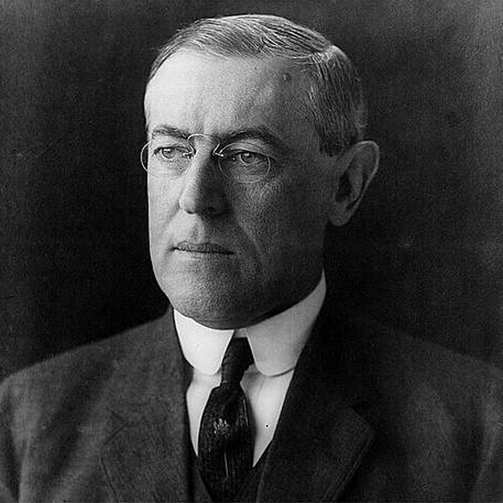
Read Woodrow Wilson: Visionary or Dreamer?
Page 118
Complete #1 and #3 of Explorations at the bottom of the page
When finished, complete #1 and #3 of Recall, Reflect, Respond on page 121

Slide 46
And Finally…
Continue with your list of terms from this chapter, which include…
Any term/phrase/concept that would be considered important in helping you with your …
Museum Display
Any suggestions as to what you should include?

Slide 47

How Nationalism played a role
with the Allies (Australia)…
A theatrical example
Complete handout as you watch
111 Minutes

Slide 48
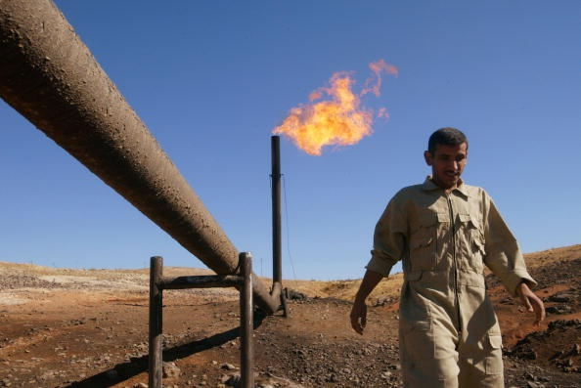
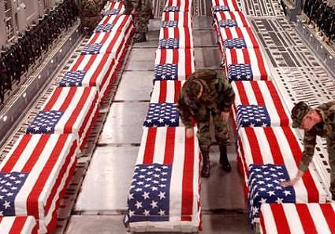
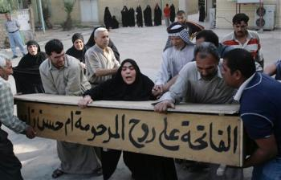


Oil and National Interest In Iraq
What do you know about the history of Oil in Iraq?
What do you know about the Iraq War of 2003?
What do you know about the Iraq War in 2009?
With a partner open to pages 122-123 and read the introduction and the passages under each heading
As you read, in a sentence or two, summarize each of these sections
Be certain you title each of the five sections
(Section #1 is the Introduction)
When complete, check your summaries with another group – revise as needed!
Complete #1 and #3 of Explorations on page 123

Slide 49
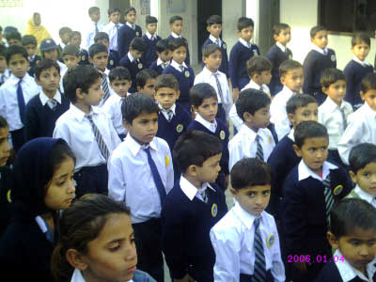
How Has Foreign Policy Shaped National Interest?
Imagine that our principal has decided to put in place a school policy that all students must wear uniforms.
How might this affect students’ ability to express their culture and individuality through their choice of clothing and accessories?
Imagine another school policy that would place a security camera at every entrance and in every hallway and classroom.
How might this policy decision affect the safety and security of students? Their behaviour? Their right to privacy?
Foreign Policies can have similar effects on a country’s citizens
Read the opening two paragraphs on page 124

Slide 50
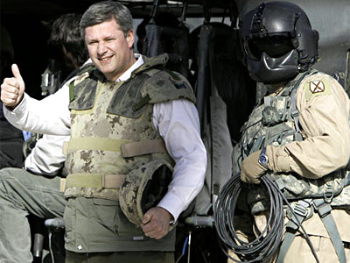
“Should Canada Continue To Support The Military Mission In Afghanistan”
Read the five sections on pages 124- 127 in order to prepare yourself for a
TAG Debate
The left-hand side of the class will take the YES side
The right-hand side of the class will take the NO side.
Give your handout the title above and use it to collect information supporting both sides of the argument, so you will be prepared to refute these points during the debate
YES
NO
What are you waiting for…?

Slide 51
“Should Canada Continue To Support The Military Mission In Afghanistan”
A Debate
Four students, two from each side, begin to debate. Either side may start and from this point on, the two sides take turns refuting the position taken by the opposing side.
Once the debate has started, the remaining students may ‘tag’ into the debate by touching the shoulder of a participating member of their team. Or I (the moderator) may choose to stop the debate at any time and require that a ‘tag’ take place.

Slide 52
And Finally…
Complete your list of terms from this chapter, which include…
Any term/phrase/concept that would be considered important in helping you with your …
Museum Display
Any suggestions as to what you should include?

Slide 53
Skill Builder to Your Challenge
With one other person, work through the Steps on page 129

