Slide 1
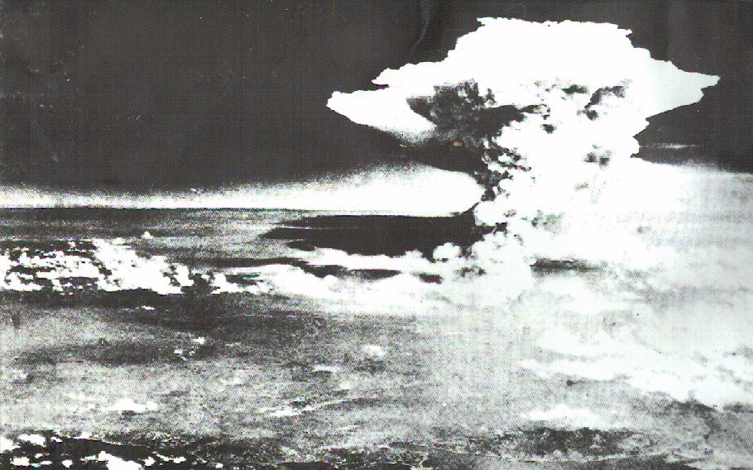
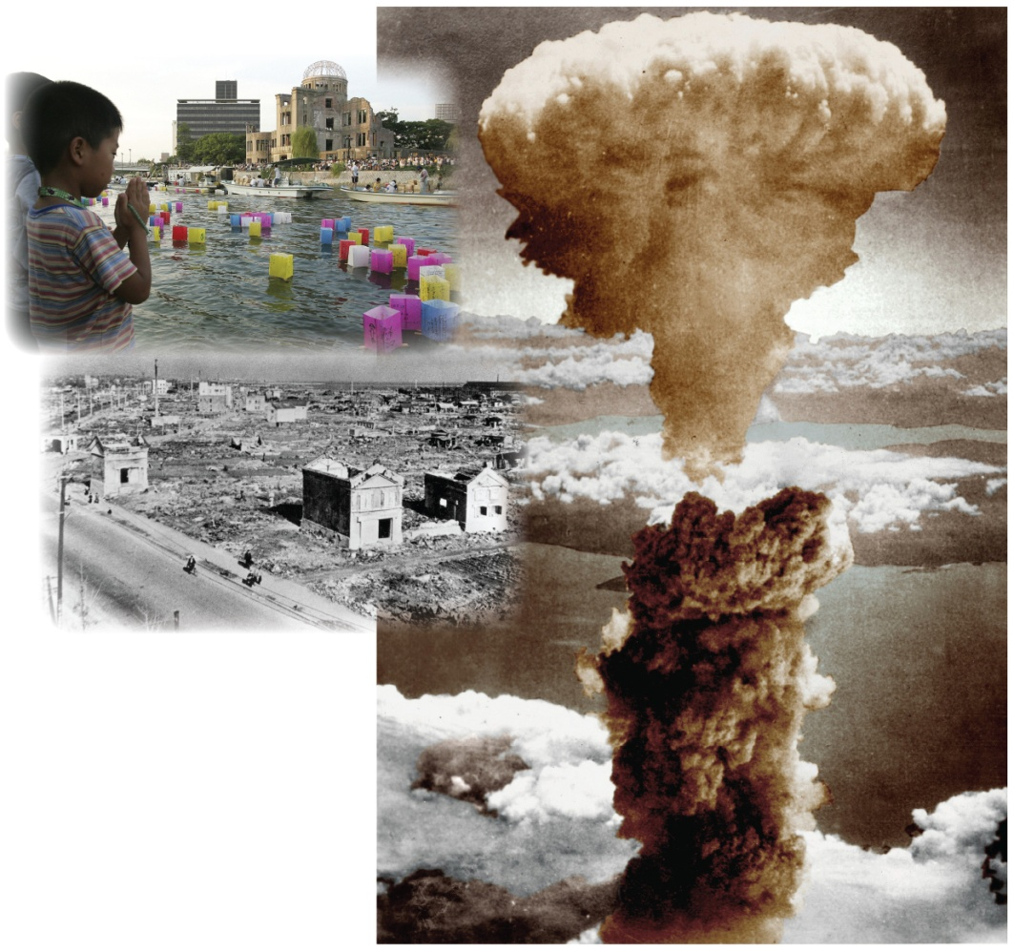
Ultranationalism and Crimes Against Humanity
Read the caption on page 152
Read the introduction on page 153
Find a partner and work through the questions
and
Review the Key Terms by writing out a guess of what you think each of them means
What do you see?
What do you think happened?

Slide 2
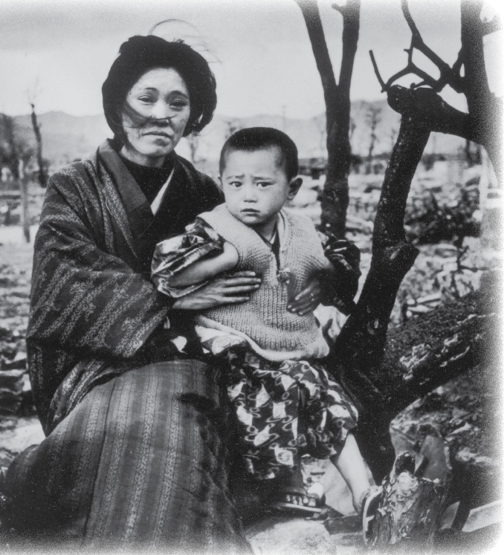
What Are Crimes Against Humanity?
Crimes
Using an ‘exploding concept’, create a list of definitions and examples that explain this term
Crimes Against Humanity
Create an ‘exploding concept’ that explain your understanding of this phrase
Check your response with the example on page 154

Slide 3
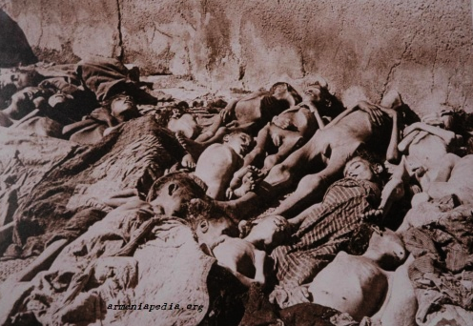


What Are Crimes Against Humanity?
Screamers: An Introduction
As an introduction to Crimes Against Humanity, including Genocide, we’ll be watching the following documentary

Slide 4
Crimes Against Humanity
“Our strength lies in our intensive attacks and our barbarity...After all, who today remembers the genocide of the Armenians?”
Adolf Hitler
Handout

Slide 5
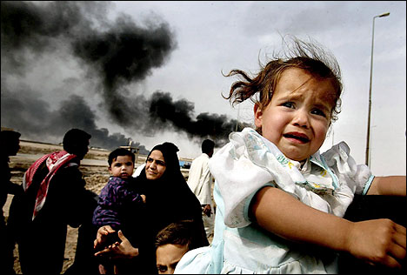
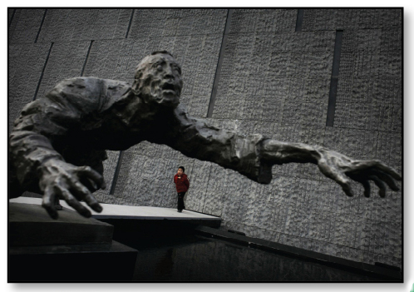
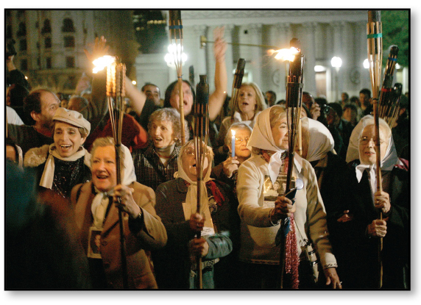
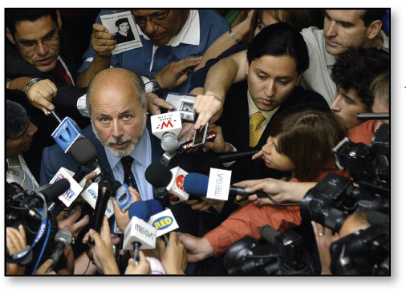
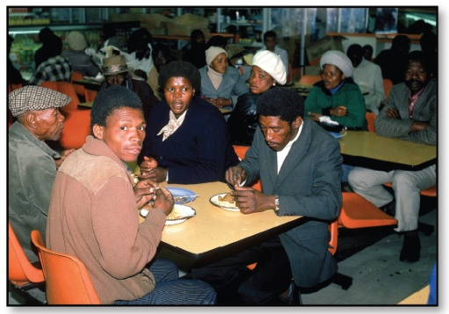
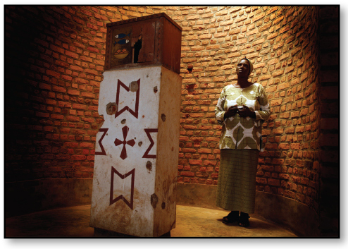
What Are Crimes Against Humanity?
Turn to the photo’s on pages 154-155
Read the introduction on page 154
Read the caption
What does the photograph show?
What happened – what is the photograph context?
Did the event take place in wartime or peacetime?
Does the photograph portray or imply an ‘other’? If so, who or what is it? How is this ‘otherness’ portrayed
How does the photograph make you feel? Does it make you want to take action?

Slide 6
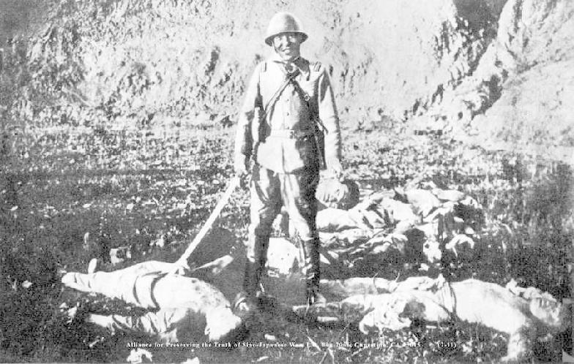
The Nanjing Massacre
Read the rest of page 154, including Voices
Chinese civilians who died at Nanjing in a six week period:
300 000
Canadian who died during all of World War II:
45 000

Slide 7
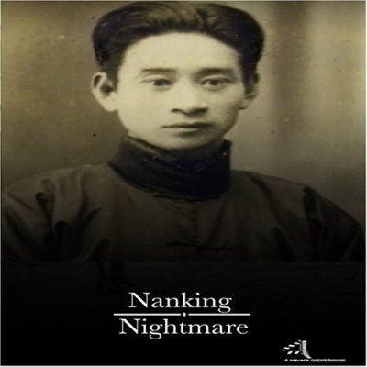
Nanking Nightmare
Personal insight into the 1937 Genocide at Nanking
46 Minutes

Slide 8
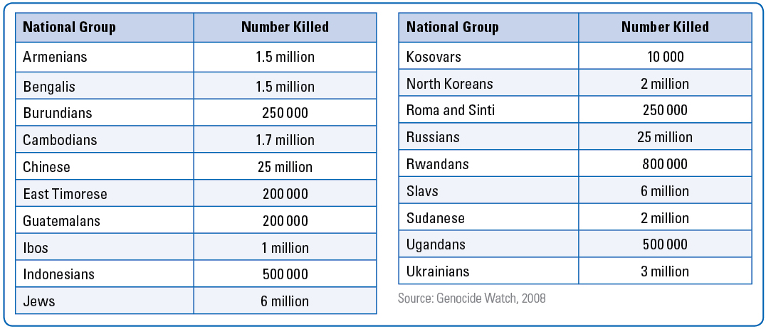
Naming The Crimes
With a partner, read page 155
As you read, compare the definitions you made with those created by the International Court of Justice
Note the similarities and differences
Review Voices (page 155) and the chart below
Why do you think the thousands of Japanese killed by the atomic bomb were not included in the chart?
Estimated Victims of Genocide and Mass Murders in the 20th Century

Slide 9
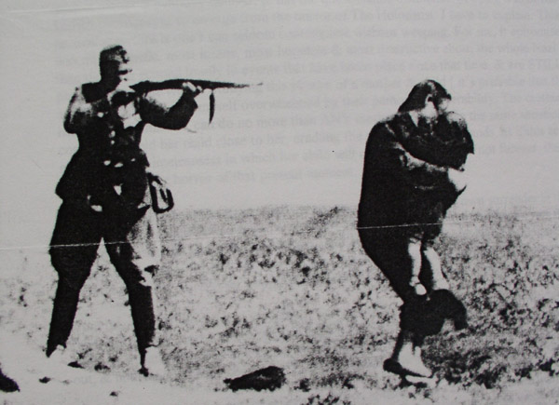
From Ultranationalism to Crimes Against Humanity
What does this word mean in context?
Read Voices (Pg. 156)
What do the two ‘human’ words mean in context?
Read the opening two paragraphs and identify where ‘human’ occurs
Respond to Figure 7-7 and read the rest of page 156
When done, complete #2 and #3 of the Recall Reflect Respond

Slide 10
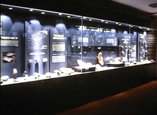
And Finally…
Begin a list of terms from this chapter, which include…
Any term/phrase/concept that would be considered important in helping you with your …
Museum Display
Any suggestions as to what you should include?

Slide 11
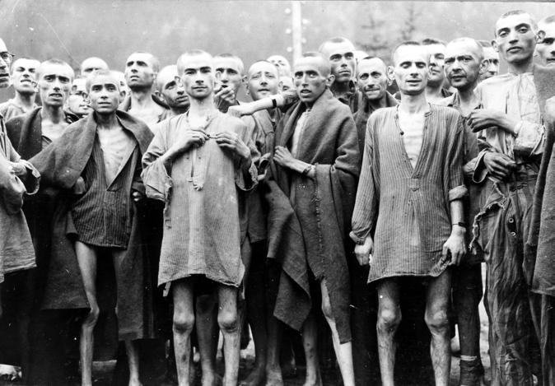
How Has Ultranationalism Caused Crimes Against Humanity?
If you want to belong, go along with the crowd
Do you agree or disagree with the statement above?
Give examples when this was true for you
In an open vote in class, have you ever changed your vote because of how everyone else was voting?
Do you wear certain styles of clothing or accessories because other people do?
Because you want to separate yourself from certain groups?
Have you ever acted unlike your usual self at a party? At a sporting event? At the mall?
Somewhere else?
Have you ever gone to a movie or concert you couldn’t afford so you could be with your friends?
Have you ever made fun of someone — to his or her face or in private — because other
people were doing so?
Read the opening half of page 157

Slide 12
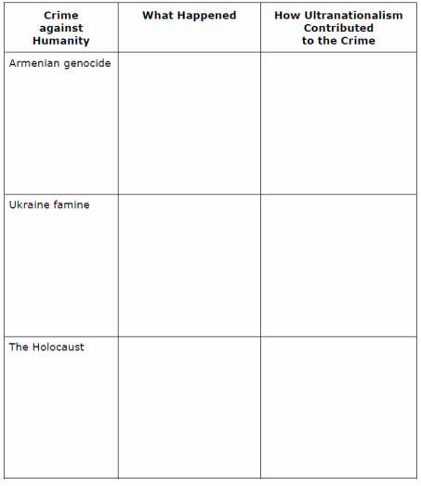
How Has Ultranationalism Caused Crimes Against Humanity?
Get into groups of three…
Momentarily, you will be numbered off one through three. Each of you will go to one of the three assigned EXPERT groups and complete a brief summary using the handout
Ultranationalism and Crimes Against Humanity.
You will have approximately 15-20 minutes to do this.
  #1 – Armenian Genocide (Pages 157-158)
  #2 – Ukrainian Famine (Page 159)
  #3 – The Holocaust (Pages 160-161)
When finished, return to your original group of three and share your EXPERTISE with your other two group members. They will do the same for you. When you are done, you will have information on all three readings
After reviewing the three events, compare the role that ultranationalism played in each
Rank each set of events on a scale of 1 to 5
(1 = No Link to Ultranationalism - 5 = Strong Link to Ultranationalism)

Slide 13
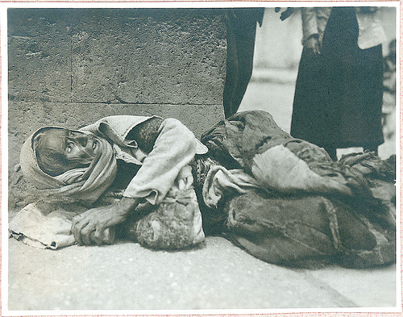


The Armenian Genocide
A Story of Over One Million Deaths
Armenian Genocide 5:30
60 minutes

Slide 14
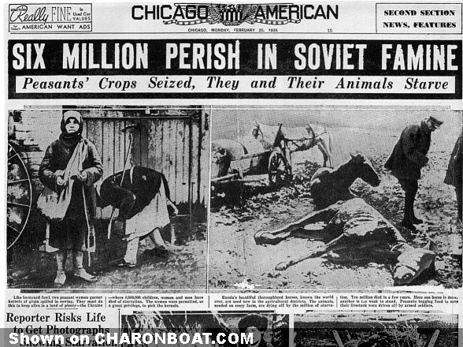


Harvest of Despair
A Story of Seven Million Deaths
Ukrainian Famine
3:00
55 minutes

Slide 15
Crimes Against Humanity
As you have just appreciated, there have been numerous historical events that fit into the category of Crimes Against Humanity
Right now, we’re going to look at five questions related to your recent textbook readings
The class will be divided up into five groups, each group will (initially) be responding to one of the questions below. After being assigned a group, write out the corresponding question at the top of your chart paper. You will be given 4-5 minutes to write a group response.
1. Why is it important to many survivors of genocide that their experience be recognized and remembered?
2. Photographs of crimes against humanity can be highly disturbing because they show terrible suffering.
Should some of these photographs have been included in Understanding Nationalism? Why or why not?
3. Why might a government deny that a genocide occurred?
4. Hitler may have used the Armenian genocide as his model for the Holocaust.
If the international community had quickly condemned the Armenian genocide, would Hitler have changed his plans? Why or why not?
5. Will contemporary communication systems make genocide impossible in the future?
When all groups are done, your group will trade chart papers with another group that is complete
Complete this process until you have read all five sections
Discuss

Slide 16
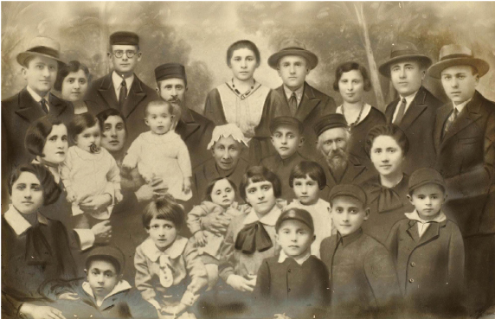
Shoah – The Holocaust
Read the opening information and review Figure 7-11 and its caption on page 160
How might it have affected Josef Pitel to be the sole survivor in his family?
Why is it important that his photograph exists?
What might have happened to other victims’ stories and memories if there were no photographs or written accounts of their tragedy?

Slide 17
Shoah – The Holocaust
Read (or re-read) pages 160-161
With a partner, respond to Explorations

Slide 18


The Last Days
The Story of Five Survivors
A Preview
3 minutes

Slide 19
The Last Days
The Story of Five Survivors
87 minutes

Slide 20
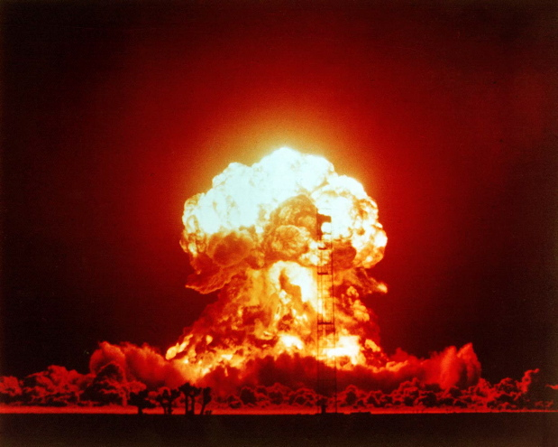
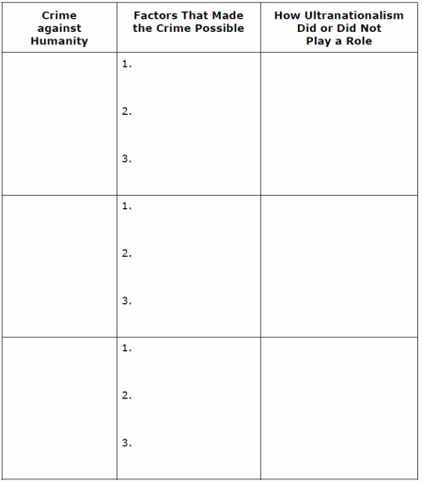
The Bombing of Hiroshima and Nagasaki 1945
Read the opening two paragraphs on page 162
Was the United States justified in dropping the atomic bombs?
Read the rest of page 162
Did you change your mind?
Using the handout, complete questions 1 and 2
in the Recall, Reflect, Respond on page 162

Slide 21
And Finally…
Continue with your list of terms from this chapter, which include…
Any term/phrase/concept that would be considered important in helping you with your …
Museum Display
Any suggestions as to what you should include?

Slide 22
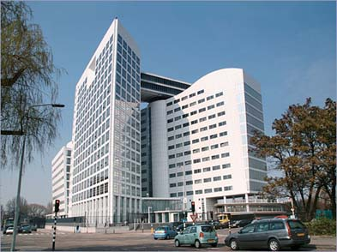
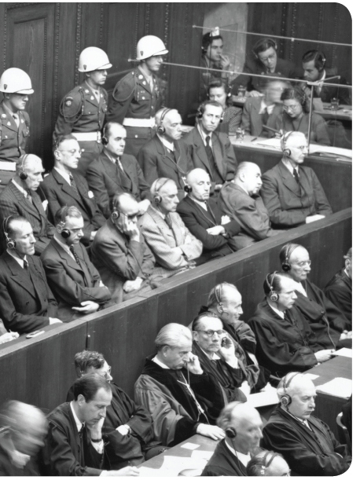
Why Was The International Criminal Court Created?
Read the caption to Figure 7-14 on page 164 and respond to the question
With your partner, read page 164
As you read and complete the Activity, keep in mind the question above
How did you respond to the Activity?

Slide 23
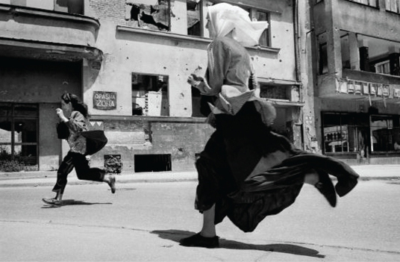
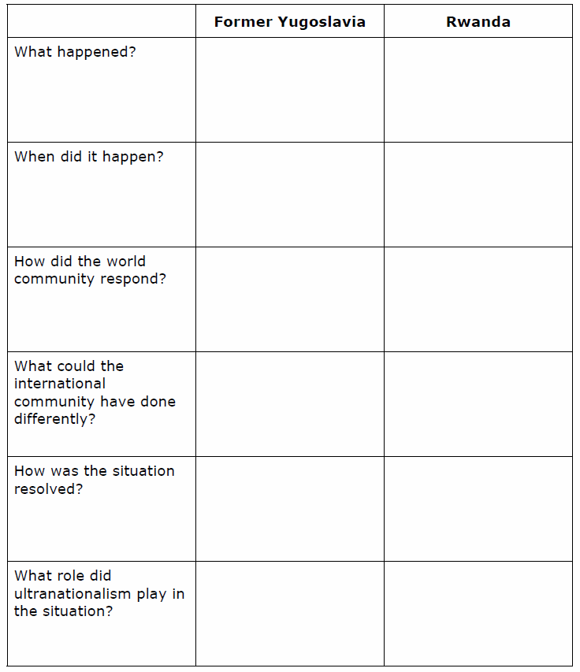
What lessons did people learn from the Holocaust?
Contemporary Examples of Crimes Against Humanity
Respond to the above question with at least five points
In groups of 2-3, read the sections titled
Crimes against Humanity in the Former Yugoslavia
and
Crimes Against Humanity in Rwanda
As you read, complete the handout
Contemporary Examples of Crimes Against Humanity

Slide 24
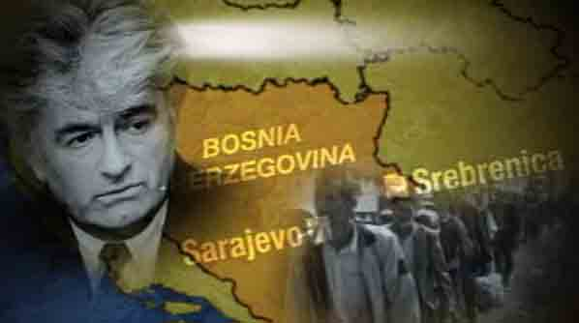
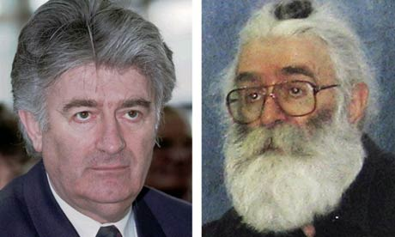
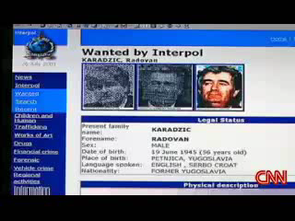
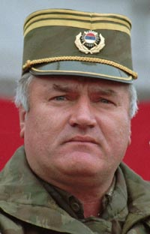
Crimes Against Humanity in the Former Yugoslavia
Radovan Karadzic, Europe's most wanted man, arrested for war crimes
Arrested after 13 years on the run - CNN
July, 2008
As of November, 2009, Ratko Mladic, Karadzic’s army chief, is still at large

Slide 25

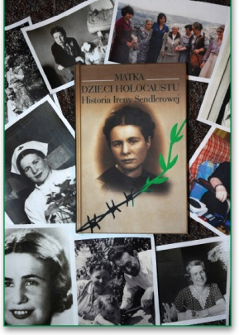
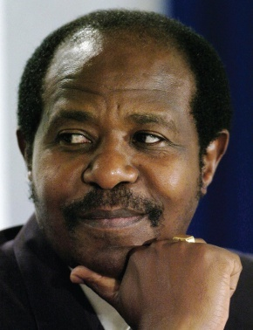
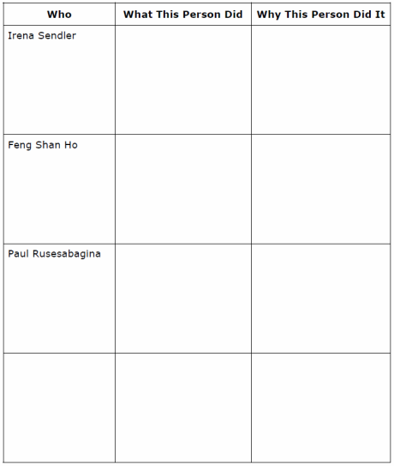
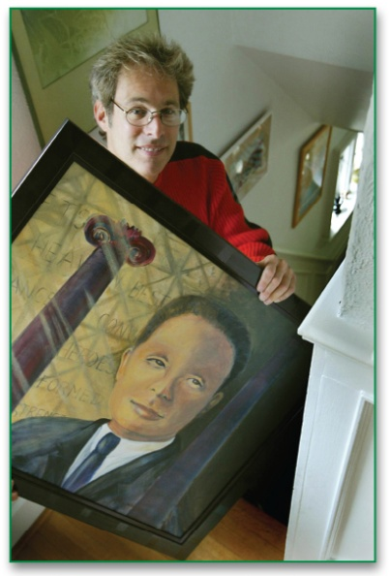
Acting For Good in the Face of Evil
Think about a situation where you helped someone in need
Why were you helpful in this situation?
Think of a situation where you did not help someone in need
Why were you not helpful in this situation?
How did you feelings compare in these two situations?
With a partner, read pages 168-169
Complete the handout
Add an example of your own
choosing

Slide 26
And Finally…
Complete your list of terms from this chapter, which include…
Any term/phrase/concept that would be considered important in helping you with your …
Museum Display
Any suggestions as to what you should include?

Slide 27
Skill Builder to Your Challenge
Present an Artifact
Work on the four steps on page 171
Remember, the artifact you choose must relate directly to the choice of map and propaganda you have already chosen for your…
Museum Display
Don’t forget that your display is due soon after completing Chapter 8

