Slide 1
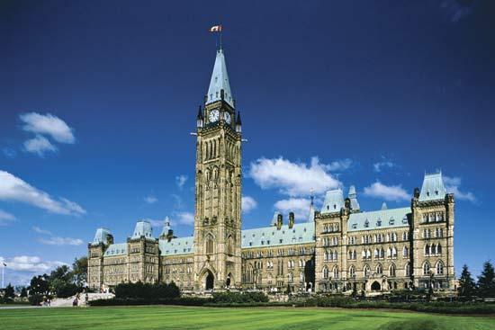
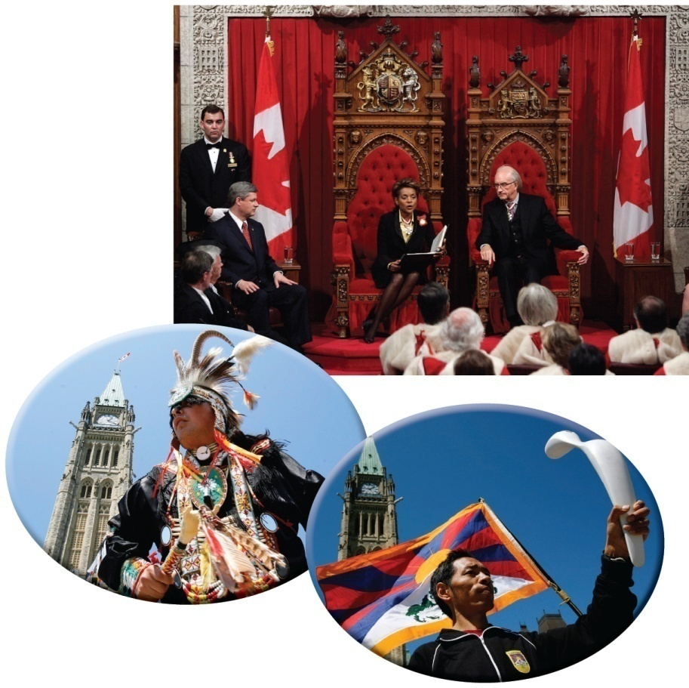
National Self-Determination
Find a partner read page 173 and work through the questions
and
Review both of the Key Terms by writing out a guess of what you think each of them means
Read the caption to Figure 8-1 on page 172
How do each of these photographs show examples of national self-determination?

Slide 2
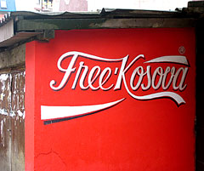
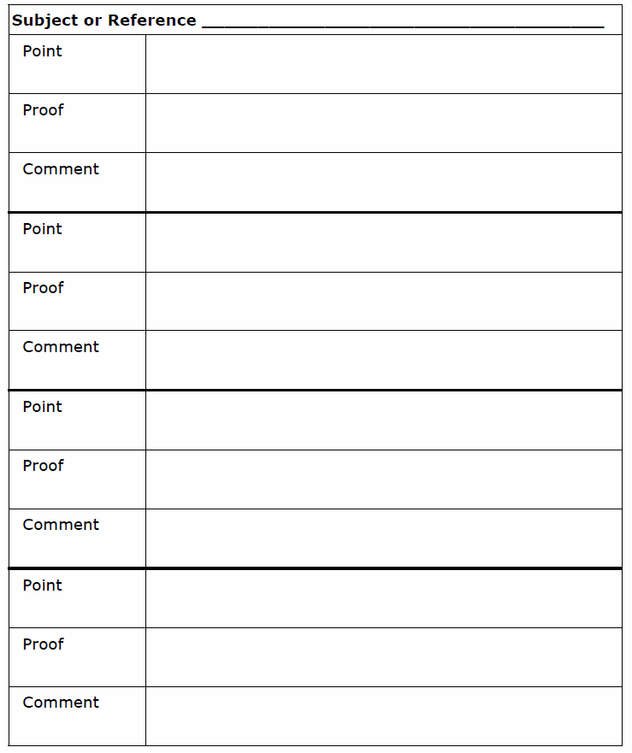
What is National Self-Determination?
Read the opening paragraph on page 174
National Self-Determination
How role might a plebiscite play in self-determination?
National self-determination is a people’s power to control their own affairs
Timor-Leste had been a Portuguese colony, then it was invaded by Indonesia in 1975,but it became independent in 2002
Independence did not bring an end to the conflict in the area — and the UN had to return in 2006 to try to prevent further violence
To organize this section of chapter 8, use the handout as you read the rest of page 174 and 175
Using the subject
National Self-Determination, complete the
Point-Proof-Comment
Handout
To assist you, use the following four points
With a partner, complete the remaining aspects of the handout
When finished, complete the Recall, Reflect, Respond
At the end of World War I, it was hoped that self-determination would bring lasting peace
This concept was articulated and supported by American president Woodrow Wilson
It did not apply to all nations — and it has not succeeded in bringing peace to the world
The desire for self-determination can unite people — or drive them apart
American historian Louis L. Snyder makes this point
Nation-states must decide how they will deal with the divisions that can occur among citizens
The right to self-determination is reflected in the charter of the United Nations and defined by the International Court of Justice as belonging to peoples as well as to governments, but it is not clear what should happen when peoples within nation-states want self-determination
Kosovo had been part of Yugoslavia, then of Serbia, until it declared independence in 2008 — but Kosovo’s independence has not been recognized by some governments or the UN
Kosovo’s declaration may not bring an end to the conflict in the area — and the UN’s continuing presence could be seen as an attempt to prevent others from regaining or taking control of the region

Slide 3
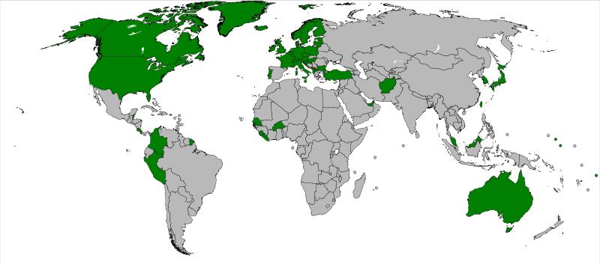
As Of Today….
States which formally recognize Kosovo
States that do not recognize Kosovo

Slide 4
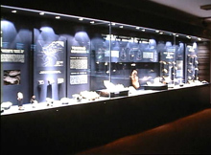
And Finally…
Begin a list of terms from this chapter, which include…
Any term/phrase/concept that would be considered important in helping you with your …
Museum Display
Any suggestions as to what you should include?

Slide 5
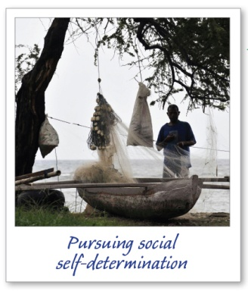
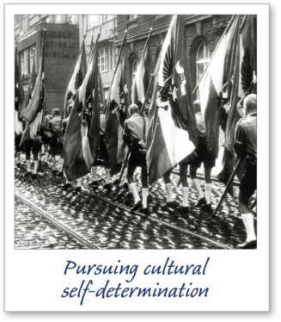
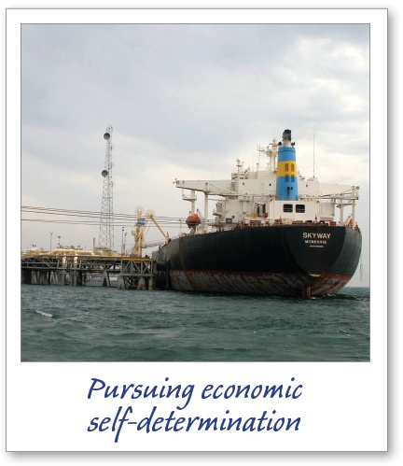
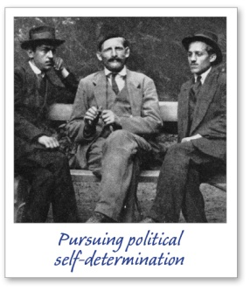
What Are Some Effects of Pursuing National Self-Determination?
Read page 176
Why is defining ‘a people’ proven so difficult?
Read the first two paragraphs on page 177
What problems might be associated with the pursuit of national self-determination?
A Bosnian Serb ultranationalist who killed Franz Ferdinand of Austria, hoping this act would lead to a Slavic nation
Slav’s national interest versus Austria’s interest in maintaining its empire
Pursuing political self-determination
A government’s actions – control over territory
A photo of Taliban fighters in Afghanistan
Examine the photographs on pages 176-177
Read their captions
Using the photographs, complete the handout
Types of National Self-Determination

Slide 6
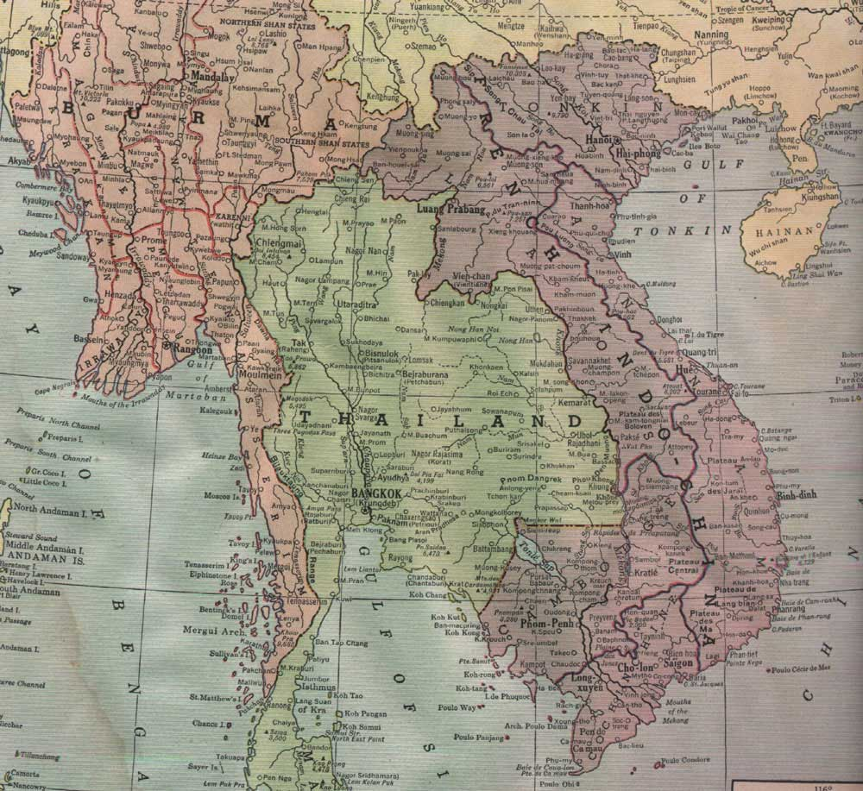
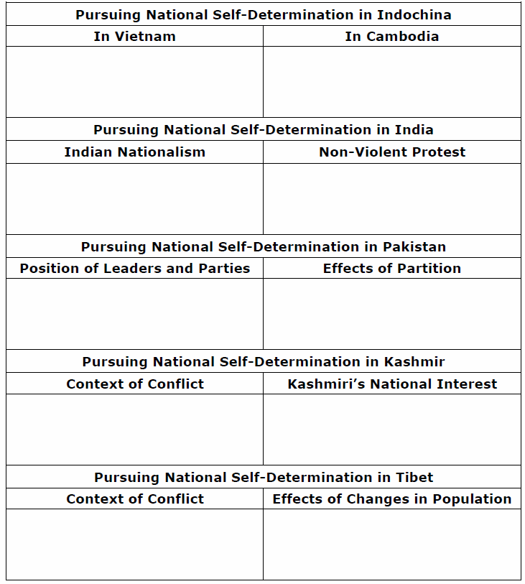
Pursuing National Self-Determination
Get into groups of five…
Momentarily, you will be numbered off one through five. Each of you will go to one of the five assigned EXPERT groups and complete both sections of your handout
Pursuing National Self-Determination: Indochina, India, Pakistan, Kashmir and Tibet
You will have approximately 15-20 minutes to do this.
#1 – Indochina (Pages 178-179)
#2 – India (Page 180)
#3 – Pakistan (Page 181)
#4 – Kashmir (Page 182)
#5 – Tibet (Pages 183-184)
When finished, return to your original group of four and share your EXPERTISE with your other four group members. They will do the same for you. When you are done, you will have information on all five readings
The Vietnam War - A Short History
Newsreel on India’s & Pakistan’s Independence

Slide 7
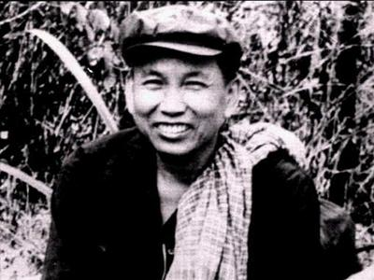
Cambodia Khmer Rouge 1975 to 1979
Part One

Slide 8
Cambodia Khmer Rouge 1975 to 1979
Part Two

Slide 9
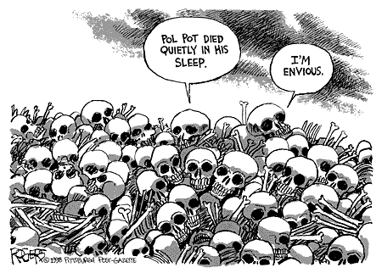

Slide 10
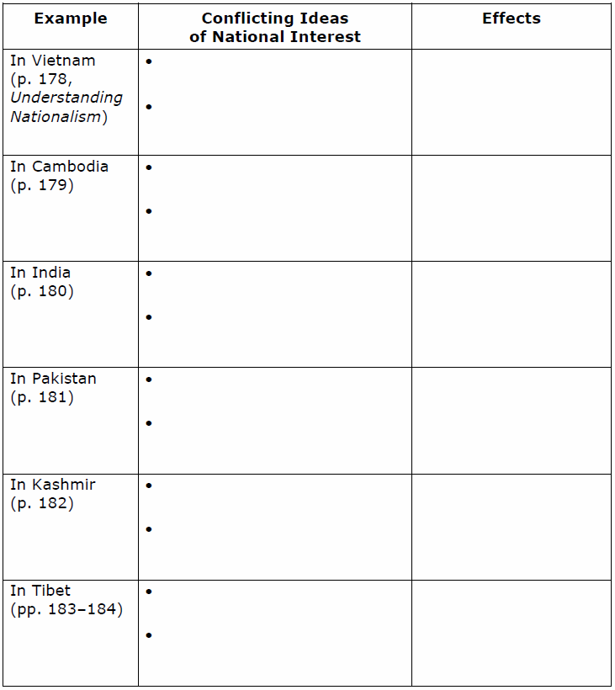
Some Effects of Pursuing Self-Determination
*Japan invaded Indochina during World War II
*France wanted to keep Vietnam under its control
*The Viet Minh wanted independence
*The United States wanted to contain communism
*Vietnam was divided into two parts
*War raged between North Vietnam,
supported by China and the Soviet
Union, and South Vietnam,
supported by the U.S.
Every National Interest has an Effect…
Using the handout, complete the final two columns
*UN-appointed judges want the tribunal to try
former Khmer Rouge officials under international
law
*Cambodians want to follow Cambodian justice
*Justice has been delayed indefinitely
* British wanted to keep India as a colony
* India wanted independence
*Mohandas Ghandi’s campaign of
non-violence to end British rule
* Independence achieved in 1947
* Mohandas Gandhi wanted Muslims and
Hindus to live together in one country
* Muhammad Ali Jinnah wanted Muslims
to have their own country
* India was divided into India and
Pakistan when India achieved
independence
* Partition led to widespread inter-
ethnic violence
We’ll do the first row together on Vietnam
* India wanted the region
* Pakistan wanted the region
* Decades of violence
* Many Kashmiris now want
independence
* Tibet wanted to stay independent
* China wanted Tibet to be part of
China
* China encouraged immigration to Tibet
* Tibetans may become a minority in the region

Slide 11
Positive and Negative Consequences of the Pursuit of Self-Determination
Using the handout, complete the Reflect and Respond on page 184
An Example:
South Asians – India, Pakistan and Kashmir
Non-violent independence
movement
Mohandas Gandhi’s Quit India campaigns in the 1930s and 1940s
Tension in the new states
Partition into India and East and West Pakistan
Success in achieving
independence from Britain
Independence achieved
in 1947
Violence between Muslims and Hindus
The conflict led to many deaths
Establishment of independent
states
India and West and East Pakistan (later Bangladesh) established
Kashmiri’s right to self-determination
still in dispute
Plebiscite has still not been held, and violence continues in Kashmir

Slide 12
And Finally…
Continue with your list of terms from this chapter, which include…
Any term/phrase/concept that would be considered important in helping you with your …
Museum Display
Any suggestions as to what you should include?

Slide 13
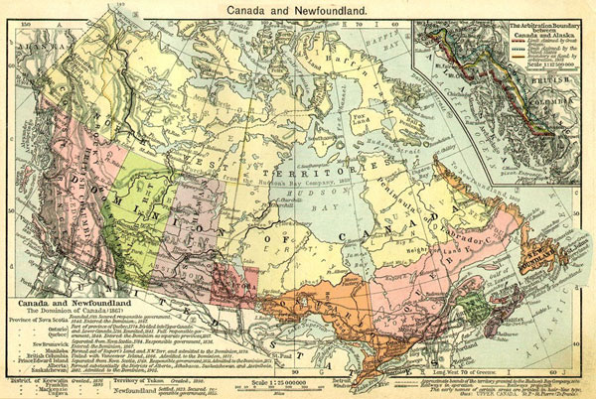
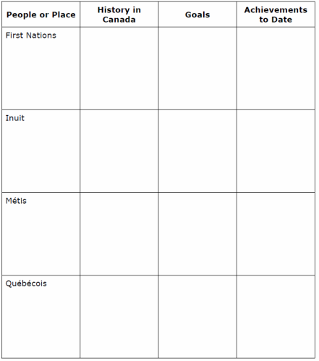
What Are Some Effects On Canada Of Pursuing National Self-Determination?
Read the opening half of page 185
Get into groups of four…
Momentarily, you will be numbered off one through four. Each of you will go to one of the four assigned EXPERT groups and complete a brief summary using the handout
Pursuit of National Self-Determination in Canada
You will have approximately 15-20 minutes to do this.
#1 – First Nations’ Pursuit of Self-Determination (Pages 185-186)
#2 – Inuit Pursuit of Self-Determination (Pages 186-187)
#3 – Métis Pursuit of Self-Determination (Page 188)
#4 – Quebec and National Self-Determination (Page 189)
When finished, return to your original group of four and share your EXPERTISE with your other three group members. They will do the same for you. When you are done, you will have information on all four readings
Complete #2 in the Recall, Reflect, Respond on page 189

Slide 14
And Finally…
Continue with your list of terms from this chapter, which include…
Any term/phrase/concept that would be considered important in helping you with your …
Museum Display
Any suggestions as to what you should include?

Slide 15
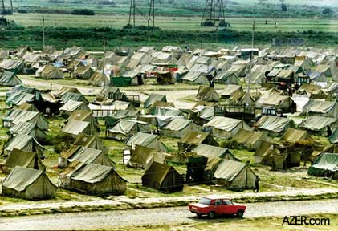
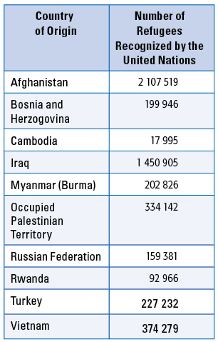
What Are Some Unintended Results Of Pursuing National Self-Determination?
Refuges From Selected Countries - 2006
What does the word ‘Refugee’ mean?
Why do refugees flee?
What do they seek?
What do they leave behind?
How do you think they feel?
Who helps them?
Review the chart
What do you think it would be like to be uprooted from your home, forced to flee your community and be separated from your family?
Read the opening paragraph on page 191
As you read the next two paragraphs,
make a list of unintended results of the pursuit of
National Self-Determination
In 2006, about 32 million people were living as refugees around the world

Slide 16
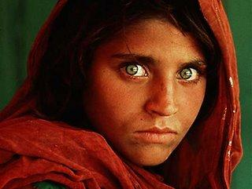
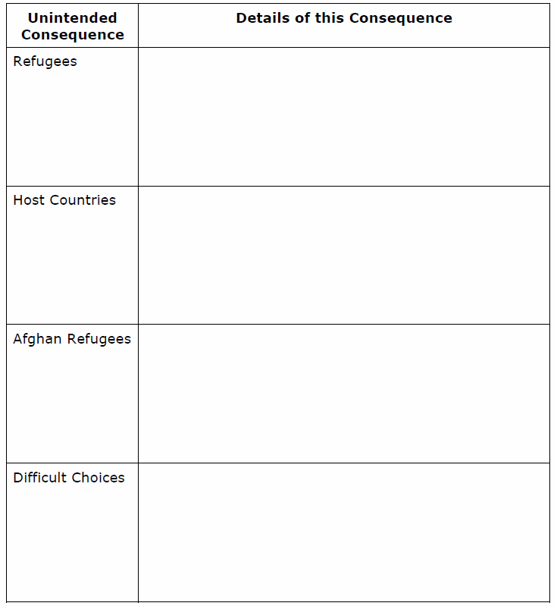
Unintended Consequences of the Pursuit of Self-Determination
With a partner, read pages 191-193
Using the handout, make notes and summarize what you have read in each of the three sections

Slide 17
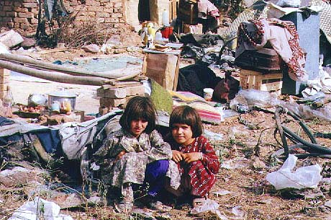
Why Doesn’t the U.N. Just Step In and Quickly Solve the Problems That Cause Refugees To Flee From Their Countries?
Respond to the question above
With So Many People Fleeing Conflict Around The World, Why Don’t Canada and Other Developed Countries Take in More Refugees?
Respond to the question above

Slide 18
And Finally…
Complete your list of terms from this chapter, which include…
Any term/phrase/concept that would be considered important in helping you with your …
Museum Display
Any suggestions as to what you should include?

Slide 19
Skill Builder to Your Challenge Present an Artifact
Work on the three steps on page 195
In order to complete this Skill Builder, however, you need to have finished the previous three for creating your:
Museum Display
Remember to have a display card for each of your map, propaganda and artifact
Also, be certain that your Museum Displays have a paragraph or two displayed to help viewers understand what they are seeing…
Be sure to review pages 106-107 and your Rubric!
Your displays are due on Friday!

Slide 20
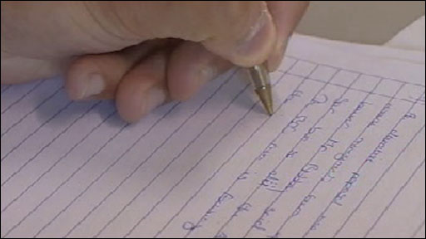
Should Nations Pursue National Interests?
Are you prepared for the Related Issue #2 Exam?
When is it?
Monday
Where will it be held?
Room 24
Who has to write it?
You
What will be on it?
5 True/False Questions – 5 Marks
5 Matching Questions – 5 Marks
20 Multiple Choice Questions – 20 Marks
1 Short Answer Question – 10 Marks
1 ‘Three Source’ Question – 20 Marks
Total - /60 Marks
Why will you be here?
‘Cause you’d rather spend a class writing an exam than listen to Mr. Edwards!

