Slide 1
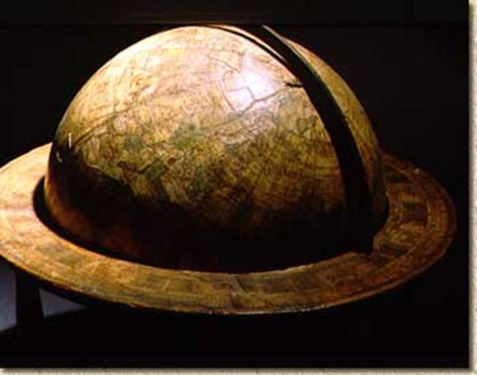
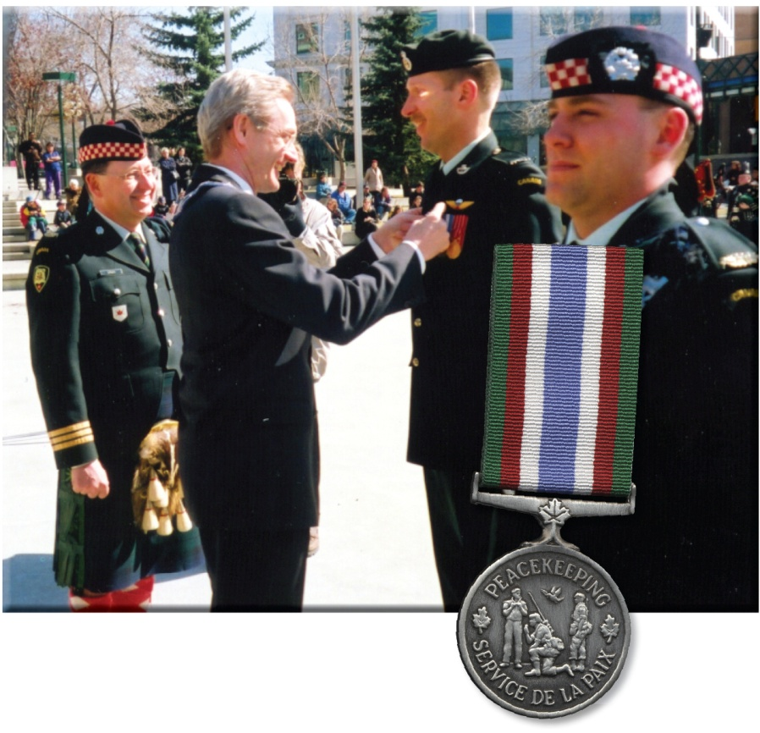
Foreign Policy and Internationalism
Is contributing to peacekeeping missions an important aspect of Canada’s foreign policy?
Why might the Canadian government have created a peacekeeping medal?
Why did the Canadian government create a monument to peacekeeping?
Individually, read the rest of page 223 and work through the questions
Read the caption to Figure 10-1 on page 222 and the two introductory paragraph on page 223
Do you think peacekeeping is apart of Canada’s national identity?

Slide 2

Foreign Policy
What is the difference between a country’s domestic and foreign policy?
How do nations and nation states decide what their foreign policy will be?
What national interests do foreign polices serve?

Slide 3
How Do Countries Set Foreign Policy?
Read the introduction on page 224
How Canada’s Foreign Policy Decisions Affect My Life
Fruit, Vegetables, Etc.
After being assigned to one of the groups listed on the handout, work as a group to fill in your assigned section
When finished, complete the summary statement
Food as an example:
United States, Mexico, China, Chile, etc.
Canada’s foreign policy includes trade agreements with the United States, Mexico, China, Chile, etc.

Slide 4
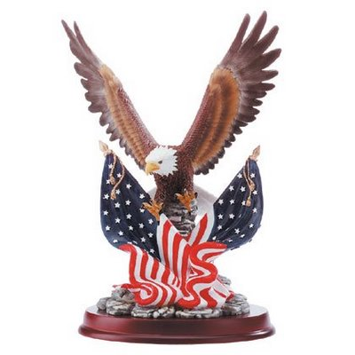
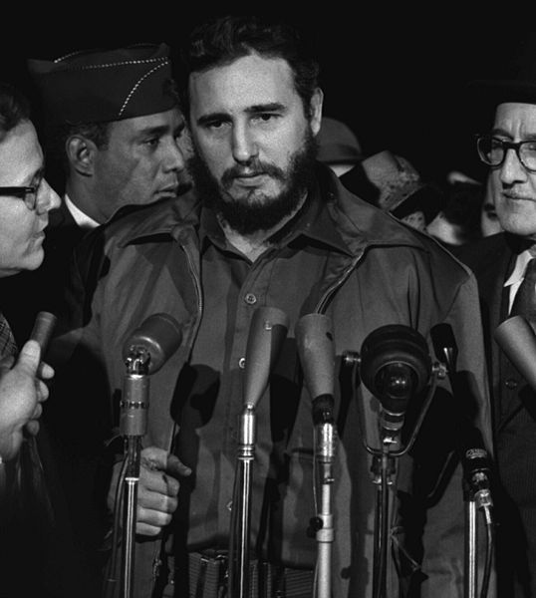
Foreign Policy
Which form of government might find it harder to set foreign policy…
A democracy or a dictatorship? Why?
A dictatorship does not have to consult with and appease the interests and will of the people, while a democratic government does
Read the section Influences on Foreign Policy Decisions on pages 224-225

Slide 5
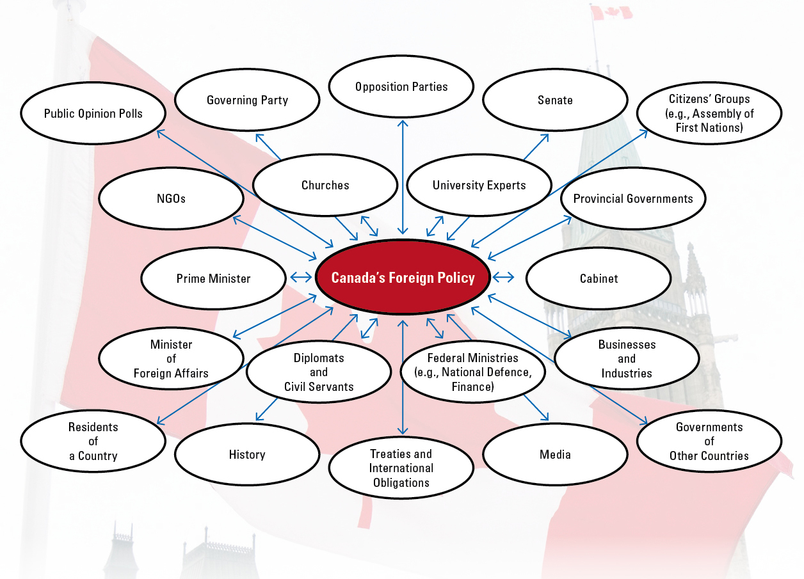
Influences on Foreign Policy Decisions
Review Figure 10-3 on page 225
Complete the Activity on page 224
Read the section Foreign Policy Goals on pages 225

Slide 6
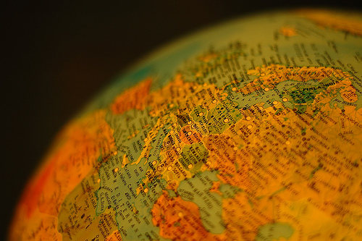
Foreign Policy
How has globalization affected foreign policy?
As you read the section Foreign Policy in a Globalizing World (page 226)
jot down points that will help you answer the above question
Remember:
Due to Globalization…
The role played by nation-states in international affairs has been reduced
The role played by multinational corporations and international business, labour, and
humanitarian organizations has increased in importance
The boundaries between domestic and foreign policy are now blurred

Slide 7
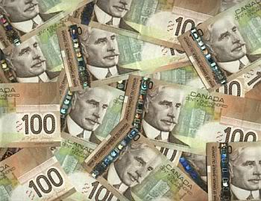
And Finally…
Begin a list of terms from this chapter, which include…
Any term/phrase/concept that would be considered important in helping you with your …
Challenge
Any suggestions as to what you should include?

Slide 8
How Can Nation-States Promote Internationalism Through Foreign Policy?
Read the introduction on page 227, including the Activity
Comparing Foreign Policy Strategies
You will be using this handout throughout this section of your textbook – Don’t lose it!
As we go forward, don’t forget:
Internationalism
Refers to:
International cooperation in order to solve global problems
Pages 228- 230
Pages 231 - 232
Pages 233- 235

Slide 9

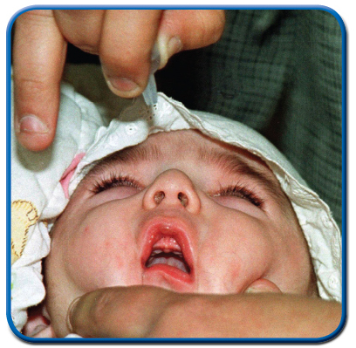
Promoting Peace
Read page 228
Review the meaning of Economic Sanctions
&
Read the FYI on page 228
How do feel about Canada’s participation in the sanctions against Iraq…
Are sanctions an effective method to promote international peace?
Examine Figure 10-8 and its caption
Has this changed your feelings about Canada’s participation in the Iraq sanctions?
Do you believe that sanctions are an effective policy method?
Why — or why not?

Slide 10
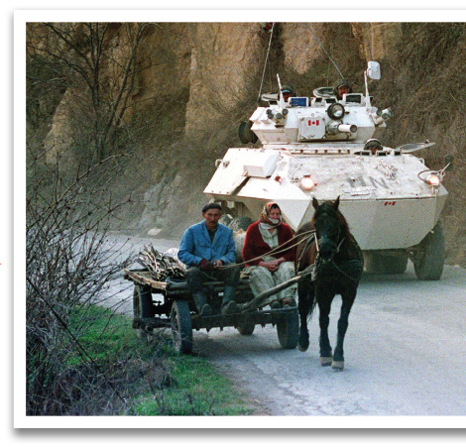
Peacekeeping and Internationalism
Read the top half of page 229
Discuss the Activity
Read the rest of page 229 and all of page 230
Individually, complete the Activity on page 230
Complete the first row of your handout:
Why do you think the use of armoured vehicles is increasing in peacekeeping missions?
Comparing Foreign Policy Strategies
In cases like Rwanda, should the UN abandon peacekeeping in favour of direct military intervention to make peace and protect people?

Slide 11
And Finally…
Continue with your list of terms from this chapter, which include…
Any term/phrase/concept that would be considered important in helping you with your …
Challenge
Any suggestions as to what you should include?

Slide 12
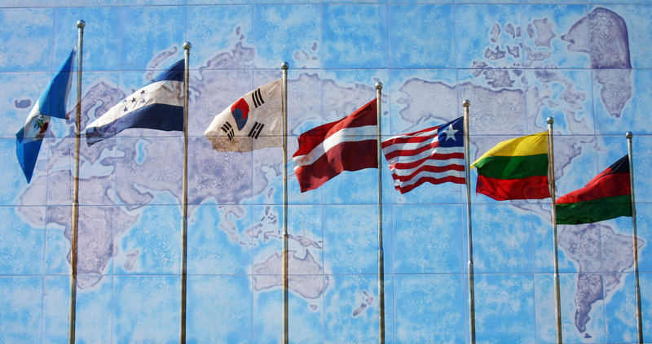
International Law and Agreements
Why do countries have laws and courts?
Read the opening two paragraphs on page 231
Why would nations need international laws to protect trade agreements?
Why some countries, such as the United States, might not sign on to agreements like these?
Why, for example, might a country not want to abide by decisions made by the International Court of Justice?
Read the rest of page 231
Why would countries need an international body or an international agreement to settle the Grand Banks dispute?

Slide 13
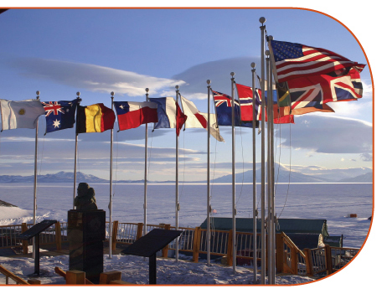
International Law Agreements
Read page 232
Answer the questions posed in Figure 10-13
When done…
Complete your second row in your handout
Comparing Foreign Policy Strategies

Slide 14
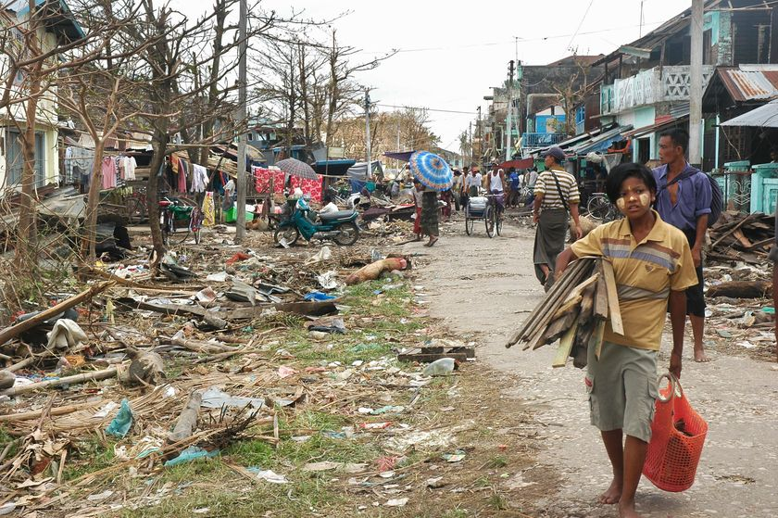
Foreign Aid and Internationalism
Read pages 233 & 235
When done, complete the final row in your handout:
Comparing Foreign Policy Strategies
Should Canada contribute 0.7% of its GNI to foreign aid?
Should the countries who donate money to countries in need, be allowed to place restrictions on the way it is spent?

Slide 15
And Finally…
Continue with your list of terms from this chapter, which include…
Any term/phrase/concept that would be considered important in helping you with your …
Challenge
Any suggestions as to what you should include?

Slide 16

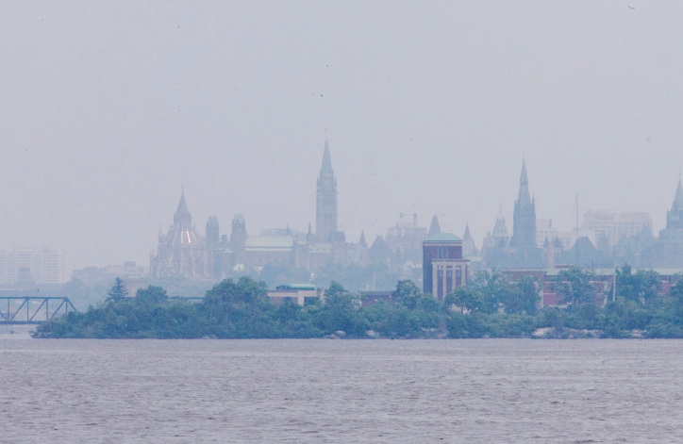
Smog Over Ottawa
How can combating smog combine a country’s national and international interests?

Slide 17
How Does Canadian Foreign Policy Try To Balance National Interest And Internationalism?
What are National Interests?
Actions taken in the national interest are supposed to benefit the people of the nation by ensuring their economic prosperity and security and safety, and by protecting their beliefs and values, and that people’s views on the national interest can change with events and circumstances
Read the opening two paragraphs and the closing two paragraphs on page 237

Slide 18
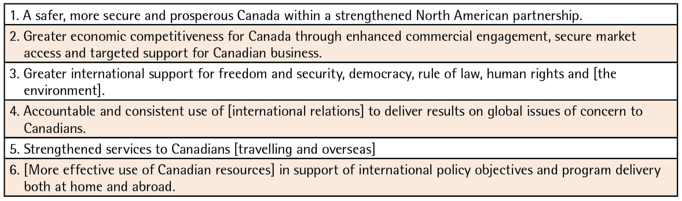
Canadian Foreign Policy
Review Figure 10-18
NATO
NAFTA
Kyoto Protocol
United Nations
Department of Foreign Affairs
Department of Foreign Affairs
Can you think of an example for each of the foreign policy goals listed above?

Slide 19
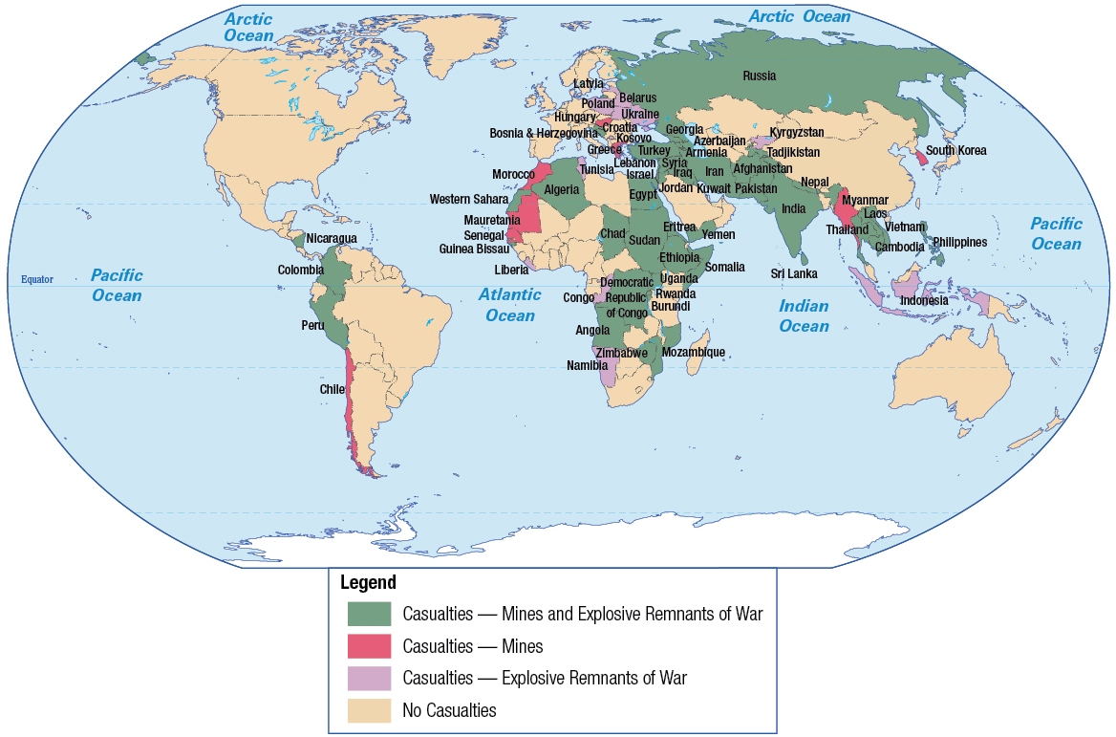
Landmines and Foreign Policy
Review Figure 10-22
Can you explain all that is in the Legend?
Read pages 240-241
Does Canada’s position on landmines strike a balance between national interest and internationalism?

Slide 20
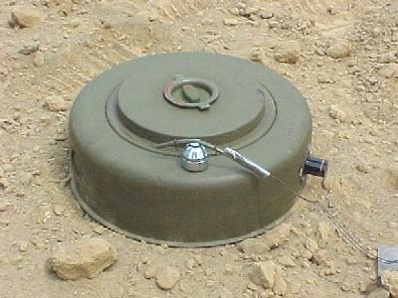

Public Service Announcement: Landmines

Slide 21
And Finally…
Complete your list of terms from this chapter, which include…
Any term/phrase/concept that would be considered important in helping you with your …
Challenge
Any suggestions as to what you should include?

Slide 22
Your Challenge
When was the last time you reviewed your challenge?
Get them out and lets review!

