Slide 1
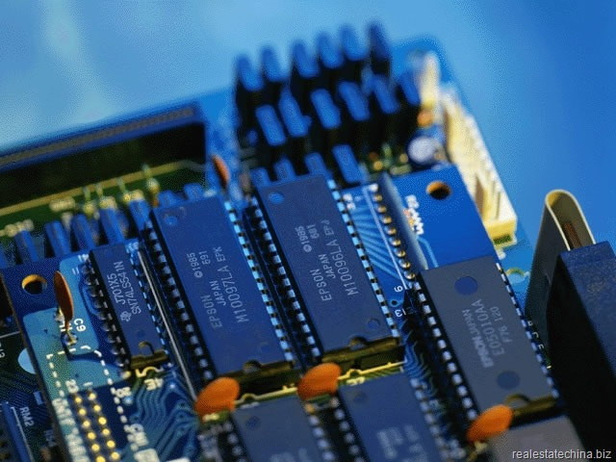
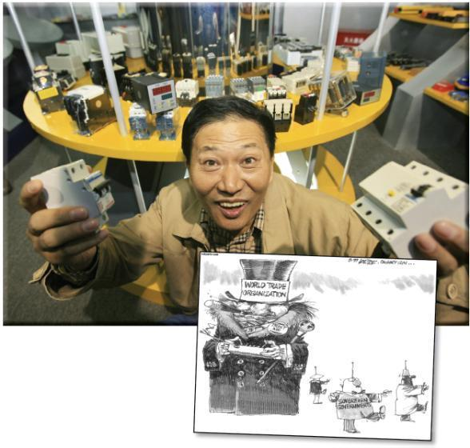
Internationalism and Nationalism
Review the bulleted questions on page 245
How do the photograph and cartoon represent the challenges and opportunities of international trade agreements?
How might the conditions that the Chinese government agreed to when it joined the WTO affect businesspeople in China?
Read the caption to Figure 11-1 on page 244 and the introduction on page 245

Slide 2
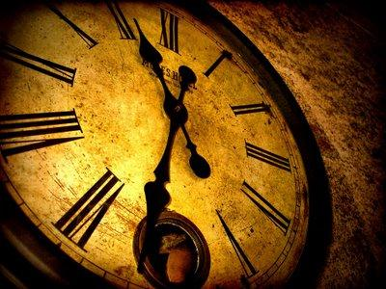
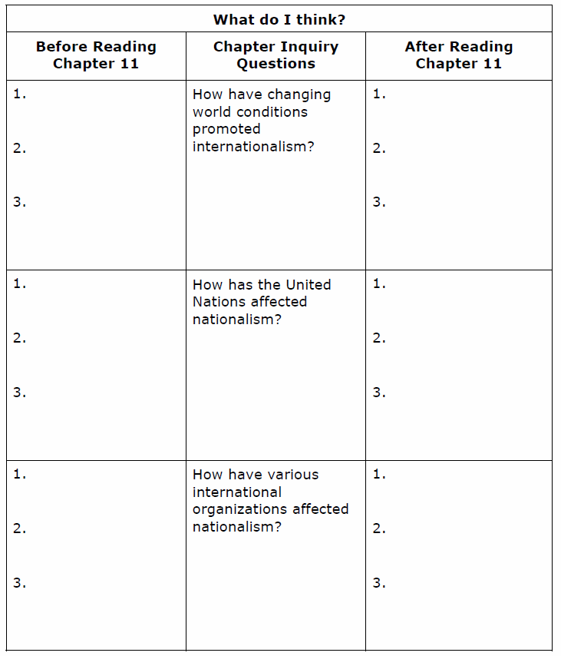
Anticipation Guide
Internationalism and Nationalism
This handout will help you think about - and form opinions on - the three inquiry questions for this chapter
Read each question and think about what you already know — or think you know — about possible responses to the question
In the first column of the anticipation guide, list three topics, issues, or ideas you expect to encounter as you consider each of the inquiry question
Leave the third column blank
Close your textbooks

Slide 3

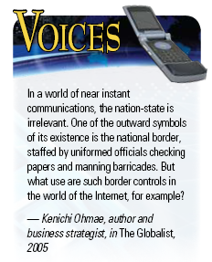
How Have Changing World Conditions Promoted Internationalism?
Read the introduction on page 246
What do Ohmae’s words mean?
Do you agree that advances in communications have made the nation-state irrelevant?
Have these advances made internationalism more important? How?
Is this a good thing for individuals? For nations? For the world? Why?
Read the rest of page 246
Read over the quote by Kenichi Ohmae
What did McLuhan mean when he said:
“The old civic, state, and national groupings have become unworkable”

Slide 4

Global Village
Does the Internet promote internationalism?
What is internationalism?
What is the Internet?
What challenges does the Internet pose to internationalism? What opportunities?
Read page 247 – Respond to the Activity
Do electronic communications like the Internet promote internationalism or do they cause people to become isolated from their own communities? Or do they do both?
How does the ability to communicate with people all over the world affect the ability to communicate with people in a local community?
What is the difference between communicating electronically and socializing in person?

Slide 5
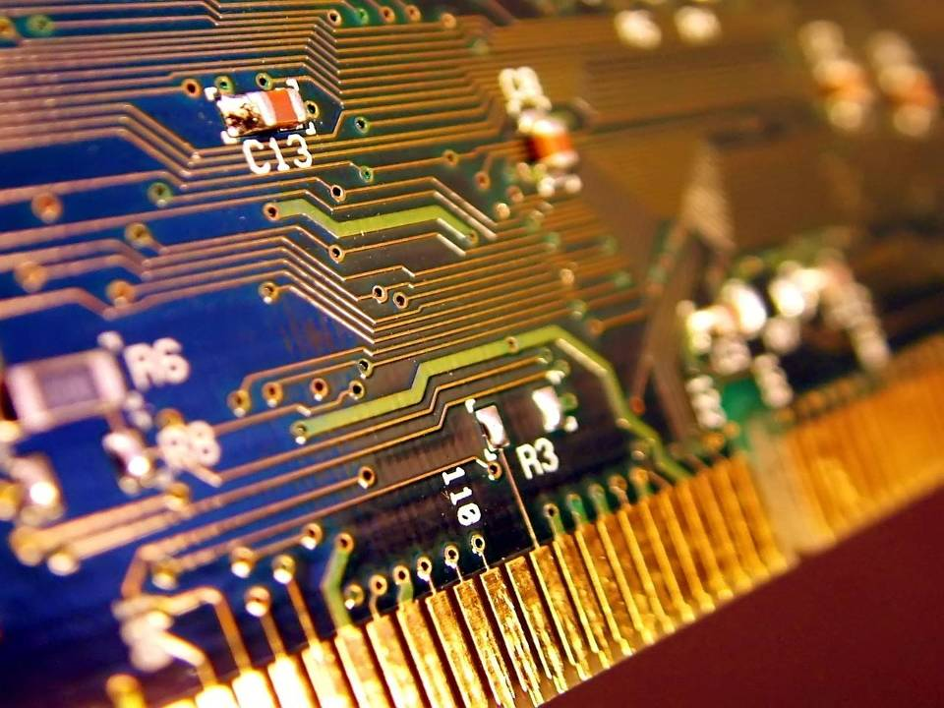
Voluntary Balkanization
Read the first two paragraphs on page 248
Do you think that Internet users try to connect with people who share the same values and opinions?
What can happen when a large group of people share values and opinions?
Do groups like these tend to create bridges or barriers among peoples?
Read the rest of page 248
Has the Internet truly created a global village or does the Internet remain a collection of small, isolated online communities?
Complete #1 of Recall / Reflect / Respond
Find your Anticipation Guide and complete the third column for the first inquiry question

Slide 6
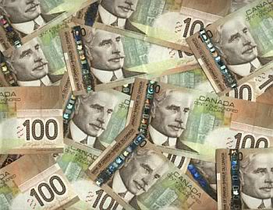
And Finally…
Begin a list of terms from this chapter, which include…
Any term/phrase/concept that would be considered important in helping you with your …
Challenge
Any suggestions as to what you should include?

Slide 7

How Has The United Nations Affected Nationalism?
Read the first half of page 249
Does the United Nations need to re-evaluate their approach?
What evidence would you use to argue for or against making what Kofi Annan calls “radical changes” in the way the UN works?
How is the world today different from the world in 1945 when the UN was founded?
What has happened to the UN in the decades since 1945?
Read the rest of page 249 and respond to the Activity

Slide 8
Internal Intervention By The United Nations
Review the FYI on page 250
When can the United Nation intervene in the internal affairs of a country?
Why might some countries support this UN mandate?
Why might some countries oppose this UN mandate?
What would you add to these points?
What would you change in these points?

Slide 9

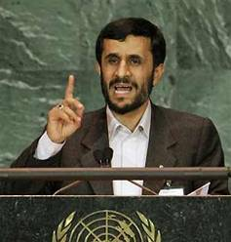
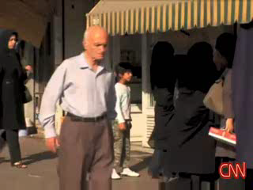
Iran Challenges The UN
Should the international community prohibit the making and selling of nuclear weapons?
Should the international community regulate the development of nuclear facilities for peaceful purposes, such as generating electrical power?
Read page 250
Respond to the Activity
CNN – Sanctions Don’t Scare Iran

Slide 10

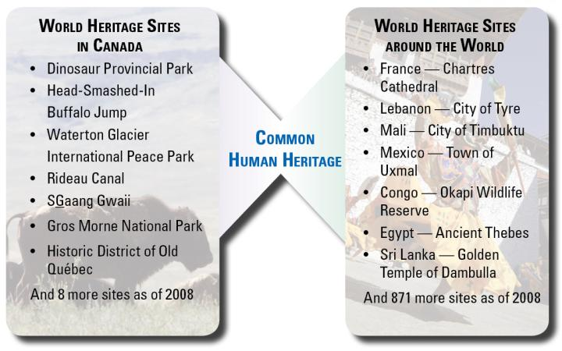
Protecting The Common Human Heritage
Read the opening paragraph and the exploding concept on page 251
How do these heritage sites relate to internationalism?
Complete reading page 251

Slide 11
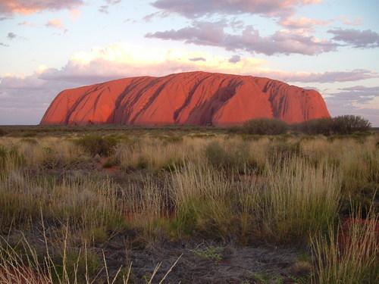
Protecting The Common Human Heritage
With a partner, read the three sections on pages 252 – 254
Including the photographs and their captions
Write a minimum of a one sentence summary for each of these three sections
If time permits, complete #1 and #3 of Recall / Reflect / Respond at the bottom of the page
Find your Anticipation Guide and complete the third column for the second inquiry question

Slide 12
And Finally…
Continue with your list of terms from this chapter, which include…
Any term/phrase/concept that would be considered important in helping you with your …
Challenge
Any suggestions as to what you should include?

Slide 13

How Have Various International Organizations Affect Nationalism?
Read the introduction on page 255
Should internationalism and co-operation among countries be encouraged if it wears down the sovereignty of nation-states?
Will the world be at greater risk of conflict if the international community fails to establish the rule of law (no nations is ‘above’ the law) in all nation-states?
Will the world be at greater risk of human rights abuses if the international community fails to establish the rule of law in all nation-states?
How much sovereignty should Canada be willing to give up to be part of the international community?

Slide 14

International Organizations
Impact of International Organizations
With a partner…
Using both sides of this handout, read the three remaining sections in your textbook and complete the final two columns:
Economic Organizations (255-258)
Cultural and Language Based Organizations (259-260)
Security Organizations (261)
When done, rank each of these organizations as to which has had the greatest impact on nationalism
Include Reasons (Use the scale: 1 = Minimal Impact; 5 = Very Strong Impact)
Find your Anticipation Guide and complete the third column for the third inquiry question

Slide 15
And Finally…
Complete your list of terms from this chapter, which include…
Any term/phrase/concept that would be considered important in helping you with your …
Challenge
Any suggestions as to what you should include?

