Slide 1
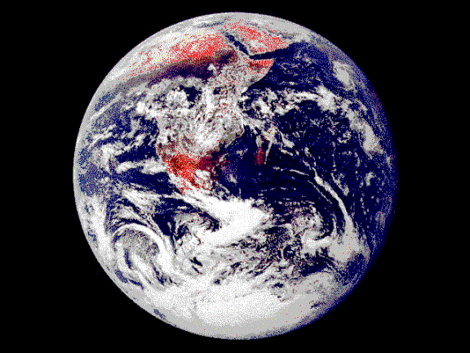
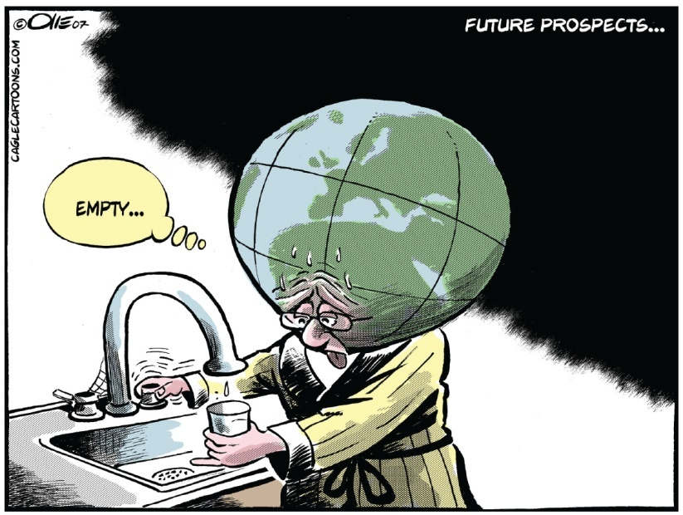
Internationalism and Global Issues
Canadians use much more water than people in most other countries. Should Canadians be encouraged - or forced - to reduce that amount?
Canada has more fresh, clean water than any other country on Earth. Should Canadians be encouraged - or forced - to share it with those who do not have enough?
Is water a resource like oil? Should private companies be able to make huge profits from it?
Could access to fresh, clean water become a major source of conflict in the future?
Read the caption to Figure 12-1 on page 264 and the introduction on page 265
Review the first and third bulleted questions on page 265

Slide 2
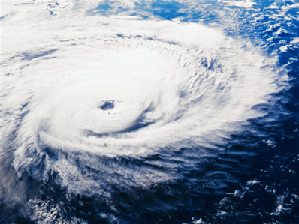
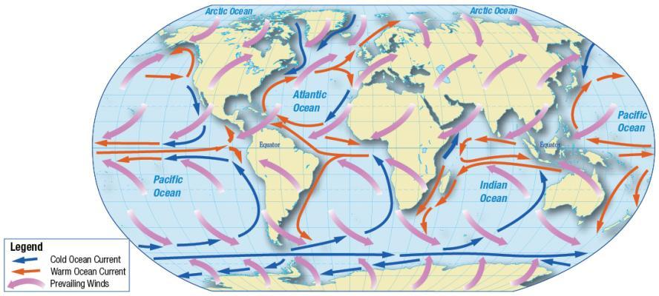
What Are Some Contemporary Global Issues?
Read the introduction on page 266
Climate Change
Read the next two paragraphs on page 266, which includes the Activity
Read the rest of page 266
Why did Canada back out of the Kyoto Protocol?
How do you feel about this decision or does it not have any impact on you?

Slide 3
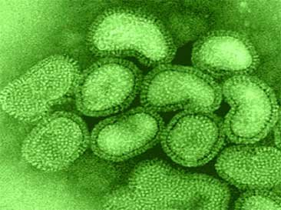
The Spread of Disease
Read this section on pages 267 and the top of page 268: Complete the handout when finished
What are other current events that have brought up the issue of a new pandemic?
Does the possibility of a new pandemic
worry you? A little or a lot?

Slide 4
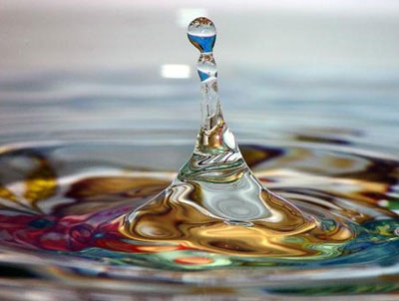
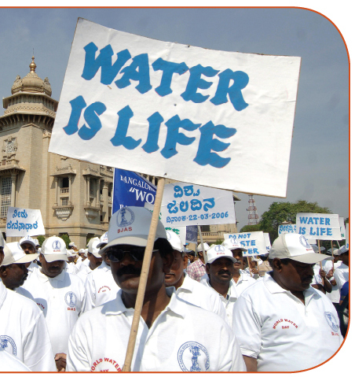
Access To Water
After reading the caption to Figure 12-7 on page 268, respond to the questions
Should Canada contribute safe drinking water to countries that do not have enough clean water?
As you read the rest of page 268 and 269 take down jot-notes
When done, respond to the question above both positively and negatively, with explanations and examples
Respond to the question #1 in the Reflect and Respond at the bottom of the page

Slide 5
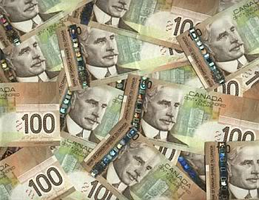
And Finally…
Begin a list of terms from this chapter, which include…
Any term/phrase/concept that would be considered important in helping you with your …
Challenge
Any suggestions as to what you should include?

Slide 6
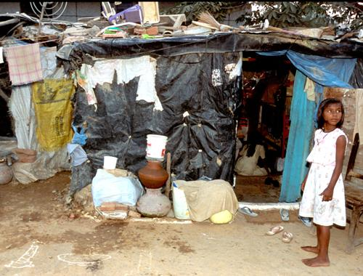

How Have People Used Internationalism To Address Contemporary Global Issues?
How can it be in Canada’s national interest to try to solve problems in other countries?
Read the introduction on page 270
What makes poverty, hunger, disease, debt, climate change, human rights, and conflict global challenges?
What issues of nationalism and national sovereignty might be involved in these challenges?
How might internationalists and international organizations help people who are grappling with these challenges?
Complete the handout Picturing Global Issues by reading each of the captions for the pictures on pages 270-271 and summarizing its content. Add one recommendation that the international community could help resolve the problem

Slide 7
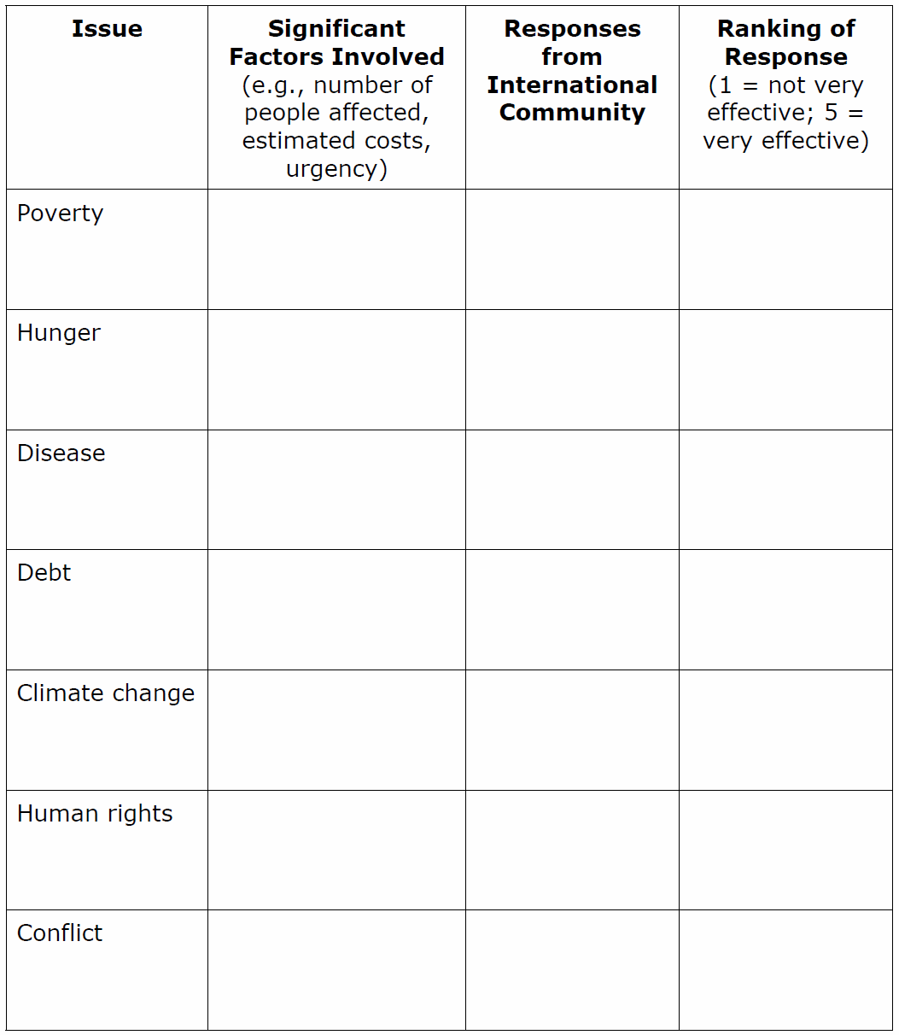
Internationalism and Contemporary Global Issues
Each of you will be numbered off one through seven
In your groups, you will complete your assigned topic on the handout Be sure it is your best work!
When done, each of your groups will present your findings
Be sure you read all the margin features on your assigned page(s)
1
Pages 271-272
2
Page 273
3
Page 274
4
Page 275
5
Pages 276
6
Page 278
7
Page 279

Slide 8


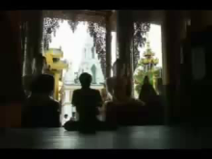

Overview of The Hunger Project
8:20
HIV/AIDS in Africa
10:00
Human Rights in Myanmar
3:20
CNN - Darfur
5:25

Slide 9
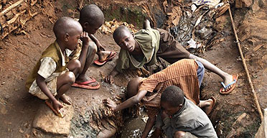
Internationalism and Contemporary Global Issues
If time permits, complete the following:
Page 272: Activity
Page 274: Activity
Page 275: Activity
Page 276: Question regarding Figure 12-22
Page 278: Activity

Slide 10
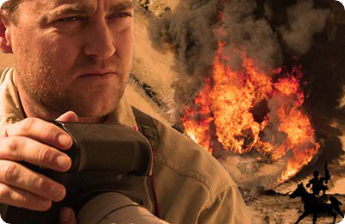
The Devil Came on Horseback
83 Minutes

Slide 11
And Finally…
Continue with your list of terms from this chapter, which include…
Any term/phrase/concept that would be considered important in helping you with your …
Challenge
Any suggestions as to what you should include?

Slide 12
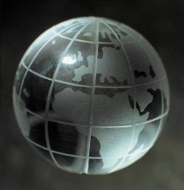

How Effective Is Internationalism In Addressing Contemporary Global Issues?
How would you respond to the above Inquiry Question?
Read the opening two paragraphs on page 280 – Including the Activity
Create and label your handout with the following:
Can International Trade Resolve Global Issues?
Yes
No
With a partner, read pages 280 and 281, pausing after each paragraph to think about what you read and summarize the arguments in a couple of points on your handout

Slide 13

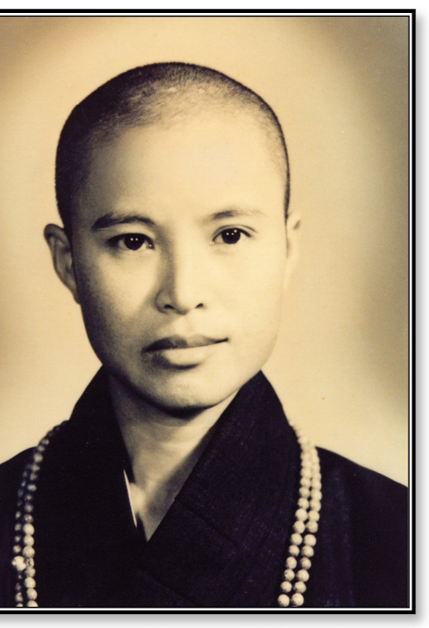
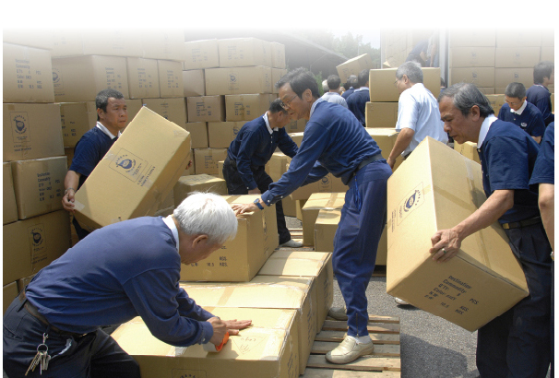
Decline Versus Change
Read the top half of page 282
Do you agree with Kofi Annan’s statement?
Civil Society
Read the rest of the page to see what he was referring to…
Read and Review Figure 12-30
How is Figure 12-31 an example of: “…the hope of humanity lies in mutual help”?

Slide 14
And Finally…
Complete your list of terms from this chapter, which include…
Any term/phrase/concept that would be considered important in helping you with your …
Challenge
Any suggestions as to what you should include?

Slide 15
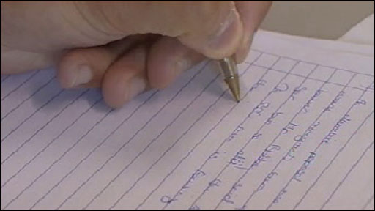
Should Internationalism Be Pursued?
Are you prepared for Related Issue #3 Exam?
When is it?
Friday
Where will it be held?
Room 24
Who has to write it?
You
What will be on it?
Five True or False - /5
20 Multiple Choice Questions - /20
One Short Answer Question - /10
One ‘Three Source’ Question - /20
Total - /55
Why will you be here?
‘Cause you’d rather spend a class this week showing off how much you know… Than waiting for another time to do so!

