Slide 1
Perspectives on Ideology

Slide 2
Ideologies

Slide 3
What ideas are behind YOUR ideology?

Slide 4
Do you believe in…

Slide 5
…your country?

Slide 7
…your class?

Slide 9
…your religion?

Slide 11
…the environment?

Slide 14
So many “…isms”

Slide 15
…environmentalism

Slide 16
…militarism

Slide 18
…consumerism

Slide 20
…racism

Slide 21
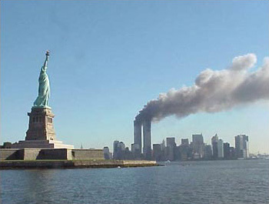
…fundamentalism

Slide 22
How much individualism?

Slide 23
What about collectivism?

Slide 24
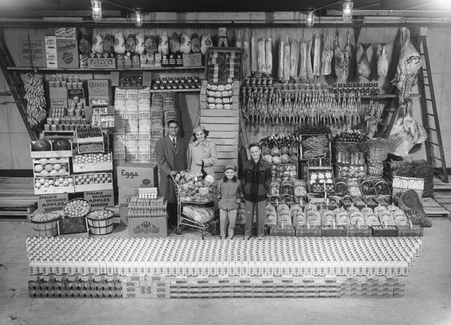
…Capitalism

Slide 26
…Socialism

Slide 28
…Communism

Slide 30
…Fascism

Slide 33
Ideology?

Slide 37
Should we embrace ideology?

Slide 38
Or…

Slide 39
Perspectives on Ideology
Review the paintings on page two and read the opening paragraph on page three
Title each painting separately and write out a response to each of the following questions:
Who was this person?
What kind of person was she?
What were her beliefs and values?
Do you agree with the last sentence in paragraph two?
Get into groups of 3-4 for the OPENING ACTIVITY

Slide 40
Perspectives on Ideology
Review the two quotations on page two
What is the author ‘saying’ in both of these quotes?
What is being said about identity, directly or indirectly?
What is being said about identity in the paintings?
How difficult would it be to ‘capture’ your identity or ideology in a painting or quotation?
Read the rest of the page
What is the key issue for the course?
What is the key issue for Part 1 (Chapters 1-2)?
When finished, write out a definition for Ideology

Slide 41
Perspectives on Ideology
Introduction
Read page four
Review pages 5-6 and respond to the following:
What is the difference between a ‘point of view’ and a ‘perspective’?
Provide an example for each
Differentiate between ‘Issues’ and ‘Inquiry’
Using the handout provided, complete the Introduction in your textbook
Be certain you complete the chart in its entirety!
Review Handout

