Slide 1
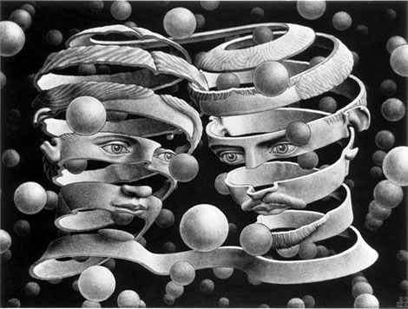
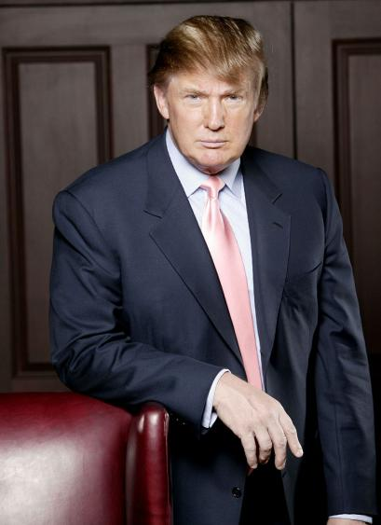
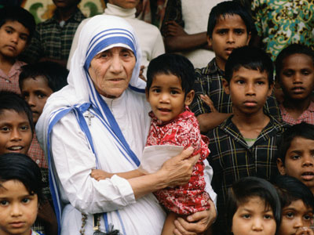
Thinking About Identity and Ideologies
Chapter One
Read pages 20-21
Complete the questions on page 20 when finished
What ideology does Donald Trump appear to embrace and how might it have contributed to his identity?
What ideology did Mother Teresa appear to embrace and how might it have contributed to her identity?
Capitalism? Materialism?
Religious Devotion? Selflessness?

Slide 2
To What Extent Are Ideology and Identity Interrelated?
Chapter One
Read Page 22
Write out the issue question for Chapter One
Using the handout provided, read and complete the required work for Chapter One
Due:

Slide 3
On your own time, create a list where you write out the following
Chapter One Terms

Slide 4
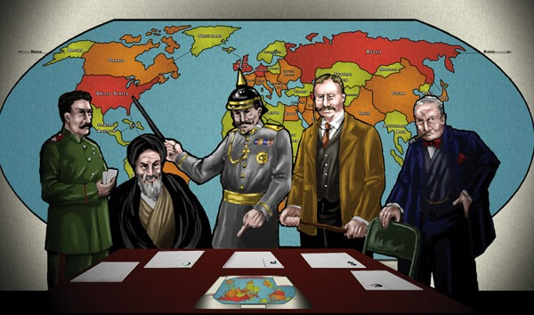
a set of principles or ideas that explains your world and your place within it, which is based on certain assumptions about human nature and society and provides an interpretation of the past, an explanation of the present and a vision for the future.
IDEOLOGY

Slide 5
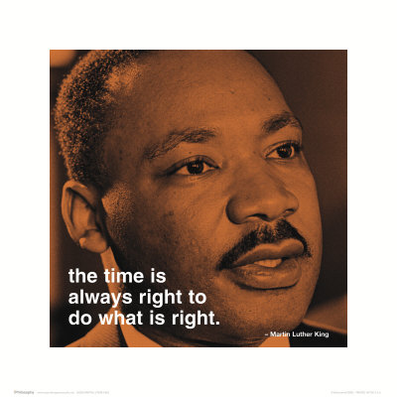
LIBERALISM
a collection of ideologies all committed to the principle of the dignity and freedom
of the individual as the foundation for society. Liberalism has faith in human
progress and tends to favour decentralized power, both in political and economic
affairs, and respect for the sovereignty of the reasoning individual.

Slide 6
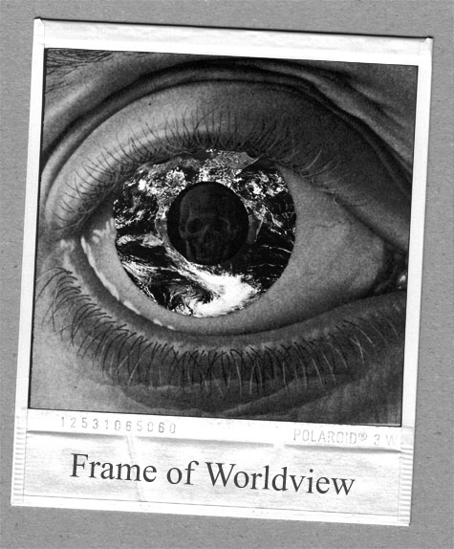
worldview
a collection of beliefs about life and the universe held by an individual or a group, the lens through which the world is viewed by an individual or a group, the overall perspective from which the world is interpreted.

Slide 7
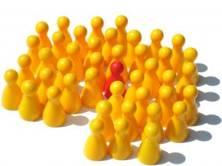
Ideologies of Individualism & Collectivism
Chapter Two
Before we begin, go back to:
Beliefs and Values Inventory: Where Do You Fit In?
(Page 30)
Complete the entire activity
Review

Slide 8
Ideologies of Individualism & Collectivism
Chapter Two
Describe what you believe a society, that emphasized individualism, would look like…
Review the Bumper Stickers on this slide and on Page 62 and answer the following questions:
Which of the bumper stickers express a perspective based more on individualism?
Which ones represent a perspective based more on collectivism?
What would you put on a bumper sticker to best represent a perspective based more on individualism?

Slide 9
To What Extent Are Individualism and Collectivism Foundations of Ideology?
Chapter Two
Read Page 63
Write out the issue question for Chapter Two

Slide 10
Understanding Individualism and Collectivism
(Pgs 64-70)
Historical Individualism and Collectivism Timeline
After reading pages 64-70, by yourself or in a group no larger than two, create a timeline in which you:
Chronologically highlight key examples of individualism and collectivism
Identify from what perspective (individualism or collectivism) the event would be important to include on the timeline and why
When completed, title your timeline and compare it with that of another group

Slide 11
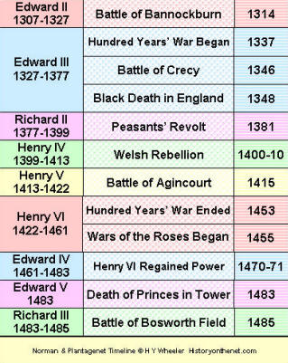
Understanding Individualism and Collectivism
(Pgs 64-70)
Historical Individualism and Collectivism Timeline
Examples

Slide 12
Understanding Individualism and Collectivism
(Pgs 64-70)
Historical Individualism and Collectivism Timeline
After reading pages 64-70, by yourself or in a group no larger than two, create a timeline in which you:
Chronologically highlight key examples of individualism and collectivism
Identify from what perspective (individualism or collectivism) the event would be important to include on the timeline and why
When completed, title your timeline and compare it with that of another group

Slide 13
Principles of Individualism and Collectivism
(Pgs 71-79)
Read the opening half of page 71
You will be completing this opening section using the handout provided:
Individualism and Ideology
Case Studies:
Obama’s attempt at reforming Health Care

Slide 14
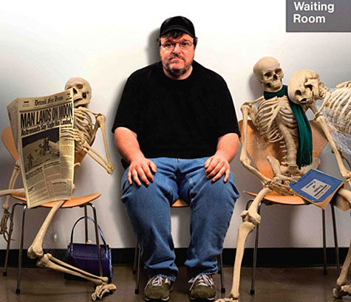
American Health Care versus Canadian Health Care
Video
123 minutes
Don’t forget the worksheet!

Slide 15
Principles of Individualism and Collectivism
(Pgs 80-86)
Read the introduction on page 80
You will be completing this section using the handout provided:
Individualism vs. Collectivism
Case Study:
Hutterite Court Challenge
Three Source Writing Assignment

Slide 16
Balancing Individual Needs With the Public/Common Good
Smoking Ban, Cell Phone Ban, Curfews, Etc.
In groups of 3-4, using the examples above, write a statement in which you respond to the following:
How does our society balance the needs of individuals with those of the public good?
For each of the issues, be sure to include a list of:
Societies needs
Individuals needs
A balanced response

Slide 17
Balancing Individual Needs With the Public/Common Good
After scanning the rest of Chapter Two (pp. 87 – 98), complete the following:
Chapter Two (pp. 76-77-Investigation - #1)
Chapter Two (pp. 92-93- Investigation - #1)
Chapter Two (pp. 96-97-Voices - #1)
Handout: Dilemmas Facing a Liberal Democracy

Slide 18
Balancing Individual Needs With the Public/Common Good
Trudeau – October Crisis
6:00
Patriot Act
4:00

Slide 19
Political & Economic Spectrums and Ideologies
What is a political and/or economic spectrum?
A political (economic) spectrum is a way of modeling different political (economic) positions by placing them upon one or more geometric axes symbolizing independent political (economic) dimensions
What might these spectrums include? Examples?
Political
Right Wing
Left Wing
Communism
Socialism
Fascism
Dictatorships
Conservatism
Liberalism
Economic
Centrally Planned
Laissez Faire
Free Market
Command
Capitalism
Collectivism
Individualism
Lets take a look…
Take a Spectrum Test
World's Smallest Political Quiz

Slide 20
Political Spectrum and Ideologies
With a partner, review the following handouts on Political/Economic Spectrums and Ideologies
As you review, create a list of at least ten questions that will assist you on your unit exam
Focus on multiple choice questions
In your questions, you may include the following formats:
Basic Knowledge
Application - (use knowledge in context)
Analysis, Synthesis and Evaluation (make a decision)
Also, you may include the following types:
Complete the statement
Which of the following
Use of "not," "except," and "least" (negative choices)
Include answers (and explanations) for all questions
Persuasive Essay

Slide 21
On your own time, create a list where you write out the following
Chapter Two Terms

Slide 22
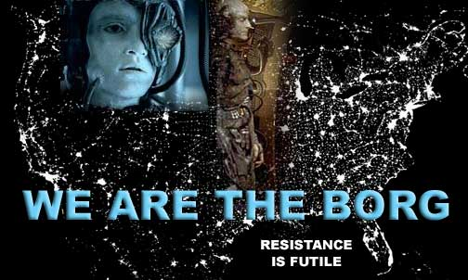
COLLECTIVISM
“The goals of the many outweigh
the goals of one.”
Charles Dickens
A Tale of Two Cities
COLLECTIVISM
a current thinking that values the goals of the group and
the common good over the goals of any one individual.

Slide 23
Adherence to collective norms
faithful observance of the norms or
standards imposed on members of
a group as a condition of member-
ship in the group. These norms can
relate to conduct, values or appearance.

Slide 24
COLLECTIVE IDENTITY
the identity that you share
with other people as a member
of a larger social group, such as
a linguistic, faith, cultural or
ethnic group. Individuals have
both individual identities and
collective identities.

Slide 25
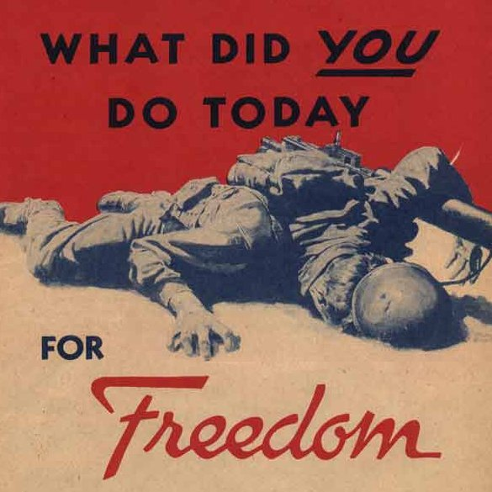
COLLECTIVE RESPONSIBILTY
holding a whole group or collective
responsible for the actions of
individuals (or individual groups)
within the group or collective.

Slide 26
COMMON GOOD
the good of the community, something that benefits the public health,
safety and/or well-being of society as a whole.

Slide 27
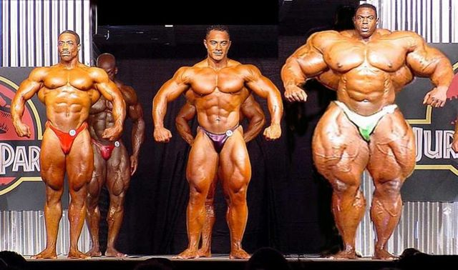
COMPETITION
the act or an instance of competing or contending with others
(for example, for supremacy, a position or prize. Competition is
seen as an incentive for individuals and groups to work harder
and more effectively

Slide 28
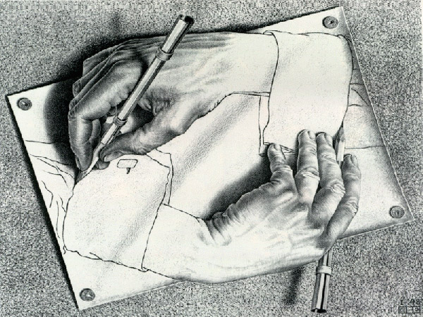
CO - OPERATION
working together
to the same end;
a principle emphasized
by collective ideologies

Slide 29
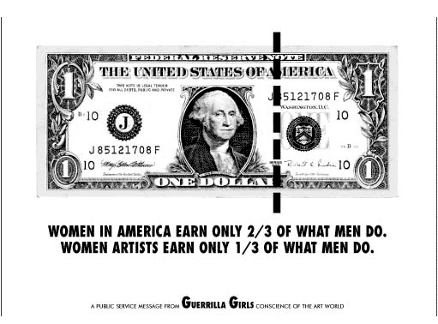
Economic EQUALITY
a principal common to collective ideologies which can have different meanings depending on the person or the ideology. Governments may try to foster economic equality through tax policies and by ensuring that all people earn equal wages for work of similar value.

Slide 30
ECONOMIC FREEDOM
the freedom to buy
what you want and
to sell your labour,
idea or product to
whomever you please.

Slide 31
a current of thinking that values
the freedom and worth of the
individual, sometimes over the security
and harmony of the group.
INDIVIDUALISM

Slide 32
INDIVIDUAL RIGHTS AND FREEDOMS
a key principle of individualism and an
important feature of liberal democracies;
examples include freedom of religion,
freedom of association and the right to
life, liberty and the security of the person.

Slide 33
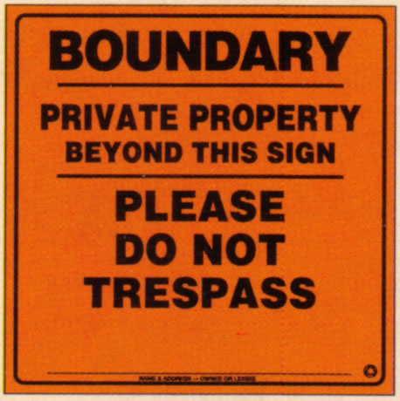
something that is owned by an individual,
including real estate, other forms of
physical possessions and intellectual
property. The right to the protection of
private property is a central principle of
Liberalism and is seen as a natural extension of the concept of the worth of each individual.
PRIVATE PROPERTY

Slide 34
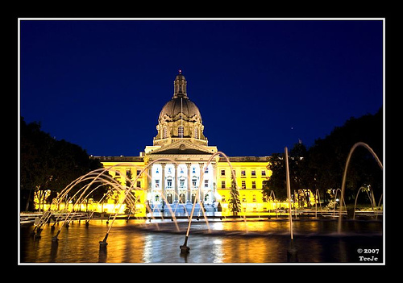
PUBLIC PROPERTY
anything (for example, land, buildings or vehicles) not privately owned by individuals. Generally speaking, public property is owned by the state or community and managed according to
the best interests of the community.

Slide 35
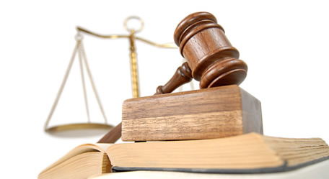
RULE OF LAW
a key principle in liberal democracies that states that every individual is equal before the law and all citizens are subject to the law.

Slide 36
SELF-INTEREST
one’s personal interest or advantage.

Slide 37
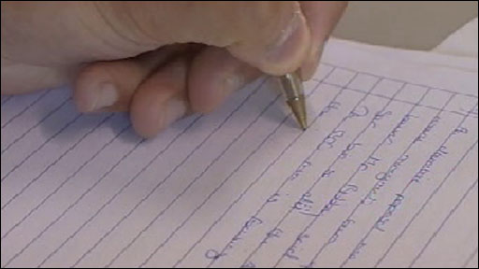
Unit One Exam
Consists of:
30 M.C. Questions

