Slide 1
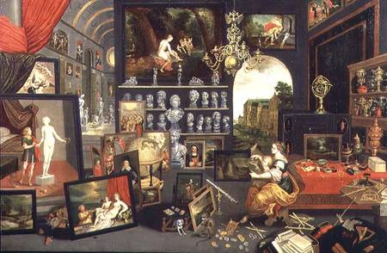
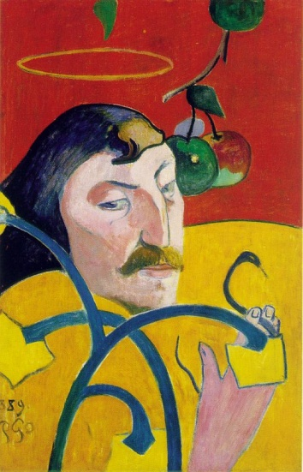
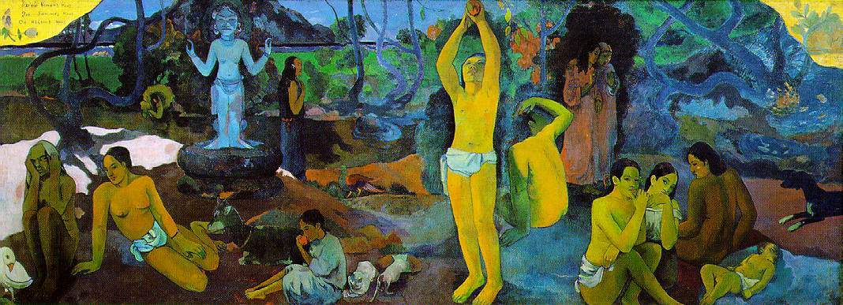
Related Issue #2 To What Extent is Resistance to Liberalism Justified?
Or
The Origin and Growth of Liberalism
Review the paintings and the three quotes, while reading pages 100-101
What does the title of Gauguin’s painting have to do with this social studies course?
Choose one of the quotations, paraphrase it and write out what it has to do with this section of the course
Write out the key issue question for Related Issue #2

Slide 2
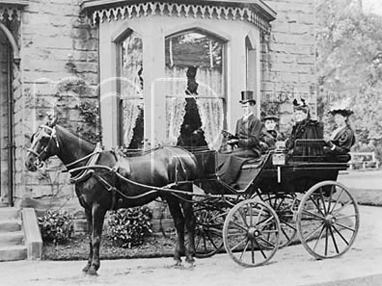
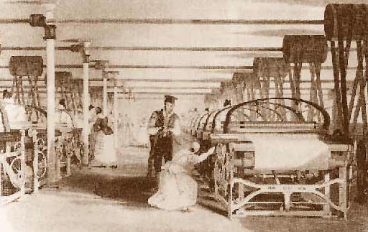
Chapter Three
Uncovering 19th Century Liberalism
Review Pages 102 – 104: Respond to the following questions:
Write out the issue question for Chapter Three
What social aspects of the Industrial Revolution did Dickens find significant?
What changes and social reforms would these activists have supported and promoted?
Where would you have stood in relation to the issue of social change, had you lived during these times?
How does Ricardo’s message differ from that of Dickens?

Slide 3
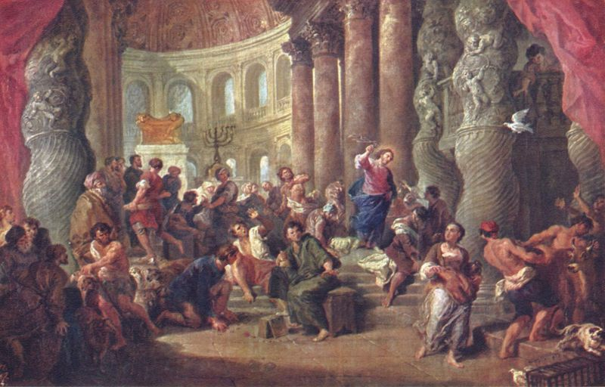
Chapter Three
Section 1: History of Classical Liberalism
What is Classical Liberalism?
Is an ideology that embraces the principles of individualism:
The rule of law
Individuals’ rights and freedoms
Private property
Economic freedom
Self-interest
Competition
Classical liberalism stresses both political and economic freedoms
Believes the best economic system is one that has limited
government intervention (free market)

Slide 4
Chapter Three
History of Classical Liberalism
Classical Liberalism followed the Renaissance, the Enlightenment and the Reformation
Renaissance sparked a belief in the importance of the individual
Reformation questioned the authority of the Catholic Church
Enlightenment reflected the importance of reason

Slide 5
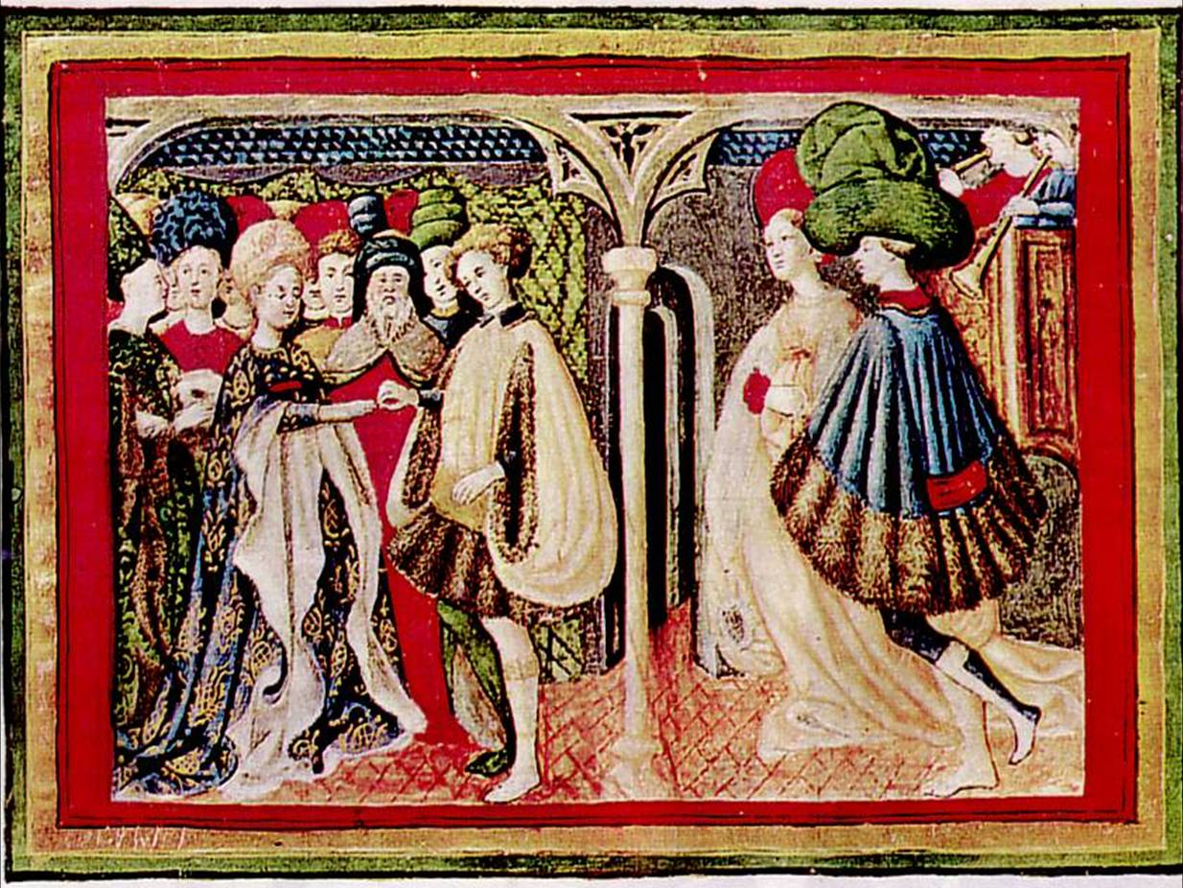
The Renaissance (14th to 16th Centuries)
“Re-birth”
Believed in the importance of arts and literature
Sought meaning and purpose in life
Cultural movement that profoundly affected European
intellectual life

Slide 6
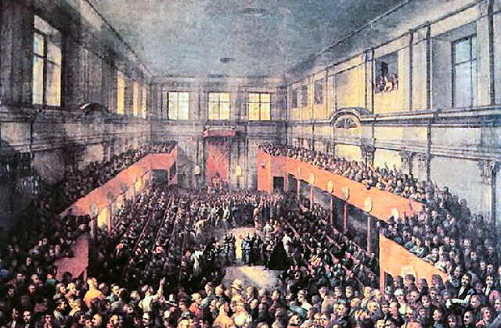
The Enlightenment (Late 17th Century)
Philosophical movement which stressed human reasoning over
blind faith or obedience and was in contrast with much of the
religious and political order of the day
Also encouraged 'scientific' thinking

Slide 7
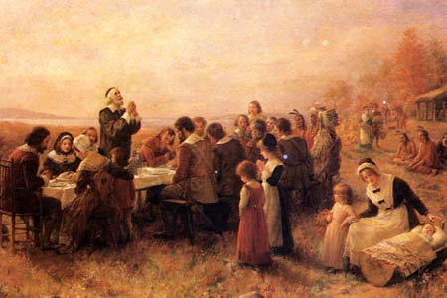
The Reformation (16th and 17th Centuries)
People began to question authority of the Catholic Church
Dramatically altered the political, economic, and social
circumstances of Europe in its opposition to the Catholic
Church
Also, during this time period, Europeans were coming into
contact with other non-Christian civilizations

Slide 8
Therefore…
Classical Liberalism
Encourages:
Individual rights and freedoms, to be exercised in the individual’s self – interest
Belief that humans are reasonable and can make rational decisions
Economic freedom, including private property
The protection of civil liberties
Limitations on the government
In your own notes, recreate the timeline found on page 105

Slide 9
Classical Liberalism
After reviewing pages 105 – 113, complete the following:
Classical Liberalism
Handout
Key Thinkers
Handout
Review

Slide 10
Classical Liberalism: Review
Review Pages 1-9 of the handout:
Chapter Three: Uncovering Nineteenth Century Liberalism – Section 1
Turn to page ten
Adam Smith Was Wrong
Big Box Mart

Slide 11
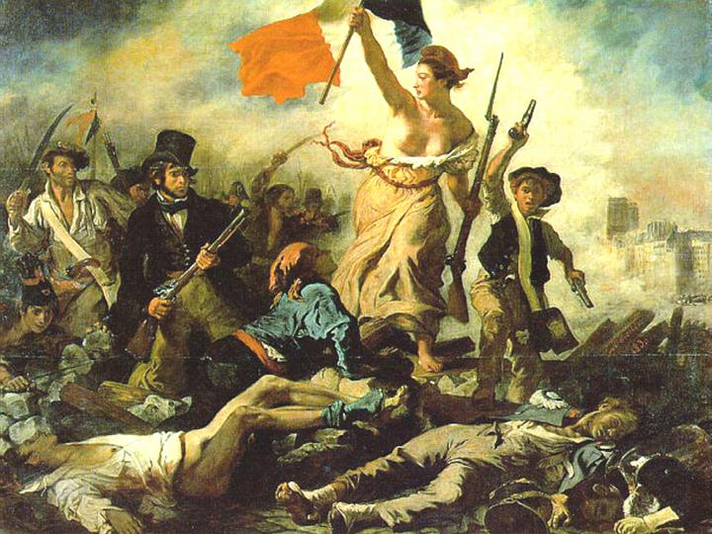
Chapter Three
Section 2: The Evolution of Classical Liberal Thought
Read the introduction on page 114

Slide 12
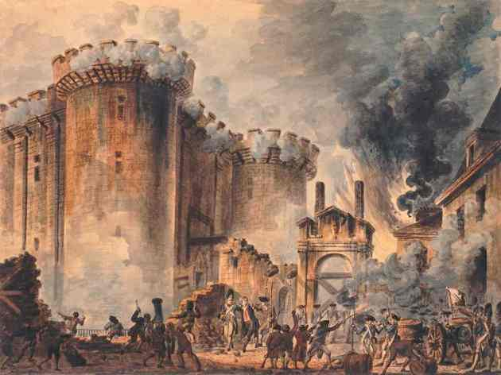
The French Revolution
What do you remember or know about this historical event?

Slide 13
Social Structure of France: Pre - Revolution
1st Estate
Made up of the clergy (the church)
Included 0.5 % of the population
2nd Estate
Made up of the nobility
Included 1.5 % of the population
3rd Estate
Included everyone else; mostly peasants
Included 98% of the population
Despite the fact that the 3rd estate held the vast majority of the population, they held virtually none of the power or the wealth of France

Slide 14
Social Structure of France, Pre - Revolution
1st Estate
2nd Estate
3rd Estate

Slide 15
Factors that led to the French Revolution
Factors that led to the French Revolution
Historical
Economic
Political
Social

Slide 16
Historical Factors
The French Revolution is viewed as a turning point in European nationalism
As a result of the French Revolution, the people changed France from an absolute monarchy (king with all power) to a republic (government elected by people)
Before the revolution, people
Were loyal to the king
Believed the king represented the nation
Believed that the only one to make decisions was the king
The king could jail, punish, or kill anyone who spoke out against him

Slide 17
Historical Factors
During the revolution, people’s idea of nation changed. They began believing that
They were the nation
They should make their own decisions
The Bastille (a French prison) was a symbol of the power that the king had over them
On July 14, 1789, angry Parisians stormed and captured the Bastille expecting to find hundreds of prisoners and weapons
In fact, there were only 7 prisoners inside
News of the successful attack on royal authority spread quickly and inspired people to take action

Slide 18
Social Factors
Before 1789 in France (pre-revolution), people’s roles in life were set before they were born
The son of a commoner was likely to remain a commoner for his entire life
The king and the nobility held most of the power
The king made and enforced rules
The nobility collected taxes and rent from the commoners but didn’t have to pay much tax
Peasants were also required to help repair roads and bridges for using the noble’s land
98% of the population was made up of commoners (peasants, laborers)

Slide 19
Changes in Ideas about Society
People resented having no say in their government
They knew that the United States had formed an independent country without a monarchy (king)
They knew that England’s king did not have absolute power as there was a parliament
People began to speak out against the government even though it was illegal
Books and newspapers began publishing these new ideas
There was a growing bourgeoisie (middle class) that lived in towns and cities
The bourgeoisie included factory owners, doctors, lawyers, writers
Members of the middle class were gaining wealth and education but still considered to be part of the 3rd estate
They were resentful towards the upper class

Slide 20
Economic Factors
During the 1700s, France was almost constantly at war
The wars were very expensive but not very successful
Building the king’s palace (Versailles) was also an economic burden
By the 1780s, the king was nearly bankrupt and wanted French citizens to pay more taxes, including the nobility
The nobility blocked the plan, so, in desperation, the king called a meeting of the Estates-General
The Estates-General was made up of the three estates who voted separately

Slide 21
Economic Factors
Traditionally, each estate had one vote, so the First and Second Estate could always outnumber the Third Estate
At this meeting, the Third Estate wanted to change the system and allow one vote per representative
They tried to meet but found that they had been locked out
They instead met at a nearby tennis court where they declared themselves the National Assembly and swore the Tennis Court Oath
They said that they were the only group that represented the nation and that they would not leave until a constitution had been created for equal rights for all men

Slide 22
Political Factors
Before the revolution, many French people did not feel a common national identity
The Third Estate’s lack of political power could be seen in the Estates-General, where each estate had one vote
The newly created National Assembly (from the Tennis Court Oath) created a document called the Declaration of the Rights of Man and of the Citizen
This took away the traditional privileges enjoyed by the king, clergy, and nobility.
It also said that the role of government was to preserve the rights of people.

Slide 23
Chapter Three
Section 2: The Evolution of Classical Liberal Thought
Read the rest of page 114, 115, 118
Read pages 116 and 117 separately
Complete the only question on page 116
Review the handout:
Chapter Three: Uncovering Nineteenth Century Liberalism: Section 2
Complete the chart on the final page of the above handout
You will need to review the following handouts to complete the chart:
The Canadian Charter of Rights and Freedoms
The Declaration of the Rights of Man
The American Declaration of Independence

Slide 24
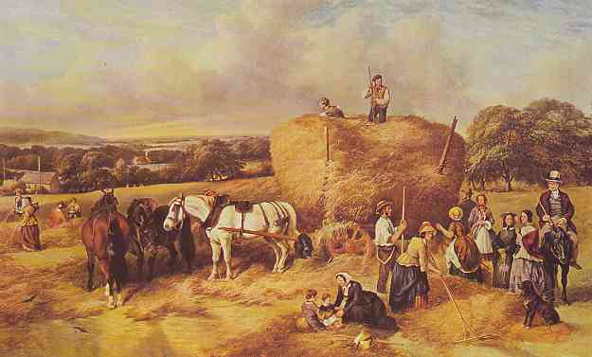
Chapter Three
Section 3: Liberal Principles in Action
Read pages 119 – 122, 124
Read page 123 separately
Review the handout:
Chapter Three: Uncovering Nineteenth Century Liberalism: Section 3
Complete all questions listed on page five of the above handout
If Time…
Determining Historical Significance
Activity
(Pages 125-126)

Slide 25
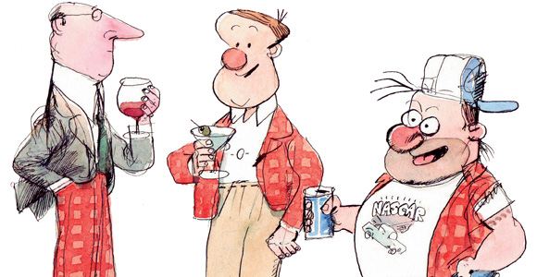
CLASS SYSTEM
the division of society into different classes of people, usually based on income or wealth.

Slide 26
ENLIGHTENMENT
an intellectual movement of the 17th
and 18th centuries when classical liberalism spread through Europe and changed some people’s beliefs about religion, reason, nature and human beings, also called the Age of Reason.

Slide 27
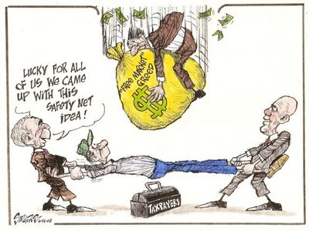
Free market
a market that operates with limited
government intervention. In a free-market economy, questions regarding production and marketing of goods and services are decided through the free interaction of producers and consumers.

Slide 28
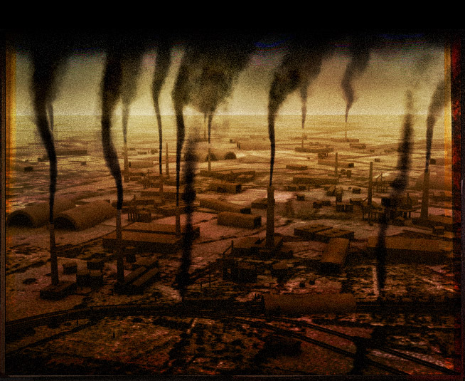
INDUSTRIALIZATION
the stage of economic
development during which
the application of technology results in mass
production and mass consumption within a
country. This is accompanied by urbanization and changes in national living standards.

Slide 29
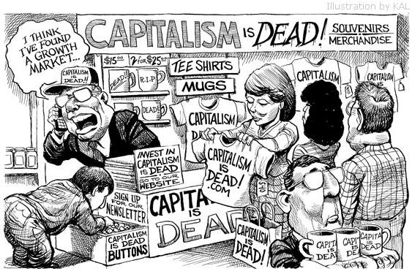
LAISSEZ-FAIRE Capitalism
Non-interference or non-intervention. Laissez-fair economics theory supports free markets
and an individual’s right to own private property.

Slide 30
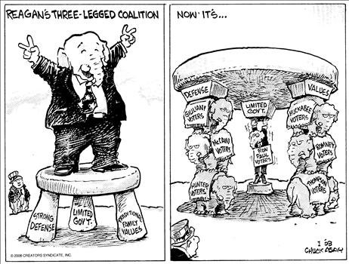
LIMITED GOVERNMENT
the principle of little government in the affairs of the economy in the belief that this results in more efficient self-regulating markets.

Slide 31
TRADITIONAL ECONOMY
an economic system
usually practiced by a
pre-industrialized society, where needs are meet through agriculture, hunting and fishing, and where there tends to be a division of labour based on custom and tradition.

Slide 32
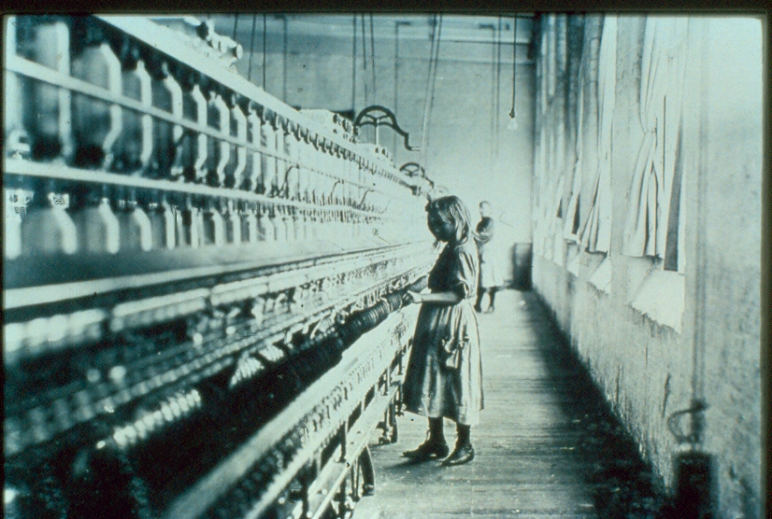
Chapter Four
Responding to Classic Liberalism
Review/compare the two quotes on page 129 and respond to the following questions:
What surprises you?
What ideas do the commentaries communicate to you about the ways in which people view the participation of children in society?
Complete the handout :
Exploring Historical and Contemporary Views
From page 130, write out the issue question for Chapter Four

Slide 33
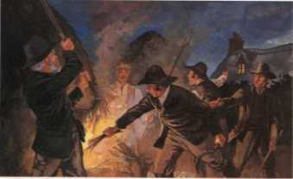
Chapter Four
Section 1: Opposition to Liberalism
Read the intro at the top of page 131
With a partner, review the rest of page 131 and up to the top half of page 144, and complete the handout:
Responses to Liberalism
Review
Responding to Classical Liberalism:
Ideologies Research Project

Slide 34
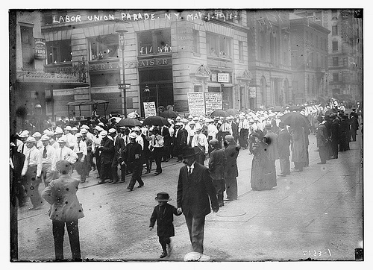
Chapter Four
Section 2: The Liberal Response
How did classical liberalism respond to competing ideologies?
Welfare Capitalism
What was it?
(Review pages 142-143)
Write out the following notes:
A classical liberal economic system combined with a government that used legislation to give workers protections like:
Limited working hours
Minimum wage,
A safety net with features like pensions and medical insurance

Slide 35
Chapter Four
Section 2: The Liberal Response
Welfare Capitalism
Getting these laws to protect workers was a long process
Each act passed would gradually improve the working conditions in factories, decrease working hours, regulate the age at which children could be employed, etc.

Slide 36
Chapter Four
Section 2: The Liberal Response
Welfare Capitalism
National Progressive Party
An example of this kind of movement was the organization of the National Progressive Party in 1912
Review pages 143 -144 and answer the following:
According to its founder, former United States President Theodore Roosevelt, why was it formed?
Identify three principles that this new party hoped to implement that challenged classical liberalism

Slide 37
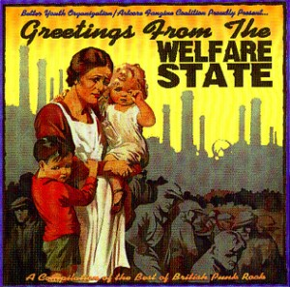
Welfare State
Read this section on pages 144-145
Write out the following notes:
The move from welfare capitalism to the welfare state was pushed by the Great Depression
Became a catalyst for change
The changes led to modern liberalism

Slide 38
Welfare State
During the 1920s, the economy in the United States was booming
Unemployment was low, wages were increasing, people had the ability to buy more things
Factories began producing more than people could buy, people began buying goods on credit, more people invested in the stock market
After the devastation of the Great War, Europe began producing grain once again

Slide 39
Welfare State
The revival of Europe’s agriculture production led to the market being oversaturated with grain, resulting in decreased prices
Led to the stock market crash which resulted in the Great Depression
Banks failed as people withdrew money, factories closed, unemployment rates grew

Slide 40
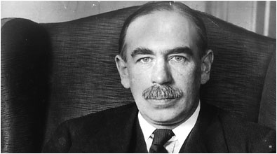
Keynesian Economics
The recession deepened through the 1930s
Read the sections Keynesian Economics and
Keynes’s Theories in Practice: The Advent of the Welfare State
On pages 147-149
Write out the following notes:
John Maynard Keynes believed that the basis for the market economy was based on a fundamental error
Classical liberalists believed that there would be full employment if supply and demand were kept in balance
Keynes argued that this was not true
Before we go any further (and in order to understand this better) here is a clear explanation of Liberal Economics from that time era

Slide 41
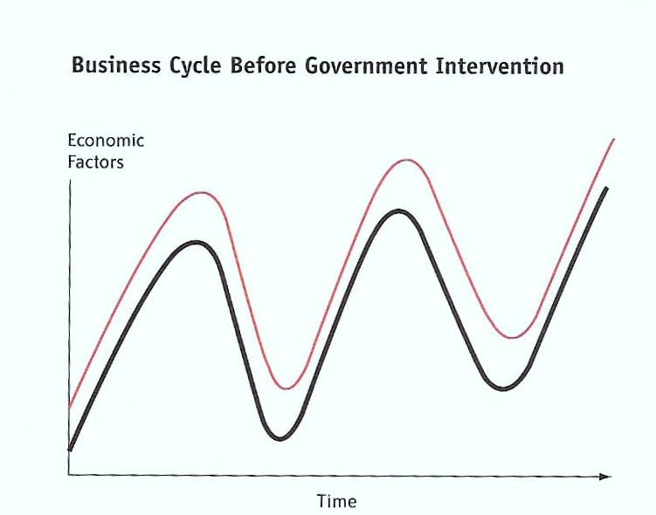
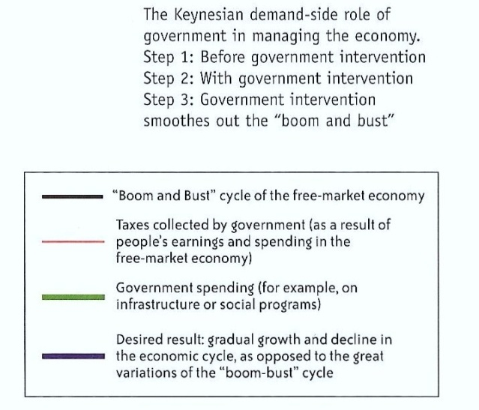
Keynesian Economics:
Step One

Slide 42
Keynesian Economics
Keynes believed that the economy was unstable and that in times of stress, people hoarded money and did not invest in the economy
Classical liberalists believed that good times followed bad, so it was an individual’s responsibility to save up for the bad times
Keynes felt that few people could successfully predict the market and that most people would inevitably suffer – he had a better idea…

Slide 43
Keynesian Economics
To avoid the ups and downs, Keynes suggested that during a recession*,
governments needed to spend more money and reduce taxes
This would provide jobs and leave more money in people’s pockets that could be spent in the economy
*a general slowdown in economic activity over a
long period of time

Slide 44
Keynesian Economics
Then during ‘boom times’, to pay back the money that had been spent during the recession by government, governments should spend less money and increase taxes
This would soften the boom, evening out the highs and lows of a capitalist economy

Slide 45
Keynesian Economics:
Step Two

Slide 46
Keynesian Economics:
Step Three

Slide 47
Keynes’s Ideas in Practice
To get the U.S.A. out of the Great Depression, Franklin D. Roosevelt used Keynes’s ideas
Known as the “New Deal”
The New Deal
(8:00)
Introduced a massive public works program to give people jobs
New Deal also had government provide emergency relief, reformed the banking system, attempted to redistribute power and resources
The involvement of the government in the economy represented the shift towards a welfare state and a mixed economy

Slide 48
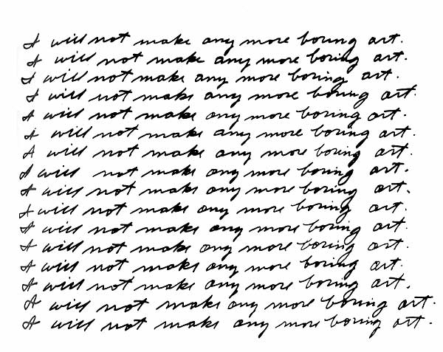
Explore the Issues
Complete questions 1, 3 & 4 on page 150
Hint for Question #1:
Focus on:
Economic Principles:
Were adapted to provided workers with limited working hours, minimum wages, pensions and medical insurance
Government Legislation:
Was passed to ensure improved wages and working conditions for workers
Keynes:
Developed rationale for adapting laissez-faire capitalism to moderate the boom and bust cycles so prevalent in capitalism

Slide 49
Explore the Issues
Question #3:
Karl Marx
Edmund Burke
Robert Owen
Theodore Roosevelt
John Maynard Keynes
Franklin D. Roosevelt
Claude Saint-Simon
Left
Right
Marxism Socialism Modern Liberalism Welfare Capitalism Classical Liberalism Classical Conservatism
Command Economy Mixed Economy Free-Market Economy Traditional Economy

Slide 50
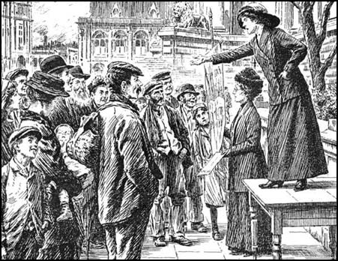
Chapter Four
Section 3: The Extension of Equality
How did the concept of equality expand?
In this final section of chapter four, we are going to look at:
Modifications made by classical liberals to the political, social, and economic foundations of the classical liberal state in its evolution toward modern liberalism
To what extent classical liberals began to demonstrate a social conscience and concern for the equality rights of workers
Examine labour standards and unions, universal suffrage, and equality rights for women
Read the introduction on page 154

Slide 51
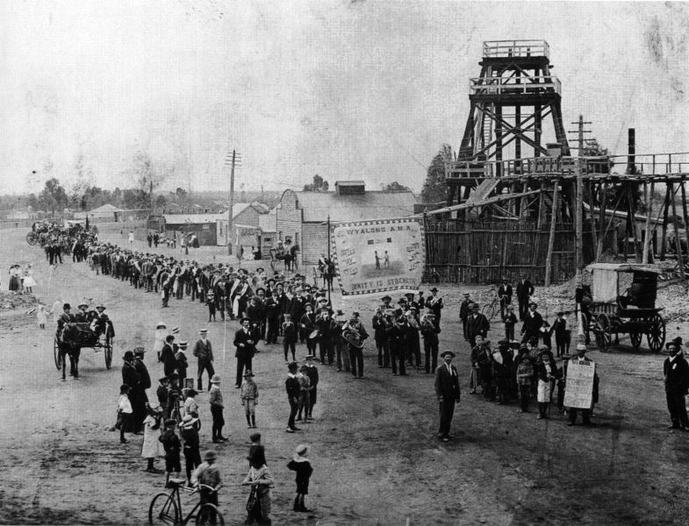
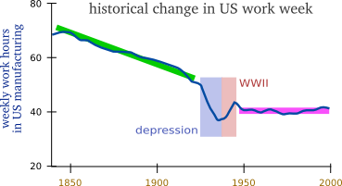
Chapter Four
Section 3: The Extension of Equality
Labour Standards and Unions
What was the average work week (in total hours) for an American in the mid-late 1800’s?
Six day work weeks were ‘the rule’ in the 1800’s
According to the chart (and the six day work week), how many hours a day would one be working in 1884?

Slide 52
Chapter Four
Section 3: The Extension of Equality
Labour Standards and Unions
The 8 Hour Song
We mean to make things over
We're tired of toil for nought
But bare enough to live on;
Never an hour for thought.
We want to feel the sunshine:
We want to smell the flowers
We're sure that God has willed it
And we mean to have eight hours.
We're summoning our forces
From shipyards, shop and mill
Eight hours for work, eight hours for rest
Eight hours for what we will!
How does the above song demonstrate workers attitudes and feelings about the situation in which they found themselves?
The Eight Hour Day Movement
The eight hour day movement began, in earnest, in 1884. That union passed a resolution to "establish eight hours work as the legal day's labour for all workers," and called for a "universal strike for the establishment of the working day of 8 hours, to take place no later that May 1, 1886." Workers across the USA were inspired, as this movement spread.
Workers ate "8 hour lunches," wore "8 hour shoes." and smoked "8 hour tobacco."
The "8 hour song" swept across the nation.
Do you want to hear it?

Slide 53
Chapter Four
Section 3: The Extension of Equality
Labour Standards and Unions
Read pages 155 – 156
Complete the Pause and Reflect at the bottom of page 155 and page 156
Discuss

Slide 54
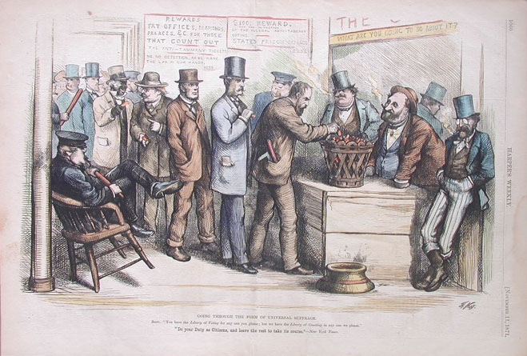
Chapter Four
Section 3: The Extension of Equality
Universal Suffrage
What does Universal Suffrage mean?
The extension of the right to vote to all adult citizens
Read page 157
Summarize the timeline at the bottom of the page (Figure 4-14) and complete the questions that go along with it

Slide 55
Chapter Four
Section 3: The Extension of Equality
Equality Rights for Women in Western Democracies
History by the Minute
As you watch each of these ‘minutes’, write down how these Canadian women impacted change and reform in Canada
Agnes Macphail
Emily Murphy
Jennie Trout
Laura Secord
Nellie McClung
Mid-Wife
Rural Teacher

Slide 56
Chapter Four
Section 3: The Extension of Equality
Equality Rights for Women in Western Democracies
Read pages 158 – 159
When finished, answer the questions at the bottom of page 159

Slide 57
Explore the Issues
Complete questions 1, 2, 5 & 6 on page 162
Question #1
Examples of the extension of equality in the late 19th century and early 20th century:
Improvement of labour standards
Labour unions fought for the right to organize and bargain collectively
with employers for increased wages and improved working conditions
Universal suffrage: for males; for females; for all minority groups in society
Equality rights for women: ex – holding public office, property rights
Changes and eventually more recognition of the rights of Aboriginal peoples

Slide 58
Chapter’s 3- 4 Exam
Consists of:
50 M.C. Questions
(38 Source Based + 12 Discrete)

Slide 59
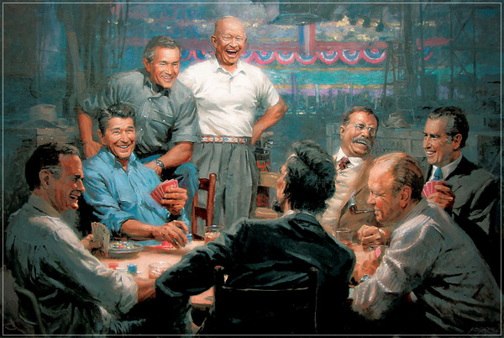
CLASSICAL CONSERVATISM
an ideology that says government should represent the legacy of the past as well as the well-being of the present, and that society should be structured in a hierarchical fashion, that government should be chosen by a limited electorate, that leaders should be humanitarian and that the stability of society is all important.

Slide 60
Command economy
an economic system based on public (state) ownership of property in which government planners decide which goods to produce, how to produce them, and how they should be distributed (for example, at what price they should be sold), also known as a centrally planned economy, usually found in communist states.

Slide 61
a system of society with property vested in the community and each member working for the common benefit according to his or her capacity and receiving according to his or her needs.
communism

Slide 62
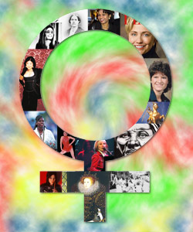
feminism
the belief in the social, political and economic equality of the sexes. The term also stands for those that advocate for these qualities.

Slide 63
Human rights
also known as “natural rights”, the rights and freedoms to which all humans are entitled. These rights are enshrined in Bills and Declaration of Rights in many countries including Canada and the United States, and in the United Nations Universal Declaration of Human Beings.

Slide 64
Labour standards
government-enforced rules and standards aimed at safe, clean working environments, and the protection of workers’ rights to free association, collective bargaining and freedom from discrimination.

Slide 65
Labour unions
associations of workers engaged in a similar
function who unite to speak with management
about their concerns. Their purpose is to provide
a united voice that speaks for the rights of its
members.

Slide 66
Marxism
a radical form of socialism, often called
scientific socialism or communism to
distinguish it from other socialist ideologies.

Slide 67
Mixed economy
an economic system based on free-market
principles but with some government
intervention, usually to regulate industry,
to moderate the boom-and-bust nature of
the free-market business cycle, and to offer
social welfare programs. In some mixed
economic systems, the government owns
some key industries (such as communications,
utilities or transportation.)

Slide 68
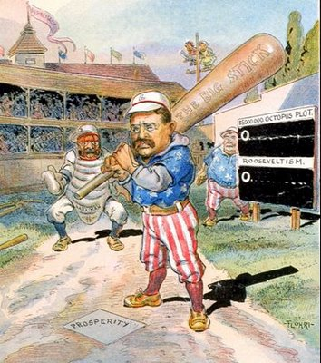
progressivism
a 1920’s movement in the United States,
usually associated with President Theodore
Roosevelt, that reacted to the perceived
abuses of laissez-faire capitalism by large
corporations. Progressives favoured “ a
square deal” for average citizens and used
legislation and some regulation of the
marketplace to achieve this.

Slide 69
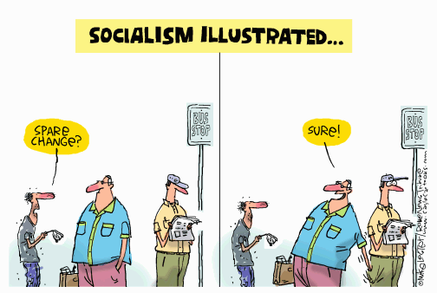
socialism
any ideology that contains the belief
that resources should be controlled
by the public for the benefit of everyone
in society, and not by private interests
for the benefit of private owners and
investors.

Slide 70
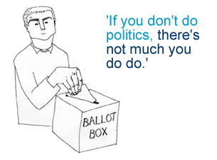
Universal suffrage
the right of all members of society,
once they reach the age of accountability, to fully participate politically. This participation begins with the right to vote.

Slide 71
Welfare capitalism
initiatives by industrialists to
provide workers with non-monetary rewards to head off the growing demands for labour unions; also refers to government programs that would provide social safety nets for workers.

