Slide 1
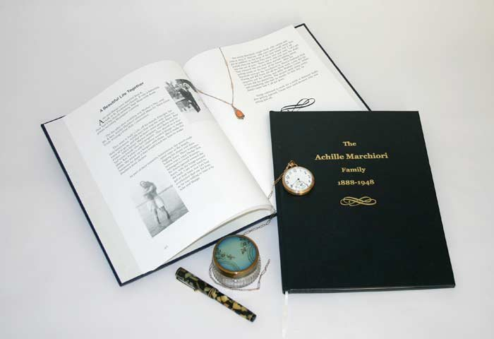
Social 10-2
Related Issue #2
Page 110 - 111
To what extent should contemporary society respond to the legacies of historical globalization?
OR
Should people in Canada respond to the legacies of historical globalization?

Slide 2

Social 10-2
Related Issue #2
Challenge
Participation in a Four Corners Debate that Discusses, Reviews and Evaluates responses to the statement below:
Contemporary society has done enough to respond to the legacies of historical globalization
This relates directly to your related issue question:
Should people in Canada respond to the effects of historical legacies of historical globalization?
Read pages 112 – 113
Handout: Four Corners Debate

Slide 3
Mock
Four-Corners Debate
Topic:
Taylor Swift should be at the top of the music charts
How do I prepare to answer this?

Slide 4
Steps to a
Four Corners Debate
Research the issue
Take a starting position
Go to one of the four corners in the room
Present information that supports your opinion
Consider the information presented by the students who took different positions
Move to a different corner if your position has changed

Slide 5
Evaluation Rubric
All categories are weighted evenly

Slide 6
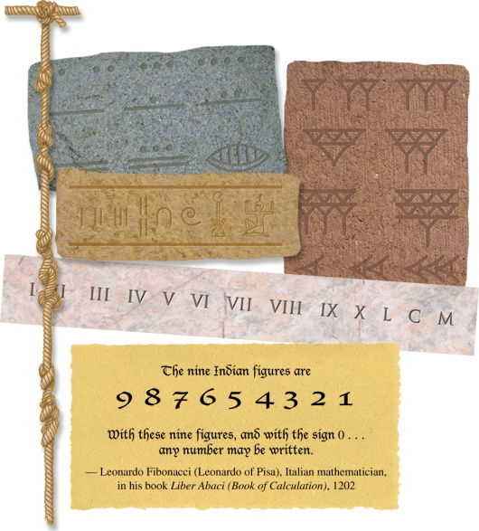
Numbers…
Write down at least ten different ways you use numbers on a daily basis
Read the caption below this picture on page 114
Read page 115 and answer the six questions

Slide 7
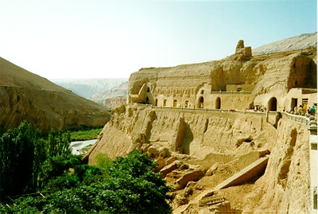
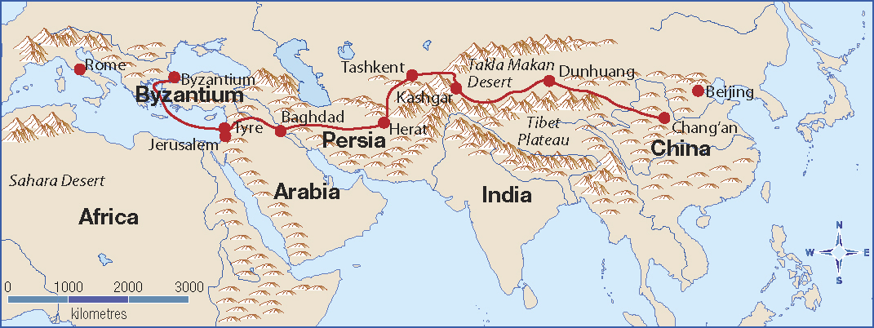
The Silk Road
What countries did the Silk Road pass through?
What are some of the present-day names of these countries?
How long was the Silk Road?
What goods were carried along this road?
What effects did the Silk Road have in the countries it passed through?
In what ways did the Silk Road contribute to historical globalization?

Slide 8
Today’s ‘Silk Road’
What are some items you can acquire today because of international trade?
How are the trade routes of today similar to the ‘Silk Road’?
What are some of the differences?

Slide 9
Why and How did Globalization Begin?
Read page 116
How important is knowing the beginning date of Globalization?
What are some events that you know the exact date of?
What are some events that you can’t know the exact date of?

Slide 10
One Theory….
Read the first half of page 117
After reading the Reflect and Respond at the bottom of this page…
Can you add one statement to this list?
How about a list of criteria…can you list three criteria?
Possible examples:
Is it supported by evidence?
Does it have the intellectual/academic support of peers?
Is it accepted by a significant number of peers?

Slide 11
The Concept of Historical Globalization
After reading the second half of page 117, can you add a second starting point of Globalization?
Is there a starting point that the entire class can agree on?

Slide 12
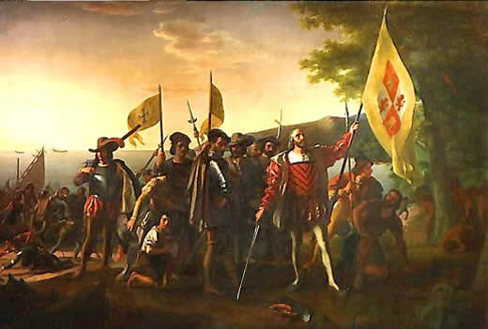
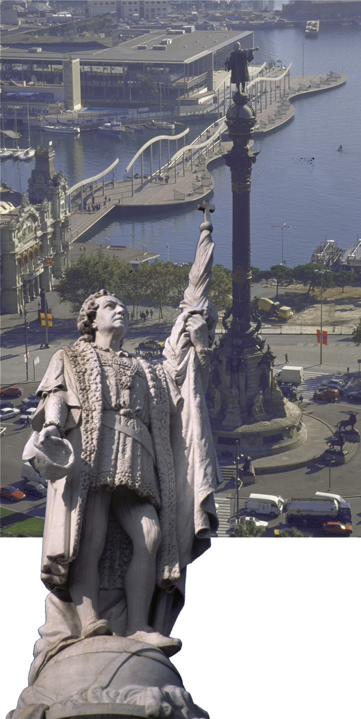
What do you know about Christopher Columbus?
What you may not know about Christopher Columbus?
Europeans brought many diseases that killed indigenous people
Europeans took land away from indigenous people
Europeans imposed their religion on indigenous people
Is it all positive? Negative?
Europeans viewed indigenous people as savages
Europeans often treated indigenous people badly

Slide 13
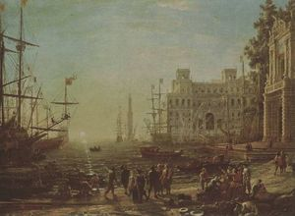
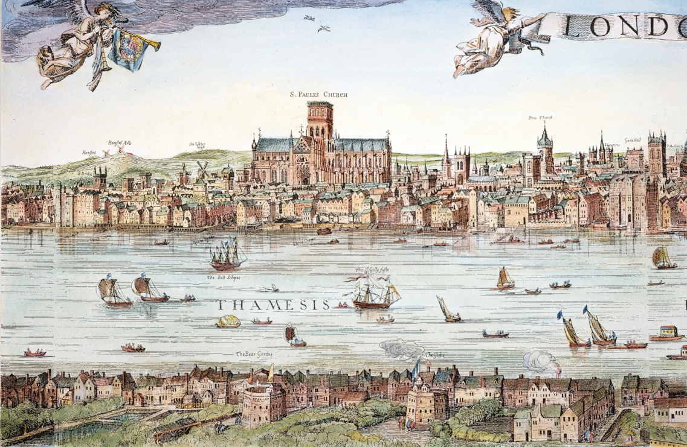
Look carefully at this illustration on page 120 What do you think London was like in 1616?
Natural Environment?
Buildings and Other Structures?
Human Activities?
Aspects of the Drawing?
Purpose of the Drawing?

Slide 14
How Did the Foundations of Historical Globalization Affect People?
Read page 120
Which Communication Technologies are contributing to globalization today?
Internet?
How does the internet shape the process of and attitudes toward globalization?

Slide 15
New Ideas
Read page 121
Complete the Activity at the bottom of the page
Predictions:
Large, square sails may have lead to…
Improved navigational tools may have lead to…
Gunpowder may have lead to….

Slide 16
Mercantilism
What other words appear to be related to mercantilism
Write down as many as you can think of…
Write down your definition and the one from the glossary

Slide 17
Analyzing Mercantilism
Read page 122 with a partner and while you read…
Complete the handout
Analyzing Mercantilism

Slide 18
Analyzing Mercantilism
What is Mercantilism?
Control of trade by a colonizing nation
Factors that made mercantilism work…
Armed forces, navies and merchant marine fleets
Forces that caused mercantilism…
The drive for more trade
Profits = control of the trade and competition gone!
The growth of the middle class in Europe
Discovery of valuable raw materials
Forces that lead to the decline of mercantilism…
Resistance from the colonies
New economic ideas

Slide 19
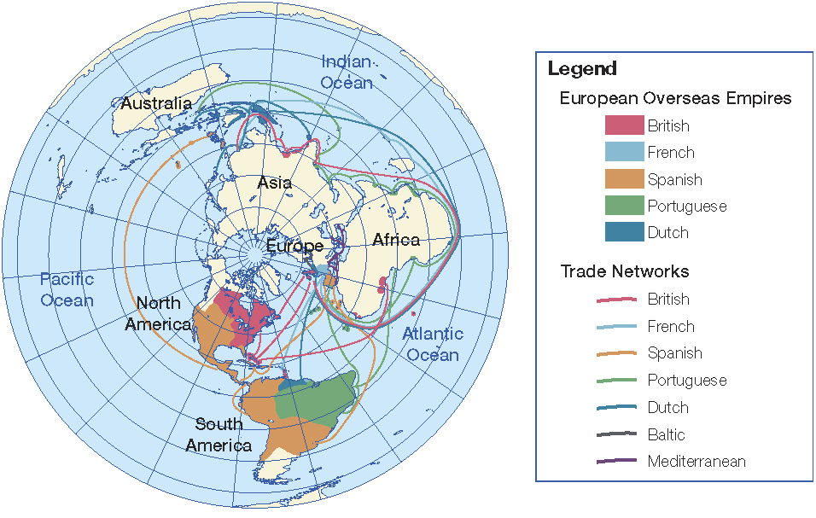
Read Dividing up the World on page 123
Now listen to the following questions about the map above…

Slide 20
Effects of European Colonial Settlement
Read page 124 and…
In groups of two, complete the Reflect and Respond assignment at the bottom of the page
After giving your own name to this conflict, sum up the perspective of each group in a sentence or two…
The British
The Rebellious Colonists
The First Nations

Slide 21
And Finally…
Begin a list of terms from this chapter, which include…
Any term or phrase that would be considered important in helping you with your …
Four Corners Debate!
Any suggestions as to what you should include?

Slide 22
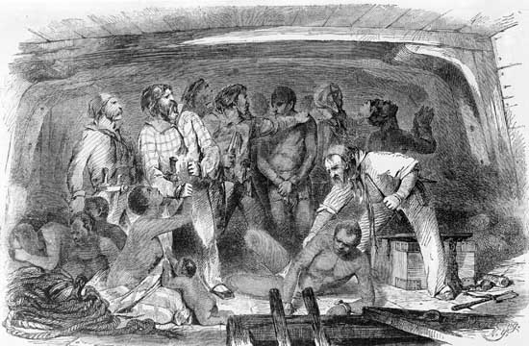
Consequences of Globalization on People
Lets Review…
Mercantilism means…
Imperialism means…
Colonization
Domination
Exploitation (Abuse)

Slide 23
How Did The Consequences of Historical Globalization Affect People?
Write out and
complete the
following chart:
Reacting to
Invasion by
Colonizing Forces
Read the first
paragraph of
page 125

Slide 24
How Did The Consequences of Historical Globalization Affect People?
Complete reading the rest of page 125, including the Activity
Approximately how many indigenous people died as a result of contact with Europeans?
Up to 10 million!

Slide 25
Differing Approaches to the Indigenous Peoples of the Americas
As you read page 126, consider the following questions and write your responses in your notebooks. This will assist you with your Four Corners Debate:
Why did the imperialist powers behave as they did toward the Indigenous peoples?
Why did the imperialist powers not think that their actions were wrong or inhumane?
Are attitudes toward Indigenous peoples the same or different today?

Slide 26
Slavery
Read page 127 and answer the following:
What do you think of Olaudah’s story?
How might his story be important to the anti-slave trade in Europe?

Slide 27
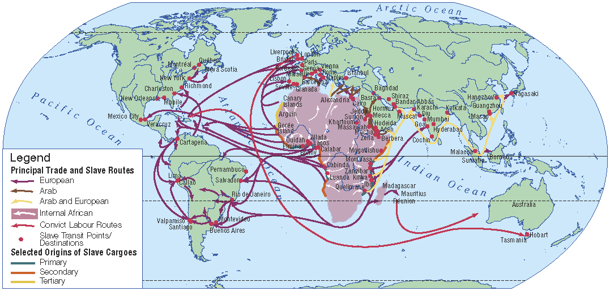
Cheap Labour
Read the Introduction on page 128
Read the handout The Slave Route, A Memory Unchained and note any questions you may have about the map

Slide 28
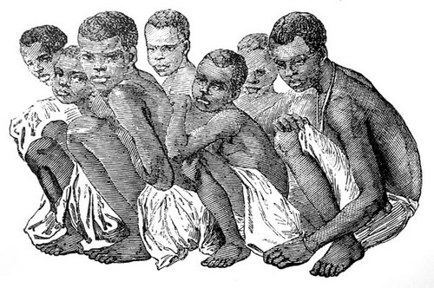
Cheap Labour
Finish reading pages 128 – 129
Consider question #1 in Explorations and record your responses in your notebook

Slide 29
Vocabulary
Add to your Chapter Five list….
Any term or phrase that would be considered important in helping you with your …
Four Corners Debate!
Any new suggestions as to what you should include?

Slide 30
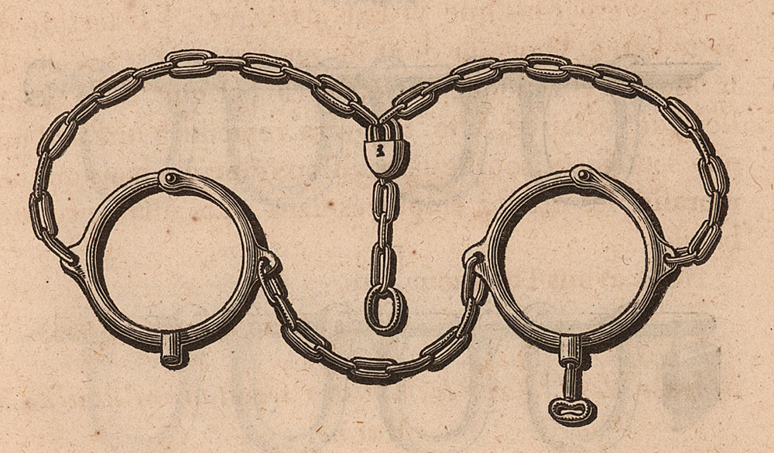
Responses to Slavery
Read the first half of page 130 followed by Making Choices
Slavery
Slave Trade
What is the difference between these terms?
Add these two terms to your list

Slide 31
Expressing Strong Opinions
Create a chart similar to the one below and complete Explorations #1 on page 130
Constructive
Cheering for your own team
Raising awareness about an issue by writing letters
Wearing school colours while cheering for your team
Destructive
Being rude to visiting team
Damaging another team’s players or school property
Rejecting another person’s idea without consideration

Slide 32
What do you think?
Was involvement in the slave trade morally better or worse than owning slaves – or did it amount to the same thing?
Write a two or three sentence summary
Be prepared to defend your response

Slide 33
Slavery – A Moral Dilemma
Your responses probably fit into one of the following three categories:
Trading and owning slaves amounts to the same thing morally because they depend on each other.
Owning is less morally wrong because owners are participating in a system they have little control over, while traders are actively dealing in lives.
Trading is less morally wrong because the traders are just meeting a need. If the owners did not demand slaves, the traders would not need to find them and sell them – and if these traders don’t do it, then someone else will.
African Imperialism Assignment

Slide 34

155 minutes

Slide 35
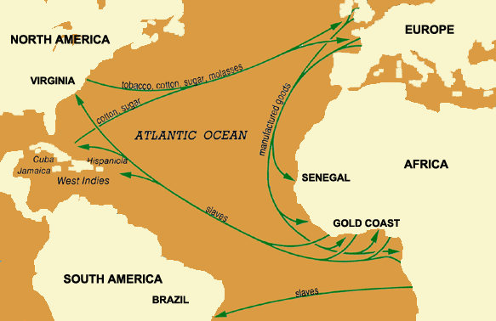
The Grand Exchange
Make a list of the foods you regularly eat, specifying the major components of each dish
Read all of page 131
Referring to Figure 5-16, circle foods on your lists that originated in Europe, Asia or Africa
What would life be like if you did not get the ‘circled’ foods?
What would you substitute for the foods that are not available?
In what ways might the loss of these foods affect your quality of life?

Slide 36
Industrialization and Social Change
Write out your own chart, similar to the one below and (with the class) complete the first two columns – for the second column, keep in mind the themes we have been covering in this chapter
As you read, add new ideas to the third column in your chart
Read page 132

Slide 37
Vocabulary
Complete your Chapter Five list….
Any term or phrase that would be considered important in helping you with your …
Four Corners Debate!
Any new suggestions as to what you should include?

Slide 38
Four Corners Debate
Take a look through the chapter, your notes and your vocabulary list…
What are some ideas discussed so far in this chapter that might be useful for your debates?
Add all of these ideas on a new list entitled:
Four Corners Debate

Slide 39
Chapter Five Quiz
Your quiz is made up of three question, all of them written response
Get to know the terms/phrases/people/events you listed as important for this chapter
One of the three questions is responding to an Inquiry Question, so be prepared to defend your response!

Slide 40
Chapter Five Activity
Now that you have completed the opening chapter on Related Issue Two, what are some of the different perspectives and points of views on colonialism?
In groups no larger than three, create a PowerPoint visual, that shows one point of view or perspective on one way colonialism has affected the world today.
This visual can be positive, negative or neither.
Include a detailed description of the people or group whose point of view or perspective you have chosen
This will be displayed by your group later this class and has to be available on one of your group members profile’s
Social 10-2
Social 10-2

