Slide 1
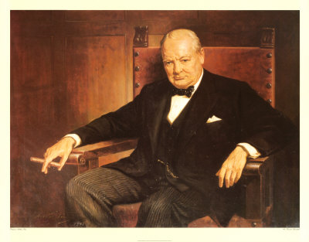
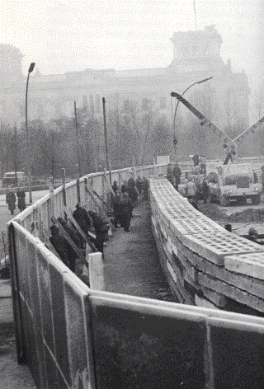
The Cold War Era
Chapter Seven
Liberalism Related To Foreign Policy
What Was
The Cold War?
Read Pages 232– 233
In terms of ideologies, what does a wall represent?
A wall can represent the physical and ideological barrier between two opposing sets of beliefs and values.
In the case of the Cold War, the Berlin Wall was a physical manifestation of the ideological barrier between East and West, between communism and democracy/capitalism
Cold War: Preview
7:00
Write out the issue question for Chapter Seven from page 234
1:00
Churchill's ‘Iron Curtain’ Speech

Slide 2
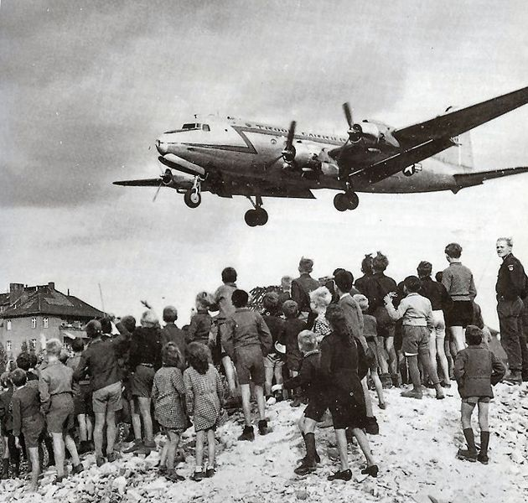
International Relations After The Second World War
Read Page 235
What was the nature of Stalin’s prediction?
Write out a complete description of:
The Cold War
Read pages 236 - 243
When finished, complete the Pause and Reflect on page 243
Write out the following notes…

Slide 3
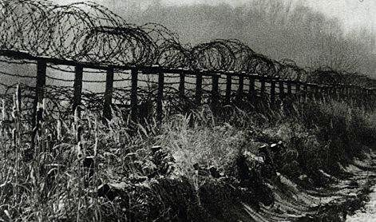
The Iron Curtain
Phrase coined by Churchill
Described the line in Europe between self-governing countries of the West and countries of the East controlled by the Soviet Union viewed differently
Americans viewed it is a barrier meant to contain those oppressed by communism
Soviets saw it as a protective measure, protecting them from capitalist influences and the potential expansion of fascism

Slide 4
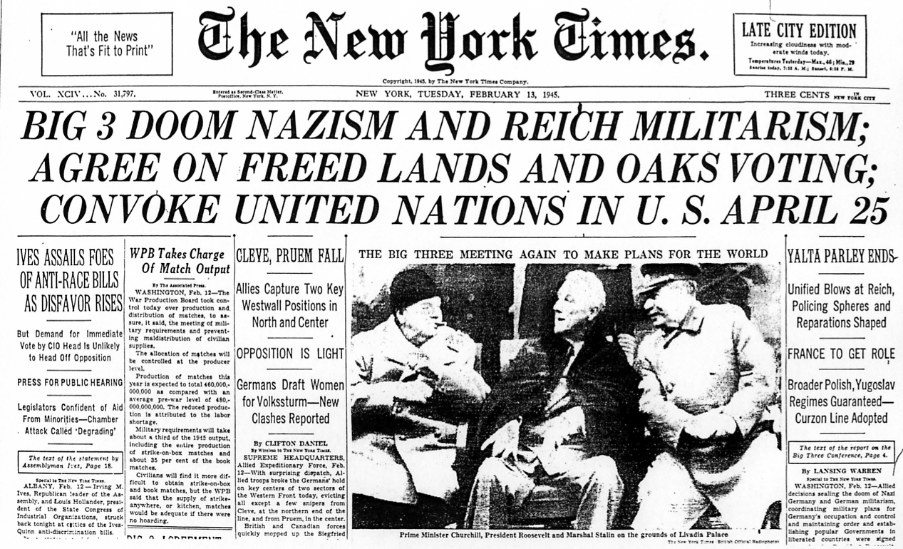
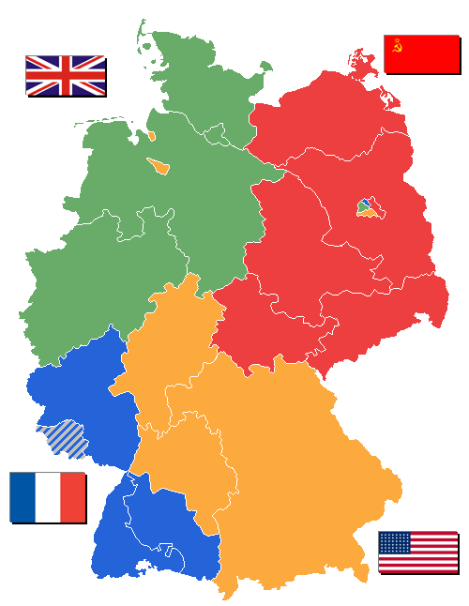
The End of WWII is Near…
The Yalta Accords
February 1945
The “Big Three” (Roosevelt, Stalin, and Churchill) met at Yalta to discuss remaining wartime actions and to determine the future of postwar Europe
Most basic (and important) task was to re-draw the map of Europe
Occupation Zones of Germany
3:00

Slide 5
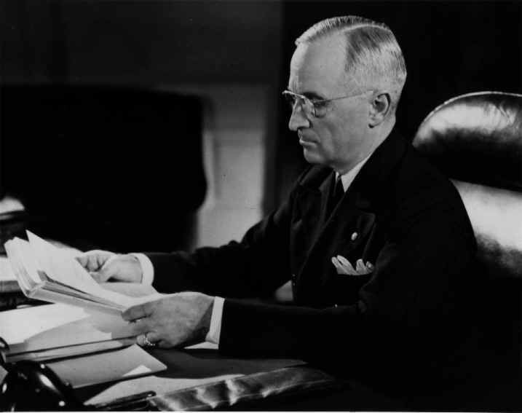
Truman Doctrine (1947)
Containing Communism
Aimed to contain the communist threat in Europe (stop it from spreading)
Sent military aid ($400 million) to Greece and Turkey to allow the authoritarian governments to win the civil war – not the communist guerillas
3:00

Slide 6
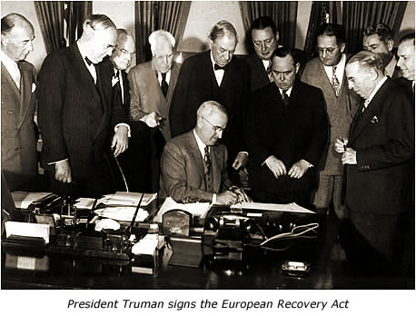
Marshall Plan (1947 – 1952)
US made reconstruction of Europe a priority
They believed that a prosperous Europe would find communism less attractive
Began a massive economic aid program for western Europe
3:00

Slide 7
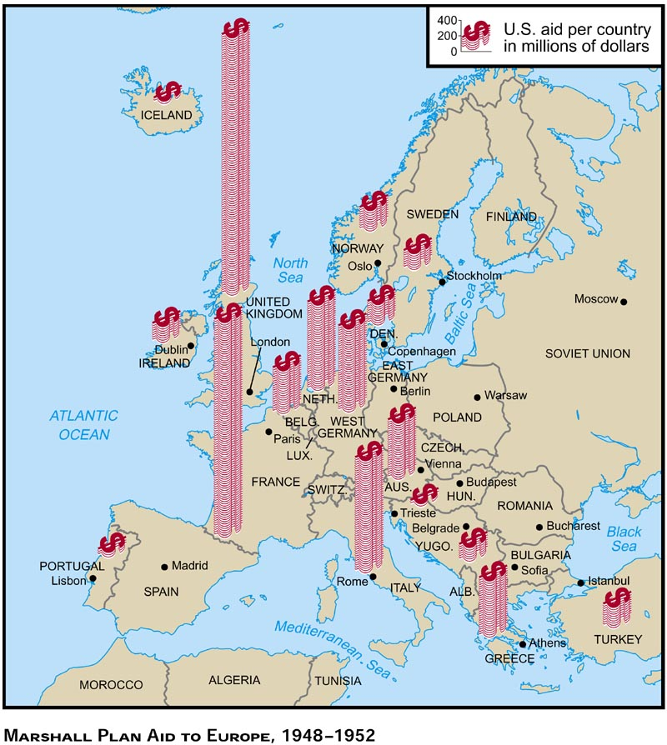
Review Figure 7-6 and its caption on page 243
Why did the Soviet Union (and its Eastern European allies) reject the Marshall Plan

Slide 8
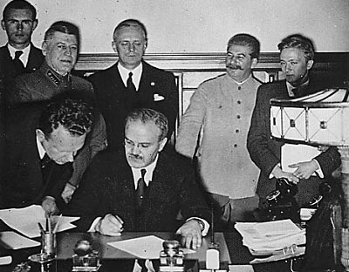
The Molotov Plan
Developed by the Soviets to counter the Marshall Plan
Involved trade agreements that helped consolidate the economics of Poland,
Czechoslovakia, East Germany, Hungary, Romania, Bulgaria
Helped solidify the Soviet presence in Europe
Read pages 244 – 248
Write out the following notes…

Slide 9
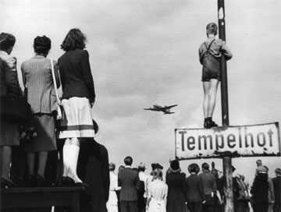
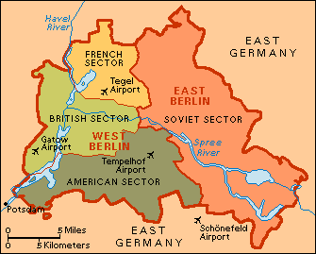
Berlin Airlift
Berlin, like Germany, was divided into four parts, even though Berlin was in the Soviet zone
of Germany

Slide 10
Berlin Airlift (Con’t)
The USSR allowed corridors through the occupation zone so that goods and people could
move between the non-Soviet zones in Germany and Berlin
The US unified the American, British, and French zones wanted West Germany to have an
anti-communist, democratic government
USSR viewed this as a threat
In June 1948, Soviet Union shut down the corridors
This trapped “West Berlin” behind the Iron Curtain
The Allies decided to fly in supplies to Berlin

Slide 11
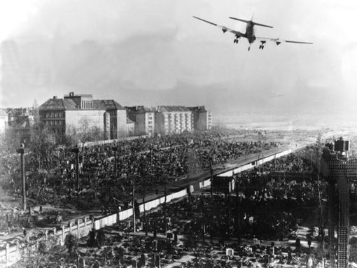
Berlin Airlift (Con’t)
The Berlin crisis introduced the idea of brinkmanship
Brinkmanship:
A tactic of meeting threat with threat until the world teetered on the edge of war
At first, Stalin did nothing figuring that the US would stop – which they didn’t
USSR contemplated shooting or sending tanks into Berlin but then the US flew
B-29 bombers to Britain (the ones that had dropped A-bombs on Japan)
Stalin lifted the blockade (having lasted 300 days)
Berlin remained split – a symbol of the deep division between the two
ideologies

Slide 12
Berlin Airlift
45:00
Complete Handout:
International Relations after the Second World War

Slide 13
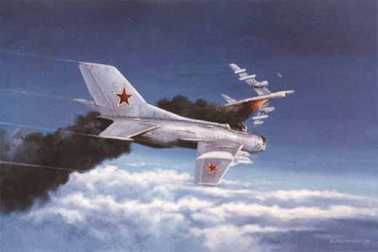
The Cold War Heats Up
Read pages 249 - 257
Write out the following notes…
Alignment vs. Non - Alignment
For security, many countries aligned themselves with either the US or the USSR
The US and USSR sometimes forced a country to choose a side by providing aid or influencing elections
Other countries chose a path of non-alignment – they chose a completely different ideology

Slide 14
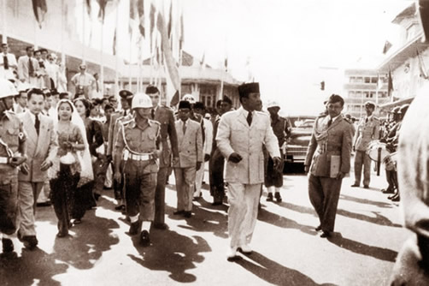
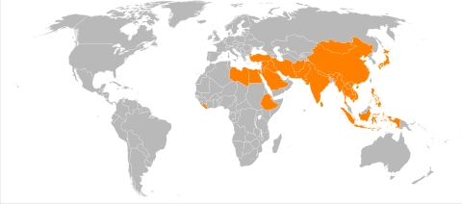
Bandung Conference
Beginning of the Non-Aligned Movement (NAM)
Representatives (from Africa and Asia) met to promote economic and cultural co operation
and oppose the imperialist nature of the superpowers
Concept of the “Third World” emerged

Slide 15
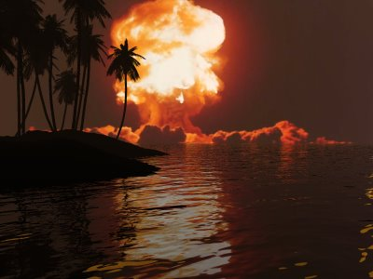
Deterrence
Involves the building up of one’s capacity to fight such that neither will fight because of the
expected outcomes
Each country builds up its capacity for weapons to deter (prevent) the other side from
attacking them
Mutually Assured Destruction (MAD) – won’t enter into direct conflict (hot war) because of the destruction to both sides that would occur
MAD
45:00

Slide 16
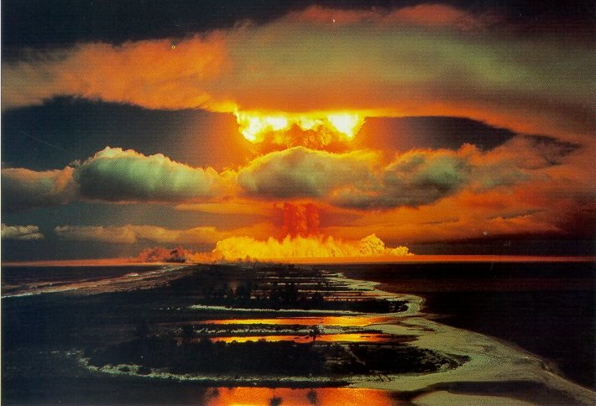
France’s Dissuasion Policy
Developed nuclear weapons independent of other countries
Didn’t build them against a specific enemy – rather, so no one would attack them
France would deter another country from attacking them because of their immense capability to strike
back with more force than the invading country

Slide 17
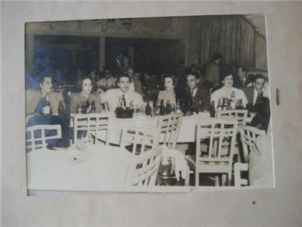
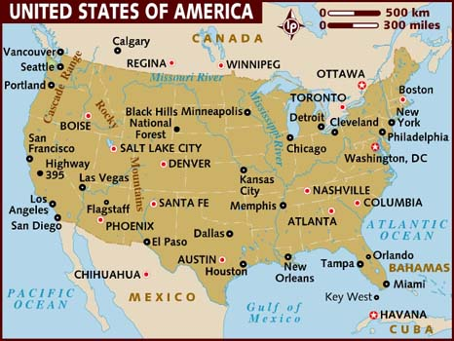
The Cuban Missile Crisis and Brinkmanship
Tensions continued to rise between the USA & USSR
Fulgencio Batista was a US supported dictator in Cuba
Batista was a corrupt, pro-capitalist military ruler whose goal was to turn Cuba into the
“Latin Las Vegas”
The Cuban poor became restless – led the way for a socialist revolution

Slide 18
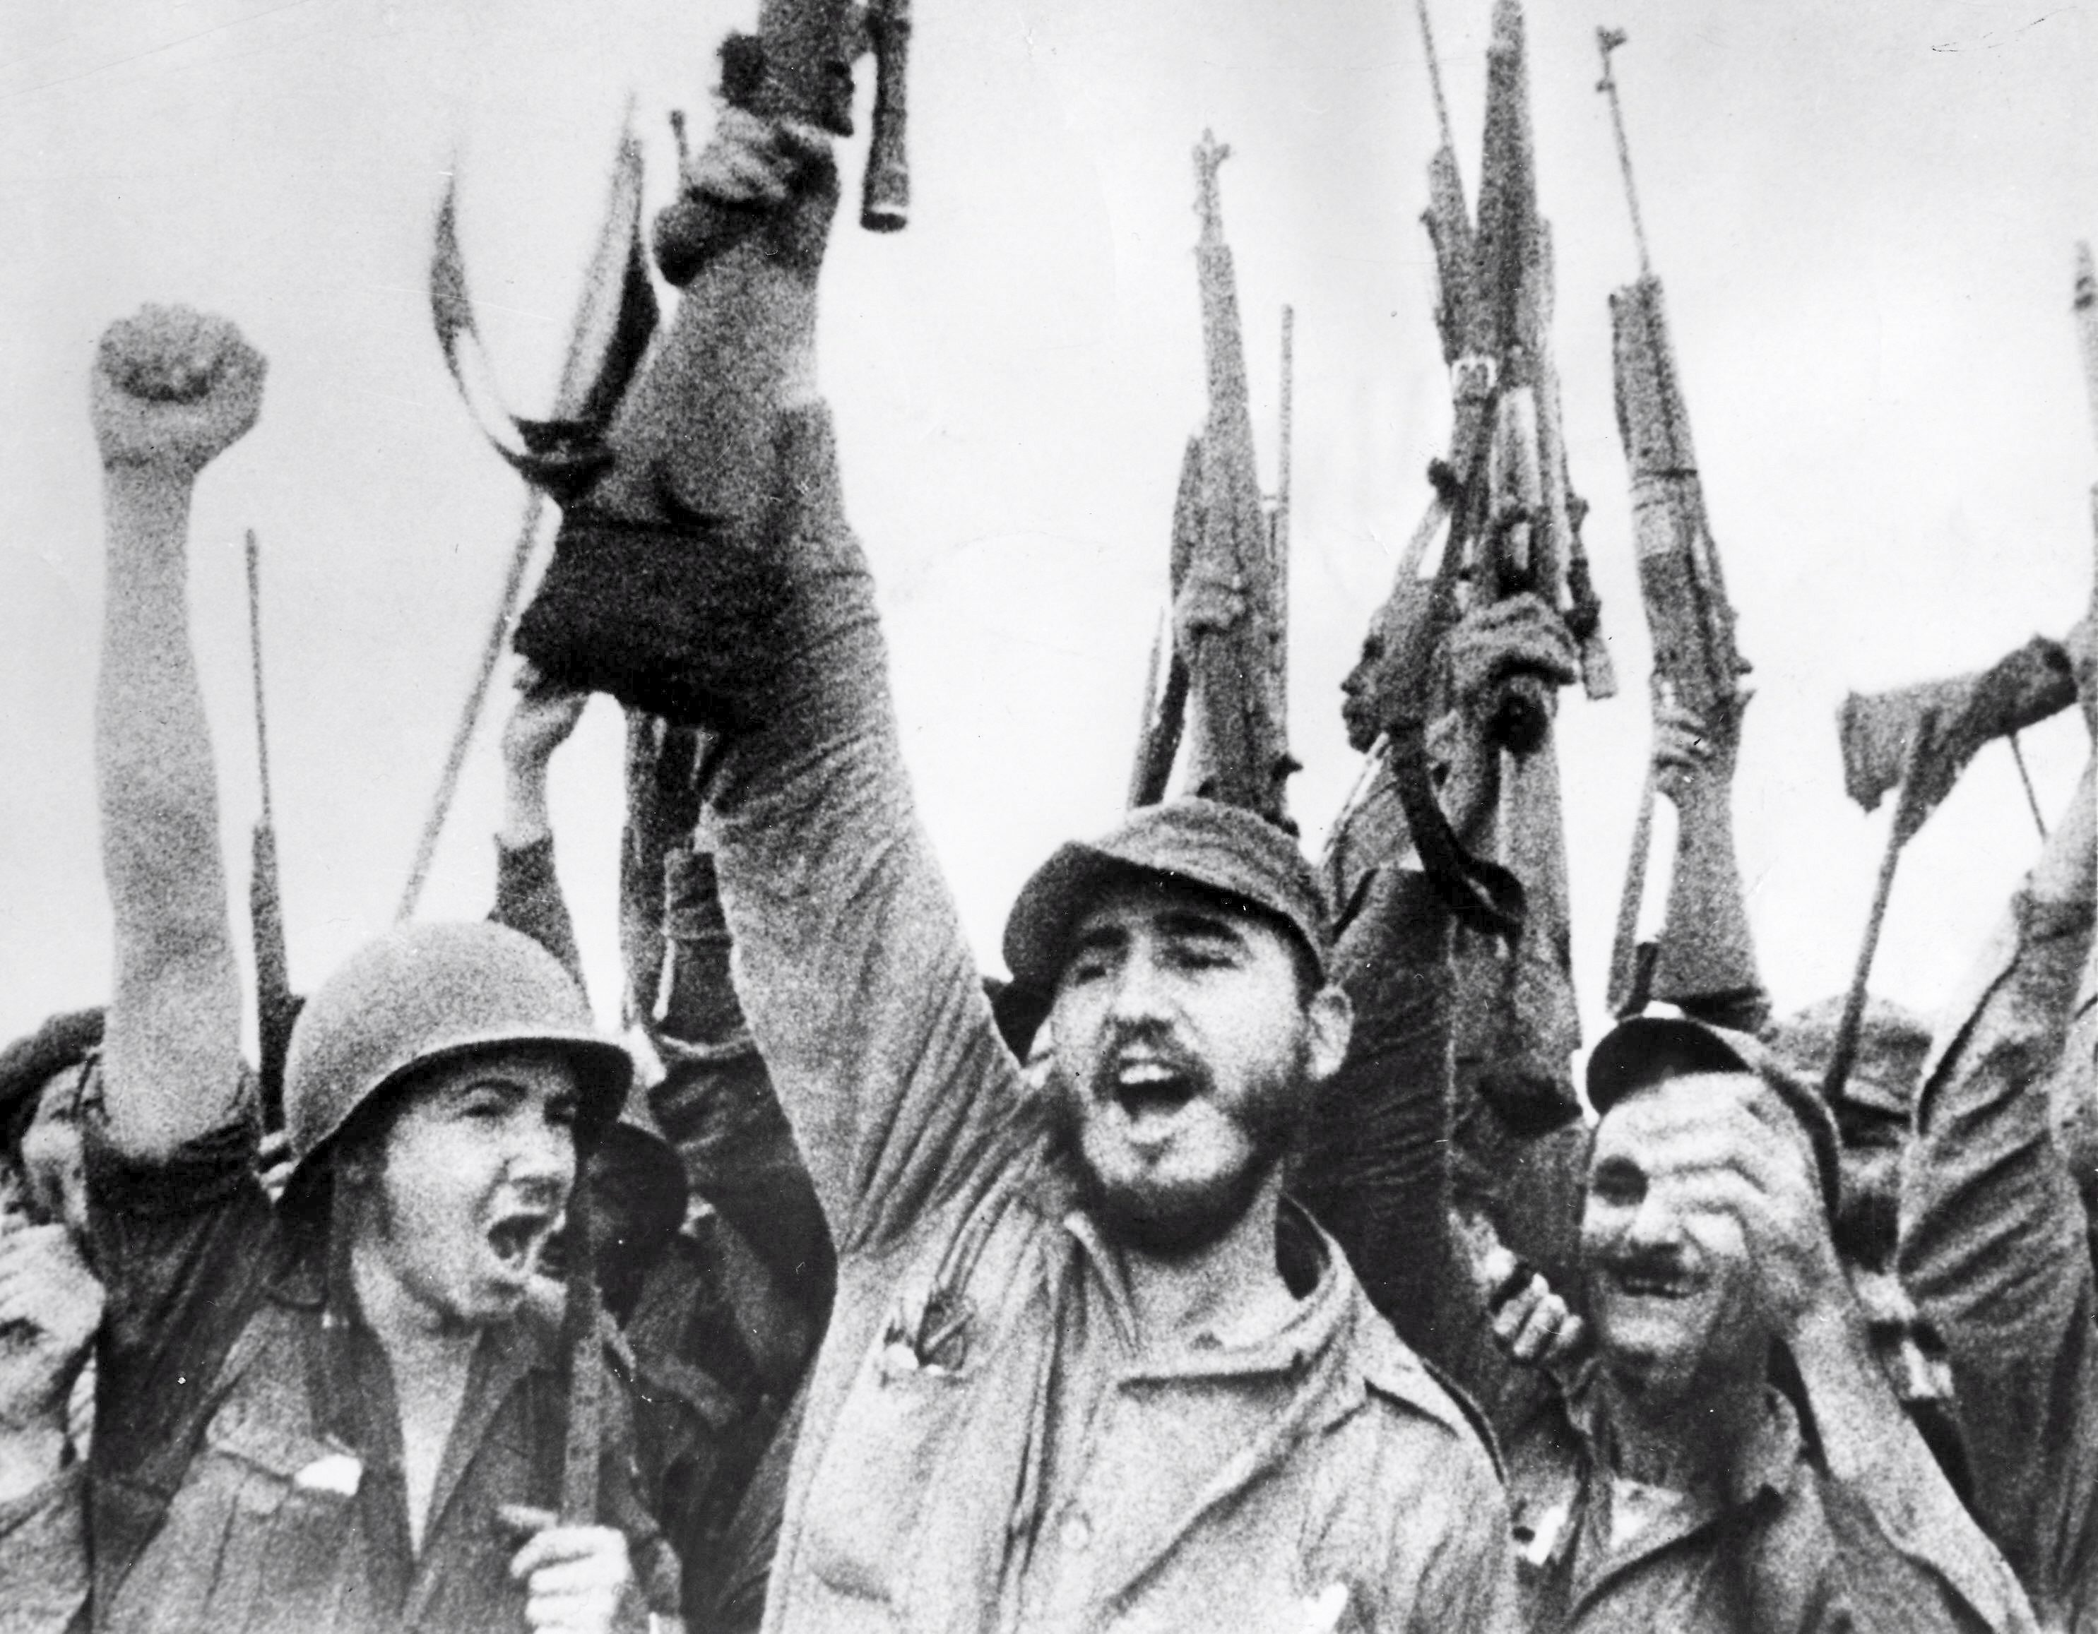
Castro Becomes Dictator of Cuba
USA controlled Cuba until 1959 when Fidel Castro seized power
Castro signed the First Agrarian Reform which broke up large landholdings, restricted
foreign land ownership, and re – distributed land to those who worked it, cooperatives,
and the state
Castro nationalized American – owned sugar industries and confiscated American
casinos and resorts
USA responded with a trade embargo in 1962 against Cuba

Slide 19
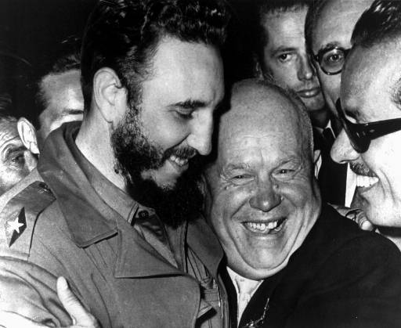
Bay of Pigs Invasion
US government tried to overthrow Castro
Trained and supplied Cubans who opposed Castro
On April 17, 1961, the US backed force, tried to land secretly in Cuba at the Bay of Pigs
Castro had heard about the invasion and was able to capture most of the invading
force
Failed invasion heightened mistrust of the USA and solidified Cuba’s relationship with
the Soviet Union

Slide 20
Tension Increases
Cuba became a Soviet ally because they were under threat from the Americans and facing
economic crisis
USSR decided to ship nuclear missiles (secretly – the Americans were unaware) to Cuba
Missiles in Cuba would give the USSR a new strategic advantage in the Cold War

Slide 21
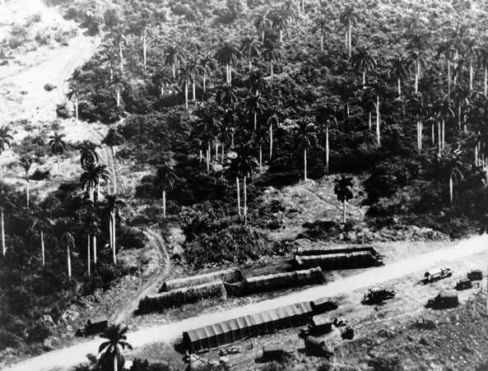
The Cuban Missile Crisis
October 1962 – an American surveillance plane photographed the missile sites under
construction
US demanded the removal of the sites
USSR denied any knowledge of them
US circled the island with warships
Told the USSR that it would stop Soviet cargo from reaching Cuba
USSR replied that they would sink the warships to get cargo through
Both sides went on worldwide alert
Both sides edged closer to nuclear war, each refusing to back down

Slide 22
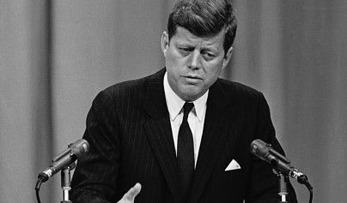
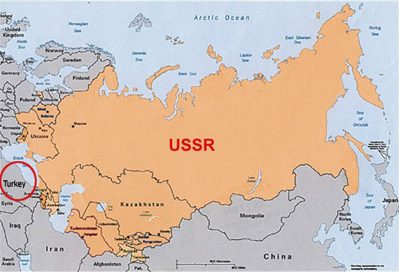
The Cuban Missile Crisis (Con’t)
October 27, 1962 – superpowers reached a deal
USSR agreed to remove missiles from Cuba
USA agreed to remove missiles from Turkey

Slide 23
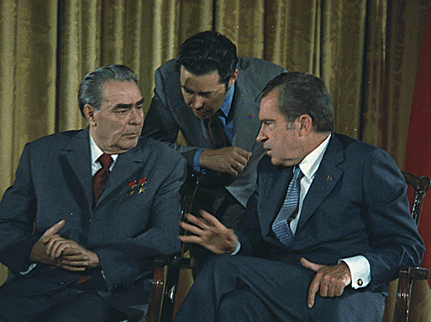
Détente
Cuban Missile Crisis marked a turning point in the war – took serious steps to reduce the
threat of a nuclear clash
Détente – period of reduced tensions from the mid 1960’s to 1979
Cuban Missile Crisis
45:00

Slide 24
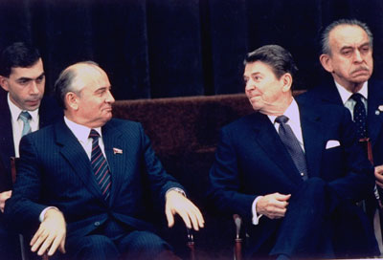
The Fall of the Soviet Union
Watch The Rise and Fall of the Soviet Union – Last 15 min
Complete the Handout: The Fall of the Soviet Union

Slide 25
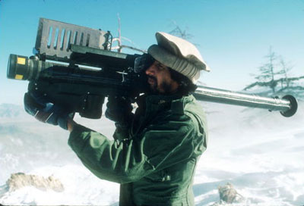
Proxy Wars
Read pages 258 - 260
Define, in your notebook, the phrases:
Proxy War
Liberation Movements
With a partner (or two), complete the following…
Under the four headings:
Korea and Vietnam, Chile, Afghanistan and The Iran Contra Affair
Complete the What, Who, Where, When, Why of each of these proxy wars
Afghanistan
5:00

Slide 26
Cold War Hysteria
Read pages 261 - 267
The threat of nuclear war and the impact of government produced propaganda led to
paranoia of citizens
Paranoia and fear was more pronounced for American citizens as they had not been
impacted with war in their borders
Duck and Cover
(9:00)

Slide 27
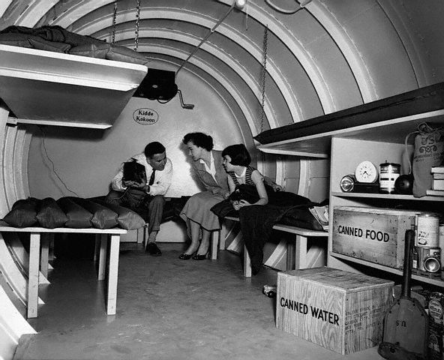
Fallout Shelters
Built around the world but extensively in the US
Would protect people from radiation in the event of nuclear attacks
Canadian government built a bunker to protect Canadian citizens
Known as the Diefenbunker after PM Diefenbaker
Lets Face It!
(14:00)

Slide 28
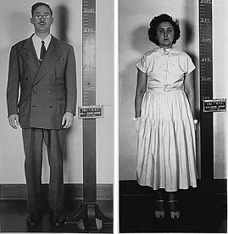
Espionage
Key tool that helped both superpowers
Alerted Americans to the presence of missiles being installed on Cuban soil
When espionage was made public, led to increased paranoia and mistrust
Argued that espionage helped keep the world away from nuclear war and direct contact
Julius and Ethel Rosenberg
Tried and convicted of espionage against the American government for delivering
secret information to the Soviets about American military weaponry
This trial fueled further investigations into “anti-American activities”

Slide 29
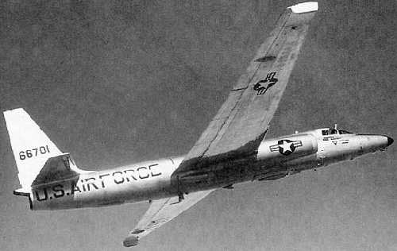
1960 U-2 Incident
With permission from Pakistan, the US set up intelligence stations that they flew
surveillance missions over Soviet territory
May 1, 1960 American spy plane flew over Soviet Union taking pictures and measuring
output of uranium producing plants
Soviets were aware of American surveillance and when they saw the spy plane, it was ordered to
be shot down
Americans initially said that a weather research aircraft had gone off course and was missing
Soviets reported that an American spy had been captured Americans were caught in a lie
Soviet / American relations were worse than ever
1:00

Slide 30
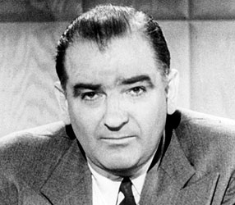
McCarthyism
Red scare – intense fear of communism
Anyone perceived as sympathetic towards communism or Soviets faced a severe backlash
McCarthy (Republican Senator) states that he had a list of individuals working in
government that were supporters of communism
Was formally reprimanded in 1954 for his unfounded accusations
Anti-Communist Cartoon (1948)
He May Be A Communist (1950’s)
10:00
3:00

Slide 31
Economic Liberalism Since the Second World War: The Ebb and Flow
Before you read pages 214 – 222…
Take a look at the world’s worst economics teacher…
Now, read pages 214 – 222…
Completing the handout, Economic Liberalism Since the Second World War as you read
Write out the following notes…

Slide 32
The Postwar Economy in Canada
Like in Britain, following the Second World War, the Canadian government strengthened
or created social programs
Universal Health Care
Canada Pension Plan
Canadian Radio and Television Commission (CRTC) –
oversees all aspects of broadcasting in Canada

Slide 33
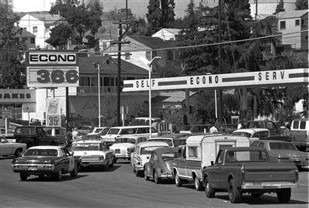
Economic Crises of the 1970s
1971 – US withdrew from Bretton Woods Agreement
(set the exchange rates of currencies of industrialized nations after WW1)
1973 – Egypt and Syria attacked Israel
Because the US and Western Europe had supported Israel, OPEC imposed a 5 month trade
embargo causing oil prices to skyrocket
Goods became more expensive causing the economy to slow down
When a recession and high inflation occur at the same time, it is called stagflation
Stagflation also affected Britain drastically as they had to borrow $3.9 billion US from the International Monetary Fund
Costs of social programs were increasing due to inflation but tax revenue was decreasing due to the economic slowdown
Led to a shift in economic thinking

Slide 34
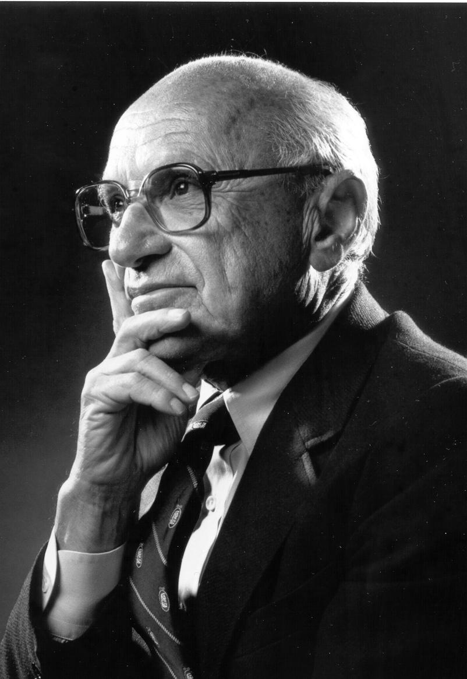
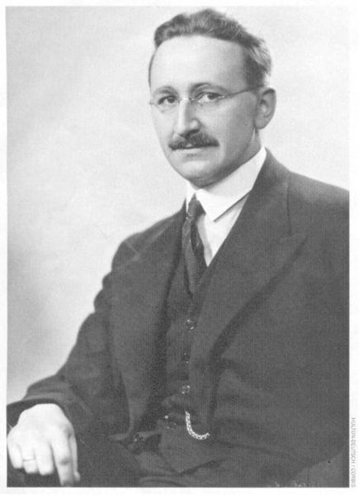
Monetarism: Friedman and Hayek
Economic thinking swings like a pendulum from interventionism and laissez-faire
Monetarist theory says that control of a country’s money supply is the best means to
encourage growth and limit unemployment and inflation
Controlled through the regulation of interest rates
Also known as supply-side economics

Slide 35
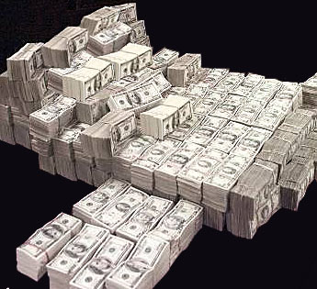
What is Monetarism?
Decrease government intervention and spending in the economy
Downsize the public sector by privatizing and deregulating government owned business and
service/programs
Decrease taxes and lower interest rates
Control the amount of money in supply
Keep some unemployment to keep wages low (helps business grow with increased profits)
Keep government small

Slide 36
Who Supports Supply-Side Economics?
Support began in the 1980s
USA – Ronald Reagan, George W. Bush
Britain – Margaret Thatcher
Canada – Brian Mulroney, Stephen Harper
Alberta – Ralph Klein, Ed Stelmach

Slide 37
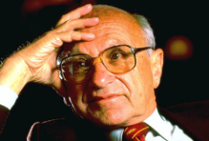
Milton Friedman
Classical economist
Key thinker for monetarism
Believed that inflation was caused by a supply of excess money produced by central banks
Felt that the amount of money issued by the central bank should be linked to economic
indicators like rate of inflation
Against the welfare state (social safety nets via government intervention) as it requires
excessive spending and large government

Slide 38
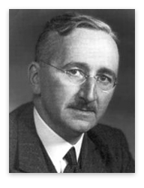
Friedrich Hayek
Critic of collectivist theory
Believed that excessive government control of economic aspects would lead to government
interfering in all aspects of life
Thought that central planners would never have enough information to make appropriate
decisions about demand
Confused?
Let Hayek and Keynes work it out for you…
Boom and Bust
7:30
Review Handout: The Creation of the Modern Economy

Slide 39
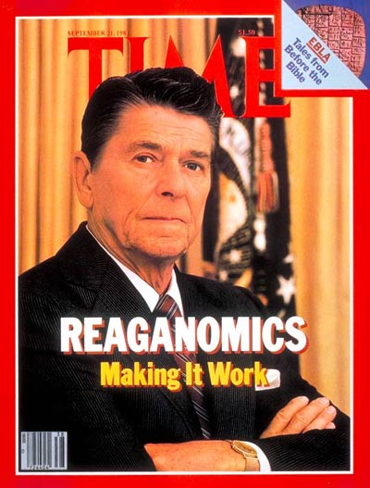
Reaganomics
Became president at a time of high unemployment and high inflation
His response included reduced income and business taxes, reduced controls on business,
increased government spending on military
Known as trickle-down economics
Believed that increased private investment and government defense spending would trickle
down the economy to the working class

Slide 40
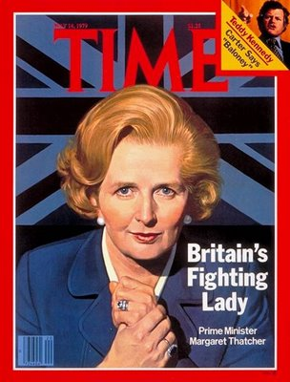
Thatcherism
Tried to reduce government involvement in the economy
Wanted to increase economic freedom and entrepreneurship
Privatized many utility companies
Took a hard line with labour unions

Slide 41
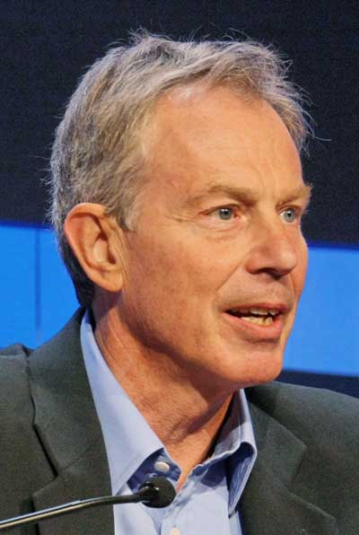
Blair’s Third Way
Tony Blair’s 1997 political platform was seen as a shift to more moderation that would adopt some Thatcherite and free-market policies, while maintaining some social programs
It would be a compromise between the Keynesian economics of the postwar period and the more recent monetarism
It was an attempt to balance the individualist values of monetarism with the collectivist values of social justice
Complete: Reaganomics – Supply-side Economics in Practice News Articles Questions

Slide 42
Balancing Laissez-Faire Economics and Socialist Interventionism
Using the handout provided, read pages 222-227 and complete the chart as required

Slide 43
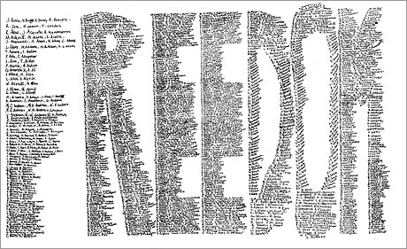
Contemporary Challenges to Liberalism
Chapter Eight
Read Pages 272– 273
How much do we want or need the government to be involved in our lives, and how much freedom are we willing to give up in exchange for security?
Possibly…
They should be virtually invisible, except in times of crisis.
They should have no right to limit my freedom with respect to my personal life.
Government is responsible for providing security for all citizens with respect to our public lives.
Write out the issue question for Chapter Eight from page 273

Slide 44
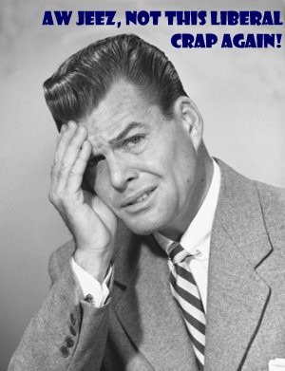
Classical Liberalism and Modern Liberalism
Read Pages 274– 279
Complete questions 1, 2(a) and 2(b) from Explore the Issues on page 279
Use the handout: Positive and Negative Liberty to help you

Slide 45
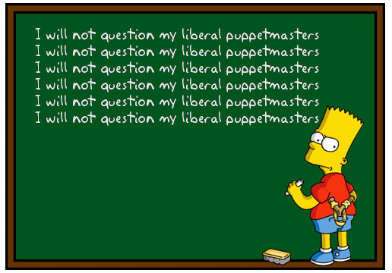
Liberalism Evolves
Read Pages 280 – 296
With a partner, complete question 1 from Explore the Issues on page 296
Also, using the pages above, complete the handout: Examining Alternative Ideologies

Slide 46
Classical Liberalism and Modern Liberalism
Complete questions 1, 2(a) and 2(b) from Explore the Issues on page 279
1 (a) – Answers may include…
Classical Liberal:
Modern Liberal:
Laissez-faire government
Government should act to protect
Individuals rights, freedoms and property
Economic freedom
Range of individual value
Equality of opportunity
Hands-on role for government
Government should establish programs to help
Disadvantaged individuals
Redistribution of wealth
Individuals valued equally
Equality of outcome

Slide 47
Classical Liberalism and Modern Liberalism
Page 279
1 (b) – Answers may include…
Classical Liberal (Negative Freedom):
Modern Liberal (Positive Freedom):
Freedom from want, freedom from prejudice
Freedom from religious persecution
Freedom from discrimination
Freedom of thought, belief, opinion, and expression (freedom of the press)
Freedom of the press
Freedom of conscience and religion
Page 279
2 (a-b)
Compare how a classical liberal vs. a modern liberal would react to a…
Family losing their home in a hurricane…
A ‘low-income’ individual not being able to afford university…

Slide 48
Liberalism Evolves
Question 1 - page 296
Challenges to modern liberalism may include:
Who decides what is progress? Is progress always desirable? (environmentalism)
What obligation do people have to others? (environmentalism, security, rule of law, property)
What actions take precedence: economic growth or environmental protection (environmentalism)
Does individual self-interest take precedent over group rights? (neo-conservatism)
What role does patriotism play in liberal ideology? (neo-conservatism)
To what extent should government intervention be allowed? (neo-conservatism)
Into what areas of life is government intervention acceptable (neo-conservatism)
Are freedoms granted to all people even if they do not support liberal practices in their cultures? (religion)
Raises questions about the integration of church and state (religion)

Slide 49
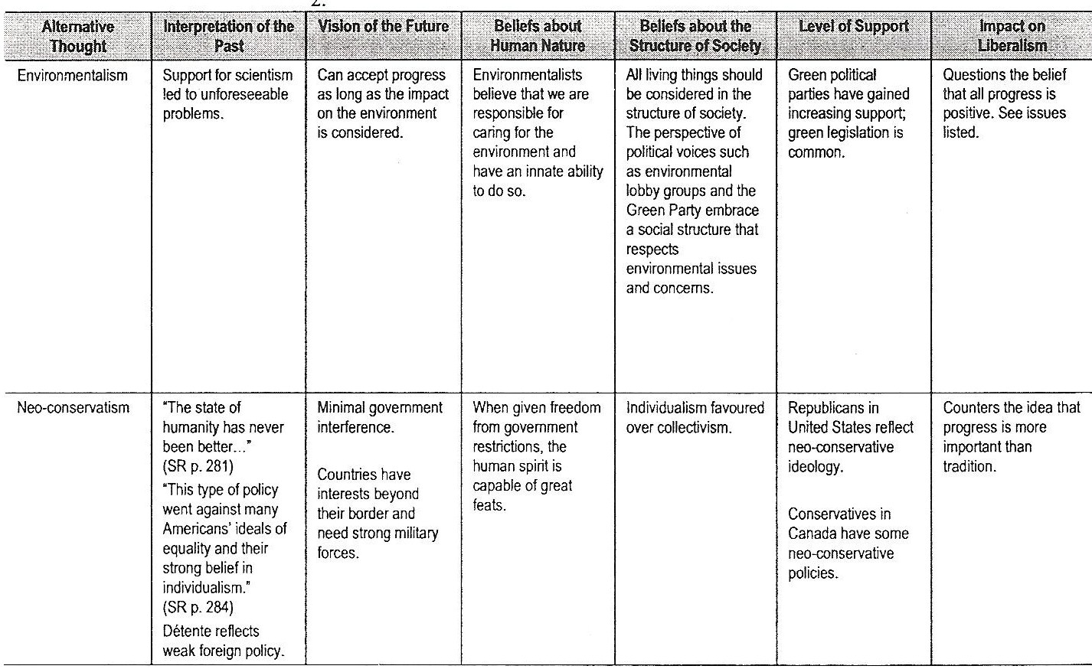
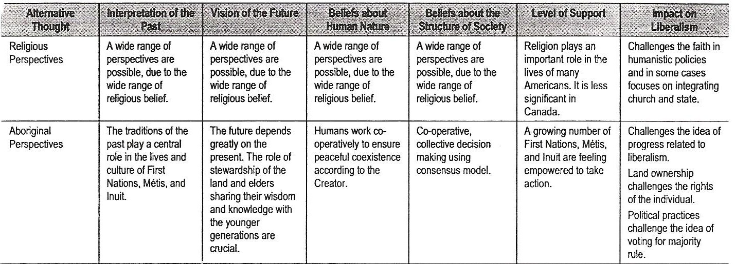
Handout: Examining Alternative Ideologies

Slide 50
Cold War, Modern Challenges and Responses to Liberalism
Chapter’s 6*, 7 and 8 Exam
Consists of:
50 M.C. Questions
(*Only pages 214-227 of chapter six)

Slide 51
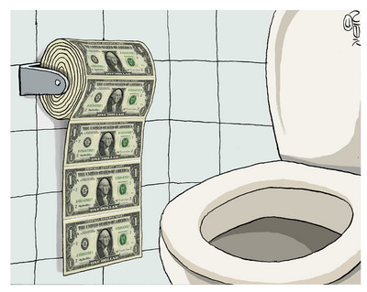
inflation
An increase in the general price level of products, the cost of labour and interest rates

Slide 52
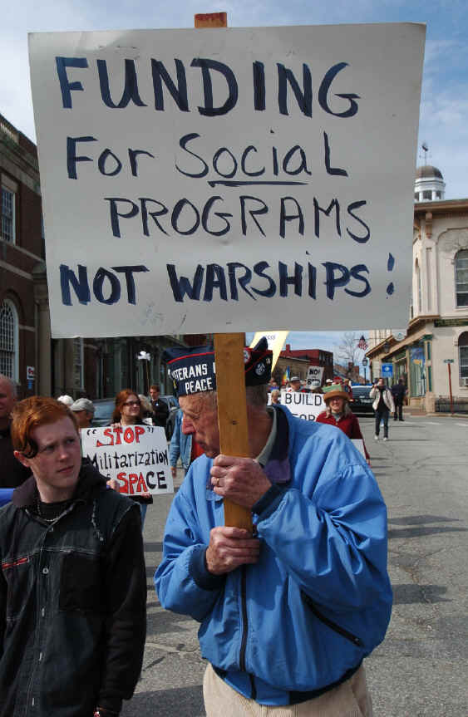
Social programs
Programs that affect human welfare in a society. Social programs are intended to benefit citizens in areas such as education, health and income support. Supporters' base their support both on humanitarian principles and economic principles.

Slide 53
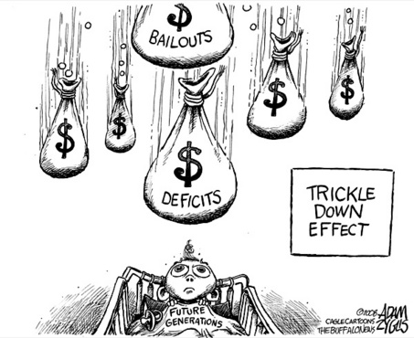
Trickle-down economics
Government economic policies that include reduced income and business taxes, reduced regulation (controls on business), and increased government spending on the military, also known supply-side economics. Generally these policies favour industry, assuming that if industry prospers then everyone will prosper as wealth “trickles down” to the ordinary workers and consumers.

Slide 54
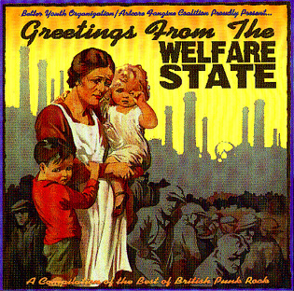
Welfare state
A state in which the economy is capitalist, but the government uses policy that directly or indirectly modify the market forces in order to ensure economic stability and a basic standard of living for its citizens, usually through social programs.

Slide 55
brinkmanship
International behavior or foreign policy that takes a country to the brink of war; pushing one’s demands to the point of threatening military action; usually refers to the showdown between the United States and the Soviet Union over Cuba in October 1962.

Slide 56
Cold war
The political, economic and social struggle between the Soviet Union and its allies, and the United States and its allies, conducted using propaganda, economic measures and espionage rather than military means.

Slide 57
containment
An American Cold War foreign policy of containing the spread of communism by establishing strategic allies around the world through trade and military alliances.

Slide 58
detente
A period of the Cold War during which the major powers tried to lessen the tensions between them through diplomacy, arms reductions and cultural exchanges.

Slide 59
deterrence
The Cold War foreign policy of both major powers aiming to deter the strategic advances of the other through arms development and arms build up. Deterrence depends on each combatant creating the perception that each is willing to resort to military confrontation.

Slide 60
expansionism
A country’s foreign policy of acquiring additional territory through the violation of another country’s sovereignty for reasons of defense, resources, markets, national pride or perceived racial superiority.

Slide 61
Liberation movements
Military and political struggles of people for independence from countries that have colonized or otherwise oppressed them.

Slide 62
McCarthyism
An anti-communist movement in the United States during the 1950’s led by Republican senator Joseph McCarthy. It was intended to uncover and persecute those with perceived ties to communism within the US government, universities and entertainment industries.

Slide 63
nonalignment
The position taken during the Cold War by those countries in the United Nations that did not form an alliance with either the United States or the Soviet Union. This group of countries became a third voting bloc within the UN and pushed for more aid for the developing world.

Slide 64
Conflicts in which one superpower provides support to a group or state that opposes the rival superpower. The support may consist of money, arms and personnel.
Proxy wars

Slide 65
Civil rights movements
Popular movements, notably in the United States in the 1950s and 1960s that work to extend rights to marginalized members of society. Often these struggles aim not only for legal and civic rights, but also for respect, dignity and economic and social equality for all.

Slide 66
environmentalism
A political and ethical ideology that focuses on protecting the natural environment and lessening the harmful effects that human activities have on the ecosystem.

Slide 67
Neo-conservatism
An ideology that emerged in the United States during the 1950s and 1960s as a reaction against modern liberal principles. Some aspects of neo-conservatism challenge modern liberal principles and favour a return to particular values of classical liberalism. Other neo-conservative ideas challenge both classical and modern liberal principles and favour values identifies as “family values” and traditional values, often resting on a religious foundation.

