Slide 1

Political Challenges to Liberalism
Chapter Ten
Read Pages 332– 334
As you just read, the issue of party solidarity is ever-present in Canadian politics…
Should MP’s vote based on the will of their constituents?
Or
Should they vote with their party regardless of their personal point of view or what their constituents believe?
Write out the issue question for Chapter Ten from page 334

Slide 2

Does Government Serve the People or Lead the People?
Read the introduction on page 335
Why is a government’s desire to follow the Will of the People seen as an ideal?
Some Questions about Democracy
After reading this section, how many of these questions (on page 335) can you answer?
Write out a response for each…
Read the following two sections:
The Will of the People & Principles of Liberalism in Direct Democracies pages 336-338
and take note of the following terms:
democracy – direct democracy – initiatives – referendums – plebiscites – recall elections

Slide 3
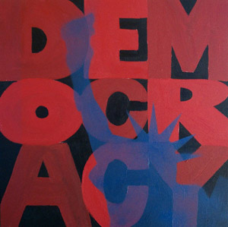
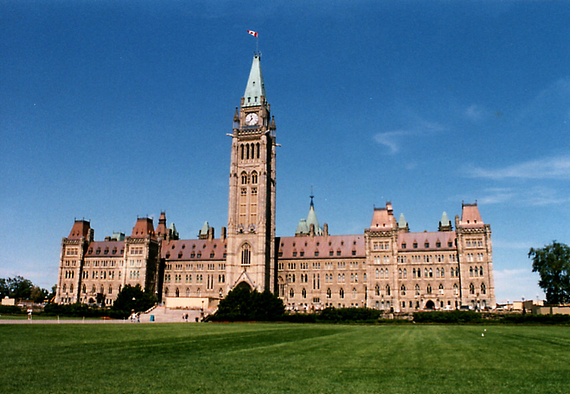
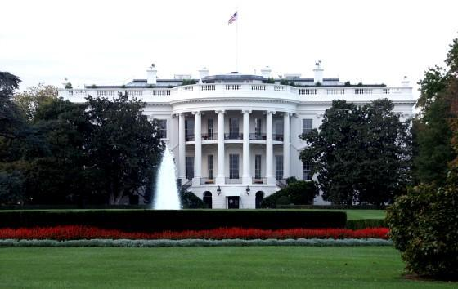
Parliamentary vs. Republican Democracy
What is different between Canada’s version of representative democracy versus that of the United States?
Individually, make a list…
Using page 337 – 343 complete the handout: Parliamentary vs. Republican Democracy

Slide 4

Parliamentary vs. Republican Democracy
Putting it all together…
Homework
Representative Democracy: More than One Option

Slide 5
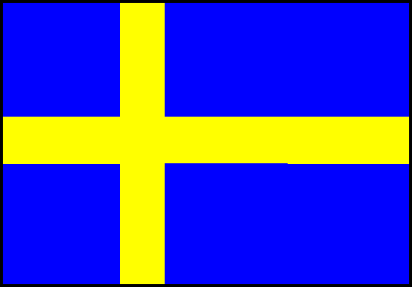
Proportional Representation
Read this section on page 343 and answer the following:
What is proportional representation referring to?
Why do many people argue that this type of representation is more representative and democratic than other types of representative government?
With a partner, read the Skill Path on pages 344 – 345 and complete questions 1, 2 and 3

Slide 6

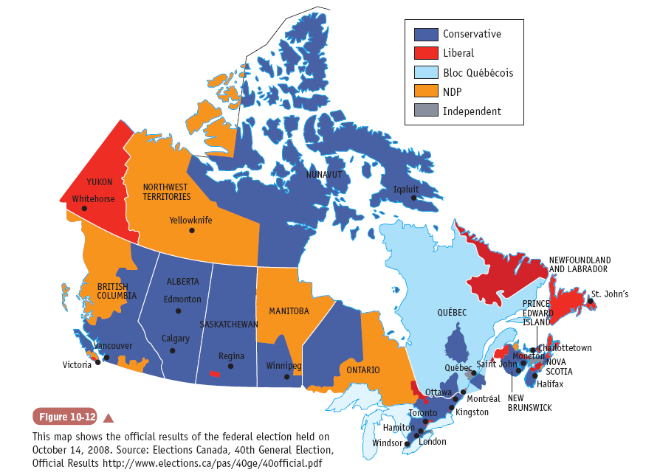
Proportional Representation
Skill Path on pages 344 – 345: Questions 1, 2 and 3

Slide 7
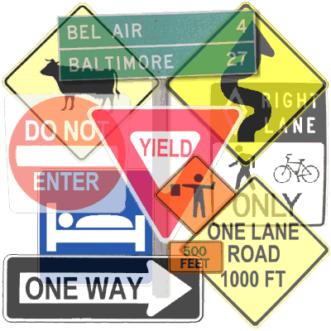
Challenges to the Will of the People
Read the introduction on page 346
According to some, what does a society need as a requirement for citizen participation in a democracy?
As Peter Levine discusses, how will citizens obtain this kind of civic-mindedness or democratic personality?

Slide 8

Voter Turnout
Read page 347, including the data presented in both the graph and the chart
What conclusions can you draw from both 10-14 and 10-15?
Complete the Pause and Reflect on this page

Slide 9
Challenges to the Will of the People
Read the final four challenges (to the will of the people) on pages 350 – 353 summarizing each section using the following headings:
Elite Theories of Democracy
Lobbying by Interest Groups
Ethics and the Common Good
Practicality versus Popular Opinion
Also
Keeping in context the information found in these sections, what is your interpretation of the cartoon on page 351?

Slide 10

Consensus Decision Making
After reading pages 353 – 354, answer the following:
Define this model of government
Which Canadian governments practice this model and how do they determine who will lead various facets of their government?
List the various benefits and drawbacks of this type of political system
When finished…
Explore the Issues: Complete #1 on page 356
*Typo – 1(a) should read ‘two’ instead of ‘three’

Slide 11
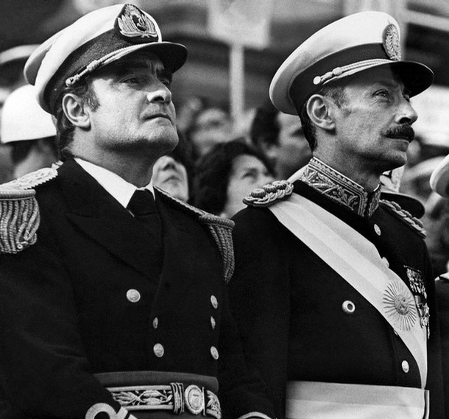
Authoritarianism
Make a list of leaders (past and present) who would be considered authoritarian
Read the introduction on page 357
In preparation for a research project, complete the handout: Authoritarianism

Slide 12
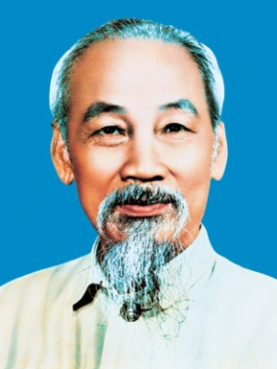
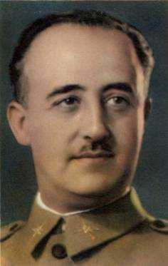
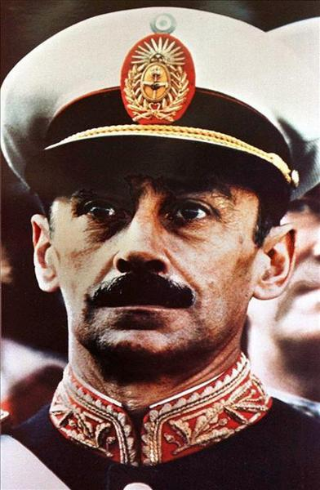
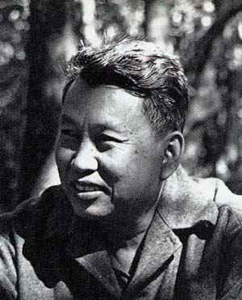
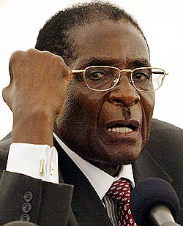
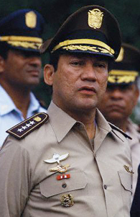
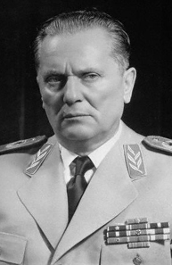
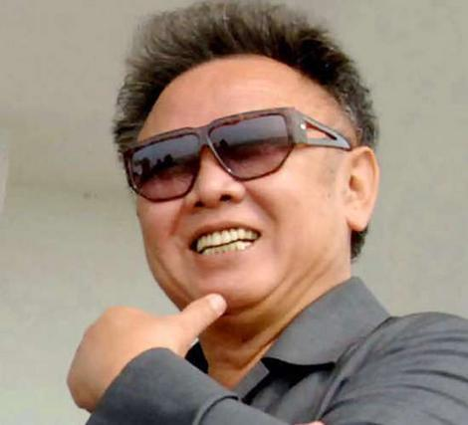
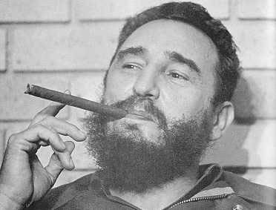
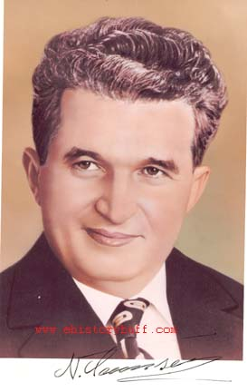
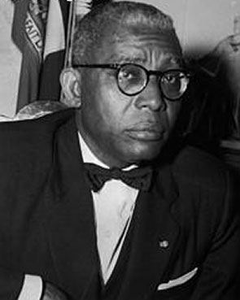
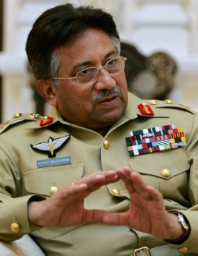
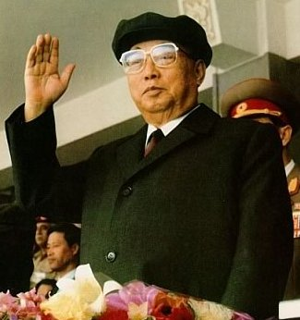
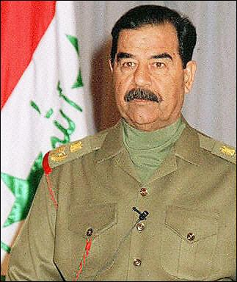
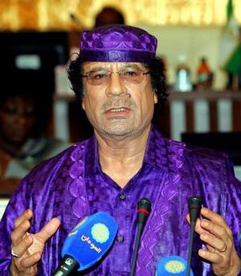
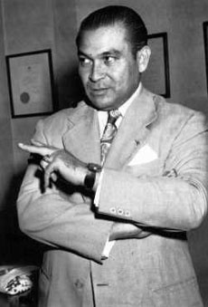
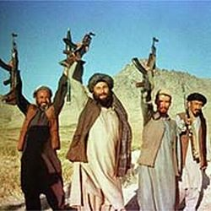
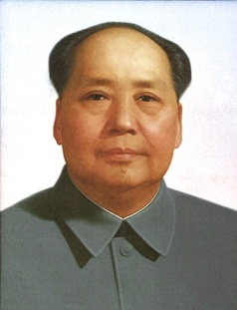
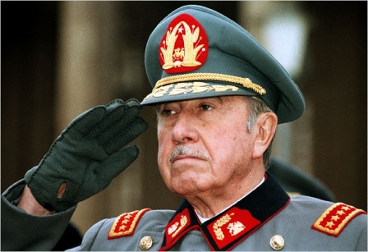
Authoritarianism
Research project: Authoritarian Governments Project

Slide 13
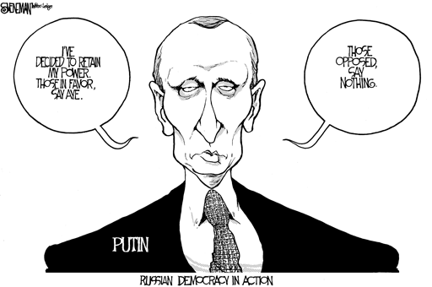
authoritarianism
A form of government with authority vested in an elite group that may or may not rule in the best interests of the people. Authoritarian political systems take many form, including oligarchies, military dictatorships, ideological one-party states and monarchies.

Slide 14
Consensus decision making
a process whereby a group of individuals share ideas, solutions and concerns to find a resolution to a problems that all members of the groups can accept.

Slide 15
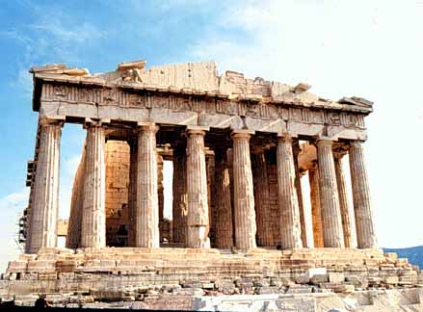
Direct democracy
A form of government in which the people participate in deciding issues directly. A direct democracy operates on the belief that every citizen’s voice is important and necessary for the orderly and efficient operation of society.

Slide 16
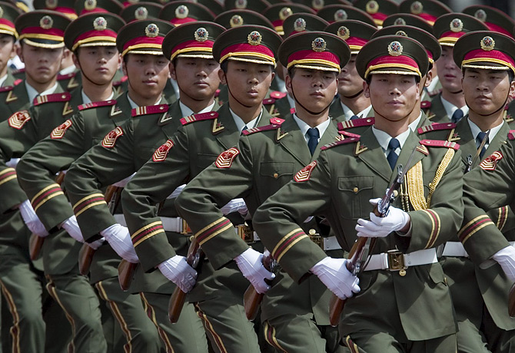
Military dictatorship
A form of government in which political power resides with the military leadership. Some countries in Latin America and the Middle East have presented many examples of military dictatorship.

Slide 17
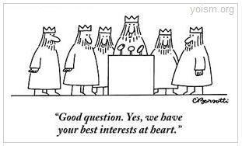
oligarchy
A form of government in which political power rests with a small elite segment of society. An oligarchy often consists of politically powerful families who pass on their influence to their children .

Slide 18
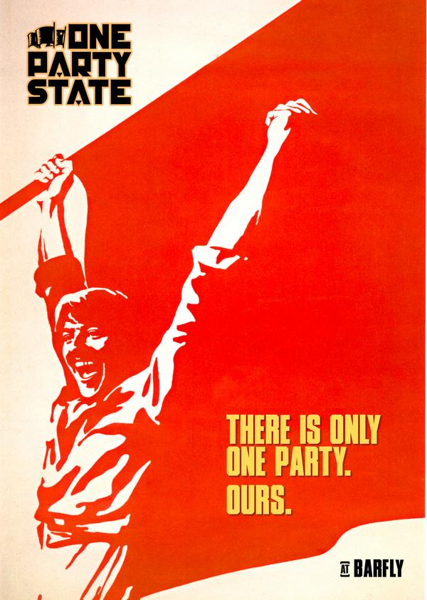
One party state
A form of government where only one party forms the government and no other parties are permitted to run candidates for election.

Slide 19

Party solidarity
In the Canadian system, a requirement that all party members vote with their party, except in rare instances when the party leadership explicitly frees them from this obligation, in what is known as a free vote.

Slide 20
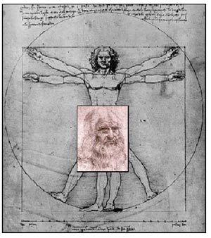
Proportional representation
A system of government where citizens vote directly for a party, and then representatives are assigned based on the amount of popular support attained. This results in a fairly accurate representation within the legislature of the will of the people.

Slide 21
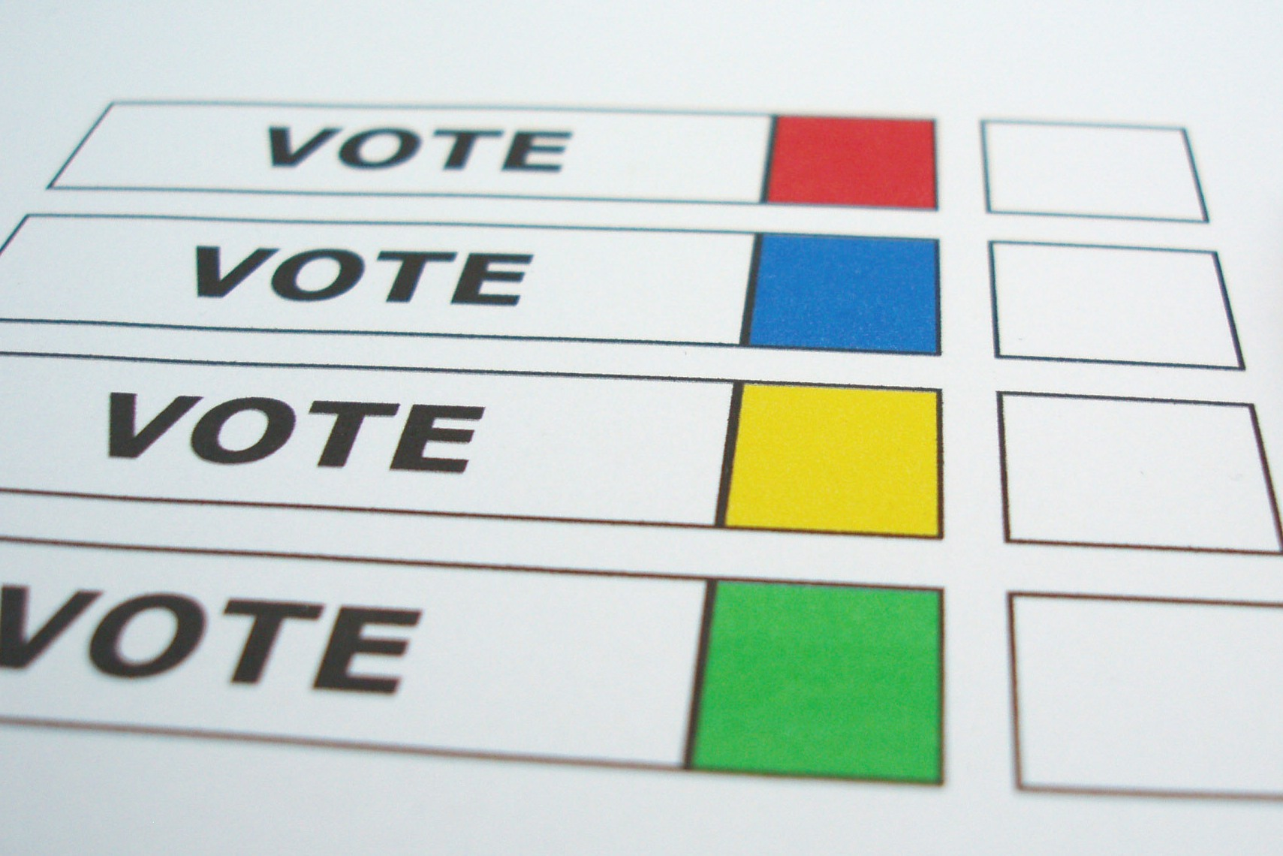
Representative democracy
A form of government in which a small group of politicians are elected by a larger group of citizens. The people participate in deciding issues through elected officials who represent them and make laws in their interests.

Slide 22
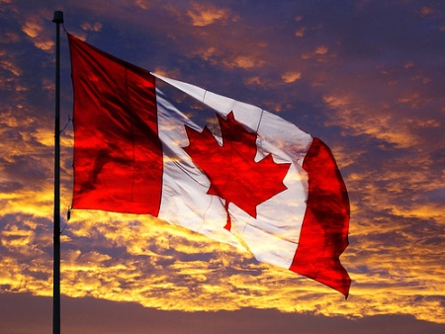
Responsible government
In the Canadian system, a form of representative democracy in which the branch of government that proposes laws, the executive branch of government (the prime minister and the cabinet members), is dependent on the direct or indirect support of elected members in the legislative branch (a majority of MPs in the House of Commons.)

