Slide 1
Complexities of Liberalism in Practice
Chapter Eleven
Read Page 368
To what extent do you think the actions of the US and Syrian governments challenged individual or collective rights?
Is it ever acceptable for a liberal democracy to suspend people’s rights to protect the common good?
Read Page 369
Write out the issue question for Chapter Eleven from page 369

Slide 2
Promoting Rights
Read the introduction on page 372
This section will consider the relationship between the principles held by liberal democratic governments and the promotion of individual rights in the pursuit of the betterment of society.
Write the above in your own words.
Protection of Rights in Liberal Democracies
After reading this section (372 – 374), respond to the following:
Define fundamental rights and provide examples.
There are limits to individual rights. Explain.
One criticism of rights legislation is that it can have unforeseen negative consequences. Using examples, explain what is meant by negative consequences.
Explain another criticism of rights legislation.

Slide 3
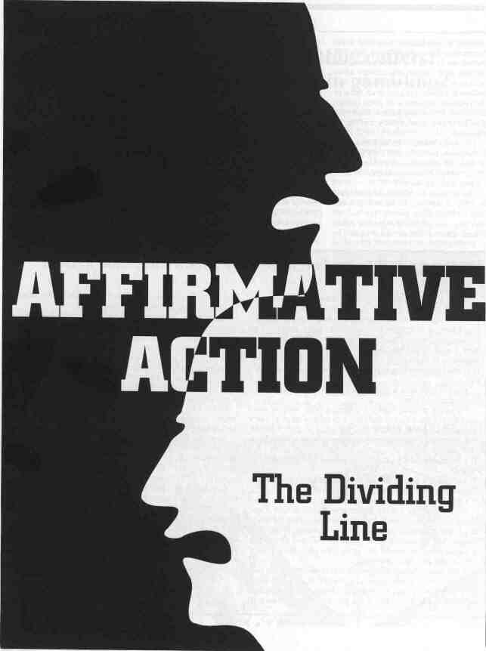
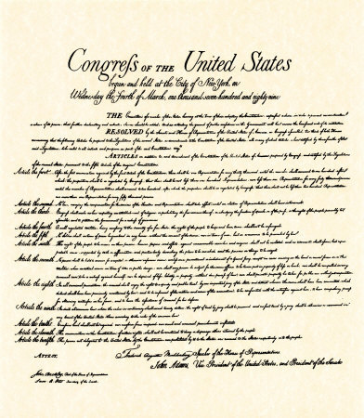
The Promotion of Collective Rights
Before reading this section (377 – 378), respond to the following:
How do collective rights affect your life?
How do they affect the lives of people in other countries?
After reading this section, respond to the following:
Describe the policy known as Affirmative Action and why some see it as reverse discrimination.
In what piece of Canadian legislation can you find collective rights?
Which two groups are primarily included?
Give two arguments, for and against, for identifying (only) these two collectives in the Charter.
What is one of the main differences between the American Bill of Rights and the Canadian Charter of Rights and Freedoms?

Slide 4
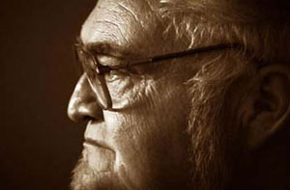
Recognition of Collective Rights
Read pages 379 - 380
Summarize both court cases involving Francophone schools in Alberta and the case of Steve Powley
What ideological differences might exist that would explain some governments reluctance to recognize constitutionally guaranteed collective rights?
Explore the Issues: Complete #1 on page 380

Slide 5
Balancing Perceived Common Good with Respect for Rights
Keeping in mind the question for inquiry for this section of chapter 11:
How do liberal democracies balance the perceived common good with the need to respect rights?
Read the newspaper article on page 381
What is the relationship between common good and the respect for rights in the newspaper article?
Part of the language legislation in Québec requires that:
“…public signs and commercial advertising must be in French. They may be in French and another language provided that French is markedly predominant…”
According to this requirement, does the Montreal pub seem to be breaking the law?

Slide 6
Balancing Perceived Common Good with Respect for Rights
Read pages 382 - 383, summarizing each of Bill 101, Bill 178 and Bill 86 and respond to the following:
For what reason is Québec able to limit peoples freedom of expression, as protected by the Canadian Charter of Rights and Freedoms?
Read the Voices section on pages 384 – 385, answering all three questions
A War of Words – 60 Minutes - 1998
13:00

Slide 7
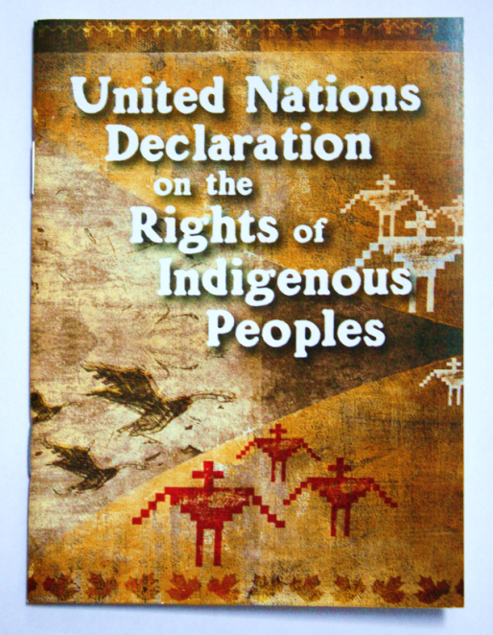
Efforts to Entrench First Nations, Métis and Inuit Rights
Read pages 386 - 389, including the Voices section
Be sure you understand the following:
The United Nations Declaration on the Rights of Indigenous Peoples
Comprehensive Land Claims
Specific Land Claims
Answer both questions thoroughly on page 389

Slide 8
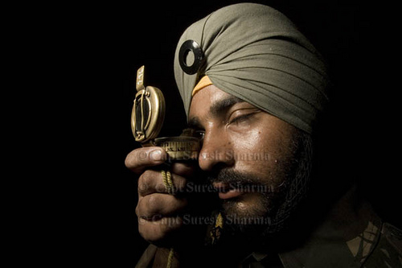
Restrictions on Religious Symbolism
Not Just in France… April, 2010.
2:00
If someone acts in an illiberal manner, how are they acting?
Read pages 390 - 392
With a partner, make a list of illiberal acts and the corresponding governments implementing them.
Be sure to include their rationale for doing so.
Respond to the questions in both Figure 11-10 and 11-11
When finished…
Explore the Issues: Complete #1 on page 392
France to Ban Muslim Veils in Public -April, 2010.
2:00
France Bans Headscarves - 2004
19:00

Slide 9
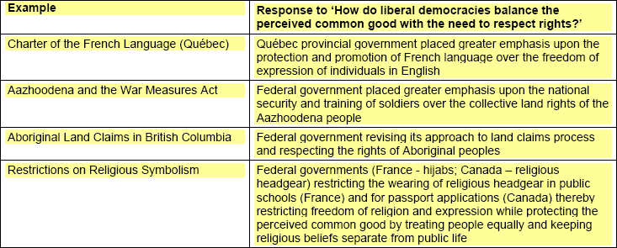
Explore the Issues: #1 on page 392

Slide 10
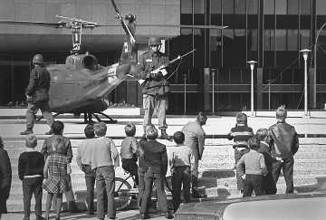
Rejecting the Principles of Liberalism
As part of our discussion on Individualism and Collectivism from Related Issue #1, we reviewed the material in this section (page 393 – 404) of chapter 11
Can you find the handout?
Be sure you re-familiarize yourself with the following:
The War Measures Act
The First World War and Enemy Aliens
The Second World War and Japanese Internment
October Crisis 1970
The USA Patriot Act
Canada’s No-Fly List
After considering each of the above, answer the following:
Is there a better way to address the need for national security that does not involve actions that infringe on the rights of individuals?

Slide 11
Rejecting the Principles of Liberalism
Explore the Issues: Complete #1 on page 404

Slide 12
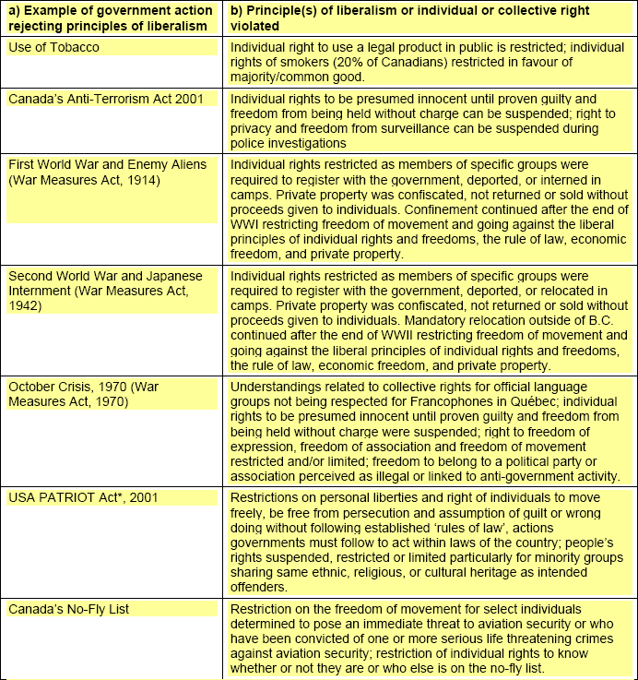
Rejecting the Principles of Liberalism
Explore the Issues: Complete #1 on page 404

Slide 13
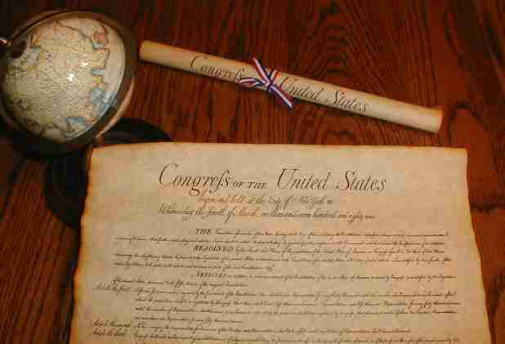
American bill of rights
The first 10 amendments to the US Constitution. Ratified by the original 13 states by 1791, it is based primarily on John Locke’s concept of “natural rights” for all individuals, including life, liberty and the protection of property.

Slide 14
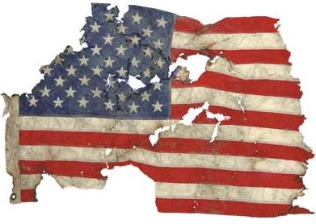
Anti-terrorism act
A set of laws passed in December 2001, in response to the September 11, 2001 attacks, it gave the Canadian government special powers, such as surveillance and detention, for dealing with people carrying out activities thought to be associated with terrorism. Some of the act’s measures, such as that of preventative arrest, expired in March 2007.

Slide 15
Canadian Charter of
rights and freedoms
A document entrenched in the Constitutional Act, 1982 that lists and describes the fundamental rights and freedoms guaranteed to Canadians.

Slide 16
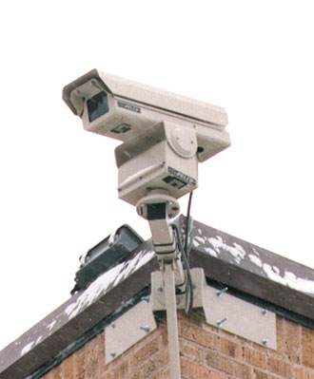
Emergency and security
legislation
A set of laws that permits the Canadian government to invoke special measures to deal with emergencies. It replaced the War Measures Act in 1988. Emergencies can include those that affect public welfare and order, Canadian security, or war or other armed conflict. The legislation is designed to protect Canadians fundamental rights and freedoms even in a time of crisis.

Slide 17
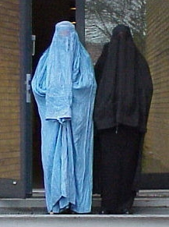
illiberal
Ideologies opposed to the values, beliefs and principals of liberalism, usually refers to undemocratic actions but may be found in democratic countries during times of crisis.

Slide 18
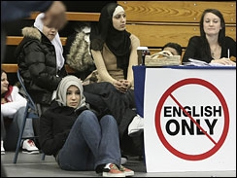
Language legislation
Laws regarding the official language of a state. In the Canadian context, such legislation is related either to Canada’s official languages (for example, the Official Languages Act, 1969) or to Quebec’s Charte de la langue francaise (Charter of the French Language, such as Bill 101, 1977.)

Slide 19
Quebec Charter of Human
rights and freedoms
(La Charte des droits st linertes de la personne): a statutory bill of rights and human rights code that was passed by the National Assembly of Quebec in 1975.

Slide 20
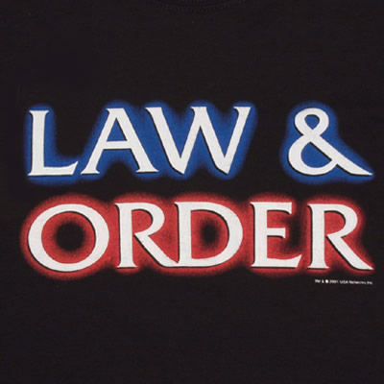
Respect for law and order
One of the responsibilities of citizens in a liberal democratic society, where people enjoy a high degree of individual rights and freedoms. Failure on the part of the population to demonstrate the type of respect could result in a state of chaos.

Slide 21
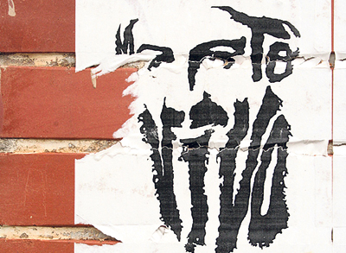
terrorism
The policy of various groups to disrupt the affairs of an enemy state or culture by the use of violent acts against non-combatants in order to create debilitating terror and confusion.

