Slide 1
The Viability of Contemporary Liberalism Chapter Twelve
What are some ideologies that oppose the principles of liberalism?
Any ideas from chapter twelve itself?
Read the chapter introduction on pages 406 - 407
According to Friedlander, to what extent are modern liberal values being challenged and is this challenge appropriate?
Read the Chapter Issue on pages 407 - 408

Slide 2
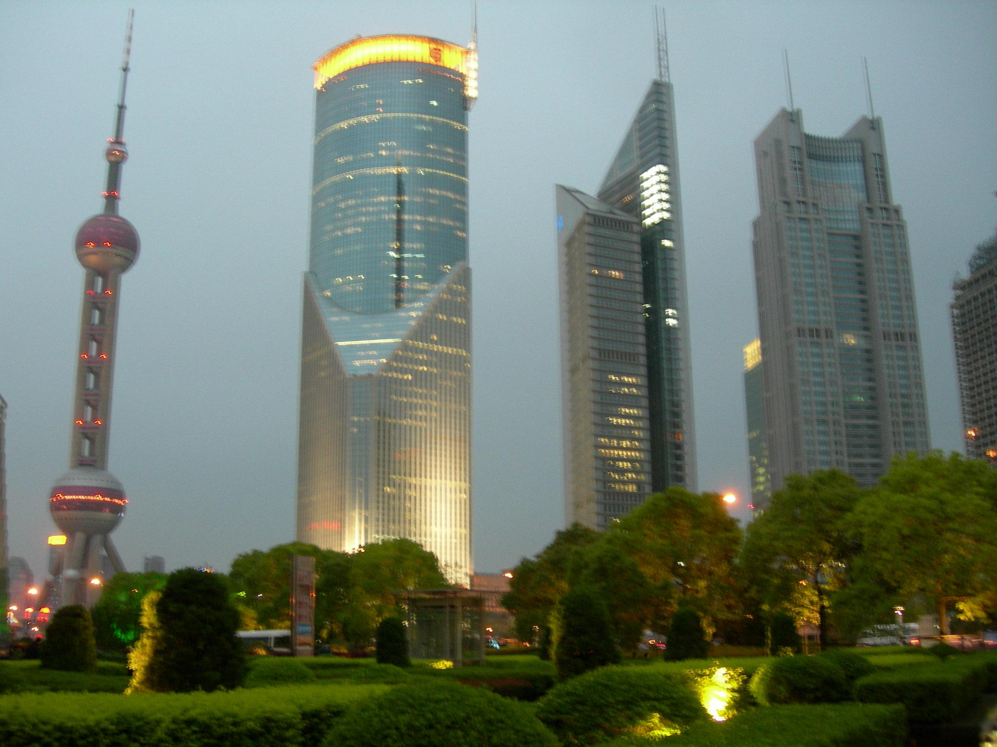
Evolution of Liberalism
The modern industrialized world is the result of the implementation of liberal principles
However the modern industrial complex has given us disparity as well as gifts of scientific
and technological progress
If liberal principles have resulted in the modern industrialized world, can they also be
harnessed to solve the problems of the industrialized world?
Write out the issue question for Chapter Eleven from page 408
To what extent do contemporary issues challenge the principles of liberalism?

Slide 3
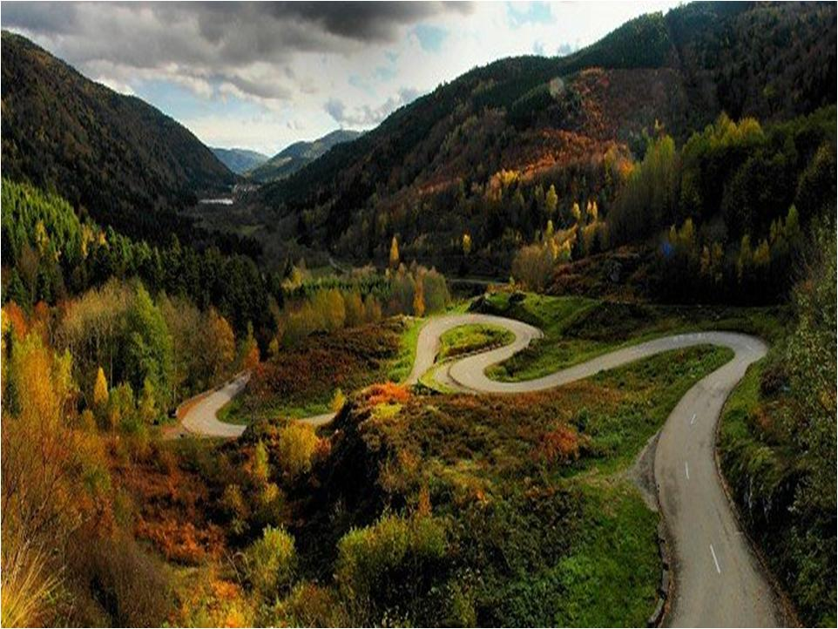
Challenges to Liberalism or
The Viability of Liberalism
Read the introduction on page 410
Modern liberalism and its ideological principles can sometimes be challenged by alternative
thought, such as environmentalism, Aboriginal collective thought, religious perspectives,
and neo-conservatism.
Additional challenges to liberal principles can be found in the examples of postmodernism
and extremism

Slide 4
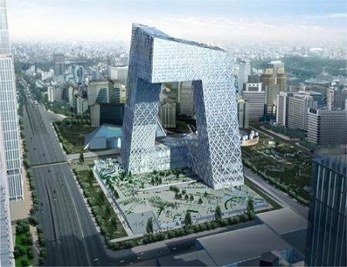
Postmodernism
Read Pages 410 – 411
Complete the following chart as you read

Slide 5
From Modernism to Postmodernism
Pages 410 – 411
Recurrent Themes in Postmodernism
Principles of Modernism
Science provides universal and eternal truths
Knowledge will lead to progress
Freedom consists of obedience to laws that are based on reason
Reason and rational thinking are the ultimate means of establishing what is true
Belief in no set of moral or political ideas that can dominate cultural, ethnic, and gender differences
Skepticism about modern liberal idea that society can be “improved”
Critique of the nature of knowledge: it is relative to linguistic, social and historical contexts
Concern for issues of gender, race, and other parts of culture previously marginalized

Slide 6
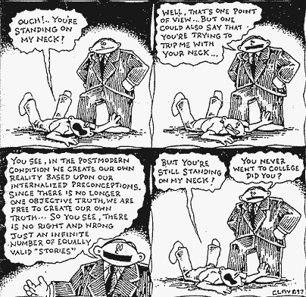
What is Postmodernism? 4:00 Min’s
Postmodernism - Comedy? 4:00 Min’s

Slide 7
Postmodern Challenge
If we claim that there are no universal truths that transcend cultural boundaries and
traditions, how can we expect all members of society to adhere to a dominant set of (liberal)
principles?
Turn to page 412 (Voices) to examine responses to this challenge
Complete 1 & 2

Slide 8
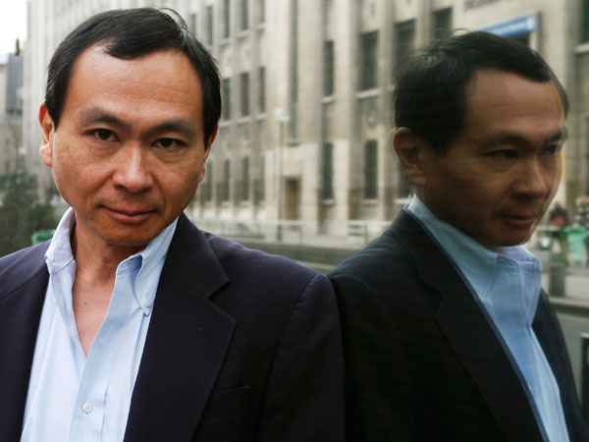
Voices
#1 - Weakness of Postmodernism
Relativism: the absence of any absolute standards that make a common shared understanding of citizenship and of common aspirations for a good life impossible
#2 - Responding to the Criticisms of Postmodernism
Standards can be agreed upon! Although they may be changed over time, citizens can use the principles of equality and personal freedom as guidelines.
Post modernists MIGHT support the principles of equality and the worth of the individual. All would therefore agree that anything that denigrates or harms an individual signals a negative presence
The Post Modernist Critique is useful. It asks modern liberals to: - Keep thinking - Keep options open - Not fall into the trap of certainty

Slide 9
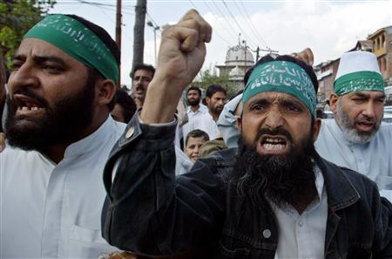
Extremism
Is a word we hear commonly today, what do you think it means?
Write a definition in your notebook
Discuss

Slide 10
Extremism
The term extremist is normally used to refer only to other people, usually in a negative sense
In other words: those who are considered as extremists by others do not usually see themselves that way
Refers to the belief system that is outside the mainstream spectrum of beliefs
It may advocate actions that are considered socially or morally unacceptable
There can be extremist views on both the right and the left of the political spectrum
Can be based on a wide range of ideas: political, economic, racial, religious, environmental etc…
Sometimes the mainstream absorbs extremists views
Can you think of examples of individuals and collective rights that are now part of liberal
democracies but were once considered extreme?
Women’s right to vote
Desegregation

Slide 11
Extremism
Read Pages 413-415 and complete the following:
What are the similarities and differences between types of extremism?
Brainstorm:
What causes extremism to turn violent?
Religious Extremism 2:00 Min’s
Extremism According to John Cleese - 2:00 Min’s

Slide 12
Extremism and Intolerance
Extremism challenges liberal beliefs about the structure of society, interpretations of
history, and even liberal visions of the future
Extremism challenges liberalism’s tolerance
For example:
Freedom of expression is challenged when extremists profess intolerant views of other people

Slide 13
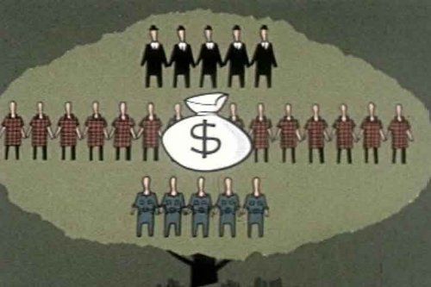
Economic Extremism
Extremism is also used by some people to characterize economic activities that strictly
adhere to a set of principles despite perceived adverse effects on a population
For example:
During the Cold War, the economic practices of communist countries were seen as extremist by the USA and some other Free Market countries

Slide 14
Economic Extremism Today
Critics of free-market principles have claimed that some forms of capitalism have become
extremist
Freidman dreamed of depatterning societies, or returning them to a state of pure capitalism, cleansed of all interruptions – government regulations, trade barriers, and entrenched interests. His rule book… made some people extremely prosperous, winning for them something approximating complete freedom – to ignore borders, to avoid regulation and taxation and to amass new wealth.
Answer the question at the bottom of page 415
Author and activist Naomi Klein

Slide 15
Silent Discussion
Write this question on the top of a blank piece of paper
“Why might some people adopt positions and actions that are so far from what is considered acceptable by most people? How does this challenge liberalism?”
You have 3 minutes to respond
Then pass the paper to the person on your right.
Then respond to the person - 3 minutes. Agree/disagree/questions?
Pass to the next person until told to stop
Return to starting point!

Slide 16
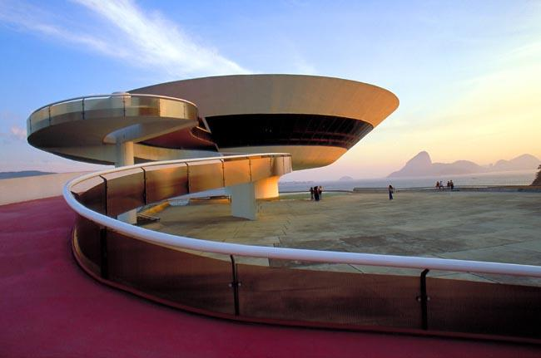
Contemporary Issues and Liberalism
Rank the following Current Issues in order from Greatest to Least Concern
Economic Crisis
Poverty/Inequality
The Environment
War/Conflict
Unemployment
Terrorism
How does your ranking compare to the rest of Canada? Other countries?
As we begin to respond to the question:
What solutions to contemporary issues are supported by the principles of liberalism?
Read all of page 417

Slide 17
Consumerism
An Introduction
Refers to consumer spending, a preoccupation with consumer goods and their acquisition,
display of things in order to denote status
A product of the success of following classical liberal principles
Classical Liberalism created economic growth whereas Modern Liberalism can be seen as an attempt to suggest solutions to the problems caused by laissez-faire principles
The impacts of consumerism, both positive and negative, are very significant to all aspects
of our lives, as well as to our planet. Equally important is examining the underlying system
that promotes certain types of consumption and not other types.

Slide 18
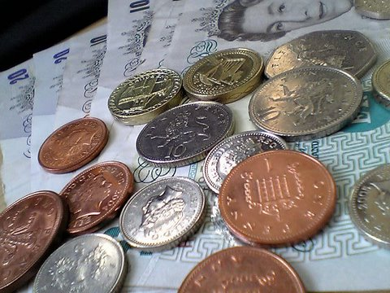
Spending Habits
Area of Spending | US $Billions per year
Cosmetics in USA | 8
Ice Cream in Europe | 11
Perfumes in Europe and USA | 12
Pet food in Europe and USA | 17
Business Entertainment in Japan | 35
Cigarettes in Europe | 50
Alcoholic drinks in Europe | 105
Narcotic Drugs in the world | 400
Military spending in the world | 780
Do you think the principles of liberalism helped create the disparity apparent in the tables? Do you think liberal governments should do something to address this issue? What?
What do the dollar amounts tell you about consumption priorities? Is there anything wrong with spending money on cosmetics or pet food?
Area of Spending | US $Billions per Year
Basic education for all | 6
Water and sanitation for all | 9
Reproductive health for all women | 12
Basic Health and nutrition for all | 13
Read all of page 418 and most of page 419
When done, complete # 1 to #9 of the handout: Contemporary Issues and Liberalism

Slide 19
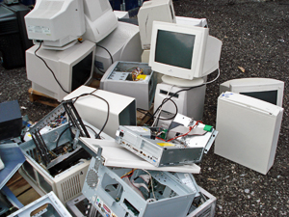
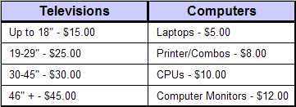
Consumerism as a Liberal Issue
How can liberal democracies take action to address issues related to consumerism?
Recycle Fees for Products
In Alberta each year, Albertans throw out 100,000 computers and 200,000 TVs There is now a recycling fee for those items
While the fees collected assist in addressing some negative consequences of consumerism,
government actions do not directly discourage or prohibit the purchasing of goods by
individuals

Slide 20
Unanticipated Consequences to Liberalism
Three Key Unanticipated Consequences of economic freedom and development
Wealth and resource development produced by economic liberalism did not benefit many of the people in former colonies (in Asia, Africa, and South America)
Citizens of colonized countries were not treated in ways that reflected the principles of
Liberalism
Differential laws regarding property ownership and land, access to health care and education has often restricted development. A legacy of racism, alienation, instability and anger resulted
Such feelings have also created conditions that support violence, illiberalism, and terrorism.

Slide 21
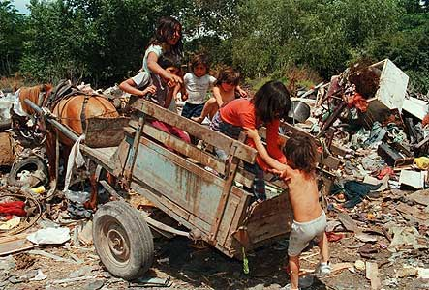
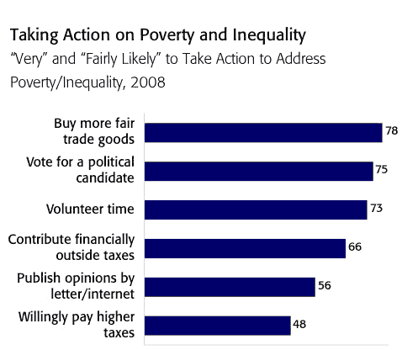
However…
Unanticipated Consequences to Liberalism
People seem willing to address these inequalities
What other remedial actions could be taken to “fix” the unanticipated consequence of liberalism?

Slide 22
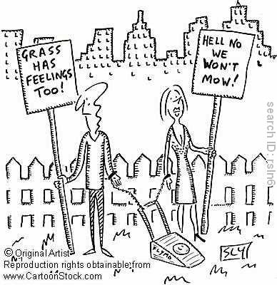
Environmental Change and Activism
Read the rest of page 419 to page 422
In response to environmental change many individuals and groups have resorted to
activism to focus media attention on problems caused by industry and societal practices (for example, air pollution from cars and consumerism)
The dilemma for liberal democracies:
How can they support principles of liberalism such as economic and personal freedom while also promoting the modern liberal principle of a high quality of life for all members of society?
When done complete # 10 - #11 of the handout: Contemporary Issues and Liberalism

Slide 23
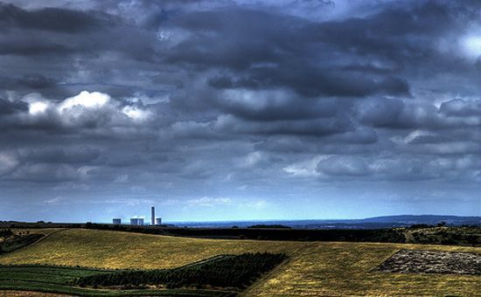
Climate Change
Results
A global plan was needed to combat climate change and although everybody was hoping for a legally binding agreement, the conference ended with a nonbinding accord.
This political agreement was signed by 28 countries, including South Africa, the U.S., China, India, Brazil and several other countries.
Please Help The World 4:00 Min’s
Canada’s Response …Mere Seconds…
What was COP15?
Up Next?

Slide 24
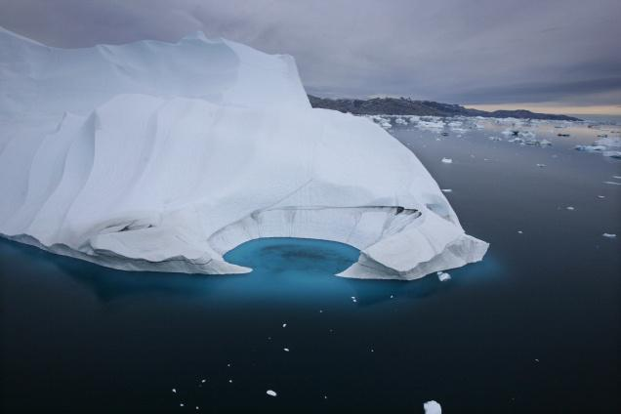
Kyoto: What’s the deal?
Read pages 423 to page 426
Agreement reached at an international convention to reduce greenhouse gases
First and only binding international agreement that includes specific goals for individual
countries to reduce their greenhouse gas emissions
In 2004, Liberal PM Paul Martin, announced a broad plan for dealing with greenhouse
gases, however (a common complication in liberal democracies) is that the Conservative,
under Harper, took power in 2006.
Harper instituted a new climate change plan focusing on additional consultations with
industry and business
When done complete # 12 - #16 of the handout: Contemporary Issues and Liberalism

Slide 25
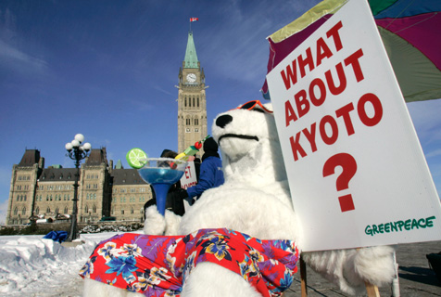
Kyoto: Canada Results (News Article)
For years, a succession of Canadian governments have dithered on the climate-change file. The results are in: Canada's greenhouse-gas emissions are growing faster than ever.
In 2007, according to new data released from Environment Canada, Canada hit a record high: 747 megatonnes of carbon-dioxide equivalent. That was up four per cent over 2006. The sudden increase can be explained, in part, by the fact that the winter was milder in 2006 than in 2007. But that doesn't explain the fact that since 1990, Canada's emissions have been climbing steadily.
This country promised, in the Kyoto agreement, to cut its emissions to six per cent below 1990 levels. Instead, it raised them to 26 per cent above 1990 levels. If this is what it looks like when Canada makes an effort, it's scary to imagine what our emissions might be today if we hadn't tried at all.
Indeed, in some sectors, emissions have declined, proving the efficacy of technological and cultural innovation. Residential emissions have stayed at 1990 levels, largely because of more efficient furnaces and buildings. There have been great successes in industrial processes, and emissions from the whole industrial sector decreased. Emissions from cars have decreased by about six megatonnes since 1990.
But emissions from SUVs and trucks increased by a whopping 44 megatonnes over the same period.
Agriculture has been another major contributor to Canada's greenhouse gases, accounting for seven percentage points of the overall increase since 1990. Environment Canada blames the growing market for meat, and the increase in the use of synthetic nitrogen fertilizer.
And then there are the tar sands. Mining, fossil-fuel production and electricity production were all major contributors to the increase in emissions since 1990. Even "fugitive releases" (pipeline leaks, etc) increased by 22 megatonnes between 1990 and 2007.
http://www.ottawacitizen.com/Technology/wrong+direction/1570792/story.html

Slide 26
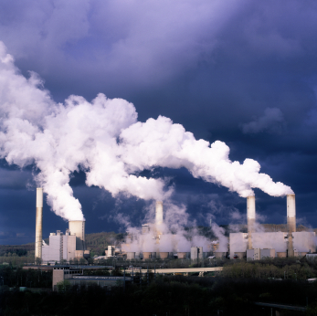
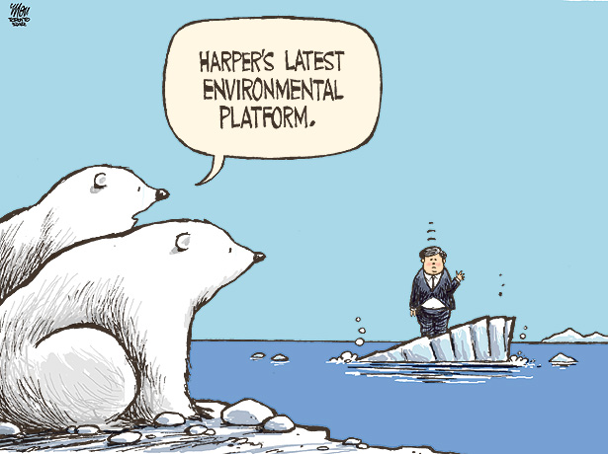
Willing to Change?
Read Article: Canadians, Conservatives differ on climate: poll
What measures do you think need to be taken to address climate change issues?
Are those measures consistent with liberalism?

Slide 27
China and India: 21st Century Economic Miracles
Read pages 428 to page 430
China and India and rapidly modernizing and have recently experienced tremendous
economic growth
However they are not using the same development path
China: Centre for low wage manufacturing
India: Concentrated on providing services, like call centers
Manufactured Landscapes 4:30 Min’s
When done complete # 17 - #18 of the handout: Contemporary Issues and Liberalism

Slide 28
Issues and Concerns
Both have had to face similar political, economic, and environmental problems as their
growth accelerated
Loss of farmland and traditional way of life
The exploitation of underpaid workers
Environmental issues: urban air quality poor due to pollution
(7 of the 10 most polluted cities on earth are located in China)
Ongoing conflict between economic development and environmental degradation
Sustainable economic development and environmental protections are luxuries that these
developing countries feel they cannot afford
Respond:
What solutions has economic liberalism brought to each country?
What problems have resulted from such liberalism?

Slide 29
Pandemics
Read pages 430 to page 433
A pandemic is an outbreak of disease on a global scale
From the Greek word “pan” (all) and “demos” (people)
It is a rapidly spreading, highly virulent disease that creates a borderless path of infection from which people have little or no immunity and for which there is presently no vaccine
Mass communication has increased our awareness, the ease of international travel has increased the spread
Examples:
Black Plague (1350s Europe) (listen to excerpt from Bubonic Nukes 3:45-8:49)
Avian Bird Flu, SARS, H1NI
When done complete # 19 - #24 of the handout: Contemporary Issues and Liberalism

Slide 30
Pandemics and Liberal Democracies
Challenging issue for liberal democracies
On one hand, limiting travel and restricting tourists, visitors, and new immigration to a country can provide greater protection
On the other hand, such actions will hamper trade and development, severely restrict the
basic freedoms of citizens and potentially create other issues related to human rights
violations
Determining a course of action is a complex matter and is international in scope
The WHO plays a crucial role in monitoring health issues at a global level
Do you think there is a point at which individual freedom should be restricted by governments in dealing with pandemics?

Slide 31
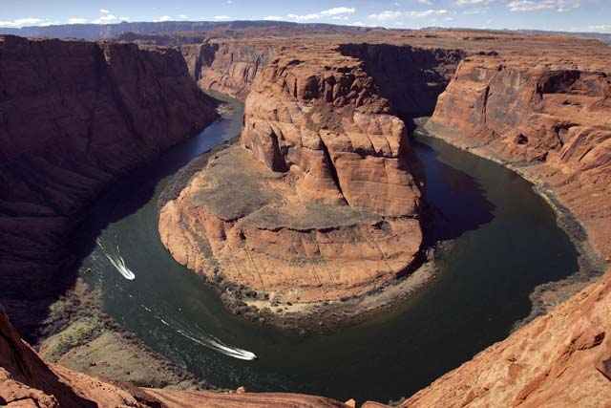
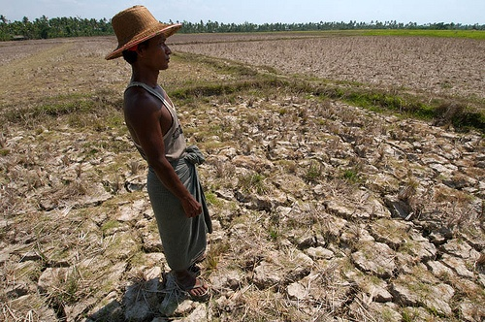
Water Shortages
Read pages 434 to page 438
There is a lack of access to clean and safe drinking water
According to the UN, more than one billion people suffer from this shortage
When done complete # 25 - #29 of the handout: Contemporary Issues and Liberalism

Slide 32
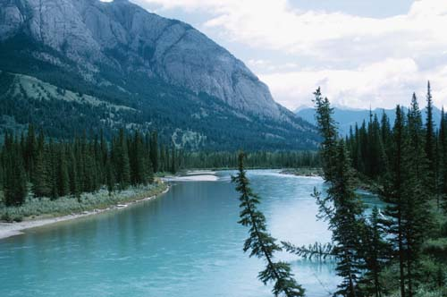
Alberta Issues…
Oil sands development in Northern Alberta involves processes that are very water and
energy intensive
Three to five barrels of fresh water are required to produce one barrel of oil
Residual waste from this process affects the environment in many ways
(Indigenous communities in Fort Chipewyan have increased cancer rates)
Liberal dilemma: balancing economic development of a country with health concerns of a
group of people

Slide 33
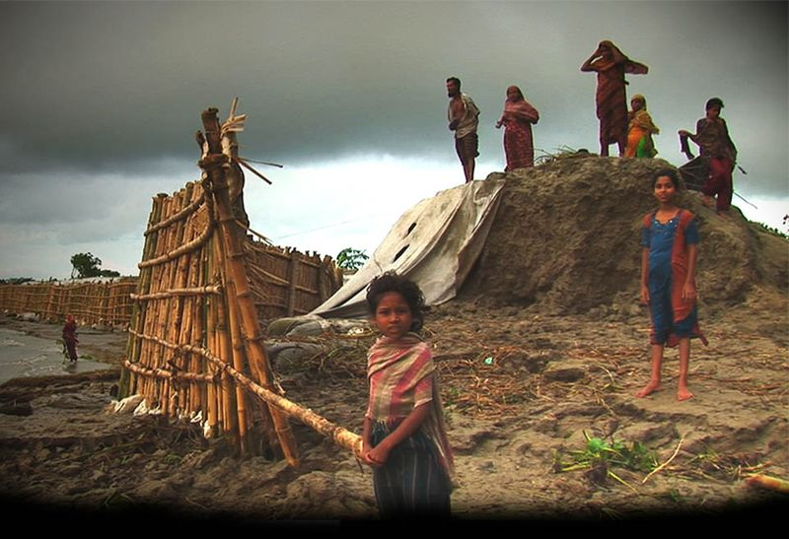
Water: A Political Issue
Until recently most people never thought about water as a political issue as water seemed to
be all around us – a renewable resource
Like oxygen, water is ESSENTIAL to life on earth
Examine the maps on page 436… within our lifetime access to fresh water could become one of the most pressing global issues
The regulation and control of water represents a dilemma:
Whose rights take precedence and who makes decisions?

Slide 34
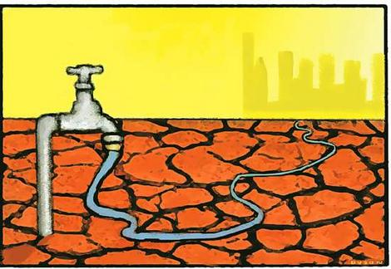
The Issue: Should water be treated as a commodity?
Historically, water has been a shared resource. Often government acts on behalf of its citizens to distribute water as a public service.
However, recent economic trends encourage governments to sell water usage and distribution rights to private businesses - known as water privatization
Show excerpt from F.L.O.W last minute of part 3, 4 minutes into part 4

Slide 35
Extension
Over the last couple classes we have focused on contemporary issues.
Pick on issue to focus on.
Make an assumption that liberalism cannot solve that issue.
Create an alternative ideology that is a reaction or solution to the issue.
Things to keep in mind:
Name your ideology (remember to end it with ______ism)
Remember it is a set of beliefs and values
Consider the characteristics of ideology
The nature of human beings
The structure of society
Interpretations of History
Visions of the future
Length = 1 page handwritten due Wednesday

Slide 36
Issues to choose from…
Consumerism
Unanticipated Consequences of Liberalism
Environmental Movements
China and India: 21st Century Economic Miracles
Pandemics
Water Shortages

Slide 37
Related Issue #3 Exam
Chapter’s 9, 10, 11 and 12
Consists of:
60 M.C. Questions

Slide 38
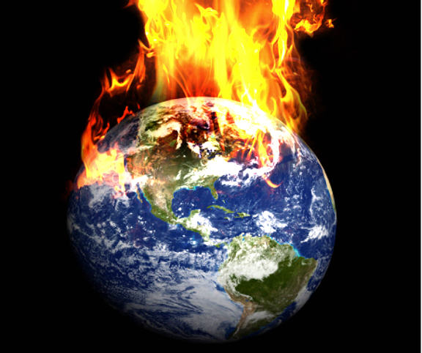
Environmental change
The changes in the natural world around us.

Slide 39
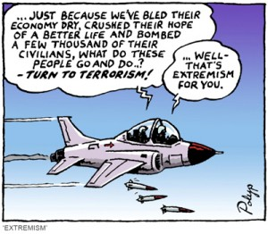
extremism
a term used by others to describe the beliefs and actions of those perceived to be outside of the accepted norms of political or social behavior. Extremism may be a response adopted by those for whom ordinary political means of redressing perceived wrongs are deemed ineffective.

Slide 40
pandemics
Outbreaks of disease
on a global scale.

Slide 41
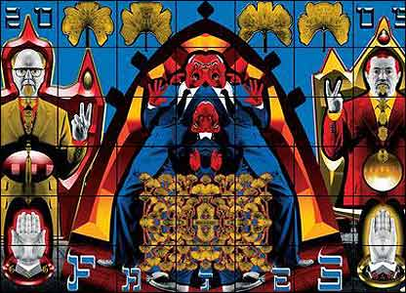
postmodernism
A movement of thought, art and criticism that raises questions about the faith that moderns have in reason, and in progress, and tries to get people to rethink their assumptions about the meaning of modern life.

