Slide 1
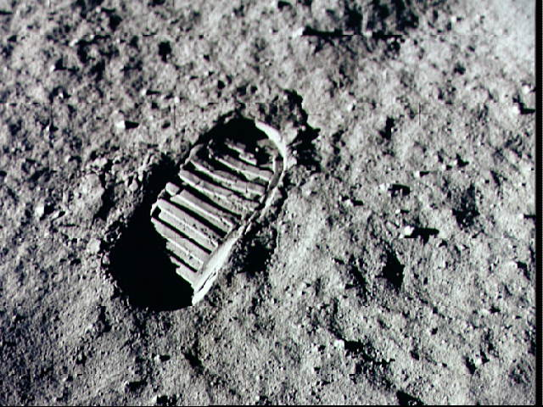
Globalization
And
Sustainability

Slide 2
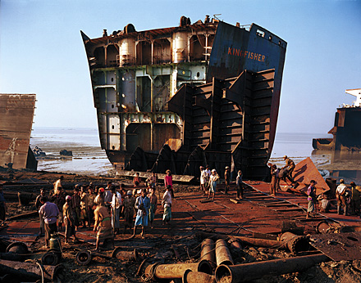
To What Extent Does Globalization Affect Sustainability?
Read page 259 and record your
responses to the seven
questions in your notebook

Slide 3
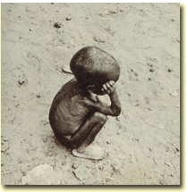
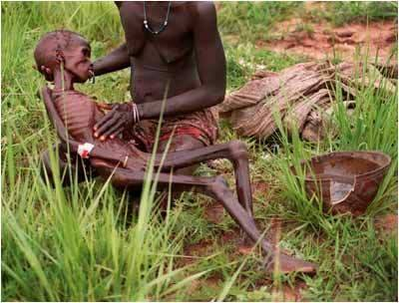
Sustainability:
To keep in existence,
to supply with
necessities or
nourishment

Slide 4
Your text book refers to an Ecological Footprint. (Also know as a Carbon Footprint.)
What is a carbon footprint?
It is the measure of impact human activities have on the environment in terms of the amount of greenhouse gases produced. Measured in units of carbon dioxide.
The challenge is to reduce your carbon footprint!

Slide 5
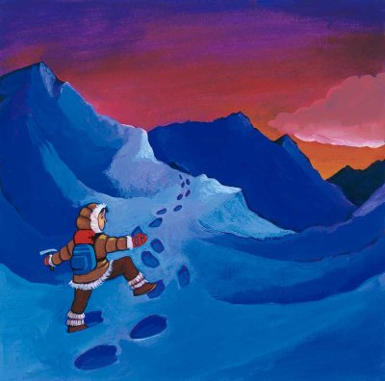
Ecological Footprints
With a partner, read and review pages 260 – 263
Answer the following in your notes:
Explain why there is such a huge inconsistency between the Ecological Footprint in Canada and that of Bangladesh.
ALSO
With a partner complete the “Reflect and Respond”
Have a list of your refuse items to share with the class
What Does Sustainability Mean?

Slide 6
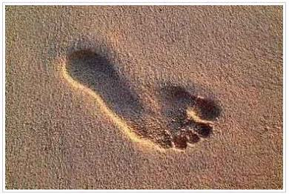
How does your list compare?
Ten things to do to reduce your footprint
Change a light
RECYCLE MORE
Changing one regular light
bulb with a compact fluorescent
light bulb will save 150 pounds of carbon dioxide a year
You can save 2,400 pounds
of carbon dioxide per year
by recycling just half of your household waste
Drive less
Walk, bike, carpool or
take public transit.
You’ll save one pound of
carbon dioxide for every
kilometre you don’t drive
Check your tires
Keeping your tires inflated
properly can improve your
gas mileage by more than
3%. Every litre of gasoline
saved keeps 20 pounds of
carbon dioxide out of the
atmosphere
USE LESS HOT WATER
It takes a lot of energy to heat
water. Use less hot water by
installing a low flow showerhead.
This saves 350 pounds of carbon
dioxide a year. Washing your clothes
in cold or warm water saves 500 pounds
per year

Slide 7
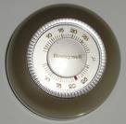
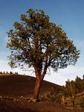
AVOID PRODUCTS WITH LOTS OF PACKAGING
You can save 1,200 pounds of carbon dioxide if you cut your garbage by 10%
ADJUST YOUR THERMOSTAT
Moving your thermostat down 2 degrees in
winter and up 2 degrees in the summer you
could save more than 2,000 pounds of
carbon dioxide a year.
PLANT A TREE
TURN OFF ELECTRONIC DEVICES
A single tree will absorb
1 ton of carbon dioxide
over a lifetime
Simply turning off your television,
DVD player, stereo and computer
when you’re not using them will
save thousands of pounds of
carbon dioxide a year
USE PRINTER PAPER THAT IS 100% RECYCLED
Save 5 kilograms of carbon dioxide per ream of paper. The paper industry
is the third greatest contributor to global warming emissions

Slide 8
And…
Begin a Chapter Eleven Terms List!

Slide 9
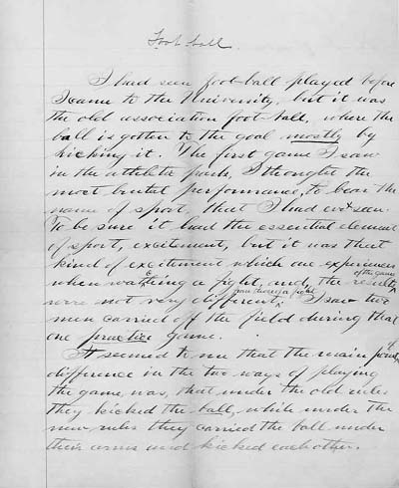
Think About Your Challenge
Is there anything in this section of Chapter Eleven that could be used for your
Persuasive Essay?

Slide 10
How Are Globalization And Sustainability Related?
With a partner, look through pages 266-267 of your textbook and…
Make a brief outline of these two pages
Also…
Answer in your notebook the second activity (267)

Slide 11
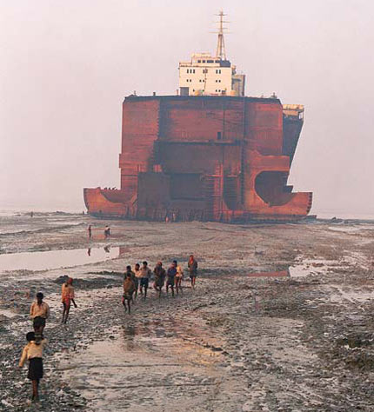
Disposing of Old Ships
Page 268 informs us about the disposal and death of a ship
After reading this page, answer in your notebook the questions in the last paragraph and the response required for Figure 11-19
What is the connection of this type of profession and how globalization and sustainability are related?

Slide 12
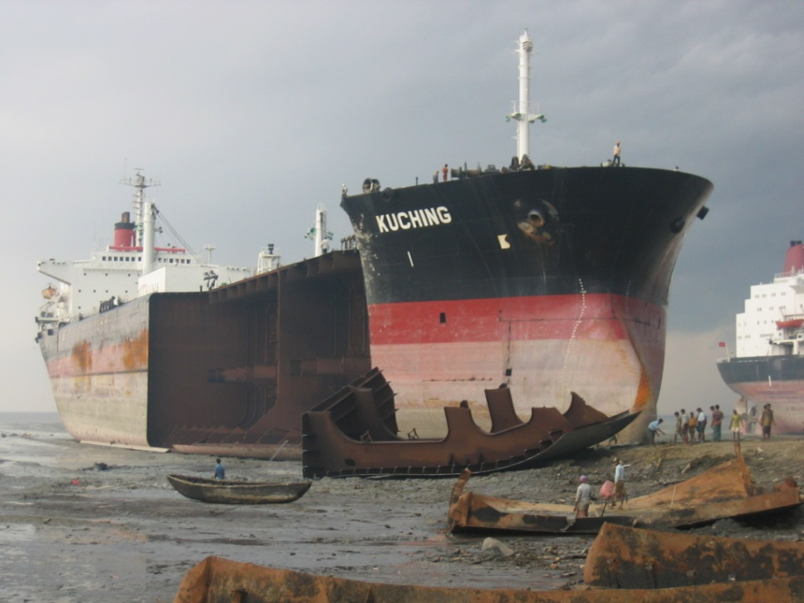
Read Pages 270 - 271
Complete a chart like the one on page 271 and answer the question…
Have Efforts to Promote Sustainability in Shipbreaking Been Successful?

Slide 13
Shipbreaking: An Example
13:00

Slide 14
Have Efforts to Promote Sustainability Been Successful?
Divide Into Six Groups
Group 1&4
The Kyoto Protocol (page 272)
Group 2&5
Alberta Tar Sands (page 273)
Group 3&6
Alternative Energy Sources (page 274)
While reading your section individually and silently, take brief jot notes.
When finished, discuss your topic with your group and be certain you all have complete notes
What do you know about the Kyoto Protocol?
Assign one leader for each group

Slide 15
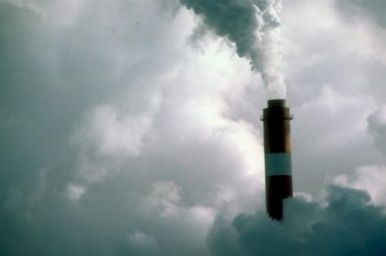
In your groups, discuss whether the efforts to achieve sustainability described in your topic have been successful.
Each group leader must report the groups findings to the class
In the same groups, create a visual that communicates the conclusion your group have reached about sustainability
THIS VISUAL WILL BE POSTED IN THE CLASS

Slide 16
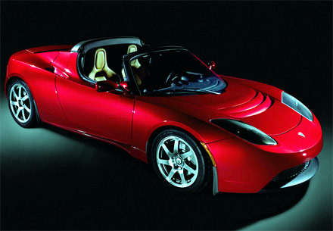
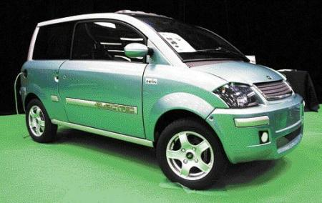
Alternative Energy Sources: Examples
13:00
5:00

Slide 17
Individual Initiatives
Read page 275 in your textbook, including the profile about Wangari Maathai
Jot down some items that you have discovered or that you already knew about what individuals can do to help with global environmental issues

Slide 18
The 11th Hour
93:00
A look at the state of the global environment including visionary and practical solutions for restoring the planet's ecosystems.

Slide 19
Think About Your Challenge
Is there anything in this last section of Chapter Eleven that could be used for your
Persuasive Essay?

Slide 20
Terms
Go through all that you have done in this chapter and add to your vocabulary list

