Slide 1
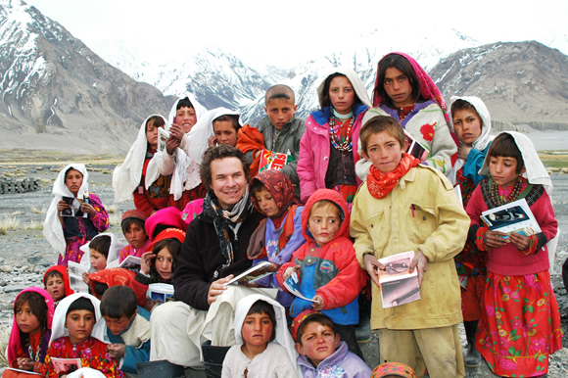
Ideology and Citizenship
Related Issue #4
In Units 1, 2 and 3 we explored ideologies in general and liberalism in particular
Part 4 of your course introduces you to the relationship between ideology and
active individual and collective citizenship
In other words:
What do you think about the extent to which you should exhibit global consciousness of the human condition and local, national and global issues?
Read the opening on page 440
Read about Greg Mortenson’s commitment to take action to demonstrate responsible citizenship in isolated regions of Afghanistan and Pakistan.
Consider the following questions as you read:

Slide 2
Ideology and Citizenship
Related Issue #4
Consider the following questions as you read:
To what extent do ideas in the source present a possible response to the Related issue for Part 4:
To what extent should my actions as a citizen be shaped by an ideology?
To what extent do the ideas in the source article present a possible response to the Chapter Issues for Part 4?
To what extent should ideology shape responses to issues in times of peace and in times of conflict?
To what extent should an ideology shape your thinking and actions as a citizen?

Slide 3
Use the following sentence starts as answers to the previous questions:
A question that I would like to ask Greg Mortenson is…
What most struck me about the information that I read was…
The idea that I found most interesting was…
Multiple perspectives that could be taken to explain the successes and failures of Greg
Mortensons’s campaign to date include…
Questions about Greg Mortenson’s campaign that remain unanswered by this source are…
Ideological beliefs and values that could be behind Greg Mortenson’s actions in response to local, national and global issues in Pakistan are…
Greg Mortenson could be seen to define his citizenship as…

Slide 4
Reflect on the beliefs about citizenship shared by Andrew Coyne and Mark Kingswell
Ideology and Citizenship
Related Issue #4
Read page 441
Do you believe that you have a moral imperative- that something a person, a community, a
person, or a nation-state chooses to do because it is the right thing to do, regardless of how
difficult it is or how many people are opposed to it- to take action?
Why would you act on your moral imperative?
Write out the issue question for Related Issue #4 from page 441
To what extent should my actions as a citizen be shaped by an ideology?

Slide 5

Greenpeace Activists
An Example of a Moral Imperative?
If you wore a Greenpeace T-shirt, and you were denied entry as an observer into the House
of Commons... is that right?
Read the Article:
Turn Greenpeace T-shirt inside-out or get turned away on Parliament Hill
What is your reaction to the governments response?
Do you think Greenpeace members should/should not have been arrested after scaling
Parliament's roof and unfurling the sign? Reasons?

Slide 6

Reflecting on Worldview, Ideology and Citizenship
Chapter Thirteen
What is citizenship to you?
What is your citizenship?
Write a response
Read the opening two paragraphs on page 442
As you read the rest of the chapter introduction on pages 442 – 444…
Write out evidence of a worldview for the following examples:
Canada, The Métis, Burma/Myanmar and Israel
Worldview:
A collection of beliefs about life and the universe held by an individual or group; the lens through which the world is viewed by an individual or group; the overall perspective from which the world is interpreted
Review the Chapter Issue on page 445 and write out the issue question for the chapter

Slide 7
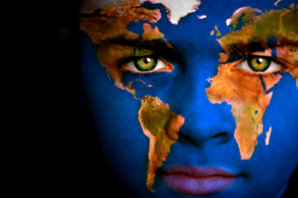
Influences of Worldview and Ideology on Citizenship
Read the introduction to this section on pages 446-447
What is meant by the term citizenship?
A citizen lives in and is a member of a country
A citizen votes
A citizen has certain responsibilities-obeying laws, paying taxes
A citizen has certain rights-legal, language, minority and fundamental freedoms

Slide 8

Citizenship is much more than “Legal Status”
Andrew Coyne, Canadian Journalist:
Believes that being a citizen of a country mean being part of a moral project
Mark Kingwall, Professor of Philosophy:
What is the world you want?
What rights and responsibilities might you have in taking action to achieve this action?

Slide 9

Examples of Youth Who Decided to Practice Their Citizenship and Make a Difference:
2001: Two female 15 year old Alberta’s sued the Alberta government to change the
Municipal Elections Act to lower the voting age from 18 to 16
Some youth join groups such as Amnesty International or youth wings of political parties
Some youth attend conferences to address social issues such as AIDS/ HIV or homelessness
The involvement of these youth is based on an ideology or way each student views the world

Slide 10
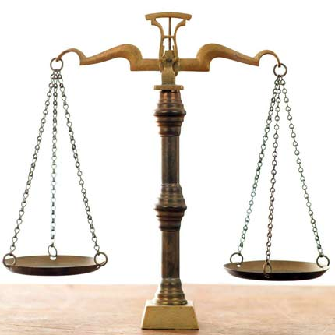

Legal and Political Understandings of Citizenship
Read pages 447 to page 450
Legal Understandings of Citizenship
Based on two principles:
Jus soli (right of the soil): a person’s citizenship or nationality is determined by place of birth
Jus sanguinis (right of blood): the citizenship and nationality of a child is the same as the
natural parents, wherever the child is born
To determine who may (and may not) legally identify themselves as a citizen:
Most countries use:
A combination of jus soli and jus sanguinis
As well as naturalization (the process of applying for citizenship)
Russell Peters on being a Canadian Citizen
6:00
When done complete # 1 - #10 of the handout: Ideology and Citizenship

Slide 11

Political Understandings of Citizenship
In ancient Athens, citizenship involved a moral right and duty to actively participate in the
politics of the city
The goal: To create a sense of belonging to a community; to have citizens becomes
stakeholders in the well being of the republic
THUS
Civic and political participation was understood as the obligations that citizens had to the state and society as a result of being granted rights

Slide 12

Broader Understandings of Citizenship
Read pages 450 to page 456
Civic Participation (Also known as: Citizen Advocacy)
Direct
Attending town hall meetings, protesting or demonstrating, participating in NGOs,
and so on
Indirect
Writing letters to newspapers, contributing money
When done complete # 11 - #14 of the handout: Ideology and Citizenship

Slide 13

1. Liberal/Individualistic Understanding of Citizenship
Three Understandings of Citizenship
Citizenship is a status
Governments function to protect and maximize individual interests
Individuals are urged to exercise their responsibilities - not to rely on governments

Slide 14

2. Communitarian Understanding of Citizenship:
Citizenship is a practice
Citizenship comes from a sense of belonging to a community and wanting to work with
others to achieve the common good
An individual’s identity is produces through its relations with others, which in turn creates
a sense of group identity

Slide 15

3. Civil Republican Understanding of Citizenship
Also known as Civic Morality
Believe that citizenship is a practice
Concerned with promoting a strong sense of civic identity
Shaped by a common public culture- and a sense of belonging to a common nation state
Strong goal of creating a reciprocal relationship between the individual and the state
Four Common Elements of Citizenship
With a partner, review the four elements that are common to all models of citizenship (page 452) and answer the two question below these elements

Slide 16
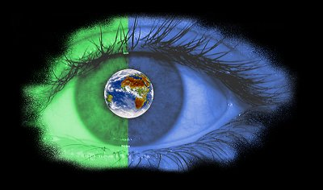
Impact of Worldview and Ideology on Citizenship
Read pages 456 to page 459
When done complete #1 - #6 of the handout: Impact of Worldview and Ideology on Citizenship
Influences of Worldview and Ideology on Citizenship
Review
Complete questions 7 – 9 on the above handout

Slide 17
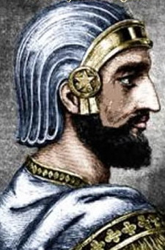
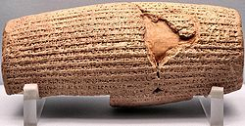
Understanding Rights, Roles and Responsibilities
Read the introduction to this section on pages 460-461
History of Human Rights
Cyrus The Greats' Cylinder
The World's First Charter of the Human Rights
Discovered in 1878 by an Assyrian archaeologist in Babylon
Includes a detailed account by Cyrus of his conquest of Babylon in 539BCE and his
subsequent humane treatment of his conquered subjects
Explains how Cyrus established peace and abolished forced labour
When done complete #1 of the handout: Understanding of Rights, Roles, and Responsibilities

Slide 18
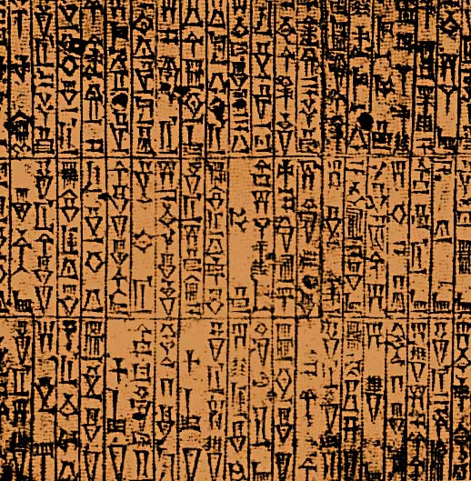
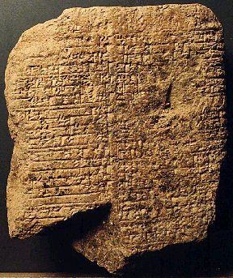
Code Of Hammurabi - 1780 BCE
A code enacted by the sixth Babylonian king
A primary example of even a king not being able to change fundamental laws concerning
the governing of a country (the “primitive form” of a constitution)
Examples…
If a man kills another man's son his son shall be cut off.
If anyone ensnares another, putting a ban upon him, but he can not prove it, then he that ensnared him shall be put to death.

Slide 19
More Examples…
If a man strikes a pregnant woman, thereby causing her to miscarry and die, the assailant's
daughter shall be put to death.
If a man puts out the eye of an equal, his eye shall be put out.
If a man knocks the teeth out of another man, his own teeth will be knocked out.
If anyone strikes the body of a man higher in rank than he, he shall receive sixty blows with
an ox-whip in public.
If a freeborn man strikes the body of another freeborn man of equal rank, he shall pay one
gold mina (an amount of money)

Slide 20
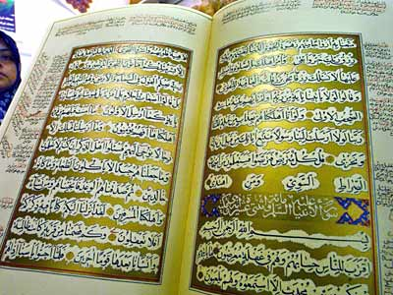
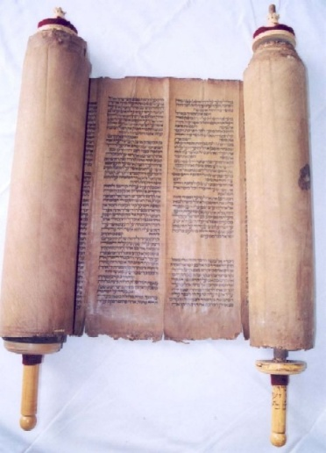


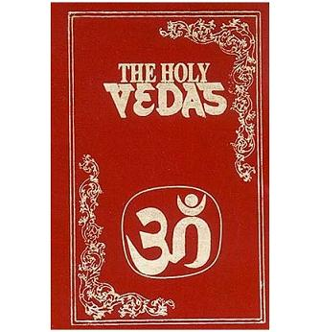
Religious Documents
Address the idea of rights as well as duties and responsibilities
Christianity: The Bible
Islam: The Quran
Hinduism: The Vedas
Judaism: The Torah

Slide 21
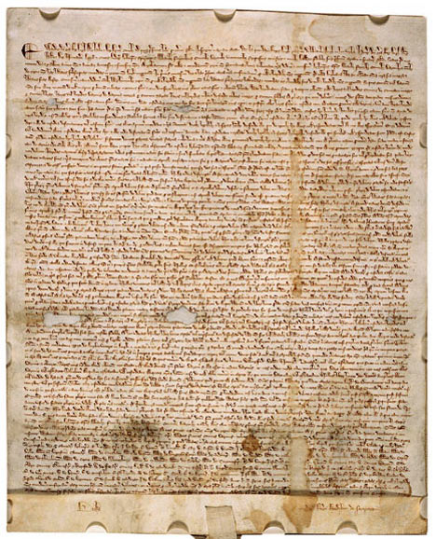
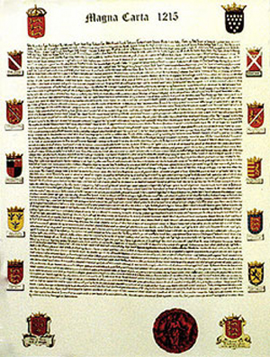
Magna Carta - 1215 CE
Widely viewed as one of the most important legal documents in the history of
democracy
Required King John of England to proclaim certain rights (pertaining to
freemen),to respect certain legal procedures, and to accept that his will could
be bound by law
Explicitly protected certain rights of the King's subjects, — and implicitly
supported what became the will of habeus corpus
Led to the rule of constitutional law today

Slide 22
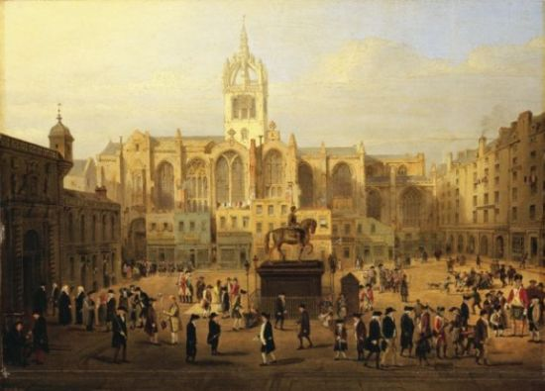
Enlightenment Ideas of Human Rights and Justice
John Locke
Thomas Hobbes
Rousseau
Montesquieu
Voltaire
Inspired by the Philosophes…
Two major revolutions occurred
The French Revolution ( 1789 – 1799 )
The American Revolution ( 1776-1783 )
Each revolution included in its philosophy an idea of individual rights
French Declaration of the Rights of Man
The American Declaration of Independence

Slide 23
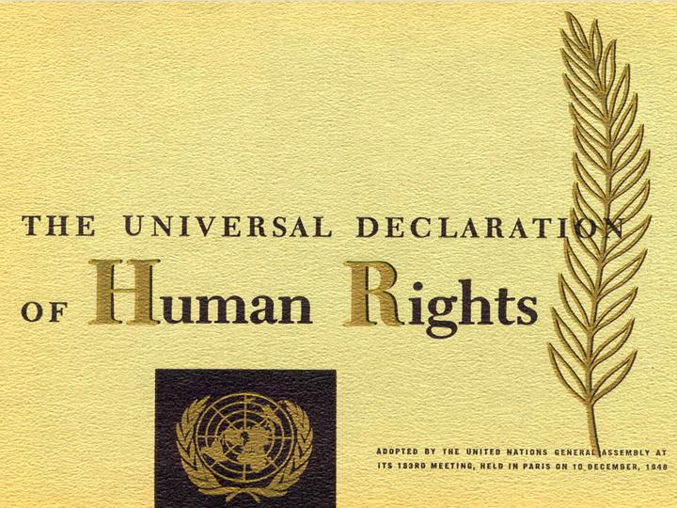

20th Century Human Rights
Several documents outlining human rights have been created
The goal: to encourage the universal recognition of human rights
One of the most recent attempts (OK, 1948 ) to outline the rights to which all people are
entitled: The UN Declaration of Human Rights
Declaration of Human Rights
4:30

Slide 24

Despite the long history of human rights and their place in the political culture of countries and supranational organizations …
A common understanding of human rights does not exist; remains contested
Why?
Our understanding of rights in “The West” is based on Western Philosophes and values that
are not necessarily applicable in other countries

Slide 25
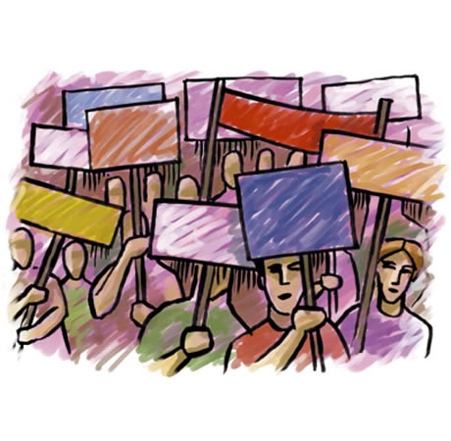
The Rights, Roles, and Responsibilities of Citizens
Read pages 461 to page 466
Review
When done complete #2 - #11 of the handout: Understanding of Rights, Roles, and Responsibilities

Slide 26
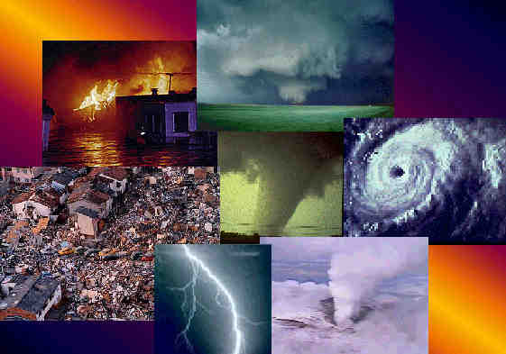
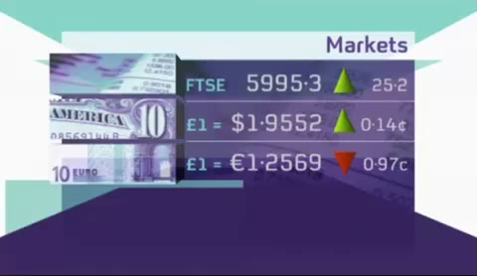
Natural Disasters and World Responses
Read pages 466 to page 468
Millions still suffer in Burma due to blocked aid 1 month after Cyclone
6:30
Review
When done complete #12 - #14 of the handout: Understanding of Rights, Roles, and Responsibilities

Slide 27
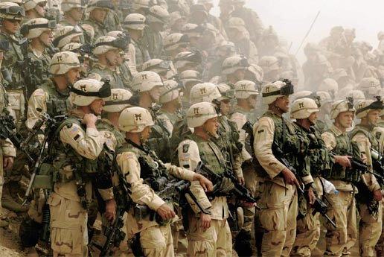

The Call To War
Read pages 469 to page 472
Sgt. Corey Glass appeals to Prime Minister Harper for asylum
1:00
Review
When done complete #15 - #17 of the handout: Understanding of Rights, Roles, and Responsibilities
Complete #1 on page 474

Slide 28
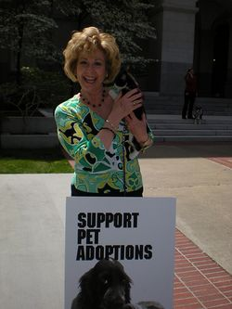
Citizen advocacy
A movement to strengthen citizen action and motivation to participate in community and civic-affairs, often focuses on bringing the marginalized back into the community.

Slide 29
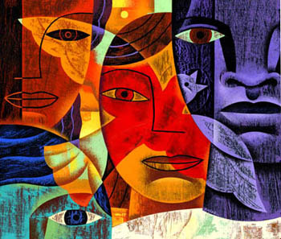
citizenship
Membership by birth or naturalization in a society, community or country that entails definable rights of participants and protection, and certain responsibilities and duties to the society, community or country.

Slide 30
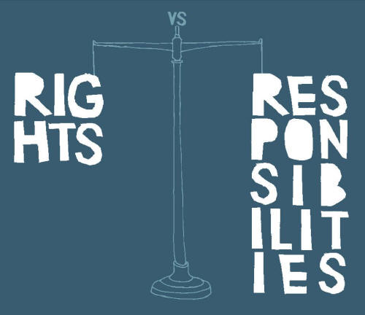
Individual rights, roles
and responsibilities
A key principle of individualism and an important feature of liberal democracies, examples include freedom of religion, freedom of association and the right to life, liberty and the security of the person.

Slide 31
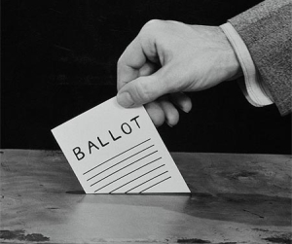
Political participation
Any number of ways a citizen can be involved in the political process, such as voting, running as a candidate, supporting a candidate, attending a constituency meeting, speaking out, demonstrating, protesting, writing letters to elected representatives.

