Slide 1
Reflecting on Ideology, Action, and Citizenship Chapter Fourteen
Review the Chapter Issue on page 478 and write out the issue question for the chapter
Review the two sections within the chapter and write out each of their Questions for Inquiry
Responding to Issues
To what extent to citizens have the right, role, or responsibility to take action?
Leading for Change
How do your ideology and your citizenship affect how you demonstrate leadership in responding to local, national and global issues?
Review assignment: Making Changes

Slide 2
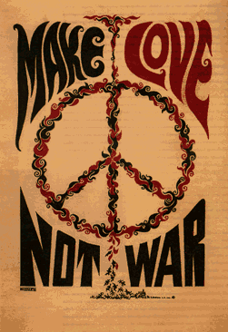
Anti-war movements
Organized campaigns against war. The Vietnam anti-war movement gained public support during the late 1960s and contributed to the United States ending that war. These movements can be pacifist in general, and aimed at ending or restricting the military policy options, or they can be movements opposing specific military campaigns.

Slide 3
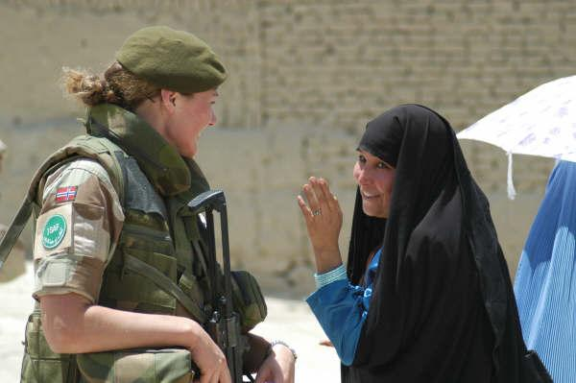
civility
Thoughtfulness about how our actions may affect others, based on the recognition that human beings live together.

Slide 4
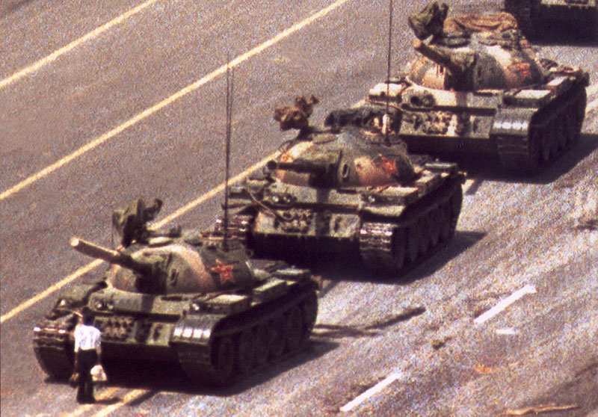
Pro-democracy movements
Movements or campaigns in favour of democracy.

