Slide 1
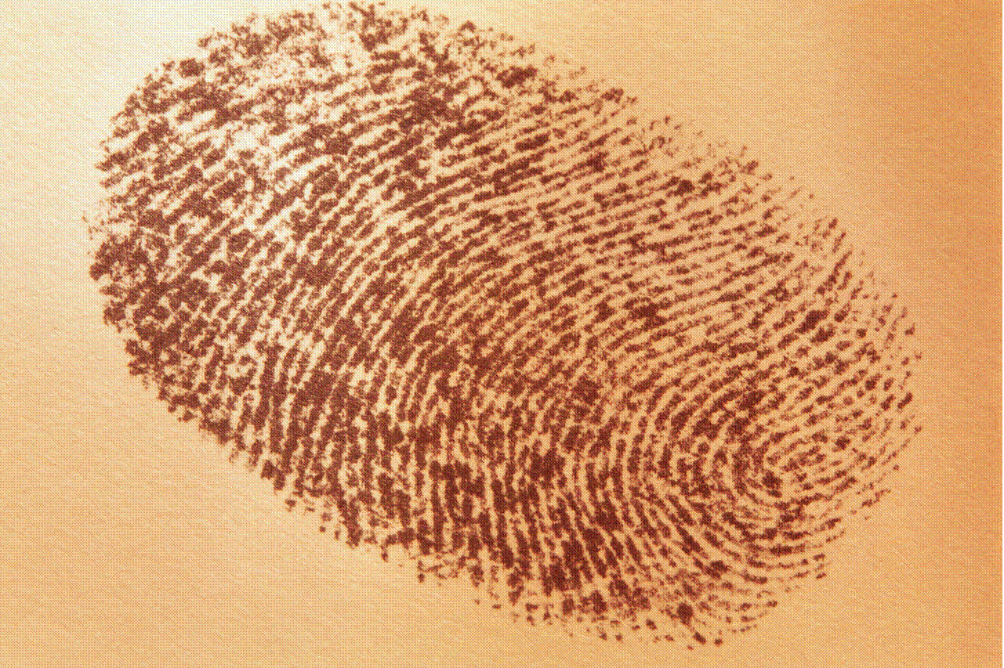
To What Extent Should Globalization Shape Identity?
Turn to page 14
Review Related Issue #1 and the four chapters included
What is the connection between related issue question, the individual chapter question and each of the chapter inquiry questions?
What is the difference between the words should and does?

Slide 2
The Big Picture
Read pages 14 – 15 and answer the following:
What is the main idea of this section?
How are the three pictures connected to the main idea?
What do the authors suggest is one of the main differences of opinion about globalization?
Which of the opinions expressed about Globalization, is closest to your own? Why? Do you think younger people and older people would answer this question differently?

Slide 3
Challenge #1
The Social Dimension of Globalization:
The Universalization & Hybridization of Culture
Research Assignment
Social 10-1

Slide 4
CULTURE & GLOBALIZATION
Universalization
and
Hybridization

Slide 5
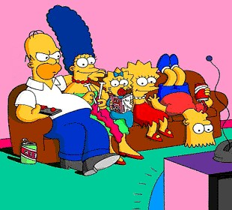
What is Popular Culture?
Mainstream culture: what people enjoy
  Clothing & personal style
  Language
  Movies & TV, Music
  Food
  Sport & Leisure Activities
  Books, magazines and visual art

Slide 6
Universalization of Culture
Around the globe, large numbers of people are experiencing the same culture.
    Transnational corporations
    Technology

Slide 7
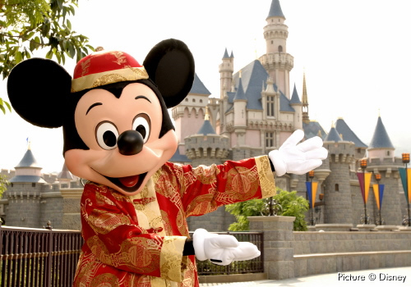
Disneyland Hong Kong

Slide 8
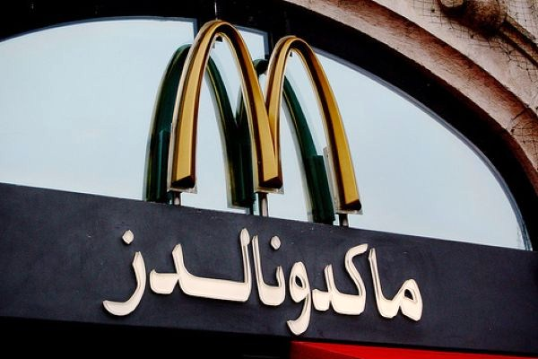
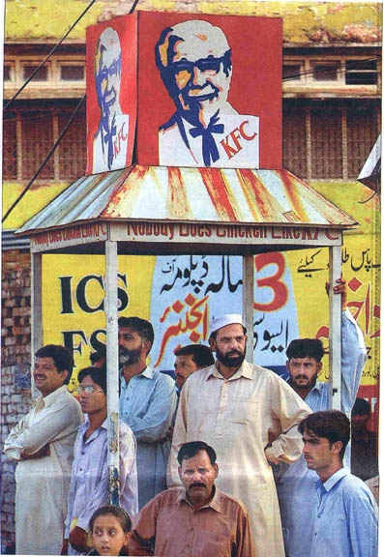

Food

Slide 9
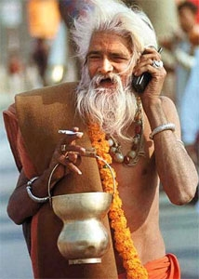
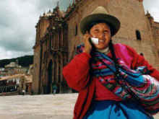
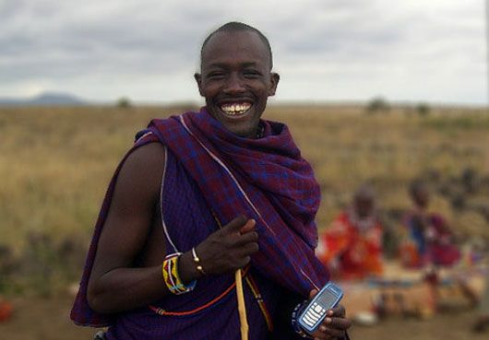
Technology

Slide 10




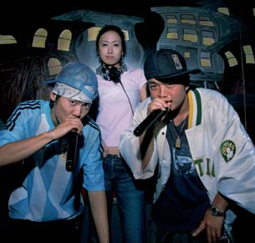
Film
&
Entertainment

Slide 11
Hybridization of Culture
Hybridization occurs when people mix cultural forms, genres or styles to create something new

Slide 12
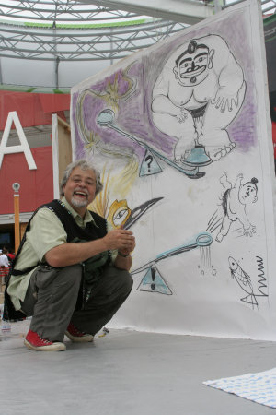
Haida Manga
Michael Nicoll Yahgulanaas
"I don't recall my great-grandmothers or my uncles mumbling mantras of traditionalism as a way to stifle change, growth or expression. I watched them innovate and adjust practices to achieve a greater sense of accomplishment.”
Canadian Artist Michael Yahgulanaas

Slide 13


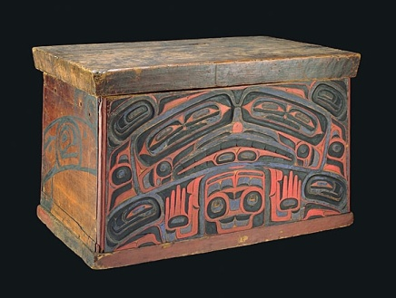

Traditional Haida

Slide 14
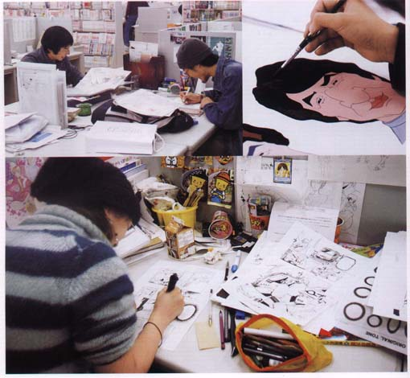
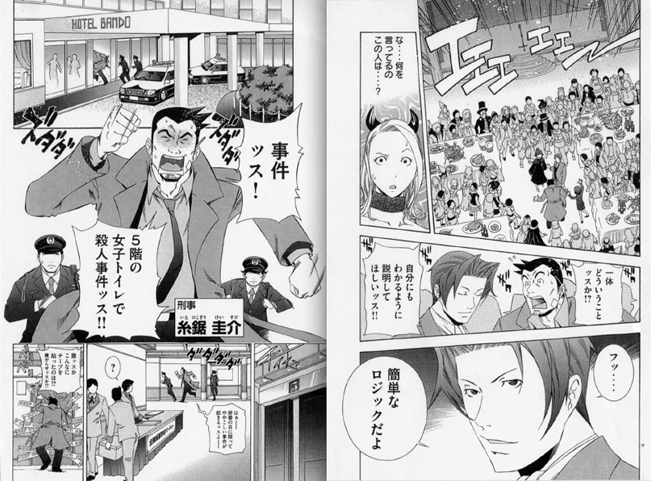
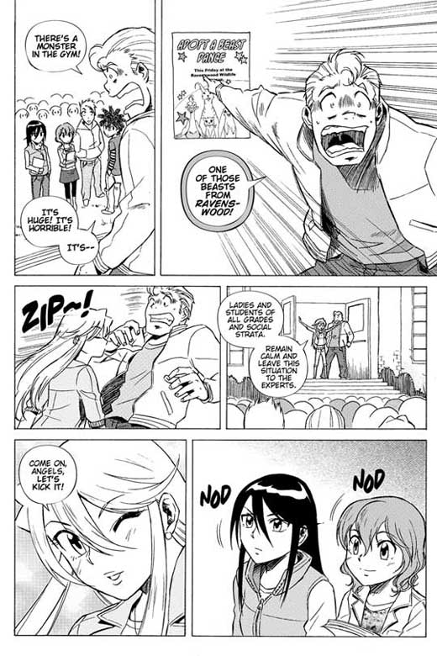
Japanese Manga

Slide 15

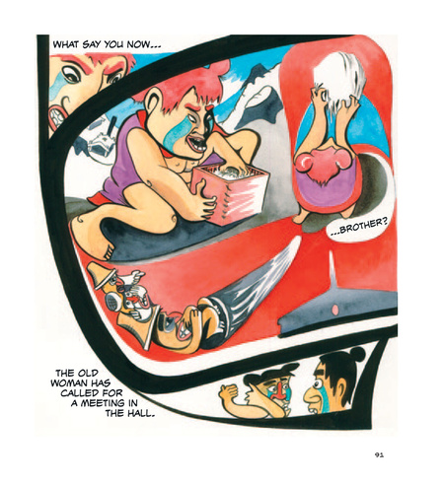

Haida Manga
Haida-Manga Animation
"Flight of the Hummingbird“
2:30
The Universalization & Hybridization of Culture: Research Assignment

Slide 16

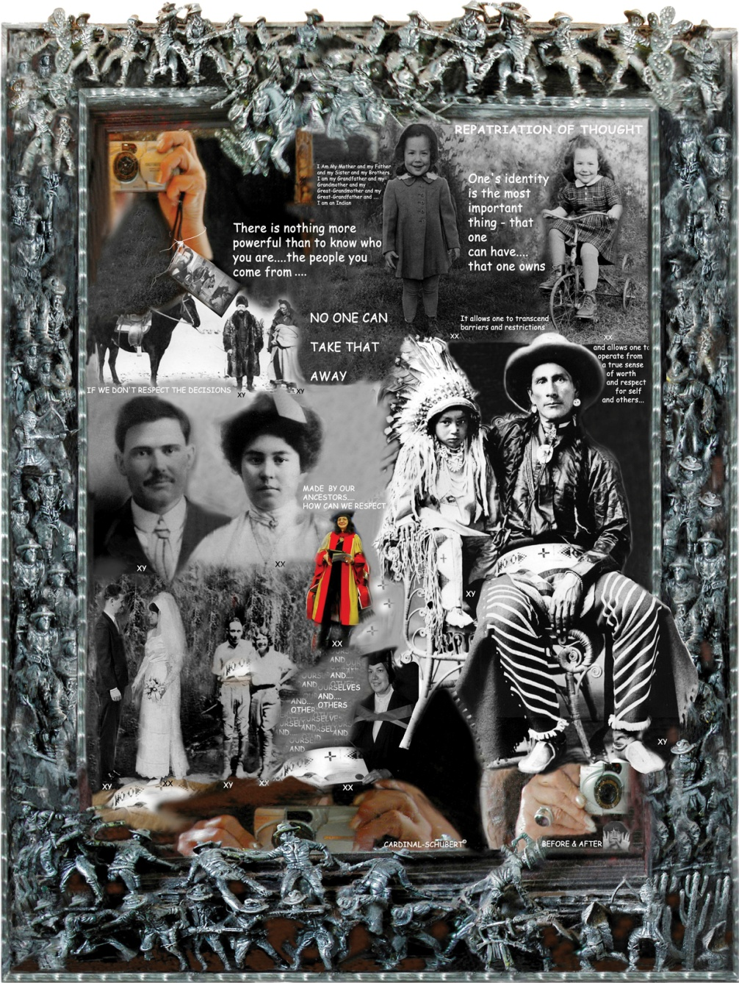
Globalization and Identity
Read page 19 and respond to the Activity
Review
Looking Ahead
To What Extent Does Globalization Shape Your Identity?

Slide 17
Who Are You?
Read pages 20 – 22
While reading, make a list of the many different factors that shape people’s identity
What role does ‘context’ play in affecting your identity?
DO NOT complete the activity

Slide 18
Characteristics:
Then & Now
Grade Eight
Same Today

Slide 19
And Finally…
Begin a list of terms from this chapter, which include…
Any term or phrase that would be considered important in helping you with your …
The Social Dimension of Globalization Presentation
Any suggestions as to what you should include?

Slide 20
How Do You Express Who You Are?
Review the photographs of page 23
Is there anything about their appearance that might tell you a little about their identity?
Read the opening two paragraphs
Read the three sections on pages 23 – 25
(Traditions, Language and Clothing/Body Adornment)
Complete the Activity on page 24

Slide 21
And Finally…
Continue with your list of terms from this chapter, which include…
Any term or phrase that would be considered important in helping you with your …
The Social Dimension of Globalization Presentation
Any suggestions as to what you should include?

Slide 22
How Do Collectives Express Who They Are?
Read the opening two paragraphs on page 26
Write out the meaning of the term COLLECTIVE
Read the rest of page 26 and answer the following question thoroughly!
How much of your identity is defined by your membership in collectives?
Ignore the Activity

Slide 23
Group Activity
Each of you will be assigned a group in which you will be responsible to read a short section in your textbook
Group #1: Expressing Collective Identity: Language (27-28)
Group #2: Slang, Jargon and Collective Identity (29)
Group #3: Collective Identity and Context (30-31)
In your assigned groups complete the following for each of the three sections:
#1. Read your section quietly together
#2. Write a minimum of one summary statement for each of the paragraphs
#3. Appoint a spokesperson to report to the class on your findings
Keep in mind the Issue Question as you read:
How Do Collectives Express Who They Are?

Slide 24
Think About Your Challenge
Review your challenge for this Related Issue
Is there anything from Chapter One, so far, that you can add to your notes for Your Challenge?
Take a few minutes to review and write
Social 10-1

Slide 25
And Finally…
Continue with your list of terms from this chapter, which include…
Any term or phrase that would be considered important in helping you with your …
The Social Dimension of Globalization Presentation
Any suggestions as to what you should include?

Slide 26

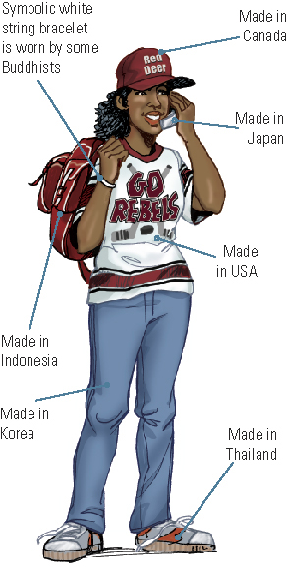
How Are We Globally Connected?
What Canadian-made items might teens in other countries own?
What are the origins of all these items?
How are these items personal connections to people in other parts of the world?
Check the labels of your clothes/items…Where are they from?
Write them down

Slide 27
How Are Identities Connected Through Globalization?
Read the opening three paragraphs on page 36
Besides the ‘things’ in our lives, there are many other examples of how we are connected globally….
What might these examples be….?
Heritage
Friends
Web Connections
Languages Spoken
Travel
Religion
More?
Write down your personal connections (including the name of the country) from the list above

Slide 28
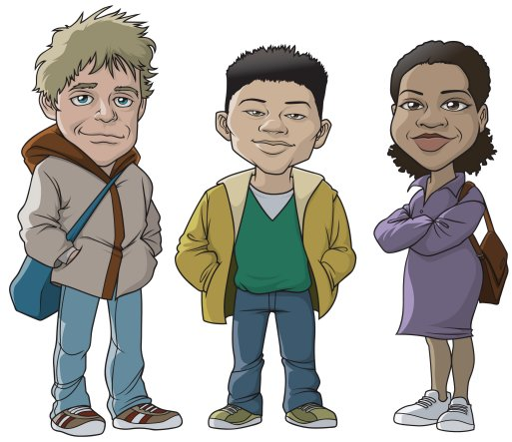
Connected to Coltan
Read Coltan and Connected Identities (pages 36 – 37)
Complete the Activity
Your Connection to Coltan
Miners You
Fill in ALL the steps that separate the identities of the Coltan Miners to your identity

Slide 29
Do Global Connections Always
Lead to Positive Results?
Recreate the chart below, including the title
Positive Results Negative Results
So, are the overall effects of globalization positive or negative?
Including your reasons, write out your response
Using the information on page 38 (as well as your own ideas) complete the chart in point form

Slide 30
And Finally…
Complete your list of terms from this chapter, which include…
Any term or phrase that would be considered important in helping you with your …
The Social Dimension of Globalization Presentation
Any suggestions as to what you should include?

Slide 31

Chapter One Quiz
Thursday
10 Multiple Choice Questions
Review the Chapter – Including the Terms

