Slide 1
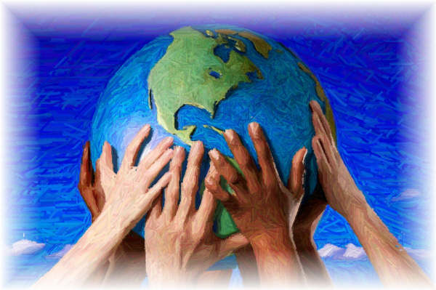
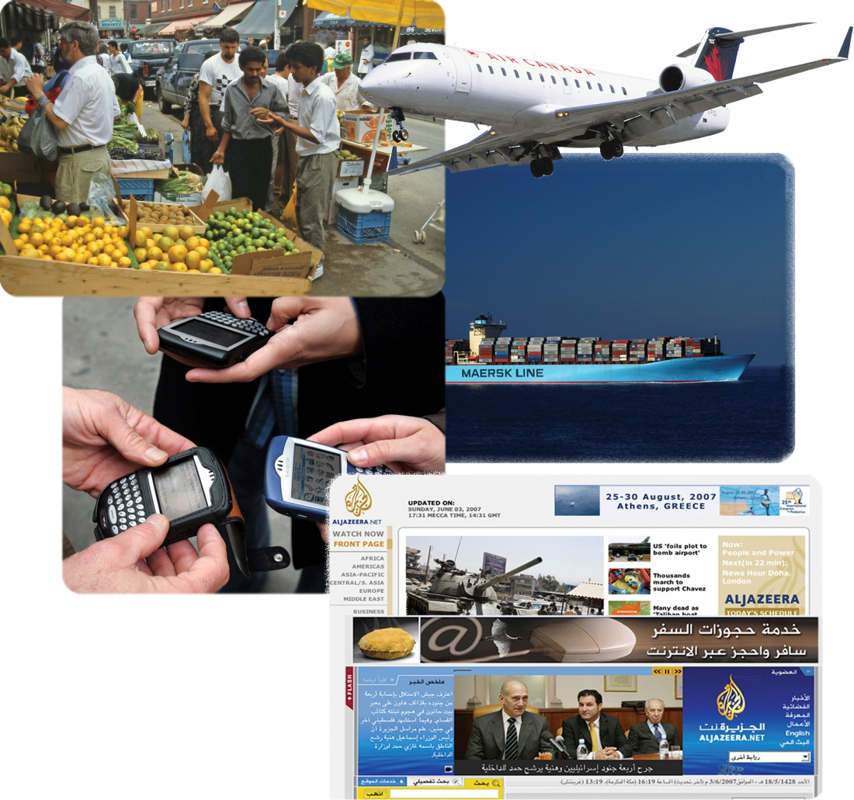
Identity and the Forces of Globalization
What other images could have been included with these?
Read the Introduction on page 43
What is the connection between these photos on page 42 and your identity?
Read the rest on page 43

Slide 2
What Are Some Forces of Globalization?
Read the opening on page 44
Complete the following chart
How important are the foods on your lists to your personal Identities?

Slide 3
Where is your food from?
Any unusual places?

Slide 4
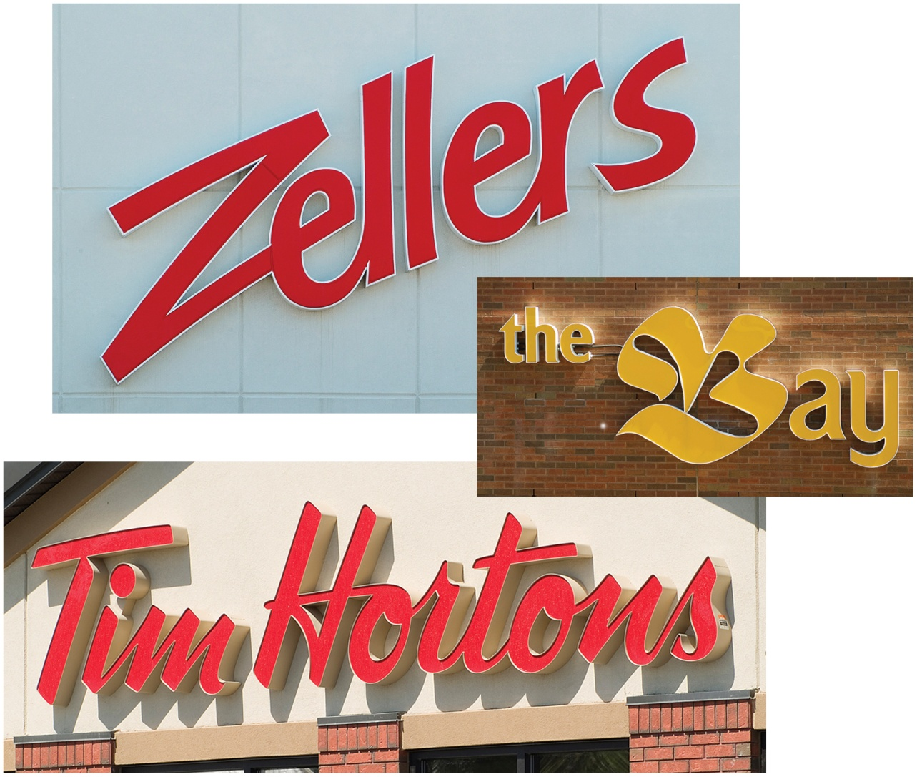
Trade as a Globalizing Force
Read the rest of page 44
Review Figure 2-4 and read all of page 45
Write out at least three reasons why people trade with one another
Why would Wendy’s want to buy Tim Hortons?

Slide 5
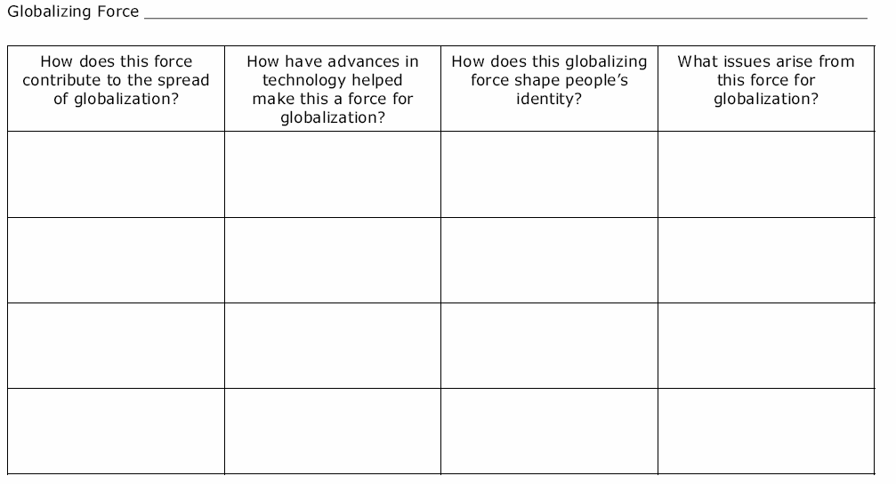
Globalizing Forces
After being assigned a number (1 - 6) read the corresponding section from your textbook listed below
Read quietly in your desk
While reading, complete the chart on your Globalizing Forces worksheet
#1 & #4 - “Transportation as a Globalizing Force” (p. 46)
#2 & #5 - “Communication Technology as a Globalizing Force” (p.47)
#3 & #6 - “The Media as a Globalizing Force” (p. 48-49)
When told, the above six groups will meet together to discuss responses and complete the chart as necessary
** You do not need to complete the activities listed in first two selections

Slide 6
Think About Your Challenge
Review your challenge for this Related Issue
To What Extent Should Globalization Shape Identity?
Now that you have began Chapter Two, is there anything you can add to your notes for
Your Challenge?
Take a few minutes to review and write
Social 10-1

Slide 7
And Finally…
Continue with your list of terms from this chapter, which include…
Any term or phrase that would be considered important in helping you with your …
The Social Dimension of Globalization Presentation
Any suggestions as to what you should include?

Slide 8
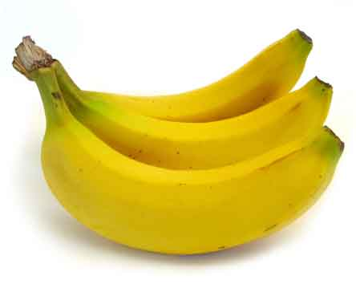
How is Identity Affected by Some Economic, Political Environmental, and Social Dimensions of Globalization?
Economic:
involving the selling of resources and money
Political:
involving a country or its government
Environmental:
related to the environment
Social:
relating to human society

Slide 9
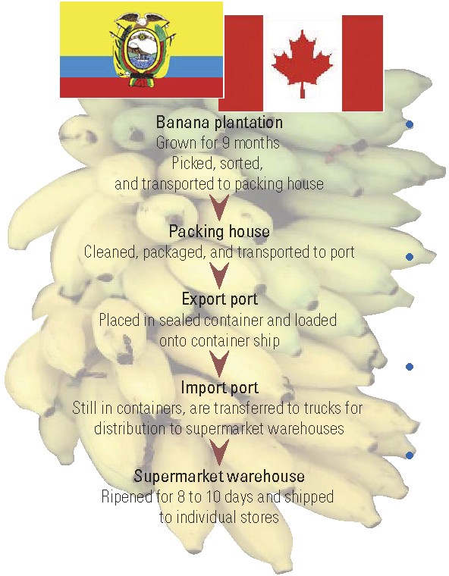
Goin’ Banana’s….
From Ecuador to Canada
Review Figure 2-9 and read the opening two paragraphs on page 50
Why would bananas be a “source of controversy”?

Slide 10
Dimensions of Globalization
Review the chart, including the questions (see handout)
Answer the questions for column one: Economic Dimensions
Read: Identity and Some Economic Dimensions of Globalization
(Pages 50-51)

Slide 11
Ecuador & the Banana Trade
You will be placed into groups of three
As a class we have just completed the Economic Dimensions column of the handout. Momentarily, you will be numbered off one through three. Each of you will go to one of the three assigned EXPERT groups and answer all of the five questions for the one dimension assigned to your group. You will have approximately 15-20 minutes to do this.
#1 – Political Dimensions
#2 – Environmental Dimensions
#3 – Social Dimensions
When finished, return to your original group of three and share your EXPERTISE with your other two group members. They will do the same for you. When you are done, your chart WILL be filled in completely.

Slide 12
The Slippery Summary
Economics: Low wages for plantation workers mean low banana prices in Canadian supermarkets.
Political: Decisions by European governments were influenced by transnational corporations that wanted to keep prices low for consumers.
Environmental: To keep production high and satisfy consumer demand, hazardous chemicals are used on many banana plantations.
Social: The need for large plantations to produce enough bananas to meet consumer demand has led to the displacement of the Indigenous peoples who lived on the land.
Why would bananas be a “source of controversy”?

Slide 13
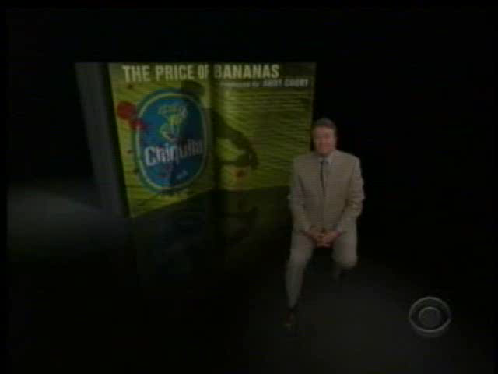
The Price of Banana’s
13:00 Min’s

Slide 14
Think About Your Challenge
Review your challenge for this Related Issue
To What Extent Should Globalization Shape Identity?
Continuing on with Chapter Two, is there anything you can add to your notes for
Your Challenge?
Take a few minutes to review and write
Social 10-1

Slide 15
And Finally…
Continue with your list of terms from this chapter, which include…
Any term or phrase that would be considered important in helping you with your …
The Social Dimension of Globalization Presentation
Any suggestions as to what you should include?

Slide 16

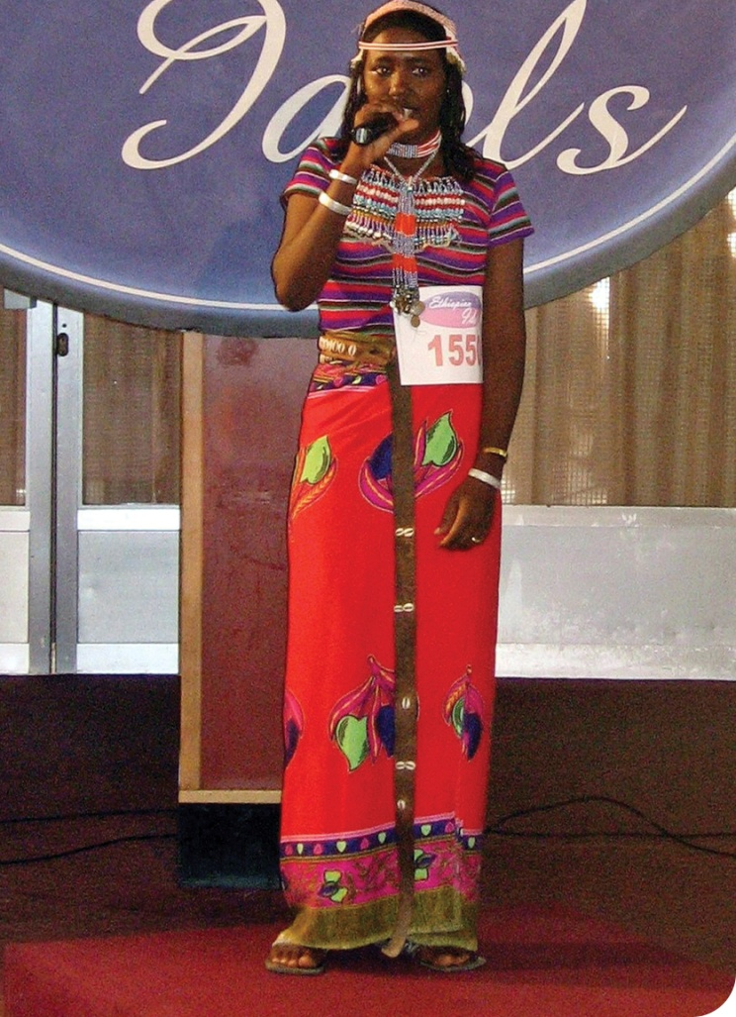
How Do Some Forces of Globalization Present Challenges to Identity?
Globalization was created by the few for the many
Globalization has enabled individuals, corporations and nations to influence actions and events around the world – faster, deeper and cheaper than ever before – and equally derive benefits from them
What are the similarities and differences of both of these statements?
What impression of globalization and identity comes from this photograph?
Respond to the question in the caption of Figure 2-14 (page 58)

Slide 17


Ethiopian Idol
All of the ‘Idol’ shows around the world (more than 30 countries) are 90% owned by the largest transnational media corporations in the world – Bertelsmann (Germany)
In 2006 it employed over 34 million people and had profits of over 3.8 billion dollars!

Slide 18
How Do Forces of Globalization Challenge Our Identity?
After reading the first three paragraphs of page 58, use the glossary of your textbook to define the following terms in your notebooks, using examples where possible:
Homogenization
Accommodation
Acculturation
Assimilation

Slide 19
Read:
‘Creation of a Nation: The Métis People’
(Page 58)
Review the activity at the bottom of page 58
How did earlier eras of global trade shape the Métis people?
When finished, share your responses with at least one other person

Slide 20
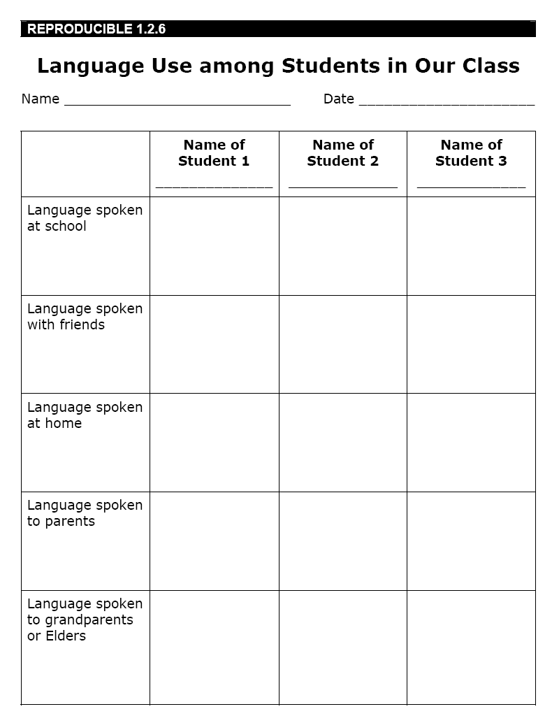
Our Spoken Language
After reading page 60, discuss the following:
What are the results of the entire class?

Slide 21
Think About Your Challenge
Review your challenge for this Related Issue
To What Extent Should Globalization Shape Identity?
Continuing on with Chapter Two, is there anything you can add to your notes for
Your Challenge?
Take a few minutes to review and write
Social 10-1

Slide 22
And Finally…
Continue with your list of terms from this chapter, which include…
Any term or phrase that would be considered important in helping you with your …
The Social Dimension of Globalization Presentation
Any suggestions as to what you should include?

Slide 23

Review…
Define the following terms from last day…
Homogenization
Accommodation
Acculturation
Assimilation
How do you think information technology might be used to promote cultural identity?

Slide 24

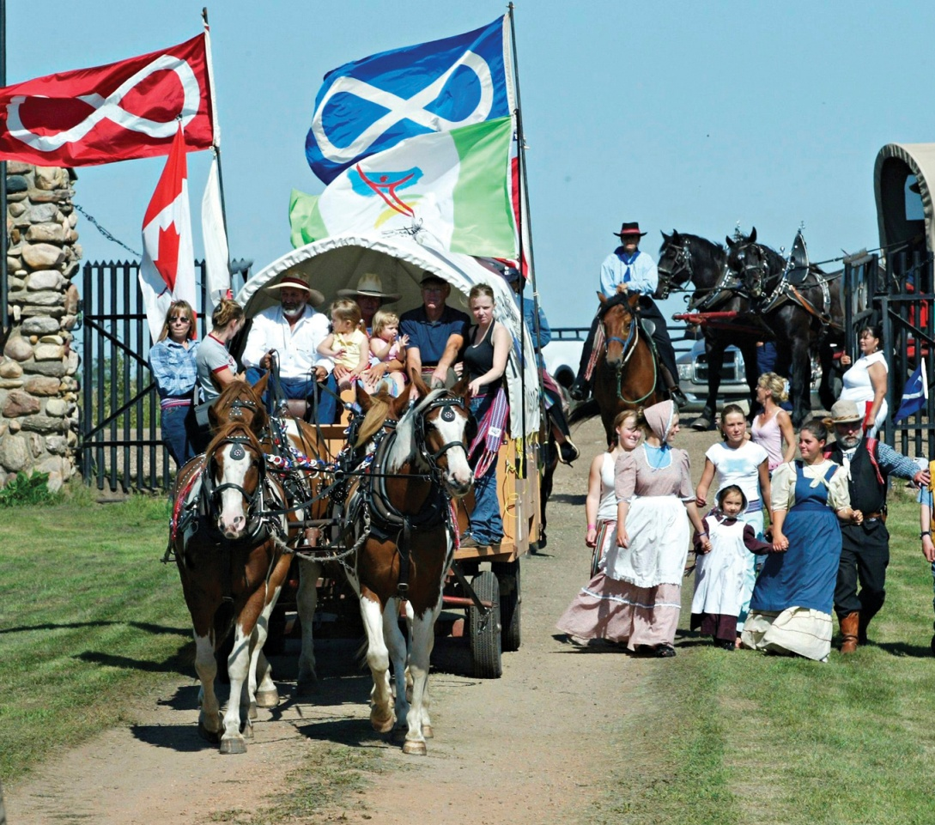
How Do Some Forces of Globalization Provide Opportunities To Affirm And Promote Identity?
Read the opening three paragraphs on page 61 as well as the caption for Figure 2-18
How has discrimination, the scattering of Métis communities and the shrinking number of Michif speakers affected the Métis identity and culture?
Did you know that, until 1996, the Canadian census did not include a category allowing people to identify themselves as Métis?
How might this have affected the Métis identity?

Slide 25
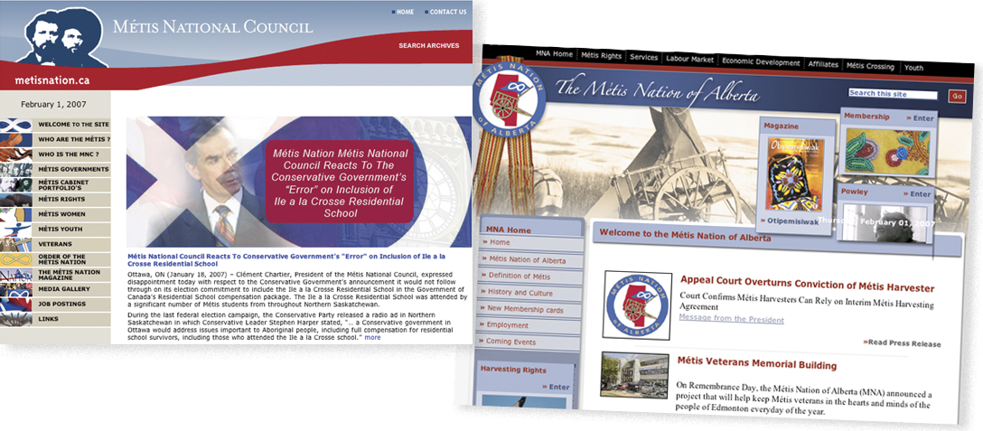
The Métis and Cultural Revitalization
Cultural Revitalization
This is the process of asserting and promoting individual and collective cultural identity
Read the rest of page 61 and all of page 62
Now, take a good look at the two websites above…
and answer the following questions…

Slide 26
Métis Organization Websites
What points of view and perspectives are indicated ?
What indications of conflict with the Canadian government are evident on the websites?
How are those conflicts connected with Métis people’s stressing their rights and affirming their identity?
What does the menu on the left side of each web site indicate about Métis peoples concerns about collective identity?

Slide 27
Cultural Revitalization for the Métis
What are some examples that the Métis are presently doing that are Revitalizing their Culture?
Staging Events and Celebrations
The World Wide Web
Others?
Are these examples connected to Globalization?
Or are they connected to other factors??

Slide 28
Cultural Revitalization in Bolivia
As you read the top of page 63, consider the chart
Decide if the following example of Cultural Revitalization in Bolivia is connected more to Globalization or other factors
Natural Gas Resources
How is it connected to Globalization?
How is it connected to the collective identity of the Indigenous people of Bolivia?

Slide 29
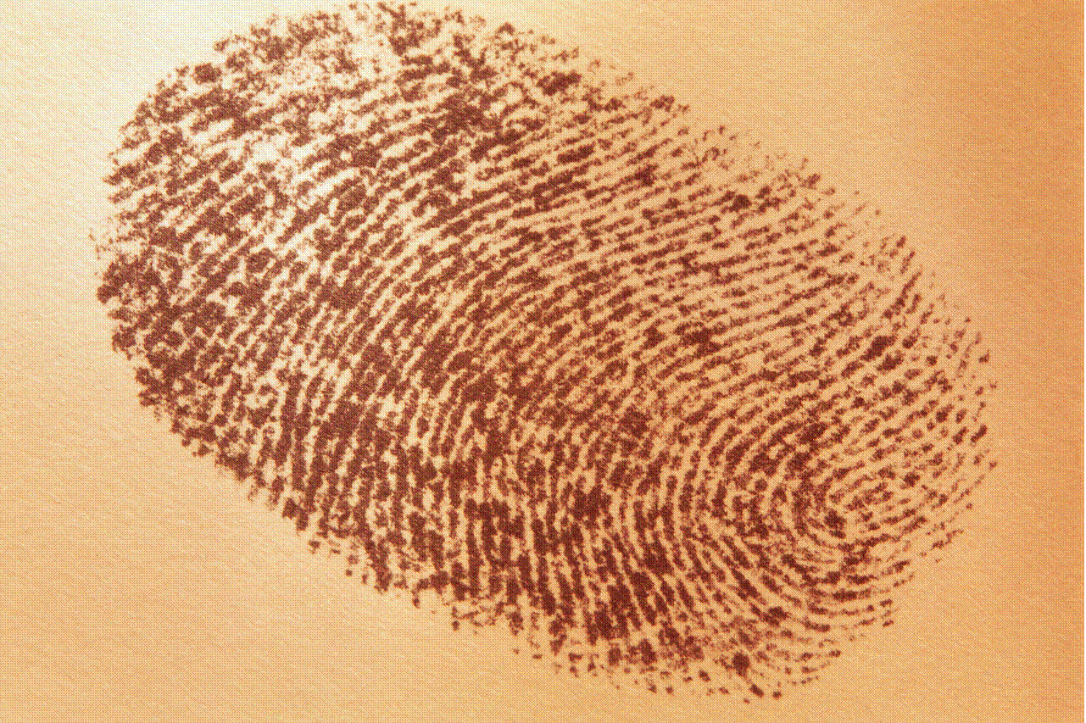
And Finally…
Complete your list of terms from this chapter, which include…
Any term or phrase that would be considered important in helping you with your …
The Social Dimension of Globalization Presentation
Any suggestions as to what you should include?

Slide 30
When is the last time you looked at...
Your Challenge…?
Two chapters down...two to go....Prioritize your time!!

