Slide 1
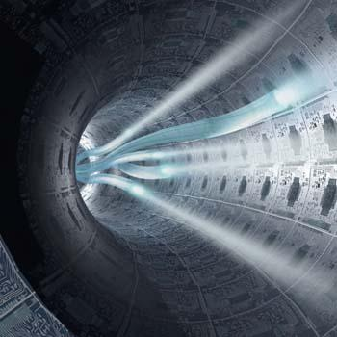
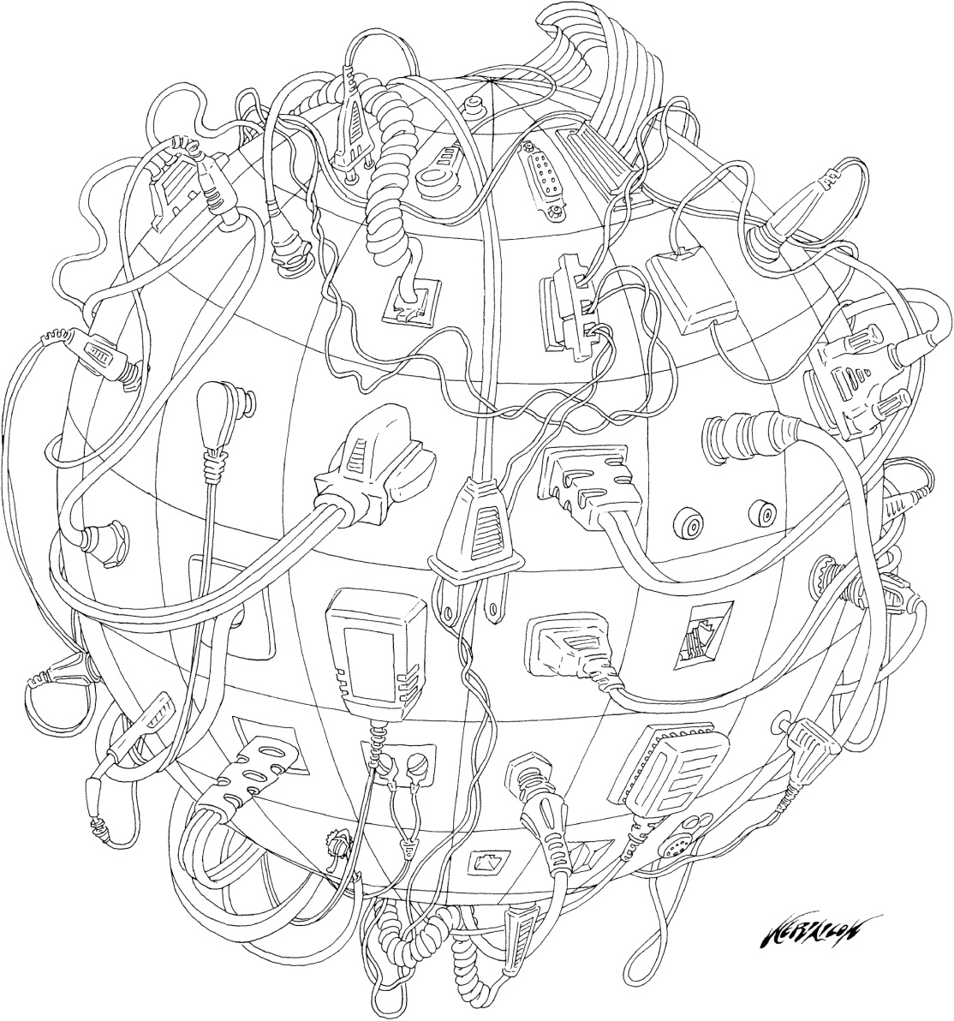
Globalization…A Cartoon
Read the caption on page 66 and the first half of page 67

Slide 2
Identity, the Media and Communication Technology
How does being able to receive messages from people around the world affect how you look at your culture?
    When you communicate with others around the world, do you feel any different about you and your culture…?
How do global communications affect your appreciation of different cultures?
    Is there anything you learn or admire from other cultures…?

Slide 3

What title would you give this?

Slide 4

List all the ways people use communication technology…
Cell phones
E-mail
Text messaging
Instant Messaging
Land-line Phones
More?
Carrier Pigeons

Slide 5
Communication
Individually, read ALL of page 68
(including ‘Voices’ & ‘FYI’)
Using blank paper, write out all the ways you communicate using various forms of technology.
Include ‘who’ you are communicating with while using this technology

Slide 6
Communication List
How many of the communications methods that we discussed earlier appeared on your page?
Is there anyone who you keep in touch primarily through electronic media? By non-electronic media?
Do you communicate with people or organizations in countries outside of Canada?
Which of the communications help you experience the world as a global village?

Slide 7
The Digital Divide….
Read all of page 69, including One Laptop Per Child
Write out a definition for ‘Digital Divide’
With a partner, complete three responses for each of these two questions:
How are communication technologies widening the digital divide?
How has communication technologies narrowing the digital divide?
Example of Widening may include:
New software demands up-to-date computers
Latest cell-phones and computers are expensive
New technology is making older technology ‘useless’
Example of Narrowing may include:
Cell-phones can be used in areas where there are no landlines
Free operating systems available for computers, etc.
Programs like One Laptop per Child offer computers at low cost

Slide 8

One Laptop Per Child
OLPC – 60 Minutes
13:00

Slide 9
Internet Usage
Read over the Activity on page 69
With your partner, make a list of both the positive and negative effects of using the Internet
Positive Effects on Internet Use on Identity…?
Negative Effects on Internet Use on Identity…?
Example…
Low Internet Use…
Isolates people from the rest of the world, however…
It may also protect people from becoming homogenized (becoming one) into a single global culture

Slide 10
Technology at Work
Read pages 70 – 71
“Technology at Work:
The Aboriginal Peoples Television Network”
Complete the Reflect and Respond on page 71

Slide 11
Think About Your Challenge
Review your challenge for this Related Issue
To What Extent Should Globalization Shape Identity?
Starting Chapter Three, is there anything you can add to your notes for
Your Challenge?
Take a few minutes to review and write
Social 10-1

Slide 12
And Finally…
Begin your list of terms from this issue, which include…
Any term or phrase that would be considered important in helping you with your …
The Social Dimension of Globalization Presentation
Any suggestions as to what you should include?

Slide 13

From Chapter Two We Read About Four of Following Five Terms….
Write each of them down
1. Media
(a way of communication that reaches or influences people widely)
2. Media Concentration
(when a few large companies own all the media, including newspapers, etc)
3. Media Convergence
(using electronic technology to combine media such as newspapers, radio, TV, etc.)
Example:iPhone which is currently the ultimate object of convergence.
This is because it includes the phone, internet, radio and video.
4. Diversity
(differences)
5. Media Cross Ownership
(has the same meaning as Media Convergence)
What might they mean…? Can you remember? Take your best guess!
Check the Glossary when you are done

Slide 14
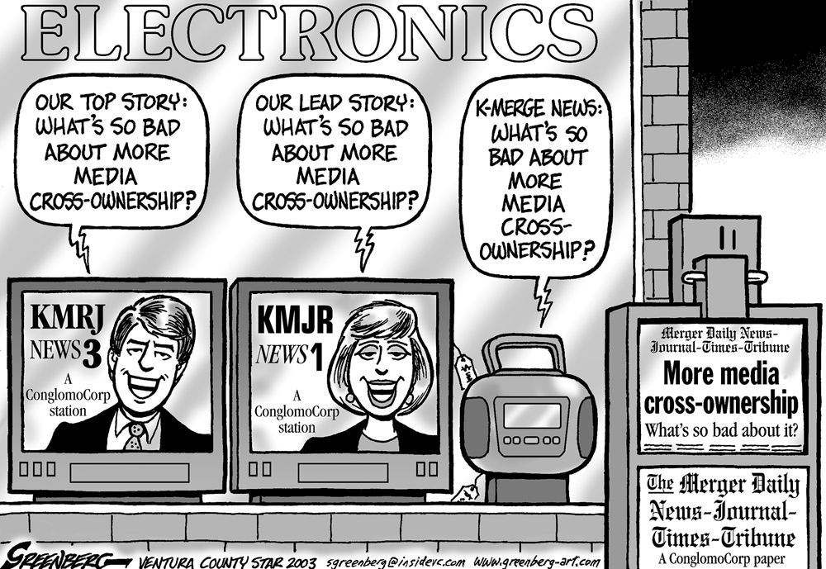
Media Cross Ownership
What message is the cartoonist making about Media Cross Ownership?

Slide 15
How is Diversity Influenced by the Media and Communication Technologies?
When the police write a report about a crime, do they ask just one of the witnesses to write what they saw or do they ask as many as possible? Why?
Read all of page 72 and the first half of page 73
When you are looking for information on Current Events, do you (or should you) look at one source only or at a variety of different sources?
What different things may each source have to offer?
A variety of points of view and perspectives!

Slide 16
Al-Jazeera in North America
Read the rest of page 73, including Voices
Define Propaganda in your notebooks
Think about your response to the question in the Voices section….
What’s all the fuss about…?
Is there anything about Al-Jazeera that the Americans/Canadians might view as propaganda?
Al-Jazeera

Slide 17
Diversity and the Internet
Read the top of page 74 and all of page 75
When was the last time you went to a website that wasn’t in English?
What was it and why did you go there?
Techno-Isolation
Does technology have an effect on Canadian cultural diversity?

Slide 18
Think About Your Challenge
Review your challenge for this Related Issue
To What Extent Should Globalization Shape Identity?
Continuing on with Chapter Three, is there anything you can add to your notes for
Your Challenge?
Take a few minutes to review and write
Social 10-1

Slide 19
And Finally…
Continue with your list of terms from this issue, which include…
Any term or phrase that would be considered important in helping you with your …
The Social Dimension of Globalization Presentation
Any suggestions as to what you should include?

Slide 20

What are some examples of recent worldwide media events?
Example:
2010 Vancouver Olympics – February, 2008
What technologies enabled people around the world to watch this event at the same time?
How would people find out about the event?
What role would media play in promoting it?
Would people have watched this event on TV or the Internet?
Why would you choose one over the other?
Did this event affect people’s identity? If so, how? If not, why not?
Olympics

Slide 21

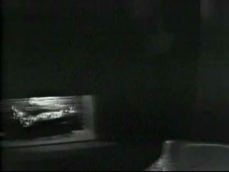
How is Identity Affected by Media Coverage of World Events?
Media coverage hasn’t always been what it is today…
Like a blanket!
One of the first events to receive intense coverage in the U.S. was…
The Assassination of J.F. Kennedy
Read the top half of page 76
The first JFK assassination bulletin

Slide 22
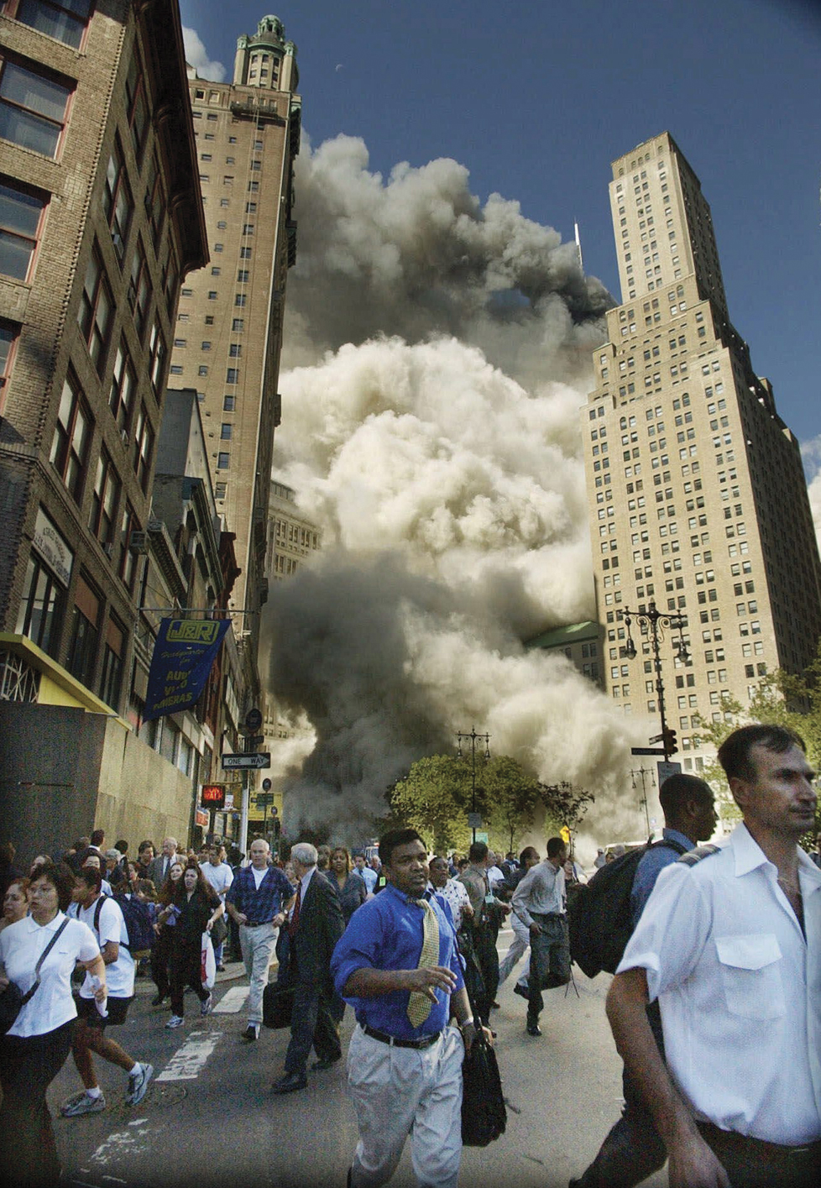
9.11.2001
Do you think that including this photograph in
Exploring Globalization is appropriate?
Read the rest of page 76 and the top of page 77
How is the coverage of September 11, 2001 different from the coverage of the Kennedy’s assassination?
Read the rest of page 77

Slide 23
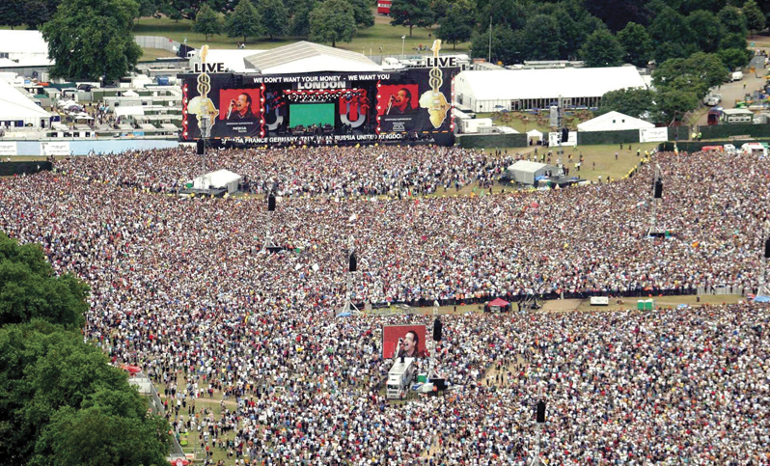
Making Poverty History and Live 8
Read all of page 80 and write out the Activity at the bottom of the page.

Slide 24
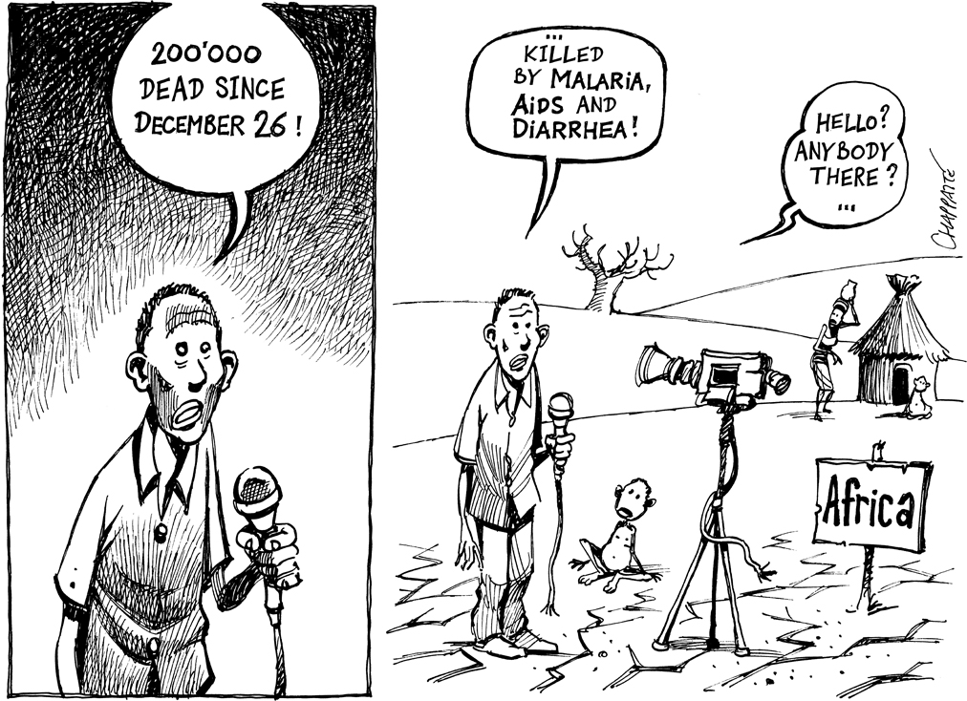
Stories that are told… and those that are not….
Read all of page 81, including “Voices”
Read and respond to the caption on page 81

Slide 25

“If it Bleeds, it Leads”
This saying is often used to describe how news editors, both print and broadcast, choose stories to “lead” their coverage
Homework….
Find an example of this from headlines from newspapers or front pages from news outlet web sites…
Choose Only One and…
Bring it to class tomorrow!

Slide 26
Think About Your Challenge
Review your challenge for this Related Issue
To What Extent Should Globalization Shape Identity?
Continuing on with Chapter Three, is there anything you can add to your notes for
Your Challenge?
Take a few minutes to review and write
Social 10-1

Slide 27
And Finally…
Continue with your list of terms from this issue, which include…
Any term or phrase that would be considered important in helping you with your …
The Social Dimension of Globalization Presentation
Any suggestions as to what you should include?

Slide 28
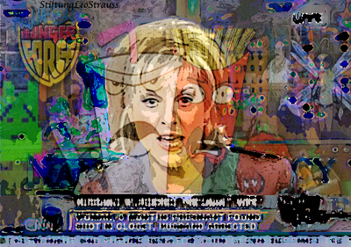

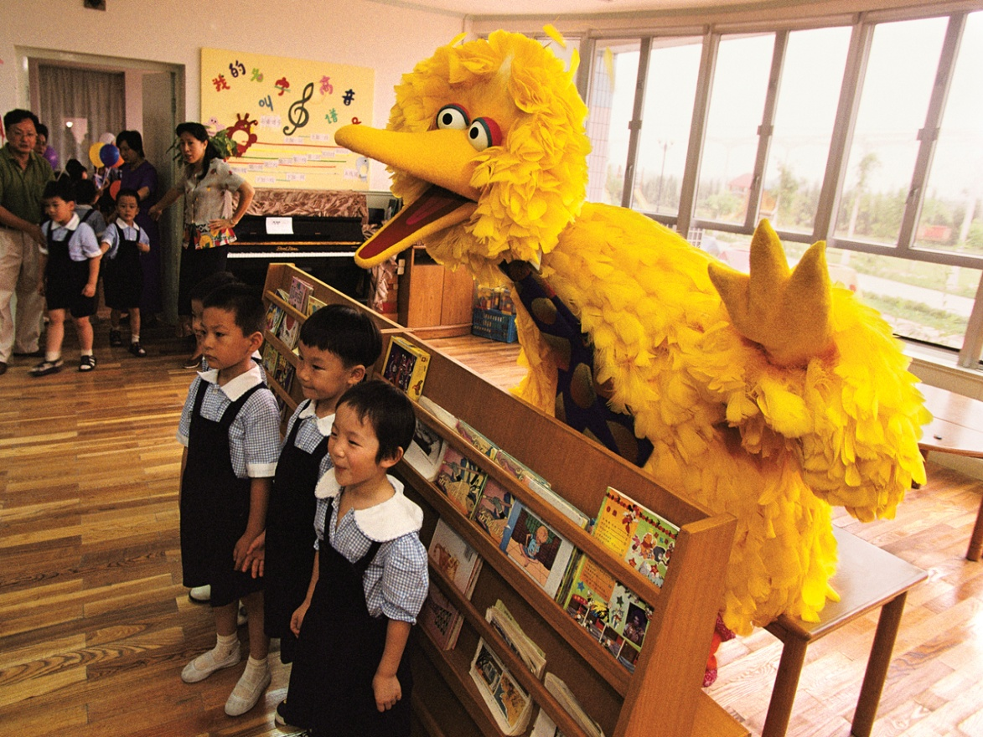
Who watched…?
Who was our favourite character?
Why do you think this show was so popular?
What values did Sesame Street promote? Were they effective?
Where did Sesame Street originate? Do you know of any Canadian connection?

Slide 29
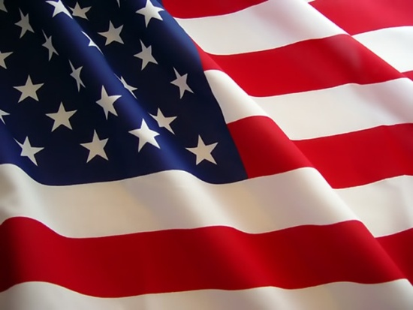
Make a list of your following favourites:
Song
Recording Artist
Book
TV Show
Movie
Web Site
Next to each of these favourites, identify their origin as being from Canada, United States or Other
Where are the majority of your examples from?

Slide 30

How Is Diversity Affected by the Dominance of American Media?
Does the domination (or control) of American media give a positive or negative role on the diversity around the world?
Read Pages 82-83
As the pages are being read, jot down at least five points that will help you respond to the question above….
When finished writing these notes, decide on an answer to the question above!

Slide 31

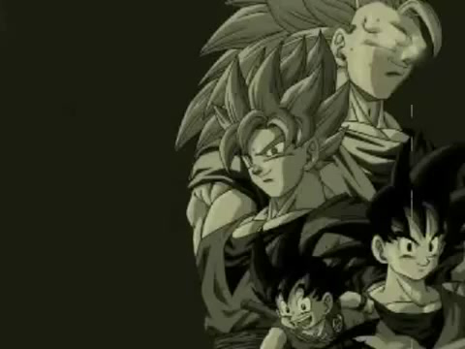
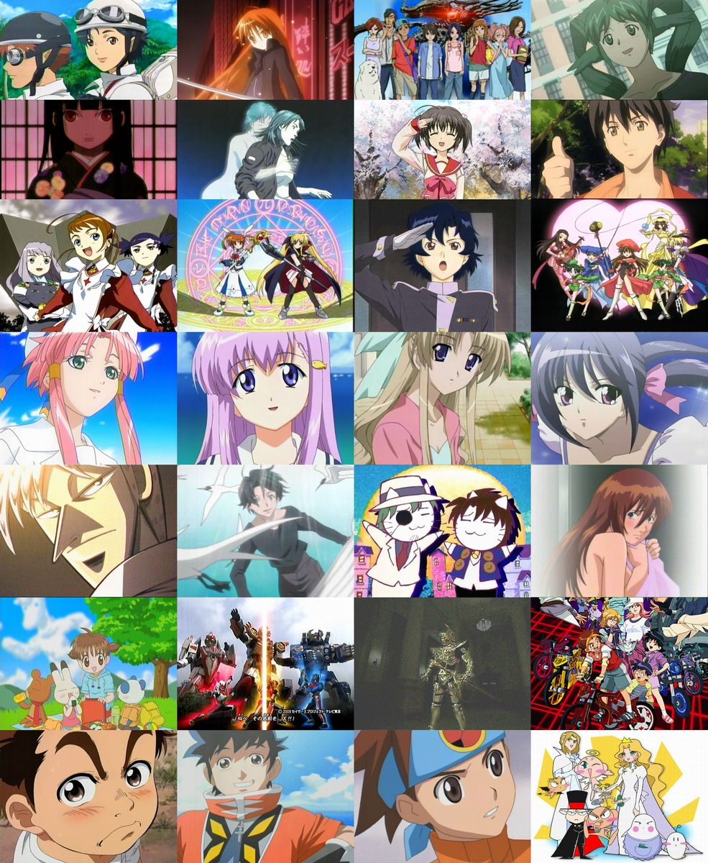
Cultural Diversity Beyond the American Media
Anime and Manga
Anime
Read Page 84

Slide 32
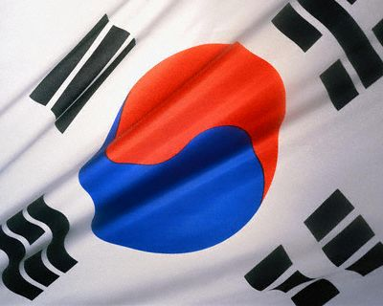
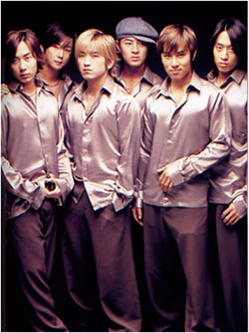




Cultural Diversity Beyond the American Media
Korean Pop Culture
Read the top half of Page 85
K-Pop - Keu Rim Ja
Read and respond to Ideas on Page 84

Slide 33
Think About Your Challenge
Review your challenge for this Related Issue
To What Extent Should Globalization Shape Identity?
Finishing Chapter Three, is there anything you can add to your notes for
Your Challenge?
Take a few minutes to review and write
Social 10-1

Slide 34
And Finally…
Continue with your list of terms from this issue, which include…
Any term or phrase that would be considered important in helping you with your …
The Social Dimension of Globalization Presentation
Any suggestions as to what you should include?

