Slide 1
2011 Study Tour to China and Korea:
A Personal Experience of the History of World War II in Asia
The Peace and Reconciliation Tour
July 13 – 28, 2011
Beijing, Harbin, Nanjing, Shanghai and Seoul
Starting in 2004, The Peace and Reconciliation Tour has offered educators a hands-on experience with the history of WWII in Asia, by visiting historical sites, museums and meeting with experts, educators, curators and survivors. Destinations include locations in China, South Korea and in the future will include sites in Japan and other Asian countries.
The Mandate of both Edmonton and Toronto ALPHA:
To preserve the truthfulness of historical records about WWII in Asia
To pursue justice for the victims of WWII in Asia
To promote global awareness, knowledge and recognition of this history such that peace and reconciliation among the perpetrating and victimized nation can be finally achieved

Slide 2
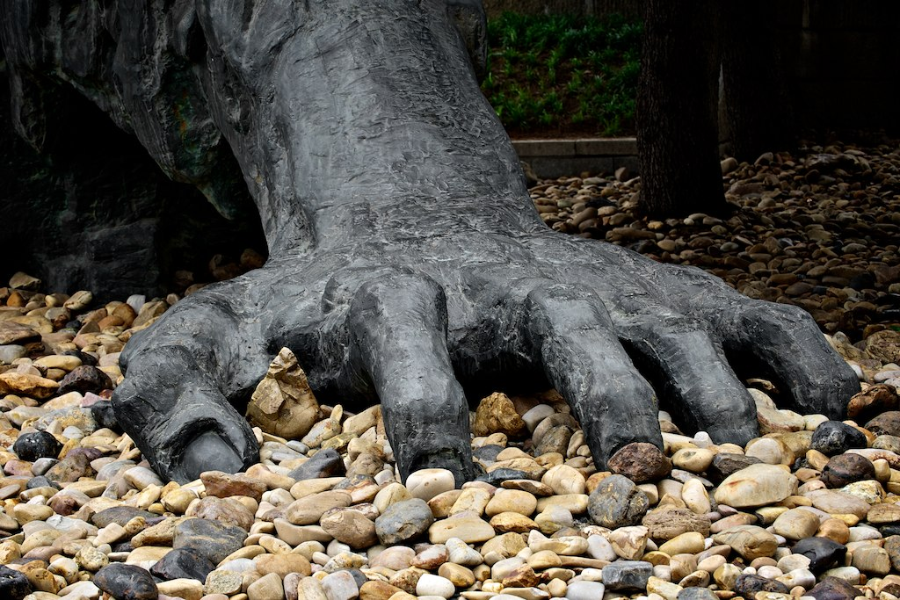
2011 Study Tour to China and Korea:
A Personal Experience of the History of World War II in Asia
We went to many places and learned many things…
The Comfort Women Issue and Survivors – Beijing, Shanghai and Seoul, South Korea
Unit 731 – Human Experimentation – Harbin, China
Nanking Massacre (The Rape of Nanking) and Survivors – Nanjing, China
Japanese Slave Labour Survivors – Beijing and Seoul, South Korea
Above all, however, the trip was about the survivors and their voices…

Slide 3
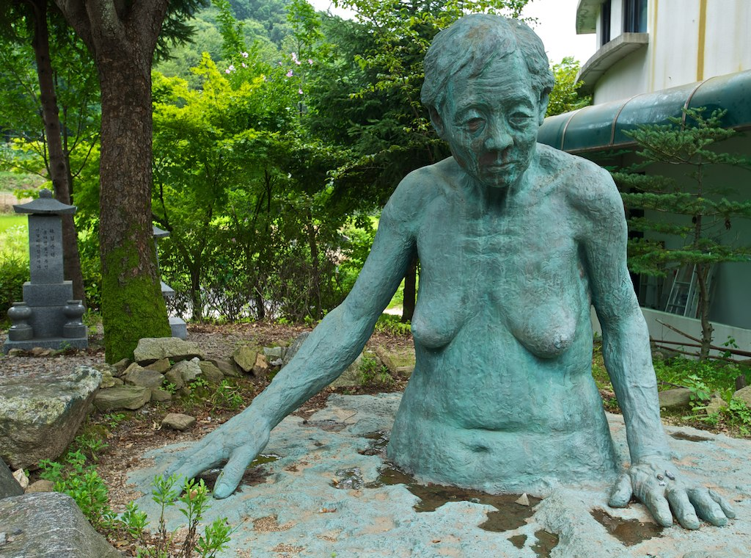
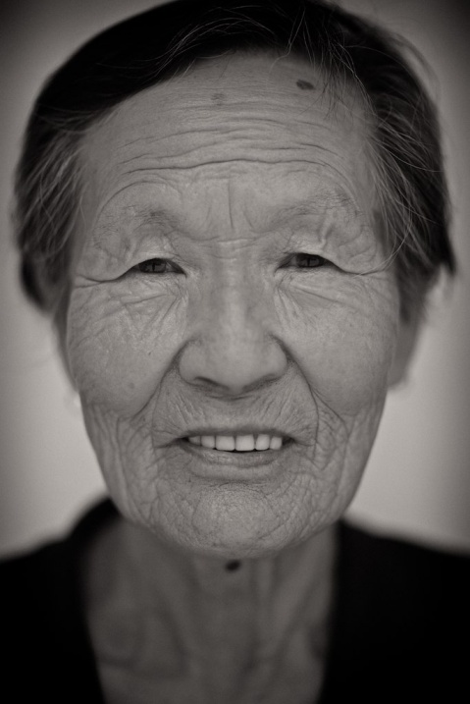
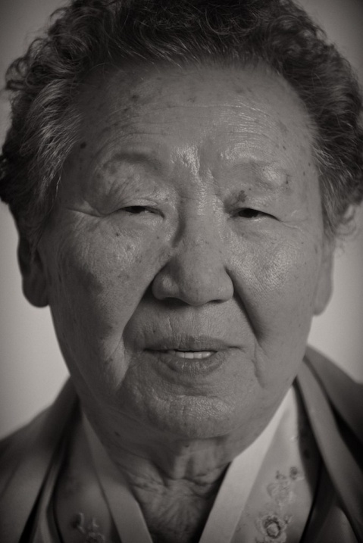
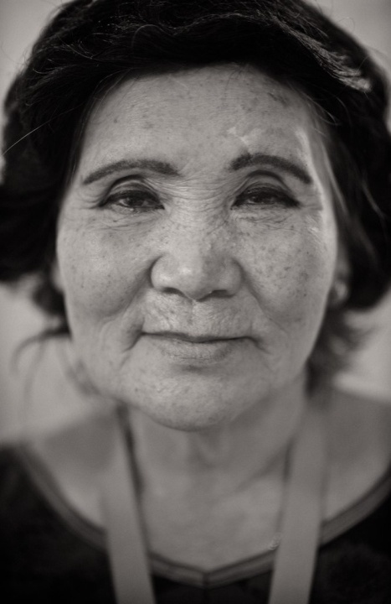
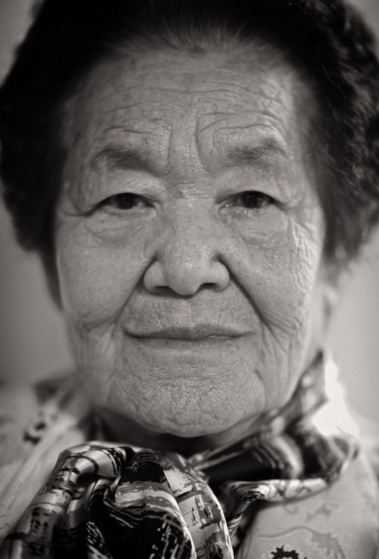
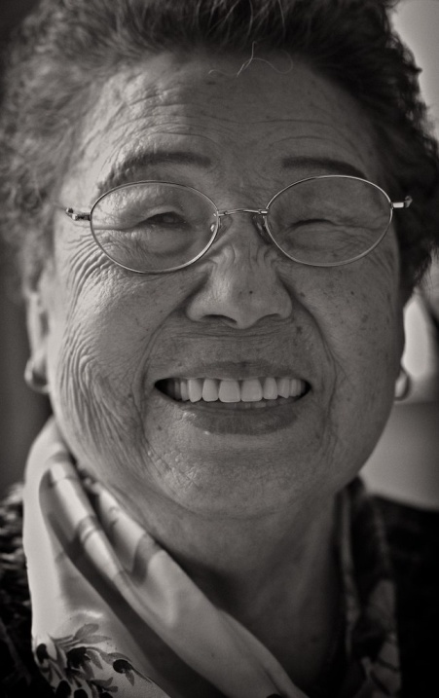
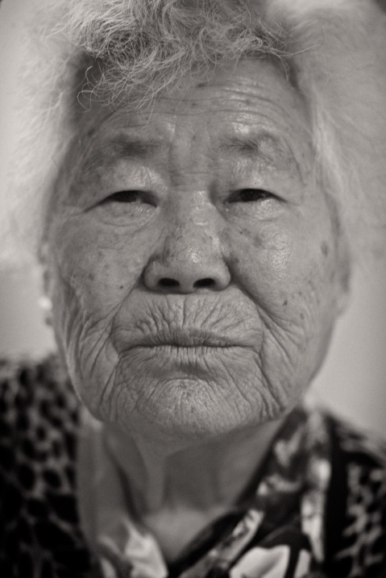
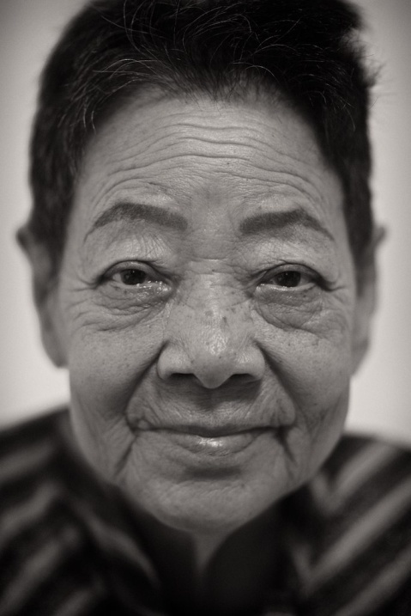
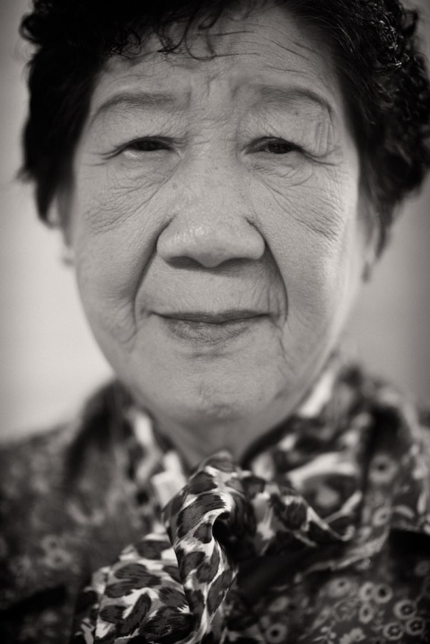
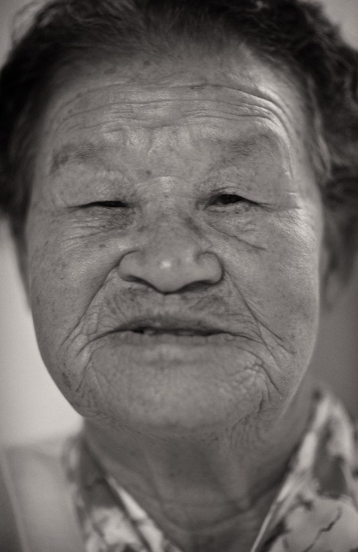
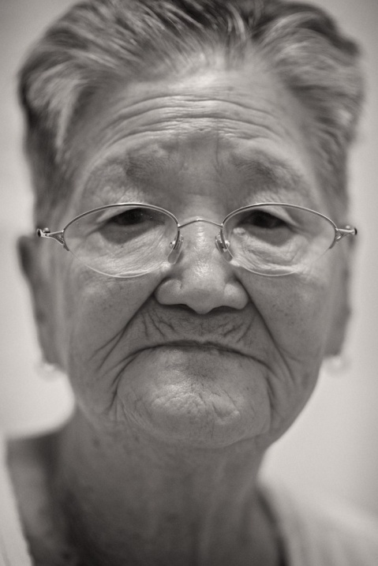
Survivors of
Forced Sexual Slavery
Comfort Women

Slide 4
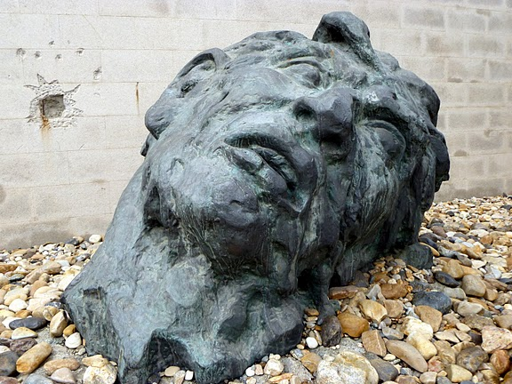
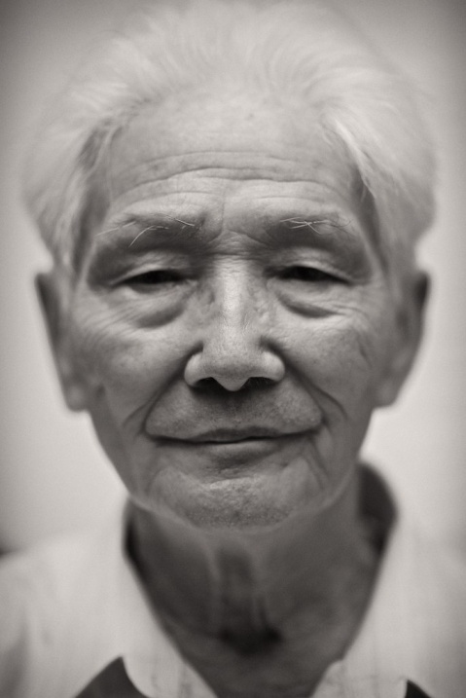
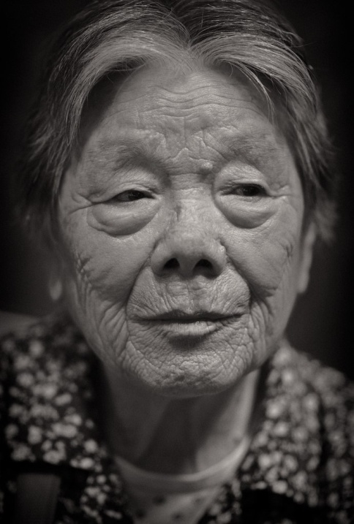
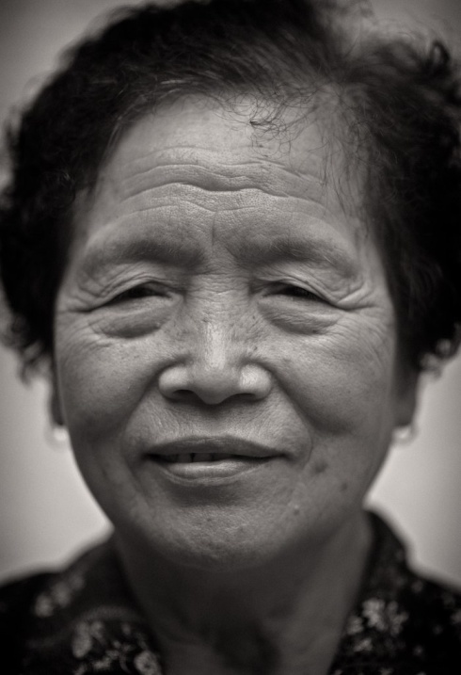
Survivors of
The Rape of Nanking

Slide 5
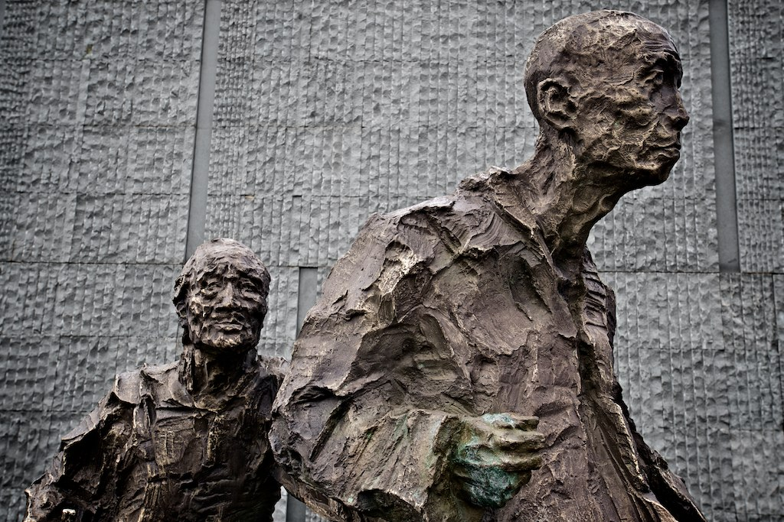
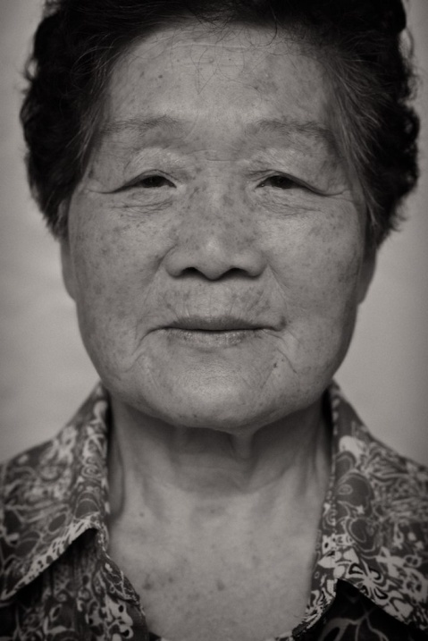
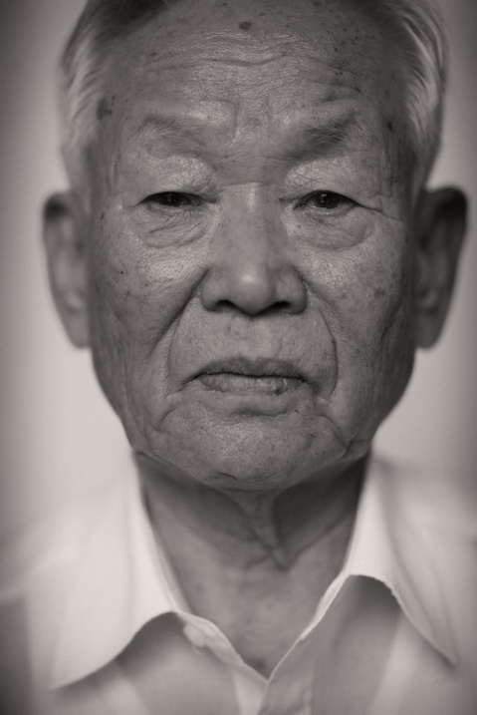
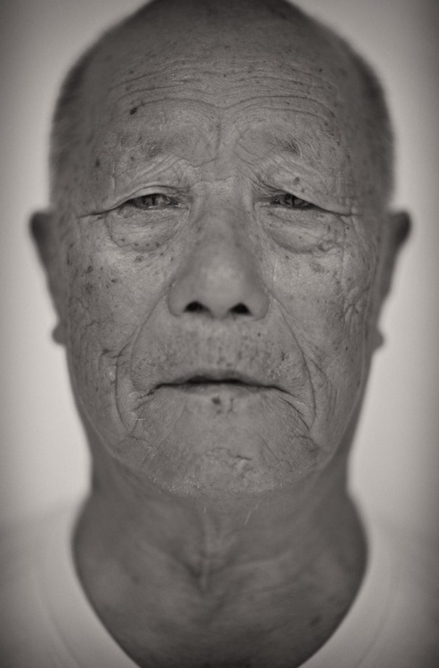
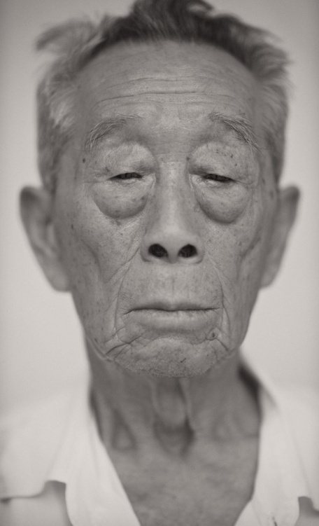
Survivors of
Japanese Slave Labour

Slide 6
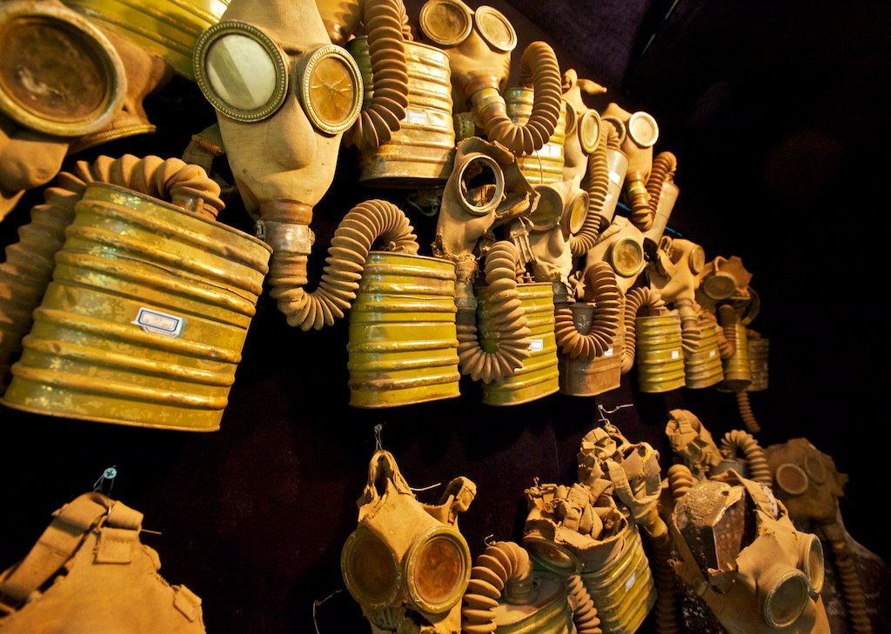
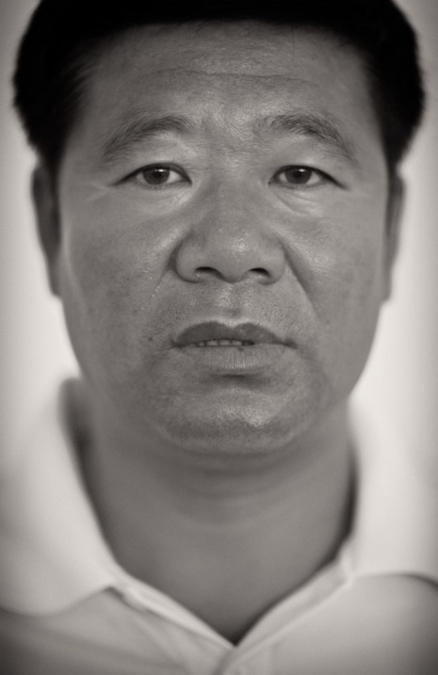
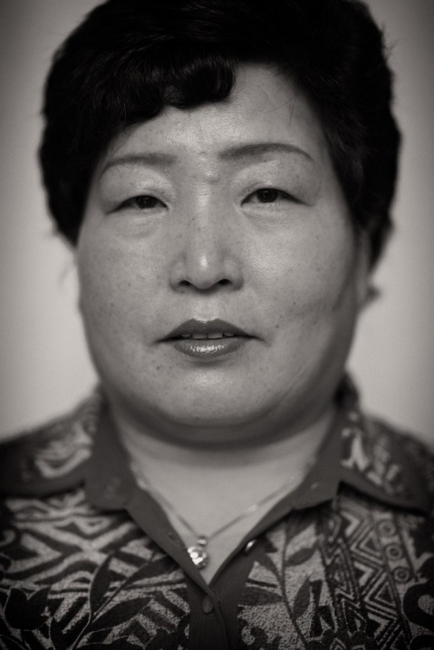
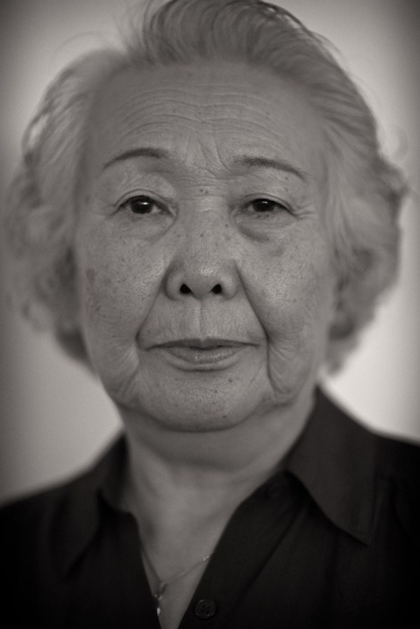
Exposure to Chemical Weapons Left Behind By The Japanese During World War Two
Second Generation Survivor of Nagasaki
Daughter of Victim of Human Experimentation at Unit 731

Slide 7
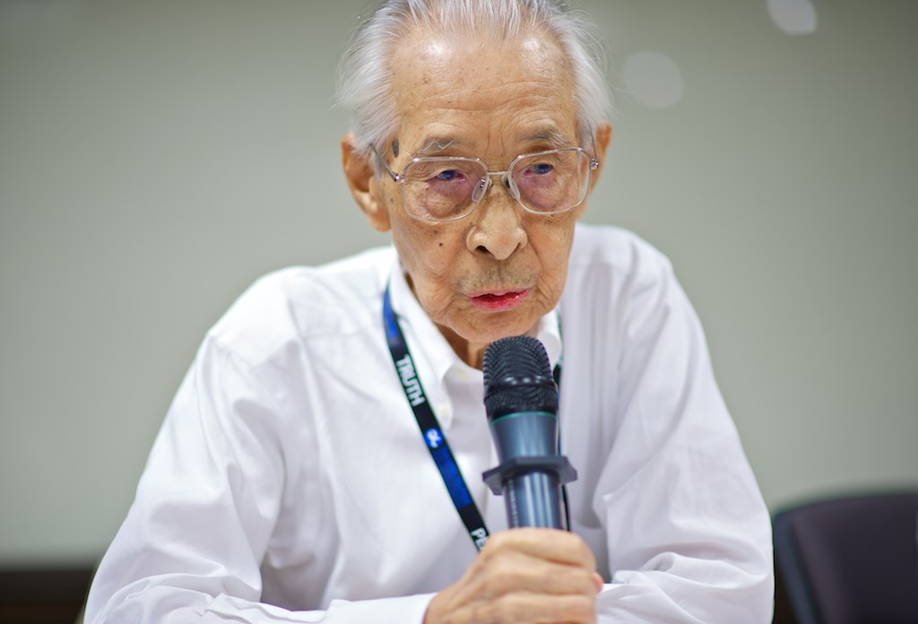
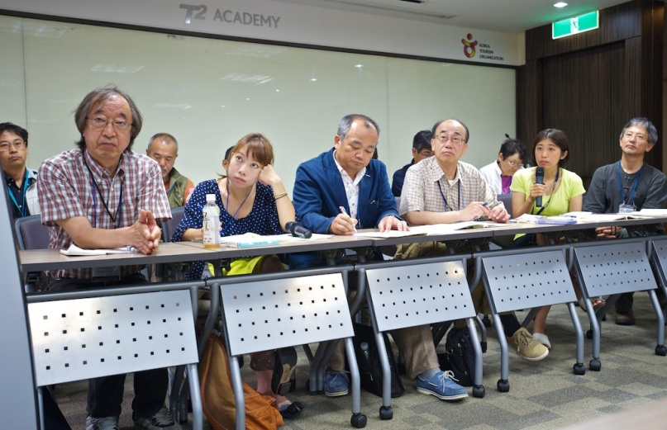
World War II Japanese Soldier
Japanese Teachers

Slide 8
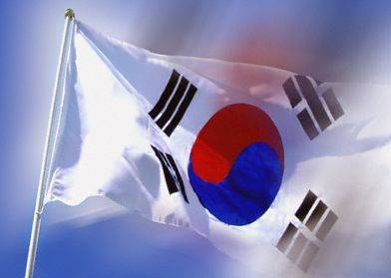
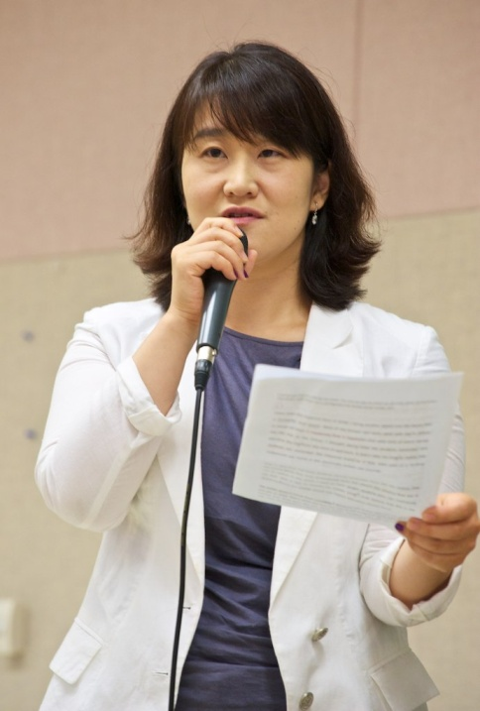
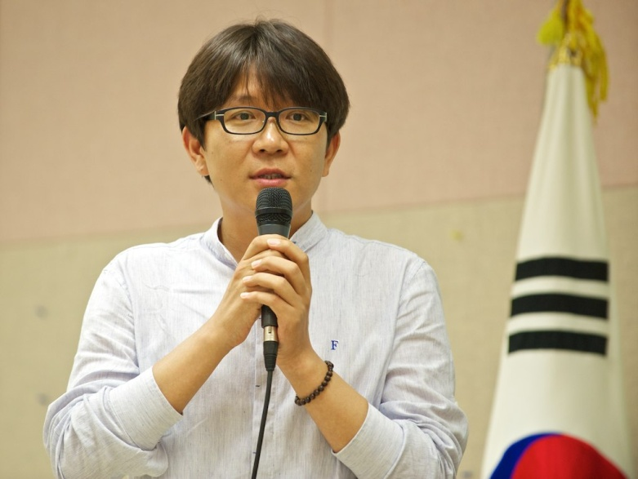
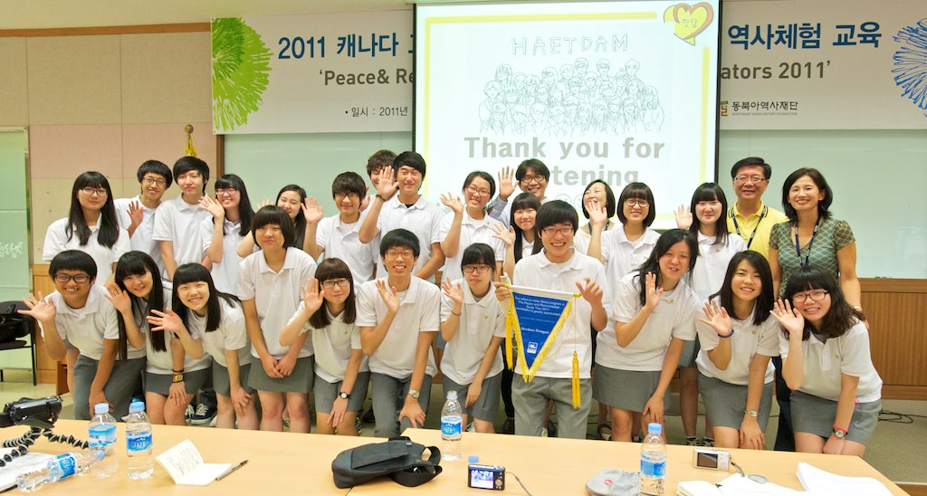
Korean Teachers and Students

Slide 9
The Comfort Women Issue and Survivors – Beijing, Shanghai and Seoul, South Korea

Slide 10
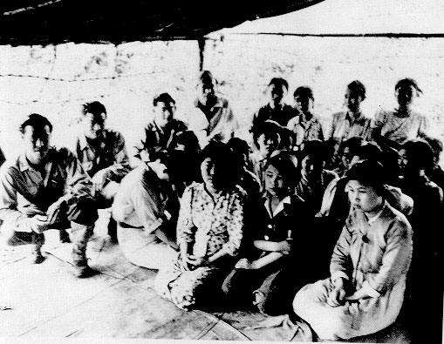
The Comfort Women Issue and Survivors – China and Korea
“You can never forget, never…” – Her Stories.
(2008)
22 Minutes

Slide 11
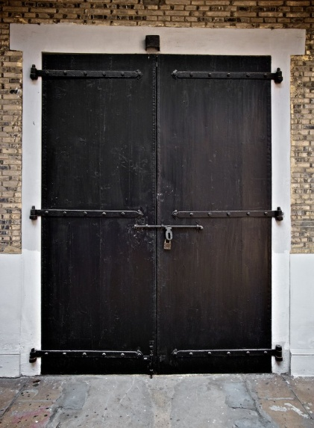
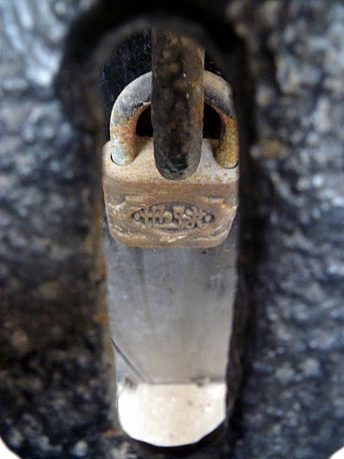
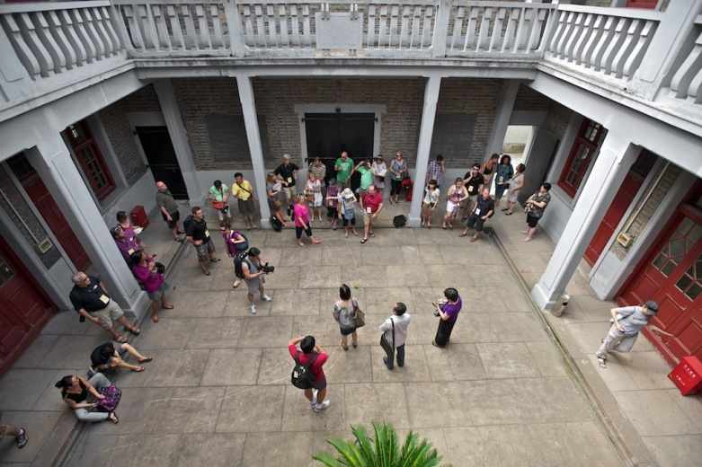
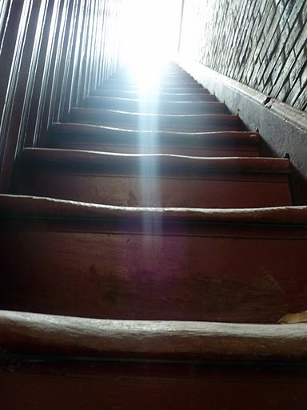
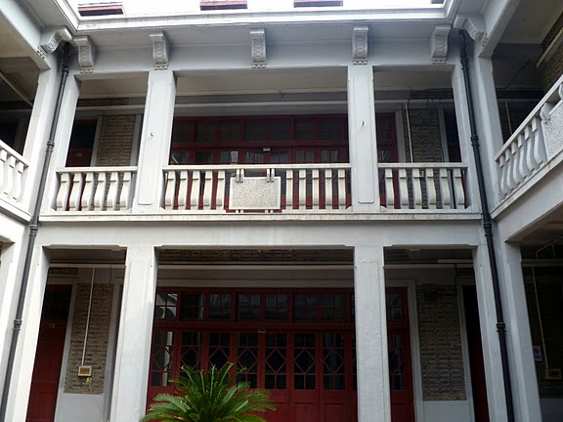
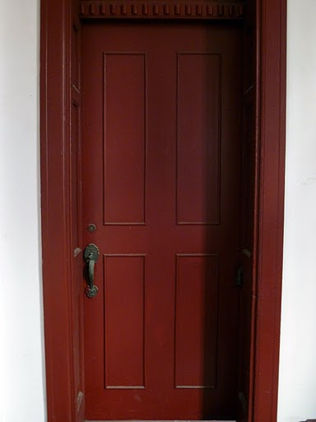
The Chen Residence: A Former Comfort Station – Shanghai
The Comfort Women Issue and Survivors – China and Korea

Slide 12
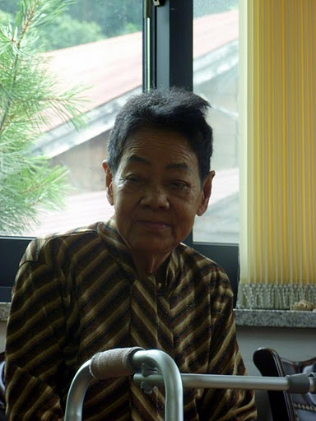
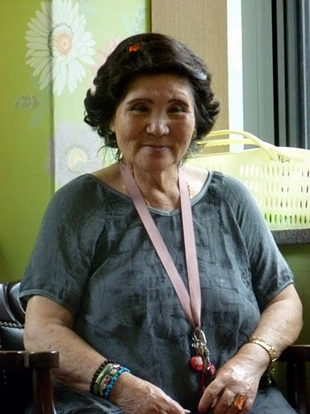
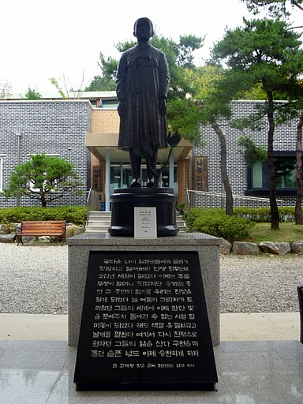
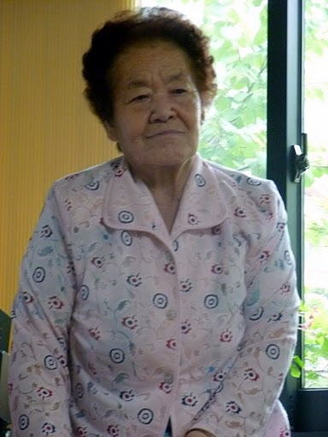
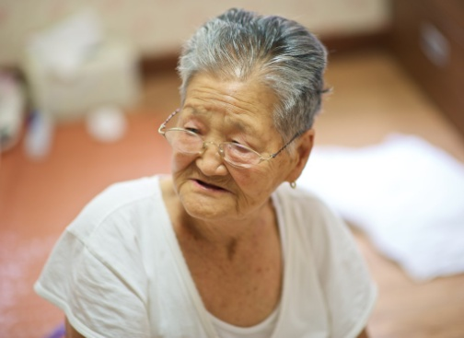
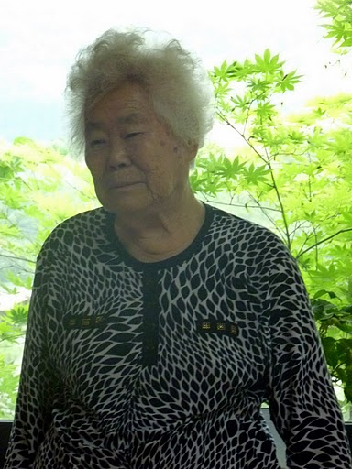
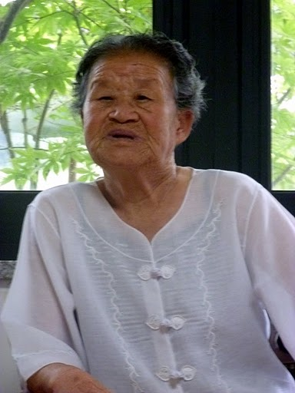
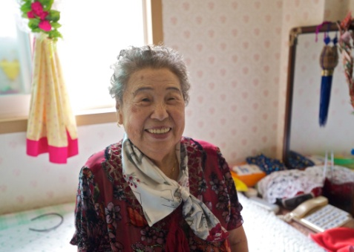
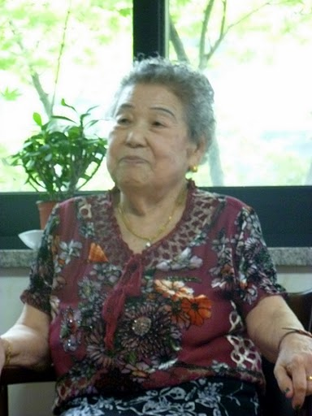
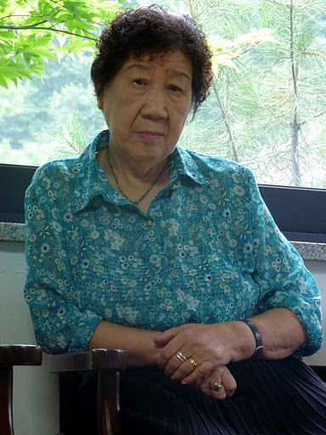
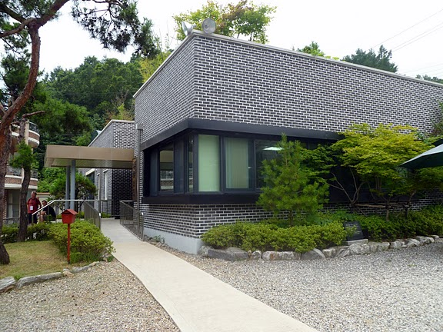
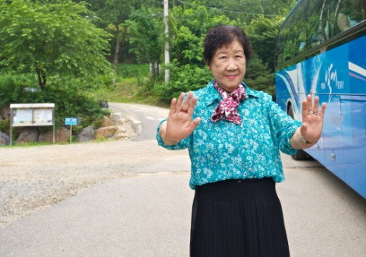
The House of Sharing – South Korea
The Comfort Women Issue and Survivors – China and Korea

Slide 13
Wednesday Demonstration– Seoul, South Korea
1000th Wednesday Demonstration – December 14th, 2011
The Comfort Women Issue and Survivors – China and Korea

Slide 14
Unit 731 – Human Experimentation – Harbin, China

Slide 15
1935 - 1945
Unit 731 – Human Experimentation – Harbin, China

Slide 16
Unit 731 – Human Experimentation – Harbin, China

Slide 17
Unit 731 – Human Experimentation – Harbin, China

Slide 18
Nanking Massacre (The Rape of Nanking) and Survivors – Nanjing, China
Iris Chang: The Rape of Nanking
Trailer

Slide 19
Nanjing Massacre Victims Memorial Hall– Nanjing, China
Nanking Massacre (The Rape of Nanking) and Survivors – Nanjing, China

Slide 20
Nanjing Massacre Victims Memorial Hall– Nanjing, China
Nanking Massacre (The Rape of Nanking) and Survivors – Nanjing, China

Slide 21
Nanjing Massacre Victims Memorial Hall– Nanjing, China
Nanking Massacre (The Rape of Nanking) and Survivors – Nanjing, China

Slide 22
So, even though we went to many places and learned many things…
The trip was about the survivors and their voices…

Slide 23
No Longer Forgotten Voices...

Slide 24
2011 Study Tour to China and Korea:
A Personal Experience of the History of World War II in Asia
Resources
Websites:
Canada ALPHA/B.C. ALPHA - www.alpha-canada.org
Edmonton ALPHA - www.edmontonalpha.org
Toronto ALPHA - www.torontoalpha.org
New Jersey ALPHA - www.nj-alpha.org – High School Curriculum Guide (unavailable online)
Iris Chang - www.irischang.net
House of Sharing - houseofsharing.org
Teaching Resources:
Study Guide for Teachers - Iris Chang: The Rape of Nanking
http://www.alpha-canada.org/studyguide/IrisChangMovie_studyguide.pdf
The Search for Global Citizenship: The Violation of Human Rights in Asia, 1931-1945
http://www.torontoalpha.org/images/EducationalResources/resource_guide_march2009.pdf
Human Rights in the Asia Pacific 1931-1945: Social Responsibility and Global Citizenship
Available for purchase at www.publications.gov.bc.ca/
Presentation Available on my eTeacher Page @ forthigh.ca

Slide 25
Questions…?

