Slide 1
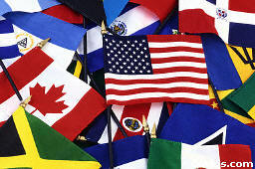
International
What does the above word mean?
Think of some ways you have seen this word used or give some examples of the word international.

Slide 2
Should Internationalism Be Pursued?
The Big Picture
Read pages 196- 197
What is the main idea of the section titled “The Big Picture”?
What are some factors that have encouraged people to become more connected?
How are national and international interests connected?
Why might people have different ideas about what internationalism means?

Slide 3
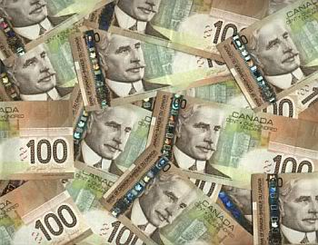
Your Challenge:
Us vs. Them: Who Gets The Cash?
Review Challenge #3 Handout
Should Internationalism Be Pursued?

Slide 4
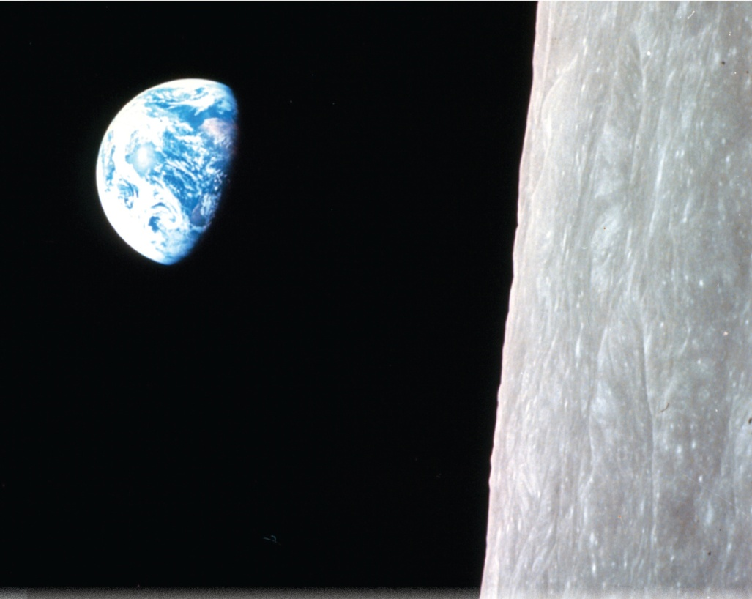
Nations, Nation-States, and Internationalism
Find a partner, read page 201 and work through the questions
and
Review the Key Terms by writing out a guess of what you think each of them means
Read the caption to Figure 9-1 on page 200
How might people have reacted when they first saw this photograph?

Slide 5

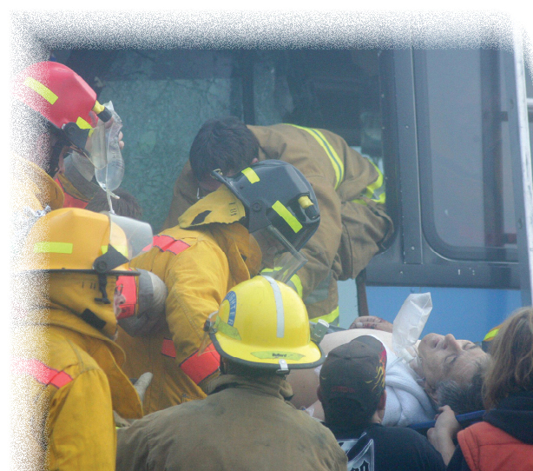
What Motives Nations And Nation-States To Become Involved In International Affairs?
Read page 202
What are some motives for becoming an emergency worker?

Slide 6
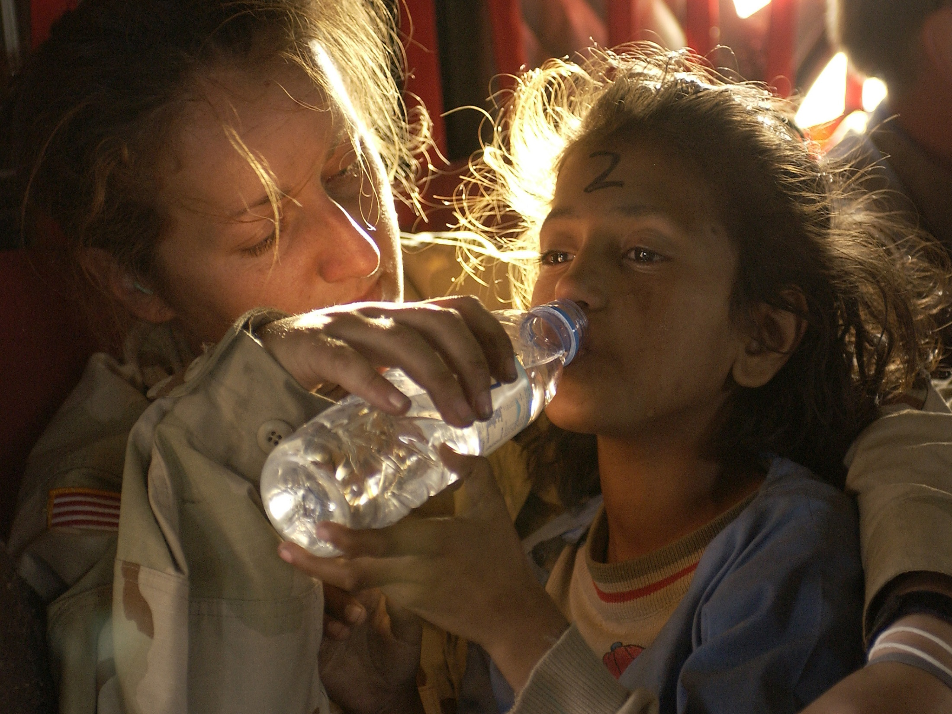
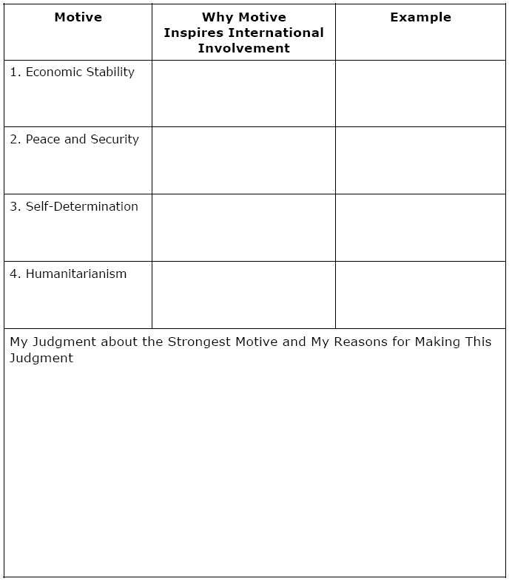
Needs and Motives of Successful Nation-States
Read the opening half of page 203
Each of you will be randomly numbered off from 1-4. Each of you will read the corresponding section in your textbook and fill in the corresponding section of the handout:
Nation-States and Involvement in International Affairs
Review all of figures and read all of their captions
As we review this as a class, complete the remaining aspects of the chart
Page 203
Page 204
Page 205
Page 206
Can any nation-state truly meet all the needs and wants of all its citizens?

Slide 7
And Finally…
Begin a list of terms from this chapter, which include…
Any term/phrase/concept that would be considered important in helping you with your …
Challenge
Any suggestions as to what you should include?

Slide 8
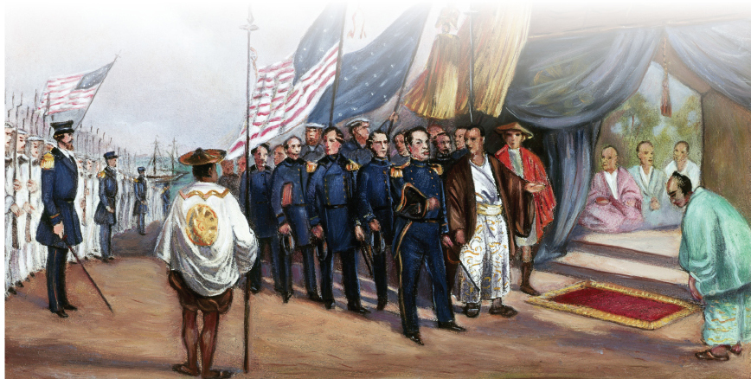
How Do The Motives Of Nations And Nation-States Shape Their Responses To The World?
Read the first three paragraphs on page 210
Using the handout, fill in the second, third and fourth columns as you read pages 210 - 213
When completing column five, include a reason for your rank
As the world becomes more globalized, are countries likely to choose isolationism more or less often?

Slide 9
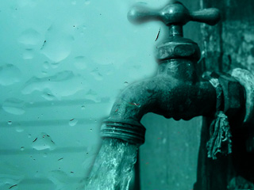
Remember…
The behaviour of individuals, groups, nations, and nation-states may often be motivated by the desire for economic stability, peace and security, self-determination, and humanitarianism.
Scenario
Suppose that runoff from a community’s waste disposal site is leaking into the water supply….
Here are a few possible response to this issue:

Slide 10
Choice #1
They could choose to ignore the issue and focus on keeping themselves safe
If the water supply is contaminated, for example, they might choose to drink only bottled water
This would be working in Isolation
Choice #2
They could try to do something about the problem on their own.
They might, for example, write a letter to the mayor of the community
This would be working Unilaterally
Choice #3
They could speak to a friend or a family member and work with that person to come
up with a solution
They might, for example, research the effects of water pollution on
communities and try to avoid circumstances that would put them in danger
This would be working Bilaterally

Slide 11
Choice #4
They could speak to members of the community and try to persuade them to work together to solve the problem
A large group of citizens could, for example, call a community meeting to voice their concerns about the water supply
This would be working Multilaterally
Choice #5
They could establish an organization that would oversee the situation and give that organization the power to resolve the problem
They might, for example, work to strengthen community or provincial laws and to elect a committee to oversee the cleanliness of the water supply
This would be working as a Supranational

Slide 12
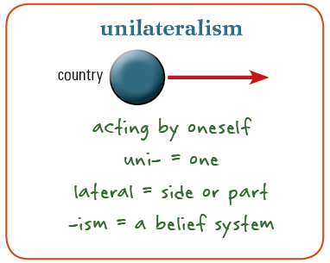
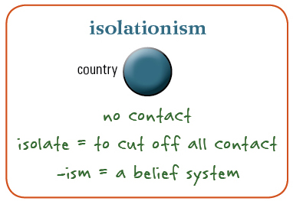
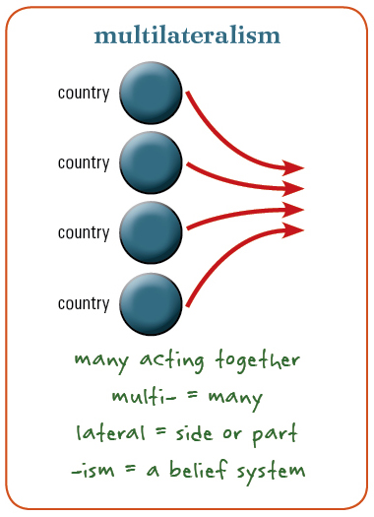
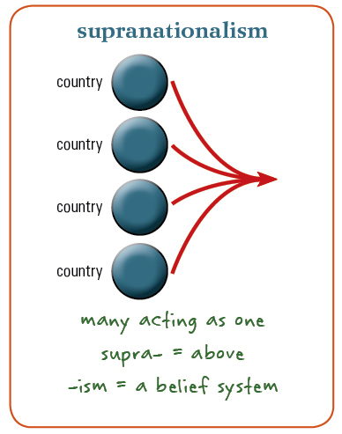
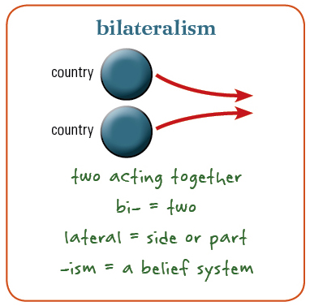
Review

Slide 13
And Finally…
Continue with your list of terms from this chapter, which include…
Any term/phrase/concept that would be considered important in helping you with your …
Challenge
Any suggestions as to what you should include?

Slide 14


What Are Some Understandings Of Internationalism?
Read the first two paragraphs on page 214
Close your book and write out your own definition of
Internationalism
Why do you think or believe it is important to embrace internationalism?
As you read the following three sections on pages 215-216, make point-form notes about:
How these three organizations take an internationalist approach to world issues.
The World Health Organization
Right to Play
The Arctic Council

Slide 15
And Finally…
Continue with your list of terms from this chapter, which include…
Any term/phrase/concept that would be considered important in helping you with your …
Challenge
Any suggestions as to what you should include?

Slide 16
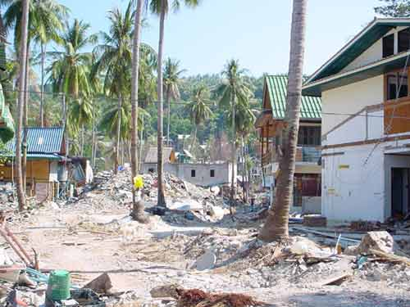
How Does Internationalism Benefit Nations And Nation-States?
Individually or with a partner, come up with an answer for each of the following questions:
Define the term “internationalism”
How can internationalism benefit nations and nation-states?
Who should be responsible for eliminating world poverty?
Who should be responsible for ensuring that failed states become successful?
Read pages 218 - 219
Do the benefits of internationalism outweigh the disadvantages?

Slide 17

Review the photographs in this chapter
Are any of them as powerful as the picture of Earth at the introduction?
Choose three which you think are the most powerful
Include an explanation

Slide 18
And Finally…
Complete your list of terms from this chapter, which include…
Any term/phrase/concept that would be considered important in helping you with your …
Challenge
Any suggestions as to what you should include?

