Slide 1
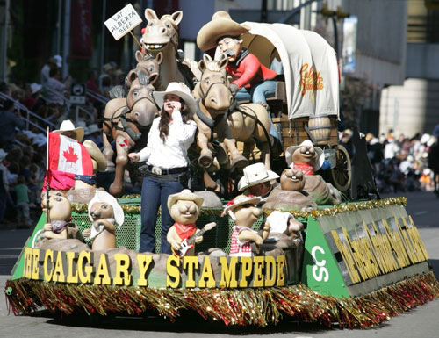
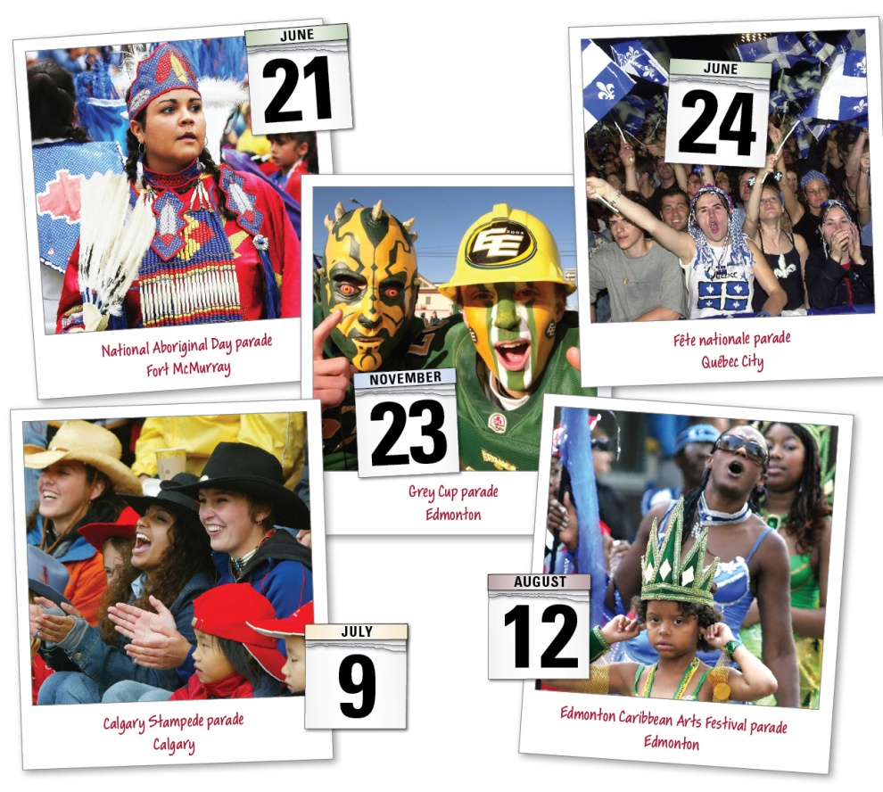
Reconciling Nationalist Loyalties
Does everyone love a parade?
Why do people enjoy them?
Read page 67
Respond to the questions in writing
Read the caption on page 66

Slide 2

How Do Nationalist Loyalties Shape People’s Choices?
Make a list of both nationalist and non-nationalist loyalties
How might nationalist and non-nationalist loyalties conflict?
How might an individual try to resolve such a conflict in his or her life?
In what ways might nationalist and non-nationalist loyalties enrich a person's life?
How might nationalist and non-nationalist loyalties affect an individual’s sense of nation?
Read page 68, completing the Activity and answering all of the questions

Slide 3
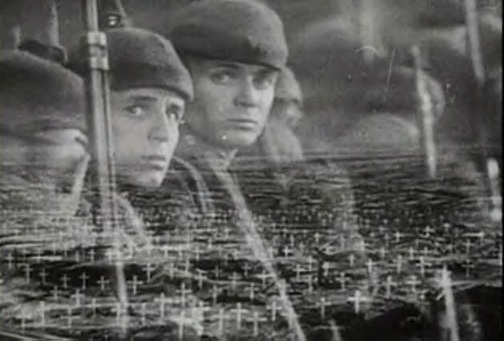
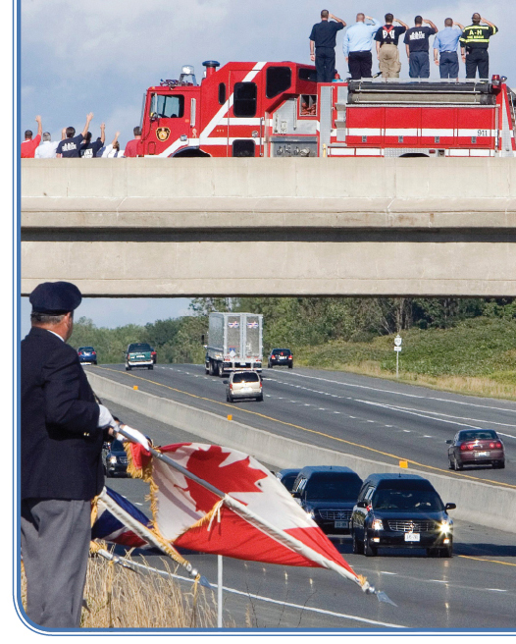
Loyalty
Read page 69
What is the link between patriotism and loyalty?
How do nationalist loyalties affect choices?
How do contending loyalties affect choices?
Review the caption on page 69
Respond to the question

Slide 4

Edmonton Troops Return Home
September 18, 2008

Slide 5

And Finally…
Begin a list of terms from this chapter, which include…
Any term/phrase/concept that would be considered important in helping you with your …
Coat of Arms
Any suggestions as to what you should include?

Slide 6

Affirming Nationalist Loyalties
Complete the first section of this handout
As you read page 70 and the top part of page 71, begin to fill out the rest of the handout
You will not be completing it until later on into the chapter
Was changing the name of the National Indian Brotherhood
to the
Assembly of First Nations
really a significant action?
What Choices Have People Made To Affirm Nationalist Loyalties?

Slide 7
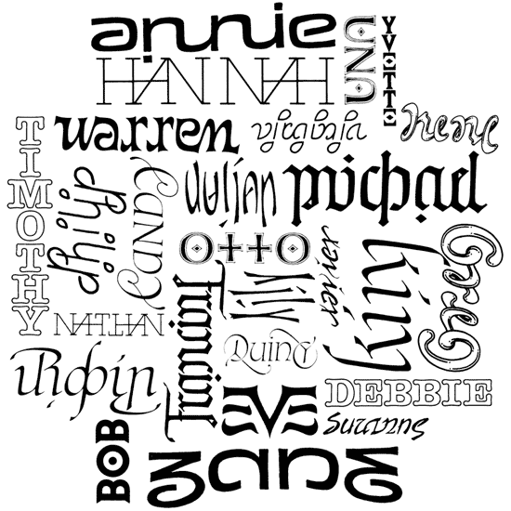
What’s In A Name?
How important is a name?
How do you feel when someone mispronounces your name?
How would you feel if someone changed your name?
What is the difference between a number and a name?
What are some examples of situations where people are referred to by a number?
How would you feel if you were referred to by a number instead of a name?
Complete Making a Difference (Page 71)

Slide 8
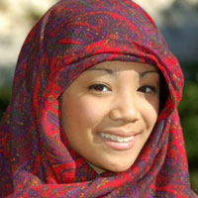
National Loyalties in a Multicultural and
Pluralistic Society
After making a similar chart, read page 72, making point form notes
Your summary statement should include two pieces of evidence

Slide 9

Oaths of Citizenship
The United States
Canada
Read the handout and complete the questions

Slide 10
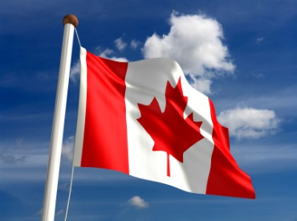
Non-Canadian Nationalist Loyalties
Read pages 73-74
When responding to Reflect and Respond, be sure to have a total of six arguments
Does the Dhillon case demonstrate that national symbols and institutions evolve, change and adapt?
Should national symbols evolve over time?
How might these changes be considered an example of reasonable accommodation?
Do you agree that these changes are reasonable? Why or why not?

Slide 11
And Finally…
Continue with your list of terms from this chapter, which include…
Any term/phrase/concept that would be considered important in helping you with your …
Coat of Arms
Any suggestions as to what you should include?

Slide 12
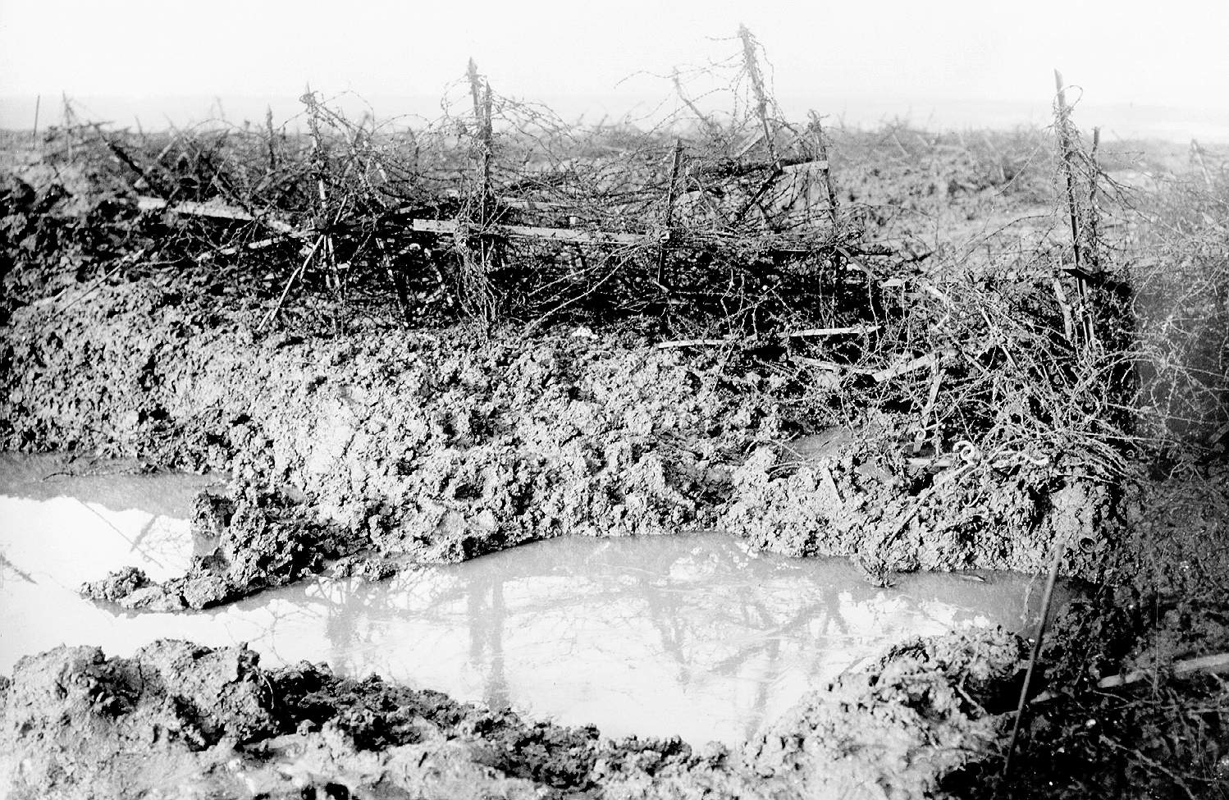

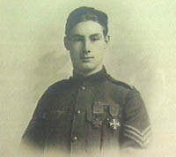
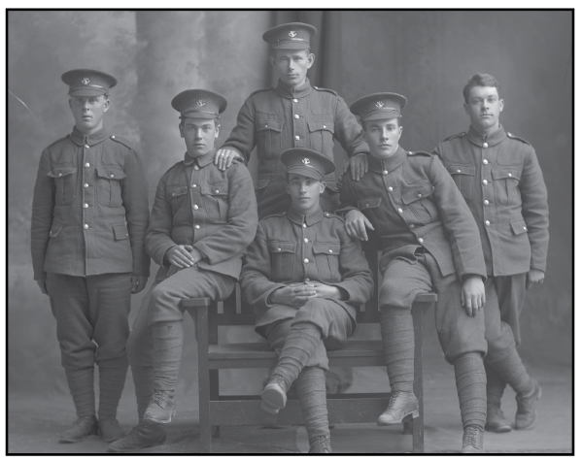
How Can Nationalist Loyalties Create Conflict?
Have you ever been in a situation where you had very mixed feelings about a person?
Have you ever had mixed feelings about being Canadian?
What are some aspects of Canada that you love?
What are some aspects of Canada that give you cause for concern?
Have you ever had to deal with contending loyalties because of competing nationalist sentiments? If so, how did you deal with this conflict?
Read page 75
Respond to the question in Figure 3-8

Slide 13
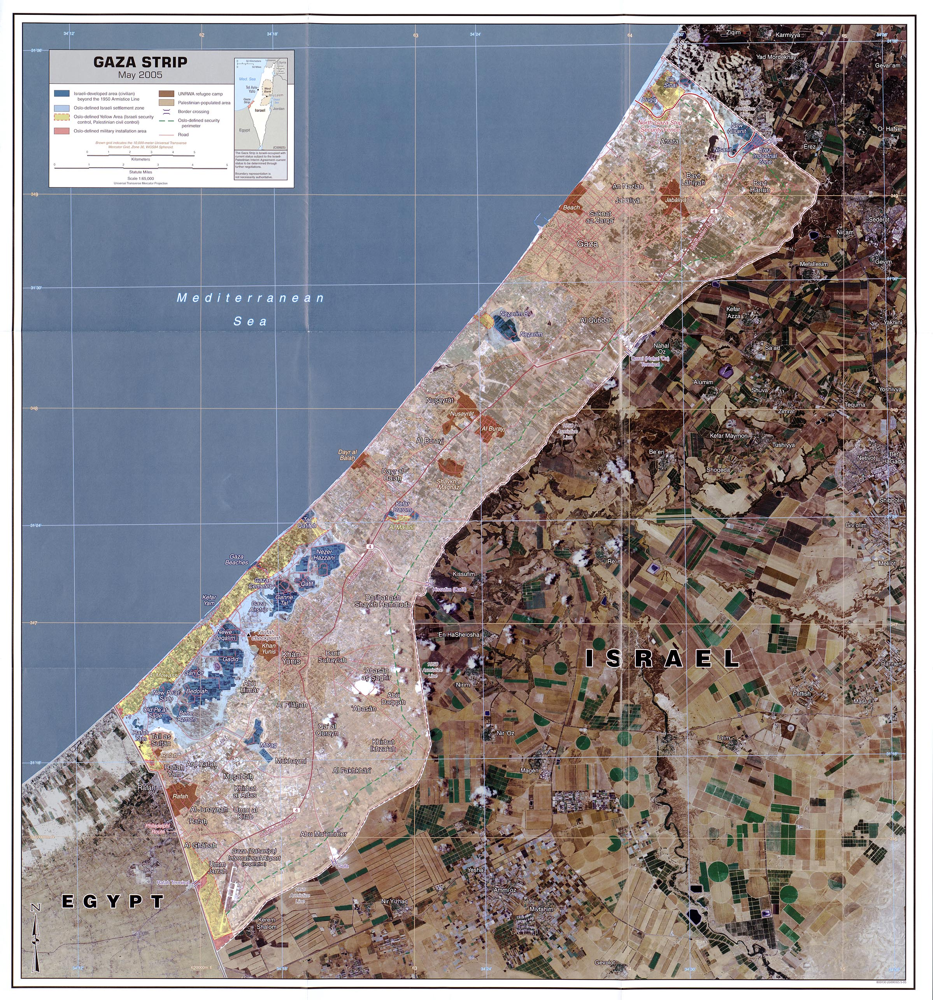
Contending Loyalties and Conflict
Read the top of page 76
What loyalties, if any, would you consider worth fighting for?

Slide 14

Contending Loyalties in Québec
Read page 77, including all margin features
Take a few minutes and complete the Reflect and Respond

Slide 15
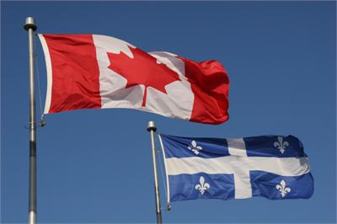
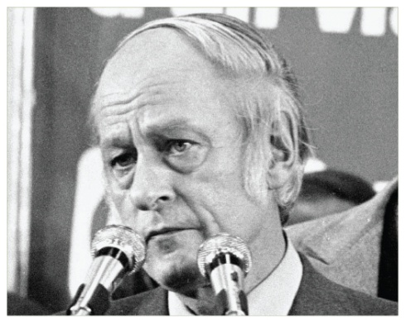
Québec - Focus of Francophone Nationalism in Canada
Protecting Language and Culture in Québec
Read pages 78-79
With a partner, complete the handout
When finished, complete Explorations on page 79

Slide 16
And Finally…
Continue with your list of terms from this chapter, which include…
Any term/phrase/concept that would be considered important in helping you with your …
Coat of Arms
Any suggestions as to what you should include?

Slide 17
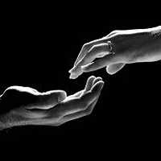
How Have People Reconciled Contending Nationalist Loyalties?
Read the first three paragraphs on page 82
Including Voices
Do you agree with Coon Come’s thoughts?
Does his position have consequences for individuals? For peoples? For governments? What might these consequences be?
Who should be responsible for protecting the right to self-determination?

Slide 18
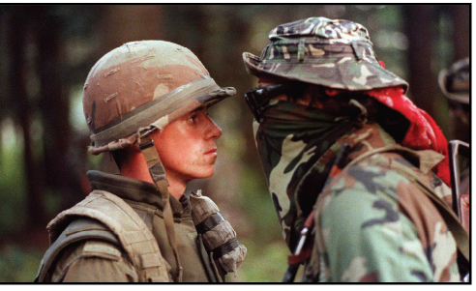

Oka
This could arguably be Canada’s most famous picture. The Oka Crisis was a land dispute between the Mohawk nation and the town of Oka, Quebec which began on March 11 1990, and lasted until September 26, 1990
What ideas make this picture so powerful?
What contending loyalties are displayed?
The Oka Crisis
13:00

Slide 19
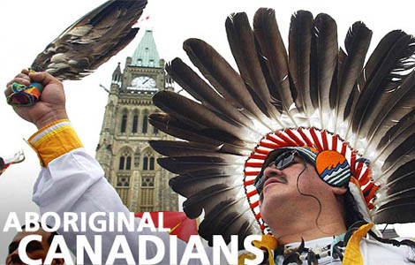
Aboriginal Peoples’ Attempts to Reconcile Contending Nationalist Loyalties
Get into groups of four…
Momentarily, you will be numbered off one through four. Each of you will go to one of the four assigned EXPERT groups and complete a brief summary. You will have approximately 15-20 minutes to do this.
  #1 – Oka Crisis (Page 82)
  #2 – The Royal Commission on Aboriginal Peoples (Page 83)
  #3 – Statement of Reconciliation (Page 83)
  #4 – Land Claims (Page 84)
When finished, return to your original group of four and share your EXPERTISE with your other three group members. They will do the same for you. When you are done, your worksheet WILL be filled in and complete.

Slide 20
Aboriginal Peoples’ Attempts to Reconcile Contending Nationalist Loyalties
When your chart is complete, for each of the four events, decide if it helped or hindered Aboriginal peoples’ attempts to reconcile contending nationalist loyalties

Slide 21
And Finally…
Complete your list of terms from this chapter, which include…
Any term/phrase/concept that would be considered important in helping you with your …
Coat of Arms
Any suggestions as to what you should include?

Slide 22

Chapter Two/Three Quiz
Review both Chapters – Including the Terms
Details…

Slide 23
Think About Your Challenge
Review the bottom of page 87
If time permits, complete this suggestion

Slide 24

Related Issue #1 Exam
Part of your exam for Related Issue One is an analysis and interpretation of three sources
And 27 multiple questions
It will be marked according to the rubric provided to you (Writing Assignment I)
You will have the entire class to complete the exam
The three sources will be used to answer the following questions:
What perspectives do each of the three sources present on the concept of national identity?
and
What relationships exist between the sources?

Slide 25
The Question: Specifics
What perspectives do each of the three sources present on the concept of national identity, and what relationships exist between the sources?
Examine each source. Write a response in paragraph form in which you:
>Interpret each source to identify and explain the perspective on nationalism and identity; explain the links between the principles of nationalism and identity and each source
>Identify and explain one or more of the relationships that exist among the sources; support your response with evidence drawn from the sources and knowledge of social studies

