Slide 1

Chapter Two/Three Quiz
Review both Chapters – Including the Terms
Details…

Slide 2

Related Issue #1 Exam
Part of your exam for Related Issue One is an analysis and interpretation of three sources
And 27 multiple questions
It will be marked according to the rubric provided to you (Writing Assignment I)
You will have the entire class to complete the exam
The three sources will be used to answer the following questions:
What perspectives do each of the three sources present on the concept of national identity?
and
What relationships exist between the sources?

Slide 3
The Question: Specifics
What perspectives do each of the three sources present on the concept of national identity, and what relationships exist between the sources?
Examine each source. Write a response in paragraph form in which you:
>Interpret each source to identify and explain the perspective on nationalism and identity; explain the links between the principles of nationalism and identity and each source
>Identify and explain one or more of the relationships that exist among the sources; support your response with evidence drawn from the sources and knowledge of social studies

Slide 4

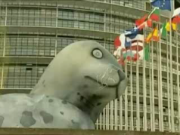

Reconciling Nationalist and Non-Nationalist Loyalties
European Seal Ban – May 2009
What are the some of the pros and cons of the seal hunt?
Pros:
Provide an income for Canadians
Preserves traditions ways of life
Controls seal population
Cons:
Killing innocent animals
Provokes international condemnation of Canada – Bad reputation!
What is the picture on page 88 displaying?
Read page 89, completing all the questions

Slide 5
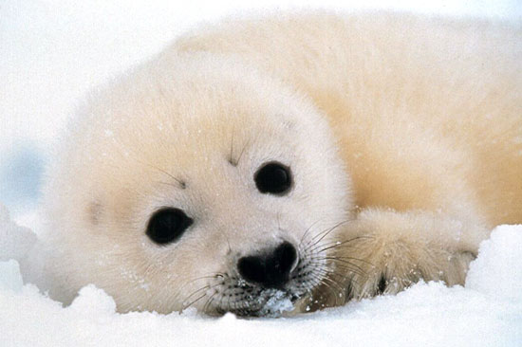
The Canadian Seal Hunt
The left-hand side of the class will take the For side
The right-hand side of the class will take the Against side.
Each side will prepare up to five arguments
Discuss
Can this conflict ever be resolved?
Read Looking Ahead on page 89

Slide 6

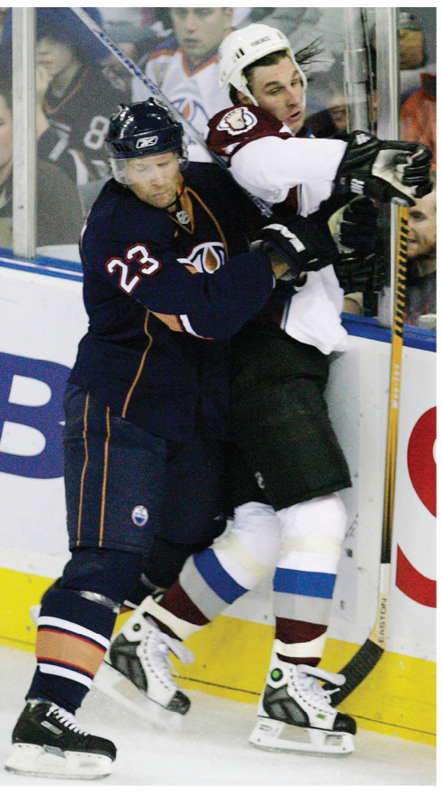
What Are Non-Nationalist Loyalties?
Read the first half of page 90 Respond to the questions
Individually, make a list of at least 10 of your loyalties, such as your family, friends…
Read the rest of page 90 and page 91
Complete the Activity on page 91
Read the caption to this picture on page 90
What contending loyalties do you think Ryan Smyth had during this game?

Slide 7

And Finally…
Begin a list of terms from this chapter, which include…
Any term/phrase/concept that would be considered important in helping you with your …
Coat of Arms
Any suggestions as to what you should include?

Slide 8
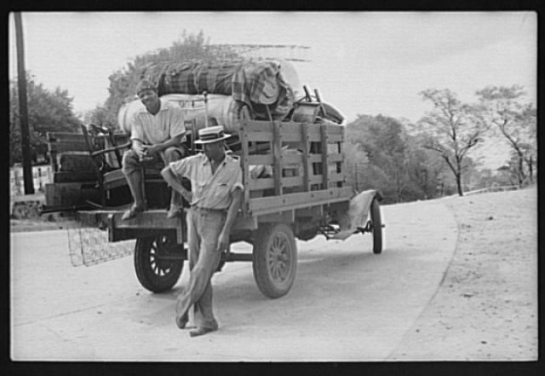
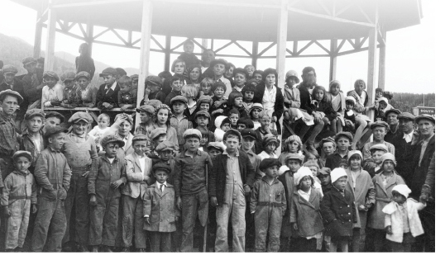

How Can Nationalist and Non-Nationalist Loyalties Compete?
When Class and Nationalist Loyalty Compete
What are socio-economic classes?
What assumptions are sometimes made about members of the upper class? The middle class? The lower – or working – class?
Do you know anyone who has experienced class conflict? How did the conflict make this person feel? How did the person respond? How was the conflict resolved?
Read page 92, responding to the Activity and answering the question from Figure 4-5
Give Voice to Class Loyalty – My Example
If I Had A Rocket Launcher

Slide 9
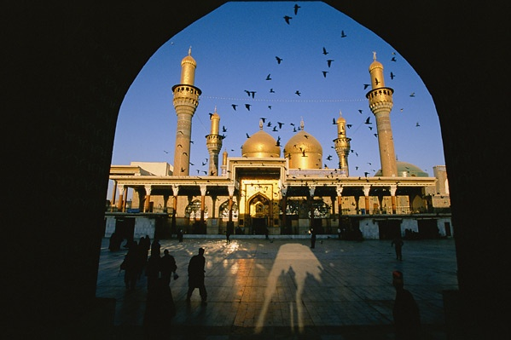
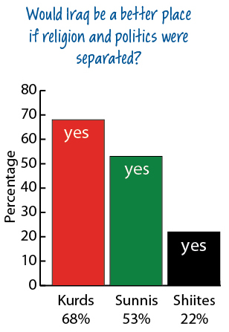
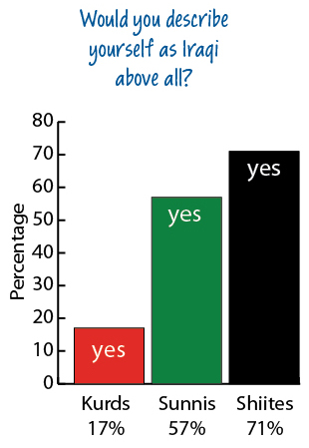
When Religious and Nationalist Loyalty Compete
Read all of page 93
Pay close attention to both of the opinion polls as you complete jot notes for the Activity

Slide 10
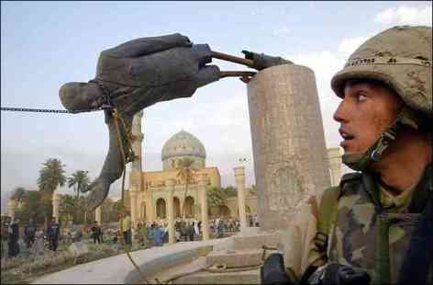
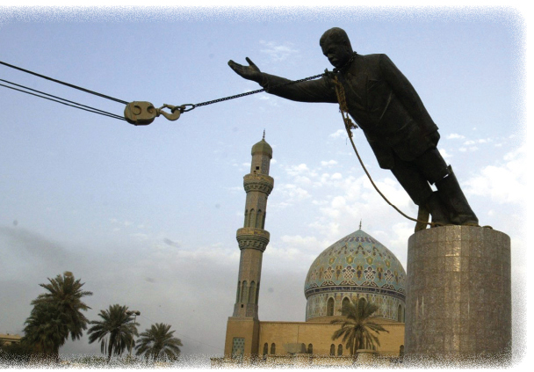
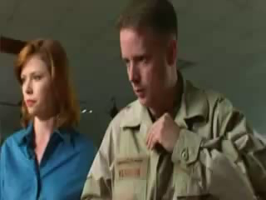
Spinbuster
Read the introduction on page 94
Review the Steps and using the provided worksheet, and a partner, fill in the chart
Was it a Media Hoax?
What is happening in the photograph?
Where was the photograph taken?
Who was involved in this action?
Why was this event considered important enough to photograph?
3:24

Slide 11
And Finally…
Continue with your list of terms from this chapter, which include…
Any term/phrase/concept that would be considered important in helping you with your …
Coat of Arms
Any suggestions as to what you should include?

Slide 12

When Regional and Nationalist Loyalty Compete
Get into groups of four…
Momentarily, you will be numbered off one through four. Each of you will go to one of the four assigned EXPERT groups and complete a brief summary. You will have approximately 15-20 minutes to do this.
  #1 – Oil, Gas and Regional Loyalty (Page 95)
  #2 – The Oil Sands and Loyalties (Page 96)
  #3 – The Oil Sands and Ideological Loyalties (Page 97)
  #4 – The Oil Sands and Cultural Loyalties (Page 98)
When finished, return to your original group of four and share your EXPERTISE with your other three group members. They will do the same for you. When you are done, your chart WILL be filled in and complete.

Slide 13
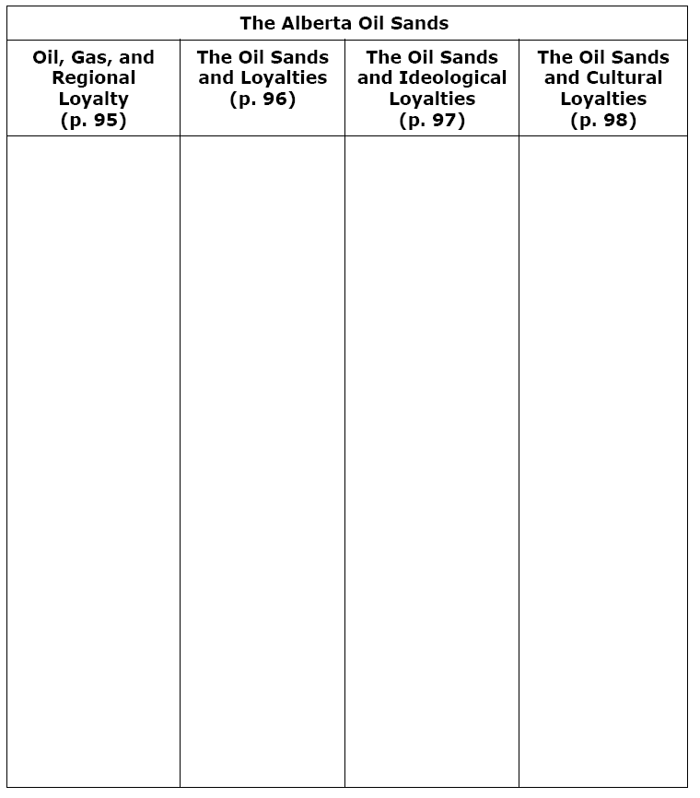
When Regional and Nationalist Loyalty Compete

Slide 14
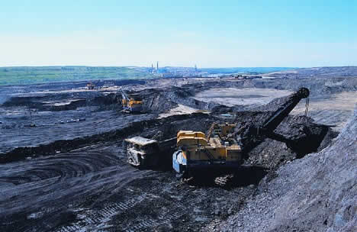
Defending an Informed Position
Read the introduction on page 100
Review the Steps and using the provided worksheet, and a partner, fill in the chart

Slide 15
And Finally…
Continue with your list of terms from this chapter, which include…
Any term/phrase/concept that would be considered important in helping you with your …
Coat of Arms
Any suggestions as to what you should include?

Slide 16
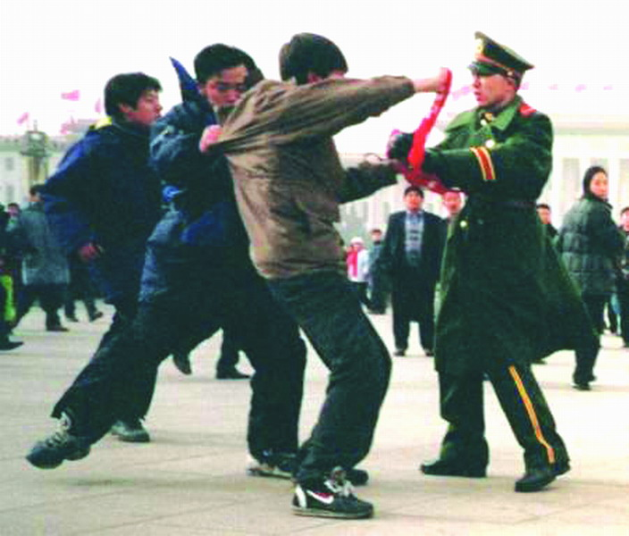
How Have People Reconciled Contending Nationalist and Non-Nationalist Loyalties?
What are examples of occasions where you may have had to struggle with contending loyalties?
How did they turn out?
Did you feel good about how they were resolved?
What would you do differently, if anything, if you had to go through it again?

Slide 17
How Have People Reconciled Contending Nationalist and Non-Nationalist Loyalties?
Read pages 102 and 103
As you read, fill in Advantages and Disadvantages of the strategies listed
When done, grab a partner and fill in as many examples as you can think of

Slide 18


Bringing About Change
Little Rock Nine
2:45
In groups of 3 or 4, read the four sections from pages 104 – 107
Individually, record the main points for one of the four sections
Be sure to title each section and share your work, being sure you have summaries for all four sections

Slide 19
And Finally…
Complete your list of terms from this chapter, which include…
Any term/phrase/concept that would be considered important in helping you with your …
Coat of Arms
Any suggestions as to what you should include?

Slide 20

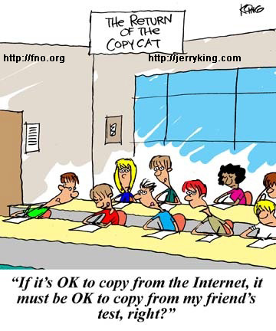
Your Challenges…
Are Due on Thursday
Looked at the Rubric?
Your Related Issue #1 Exam…
Is on Wednesday

Slide 21
Related Issue #1 Exam
Your exam for Related Issue One is 27 Multiple Choice Questions and…
An analysis and interpretation of three sources
It will be marked according to the rubric provided to you (Writing Assignment I)
You will have the entire class to complete the exam
The three sources will be used to answer one of the following questions:
What perspectives do each of the three sources present on national identity and what relationships exist between the sources?
OR
What perspectives do each of the three sources present on contending loyalties and what relationships exist between the sources?

Slide 22
The Question: Specifics
What perspectives do each of the three sources present on national identity, and what relationships exist between the sources?
OR
What perspectives do each of the three sources present on contending loyalties, and what relationships exist between the sources?
Examine each source. Write a response in paragraph form in which you:
>Interpret each source to identify and explain the perspective on national identity/contending loyalties; explain the links between the principles of nationalism and each source
>Identify and explain one or more of the relationships that exist among the sources; support your response with evidence drawn from the sources and knowledge of social studies

