Slide 1
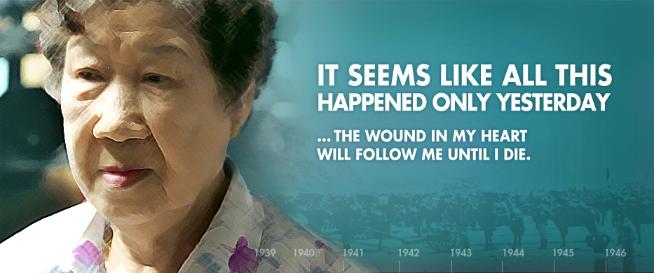
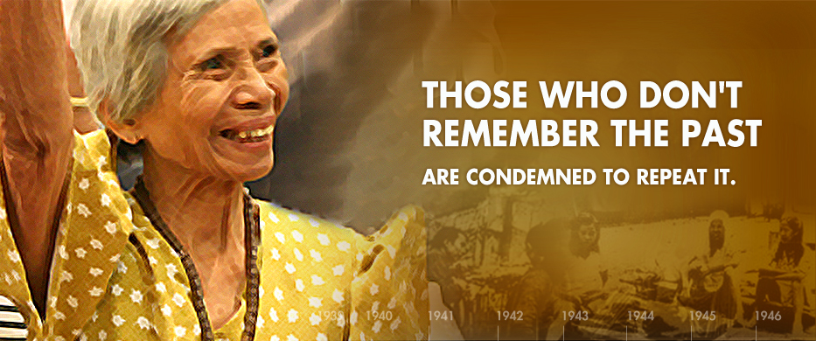
Asian Holocaust in High School Social Studies
2011 Study Tour to China and South Korea
The Peace and Reconciliation Tour
Starting in 2004, Toronto ALPHA
(The Association for the Learning and Preserving the History of World War Two in Asia)
with its chapters in British Columbia, Edmonton and New Jersey, has offered to educators a hands-on experience with the history of WWII in Asia, by visiting historical sites, museums and meeting with experts, educators, curators and survivors.
Destinations include locations in China, South Korea and in the future will include sites in Japan, Hong Kong and other Asian countries.
The Peace and Reconciliation Tour
July 13 – 28, 2011
Beijing, Harbin, Nanjing, Shanghai and Seoul

Slide 2


Asian Holocaust in High School Social Studies
2011 Study Tour to China and South Korea
What does ALPHA do?
The Mandate of both Edmonton and Toronto ALPHA:
To preserve the truthfulness of historical records about WWII in Asia
To pursue justice for the victims of WWII in Asia
To promote global awareness, knowledge and recognition of this history such that peace and reconciliation among the perpetrating and victimized nation can be finally achieved

Slide 3
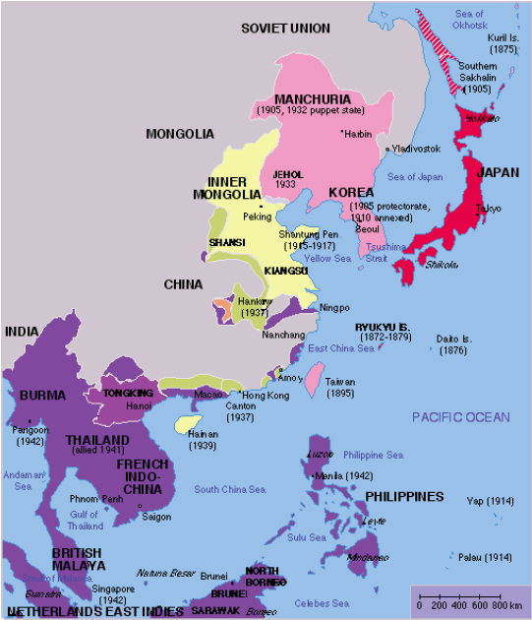
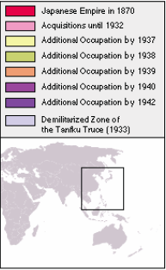
Asian Holocaust in High School Social Studies
Historical Overview of the Asian Holocaust
Map of the Japanese Empire 1870 - 1942

Slide 4
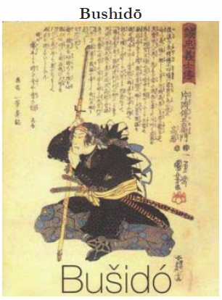
Asian Holocaust in High School Social Studies
Historical Overview of the Asian Holocaust

Slide 5
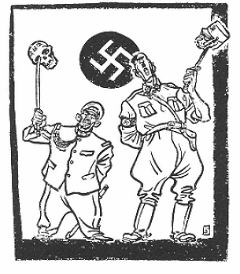
Asian Holocaust in High School Social Studies
Historical Overview of the Asian Holocaust

Slide 6
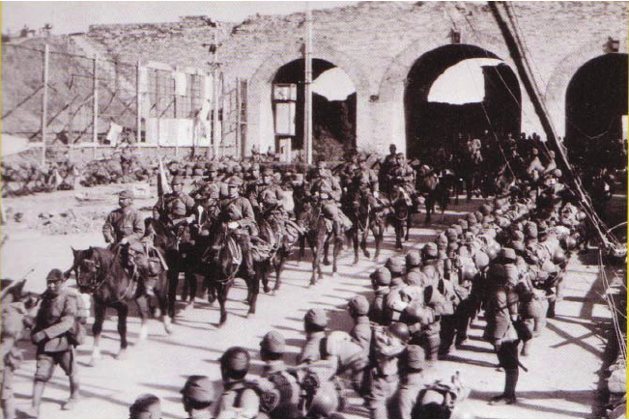
Asian Holocaust in High School Social Studies
Historical Overview of the Asian Holocaust
Japanese Army marches into Nanking in December, 1937

Slide 7
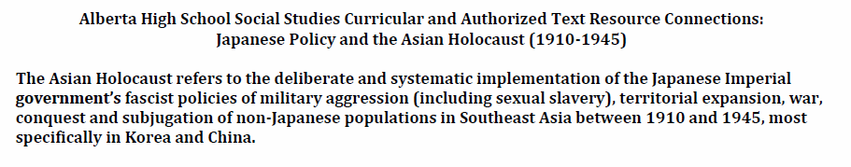
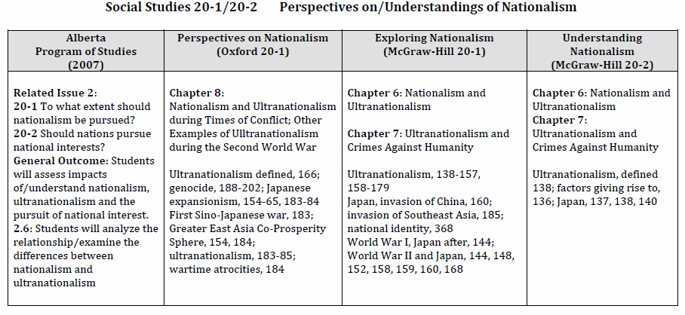
Asian Holocaust in High School Social Studies
Program of Studies and Resource Connections

Slide 8
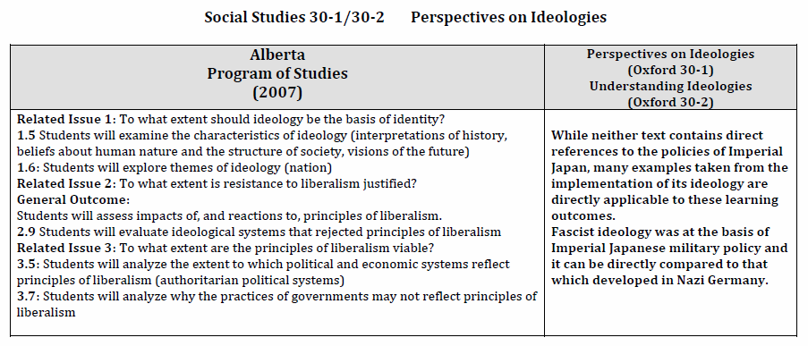
Asian Holocaust in High School Social Studies
Program of Studies and Resource Connections

Slide 9
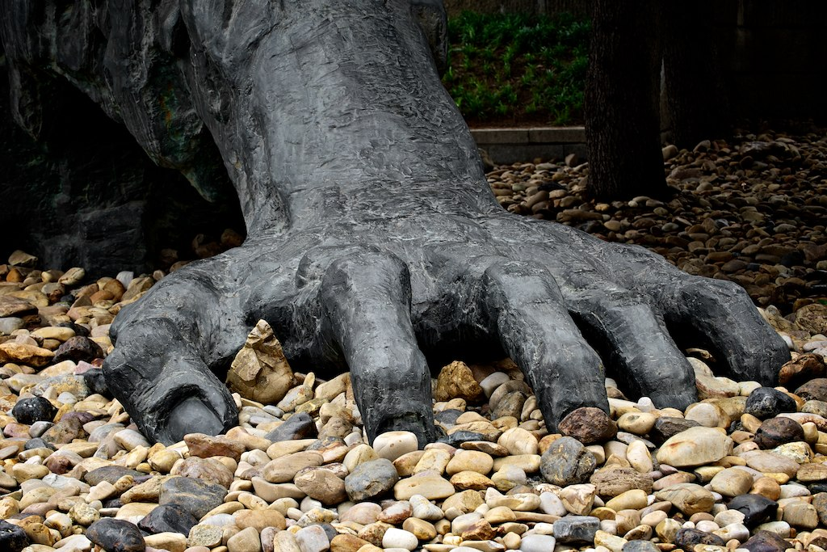
2011 Study Tour to China and Korea:
A Personal Experience of the History of World War II in Asia
We went to many places and learned many things…
The Comfort Women Issue and Survivors – Beijing, Shanghai and Seoul, South Korea
Unit 731 – Human Experimentation – Harbin, China
Nanking Massacre (The Rape of Nanking) and Survivors – Nanjing, China
Japanese Slave Labour Survivors – Beijing and Seoul, South Korea
Above all, however, the trip was about the survivors and their voices…

Slide 10
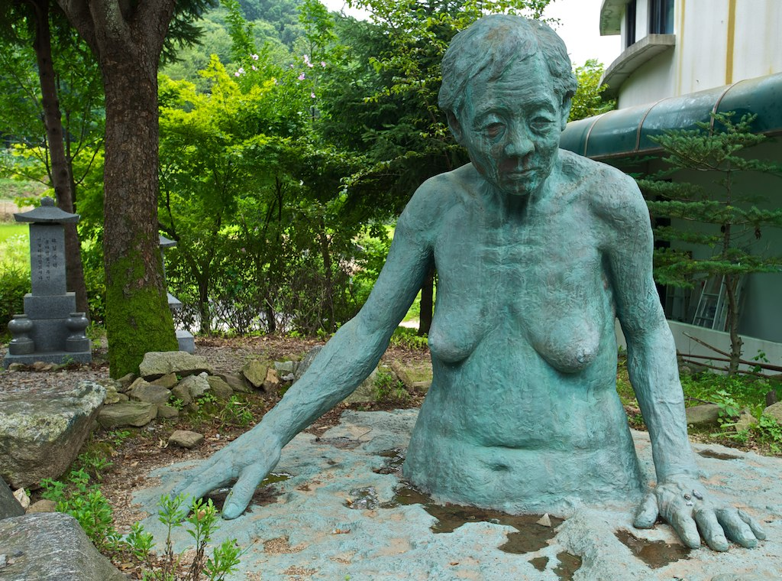
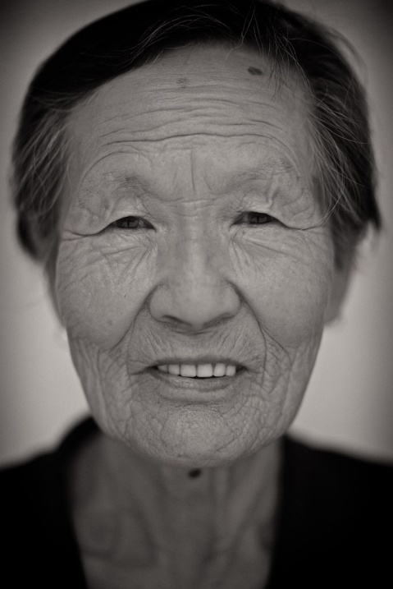
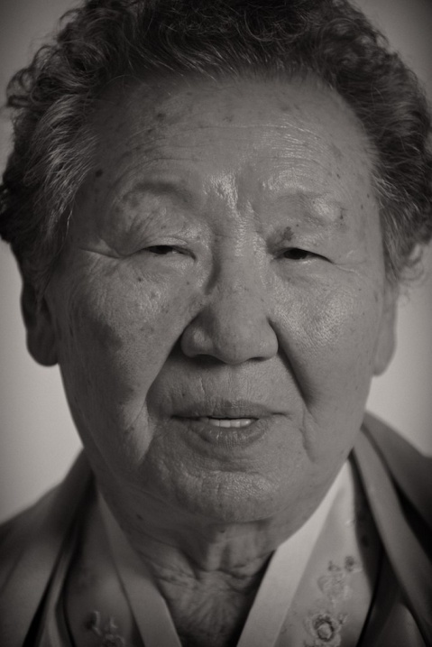
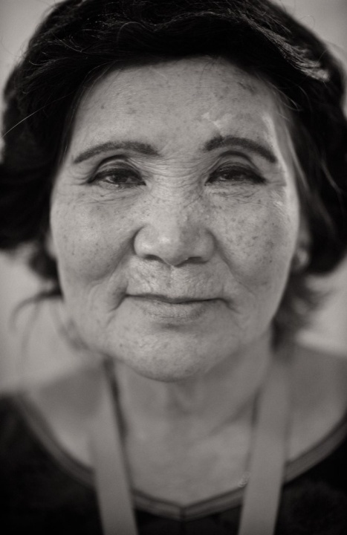
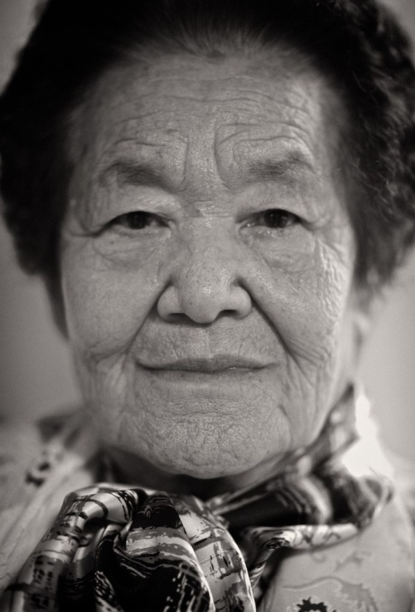
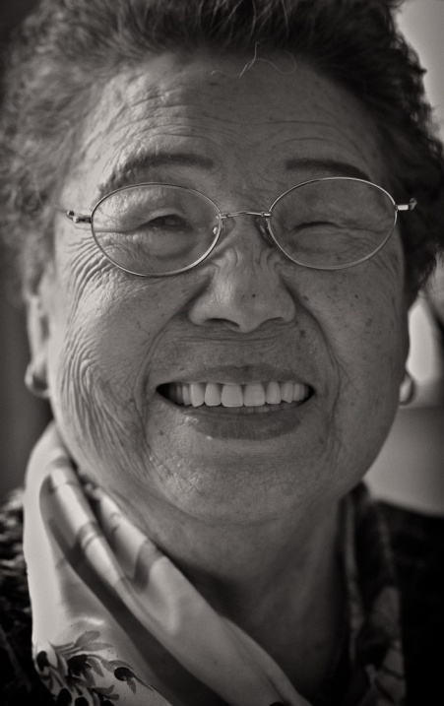
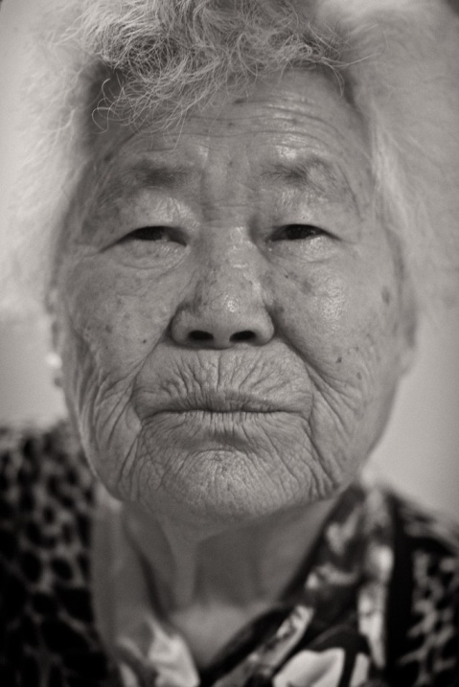
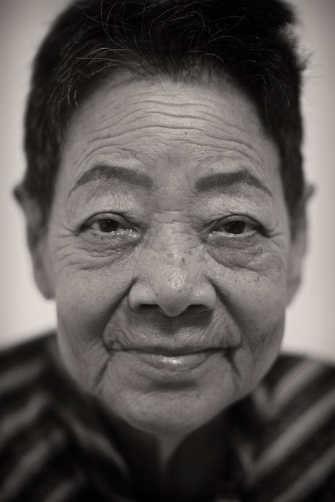
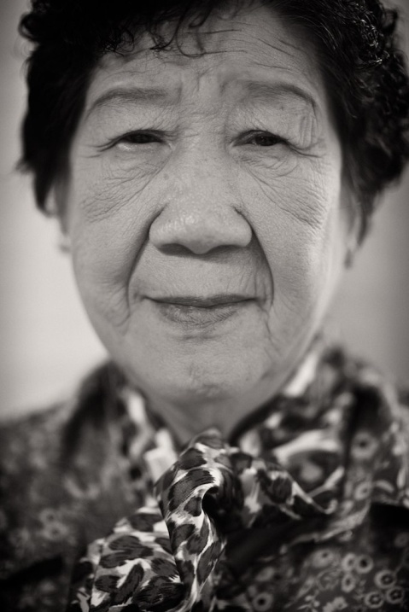
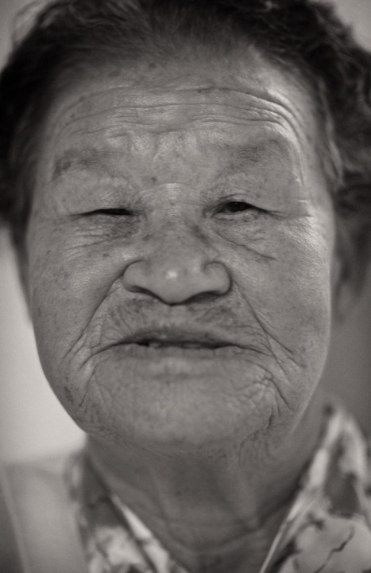
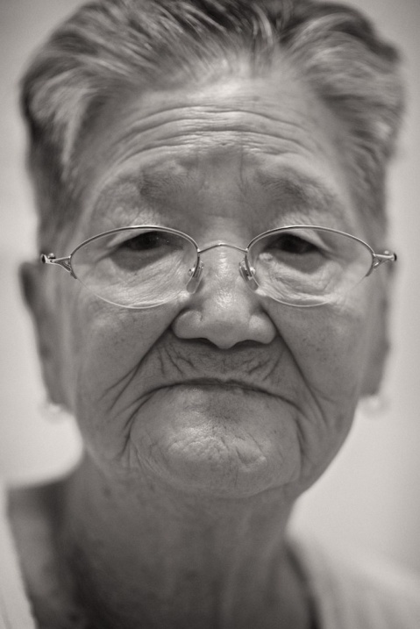
Survivors of
Forced Sexual Slavery
Comfort Women

Slide 11
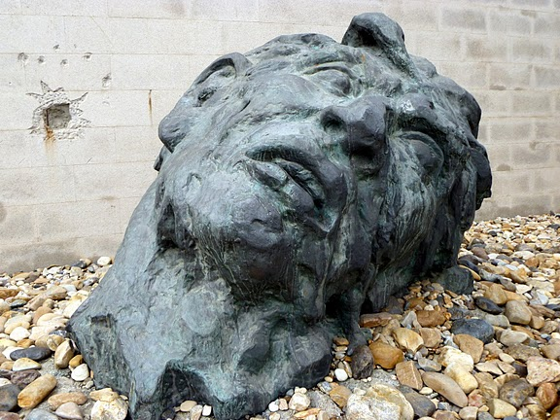
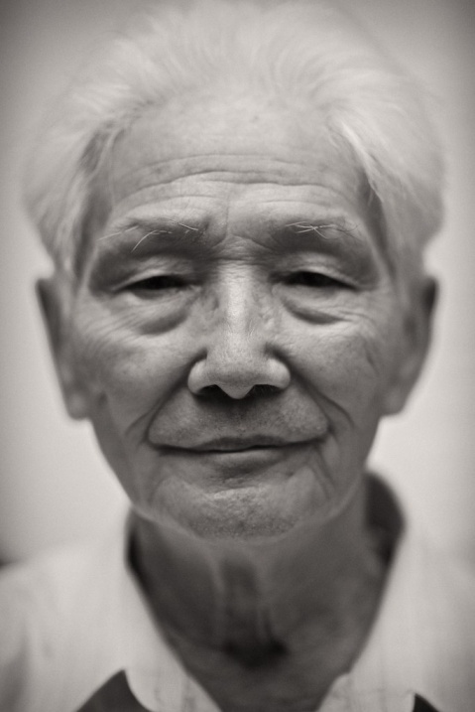
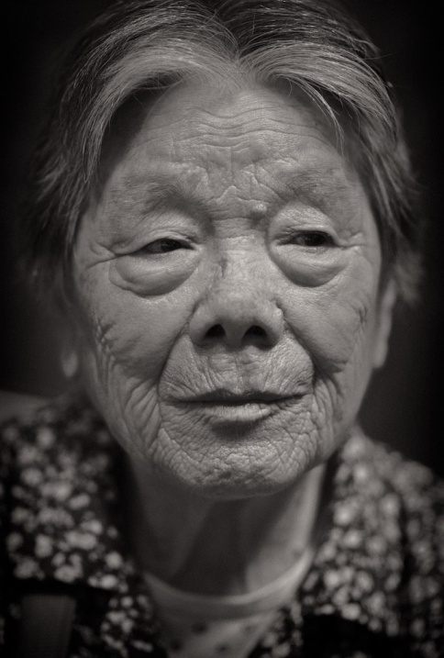
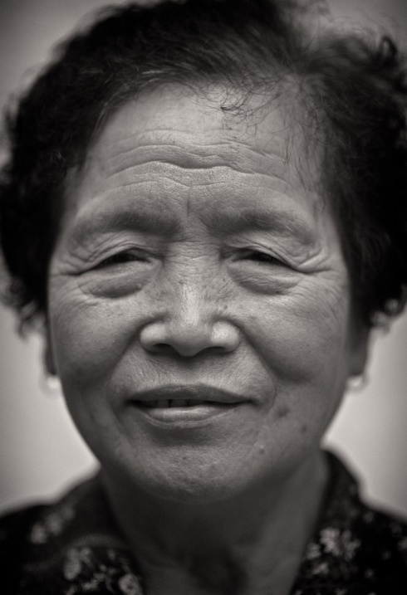
Survivors of
The Rape of Nanking

Slide 12
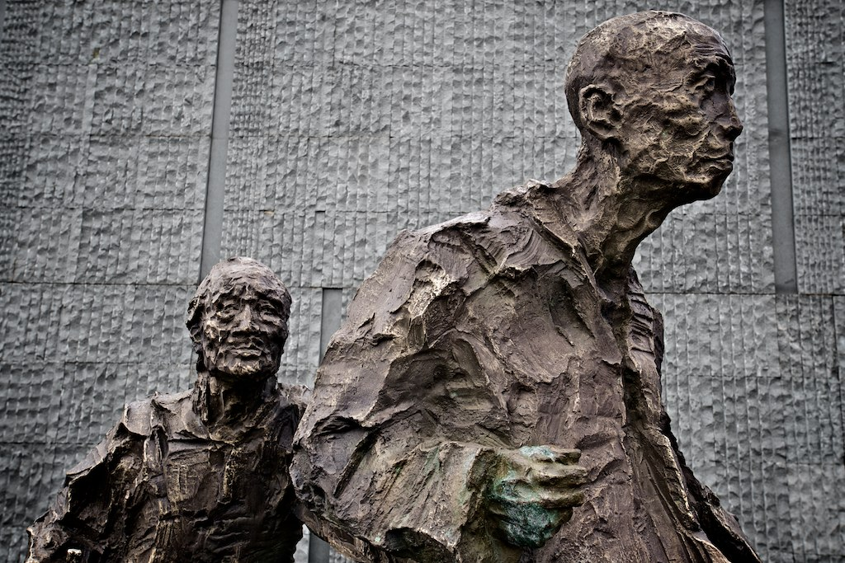
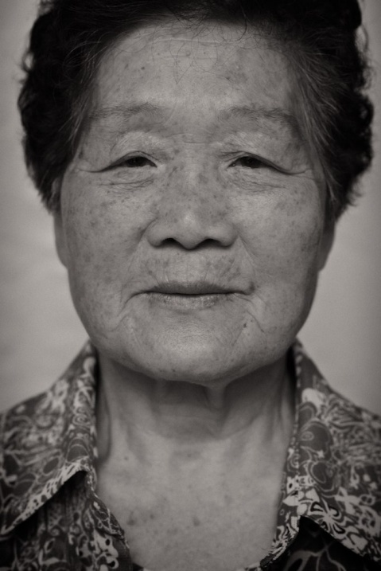
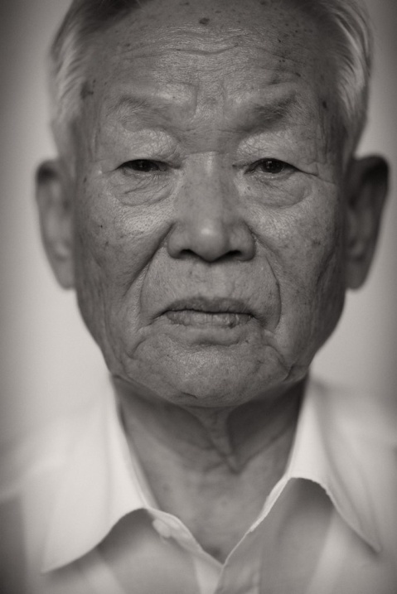
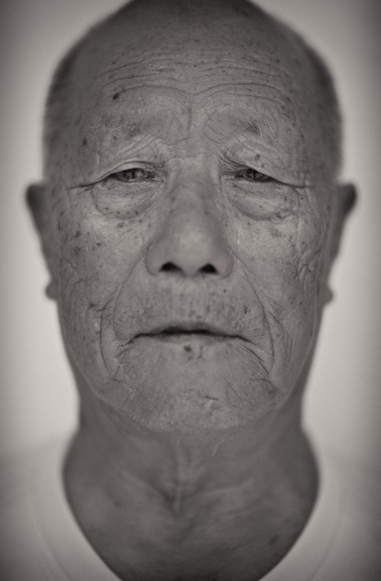
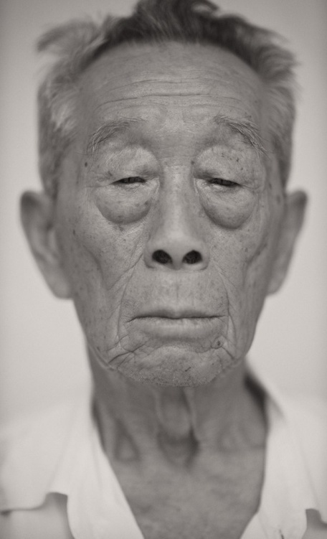
Survivors of
Japanese Slave Labour

Slide 13
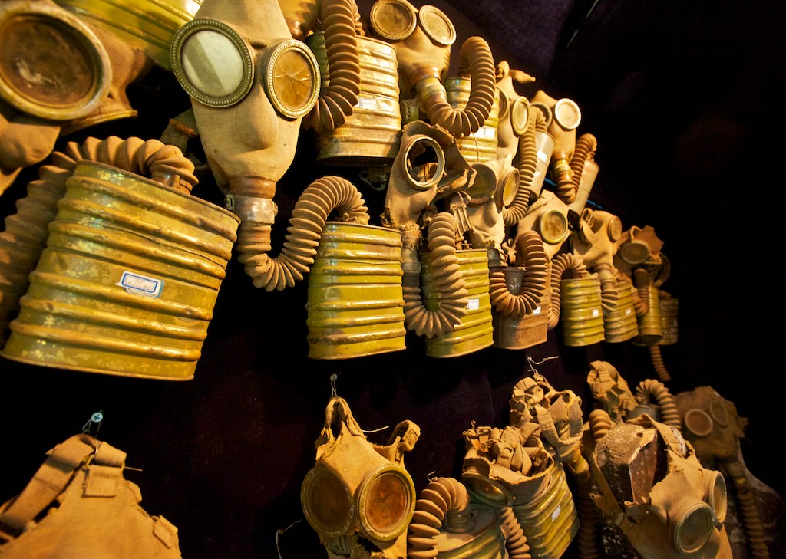
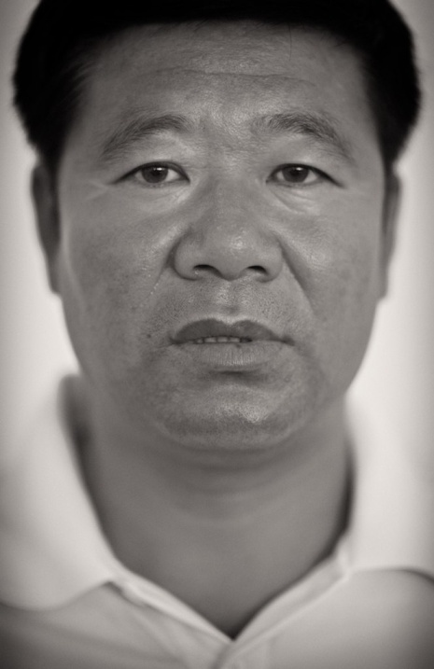
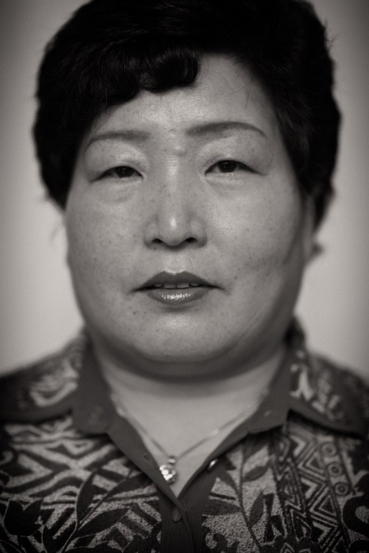
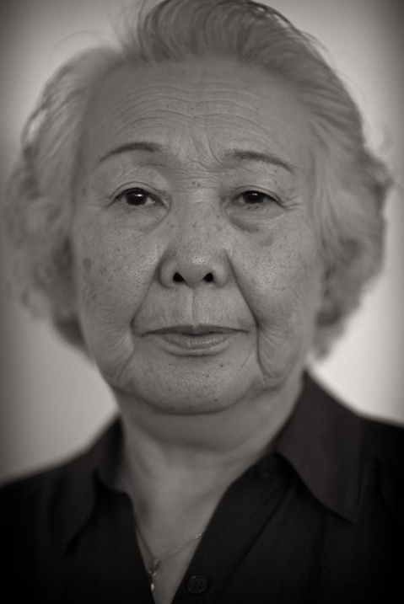
Exposure to Chemical Weapons Left Behind By The Japanese During World War Two
Second Generation Survivor of Nagasaki
Daughter of Victim of Human Experimentation at Unit 731

Slide 14
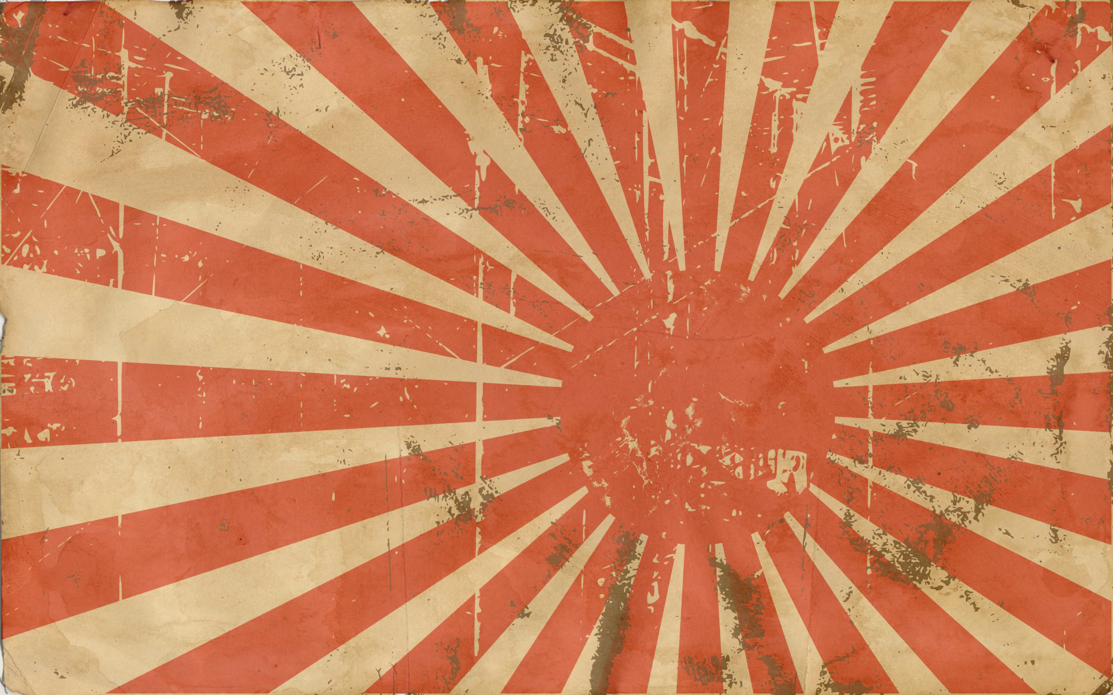
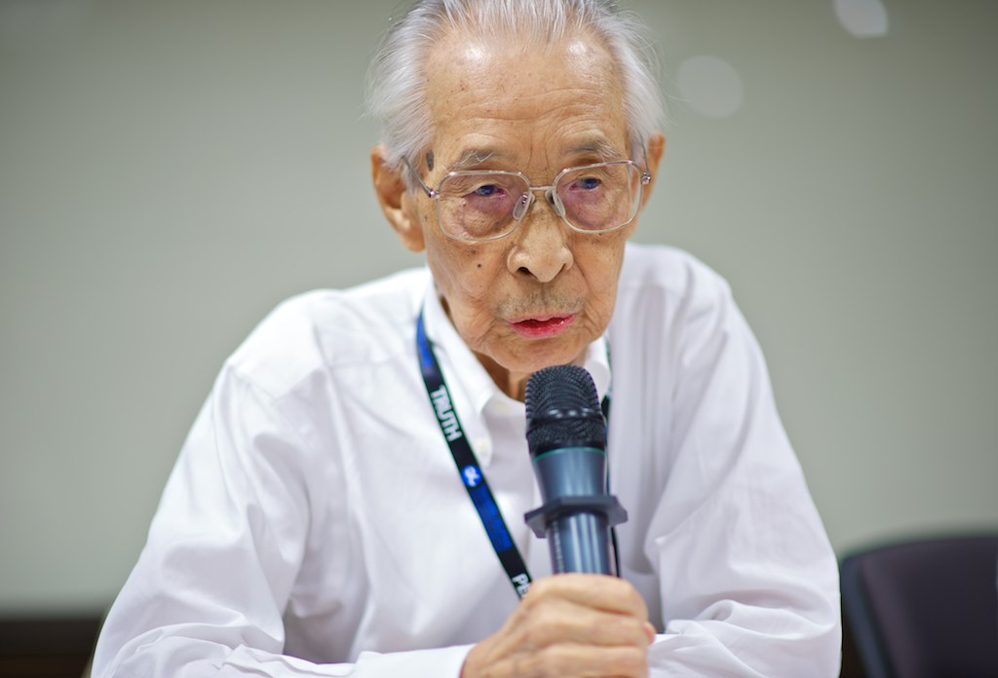
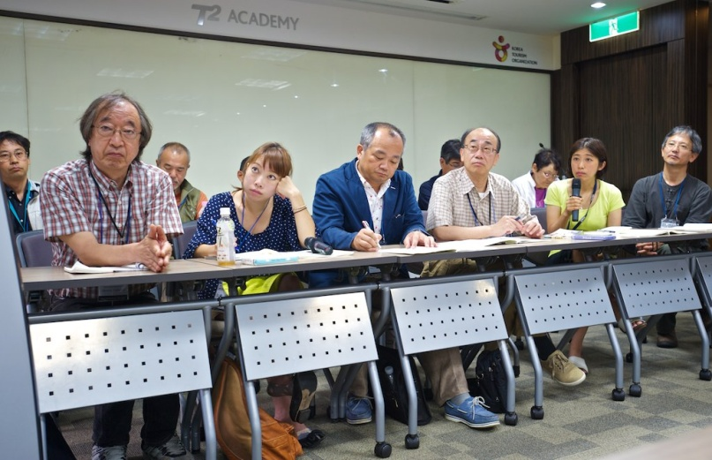
World War II Japanese Soldier
Japanese Teachers

Slide 15

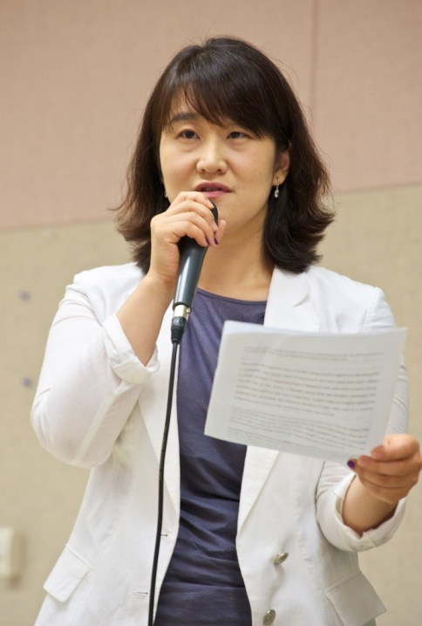
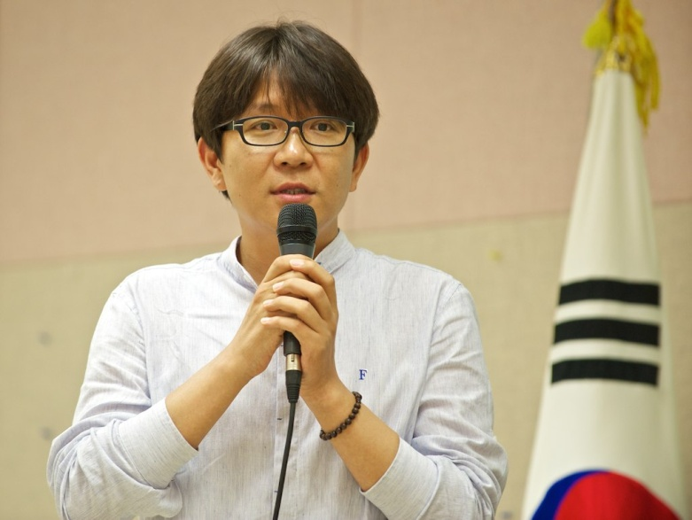
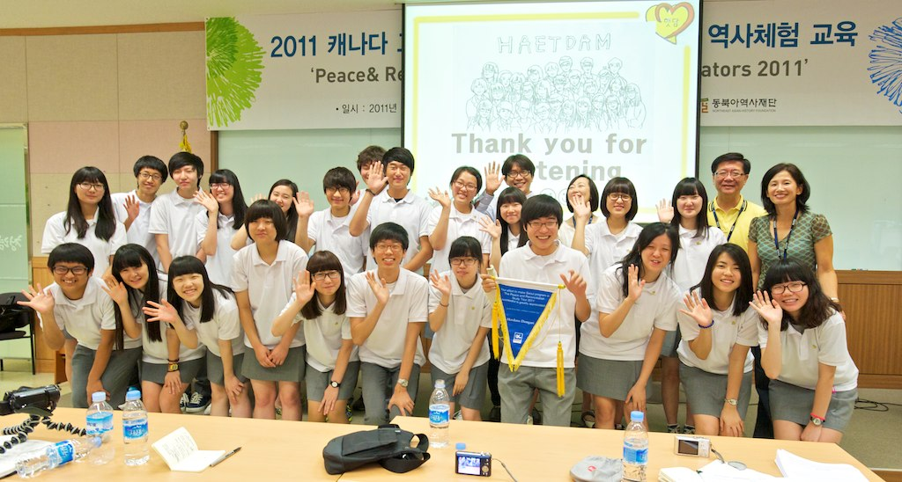
Korean Teachers and Students

Slide 16

The Comfort Women Issue and Survivors – Beijing, Shanghai and Seoul, South Korea

Slide 17
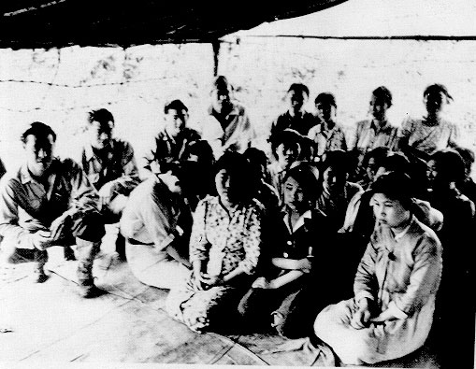
The Comfort Women Issue and Survivors – China and Korea
“You can never forget, never…” – Her Stories.
(2008)
22 Minutes

Slide 18
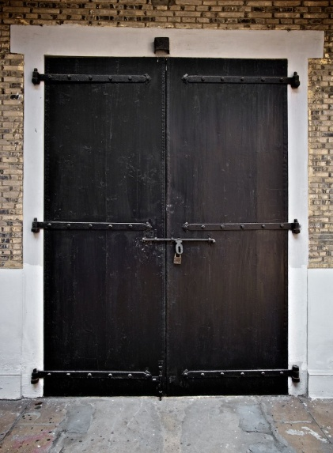
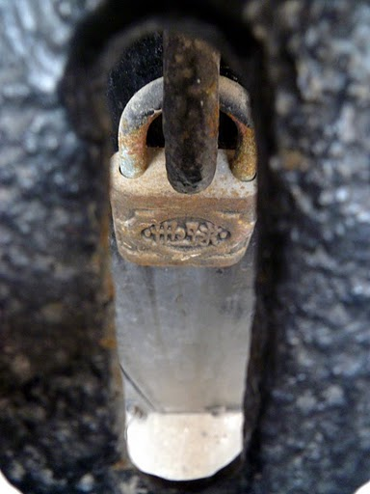
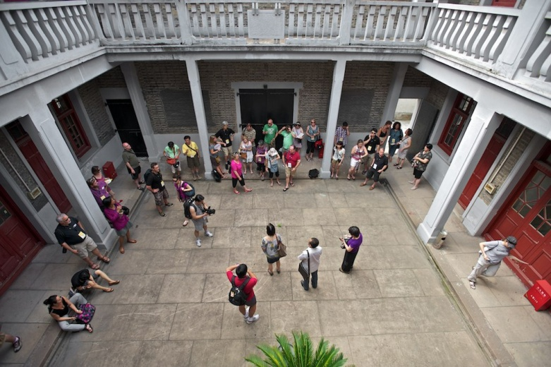
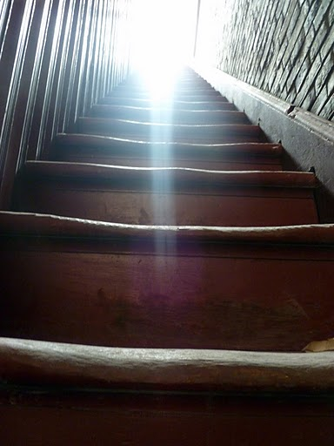
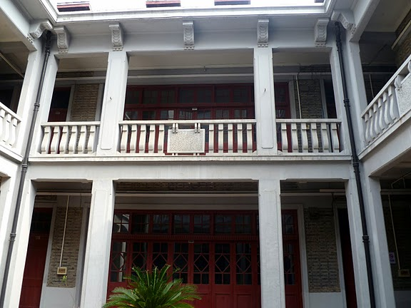
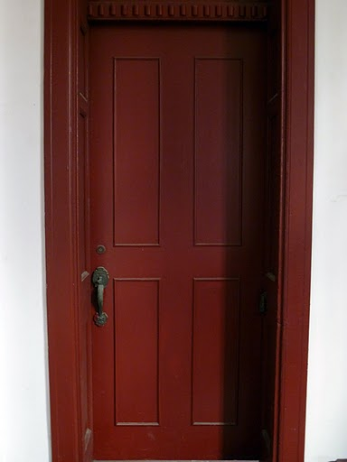
The Chen Residence: A Former Comfort Station – Shanghai
The Comfort Women Issue and Survivors – China and Korea

Slide 19
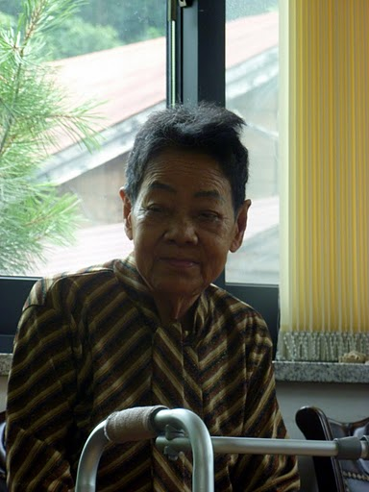
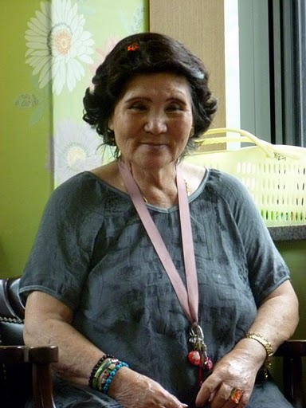










The House of Sharing – South Korea
The Comfort Women Issue and Survivors – China and Korea

Slide 20






Wednesday Demonstration– Seoul, South Korea
1000th Wednesday Demonstration – December 14th, 2011
The Comfort Women Issue and Survivors – China and Korea

Slide 21


Unit 731 – Human Experimentation – Harbin, China

Slide 22





1935 - 1945
Unit 731 – Human Experimentation – Harbin, China

Slide 23





Unit 731 – Human Experimentation – Harbin, China

Slide 24




Unit 731 – Human Experimentation – Harbin, China

Slide 25




Nanking Massacre (The Rape of Nanking) and Survivors – Nanjing, China
Iris Chang: The Rape of Nanking
Trailer

Slide 26

Nanjing Massacre Victims Memorial Hall– Nanjing, China
Nanking Massacre (The Rape of Nanking) and Survivors – Nanjing, China

Slide 27




Nanjing Massacre Victims Memorial Hall– Nanjing, China
Nanking Massacre (The Rape of Nanking) and Survivors – Nanjing, China

Slide 28








Nanjing Massacre Victims Memorial Hall– Nanjing, China
Nanking Massacre (The Rape of Nanking) and Survivors – Nanjing, China

Slide 29
The Rape of Nanking
75th Anniversary Events
Insert Details When Available

Slide 30

So, even though we went to many places and learned many things…
The trip was about the survivors and their voices…

Slide 31
No Longer Forgotten Voices...

Slide 32
Asian Holocaust in High School Social Studies
2011 Study Tour to China and South Korea
Resources
  Websites:
  Canada ALPHA/B.C. ALPHA - www.alpha-canada.org
  Edmonton ALPHA - www.edmontonalpha.org
  Toronto ALPHA - www.torontoalpha.org (Follow the Education/Resources link)
  New Jersey ALPHA - http://www.state.nj.us/education/holocaust/curriculum
  Iris Chang - www.irischang.net
  House of Sharing - houseofsharing.org
  Teaching Resources:
  Study Guide for Teachers - Iris Chang: The Rape of Nanking
  http://www.alpha-canada.org/studyguide/IrisChangMovie_studyguide.pdf
  The Search for Global Citizenship: The Violation of Human Rights in Asia, 1931-1945
  http://www.torontoalpha.org/images/EducationalResources/resource_guide_march2009.pdf
  Human Rights in the Asia Pacific 1931-1945: Social Responsibility and Global Citizenship
  Available for purchase at www.publications.gov.bc.ca/

Slide 33
2012 Study Tour Info
Hong Kong, Mainland China, South Korea
July 5 - July 18, 2012
Information and application forms can be found at the Edmonton ALPHA website:
http://www.edmontonalpha.org/2012_study_tour.html
Application Deadline:
As of February 20th, Firm Deadline Still Unavailable

Slide 34
Questions…?
This presentation is available for download @:

