Slide 1
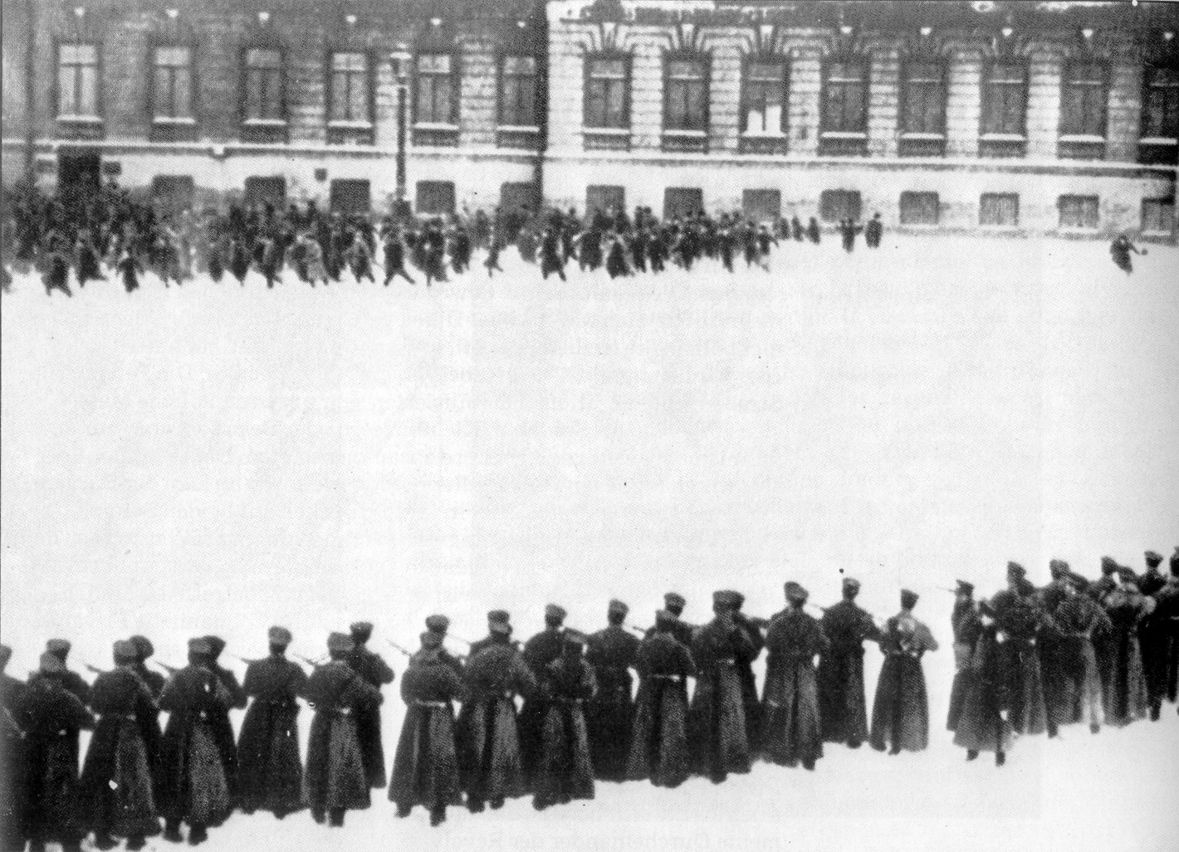
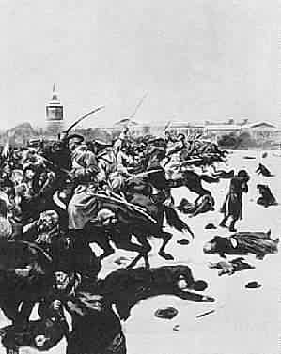
Twentieth Century Rejections of Liberalism
Chapter Five
Rise and Evolution of Communism in Russia / Soviet Union
Read Pages 164 – 165
What specific aspects of economic liberalism were the Russian workers reacting to?
They lack of the following basic human rights…
Freedom of speech, the press, religion and conscience
They wanted…
State-sponsored education, improved working conditions, fairer wages, a reduction in the workday to eight hours and a condemnation of the overtime that the factory owners had forced upon them
Needless to say, things did not go too well…
Write out the issue question for Chapter Five from page 166
Intro to Russian Communism – (Communism & Socialism) - 10 minutes

Slide 2
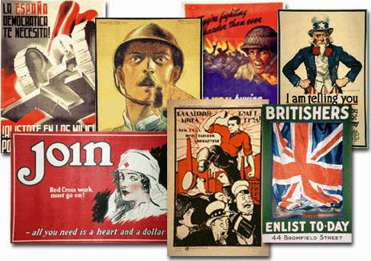
Propaganda
Can anyone give me a definition of propaganda?
Can you think of everyday examples of modern propaganda?
What are some of the propaganda techniques used to persuade us?
How is propaganda used?
Is propaganda always obvious, or can it be subtle?
Can you think of examples of subtle propaganda?
Can you remember a time when a medium of propaganda convinced you to take a particular position on an event, individual or organization?
Review the handout: Some Common Propaganda Techniques

Slide 3
Propaganda
Using the handout: Some Common Propaganda Techniques, complete the activity for each of the propaganda posters to follow:

Slide 4
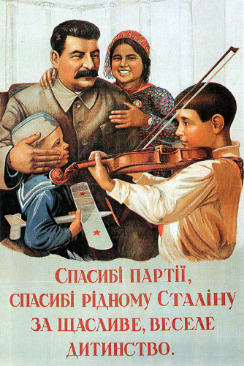
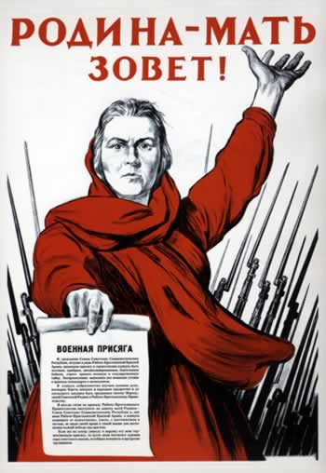
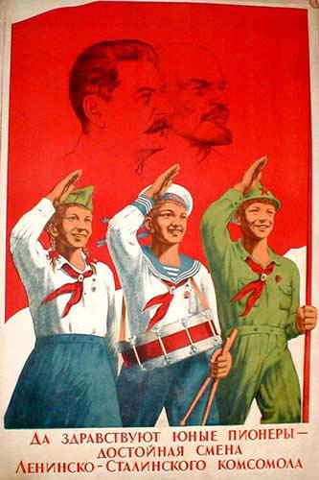
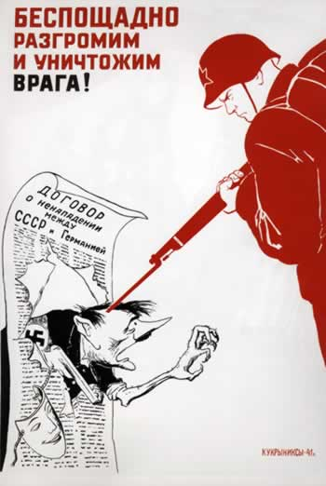

Soviet Propaganda
Thanks to Comrade Stalin
Pioneers!
The Motherland is Calling!
Mercilessly, we humiliate and destroy the enemy!
Build Like You Would Yourself!

Slide 5
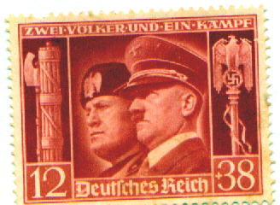
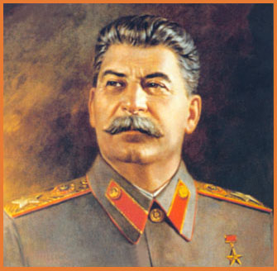
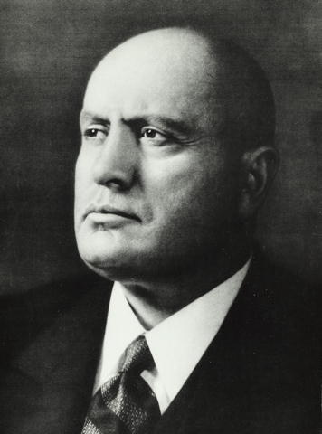
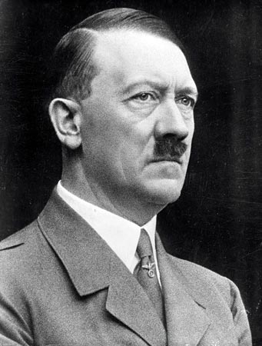
Totalitarian Regimes
"All power tends to corrupt, and absolute power corrupts absolutely".
~ Lord Acton
Write out the following notes…

Slide 6
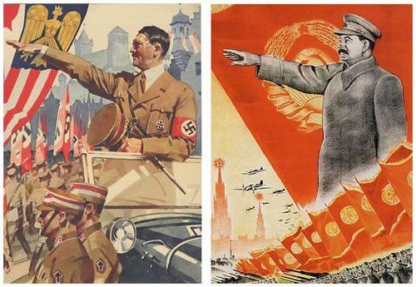
Totalitarianism
Also known as authoritarianism or a dictatorship
Varies in practice – different ideologies (ex. Communism vs. Fascism) will exist but share the same fundamental ideas on how to keep control
Characteristics of Dictatorships
All public decisions are made by the ruling elite
(based on the idea that only the elite can make informed decisions)
Rights and freedoms of individuals and groups are not respected
Political inequality
Absence of political competition (1 party)
Use of force and terror (threat or real) to suppress opposition
(arrest, detain, punish, liquidate)
Individuals are meant to serve the government
Major control by the government over all aspects of society and life

Slide 7
Dictatorships (con’t)
Indoctrination
Use of propaganda, slogans, youth groups, censorship, control of media are widely used
Direction of popular discontent
Build up of hatred against real or imagined enemies (scapegoat) is utilized
Controlled participation
Certain people are allowed to join the elite; fixed elections; token appointments
And there always is an…
Account of the past, an explanation of the present and a vision for the future

Slide 8
The Role of the Citizen in a Dictatorship
Citizens at a young age are permitted to join youth groups
Participation in the military is encouraged in order to become sturdy and disciplined
It is the duty of a citizen to support the leadership
Citizens are permitted to participate in elections as it allows them to feel like they are part of the political process but there won’t be multiple parties or secret ballot
Citizens must provide loyalty and obedience to the leadership

Slide 9
Advantages of Dictatorships
Simpler to run the country
Quick action is possible due to no opposition
Everything can be unified (e.g. education)
Solid economic gains are possible:
High rate of employment
Industrialization
No strikes or lockouts are permitted

Slide 10
Disadvantages of Dictatorships
Individual freedoms denied
Governments assume they have the final knowledge and
authority on all matters
Criticism and alternative ways of thinking are not allowed
Citizens must act entirely according to the government’s wishes
Fear – constant state of tension
Death may be the consequence of not obeying the government
Horrible events have occurred (e.g. Holocaust)

Slide 11
‘GREAT MAN THEORY’
What do you think this theory is referring to?
German philosopher – Friedrich Nietzsche – envisioned a future society run by a ‘superman’ who set his own morality.
He believed that, while democracy created equality for all, it also bred conditions in which the spirits of superior people were crushed in the interests of the mediocre
Examples to support theory-
Napoleon & Napoleonic Code
His ideas influenced Hitler

Slide 12

The Nature of Totalitarianism
Societal Conditions That Led to the Rise of Totalitarianism in the 20th Century
Read the introduction of page 167
After reading this section (167-168), in your notes, define both Radical and Reactionary
And…
Write out which values and beliefs of liberalism were rejected by both
Soviet Russia and Nazi Germany

Slide 13


Group Discussion Exercise Chapter 5
Instructions:
The class will be split into equal groups, these groups remain the same throughout these types of discussions
The class will be given a question to respond to.
Students must discuss with each other and come up with a response that is satisfactory for the whole group. Record on the chart paper provided.
When each group completes one question, they pass to next group
You will find as more groups respond, it becomes challenging to present new ideas
After all groups complete, return paper to original group.
Home group provide synopsis for class.
React to this statement:
“Democracy is slow in crisis situations – politicians discuss matters at length in parliament, various groups are consulted, any action taken is slow, and often comes too late or is too weak to make any significant change or improvement.”
How might this idea allow for the rise of a totalitarian leader?
Identify one change that democracies could do to reduce the problem.
(Each group must suggest a different change)

Slide 14

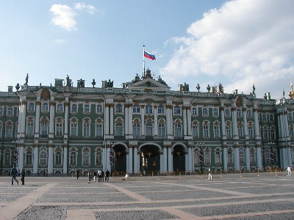
20th Century Rejections of Liberalism
Rise and Evolution of Communism in Russia / Soviet Union
Bloody Sunday
In January of 1905..
Protest demonstrators marched to the Winter Palace to present a petition to Tsar Nicholas II
Petition asked for freedom of speech, the press, religion, state-sponsored education, better working conditions
However, the Tsar was in no condition to meet the demands of the workers due to the depression sweeping Russia.
Read pages 168 to the top of page 172
Take the following notes…

Slide 15

Bloody Sunday
The demonstrators brought along their families in hope of seeing their Tsar and delivering the petition to him as they believed he would take into account their miseries and attempt to sort their problems for them.
The army was near the palace, released warning shots, and then fired directly into the crowds to disperse them.
Although the Tsar had not been present at the Winter Palace at this time, he received the blame for these deaths, resulting in a surge of bitterness towards himself and his autocratic rule from the Russian people.
Russian Revolution(1)
(9:00)

Slide 16

Russian Revolutions of 1917
Two revolutions occurred in Russia in 1917.
The first revolution, in February, overthrew the Russian monarchy.
The second revolution, in October, created the world’s first Communist state.

Slide 17
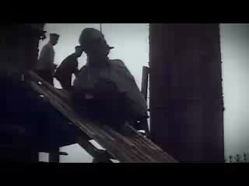
Russian Revolution of February, 1917
After the overthrow of the Tsar, a coalition of conservative, liberal, and moderate socialist politicians declared itself the Provisional Government, on February 27, 1917.
However, the Provisional Government proved unable to resolve the problems that had led to the February Revolution.
Especially the problem of ending Russia’s involvement in World War I.
Russian Revolution (2)
(9:00)

Slide 18
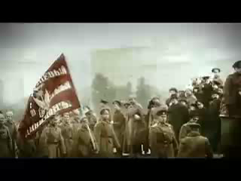
Russian Revolution of October, 1917
The second revolution (October Revolution) was led by a group of revolutionary socialists called Bolsheviks.
It swept aside the Provisional Government with the goal of giving “all power to the soviets.”
The Bolsheviks hoped that their revolution would result in more fundamental changes in Russian society and also inspire the working people of other countries to carry out socialist revolutions.
Russian Revolution (3)
(9:00)

Slide 19
Group Discussion Exercise Chapter 5
Instructions:
The class will be split into equal groups, these groups remain the same throughout these types of discussions
The class will be given a question to respond to.
Students must discuss with each other and come up with a response that is satisfactory for the whole group. Record on the chart paper provided.
When each group completes one question, they pass to next group
You will find as more groups respond, it becomes challenging to present new ideas
After all groups complete, return paper to original group.
Home group provide synopsis for class.
Re-examine the characteristics of totalitarianism pages 167-168.
Identify one characteristic that you believe to be the most or least effective and explain why.
Suggest a contemporary example of the characteristic you selected.
(Each group select different characteristic)

Slide 20

Let's Review
What did classical liberalism focus on?
Classical liberalism focused on allowing citizens the freedom to exercise their rights in their economic, political and social live to the best of their ability.
Classical liberalism is typically considered to encourage the principles of individual rights, private property, economic freedom and the rule of law
How did classical liberalism evolve into modern liberalism?
Modern liberalism evolved to incorporate welfare capitalism, certain aspects of the welfare state and the extension of equality rights – labour standards and unions, universal suffrage, feminism and the protection of human rights
What are some of the downsides (real or perceived) to modern liberalism?
Read pages 179 – through to the top of page 181
Write out the following notes…

Slide 21
War Communism (1918)
An attempt to rapidly transform Russia into a communist society occurred during the Russian Civil War
(The Red Army versus the White Army)
All industry was nationalized and strict centralized management was introduced
State monopoly on foreign trade was introduced
Discipline for workers was strict, and strikers could be shot.
Food and most commodities were rationed and distributed in a centralized way.
Private enterprise (business) became illegal
Military-like control of railroads was introduced

Slide 22
War Communism (1918)
Because all of these measures were implemented in a time of civil war, they were far less coordinated in practice than they might appear.
Large areas of Russia were outside the Bolsheviks' control, and poor communications meant that even those regions loyal to the Bolshevik government often had to act on their own, lacking any orders or central coordination from Moscow.
By 1921, it was clear that war communism was not working as agricultural and industrial production had dropped

Slide 23

New Economic Policy (1921)
Brought back some aspects of capitalism, on a temporary basis, to stimulate the economy (to prevent it from collapsing).
Peasants were allowed to own their own land and decide what they were going to produce.
Small companies allowed to sell consumer goods.
State retained control of banking, large industry, transportation, and foreign trade.
Lenin (4)
(9:00)

Slide 24
Stalin
Read pages 181 – 183
Write out the following notes…
The Five-Year Plans and Collectivism
Collectivism is the changing of agriculture from small, individual farms into one big system of large collective farms. The collective farms in Russia were established by Joseph Stalin in his First Five-Year Plan. This plan, approved in April-May 1929, formed five million peasant farms into one big farm, a kolkhoz, in order to yield enough grain to feed the workers involved in Stalin’s massive industrialization projects.
Stalin was unfriendly toward the kulaks, the wealthier peasants who opposed collectivization. As a result, five million kulaks that left were never seen again. These people were sent to Siberia to live in worse conditions than they already were living in. The rest of the peasants were re-collectivized with force.
From 1929 to 1930, the number of peasants working on collective farms increased from 5 million to 30 million

Slide 25

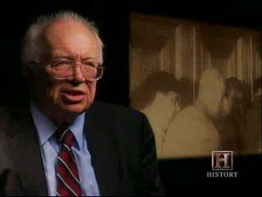
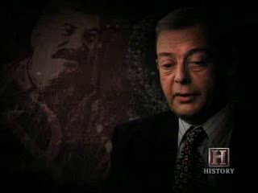
Stalin
Continue with the following notes…
The Five-Year Plans and Collectivism
The re-collectivization led to the famine.
As a weapon to try to eliminate Ukrainian nationalism and identity, Stalin used famine against the Ukraine
More than 7 million people died in this genocide, known today as the Holodomor
Stalin Eliminates Political Opposition
Make your own summary of this section
Refer to the handout – Stalin Politics of Terror – if necessary
When finished, read page 184 and complete the Questions For Reflection
Stalin(1)
(9:00)
Stalin(2)
(9:00)
Stalin(3)
(9:00)

Slide 26
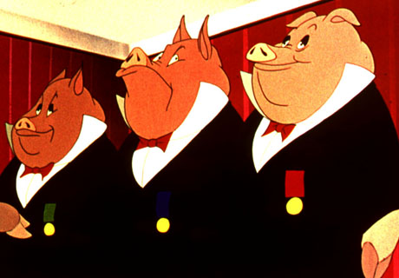

Animal Farm
Review the handout: Film Study: Animal Farm
91 Minutes

Slide 27
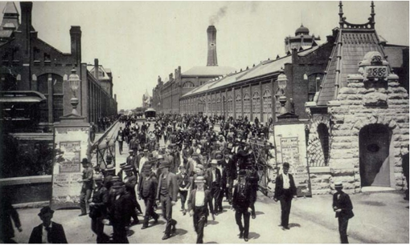
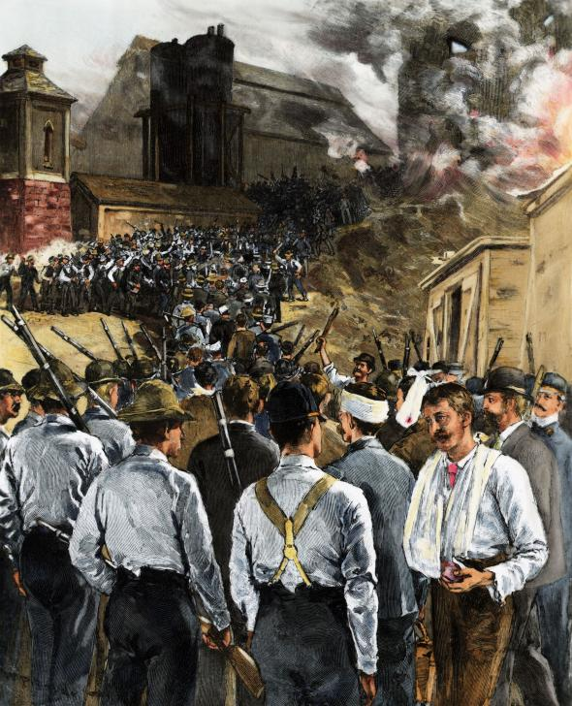
The Evolution of Modern Liberalism
Chapter Six
Read page 196 – to the top of page 197
How did the ruthless business practices of classical liberalism lead to the evolution of modern liberalism?
Workers suffered greatly at the hands of ruthless factory owners and industrialists.
Strikes and the creation of unions were some of the responses that led to the evolution of modern liberalism, an ideology that had more regard for the rights of the worker and working conditions, and more equality in society
Homestead Strike of 1882

Slide 28

The Evolution of Modern Liberalism
Chapter Six
Economics and the Principles of Liberalism in North America
Read the rest of page 197
What is the focus of chapter six?
Write out a summary statement
And…
Write out the issue question for Chapter Six

Slide 29
Economics and the Principles of Liberalism in North America
In what ways did economies in the first half of the 20th century reflect the principles of liberalism?
In order to consider the above question, review pages 198 – 212
Complete the handout:
How did the economies of the first half of the 20th century reflect the principles of liberalism?
Review

Slide 30
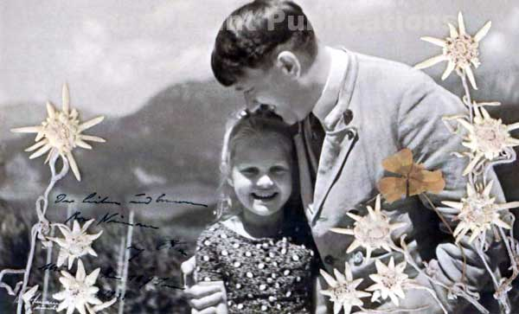
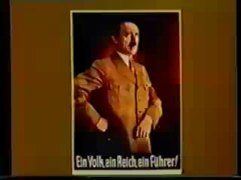
The Rise of Totalitarianism in Germany
What do you know about the events that lead to Hitler's rise to power in Germany?
Hitler’s Rise To Power
(9:00)
Read Pages 172 – 175, 177
Complete the question with Figure 5-9 – Page 174
With a partner, complete all the questions on page 176
Be prepared to take the following notes:

Slide 31
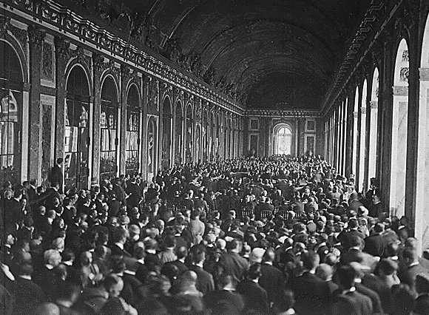
The End of World War I
Treaties
After the war was over, the Allied powers had each of the Central Powers sign individual treaties.
  Treaty of Versailles – Germany
  Treaty of St. Germain-en-Laye – Austria
  Treaty of Neuilly – Bulgaria
  Treaty of Trianon – Hungary
  Treaty of Sevres – Ottoman Empire

Slide 32
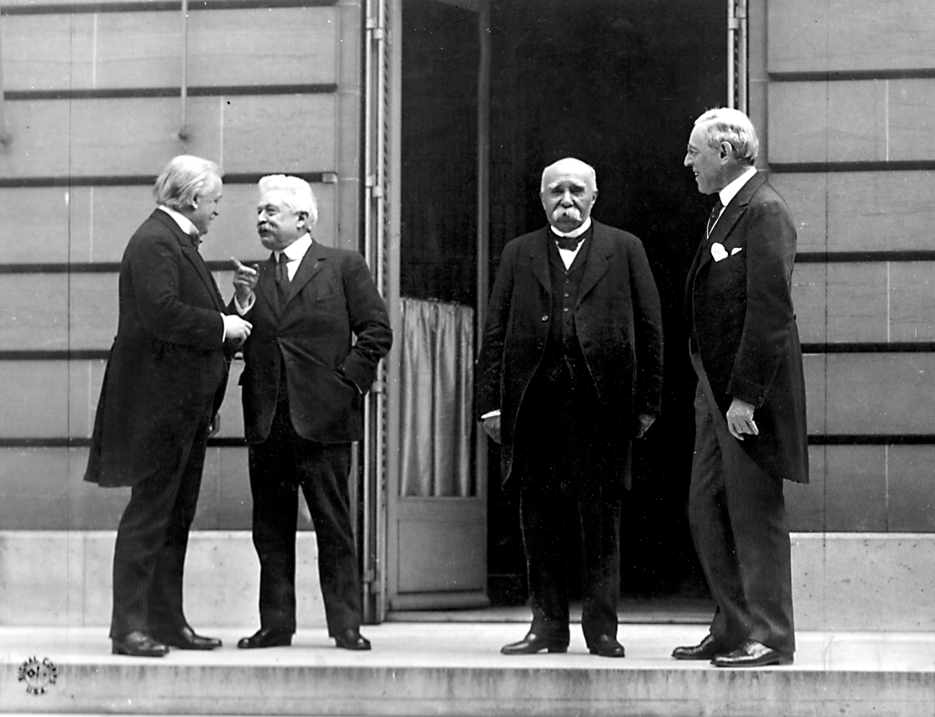
Treaty of Versailles
This was the peace treaty which officially ended World War I.
After six months of negotiations at the Paris Peace Conference,
the Treaty of Versailles was signed as a follow-up to the armistice
of November 11, 1918
The "Big Four” that negotiated the treaty consisted of Prime
Minister David Lloyd George of the United Kingdom, President
Georges Clemenceau of France, President Woodrow Wilson of
the U.S.A., and the Prime Minister of Italy, Vittorio Orlando
It was difficult to decide on a common position because their
aims conflicted with one another.

Slide 33
Treaty of Versailles
The result??
A compromise that nobody liked.
Germany, Austria, Hungary and Russia were excluded from
the negotiations.
Due to differences of opinion, Italy left, and the final conditions
were determined by the "Big Three": United States, France
and Great Britain.
Because Germany was not allowed to take part in the
negotiations, the German government issued a protest to what it
considered to be unfair demands

Slide 34
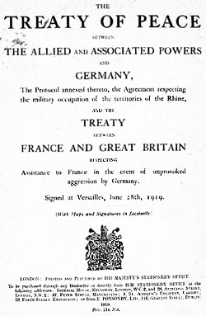
Reaction to the Treaty
The French felt they had been slighted, Britain felt that the
Treaty was too harsh, and the USA saw it as Europe’s problem,
and that overall, the Treaty was too harsh.
Germany signed the Versailles Treaty under protest.
The USA Congress refused to ratify the treaty.
Many people in France and Britain were angry that there was no trial of the Kaiser or the other war leaders.

Slide 35
Results of the Treaty
The Treaty signaled the beginning of a period of isolation for Germany.
  Germany was an outcast in international politics and was feared and distrusted by the Allies.
Controversial even today, it is often argued that the punitive terms of the treaty supported the rise of the Nazis led to the outbreak of World War II.

Slide 36
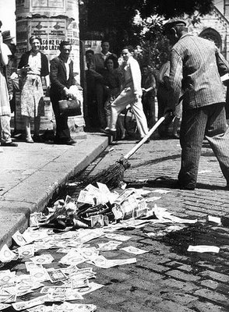
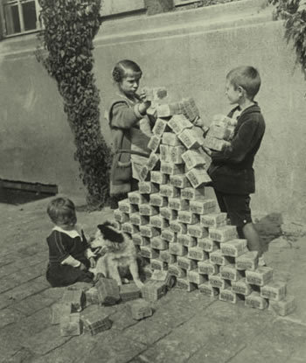
Hyperinflation
Results of the Treaty
After WWI, the German economy was in ruins
They were unable to pay reparations to the Allies
France and Belgium invaded the Ruhr (industrial heartland of Germany) to get the reparations they were owed

Slide 37
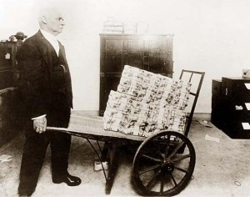
Hyperinflation
Workers went on strike, industrial production further declined
The German mark became worthless
The middle class lost a lot of their savings as it was now worthless
People had to get paid daily and had to haul money around in wheelbarrows

Slide 38
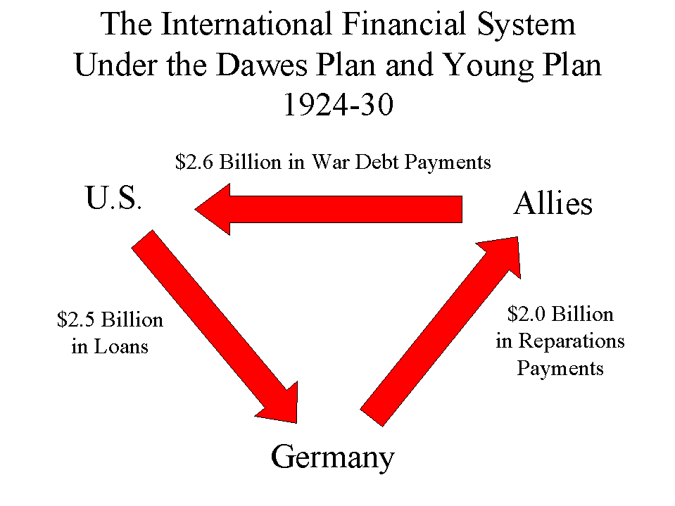
Dawes Plan
Introduced by American banks that lent money to Germany’s
Government
Slowed the pace of Germany’s reparation plan
Allowed Germany’s economy to recover
However, this mean that Germany had a very large debt
(that would prove disastrous with the 1929 stock market crash)

Slide 39
Group Discussion Exercise Chapter 5
Instructions:
The class will be split into equal groups, these groups remain the same throughout these types of discussions
The class will be given a question to respond to.
Students must discuss with each other and come up with a response that is satisfactory for the whole group. Record on the chart paper provided.
When each group completes one question, they pass to next group
You will find as more groups respond, it becomes challenging to present new ideas
After all groups complete, return paper to original group.
Home group provide synopsis for class.
React to this statement:
Select one ‘point’ from the Nazi Party Program (page 176).
Consider the reaction from the German population.
Would this ‘point’ appeal, concern or shock them? Why? What is your reaction?
(Each group must select a different article to examine)

Slide 40
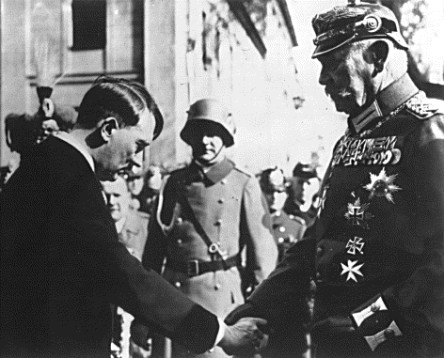
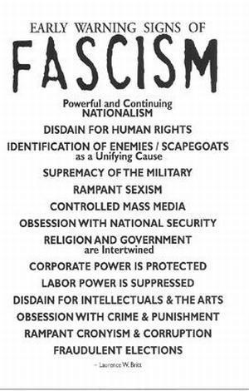
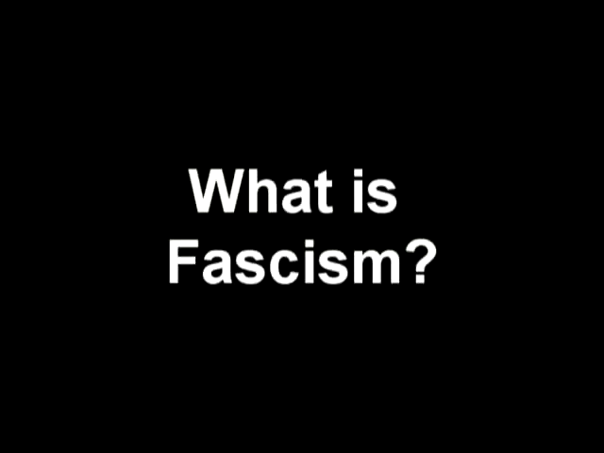
What is Fascism?
Fascism in Europe
Propaganda?
5 minutes
Read Pages 186 – 192
Be prepared to take the following notes:

Slide 41
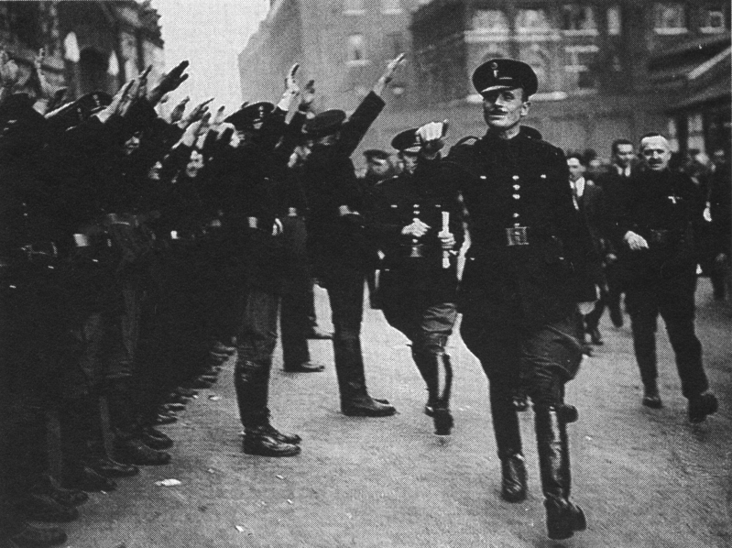
Fascism
An authoritarian nationalist political ideology that is
Reactionary
Fascists believe that certain people are superior to others
Are willing to remove the perceived ‘weak links’ in society
Advocate a single party state
Fascist governments forbid and suppress openness and
opposition to the government
Don’t believe in class struggle (communism) but rather a race
struggle
Fascism is heavily nationalistic

Slide 42
Fascism
Common examples of fascism are Mussolini (Italy)
during the 1930s as well as Hitler (Germany) who
refines fascism into an ideology uniquely his
(Nazism)

Slide 43
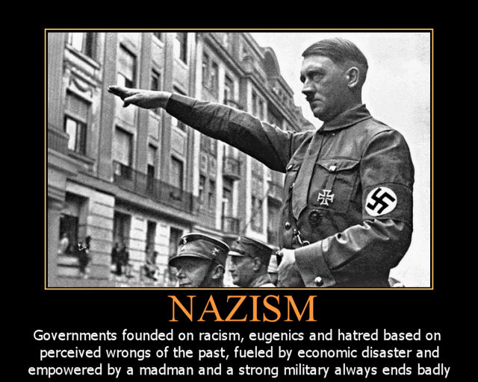
Fascism in Germany (Nazism)
Hitler’s desire was to rebuild Germany into an empire that would reclaim and increase its international power and influence
Believed that it was the liberals, Jews, and Marxists who had undermined the German nation
Nazism has a belief in the superiority of the Aryan race
During Hitler’s time, the Nazis had a strong, centralized government under the Fuhrer
Claimed to defend Germany and the German people against Communism and so-called Jewish subversion
Ultimately, the Nazis sought to create a largely homogeneous ethnic state

Slide 44
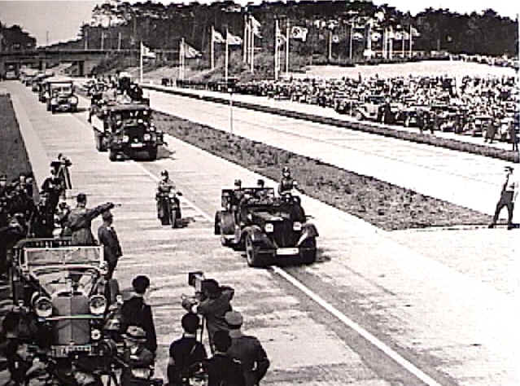
Nazism and the German Economy
While individual rights suffered, the German economy
benefitted
The number of unemployed Germans decreased dramatically under the Nazi party
Ban on trade unions and strikes
Created massive public projects to provide employment
Eg. The Autobahn (highways)

Slide 45
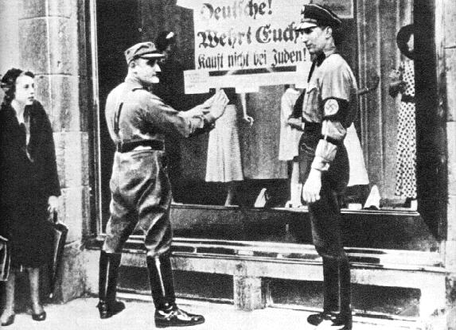
Persecution of Minorities
Nazi ideology claimed that Germans formed a superior Aryan race that was ‘pure’
Used the Jewish people as a target for the German population to focus their frustrations
Claimed that the Jews were the cause of the Treaty Versailles, the exploitation of the working classes, and all other problems
Hitler claimed that Jews (along with Gypsies and those with
disabilities) were diluting the purity of the German race and needed to be removed

Slide 46
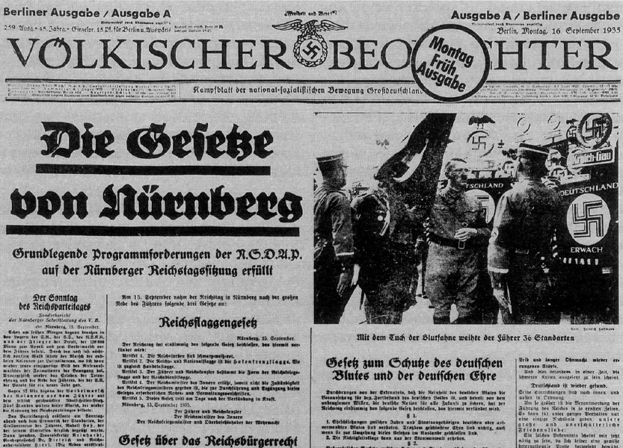
Nuremberg Laws (1935)
Passed with the intent of defining who the Jewish people were and how
to ensure the preservation of the Aryan race
Legal discrimination against Jews had come into being before the
Nuremberg Laws and steadily grew as time went on
For discrimination to be effective, it was essential to have a clear
definition of who was or was not a Jew. This was one important
function of the Nuremberg Laws and the numerous supplementary
decrees that were proclaimed to further them.
People defined as Jews could then be barred from employment as
lawyers, doctors or journalists.

Slide 47
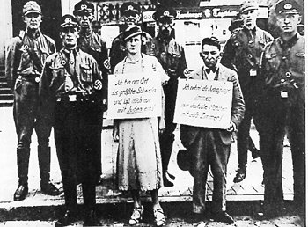
Nuremberg Laws (1935)
Jews were prohibited from using state hospitals and could not be educated
by the state past the age of 14.
Public parks, libraries and beaches were closed to Jews.
War memorials were to have Jewish names removed.
The lottery could not award winnings to Jews
Passports were required to have a large "J" stamped on them and could be
used to leave Germany - but not to return.
From September 1941 all Jewish people living within the Nazi empire,
including Germany, were required to wear a yellow badge, which had
been required in Poland beginning in 1939.

Slide 48
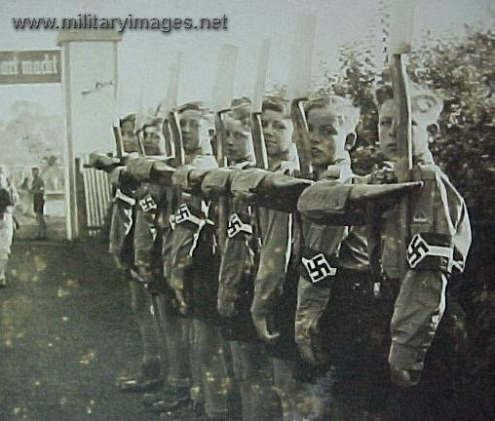

Recruiting Youth
Needed to use youth in order to ensure a 1000 year dynasty
Encouraged to belong to special organizations that promoted loyalty
to Nazis
Hitler Youth
10 minutes

Slide 49
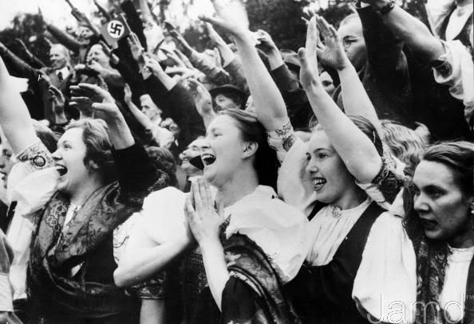
Nazism Collides with Feminism
Read page 193-194
Hitler vehemently disagreed with feminist ideas
Believed that the German woman’s world consisted of “her husband, her family, her children, and her home”
Complete questions 1 and 3 on page 194

Slide 50


One of the greatest crimes against humanity was perpetrated in just over an hour
Conspiracy:
A secret agreement between two or more people to perform an unlawful act
Conspiracy:
A plot to carry out some harmful or illegal act
Film Study: Conspiracy
95 minutes
Conspiracy:
A group of conspirators banded together to achieve some harmful or illegal purpose
Conspiracy:
An agreement to perform together an illegal, wrongful, or subversive act.
Handout

Slide 51

"Beneath this mask there is more than flesh... Beneath this mask there is an idea… and ideas are bulletproof."
“Strength through unity. Unity through faith.”
Film Study: V For Vendetta
132 minutes
Remember, remember the fifth of November
Gunpowder, treason and plot.
I see no reason why gunpowder, treason
Should ever be forgot...
“People should not be afraid of their governments. Governments should be afraid of their people.”
Handout

Slide 52
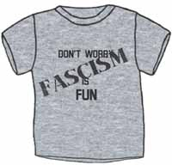
Is Fascism Fun?
The Fascist Party
The perfect solution to the busy professional in this day and age who has no time to waste on the 'democratic process’!
3:30 minutes

Slide 53
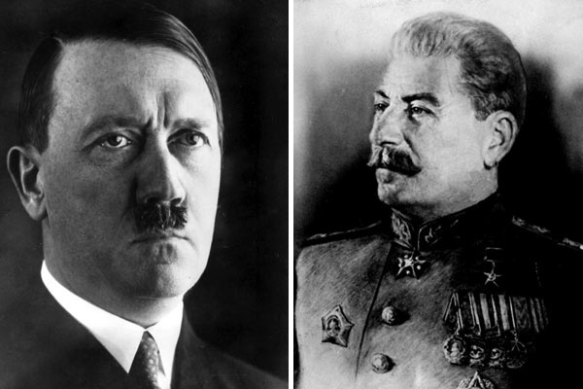
Soviet Union and Nazi Germany:
Putting it Altogether
As review, complete the following with a partner:
Complete the table as described on page 167
Complete questions 1a, 1b and 2b (Page 177)
Complete questions 1a, 1b, 2a, 2b and 3 (Page 194)

Slide 54
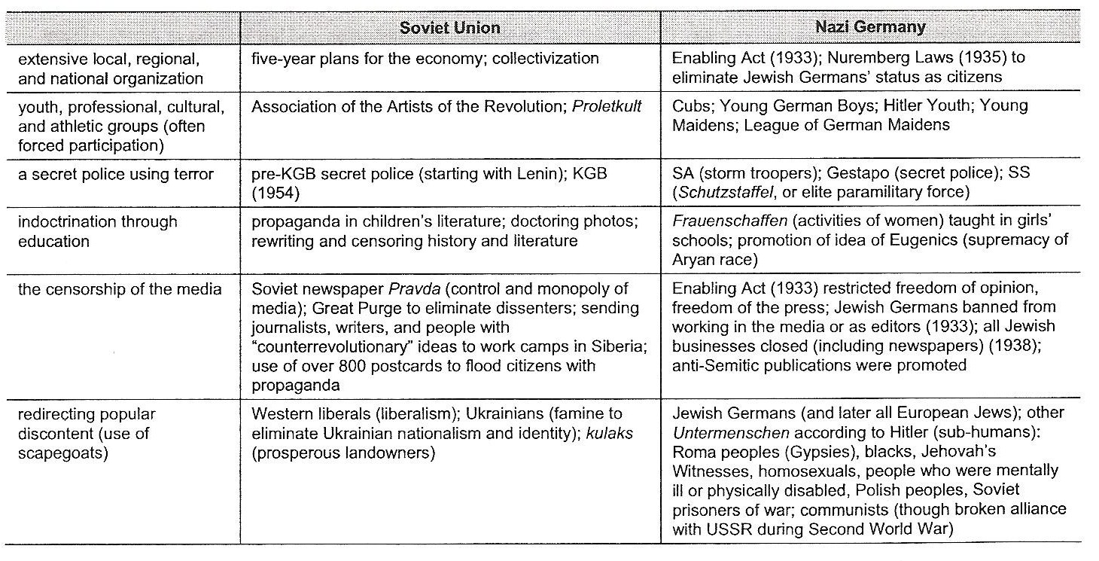
Soviet Union and Nazi Germany:
Putting it Altogether
Totalitarian methods used to reject Liberalism as described on page 167

Slide 55
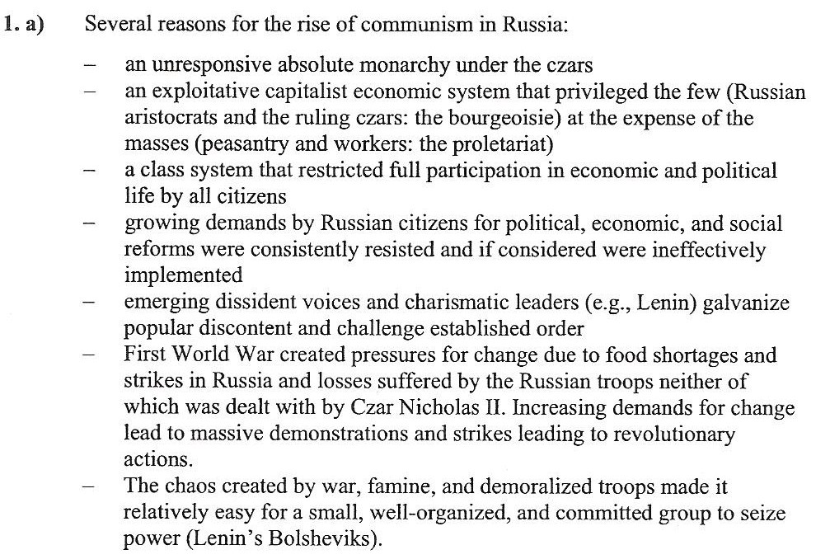
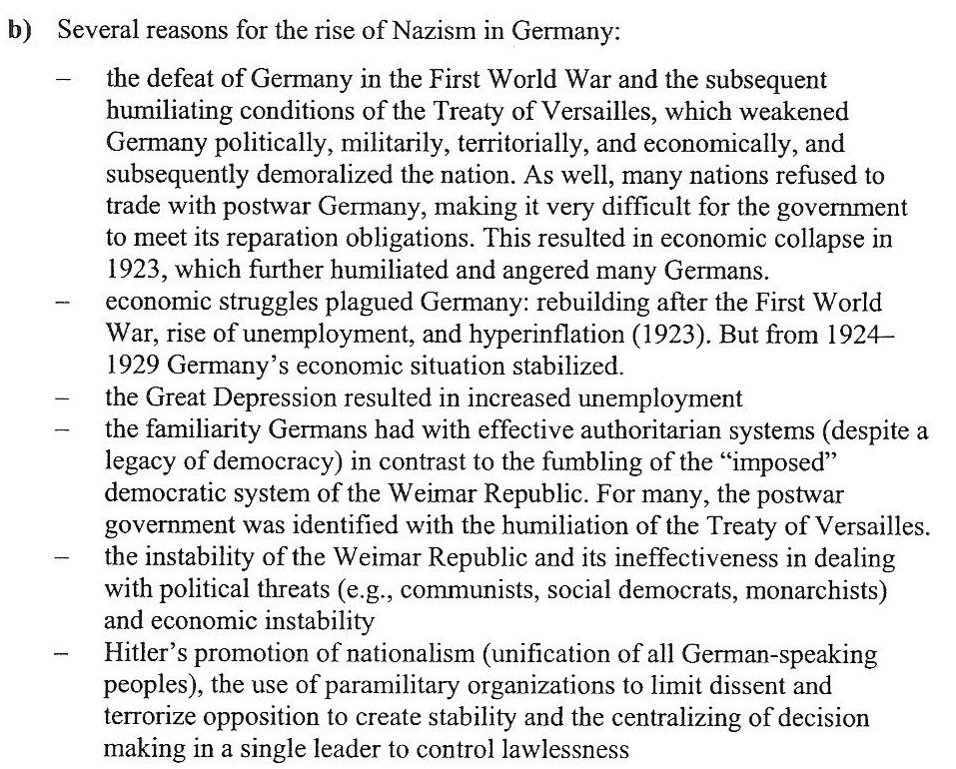
Soviet Union and Nazi Germany:
Putting it Altogether
Page 177
Questions 1(a) & 1(b)
Question 2(b)

Slide 56
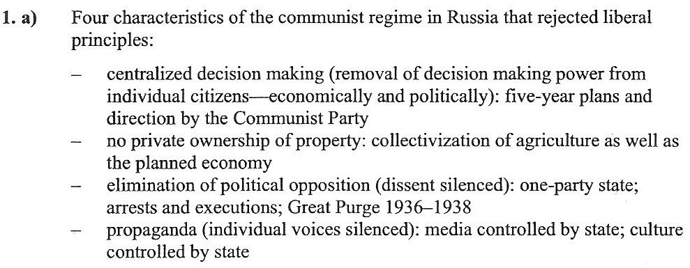
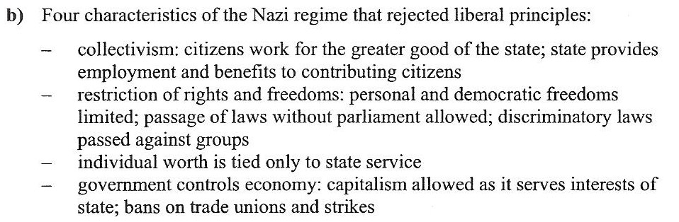
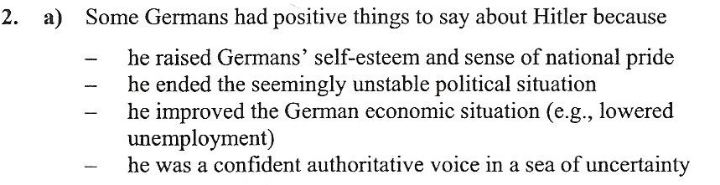
Soviet Union and Nazi Germany:
Putting it Altogether
Page 194
Questions 1(a) & 1(b)
Questions 2(a) & 2(b)

Slide 57
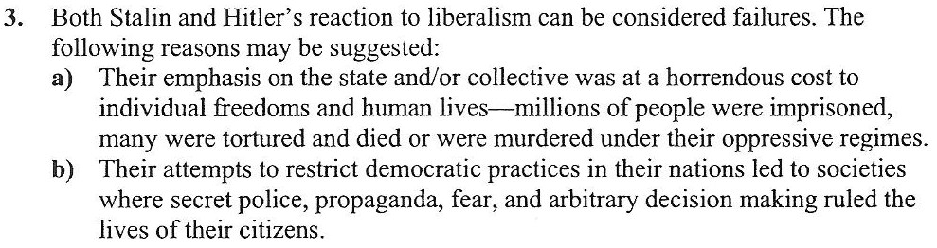
Soviet Union and Nazi Germany:
Putting it Altogether
Page 194
Question 3

Slide 58

Chapter’s 5 - 6* Exam
Consists of:
48 M.C. Questions
(*Only up to page 212 of chapter six)

Slide 59

Position Paper

Slide 60
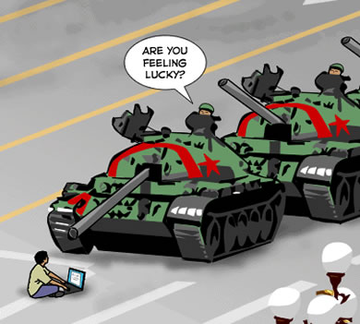
censorship
the act of restricting freedom of expression or freedom of access
to ideas or works, usually by
governments, and usually to protect
the perceived common good, may
be related to speech, writings, works
of art, religious practices or military
matters.

Slide 61

collectivization
an economic policy where all land is taken away from private owners and combined in large collectively worked farms.

Slide 62

a system of society with property vested in the community and each member working for the common benefit according to his or her capacity and receiving according to his or her needs.
communism

Slide 63

dissent
the political act of disagreeing,
the right to disagree. Sometimes
dissent takes the form of popularly
organized opposition to a tradition
or an official policy or statute.

Slide 64

fascism
an extreme, right-wing, anti-democratic, anti-communist, nationalist movement which lead to totalitarian forms of governments in Germany and Italy from the 1920’s to the 1940’s.

Slide 65

reactionary
tending to oppose change. A reactionary change in a political regime often idealizes the past and accepts economic inequality.

Slide 66

totalitarianism
a government system that seeks complete control over the public and private lives of its citizens.

Slide 67

consumerism
consumer spending a preoccupation with consumer goods and their acquisition:
a set of values focused on the acquisition and display of things in order to denote status.

Slide 68

Income disparity
difference in earnings between the rich and the poor.

Slide 69

inflation
an increase in the general price level of products, the cost of labour and interest rates

Slide 70

the exclusive ownership or control of trade in a particular good or service.
monopoly

Slide 71

Social programs
programs that affect human welfare in a society. Social programs are intended to benefit citizens in areas such as education, health and income support. Supporters' base their support both on humanitarian principles and economic principles.

Slide 72

Trickle-down economics
government economic policies that include reduced income and business taxes, reduced regulation (controls on business), and increased government spending on the military, also known supply-side economics. Generally these policies favour industry, assuming that if industry prospers then everyone will prosper as wealth “trickles down” to the ordinary workers and consumers.

Slide 73

Welfare state
a state in which the economy is capitalist, but the government uses policy that directly or indirectly modify the market forces in order to ensure economic stability and a basic standard of living for its citizens, usually through social programs.

