Slide 1
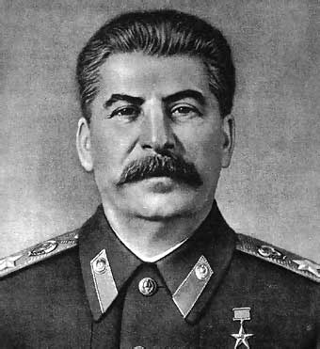
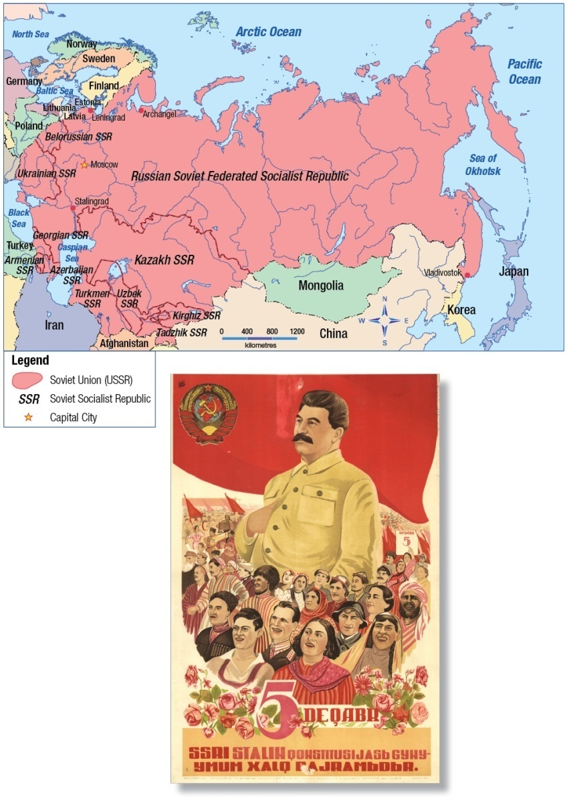
Nationalism and Ultranationalism
After reviewing Figure 6-1 on page 136, consider the following questions:
How would you describe the tone or mood of the poster?
How would you describe the facial expressions of Joseph Stalin and the people around him?
How are colour and other elements of the poster used to create a particular impression?
How does the slogan on the poster reinforce the images?
What impression of this leader does the poster convey?
Why do you think this poster was made?
Read the introduction and complete all of the questions on page 137

Slide 2
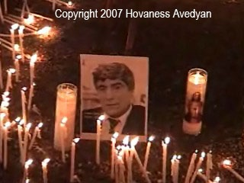

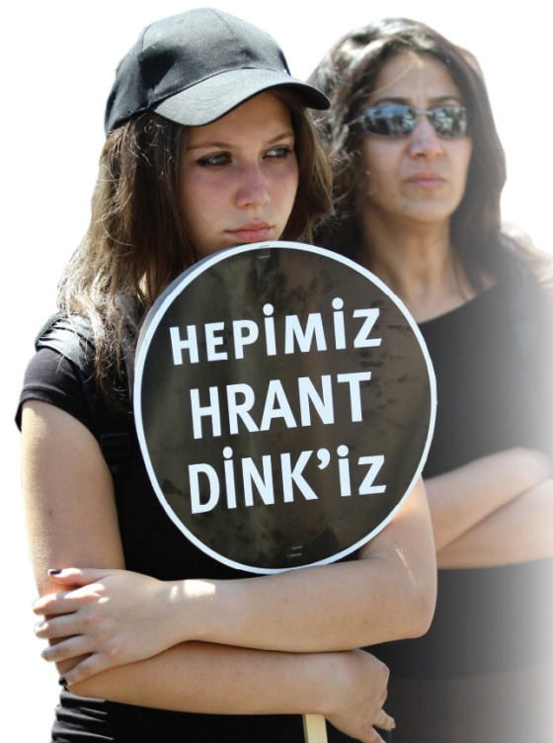
Ultranationalism
An extreme form of nationalism
Where would you draw the line between nationalism and ultranationalism?
Examples?
Ultranationalism
Read page 138
Respond to the Activity and to Figure 6-2

Slide 3
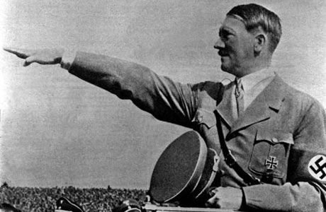
Ultranationalism Under Stalin and Hitler
Create a chart like this and with a partner, read pages 139 – 140 and record examples of Ultranationalism
Remember to review all photographs and margin features
Rank the tactics based on the harm they can do
Do ends justify the means? Why or why not?
Complete the Reflect and Respond on page 140
Review the bulleted information on page 140
Rank the tactics used by propagandists on a scale of 1 to 5
(1 = Very Effective – 5 = Not Very Effective)

Slide 4
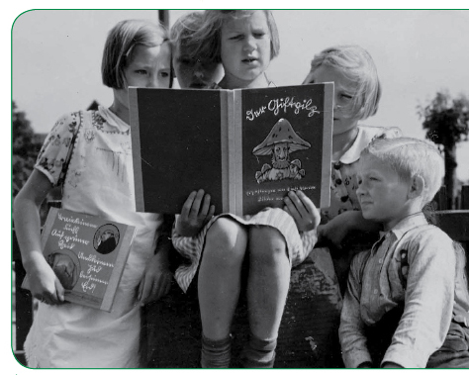
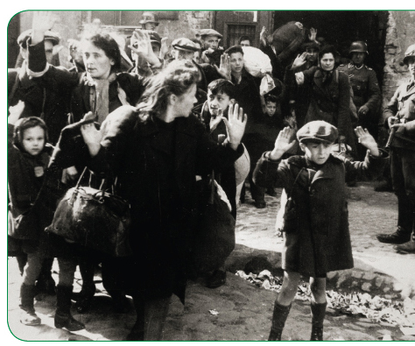
Read the caption to this picture on page 140
Do you think the Nazi tactic of using propaganda on children is acceptable? Why or why not?
Read the caption to this picture on page 140
What do you think is so disturbing about this picture?
What is the connection between these two photographs?

Slide 5
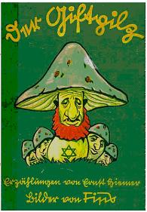
The Poisonous Mushroom
The Poisonous Mushroom was a collection of 17 short stories by the Nazi writer Ernst Hiemer, with pictures by the Nazi artist Fips.
The purpose of the stories was to indoctrinate (brainwash) young German children to despise and hate the Jews. The stories infiltrated the thoughts and beliefs of German children.
By studying them, historians can observe how the Nazis thought, and how they taught their children to think the same way as them.

Slide 6
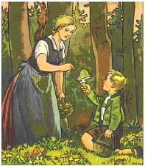
The Poisonous Mushroom
In the first story of the book, a German mother explains to her son how there are good and bad people, just as there are edible and poisonous mushrooms. The Jews, she tells him, are a 'poison' within Germany. 'Just as a single poisonous mushroom can kill a whole family, so a solitary Jew can destroy a whole village, a whole city, even an entire folk.' she warns him.

Slide 7
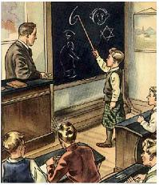
The Poisonous Mushroom
In one story, the teacher - a trusted authority who children naturally believe - teaches the children about Jewish features: 'One can tell a Jew by his nose. The Jewish nose is bent at the tip. It looks like a figure 6.' When he turns round the board, the children read and learn this verse:
From a Jew's face The wicked Devil speaks to us,
The Devil who, in every country, Is known as evil plague.
Would we from the Jew be free, Again be gay and happy,
Then must youth fight with us To get rid of the Jewish Devil.

Slide 8
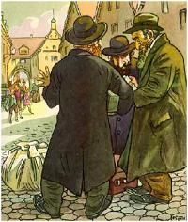
The Poisonous Mushroom
In the text accompanying this picture, the young German boy is portrayed as crying out to his brother in horror: 'Those sinister Jewish noses! Those lousy beards! Those dirty, standing out ears! Those bent legs! Those flat feet! Those stained, fatty clothes! Look how they move their hands about! How they haggle! And those are supposed to be men!

Slide 9
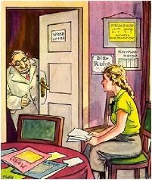
The Poisonous Mushroom
In the frightening story accompanying this picture, a young German girl called Inge is told by her mother to go to a Jewish doctor. Waiting to see him, she remembers the warnings of her League of German Girls leader that she should not go to see a Jewish doctor. When he comes out to her, his face 'is the face of the Devil. In the middle of this devilish face sits an enormous crooked nose. Behind the glasses glare two criminal eyes. And a grin runs across the protruding lips. A grin that wants to say: Now I have you at last, little German girl!'
The girl runs out of the surgery, but - when she tells her mother about her experience - 'her mother lowers her head in shame' and admits that Inge had been right all along. 'I'm finding out that one can learn even from you children', Inge's mother admits.

Slide 10
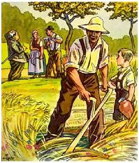
The Poisonous Mushroom
In this story, a Jewish business man cheats a German farmer out of his land. The man's son assures his father: 'Daddy, when I have my own farm, no Jew shall enter my home'.

Slide 11
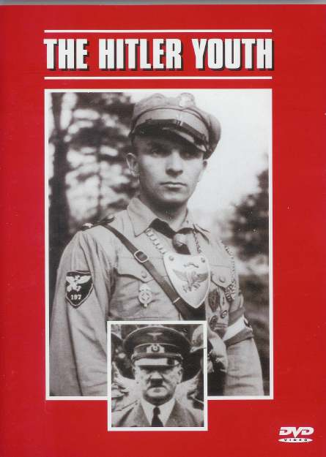

The use of propaganda as an example of Ultranationalism
The Hitler Youth 3 minutes
11:32 – 14:30
Inside the Reich
9 minutes
3:40 – 12:18

Slide 12

And Finally…
Begin a list of terms from this chapter, which include…
Any term/phrase/concept that would be considered important in helping you with your …
Investigative Report
Any suggestions as to what you should include?

Slide 13


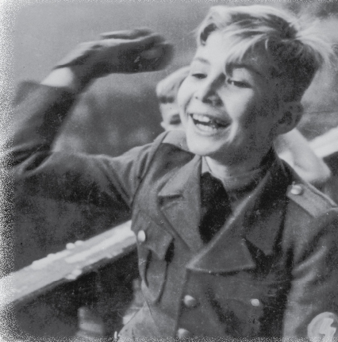
How Does Ultranationalism Develop?
Read all of page 141 and the top part of page 144
As you read, record on your chart other factors that can contribute to the development of ultranationalism and why
Factors That Can Contribute to the Development of Ultranationalism
We will be using this chart for some time so keep it close by
Review figure 6-6 and its caption on page 141
Using the handout, record “Indoctrinating Children” as the first example. Write out why you think this to be true in the second column

Slide 14
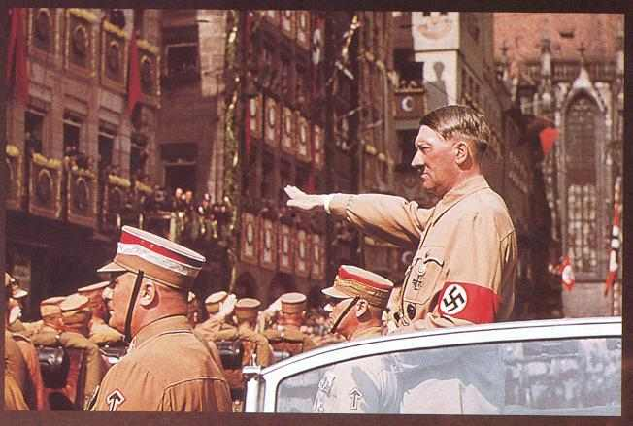
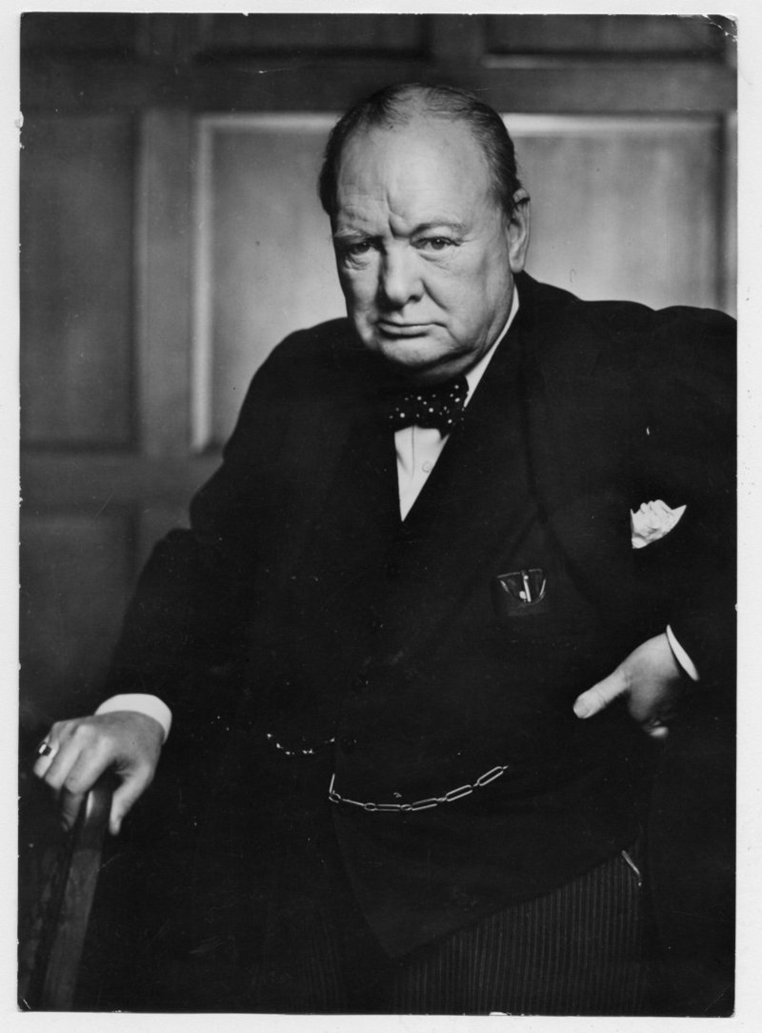
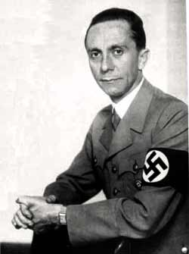
Assessing the Validity of Information
Read the introduction on page 142
Is it possible to know how valid information is from a limited or short reading?
With two copies of the Checklist, and a partner, complete the three steps on page 142
When complete, decide how effective each of the speeches were in achieving their purpose?
Explain why or why not

Slide 15
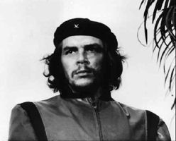
Charismatic Leaders
What does the word Charisma mean?
How can leaders who are charismatic be linked to ultranationalism?
Brainstorm a list of important or famous world leaders
Why have you heard of these leaders?
Many famous (or infamous) leaders are well-known because of what they have accomplished; they are/were good speakers; they were widely reported in the media; or were just a great leader
Take out your chart Factors That Can Contribute to the Development of Ultranationalism
Read page 145, recording information about the role that Hitler, Hirohito and Tojo played in the emergence of ultranationalism in Germany and Japan in the 1920’s and 1930’s

Slide 16

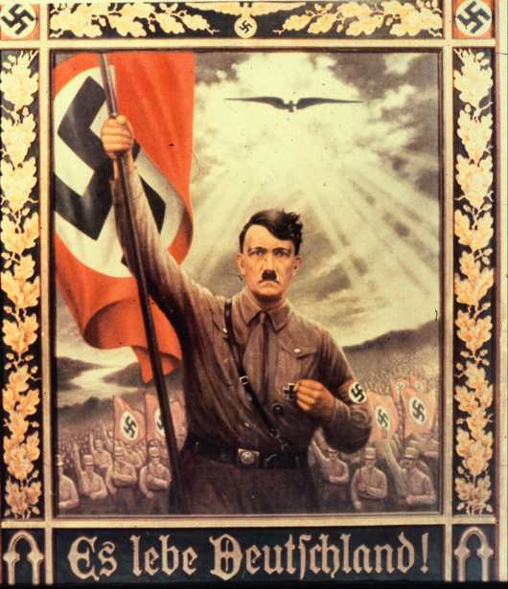
Review this poster.
Is there anything that strikes you as charismatic?
This poster from the mid-1930’s makes a direct Christological comparison. Just as a dove descended on Christ when he was baptized by John the Baptist, so what looks to be an eagle hovers against the light of heaven over an idealized Hitler. The text: "Long live Germany!."
What is significant about this similarity?

Slide 17

Hitler’s charismatic rise to power…
Double Headed Eagle (00:00 – 14:00)

Slide 18

Who has read one of the Harry Potter books?
Did you know, that in 2002, the Durham Board of Education in Ontario received a number of complaints about reading these books in classrooms?
Parents thought that wizardry was inappropriate subject matter and that the books promoted a nature-based religion called Wicca, which is often associated with witchcraft
Do you think that you should be restricted from access to information in school?
Should students be protected from certain ideas?
From some images?
What can happen if people are exposed to controversial materials?
Should governments be able to decide what to ban?
Should school boards or parents?

Slide 19

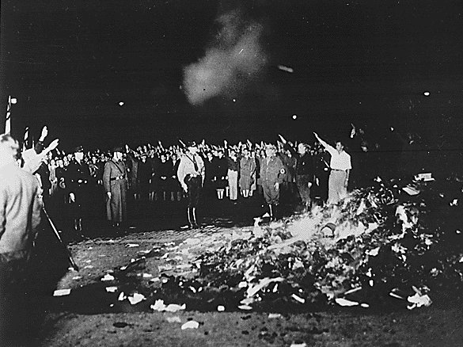
Instilling Ultranationalist Values
Read pages 147 and 148, recording information and completing your chart
Review and complete the Activity and Figure 6-13 on page 147
Complete the Reflect and Respond when you are finished

Slide 20
And Finally…
Continue with your list of terms from this chapter, which include…
Any term/phrase/concept that would be considered important in helping you with your …
Investigative Report
Any suggestions as to what you should include?

Slide 21
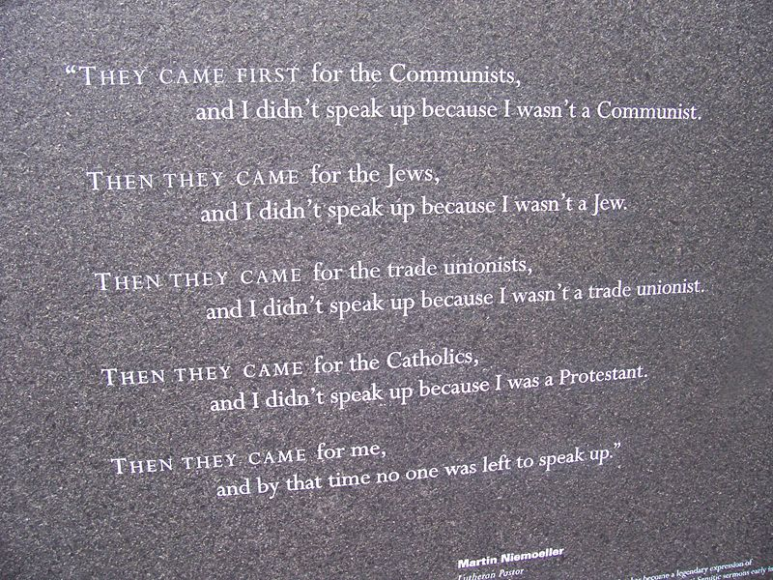
First they came for the communists, and I did not speak out - because I was not a communist;
Then they came for the socialists, and I did not speak out - because I was not a socialist;
Then they came for the trade unionists, and I did not speak out - because I was not a trade unionist;
Then they came for the Jews, and I did not speak out - because I was not a Jew;
Then they came for me - and there was no one left to speak out for me.
Martin Neimoeller, German Lutheran pastor and anti-Nazi activist who spent eight years in a German concentration camp
What is Neimoeller saying about why some people failed to take action?
Does Neimoeller sound critical or not? What makes you say this?
How might people who failed to take action have felt when they became aware of the Holocaust?
What lessons can be learned from this failure to take action? From the Holocaust?

Slide 22

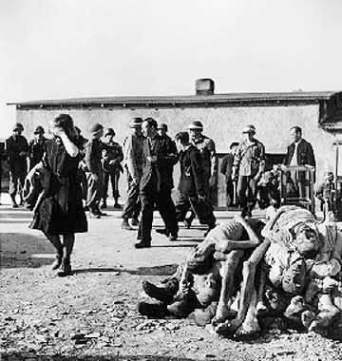
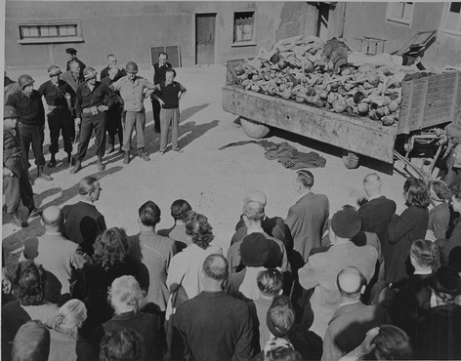
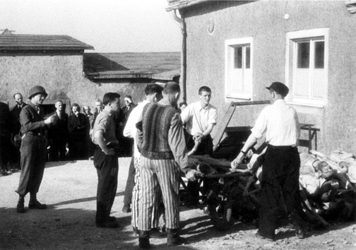
German Civilians Tour Buchenwald Camp
After the Buchenwald concentration camp was liberated in April, 1945, the German civilians from the nearby town of Weimar were brought to see the evidence of Nazi atrocities.
Failure to act is only one response to ultranationalism…
This is only a part of what they saw

Slide 23
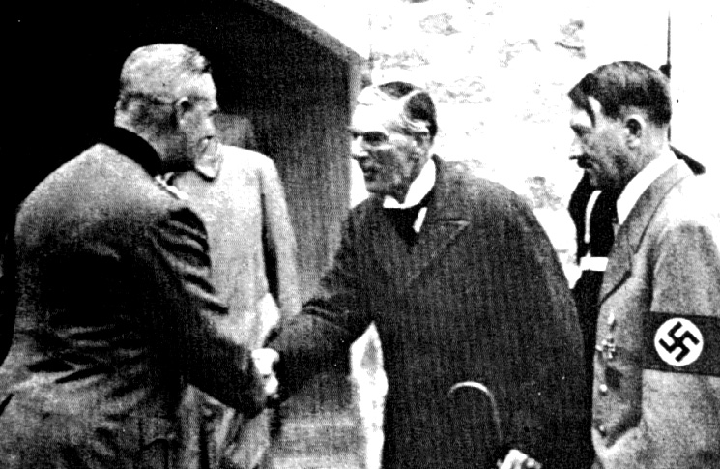
How Have People Responded to Ultranationalism?
Review the handout
The first row of the chart has been completed with information about one response to ultranationalism and refers to the comments in Voices on page 149
Read pages 149 – 150
Use the chart to jot notes about the next two responses to ultranationalism
If time, compare your notes with another student’s notes
We will be using this chart for some time so keep it close by
When finished, complete the Activity on page 149

Slide 24
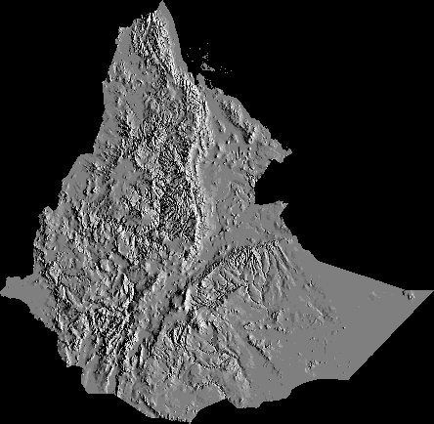
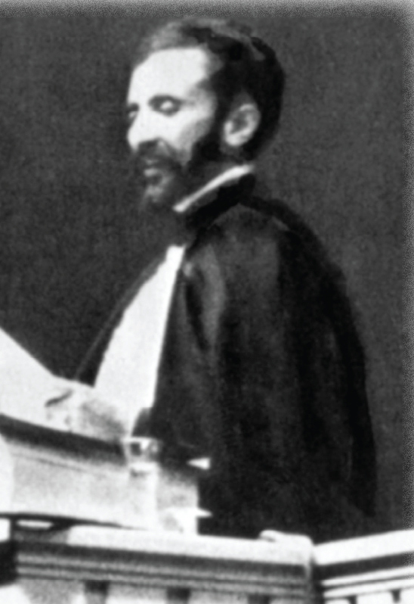
China, Ethiopia and the League of Nations
Now, imagine that you are a teenager living in either Ethiopia or China at this time
Half of you will be teenagers living at this time in China and the other half living in Ethiopia
As a teenager in one of these two countries, you will be writing a letter to a relative living outside your country. You will be explaining your living conditions and your feelings about what is happening.
When you are done, you will be exchanging your letter with another student and writing a brief letter back as the relative.
Review Figure 6-16 on page 150 and its caption
How would you respond to the information Selassie presented

Slide 25

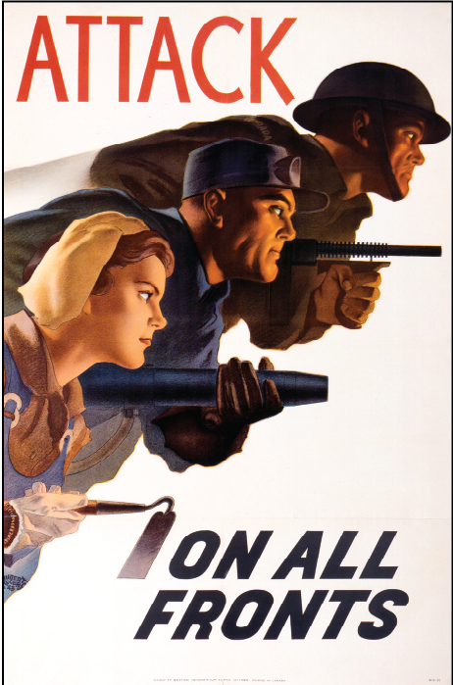
War as a Response to Ultranationalism
Review and discuss the questions for Figure 6-17 on page 151
What is your criteria for this poster to be (or not to be) propaganda?
Read the top half of page 151
Choose a criteria and decide whether or not Prime Minister King’s words were propaganda

Slide 26
Responses To Ultranationalism
Locate your handout: Responses To Ultranationalism
Get into groups of four…
Momentarily, you will be numbered off one through four. Each of you will go to one of the four assigned EXPERT groups and complete a the remaining responses on your handout. You will have approximately 10-15 minutes to do this.
1. Total War (Pages 151)
2. Conscription in Canada (Page 152)
3. Internment in Canada (Pages 152-153)
4. Peacekeeping (Page 154)
When finished, return to your original group of four and share your EXPERTISE with your other three group members. They will do the same for you. When you are done, your chart will be complete
Upon completion, rank the responses to ultranationalism on a scale of 1 to 5 (1 = least effective 5 = most effective)

Slide 27
And Finally…
Continue with your list of terms from this chapter, which include…
Any term/phrase/concept that would be considered important in helping you with your …
Investigative Report
Any suggestions as to what you should include?

Slide 28
Think About Your Challenge
Review the bottom of page 157
Did you complete the work from page 135
Have you decided what nationalist movement you want to research?
Have you started any of your research?
Have you started tracking down sources?
What format will your report take?

Slide 29
Chapter Five - Six Quiz
Your quiz is made up of 12 multiple choice questions, and one written response question
Get to know the terms/phrases/people/events you listed as important for these chapters
Each of the multiple choice questions are worth two marks each and the written response is worth 20 marks
Total: /44

