Slide 1
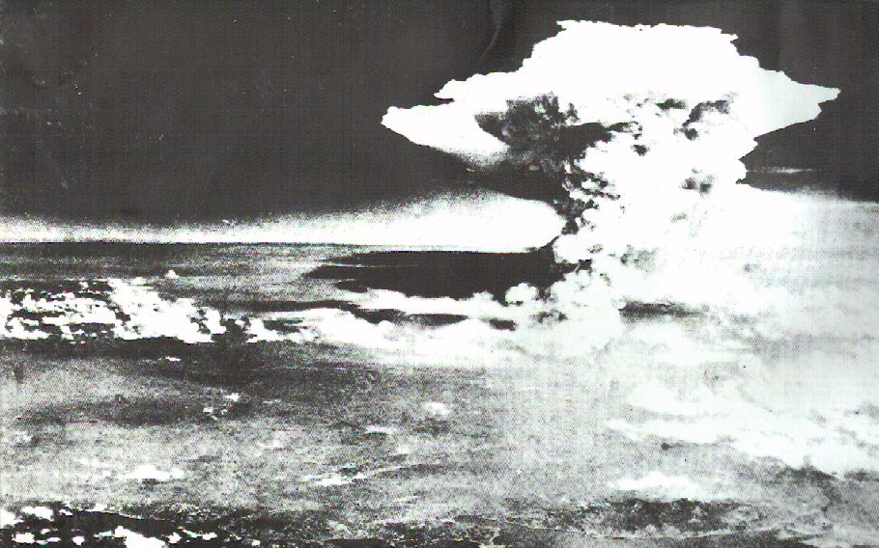
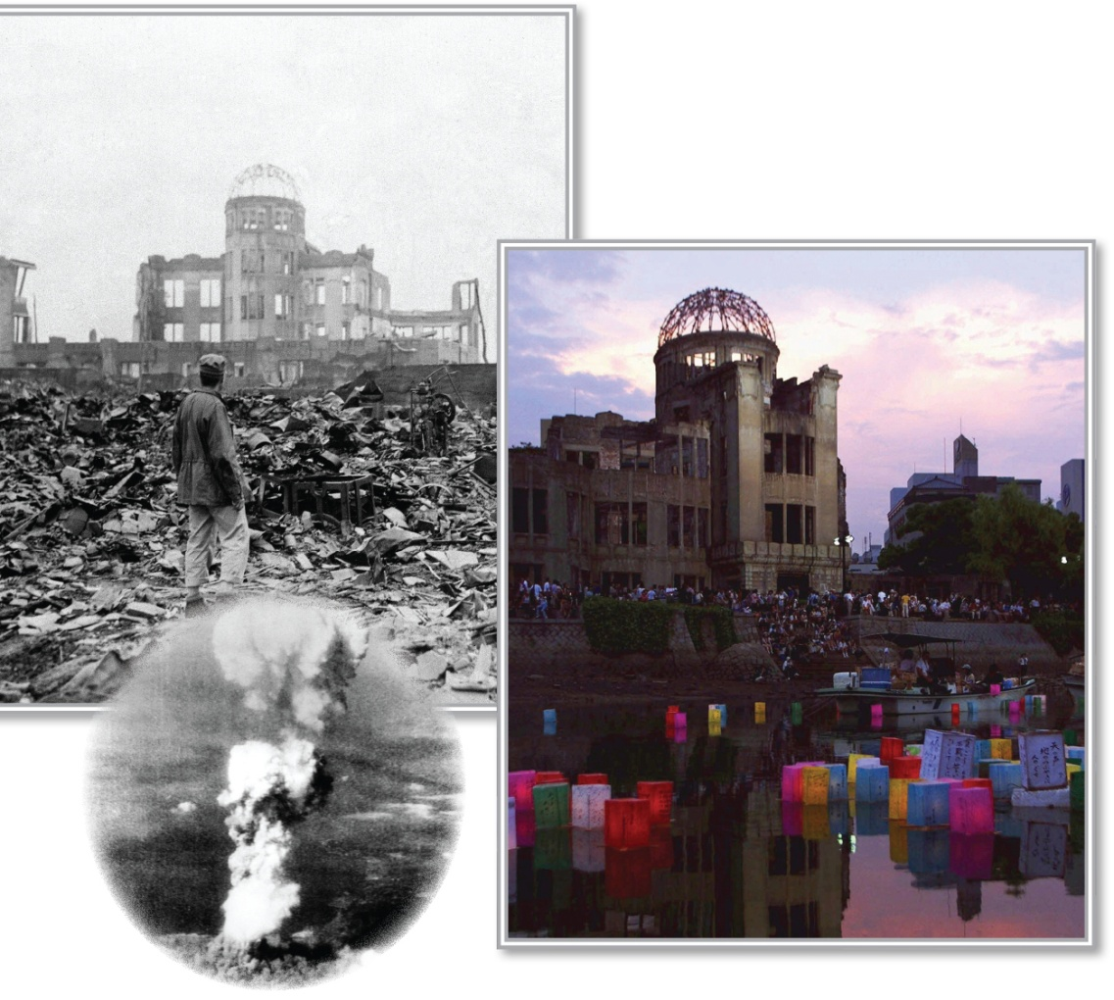
Ultranationalism and Crimes Against Humanity
Read the caption on page 158
Read the introduction on page 159
Find a partner and work through the questions
and
Review the Key Terms by writing out a guess of what you think each of them means
What do you see?
What do you think happened?

Slide 2

Homework
Genocide Project

Slide 3
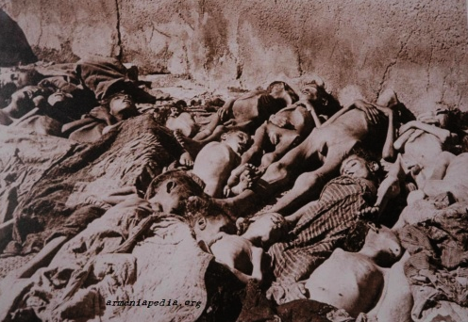


What Are Crimes Against Humanity?
Screamers: An Introduction
As an introduction to Crimes Against Humanity, including Genocide, we’ll be watching the following documentary

Slide 4
Crimes Against Humanity
“Our strength lies in our intensive attacks and our barbarity...After all, who today remembers the genocide of the Armenians?”
Adolf Hitler – 1939
95 minutes
Handout
Update:
Has there been any change in the United States’ stand since 2006?
Research and respond for next class.
Be sure to review the
Statement by the President on Armenian Remembrance Day
April 24th, 2012

Slide 5
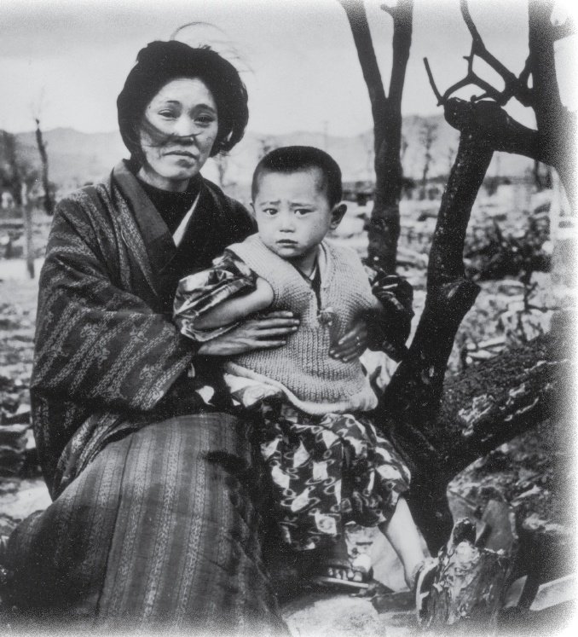

What Are Crimes Against Humanity?
With your partner, read page 160
As you read, answer the following:
How might the following people define “crimes against humanity”?
Write out your response
Hong Guiying
J. Robert Oppenheimer
Hiroshi Sawachika
The woman in Figure 7-2
ALPHA Tour 2011

Slide 6
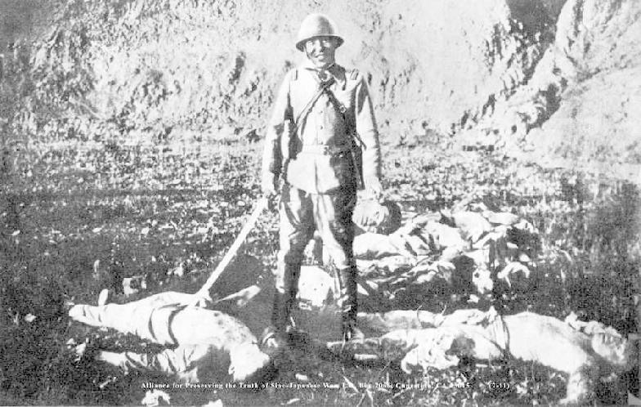
The Nanjing Massacre
Chinese civilians who died at Nanjing in a six week period:
300 000
Canadian who died during all of World War II:
45 000

Slide 7
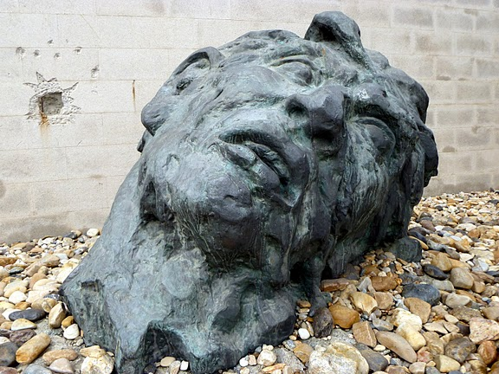
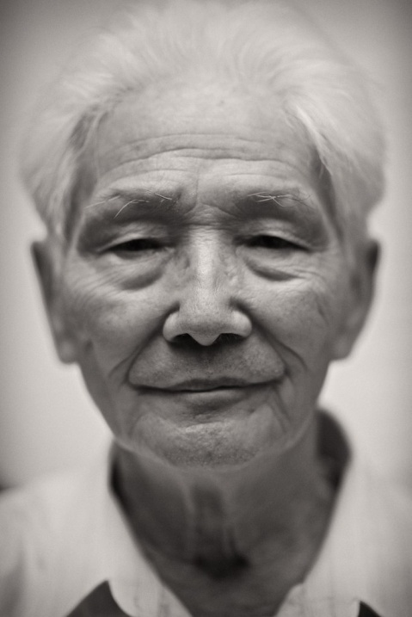
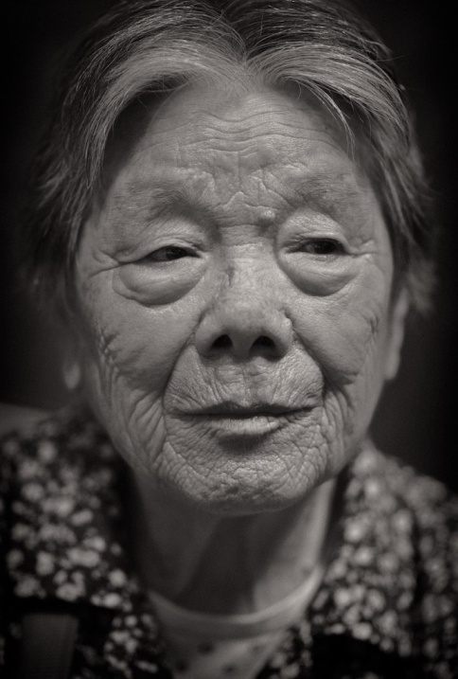
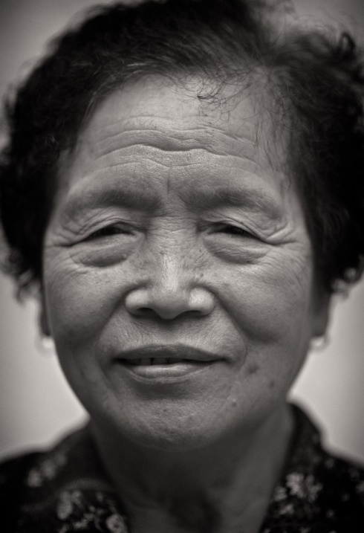
Survivors of
The Rape of Nanking

Slide 8
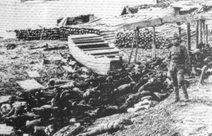
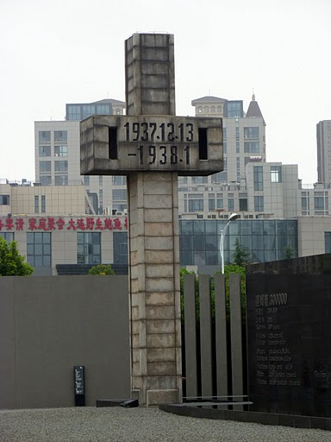
Nanjing Massacre Victims Memorial Hall– Nanjing, China
Nanking Massacre (The Rape of Nanking) and Survivors – Nanjing, China

Slide 9
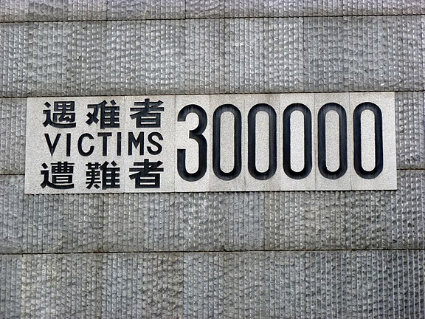
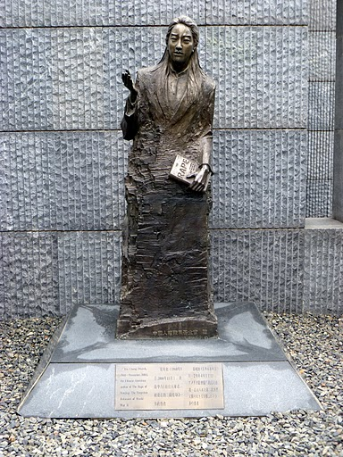
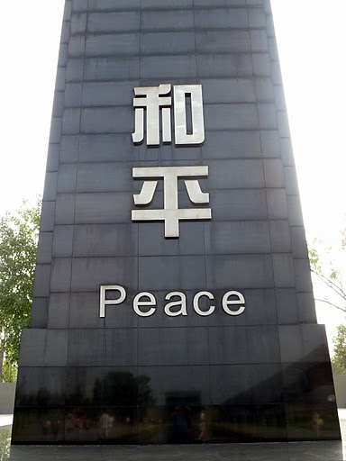
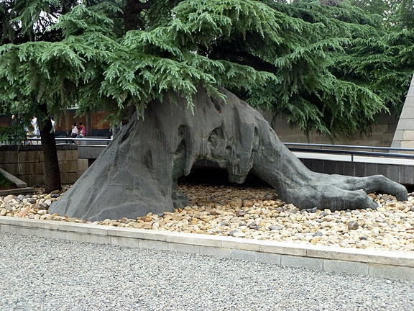
Nanjing Massacre Victims Memorial Hall– Nanjing, China
Nanking Massacre (The Rape of Nanking) and Survivors – Nanjing, China

Slide 10
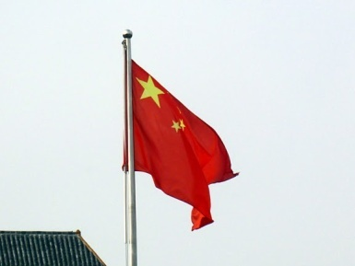
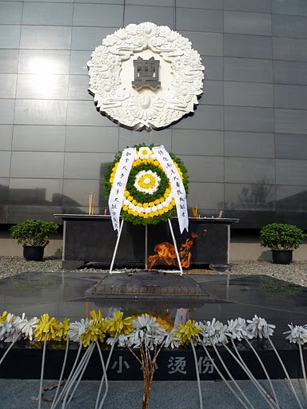
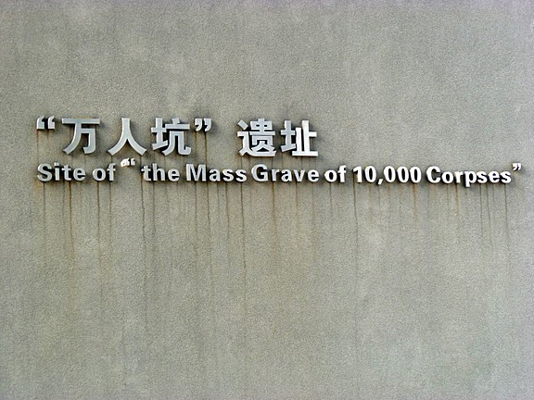
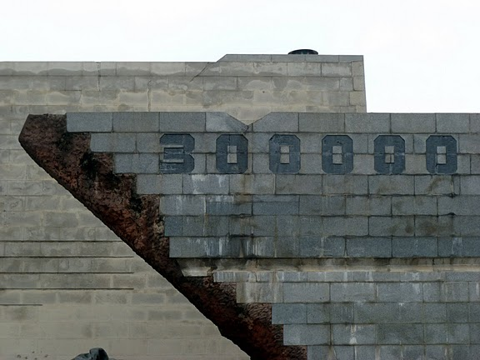
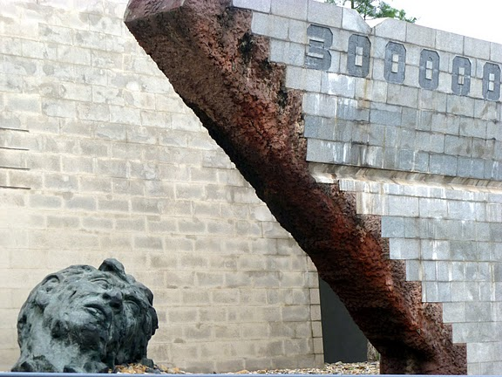
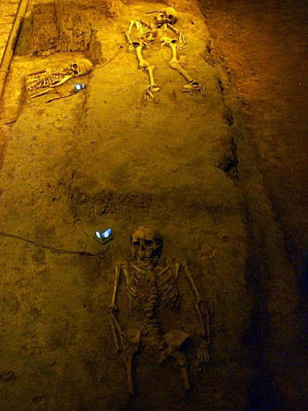
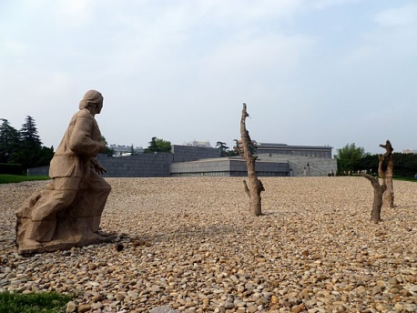
Nanjing Massacre Victims Memorial Hall– Nanjing, China
Nanking Massacre (The Rape of Nanking) and Survivors – Nanjing, China

Slide 11
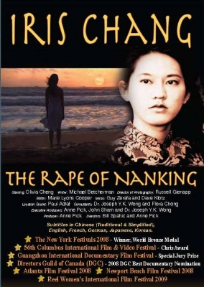

The Rape of Nanking
Personal insight into the 1937 Genocide at Nanking
A Preview
103 Minutes
Personal Response: You are required to respond to any one of the Reflection Questions – Minimum of one page typed

Slide 12
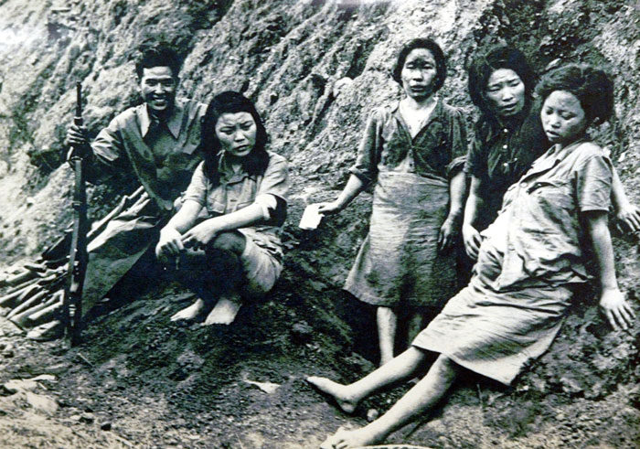
Comfort Women
As a result of the atrocities committed against the women and girls at Nanking, the Japanese stepped up their policy that amounted to nothing more that legalized rape…
With a partner, read the article – “Comfort Women”
In your notes, write a personal definition of ‘comfort women’.
Include specific people and places in your examples.

Slide 13
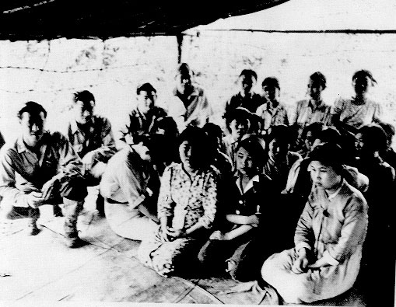
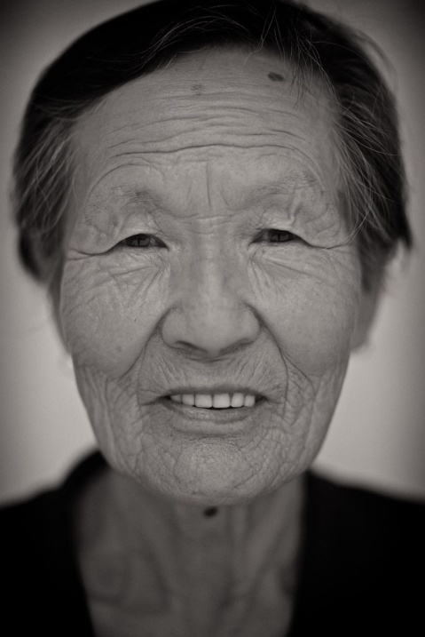
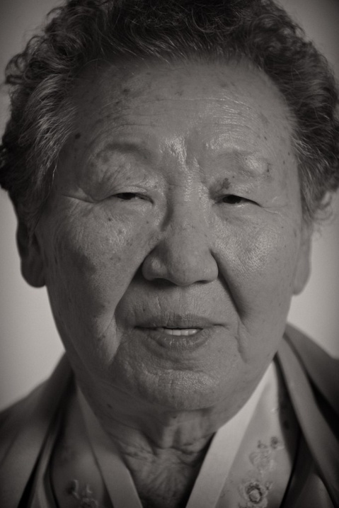
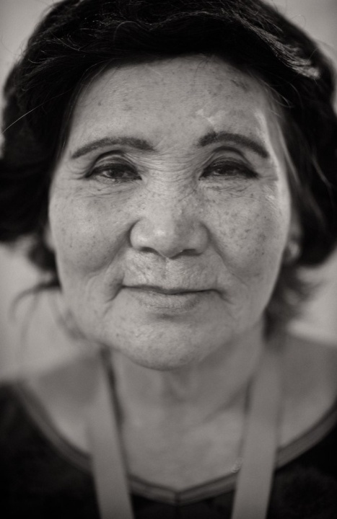
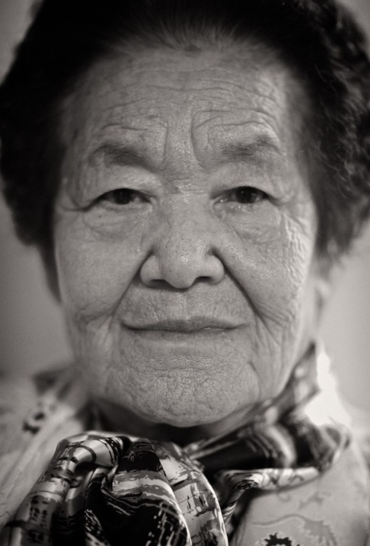
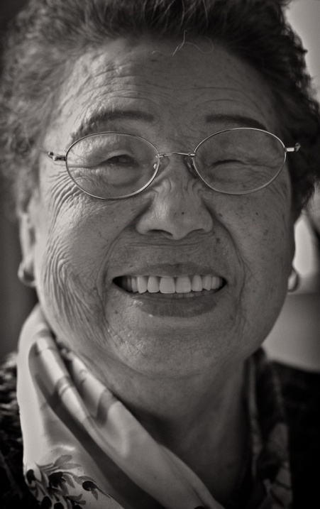
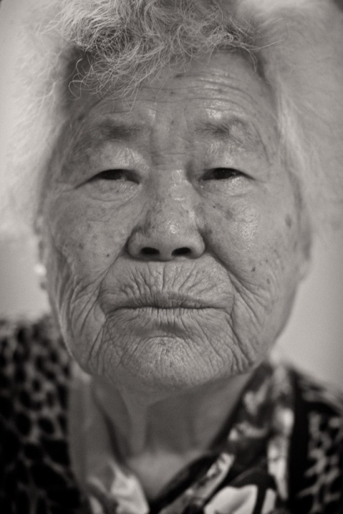
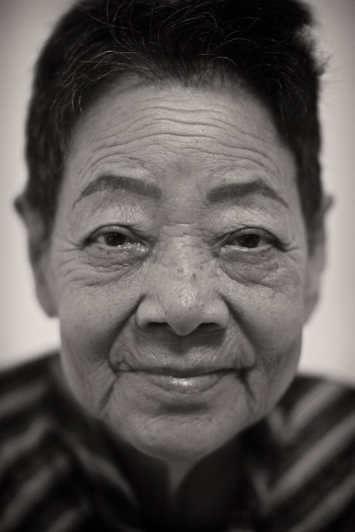
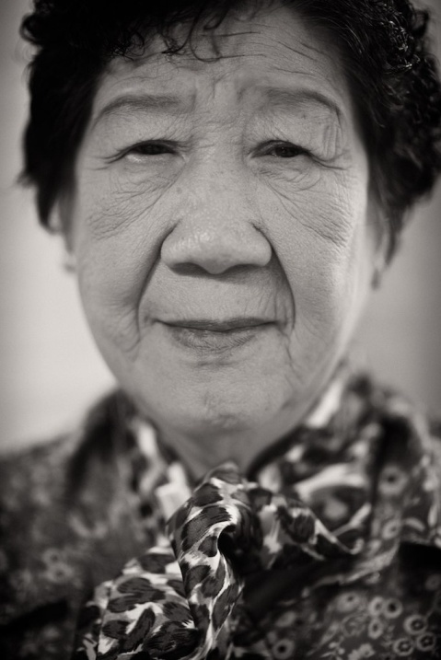
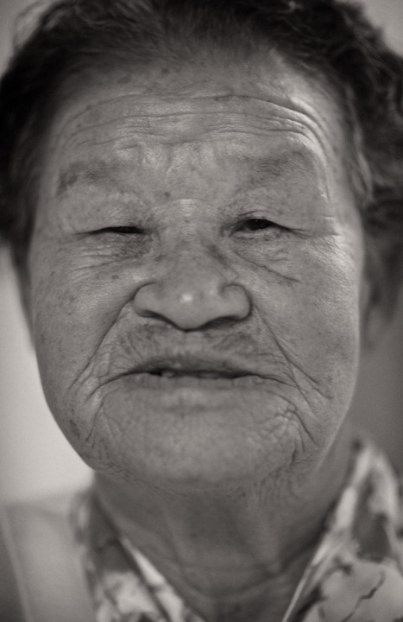
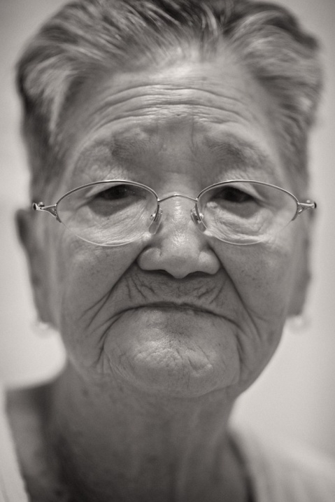
The Comfort Women Issue and Survivors – China and Korea
“You can never forget, never…” – Her Stories.
(2008)
22 Minutes

Slide 14

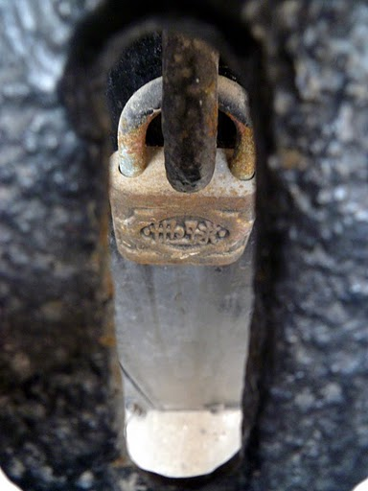
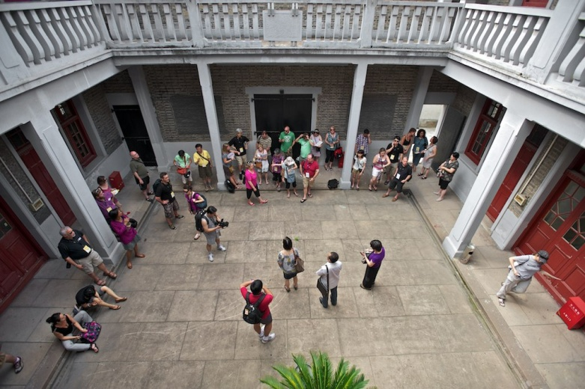
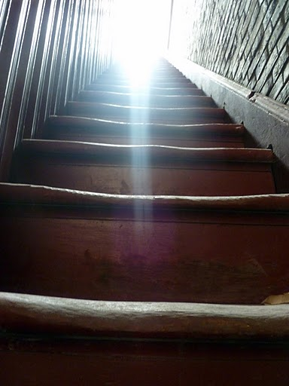
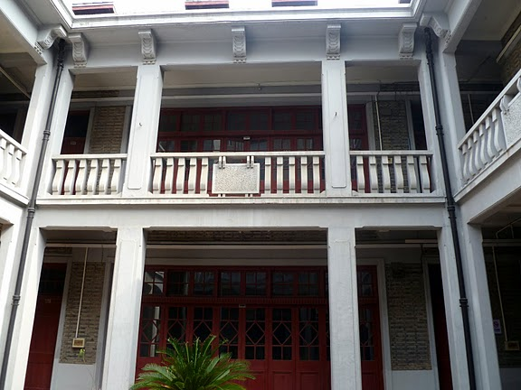

The Chen Residence: A Former Comfort Station – Shanghai
The Comfort Women Issue and Survivors – China and Korea

Slide 15
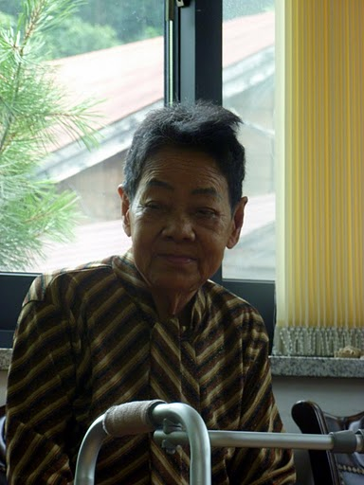
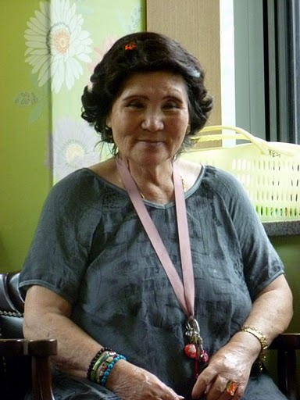
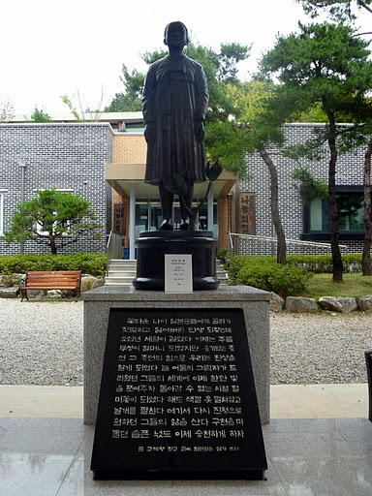
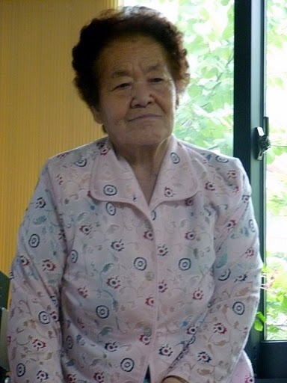
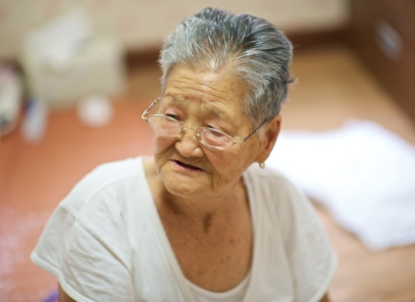
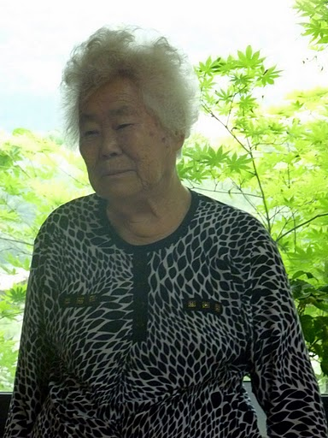
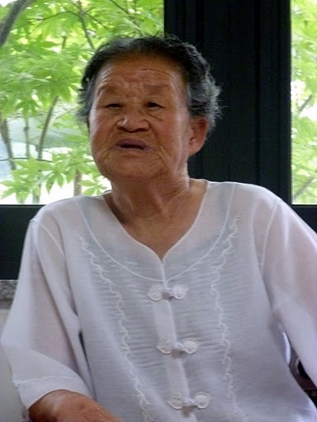
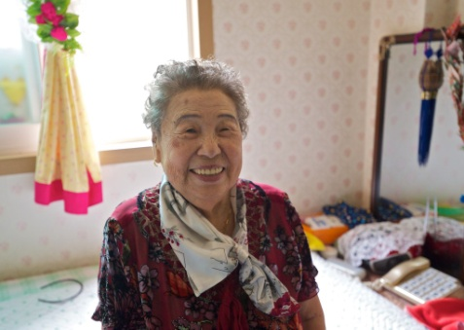
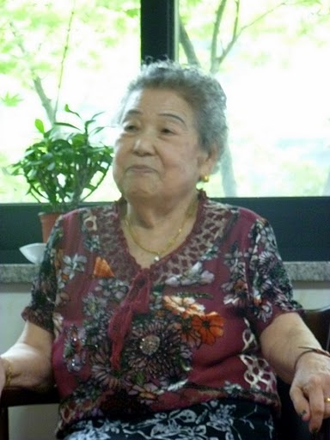
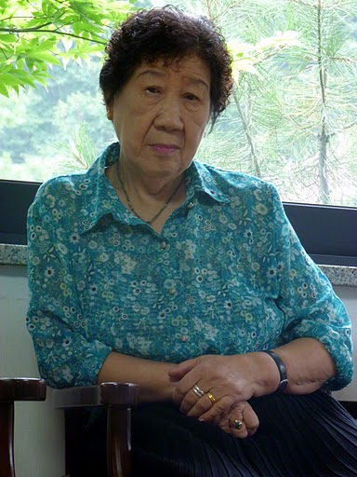
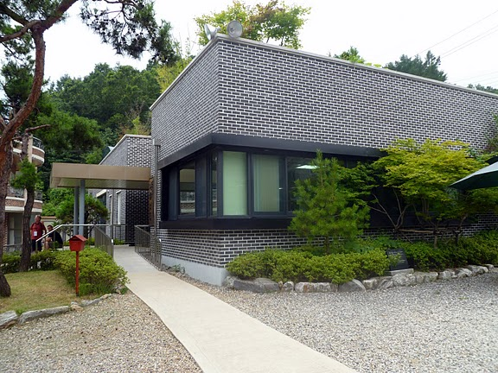

The House of Sharing – South Korea
The Comfort Women Issue and Survivors – China and Korea

Slide 16






Wednesday Demonstration– Seoul, South Korea
1000th Wednesday Demonstration – December 14th, 2011
The Comfort Women Issue and Survivors – China and Korea

Slide 17

Naming The Crimes
Read page 161
As you read, compare the definitions you made with those created by the International Court of Justice
Note the similarities and differences
Review Voices and Figure 7-3 on page 161
Why do you think the thousands of Japanese killed by the atomic bomb were not included in the chart?
What is a “crimes against humanity”?
Write out your response
Estimated Victims of Genocide and Mass Murders in the 20th Century

Slide 18


Ultranationalism and Crimes Against Humanity
Read the caption to Figure 7-4 on page 162
How might ultranationalism lead to crimes against humanity such as the Holocaust?
Read page 162, completing the Activity
When done, complete the Reflect and Respond

Slide 19

And Finally…
Begin a list of terms from this chapter, which include…
Any term/phrase/concept that would be considered important in helping you with your …
Investigative Report
Any suggestions as to what you should include?

Slide 20

Peer Pressure Involves the Desire to Feel a Sense of Belonging by Going Along With Group Actions
Write the following statement in your notebook
Relate some experiences where the above statement has been true for you…
Write the following inquiry question in your notes:
To what extent do you think peer pressure is a factor in motivating ordinary people to commit crimes against humanity, genocide or war crimes?
Discuss

Slide 21

How Has Ultranationalism Caused Crimes Against Humanity?
Get into groups of four…
Momentarily, you will be numbered off one through four. Each of you will go to one of the four assigned EXPERT groups and complete a brief summary using the handout
Ultranationalism and Crimes Against Humanity.
You will have approximately 15-20 minutes to do this.
  #1 – Armenian Genocide (Pages 163-164)
  #2 – Ukrainian Famine (Page 165)
  #3 – The Holocaust (Pages 166-167)
  #4 – The Bombing of Hiroshima and Nagasaki (Pages 168-169)
When finished, return to your original group of four and share your EXPERTISE with your other three group members. They will do the same for you. When you are done, you will have information on all four readings
After reviewing the four events, compare the role that ultranationalism played in each
Rank each set of events on a scale of 1 to 5
(1 = No Link to Ultranationalism - 5 = Strong Link to Ultranationalism)

Slide 22


The Armenian Genocide
A Story of Over One Million Deaths
Armenian Genocide 5:30

Slide 23


Harvest of Despair
A Story of Seven Million Deaths
Ukrainian Famine
3:00

Slide 24
Crimes Against Humanity
As you have just appreciated, there have been numerous historical events that fit into the category of Crimes Against Humanity
Right now, we’re going to look at four questions related to your recent textbook readings
The class will be divided up into four groups, each group will (initially) be responding to one of the questions below. After being assigned a group, write out the corresponding question at the top of your chart paper. You will be given 3-4 minutes to write a group response.
1. Is a nation that refuses to acknowledge guilt for crimes against humanity doomed to repeat such crimes?
2. Will contemporary communication systems make genocide impossible in the future?
3. Should U.S. President Harry S. Truman have been accused of war crimes for dropping two atomic bombs on Japan?
4. Why is it important to many survivors of genocide that their stories be recorded and memorials erected to commemorate the events?
When all groups are done, your group will trade chart papers with another group that is complete
Complete this process until you have written on all four sections
Discuss

Slide 25

Shoah – The Holocaust
Review Figure 7-9 and its caption on page 166
How might it have affected Josef Pitel to be the sole survivor in his family?
Why is it important that his photograph exists?
What might have happened to other victims’ stories and memories if there were no photographs or written accounts of their tragedy?

Slide 26
Shoah – The Holocaust
Read (or re-read) pages 166-167
With a partner, respond to Explorations

Slide 27

The Last Days
The Story of Five Survivors
A Preview
3 minutes

Slide 28

The Last Days
The Story of Five Survivors
87 minutes

Slide 29
And Finally…
Continue with your list of terms from this chapter, which include…
Any term/phrase/concept that would be considered important in helping you with your …
Investigative Report
Any suggestions as to what you should include?

Slide 30


Why was the International Criminal Court created?
Read page 170
As you read and complete the Activity, keep in mind the question above
How did you respond to the Activity?

Slide 31


What lessons did people learn from the Holocaust?
Contemporary Examples of Crimes Against Humanity
Respond to the above question with at least five points
In groups of 2-3, read the sections titled
Crimes against Humanity in the Former Yugoslavia
(Pages 171 – 172)
and
Crimes Against Humanity in Rwanda
(Page 173)
As you read, complete the handout
Contemporary Examples of Crimes Against Humanity

Slide 32




Crimes Against Humanity in the Former Yugoslavia
Radovan Karadzic, Europe's most wanted man, arrested for war crimes
Arrested after 13 years on the run
July, 2008
7:00 - CNN
On May 26th, 2011, Ratko Mladic, Karadzic’s army chief, was arrested in rural Serbia

Slide 33


Analyzing Cause and Effect Relationships
Read the Introduction on page 174
Review the Four Steps on these two pages
In small groups of no less than three students, complete each of the steps on pages 174-175
You will need a recorder, a summary writer and a speaker
Remember, when using the organizer below, each person in your group is to use a different example

Slide 34





Acting For Good in the Face of Evil
Think about a situation where you helped someone in need
Why were you helpful in this situation?
Think of a situation where you did not help someone in need
Why were you not helpful in this situation?
How did your feelings compare in these two situations?
Read pages 176-177
Complete the handout
Add an example of your own
choosing

Slide 35
And Finally…
Continue with your list of terms from this chapter, which include…
Any term/phrase/concept that would be considered important in helping you with your …
Investigative Report
Any suggestions as to what you should include?

Slide 36
Think About Your Challenge
Prepare an investigative report on a historical or contemporary nationalist movement
On the question:
To What Extent Should National Interest Be Pursued?
Review the following from page 179:
Review the research you have completed so far
Make notes about the connections between the movement you are investigating and the nationalist interests the movement is pursuing
Do this by:
Identifying the national interests involved and who stands to gain or lose if these interests are pursued
Predict whether the movement is likely to lead to ultranationalism
Your Challenge is Due Shortly after Chapter Eight!

