Slide 1
Asian Holocaust in High School Social Studies
2011 Study Tour to China and South Korea
The Peace and Reconciliation Tour
Starting in 2004, Toronto ALPHA
(The Association for the Learning and Preserving the History of World War Two in Asia)
with its chapters in British Columbia, Edmonton and New Jersey, has offered to educators a hands-on experience with the history of WWII in Asia, by visiting historical sites, museums and meeting with experts, educators, curators and survivors.
Destinations have included locations in China, Hong Kong, South Korea and future plans may include Japan.
The Peace and Reconciliation Tour
July 13 – 28, 2011
Beijing, Harbin, Nanjing, Shanghai and Seoul

Slide 2
Asian Holocaust in High School Social Studies
2011 Study Tour to China and South Korea
What does ALPHA do?
The Mandate of both Edmonton and Toronto ALPHA:
To preserve the truthfulness of historical records about W.W. II in Asia
To pursue justice for the victims of W.W. II in Asia
To promote global awareness, knowledge and recognition of this history such that peace and reconciliation among the perpetrating and victimized nation can be finally achieved

Slide 3
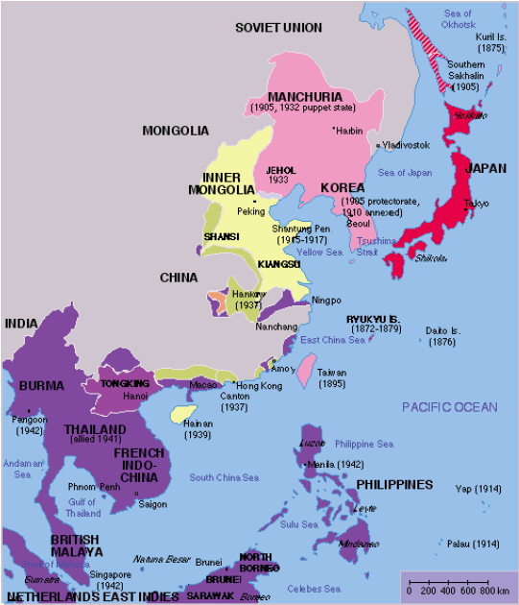
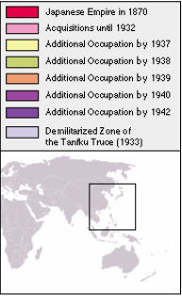
Asian Holocaust in High School Social Studies
Historical Overview of the Asian Holocaust
Map of the Japanese Empire 1870 - 1942

Slide 4
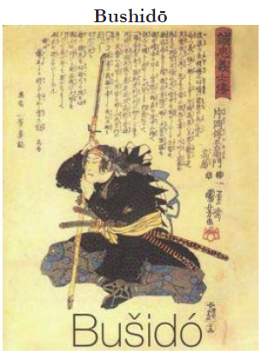
Asian Holocaust in High School Social Studies
Historical Overview of the Asian Holocaust

Slide 5
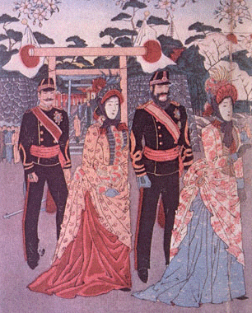
Asian Holocaust in High School Social Studies
Historical Overview of the Asian Holocaust

Slide 6
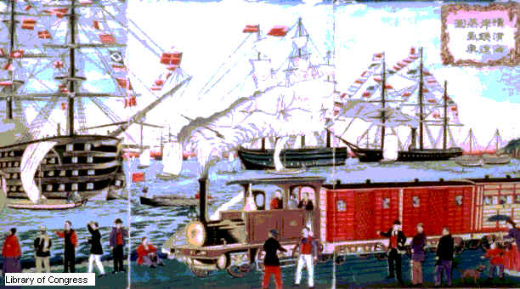
Asian Holocaust in High School Social Studies
Historical Overview of the Asian Holocaust

Slide 7
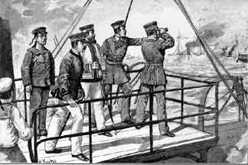
Asian Holocaust in High School Social Studies
Historical Overview of the Asian Holocaust

Slide 8
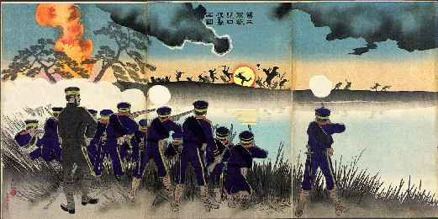
Asian Holocaust in High School Social Studies
Historical Overview of the Asian Holocaust

Slide 9
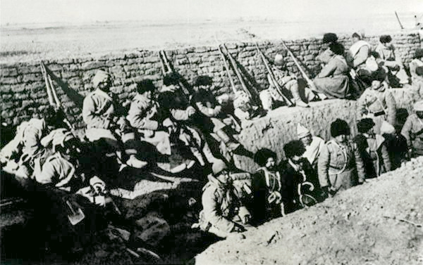
Asian Holocaust in High School Social Studies
Historical Overview of the Asian Holocaust

Slide 10
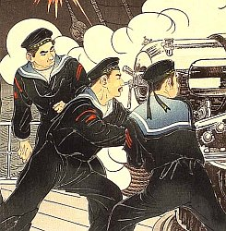
Asian Holocaust in High School Social Studies
Historical Overview of the Asian Holocaust

Slide 11
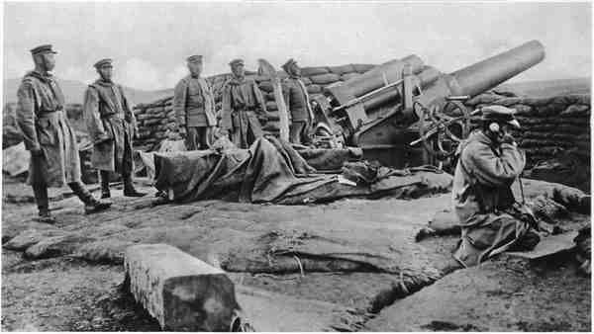
Asian Holocaust in High School Social Studies
Historical Overview of the Asian Holocaust

Slide 12
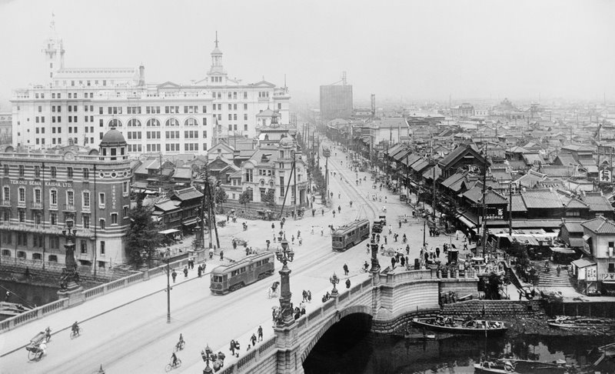
Asian Holocaust in High School Social Studies
Historical Overview of the Asian Holocaust

Slide 13
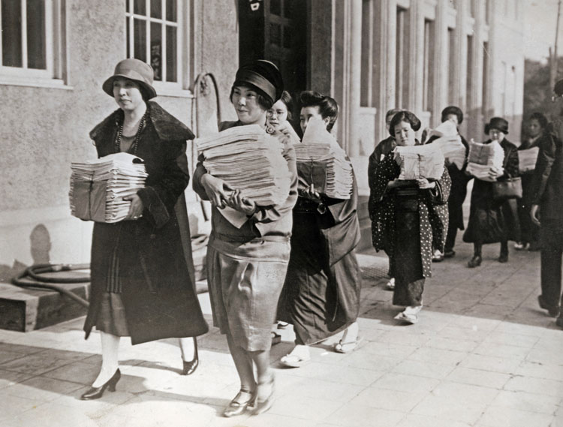
Asian Holocaust in High School Social Studies
Historical Overview of the Asian Holocaust

Slide 14
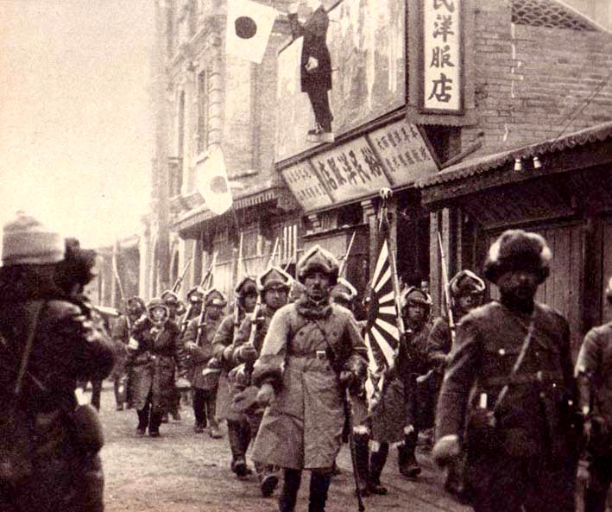
Asian Holocaust in High School Social Studies
Historical Overview of the Asian Holocaust

Slide 15
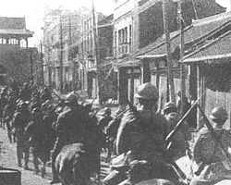
Asian Holocaust in High School Social Studies
Historical Overview of the Asian Holocaust

Slide 16
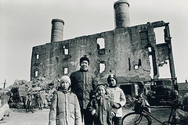
Asian Holocaust in High School Social Studies
Historical Overview of the Asian Holocaust

Slide 17
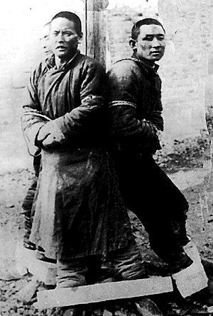
Asian Holocaust in High School Social Studies
Historical Overview of the Asian Holocaust

Slide 18
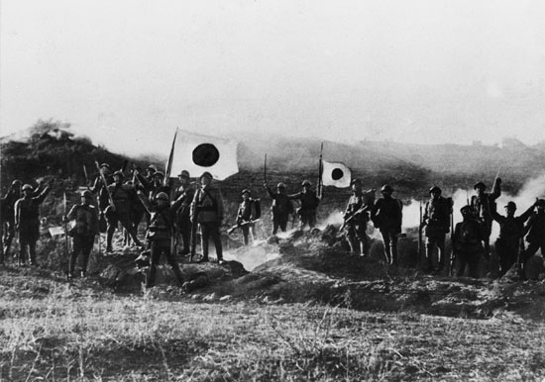
Asian Holocaust in High School Social Studies
Historical Overview of the Asian Holocaust

Slide 19
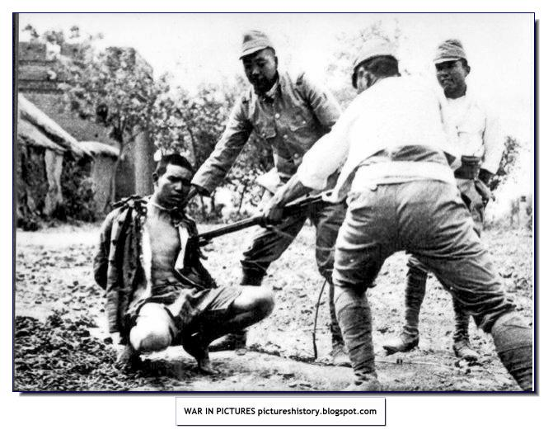
Asian Holocaust in High School Social Studies
Historical Overview of the Asian Holocaust

Slide 20
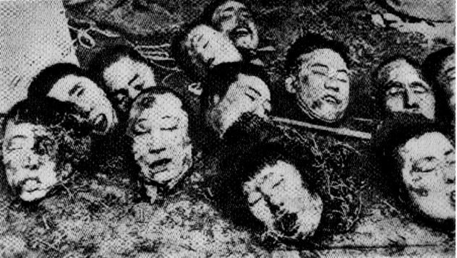
Asian Holocaust in High School Social Studies
Historical Overview of the Asian Holocaust

Slide 21
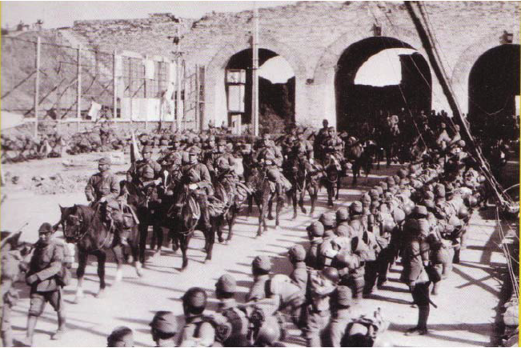
Asian Holocaust in High School Social Studies
Historical Overview of the Asian Holocaust
Japanese Army marches into Nanking in December, 1937

Slide 22
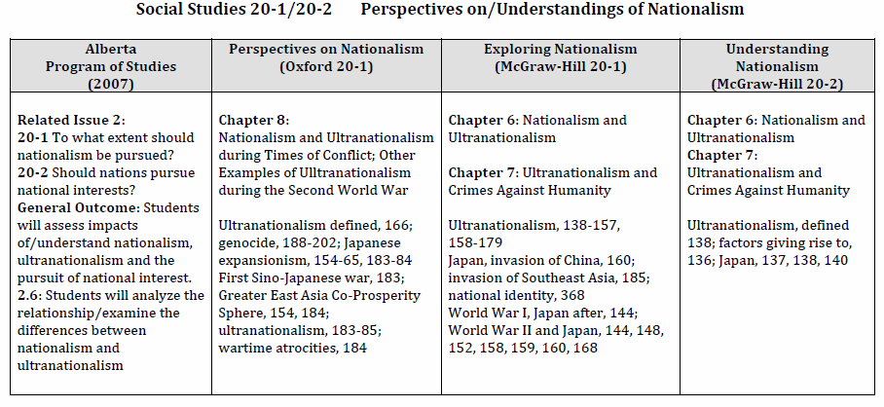
Asian Holocaust in High School Social Studies
Program of Studies and Resource Connections

Slide 23
Asian Holocaust in High School Social Studies
Program of Studies and Resource Connections

Slide 24
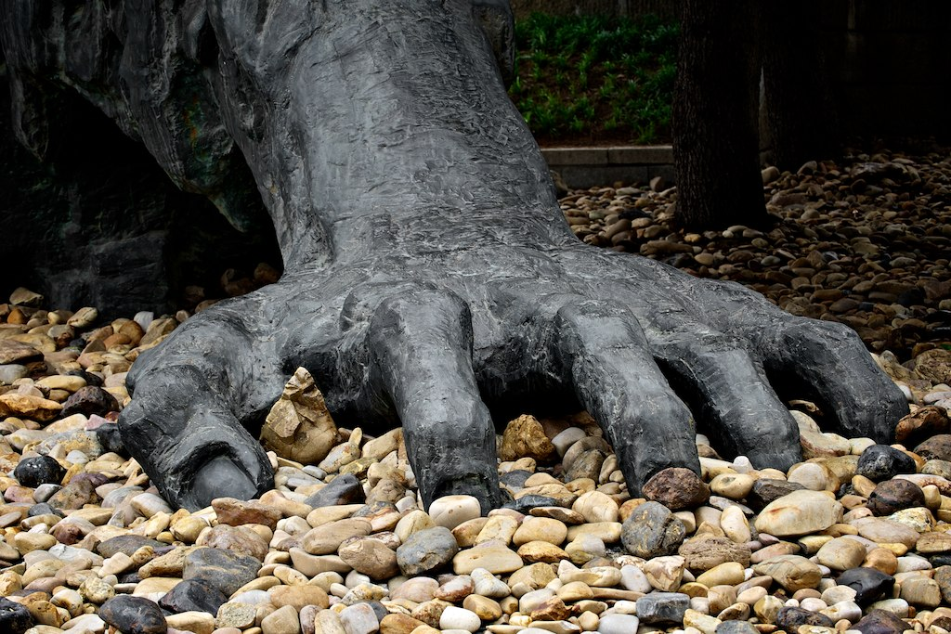
2011 Study Tour to China and Korea:
A Personal Experience of the History of World War II in Asia
We went to many places and learned many things…
The Comfort Women Issue and Survivors – Beijing, Shanghai and Seoul, South Korea
Unit 731 – Human Experimentation – Harbin, China
Nanking Massacre (The Rape of Nanking) and Survivors – Nanjing, China
Japanese Slave Labour Survivors – Beijing and Seoul, South Korea
Above all, however, the trip was about the survivors and their voices…

Slide 25
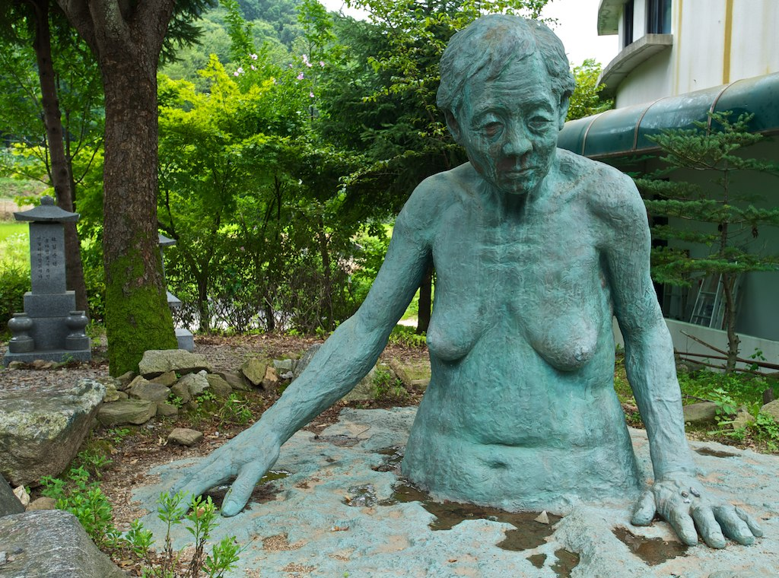
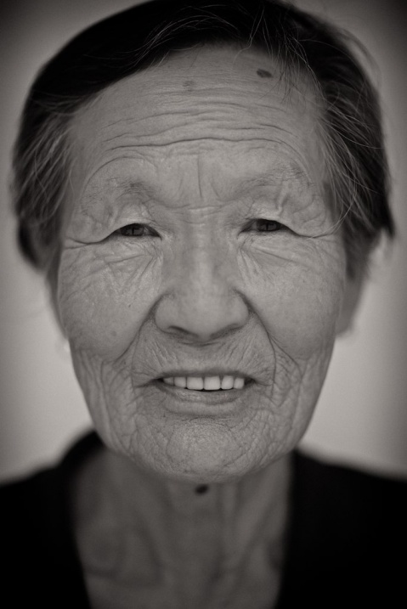
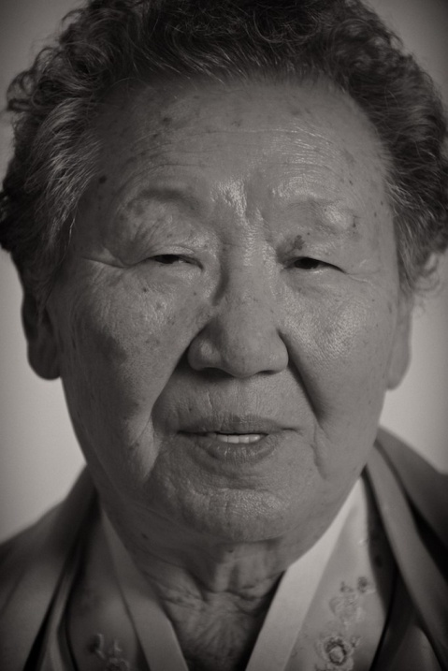
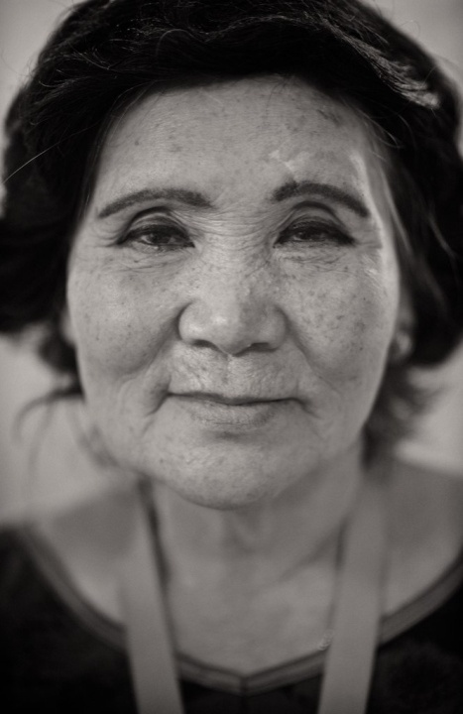
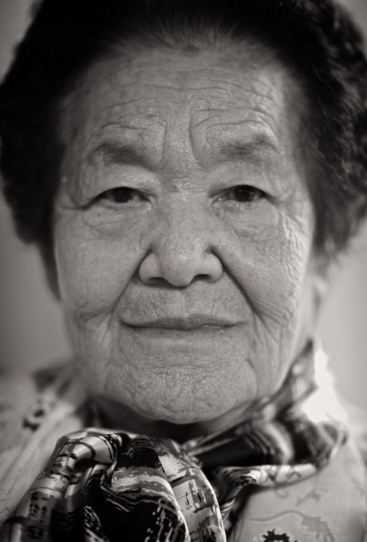
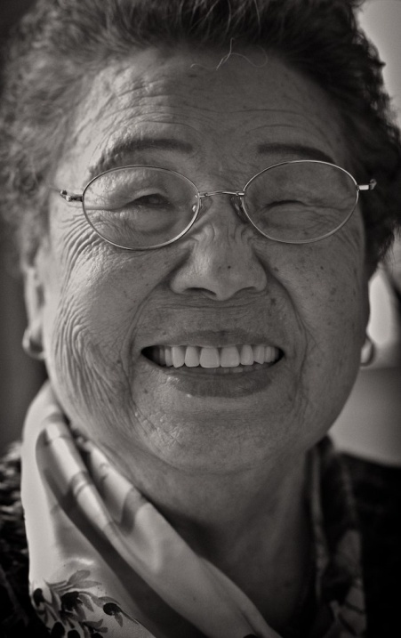
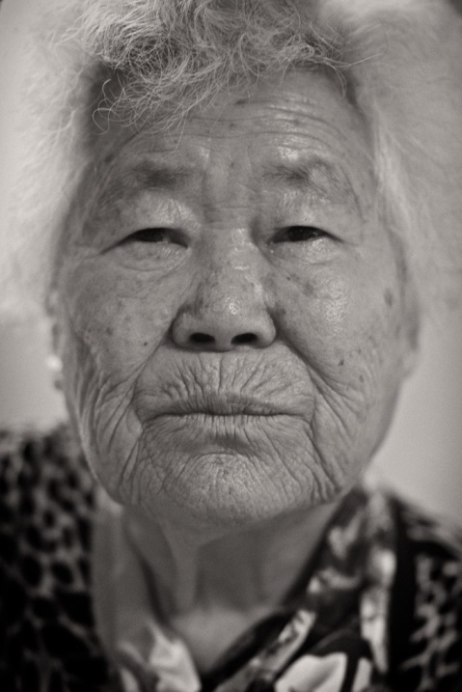
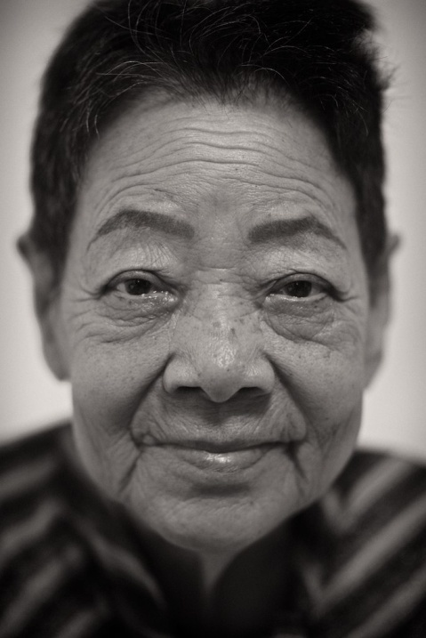
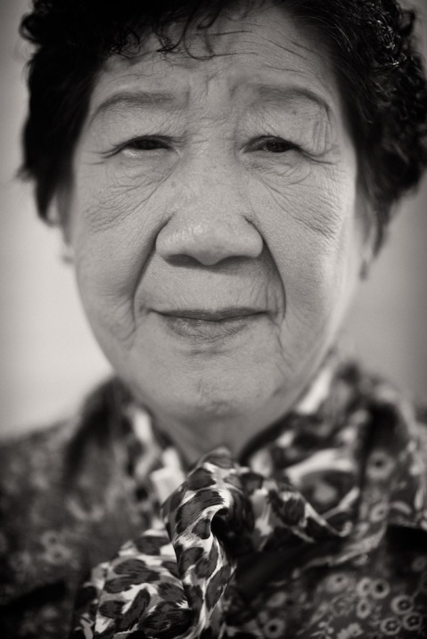
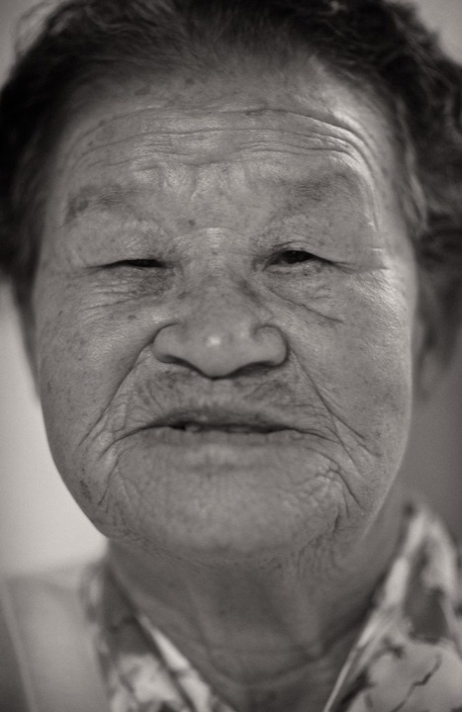
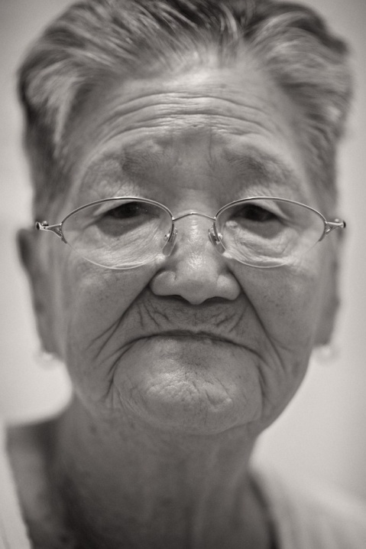
Survivors of
Forced Sexual Slavery
Comfort Women

Slide 26
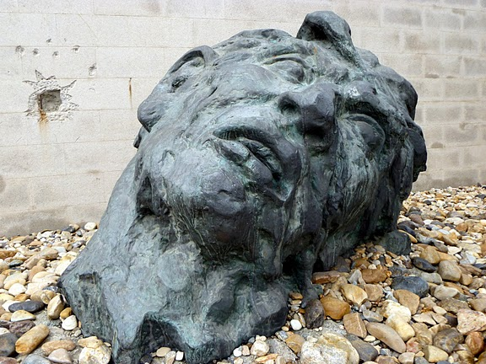
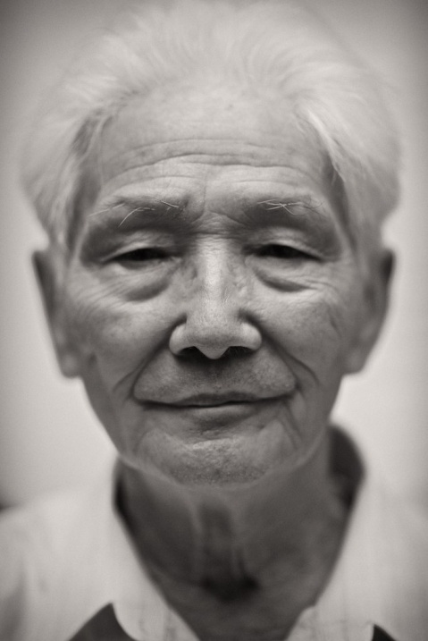
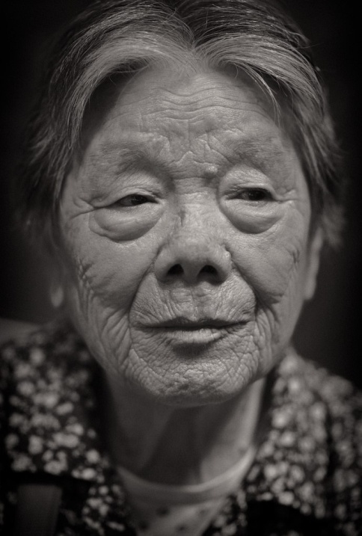
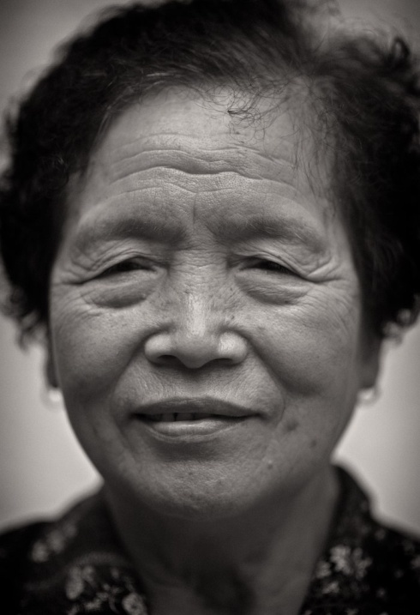
Survivors of
The Rape of Nanking

Slide 27
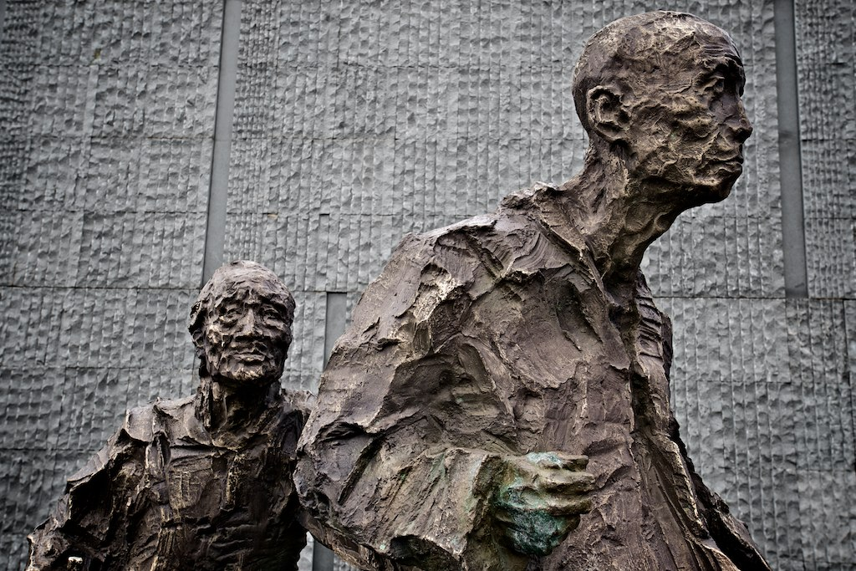
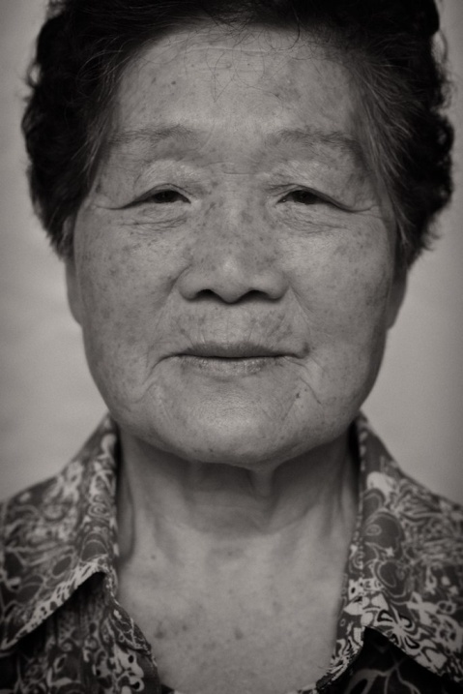
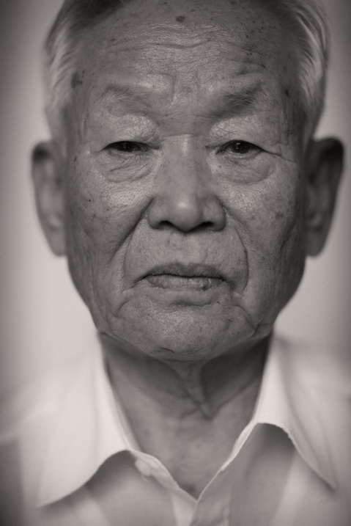
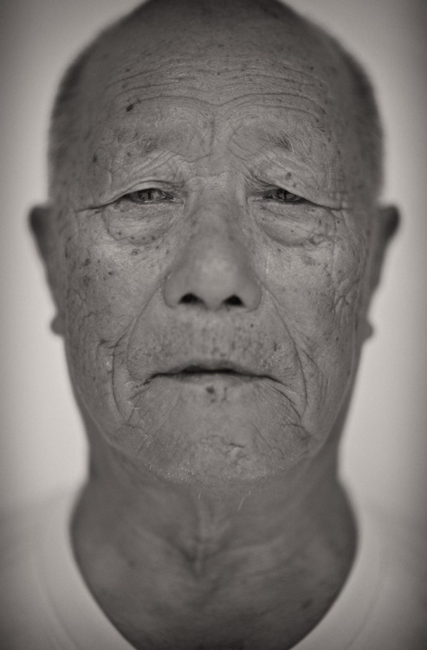
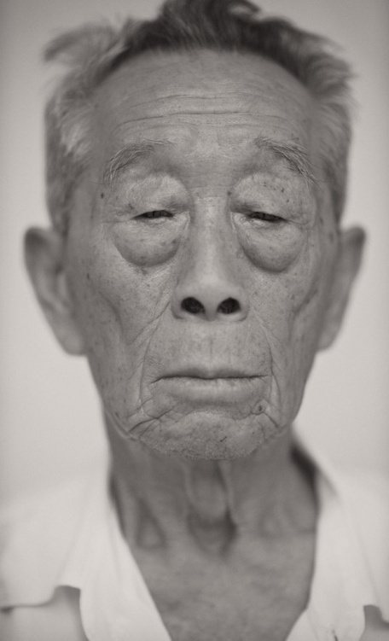
Survivors of
Japanese Slave Labour

Slide 28
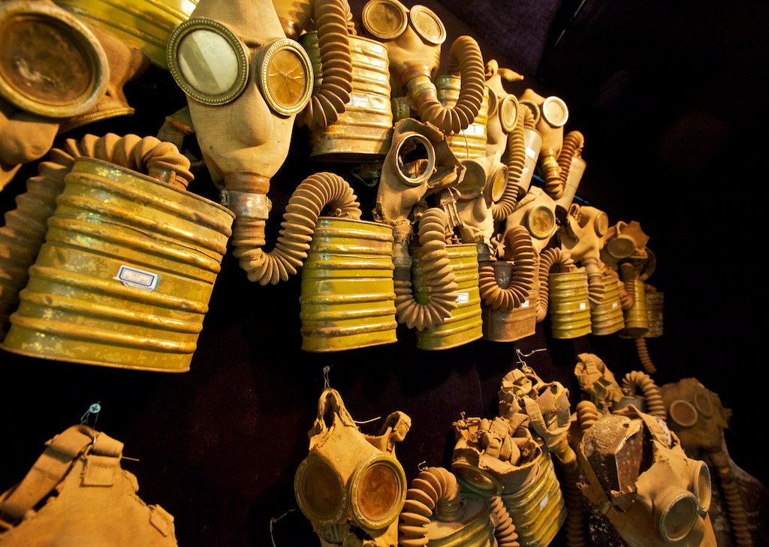
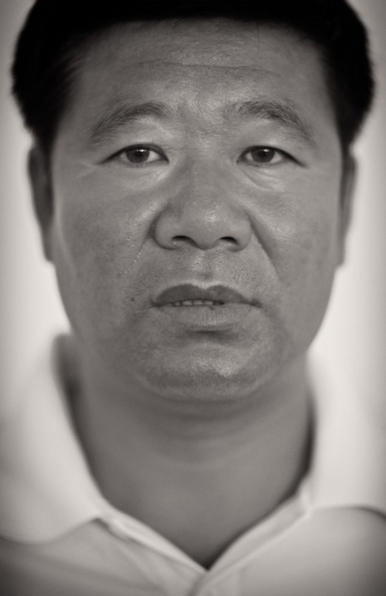
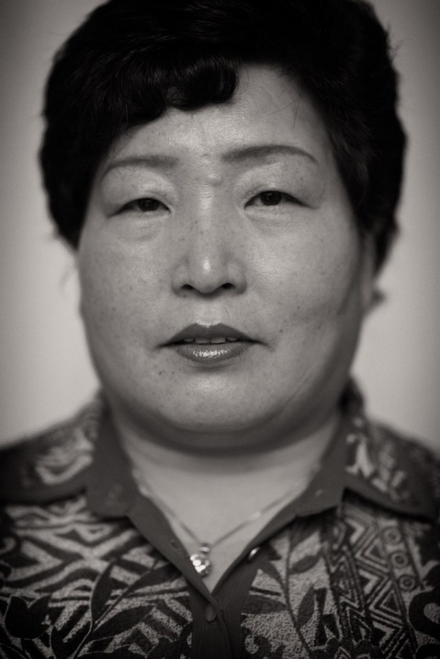
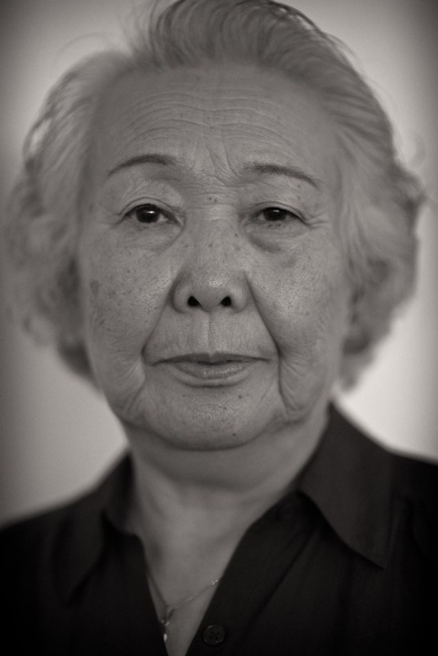
Exposure to Chemical Weapons Left Behind By The Japanese During World War Two
Second Generation Survivor of Nagasaki
Daughter of Victim of Human Experimentation at Unit 731

Slide 29
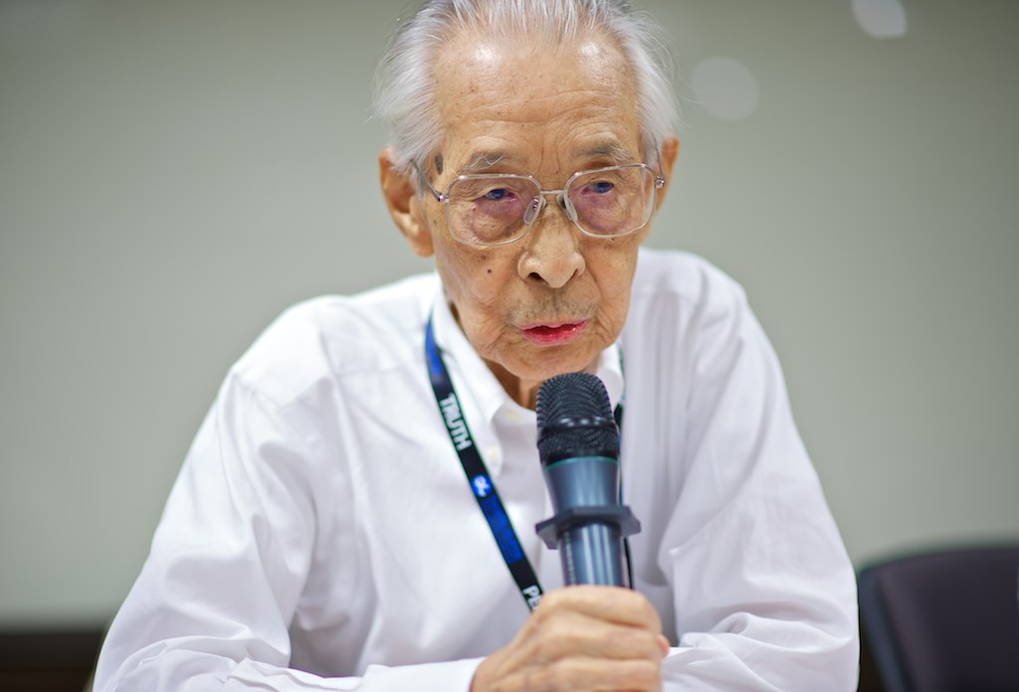
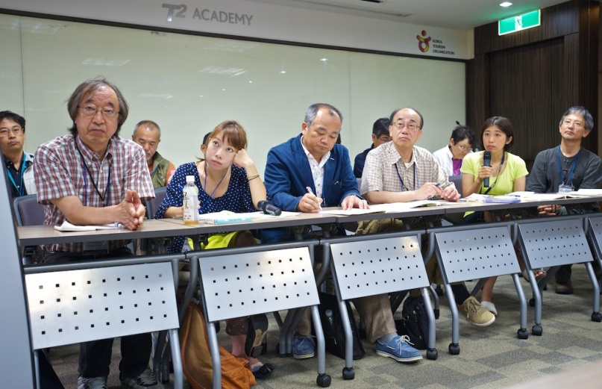
World War II Japanese Soldier
Japanese Teachers

Slide 30
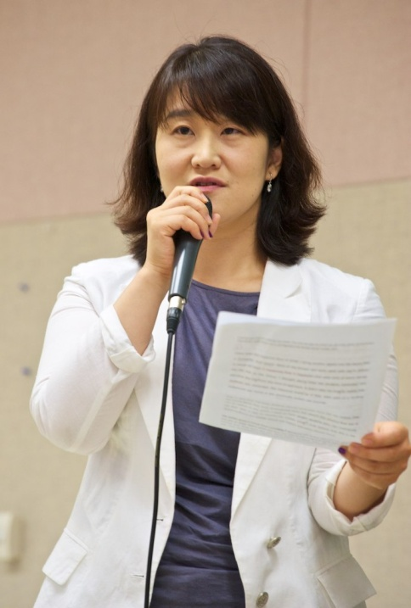
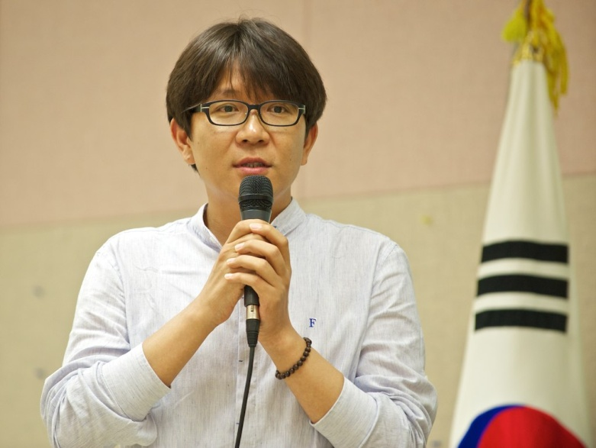
Korean Teachers and Students

Slide 31
The Comfort Women Issue and Survivors – Beijing, Shanghai and Seoul, South Korea

Slide 32
The Comfort Women Issue and Survivors – China and Korea
“You can never forget, never…” – Her Stories.
(2008)
22 Minutes

Slide 33
The Chen Residence: A Former Comfort Station – Shanghai
The Comfort Women Issue and Survivors – China and Korea

Slide 34
The House of Sharing – South Korea
The Comfort Women Issue and Survivors – China and Korea

Slide 35
Wednesday Demonstration– Seoul, South Korea
1000th Wednesday Demonstration – December 14th, 2011
The Comfort Women Issue and Survivors – China and Korea

Slide 36
Unit 731 – Human Experimentation – Harbin, China

Slide 37
1935 - 1945
Unit 731 – Human Experimentation – Harbin, China

Slide 38
Unit 731 – Human Experimentation – Harbin, China

Slide 39
Unit 731 – Human Experimentation – Harbin, China

Slide 40
Asian Holocaust in High School Social Studies
Historical Overview of the Asian Holocaust

Slide 41
Nanking Massacre (The Rape of Nanking) and Survivors – Nanjing, China
Iris Chang: The Rape of Nanking
Trailer

Slide 42
Nanjing Massacre Victims Memorial Hall– Nanjing, China
Nanking Massacre (The Rape of Nanking) and Survivors – Nanjing, China

Slide 43
Nanjing Massacre Victims Memorial Hall– Nanjing, China
Nanking Massacre (The Rape of Nanking) and Survivors – Nanjing, China

Slide 44
Nanjing Massacre Victims Memorial Hall– Nanjing, China
Nanking Massacre (The Rape of Nanking) and Survivors – Nanjing, China

Slide 45
So, even though we went to many places and learned many things…
The trip was about the survivors and their voices…

Slide 46
No Longer Forgotten Voices...

Slide 47
Asian Holocaust in High School Social Studies
2011 Study Tour to China and South Korea
Resources
Websites:
Canada ALPHA/B.C. ALPHA - www.alpha-canada.org
Edmonton ALPHA - www.edmontonalpha.org
Toronto ALPHA - www.torontoalpha.org (Follow the Education/Resources link)
New Jersey ALPHA - http://www.state.nj.us/education/holocaust/curriculum
Iris Chang - www.irischang.net
House of Sharing - houseofsharing.org
Teaching Resources:
Study Guide for Teachers - Iris Chang: The Rape of Nanking
http://www.alpha-canada.org/studyguide/IrisChangMovie_studyguide.pdf
The Search for Global Citizenship: The Violation of Human Rights in Asia, 1931-1945
http://www.torontoalpha.org/images/EducationalResources/resource_guide_march2009.pdf
Human Rights in the Asia Pacific 1931-1945: Social Responsibility and Global Citizenship
Available for purchase at www.publications.gov.bc.ca/

Slide 48
2014 Study Tour Info
Details are not yet available, but the itinerary may include:
Mainland China, South Korea, Hong Kong, Japan
July of 2014
When available, information and application forms will be available at the
Edmonton ALPHA website:
http://www.edmontonalpha.org
Questions can be forwarded to anyone of us or via Edmonton ALPHA’s e-mail
< info@edmontonalpha.org >
Application Deadline:
Early Spring of 2014 (?)

Slide 49
Questions…?
If you’re interested in downloading this presentation, please email Brendan Edwards @ brendan.edwards@eips.ca
I’ll forward you a link

